Slide 1
SOTER – Final Work
José Silva - 1130352
Daniel Freire - 1130858

Slide 2
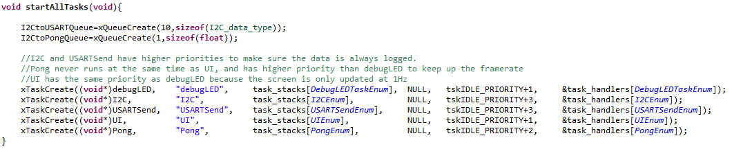
Task Creation

Slide 3
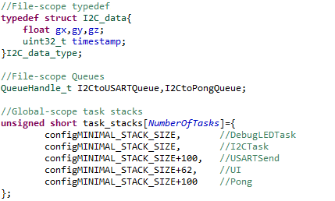
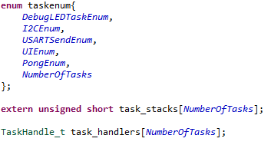
Task Creation

Slide 4
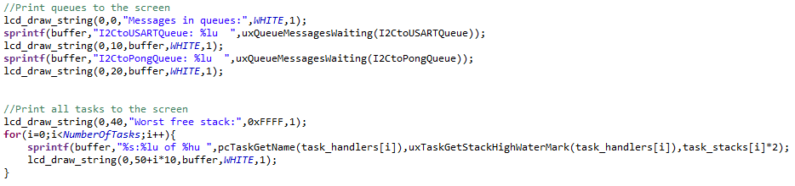
UI Task

Slide 5
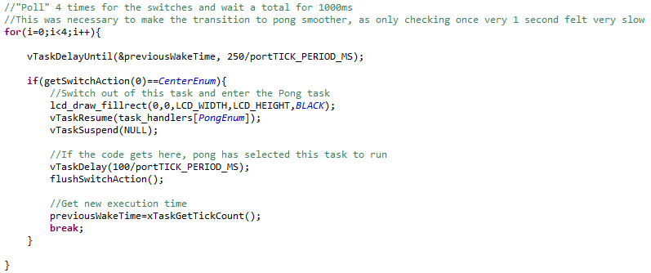
UI Task

Slide 6

USARTSend

Slide 7
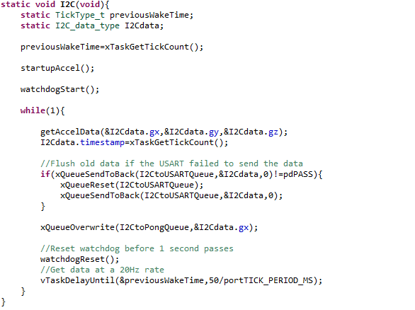
I2C (Task)

Slide 8
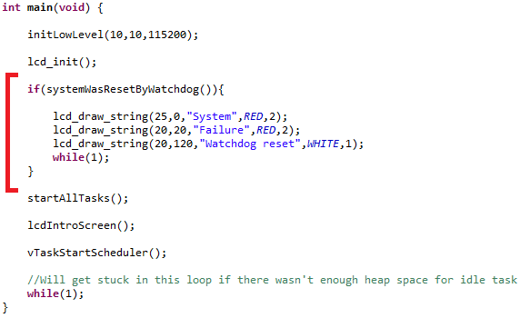
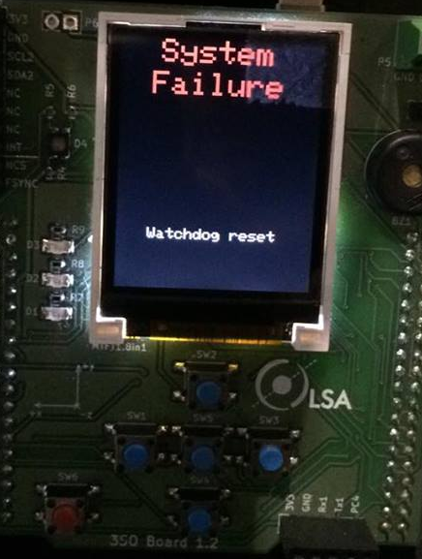
Watchdog reset

Slide 9
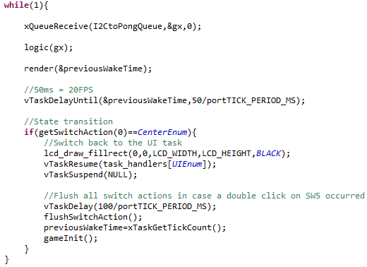
Pong (Task)

Slide 10
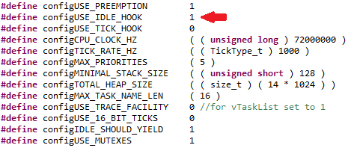

Idle Hook

Slide 11
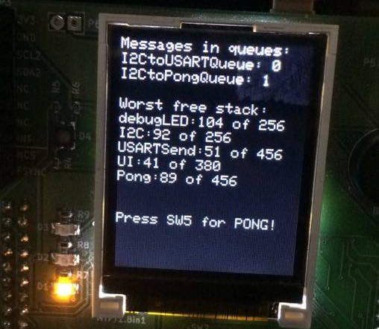

Pong

Slide 12
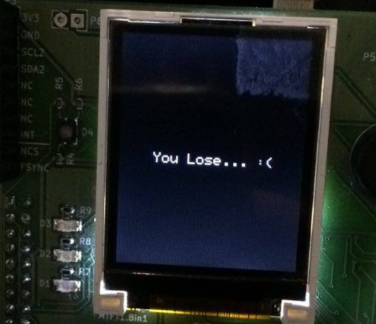
Pong

Slide 13
“Standard” Peripheral Library
Terrible documentation
PDF version does not match website version
Both have macros that do not exist in the actual library
Inconsistency
All macros about GPIO outputs are GPIO_Mode_Out_xx, but inputs can be GPIO_Mode_IN_FLOATING or GPIO_Mode_IPU or _IPD.... what??? Also, uppercase “IN” but no uppercase “Out”?!
Bad code
Disabling any USART interrupt actually disables all USART interrupts.
Deprecated
New “Hardware abstraction layer” is prefered over the “standard” peripheral library, as it is no longer ported to new ST microcontrollers!
Congratulations! Almost everything you learned in SISEM is now useless!

Slide 14
CMSIS - Cortex Microcontroller Software Interface Standard
Standard way of accessing all ARM Cortex microcontroller registers.
Same programming style, doesn’t matter if the micro is from ST, NXP, Infineon, etc...
Standard way of configuring all interrupts in all ARM Cortex microcontrollers
NVIC is a part of the ARM processor and not part of the peripherals
Only portable to the same series of microcontrolers because the registers are different, so it’s less portable than the standard peripheral library...
Except if the standard peripheral library changed between microcontroller families.... Which it does!
The best documentation you can get
Which is the reference manual of the microcontroller you want to program.
If something doesn’t work, it’s always your fault!*
*Except when it isn’t and the hardware is broken in very peculiar ways, such as the I2C events. But that’s why you always check the errata for your microcontroller! ☺

Slide 15
How to decrapify a project?
ST doesn’t want you using CMSIS – otherwise you wouldn’t be stuck to their microcontrollers!
Because of this, ST doesn’t provide a direct download, but all Cortex microcontrollers have it!
1) Start a project with the HAL or Standard Library. Choose the option to “Add low level drivers as sources in the application project”. This will create a separate CMSIS folder.
2) Remove every file related to the standard library/HAL. Leave only the assembly startup file.
This startup file has weak aliases for the interrupt handlers.
3) Go to the project properties and remove all the includes from the standard library/HAL in C/C++ Build > Settings.
4) Go to C/C++ General > Paths and Symbols and remove all include directories for the standard library/HAL for assembly and GNU GCC.
5) In the same place, go to the “Symbols” tab and remove all macros related to the libraries (such as USE_STDPERIPH_DRIVER).

Slide 16
How to decrapify a project?
Pro tips:
You can also add your own include paths for custom folders!
You can add custom configuration-dependent macros! Want to blink a LED in a debug version? Easy! Just define a DEBUG macro in the “DEBUG” configuration and use the preprocessor to check for this macro with #ifdef
You can also change the optimization level in the C/C++ Build > Settings > MCU GCC Compiler > Settings

Slide 17
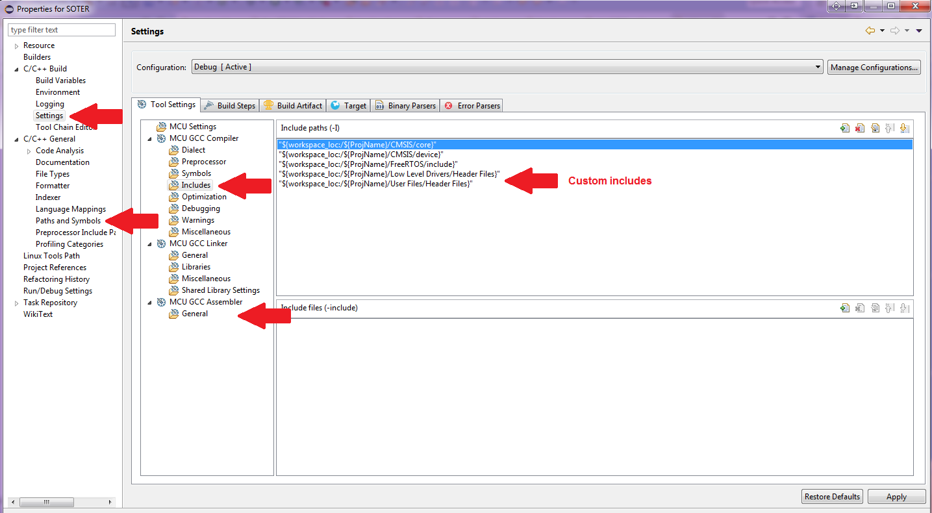

How to decrapify a project?

Slide 18
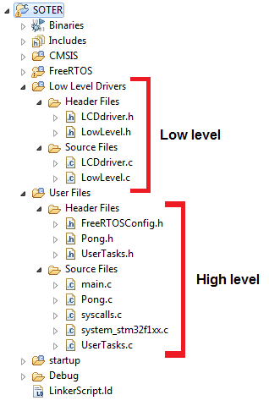
Getting organized

Slide 19
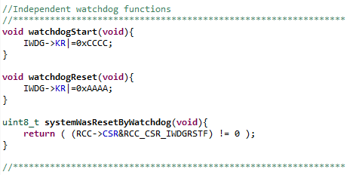
Watchdog? Easy

Slide 20
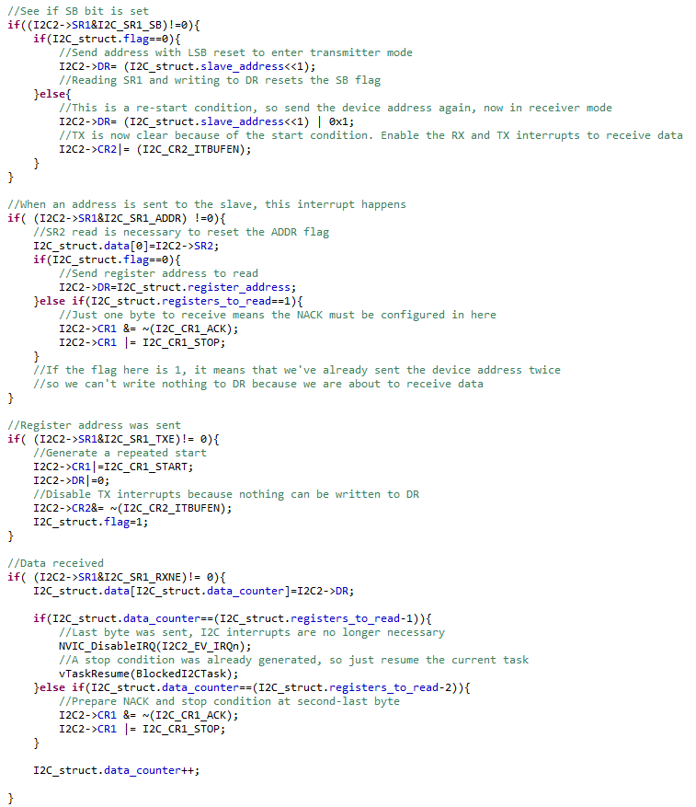
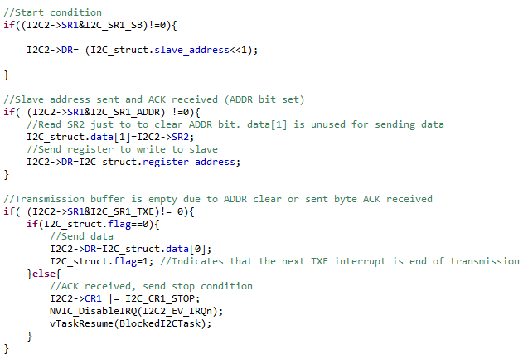
I2C? Not so easy

Slide 21
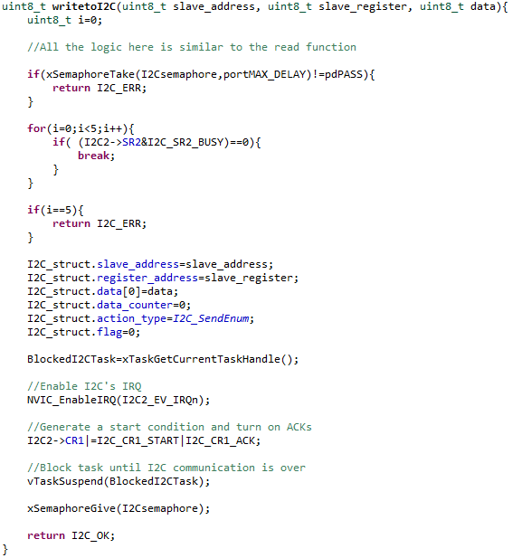
I2C – File-scope struct data setup

Slide 22
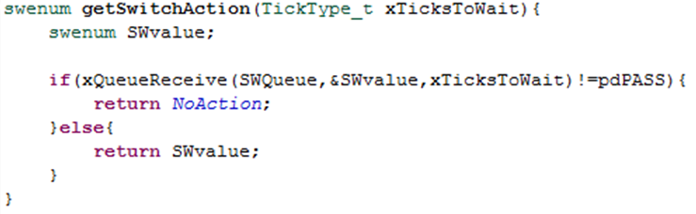
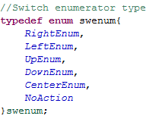
Switch internal queues

Slide 23
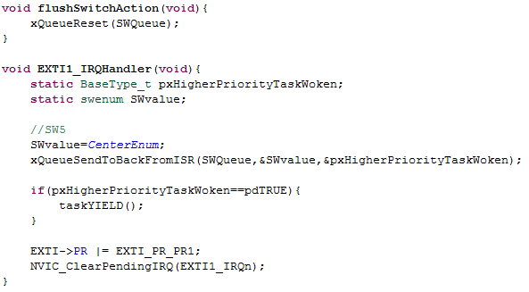
Switch internal queues

Slide 24
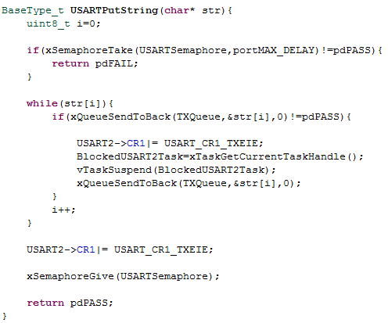
USART

Slide 25
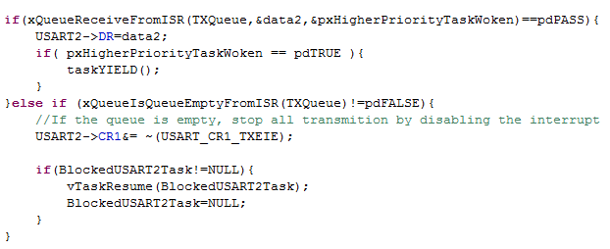
USART

Slide 26
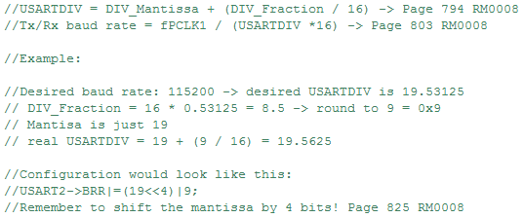
USART

Slide 27
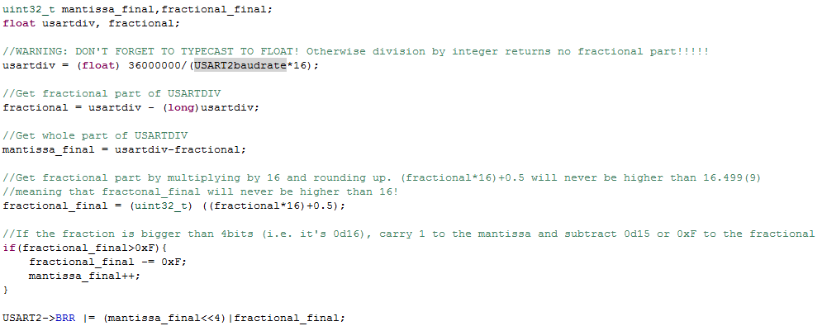
USART

Slide 28

Want to go down the same path?
Check it out:
https://github.com/Kagehiko/CMSIS-FreeRTOS-STM32F103

Slide 29
Questions?

