Slide 1
Zybo VGA Pong
PROSE 2018

Slide 2
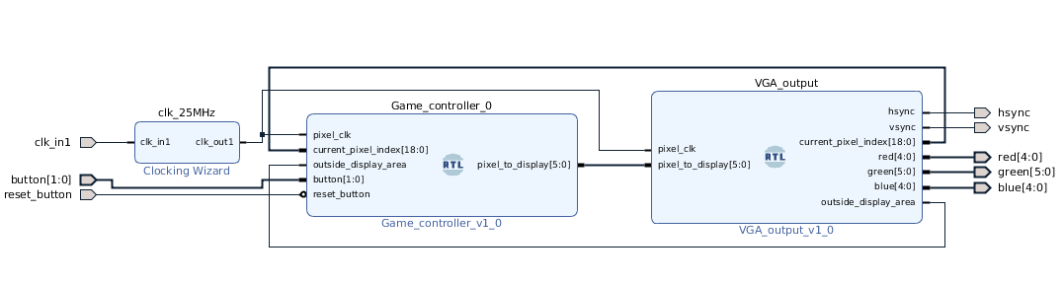
Block Diagram
Game controller block reads inputs and decides current pixel color (6 bit)
VGA output block generates HSYNC, VSYNC and RGB signals

Slide 3
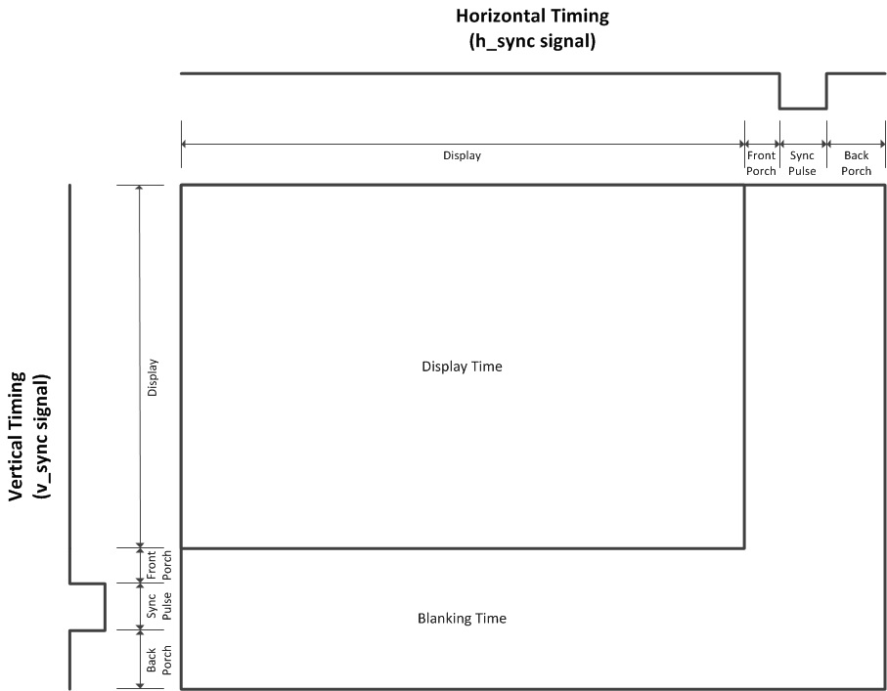
VGA Output
VGA timings are for 640x480 @ 60Hz

Slide 4
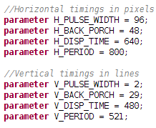
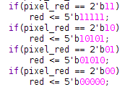
VGA Output
6bit color (RGB 222) is translated to 16bit color (RGB 565)

Slide 5
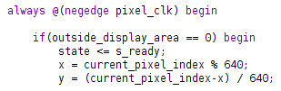

Game Logic
When the VGA output is drawing, signal “outside_display_area” is 0
  Game logic decides pixel color based on “current pixel index” signal
...
...

Slide 6
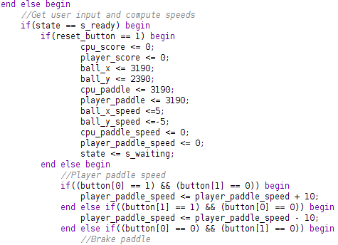
Game Logic
When VGA output is not drawing, signal “outside_display_area” is 1
  Game logic uses remaining pixel clocks to perform game logic calculations

Slide 7
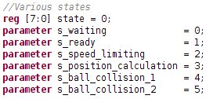
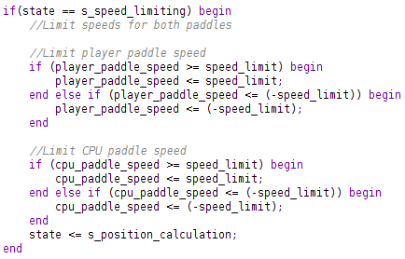
Game Logic
Game logic block uses 6 different states to compute game logic during blanking area

Slide 8
Game Logic
CPU paddle speed is dependent on its position and the ball’s position
CPU paddle speed is also dependent on player score, so difficulty increases with each point scored
Ball increases vertical speed when it hits a paddle, up to a certain maximum
On paddle collision, a percentage of the paddle speed is added to the ball
Game ends on 10 points scored

Slide 9
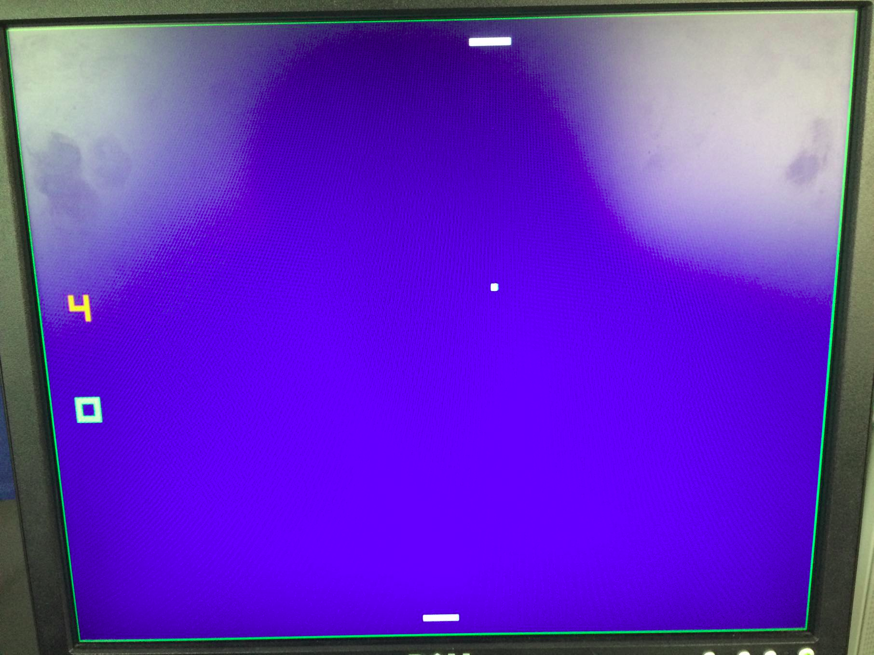
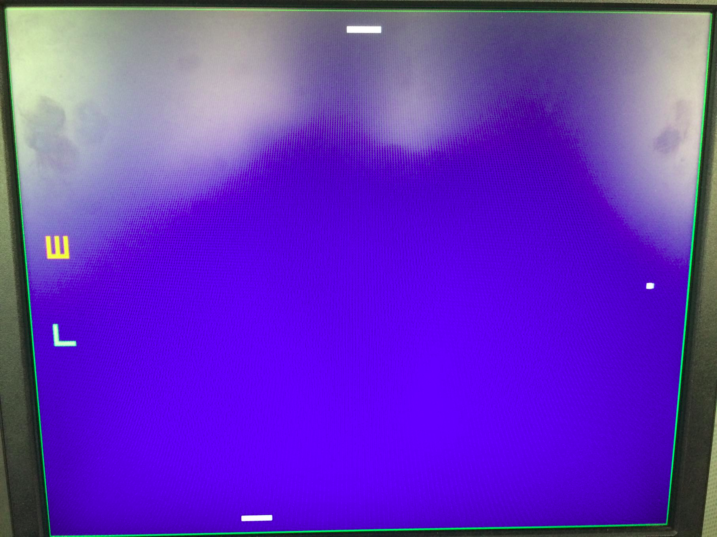
Results

Slide 10
The end
Questions?

