Slide 1
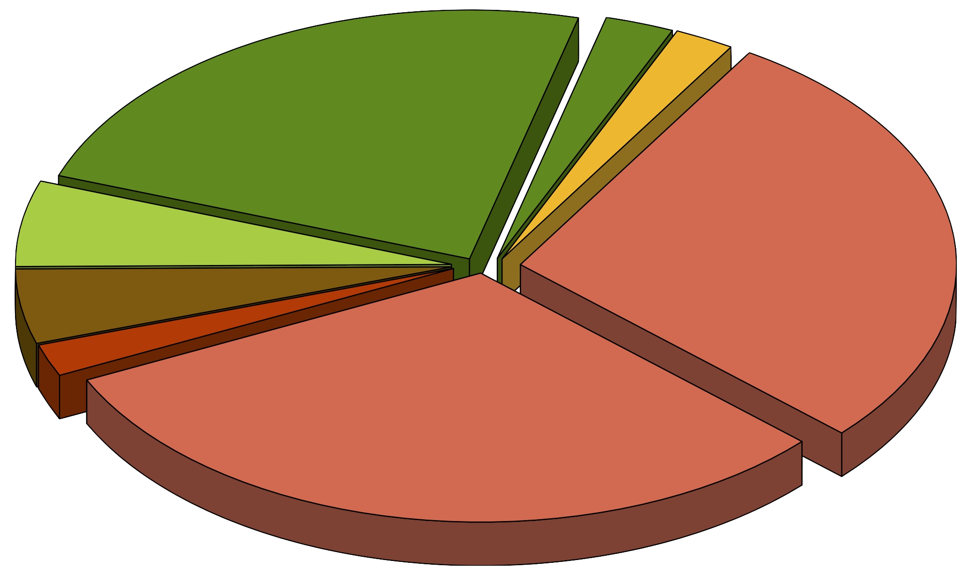
Normal adjacent
HGPIN
351
38*
33
Normal prostate
83
417
72
Metastasis
31
Metastatic
primary tumour
463*
Primary tumour

