Slide 1
BEERS AND BREWERIES

Slide 2

This Photo by Unknown Author is licensed under CC BY-NC

Slide 3
Creating connection to postgres

Slide 4
Creating and cleaning up dataframes
READ csv file
Rename columns
Reset index

Slide 5
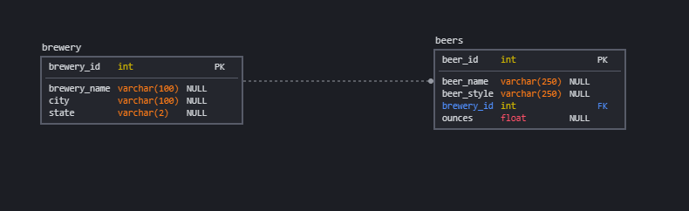
Building our schema in sql
ERD diagram created using *___*

