Slide 1
BEERS AND BREWERIES

Slide 2

This Photo by Unknown Author is licensed under CC BY-NC

Slide 3
Creating connection to postgres
We used the psycopg2 library in order to call external SQL Scripts to create the Database and tables from within the Jupyter notebook
After creating the database and schema we utilized sqlalchemy and pandas to load our table and perform our query against those tables.

Slide 4
Creating and cleaning up dataframes
READ csv file
Rename columns
Reset index

Slide 5
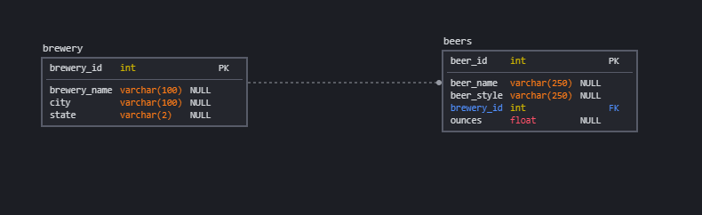
Building our schema in sql
ERD diagram created using *___*

