Slide 1
Predicting Salary and Attrition
Frito Lay Data – Can we determine Salary and attrition from employee data?

Slide 2
Executive Summary:
With current inflation data showing that inflation is outpacing wage growth drastically, employees are feeling an impact to their financial bottom line at home. No longer can employees accept idle wage growth as such is accepting wage reductions when inflation is taken into account.
As a business, you must reward your employees financially with incentives that both satisfy their financial desires and address others they may have.
The question is, do we know what desires cause an employee to stay in a role? Is it financial alone? Is there some other factor which can cause an otherwise happy employee to leave? Does this change over time, such as when inflation is growing at the rate it is now, in 2021 and 2022?
I've set out to provide you with insights using the data set you have provided, of 870 employees.

Slide 3
Exploring the data…
The data provided included numerous features on 870 employees, including attrition, monthly income, various performance indicators, descriptive qualities about the employee, and information that describes the employees job.
You also provided 2 sets of data with the requirement that I predict attrition and salary in the respective files where that feature is missing, so that you can evaluate the quality of any models I develop.
A walk through the data showed a number of features where I did not feel enough information was provided to make the feature useful in my analysis. These included 3 features of “rate” with no descriptive qualities, StandardHours, where all values where equal, Over18 that while it may have been self explanatory, was not useful as all employees met that quality, and EmployeeCount, which did not appear to represent any discernable feature of the employees. Those features were removed before moving forward.
To convert some features to categorical values, I placed the employees into groups, such as age groups and annual income groups.

Slide 4
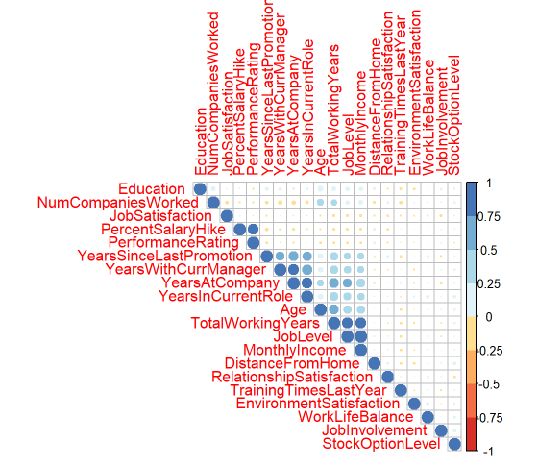
Exploring the data…
The next step was to evaluate the correlation between pairs of features.
The chart below shows which features are correlated and the level at which they are such.

Slide 5
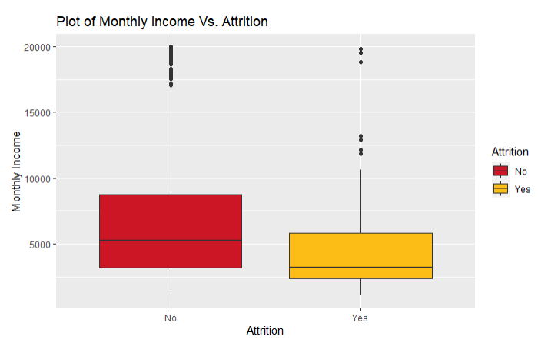
Exploring the data…
Next, I wanted to see some details of those who left Frito Lay and those who didn’t.
I found the mean age at which an employee stayed at Frito Lay was 37.4 years while an employee who left had a mean age of 33.8 years.
I also found a noticeably higher mean monthly income among those employees who stayed. That data is plotted below.

Slide 6
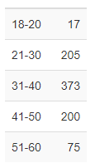
Exploring the data…
I wanted to see if there was anything exceptional about the ages of all employees. I found that there appeared to be a normal distribution of employees across typical working ages. Those ages are shown below.

Slide 7
Prepare for modelling…
I then moved into the final stages of preparing to make predictive models using the features selected.
I chose to remove a few features which showed a high correlation that I felt was due to two features explaining the same thing about the employees. I chose to remove Years Since Last Promotion, Total Working Years, and Percent Salary Hike.
As a last step to prepare the data for training models, I split the deta into a training and testing group with a random 75% assigned to the training group and the remaining 25% assigned to the testing group.
It is important to note that the data was split randomly and the ratio of attrition was kept close across the two samples.

Slide 8
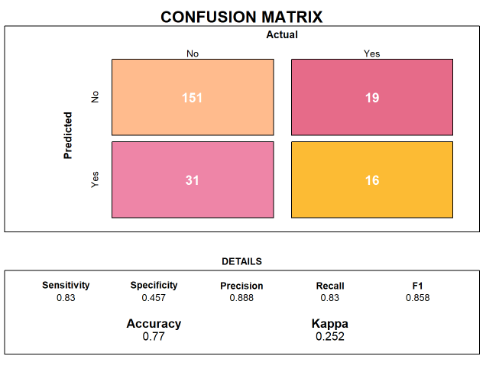
Classification Prediction - Attrition
I began the process of developing a classification prediction model to predict attrition by using a Naïve Bayes Classifier.
The model did a fair job of predicting when an employee would not leave at 83 % sensitivity but performed rather poorly predicting when an employee would leave, at 45.7% specificity.

Slide 9
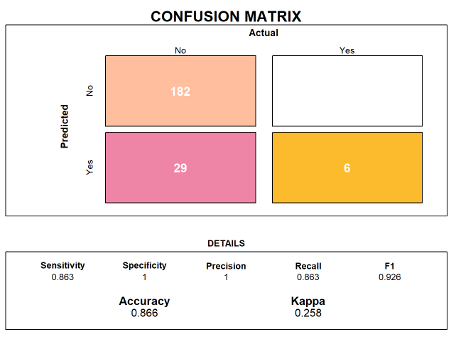
Classification Prediction - Attrition
Knowing better results were within my grasp, I moved onto a random forest classifier.
After tuning the model, I was able to predict an employee staying with Frito Lay with 86.3% sensitivity and the specificity achieved 100% in the test sample.
The features which weighed the most heavily in attrition were Age, Business Travel for those who traveled both frequently and rarely, Department for those in R&D and Sales, Distance from home, and education including Life Sciences, Marketing, and Medical.

Slide 10
Regression Prediction - Salary
I began the salary prediction model with a simple linear regression and evaluating the importance of the features. A basic linear model using the features kept to date resulted in a respectable RMSE of $1062 and an Adjust R-squared of .9445.
I attempted to eliminate additional features using the variance inflation factors but performance dropped substantially.
The modified linear model performed with an RMSE of $1379 and an adjusted R Squarted of 0.9064.

Slide 11
Regression Prediction - Salary
To increase performance of the regression model, I looked to the Cubist Regression Model. Cubist is a rule based model that had shown promising results through my research.
A first run came in with an RMSE of $1223 and an R Squared of 0.9372.
I sat out to do better and used 10 fold cross validation along with a tuning grid to test for optimum values of the number of committees and the number of neighbors.
Committees perform iterative trees in sequence, where the prior section informs the current tree, using adjusted versions of the training set outcome.
These help to narrow the gap between predicted and actual values and improve the model performance.
Neighbors are used in the prediction to adjust any given prediction based on the average of its n nearest neighbors.

Slide 12
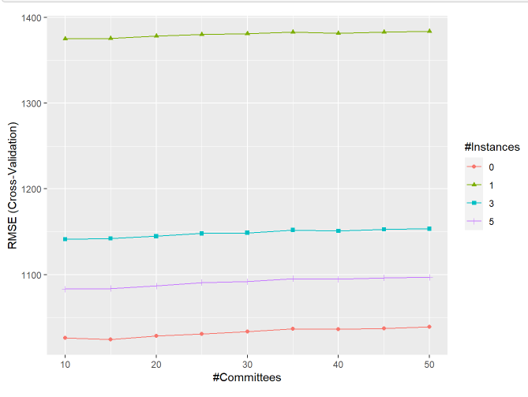
Regression Prediction - Salary
Applying the best case of 15 committees and 0 neighbors, I was able to achieve a respectable RMSE of $1024.26 and an R Squared of 0.9473.

Slide 13
Final Thoughts
In closing, I have been able to develop a classification model using a random forest model which is able to predict attrition with high accuracy.
Further, I have developed a model using the Cubist rule based model that achieved an RMSE very close to $1000 with a high R Squared.
I have generated the requested prediction in the attrition and salary files, in the format required, and have delivered those.
Thank you for the opportunity to work with Frito Lay and should there be an opportunity in the future, I would certainly appreciate the chance to work with your team again.

