Slide 1
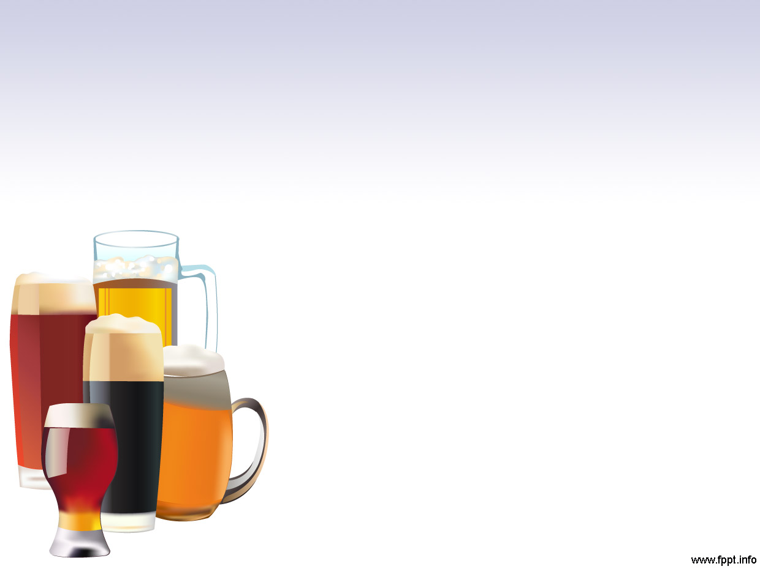
Exploratory Data Analysis of Breweries and Beer
Prepared for Brendan Whitworth, CEO, and Fernando Tennenbaum, CFO, of Anheuser Busch In Bev
By-Jason Mcdonald And Ranjan Karki

Slide 2
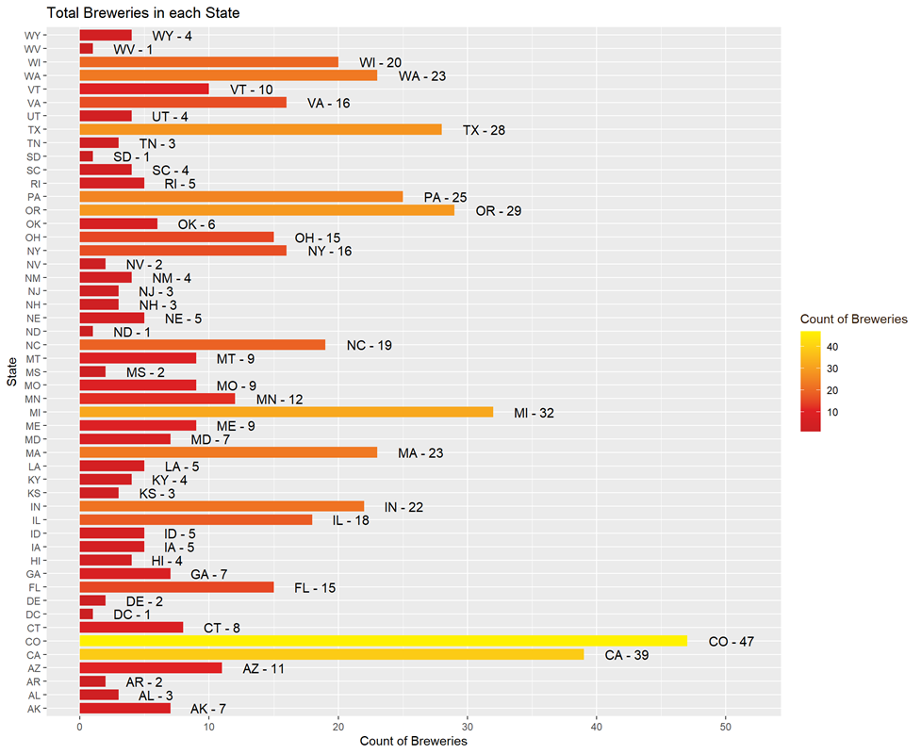
Breweries Per State

Slide 3
Missing values
ABV | IBU
62 | 1005

Slide 4
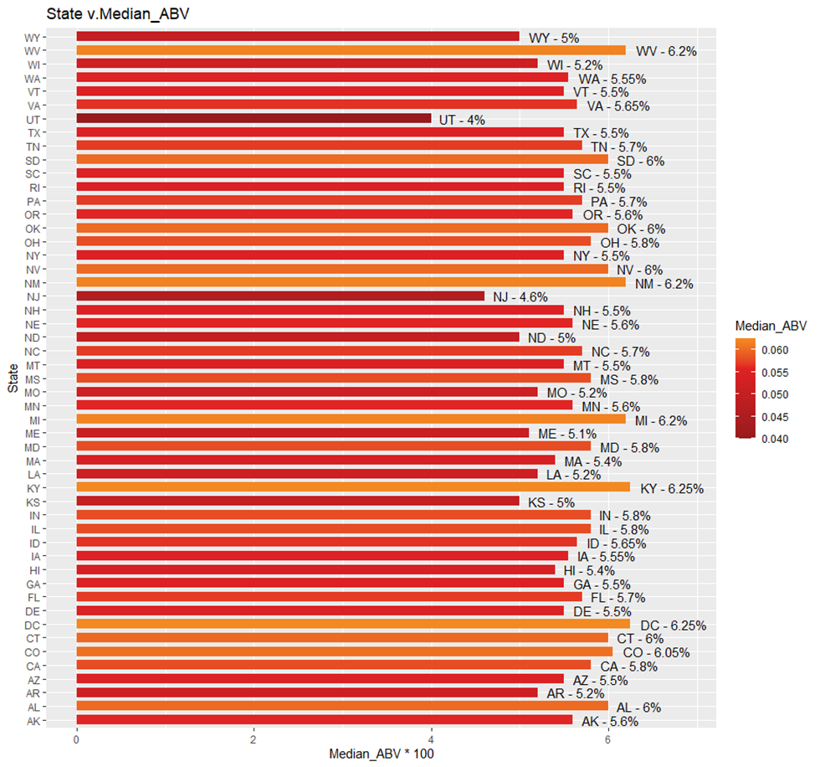
Alcohol by Volume (ABV) by State

Slide 5
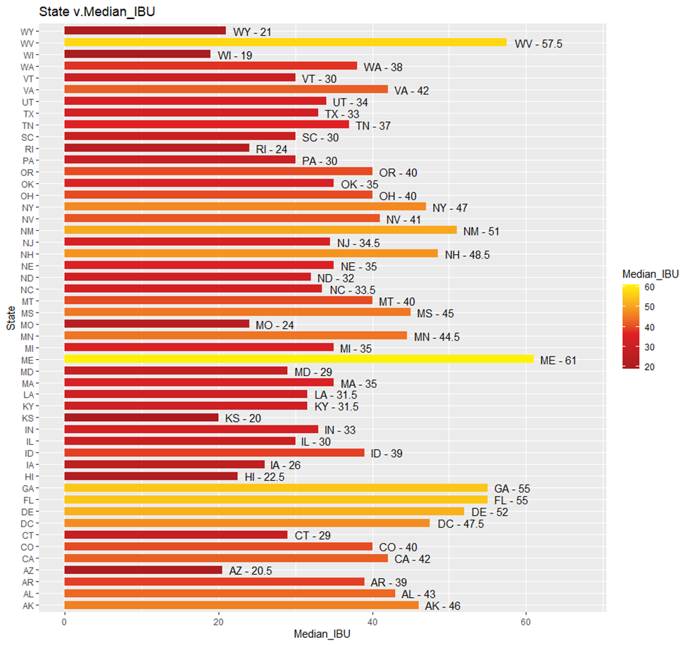
International Bitterness Unit (IBU) by State

Slide 6
Maximum ABV
And
Most IBU
Maximum- Median ABV and Median IBU
State | ABV
Washington DC | 6.25 %
Kentucky | 6.25 %
State | IBU
Maine | 138
Notes:
df1[which.max(df1$Median_ABV),]
df2[which.max(df2$Median_IBU),]

Slide 7
Single Highest ABV and IBU
State | Beer Name | Max ABV
CO | Lee Hill Series Vol5 | 12.8 %
State | Beer Name | Max IBU
OR | Bitter Bi** Imperial IPA | 138

Slide 8

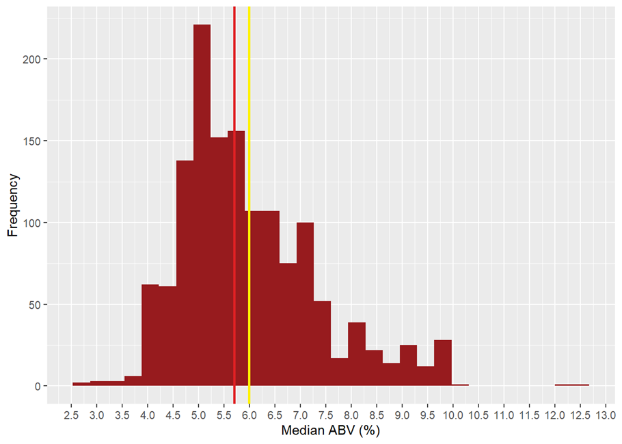
ABV Summary
Mean | SD
5.99 | 1.35

Slide 9
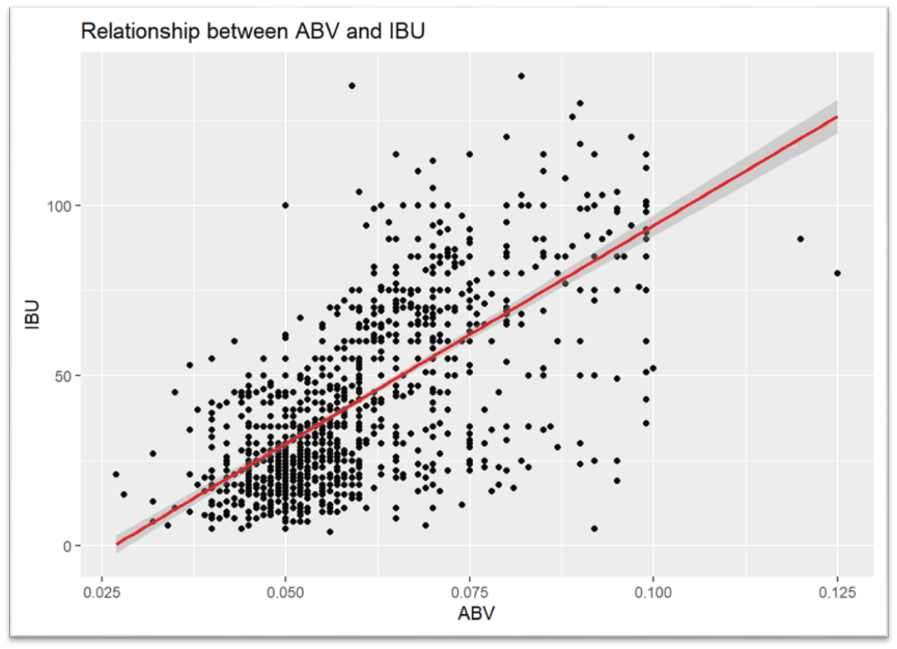
ABV vs IBU

Slide 10
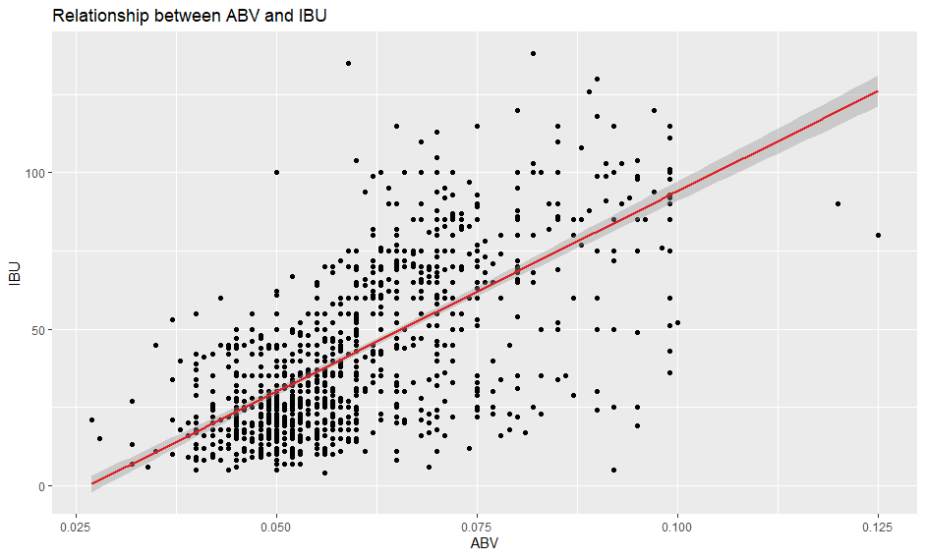
High ABV and Low IBU
Style (Mostly Ales and Witbeer)
Scotch Ale / Wee Heavy
Quadrupel (Quad)
Dubbel
MÃ¤rzen / Oktoberfest
Fruit / Vegetable Beer
American Strong Ale
Scottish Ale
Witbier
Tripel
Scottish Ale

Slide 11
KNN to investigate on IPA and ALE
-Machine Learning Algorithm
-Relationship between IPA and ALE beer based on IBU and ABV
Analogy of KNN : People get affected by people around them

Slide 12
KNN
ABV vs IBU | IPA and ALE
Accuracy- 83.1 %
Sensitivity – 72.09 %
Specificity – 91.93 %
Actual |  | Predicted
 |  | IPA | ALE
 | IPA | 93 | 13
 | ALE | 36 | 148

Slide 13
Most Popular Beer in US
Craft Beer ME
(https://craftbeerme.com/guide-to-the-most-popular-types-of-craft-beer-in-america/)
1. Lager
2. IPA
3. American Pale Ale

Slide 14
Comparing Craft Beer with Budweiser
Per Publix(American grocery market)
Budweiser- ABV – 5% | IBU – 11
Our findings for Lager Beer
Measure | Value
Max ABV | 7.2%
Min ABV | 3.2%
Max IBU | 80
Min IBU | 8
Median ABV | 4.9%
Median IBU | 19

Slide 15
American Pale Ale Statistics
Measure | Value
Max ABV | 7.0 %
Min ABV | 3.7%
Max IBU | 68
Min IBU | 16
Median ABV | 5.5%
Median IBU | 44

Slide 16
India Pale Ales (IPA) Statistics
Measure | Value
Max ABV | 9.9%
Min ABV | 3.8%
Max IBU | 138
Min IBU | 30
Median ABV | 6.8%
Median IBU | 70

Slide 17
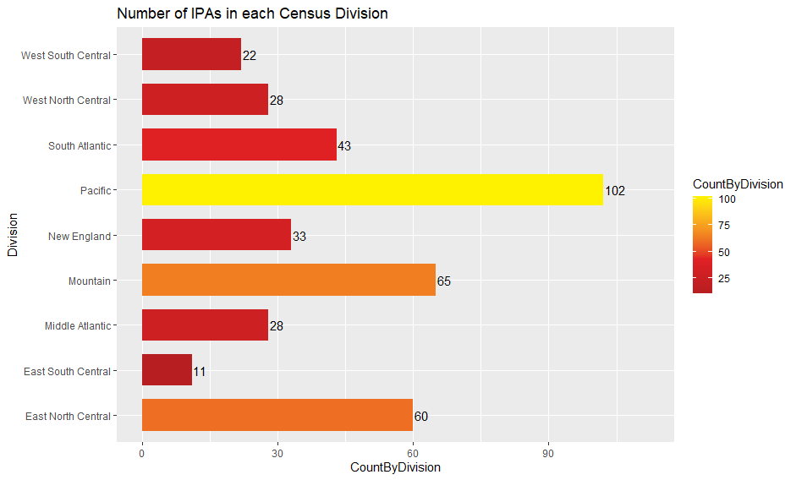
Where to Launch Bud-IPA

Slide 18
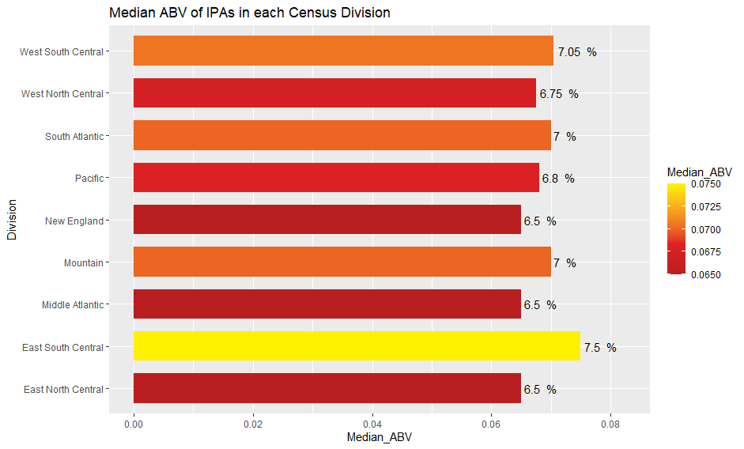
Where to Launch Bud-IPA

Slide 19

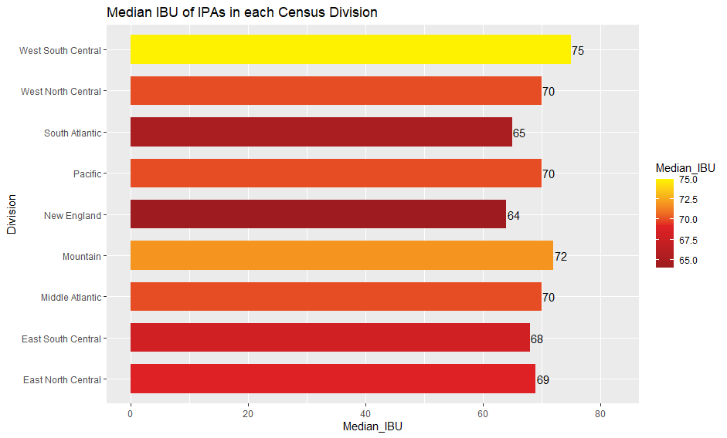

Slide 20
THANK YOU

