Slide 1
Data Science Capstone Pittsburgh vs. Manhattan and Toronto for Amenities
JMc
May 2019

Slide 2
Introduction
General Business Problem
Comparison of smaller and cheaper midwestern cities to larger cities with respect to quality of life using sound and defendable data science techniques.
Assume Toronto and Manhattan have attractive neighborhoods from a venue perspective
Compare Pittsburgh (smaller city) to see how it stacks up in a comparison of neighborhoods.
Create a list of correlation between Pittsburgh Neighborhoods and popular Manhattan and Toronto Neighborhoods

Slide 3
Data Sources and Use
Coursera Data Science Capstone New York Neighborhood Venue analysis provided New York Neighborhood geo data
Source of Manhattan neighborhood list and geo data for each neighborhood center
Toronto Neighborhood Wikipedia Page
Source of Toronto neighborhood list
Pittsburgh Wikipedia Page
Source of Pittsburgh neighborhood list
Google Geocoder API derived data for neighborhoods
Source or verification of geo coordinates for center of neighborhood
Foursquare (venues/explore) data for each neighborhood
Source of venue name, type and geo data for each neighbothood

Slide 4
Methodology
High Level
Take the well-known neighborhoods in each city as identified by public reference sites such as Wikipedia
Get good reference long/lat data for each neighborhood by whatever means available
Search for venues by amenity in each neighborhood
Run the neighborhood amenity data through an unsupervised clustering algorithm to classify the neighborhoods for similarity based on the amenity venues
Interpret the classification
Tools Used
Geopy
Google mapsapi geocoder
Nominatim
Folium
Foursquare (venues/explore)
K_means Clustering

Slide 5
Results
Sample run of methodology using K-means clustering classification
K=15
Radius from Neighborhood center is 1000m

Slide 6
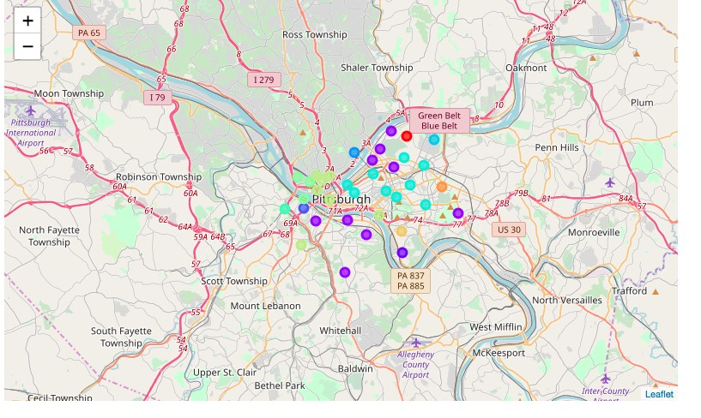
Pittsburgh Cluster Map

Slide 7
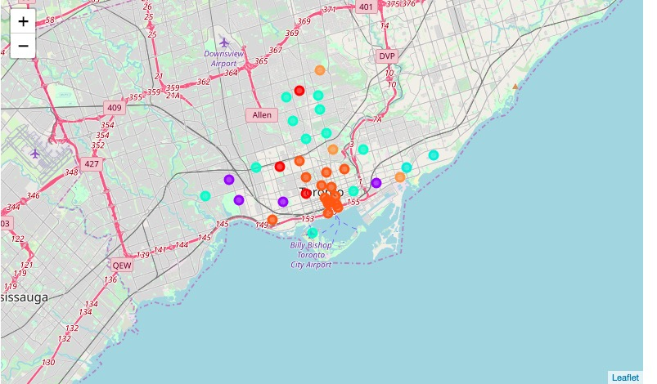
Toronto Cluster Map

Slide 8
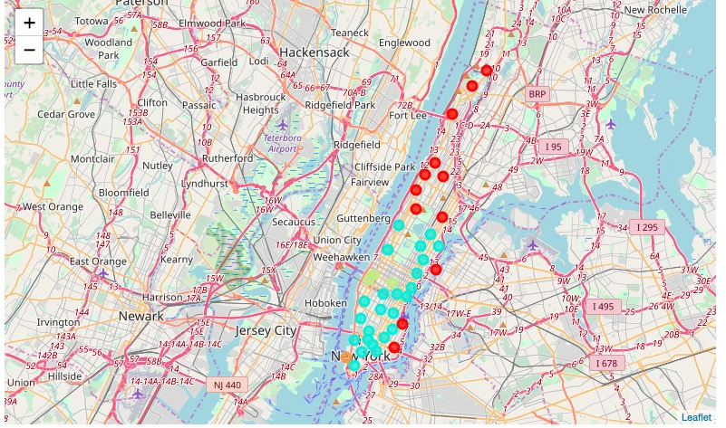
Manhattan Cluster Map

Slide 9
Cluster 3 Neighborhoods
City | Neighborhood | 1st Most Common Venue | 2nd Most Common Venue | 3rd Most Common Venue
Toronto | Studio District | Coffee Shop | Bar | Caf√©
Toronto | Little Portugal, Trinity | Bar | Caf√© | Bakery
Toronto | High Park, The Junction South | Bar | Caf√© | Coffee Shop
Toronto | Parkdale, Roncesvalles | Pizza Place | Sushi Restaurant | Coffee Shop
Pittsburgh | Bloomfield | Coffee Shop | Pizza Place | Bar
Pittsburgh | Carrick | Pizza Place | Bank | Pharmacy
Pittsburgh | Central Lawrenceville | Bar | Coffee Shop | Pizza Place
Pittsburgh | Lower Lawrenceville | Bar | Coffee Shop | Sandwich Place
Pittsburgh | Mount Washington | Bar | Scenic Lookout | Tunnel
Pittsburgh | Regent Square | Trail | Bar | Park
Pittsburgh | Southside Flats | Bar | Pizza Place | Sandwich Place
Pittsburgh | Southside Slopes | Bar | Clothing Store | Mexican Restaurant
Pittsburgh | Upper Lawrenceville | Bar | Brewery | Thrift / Vintage Store

Slide 10
Cluster 8 Neighborhoods
City | Neighborhood | 1st Most Common Venue | 2nd Most Common Venue | 3rd Most Common Venue
Manhattan | Chinatown | Ice Cream Shop | Cocktail Bar | Chinese Restaurant
Manhattan | Upper East Side | Exhibit | Italian Restaurant | Gym / Fitness Center
Manhattan | Yorkville | Italian Restaurant | Gym | Coffee Shop
Manhattan | Lenox Hill | Sushi Restaurant | Italian Restaurant | Sporting Goods Shop
Manhattan | Upper West Side | Italian Restaurant | Wine Bar | Vegetarian / Vegan Restaurant
Manhattan | Lincoln Square | Gym / Fitness Center | Coffee Shop | Jazz Club
Manhattan | Murray Hill | Korean Restaurant | Gym / Fitness Center | Japanese Restaurant
Manhattan | Chelsea | Art Gallery | Coffee Shop | Ice Cream Shop
Manhattan | Greenwich Village | Italian Restaurant | Spa | Seafood Restaurant
Manhattan | East Village | Coffee Shop | Cocktail Bar | Wine Bar
Manhattan | Tribeca | Park | Coffee Shop | American Restaurant
Manhattan | Little Italy | Yoga Studio | Men's Store | Clothing Store
Manhattan | Soho | French Restaurant | Italian Restaurant | Clothing Store
Manhattan | West Village | Italian Restaurant | American Restaurant | Wine Bar
Manhattan | Gramercy | American Restaurant | New American Restaurant | Gym
Manhattan | Financial District | Coffee Shop | Pizza Place | Hotel
Manhattan | Carnegie Hill | Coffee Shop | Pizza Place | Yoga Studio
Manhattan | Noho | Japanese Restaurant | Italian Restaurant | Cocktail Bar
Manhattan | Civic Center | Bakery | French Restaurant | Coffee Shop
Manhattan | Midtown South | Gym / Fitness Center | Korean Restaurant | Japanese Restaurant
Manhattan | Sutton Place | Italian Restaurant | Spa | Gym
Manhattan | Turtle Bay | American Restaurant | Seafood Restaurant | Coffee Shop
Manhattan | Tudor City | Japanese Restaurant | Coffee Shop | Sushi Restaurant
Manhattan | Flatiron | Gym / Fitness Center | Gym | Cycle Studio
Toronto | The Beaches | Pub | Coffee Shop | Pizza Place
Toronto | The Beaches West, India Bazaar | Indian Restaurant | Coffee Shop | Beach
Pittsburgh | Central Oakland | Sandwich Place | Coffee Shop | Pizza Place
Pittsburgh | East Liberty | Coffee Shop | American Restaurant | Grocery Store
Pittsburgh | Garfield | Coffee Shop | Art Gallery | Grocery Store
Pittsburgh | Hill District | Grocery Store | Bar | Bakery
Pittsburgh | North Oakland | Coffee Shop | Pizza Place | Indian Restaurant
Pittsburgh | Polish Hill | Italian Restaurant | Coffee Shop | Bar
Pittsburgh | Shadyside | Hotel | Pharmacy | Coffee Shop
Pittsburgh | Squirrel Hill | Coffee Shop | Pizza Place | Thai Restaurant
Pittsburgh | Strip District | Coffee Shop | Grocery Store | Bakery

Slide 11
Cluster 12 Neighborhoods
City | Neighborhood | 1st Most Common Venue | 2nd Most Common Venue | 3rd Most Common Venue
Manhattan | Clinton | Theater | Hotel | Gym / Fitness Center
Manhattan | Midtown | Theater | Hotel | Coffee Shop
Manhattan | Hudson Yards | Hotel | Dance Studio | Italian Restaurant
Pittsburgh | Allegheny Center | Art Museum | Coffee Shop | American Restaurant
Pittsburgh | Beechview | Light Rail Station | Pizza Place | Hotel
Pittsburgh | Central Business District (Downtown) | Hotel | Italian Restaurant | Coffee Shop
Pittsburgh | Central Northside | Deli / Bodega | American Restaurant | Sandwich Place
Pittsburgh | East Allegheny | Trail | American Restaurant | Deli / Bodega
Pittsburgh | North Shore | Bar | Sandwich Place | Coffee Shop
Pittsburgh | South Oakland | Hotel | Sandwich Place | Pizza Place

Slide 12
Cluster 14 Neighborhoods
City | Neighborhood | 1st Most Common Venue | 2nd Most Common Venue | 3rd Most Common Venue
Manhattan | Battery Park City | Park | Coffee Shop | Wine Shop
Toronto | Rosedale | Coffee Shop | Park | Grocery Store
Toronto | Business Reply Mail Processing Centre 969 Eastern | Park | Coffee Shop | Brewery
Toronto | Lawrence Park | Trail | College Gym | Park
Pittsburgh | Point Breeze | Coffee Shop | New American Restaurant | Park

Slide 13
Outliers
Cluster 0 was exclusively Toronto.
Cluster 1 was mostly Manhattan (1 Toronto Neighborhood)
Cluster 2 was (an outlier) the Stanton Heights section of Pittsburgh only
Cluster 4 was (an outlier) the Hazelwood section of Pittsburgh
Cluster 5 was (an outlier) the Duquesne Heights section of Pittsburgh
Cluster 6 was (an outlier) the Troy Hill section of Pittsburgh
Cluster 7 was (an outlier) the Highland Park section of Pittsburgh
Cluster 9 was exclusively Toronto
Cluster 10 was (an outlier) the West End section of Pittsburgh
Cluster 11 was all Pittsburgh (Allegheny West, Southshore and Manchester) and closely located to major Stadium and River Confluence.
Cluster 13 was (an outlier) the Greenfield section of Pittsburgh

Slide 14
Issues Complicating Comparison
Neighborhood Boundary Definition
Not formal in use
Foursquare uses radius to determine proximity
Practical use of amenities is not constrained by neighborhood boundaries
Density of People
The more dense, the smaller te neighborhood
Manhattan is a lot more dense than Toronto which is a lot more dense than Pittsburgh
Mobility
How ‘big (geo range) ’ is the practical mobility range to get to amenities
Unique business categories
Categories are generic
Foursquare has a large number of discrete categories but venue categories are continuous

Slide 15
Attractive Neighborhoods are a matter of Taste
Individuals may interpret the permutations/combinations of amenities in a neighborhood differently than the K_Means analysis we did
Our Analysis is a good approximation

Slide 16
Follow on areas of adjacent study
Additional Neighborhood data should be analyzed for Similarity
Cost of living
Mobility profile (How easy is it to get a certain distance to a particular amenity

Slide 17
Conclusions
Pittsburgh stacks up well in its comparison to Manhattan and Toronto for its inventory of Neighborhoods that have good amenities
The Neighborhoods shown in cluster 3, 8, 12 and 14 are illustrative.

