Slide 1
The Fork-Join Framework

Slide 2

Objectives
After completing this lesson, you should be able to:
Apply the Fork-Join framework
Notes:
Java SE 8 Programming 16 - ‹#›

Slide 3
Parallelism
Modern systems contain multiple CPUs. Taking advantage of the processing power in a system requires you to execute tasks in parallel on multiple CPUs.
Divide and conquer: A task should be divided into subtasks. You should attempt to identify those subtasks that can be executed in parallel.
Some problems can be difficult to execute as parallel tasks.
Some problems are easier. Servers that support multiple clients can use a separate task to handle each client.
Be aware of your hardware. Scheduling too many parallel tasks can negatively impact performance.
Notes:
CPU Count
If your tasks are compute-intensive as opposed to I/O intensive, the number of parallel tasks should not greatly outnumber the number of processors in your system. You can detect the number of processors easily in Java:
int count = Runtime.getRuntime().availableProcessors();
Java SE 8 Programming 16 - ‹#›

Slide 4
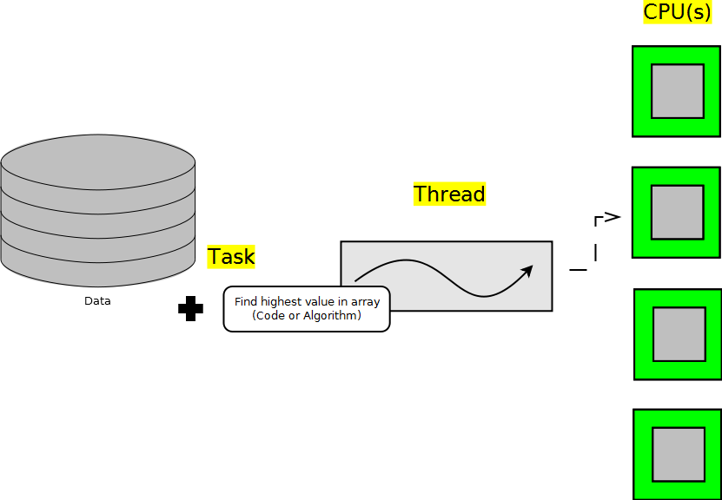
Without Parallelism
Modern systems contain multiple CPUs. If you do not leverage threads in some way, only a portion of your system’s processing power will be utilized.
Notes:
Setting the Stage
If you have a large amount of data to process but only one thread to process that data, a single CPU will be used. In the slide's graphic, a large set of data (an array, possibly) is being processed. The array processing could be a simple task, such as finding the highest value in the array. In a four CPU system, there would be three CPUs sitting idle while the array was being processed.
Java SE 8 Programming 16 - ‹#›

Slide 5
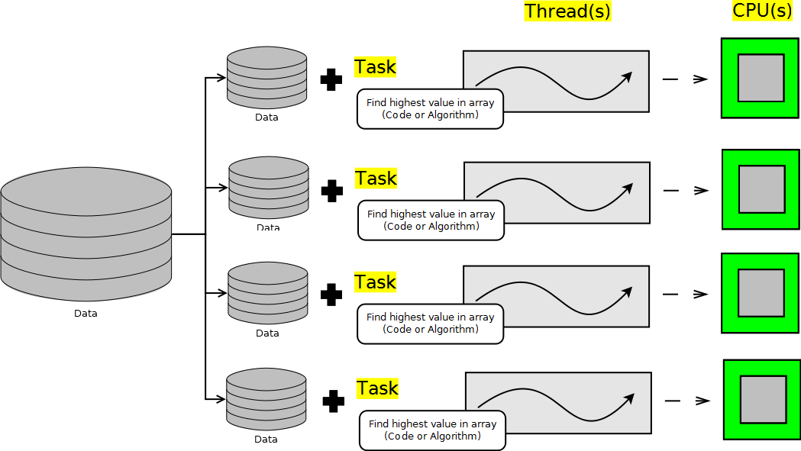
Naive Parallelism
A simple parallel solution breaks the data to be processed into multiple sets: one data set for each CPU and one thread to process each data set.
Notes:
Splitting the Data
In the slide's graphic, a large set of data (an array, possibly) is split into four subsets of data, one subset for each CPU. A thread per CPU is created to process the data. After processing the subsets of data, the results will have to be combined in a meaningful way. There are several ways to subdivide the large dataset to be processed. It would be overly memory-intensive to create a new array per thread that contains a copy of a portion of the original array. Each array can share a reference to the single large array but access only a subset in a non-blocking thread-safe way.
Java SE 8 Programming 16 - ‹#›

Slide 6
The Need for the Fork-Join Framework
Splitting datasets into equal sized subsets for each thread to process has a couple of problems. Ideally all CPUs should be fully utilized until the task is finished, but:
CPUs may run at different speeds
Non-Java tasks require CPU time and may reduce the time available for a Java thread to spend executing on a CPU
The data being analyzed may require varying amounts of time to process
Notes:
Java SE 8 Programming 16 - ‹#›

Slide 7
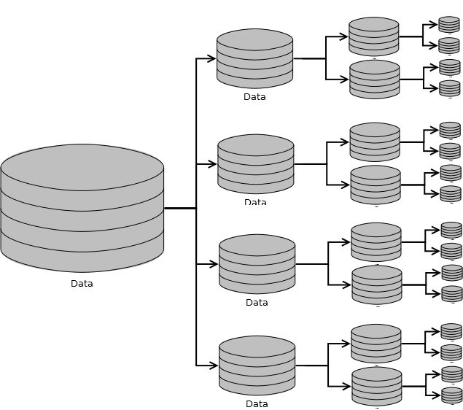
Work-Stealing
To keep multiple threads busy:
Divide the data to be processed into a large number of subsets
Assign the data subsets to a thread’s processing queue
Each thread will have many subsets queued
If a thread finishes all its subsets early, it can “steal” subsets from another thread.
Notes:
Work Granularity
By subdividing the data to be processed until there are more subsets than threads, we are facilitating “work-stealing.” In work-stealing, a thread that has run out of work can steal work (a data subset) from the processing queue of another thread. You must determine the optimal size of the work to add to each thread’s processing queue. Overly subdividing the data to be processed can cause unnecessary overhead, while insufficiently subdividing the data can result in underutilization of CPUs.
Java SE 8 Programming 16 - ‹#›

Slide 8
A Single-Threaded Example
int[] data = new int[1024 * 1024 * 256]; //1G
for (int i = 0; i < data.length; i++) {
data[i] = ThreadLocalRandom.current().nextInt();
}
int max = Integer.MIN_VALUE;
for (int value : data) {
if (value > max) {
max = value;
}
}
System.out.println("Max value found:" + max);
A very large dataset
Fill up the array with values.
Sequentially search the array for the largest value.
Notes:
Parallel Potential
In this example, there are two separate tasks that could be executed in parallel. Initializing the array with random values and searching the array for the largest possible value could both be done in parallel.
Java SE 8 Programming 16 - ‹#›

Slide 9
java.util.concurrent.ForkJoinTask<V>
A ForkJoinTask object represents a task to be executed.
A task contains the code and data to be processed. Similar to a Runnable or Callable.
A huge number of tasks are created and processed by a small number of threads in a Fork-Join pool.
A ForkJoinTask typically creates more ForkJoinTask instances until the data to processed has been subdivided adequately.
Developers typically use the following subclasses:
RecursiveAction: When a task does not need to return a result
RecursiveTask: When a task needs to return a result
Notes:
Java SE 8 Programming 16 - ‹#›

Slide 10
RecursiveTask Example
public class FindMaxTask extends RecursiveTask<Integer> {
private final int threshold;
private final int[] myArray;
private int start;
private int end;
public FindMaxTask(int[] myArray, int start, int end, int threshold) {
// copy parameters to fields
}
protected Integer compute() {
// shown later
}
}
Result type of the task
The data to process
Where the work is done. Notice the generic return type.
Notes:
Java SE 8 Programming 16 - ‹#›

Slide 11
compute Structure
protected Integer compute() {
if DATA_SMALL_ENOUGH {
PROCESS_DATA
return RESULT;
} else {
SPLIT_DATA_INTO_LEFT_AND_RIGHT_PARTS
TASK t1 = new TASK(LEFT_DATA);
t1.fork();
TASK t2 = new TASK(RIGHT_DATA);
return COMBINE(t2.compute(), t1.join());
}
}
Asynchronously execute
Process in current thread
Block until done
Notes:
Java SE 8 Programming 16 - ‹#›

Slide 12
compute Example (Below Threshold)
protected Integer compute() {
if (end - start < threshold) {
int max = Integer.MIN_VALUE;
for (int i = start; i <= end; i++) {
int n = myArray[i];
if (n > max) {
max = n;
}
}
return max;
} else {
// split data and create tasks
}
}
You decide the threshold.
The range within the array
Notes:
Java SE 8 Programming 16 - ‹#›

Slide 13
compute Example (Above Threshold)
protected Integer compute() {
if (end - start < threshold) {
// find max
} else {
int midway = (end - start) / 2 + start;
FindMaxTask a1 =
new FindMaxTask(myArray, start, midway, threshold);
a1.fork();
FindMaxTask a2 =
new FindMaxTask(myArray, midway + 1, end, threshold);
return Math.max(a2.compute(), a1.join());
}
}
Task for left half of data
Task for right half of data
Notes:
Memory Management
Notice that the same array is passed to every task but with different start and end values. If the subset of values to be processed were copied into a new array each time a task was created, memory usage would quickly skyrocket.
Java SE 8 Programming 16 - ‹#›

Slide 14
ForkJoinPool Example
A ForkJoinPool is used to execute a ForkJoinTask. It creates a thread for each CPU in the system by default.
ForkJoinPool pool = new ForkJoinPool();
FindMaxTask task =
new FindMaxTask(data, 0, data.length-1, data.length/16);
Integer result = pool.invoke(task);
The task's compute method is automatically called .
Notes:
Java SE 8 Programming 16 - ‹#›

Slide 15
Fork-Join Framework Recommendations
Avoid I/O or blocking operations.
Only one thread per CPU is created by default. Blocking operations would keep you from utilizing all CPU resources.
Know your hardware.
A Fork-Join solution will perform slower on a one-CPU system than a standard sequential solution.
Some CPUs increase in speed when only using a single core, potentially offsetting any performance gain provided by Fork-Join.
Know your problem.
Many problems have additional overhead if executed in parallel (parallel sorting, for example).
Notes:
Parallel Sorting
When using Fork-Join to sort an array in parallel, you end up sorting many small arrays and then having to combine the small sorted arrays into larger sorted arrays. For an example see the sample application provided with the JDK in C:\Program Files\Java\jdk1.7.0\sample\forkjoin\mergesort.
Java SE 8 Programming 16 - ‹#›

Slide 16

Summary
In this lesson, you should have learned how to:
Apply the Fork-Join framework
Notes:
Java SE 8 Programming 16 - ‹#›

Slide 17
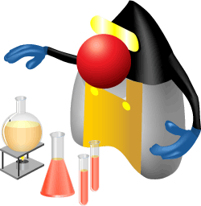
Practice 16-1 Overview: Using the Fork-Join Framework
This practice covers the following topics:
Extending RecursiveAction
Creating and using a ForkJoinPool
Notes:
In this practice, you create a multithreaded network client.
Java SE 8 Programming 16 - ‹#›

Slide 18
Quiz
Applying the Fork-Join framework will always result in a performance benefit.
True
False
Notes:
Answer: b
Java SE 8 Programming 16 - ‹#›

