Slide 1
Oracle Application Container Cloud Service Overview

Slide 2
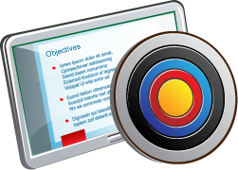
Objectives
After completing this lesson, you should be able to:
Get an overview of Oracle Application Container Cloud
Understand the unique features of Oracle Application Container Cloud
Understand how to build, zip, and deploy applications to the cloud

Slide 3

Oracle Application Container Cloud Service
An open highly available Docker container-based elastic polyglot cloud application platform

Slide 4

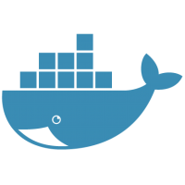













Oracle Application Container Cloud
Notes:
Simple and easy to use deployment platform for Java SE & Node applications
Open platform—use any application frameworks and libraries
Runs applications in Docker containers for reliability and scalability

Slide 5
Polyglot Platform
Deploy applications to a selection of popular language runtimes supported
Latest release supports Java SE, Java EE Web Apps, Node.js, and PHP
Leverage unique Oracle Java SE features
Immediate access to platform upgrades, security, platform optimizations
Continued commercial support for Java SE versions no longer receiving public updates
Node access to Oracle DB with open source database driver
Notes:
Runtime releases regularly updated to the latest

Slide 6












Open Platform
Notes:
Use any of the thousands of open source or commercial Java or Node frameworks—no restrictions.

Slide 7
Container-based Application Platform as a Service
Applications run on Oracle Linux in Docker containers
Stateless Applications
Ephemeral disk
Permanent storage through database or storage service

Slide 8
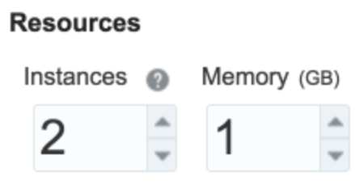
Elastic Scaling
On demand elastic scaling either through the service console or using the service REST API
Scale out / in
Add / remove application instances to handle workloads
Scale up / down
Add / remove RAM to accommodate application memory requirements

Slide 9
Profiling
Java application can use Java Flight Recorder to monitor application and JVM behavior and analyze in Mission Control
Use Application Performance Monitoring Cloud Service for advanced use cases

Slide 10
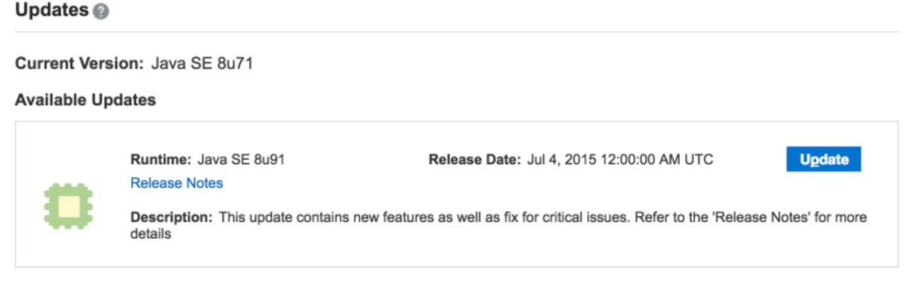
Manageable
New Java and Node releases published in the service console
One-click upgrade to the latest releases—applications are simply restarted to upgrade to new runtime

Slide 11




Build
Zip
Deploy!
Notes:
Build
Use your favourite or corporate standard build system to produce binaries and deployable resources.
Zip
Zip up all binaries, scripts, html files, images, etc. that make up your application. The structure of the zip is entirely up to the user—we have no opinion on structure.
Deploy
Deploy the application archive (zip) to the platform and tell us how to start the application. This could be “java –jar’, “java –classpath … <main>”, “node myapp.js”, or “sh bootmyapp.sh”.

Slide 12
Deploy—Application Archive (Zip)
All application binaries
All required libraries
Binaries of any container/embedded container
Images files
HTML files
Everything you'd need to run your application on a virgin machine

Slide 13





Application Deployment
Java SE
Node.js
Java EE
PHP
Application Image
Language Runtimes Docker Image Repository
Private Tenant Docker Image Repository
Developer
Image Builder
Application Archive
Load Balancer
App-1
App-2
App-3

Slide 14










Application Container Cloud Architecture
Database Cloud Service
Load Balancer
Developer Cloud Service
Storage Cloud Service
…
Java SE, Node Cloud Service
Tenant 2
Tenant 1
App-1
App-2
App-3
App-1
App-2
App-3
App-1
App-2
App-3
Java Cloud Service
Developer
Messaging Cloud Service
Notes:
Tenant Isolation
Polyglot
Integrated
Developer Friendly

Slide 15

Load Balancer
Fully automated—no user management required
Scale out or in and application instances are automatically registered/unregistered
Notes:
Vanity URL support (upcoming) will allow installation of certificates

Slide 16

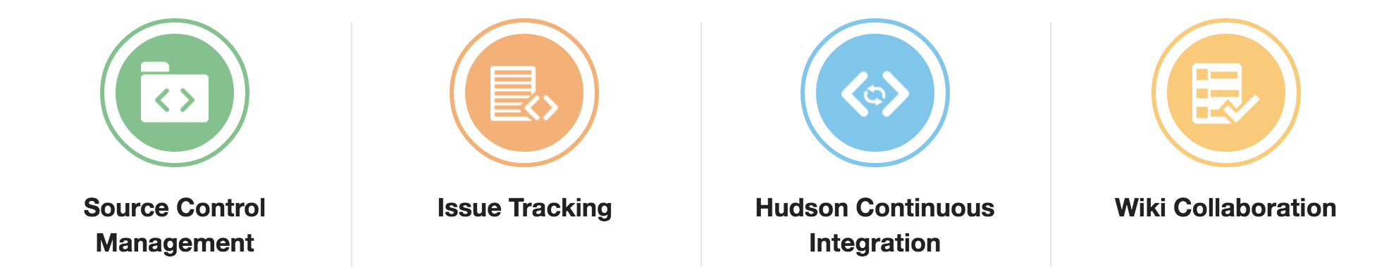
Oracle Developer Cloud Service
Notes:
Complete, Integrated Development Platform—as a Service
Application Lifecycle Management
Team Management
Entitlement with all Application Container Cloud services

Slide 17









Developer Cloud Service – Easy Adoption/Integration
Pre-integrated development technologies in the cloud
Standards Based
Git, Maven, Hudson, Ant, Grunt, Gulp, etc.
Built-in IDE Integration
Eclipse, NetBeans, JDeveloper
Flexible Source Location
Hosted Git or GitHub
Choice of Deployment Target
Oracle Cloud or on-premise

Slide 18





Build
Zip
Deploy!
Push
Notes:
Rather than build on-premise, use DevCS to perform continuous build, test, and deployment.

Slide 19




Application Container Cloud Service Advantages
Integrated enterprise ecosystem and services from IaaS to PaaS and SaaS
Java SE Advanced – completely unique and unavailable on any other cloud platform
Developer Cloud Service – included and integrated

Slide 20
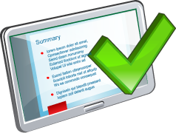
Summary
In this lesson, you should have :
Got an overview of Oracle Application Container Cloud
Understood the unique features of Oracle Application Container Cloud
Understood how to build, zip, and deploy applications to the cloud

