Slide 1
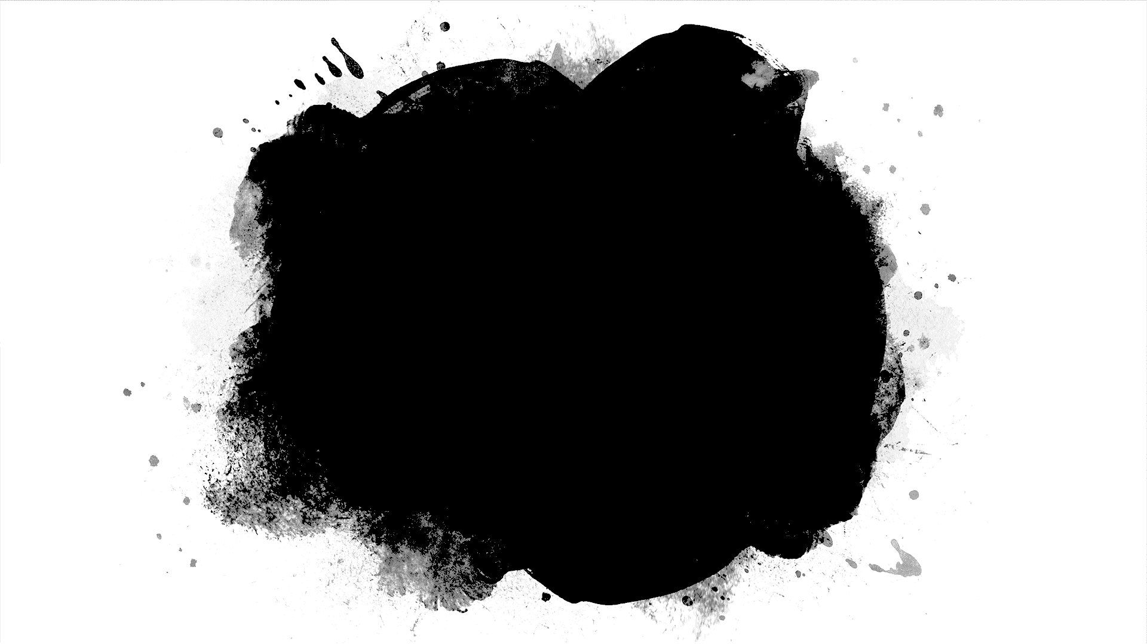
DriverPass System Analysis
John Melton
Notes:
[No speaker notes required for this slide.]

Slide 2
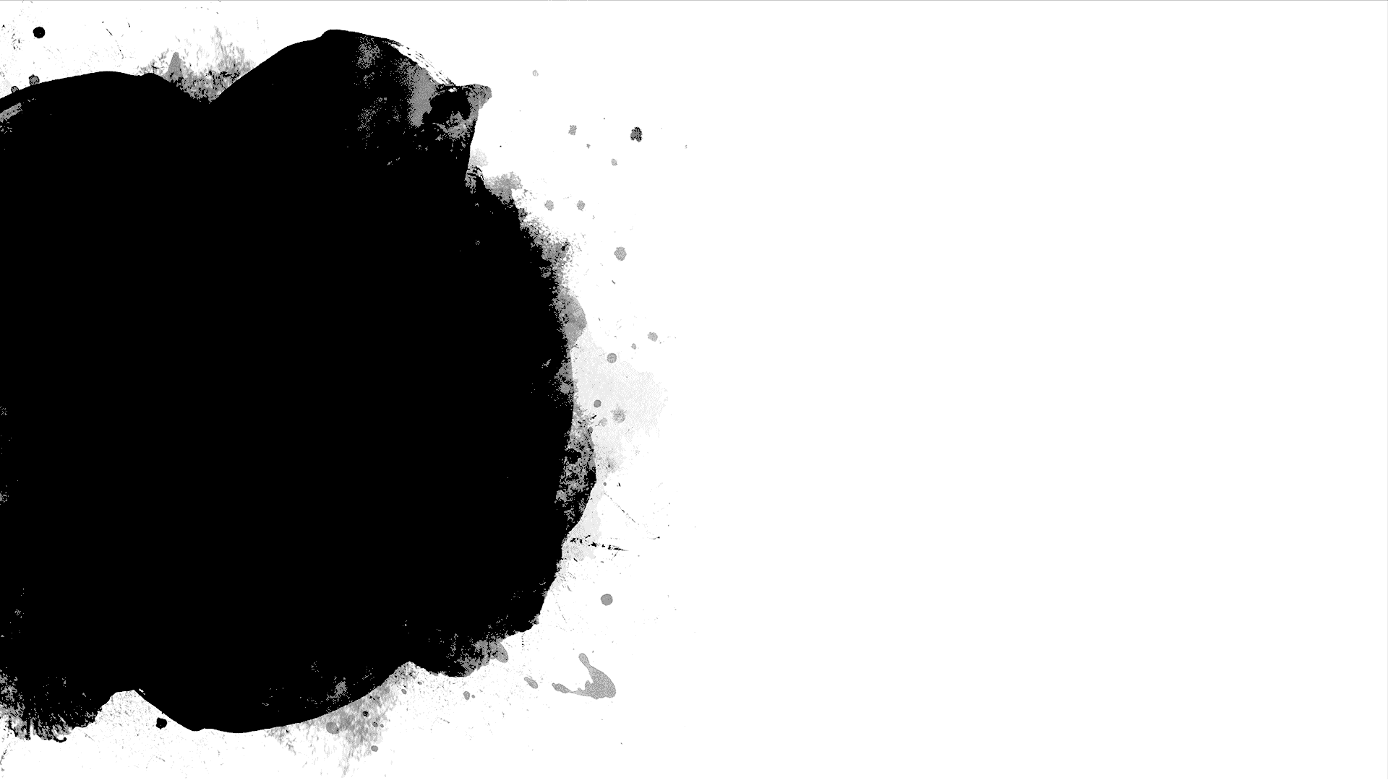
System Requirements
The system shall allow users to take practice tests and check their results.
The system shall allow users to schedule driving appointments.
A web-based application will be used to allow the maximum amount of users access to the program.
The application should be able to get and send data almost immediately to the users.
Notes:
[In your speaker notes, include an explanation of the different requirements you determined for DriverPass’s system. What are the functional requirements you selected to describe? What are the nonfunctional requirements you selected to describe? Be sure to explain how these requirements meet DriverPass’s needs.]
One of the main actions we want users to be able to perform is taking practice tests.
This will help Users learn and practice the material before they take their test at the DMV.
After they take the practice test we let them review their answers and provide explanations on why each question is right or wrong.
Another key service is scheduling in person appointments to practice their driving.
We will provide a p[platform for students to schedule these appointments to meet with our instructors
We believe that providing this program in a web application will allow the client’s customer base to be as vast as possible.
By providing the system on the web we are able to allow users to access the content using also any device they already own and we are not required to provide instructors with minimal additional hardware.
With a modern device users should be able to access the application almost immediately.
While there will always be a minor delay while loading content it should be nearly imperceivable to the average user.

Slide 3
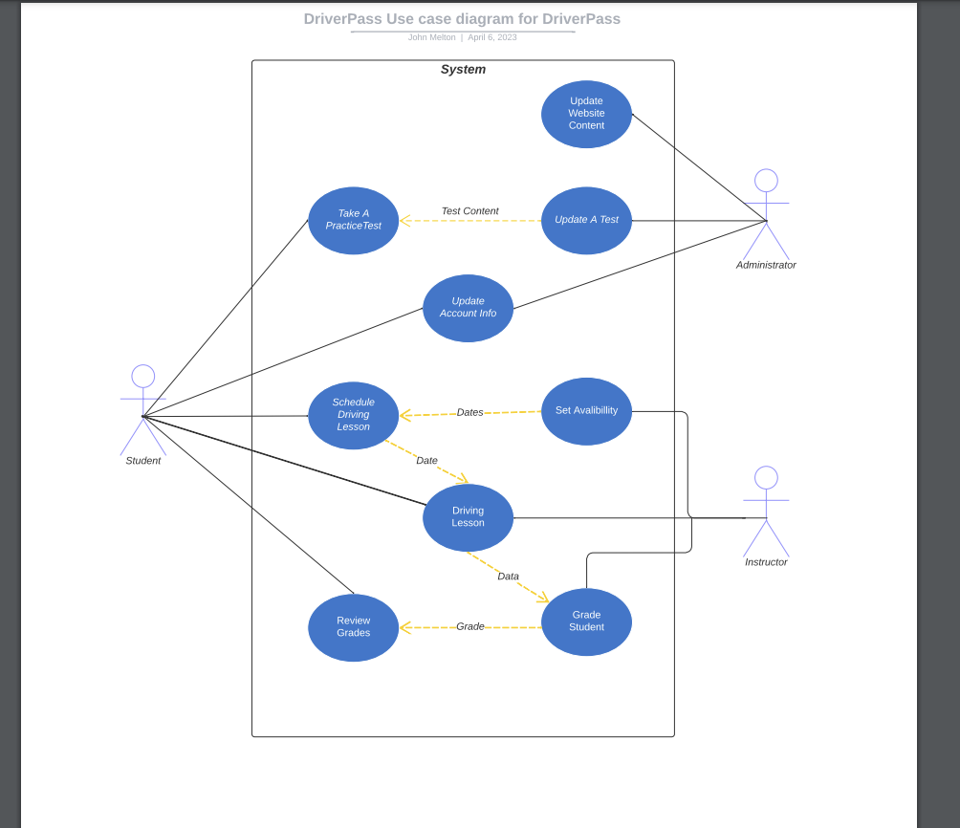
Use Case Diagram
Notes:
[Explain your diagram. Who are the different actors in the system? What are the different use cases? How did you account for DriverPass’s needs in your design? In your explanation, keep your audience in mind. Avoid the use of terms like “actors” and “use cases” in your explanation.]
In this diagram we want to show the different aspects of the program and how users will interact with the program.
The best way to look this diagram is to break it up into what actions each user will perform.
For instance if we look at Administrator we can see that the majority of what they will be responsibly lies in updating the website.
They are able to update the tests and the look and styling of the website as needed.
This is important because we want to give the client as much control over the website as possible so they can be as independent as possible.

Slide 4
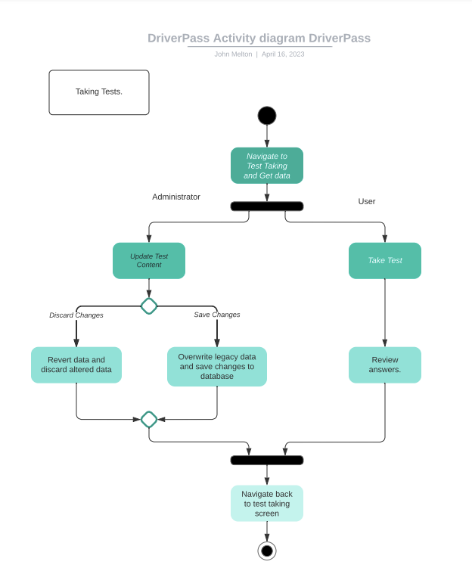
Activity Diagram
Notes:
[Explain your diagram. Which use case are you breaking down? What are the steps for this use case? How did you account for DriverPass’s needs in your design? In your explanation, keep your audience in mind. Avoid the use of technical terms such as “nodes,” “control flows,” and so on.]
Here we have a flowchart of how the administrator and user interact with the tests on the website.
As laws change we need to be able to change the content that we are testing students on.
This will be one of the main responsibilities of the administrator.
Here we can see where the administrator we be able to update the tests as needed.
The Student on the other hand will simply be able to take test whenever they choose.
After taking the test the student will then by able to review their results and take additional tests to assist them in learning the material

Slide 5
Security
Since the servers will be cloud based the cloud service provider will manage direct security to the server.
If a user attempts too many logins within a brief time we will lock out their account to prevent brute force attacks.
We will use captcha authentication to prevent bots from accessing user data.
Notes:
[How did you consider security in your design? In your explanation, keep your audience in mind by avoiding the use of technical terms.]
Based on my recommendation of using a cloud service provider we will be able to avoid some of the security issues we would be responsible for.
This will allow us to shift the responsibility of the physical security and use some of their built in security features.
We will also monitor login attempts and try to minimize someone logging into a user that they shouldn't have access to.
For instance if someone tries to login to their account with an incorrect password too many time we can lock out their account and require them to contact an administrator to regain access.

Slide 6
System Limitations
Users will have a powered device that is capable of connecting the web application.
The client will be responsible for determining their budget for data replication and capabilities of their cloud service provider.
The client will provide technical service personal to solve support issues among their userbase.
The client will provide the infrastructure of driving instructors for their appointment scheduled by their users.
Notes:
[What are the limitations of your design? In your explanation, keep your audience in mind by avoiding the use of technical terms.]
We will have a few limitations on who will be able to use our program.
The biggest one will be requiring users to use a device that can connect to the internet to use the program.
Additionally, we will require the client to provide certain infrastructure to maintain the program.
This will include staff to update the website and solve support issues as they arise for users.
We also need to client to determine who will be their cloud service provider to host and serve the website to users.

