Slide 1

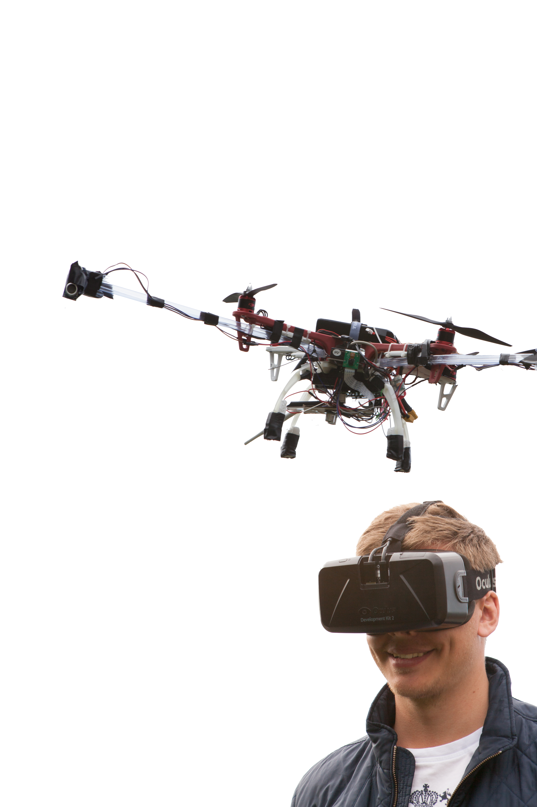
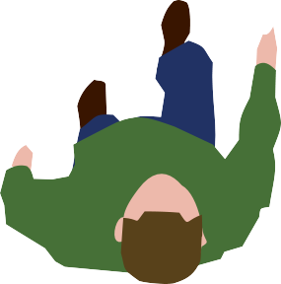
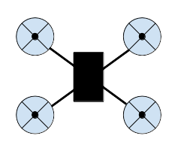
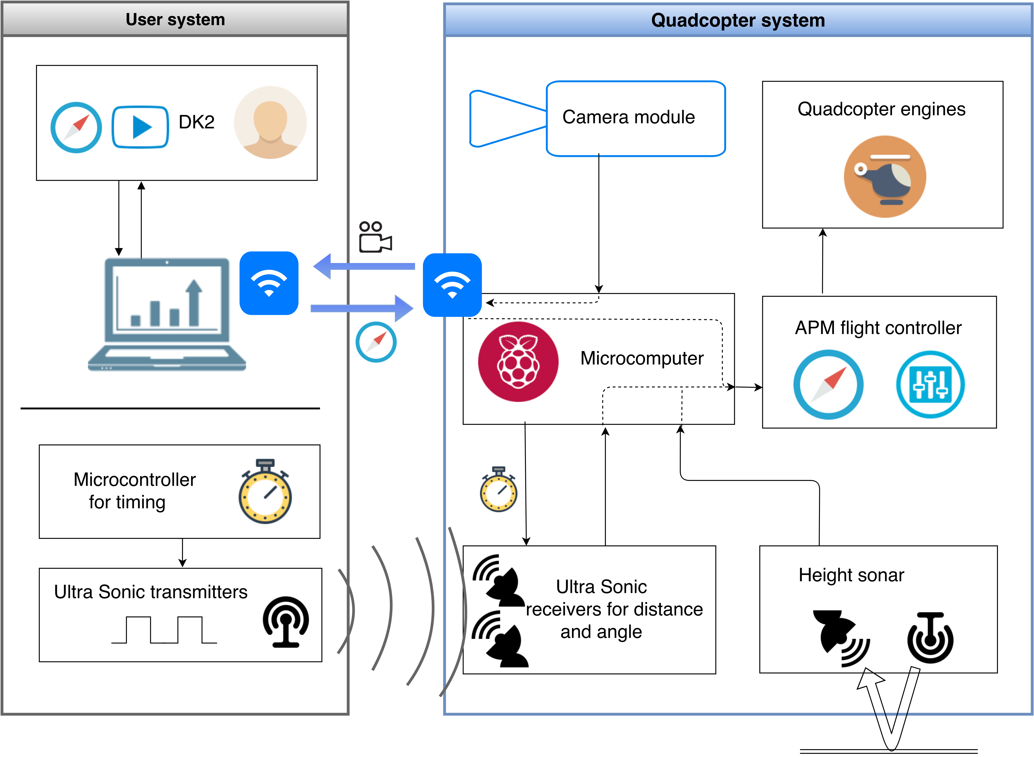
Third Person View is a system to delvier high quality video streaming to a user wearing the Oculus Rift Display. As the title implies the user sees themselves from a third person view. Our project has dealt with designing this sytem from scratch including solutions for video streaming, communication, user tracking and regulation.
The tracking is powered by an ultrasonic pulse transmitter at the user and receivers at the quadcopter's extended arms. Thanks to in-house developed method of clock syncing this system gives an accurate reading of the user position. The user rotation is determined from comparing the magnetic field at the user to that at the quadcopter.
This tracking data is sent to a PID controller which adjusts the quadcopter engine to manuever the quadcopter to behind the user autonomously. The same is true for height regulation where the readings is done by an ultrasonic sonar.
The video stream is captured by a digital camera and fed to Raspberry pi microcomputer at the quadcopter. It is sent wirelessly to the Oculus Rift and the real time third person view is achieved!
Immersive
Third Person View
Discover new perspectives...
α < β
θ > 0
β
α
θ
α
The quadcopter reacts to user movement
so the user always see themselves centered
”Wow!”

