Slide 1
2017160111_안진모
2D DCT design
in JPEG Image Compression

Slide 2
CONTENTS
01
02
MATLAB
Verilog
03
Result
CONTENTS

Slide 3
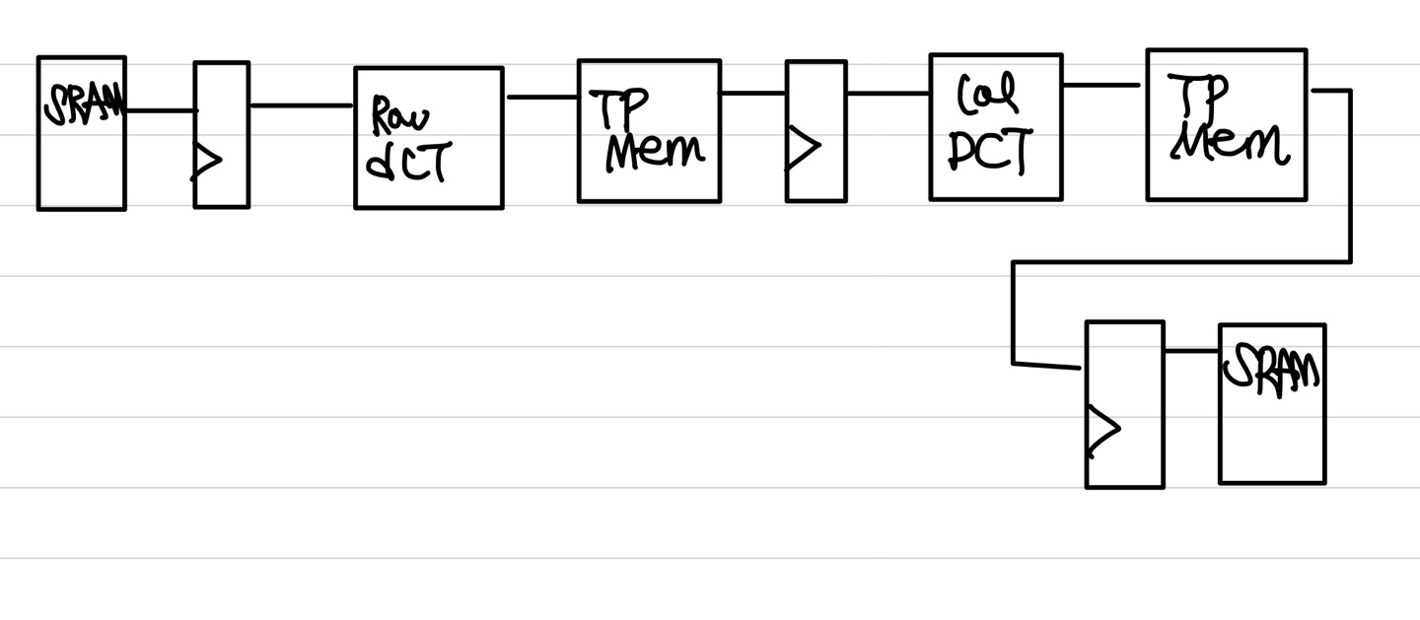
00
Architecture

Slide 4
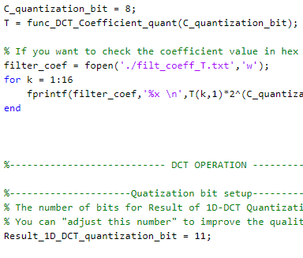
01
MATLAB setup
Quantization
설명을 입력하세요
Choose C quantization bit =8
-> 8bit – easily display to hexadecimal
Result of 1D row DCT quantization bit = 11
<Jpeg codec full>

Slide 5
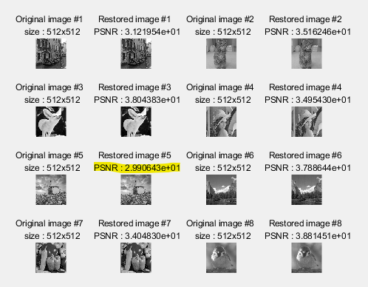
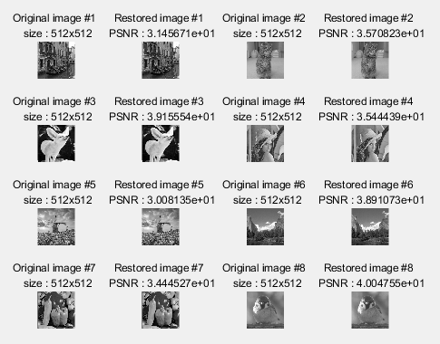
01
MATLAB setup
Quantization
설명을 입력하세요
C qt num = 8, 1D row quantize num = 10 C qt num = 8, 1D row quantize num = 11
-> image #5 has PSNR 29.9!! . So, 8, 11 is good choice

Slide 6
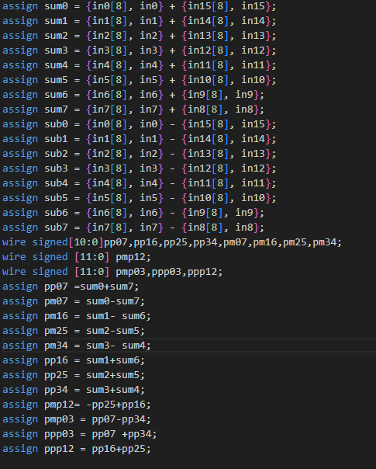
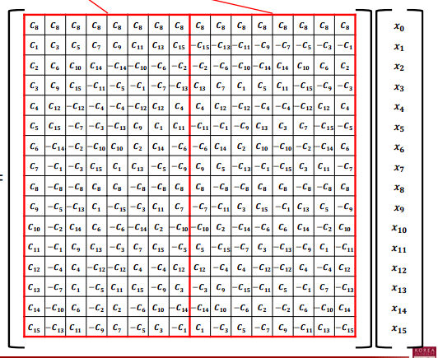
02
Verilog ( DCT module)
Cos fun is periodic even function, So we can reduce multiply operation by using symmetry
-> less operation
Data reuse has good benefit for Area

Slide 7
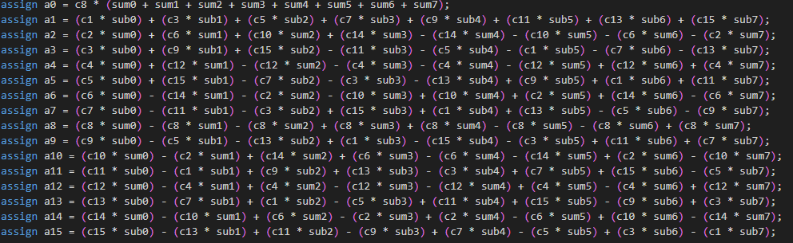
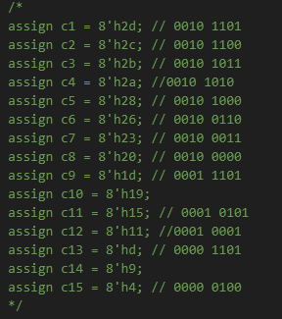
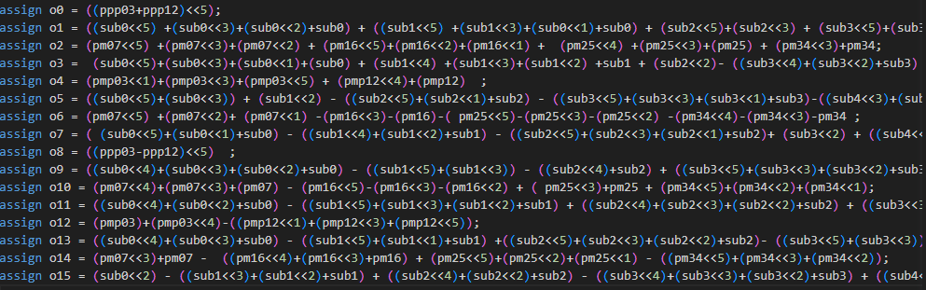
02
Verilog ( DCT module)
Hardware doesn’t like multiply unit
-> applying canonical signed digit method!
better performance , less Area
Applying canonical signed digit & symmetric!
(We don’t need coefficient C in our module.)

Slide 8
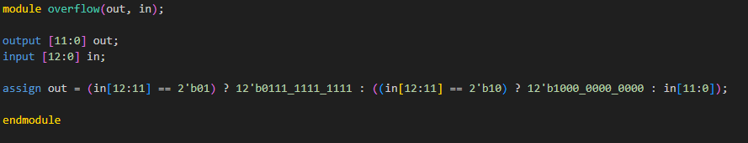
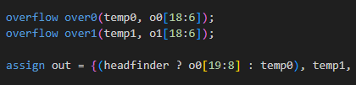
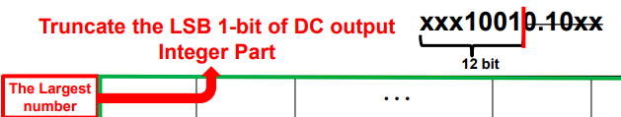
02
Verilog ( DCT module)
headfinder -> when matrix=(0,0) -> on
Controling overflow, head bit, next bit has overflowed value
-> over 2047 = 2047 , under -2048 = -2048, other = 기존의 값
Col[15] remove (Area issue)

Slide 9
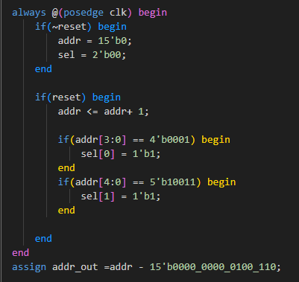
02
Verilog (Memory control)
Input part memory control
Output part 18cycle difference (16-matrix+2-dff 2cycle) cycle difference

Slide 10
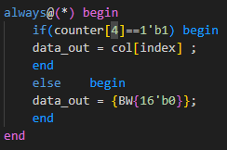

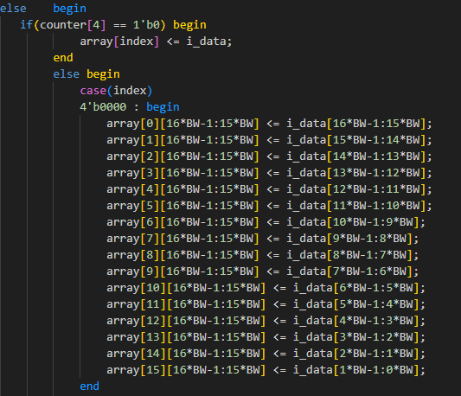
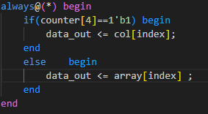
02
Verilog (memory control)
2 Tpmem -> 1 Tpmem (Area issue), cycle 16 -> cycle32
Fisrt half (col read, array write), second half (col write, array read)

Slide 11
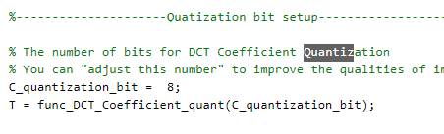
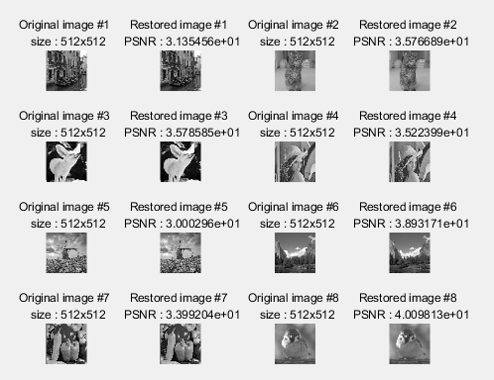
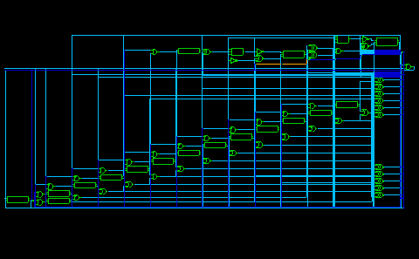
03
result
Verilog I/O , all of restored image’s PNSR over 30!

Slide 12
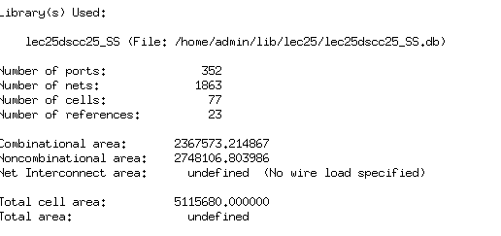
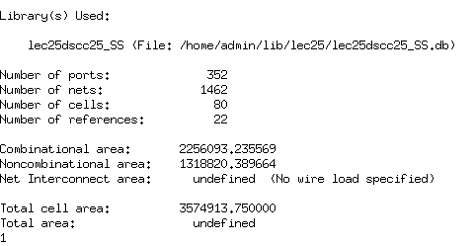
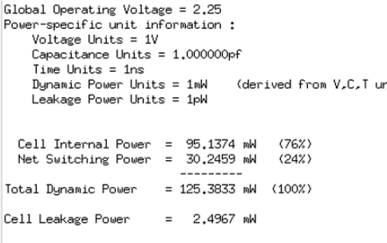
03
Result (Area)
By Symmetric ,Adder Tree, Simultaneous Tpmemory -> reduce almost 1550000 (micro meter)^2

Slide 13
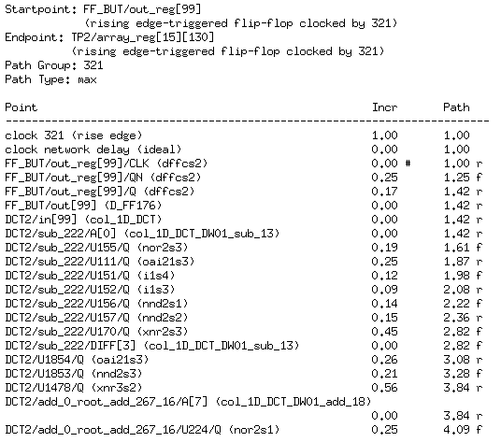
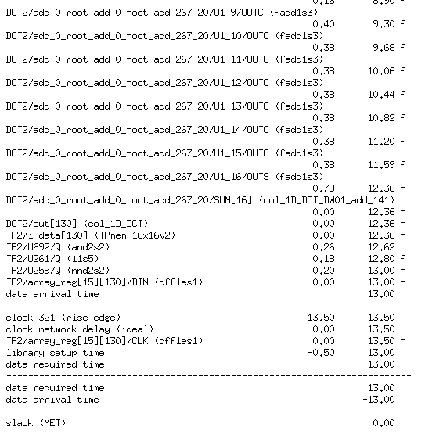
03
Result (Timing)

Slide 14
THANK YOU -
경청해주셔서 감사합니다.

