Slide 1














$${(F}_{drag})\hat{x_{r}}$$
$$\hat{z_{r}}$$
$$\hat{y_{r}}$$
$$\overset{⃑}{dP}$$
$$F_{g}\hat{z_{r}}$$
$$\hat{x_{r}}$$
$$T_{in}\hat{y_{r}}$$
$$∇H$$
$$r$$
$$\hat{z_{G}}$$
$$F_{N}\hat{z_{r}}$$
$$\hat{y_{G}}$$
$$\hat{x_{G}}$$
$$F_{rr}\hat{z_{r}}$$

Slide 2
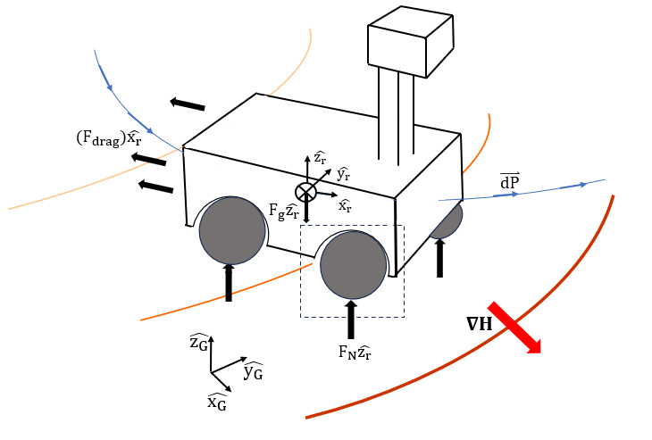
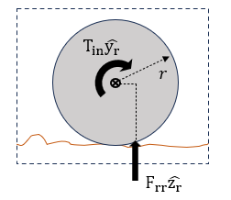

Slide 3
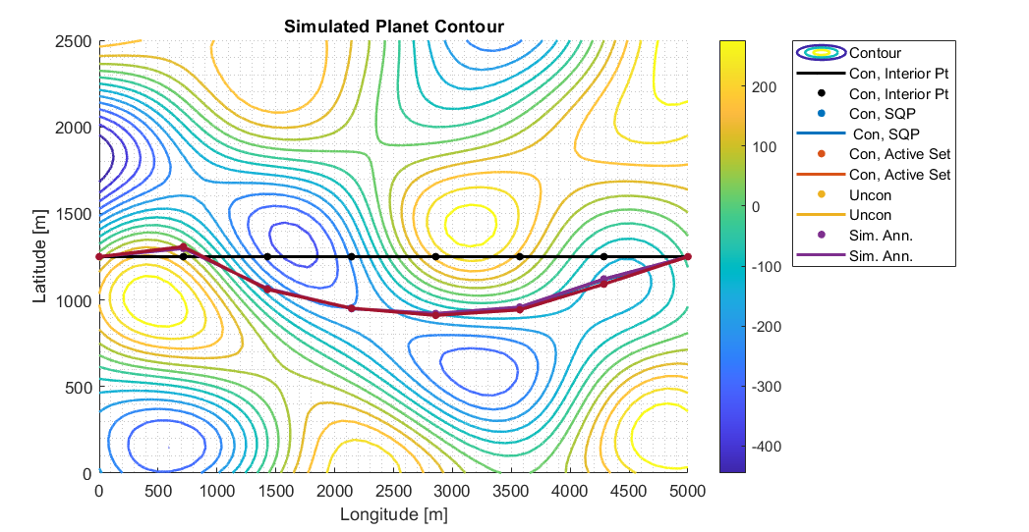
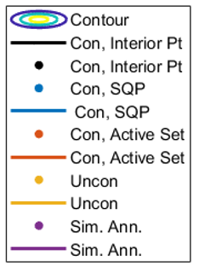

Design point, $N_{3}$
Contour Height [m]

Slide 4










$$I_{0}$$
$$I_{20}$$
$$I_{50}$$
$$I_{80}$$
Contour Height [m]
$$I_{186}$$
$$I_{0}, t_{m}=541$$
$$I_{20}, t_{m}=525$$
$$I_{50}, t_{m}=519$$
$$I_{80}, t_{m}=518$$
$$I_{186}, t_{m}=517$$

