Slide 1
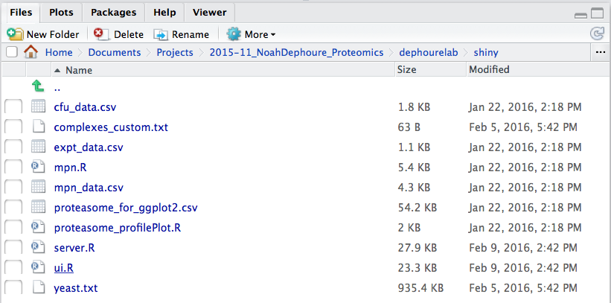


!
Notes:
ss_startApp.png
ss_startApp02.png
ss_appOverview.png
exclamationmark.pdf

Slide 2
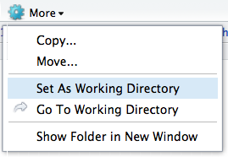

Slide 3
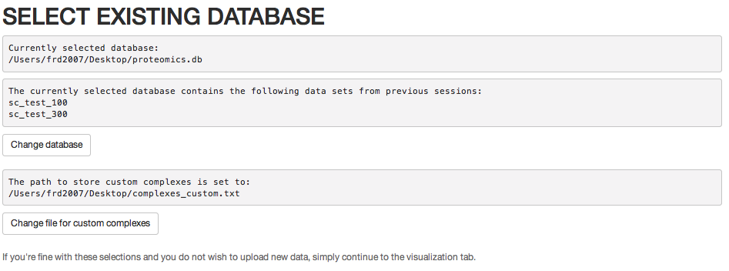
Notes:
ss_selectDB.png

Slide 4
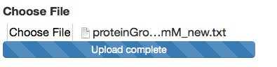
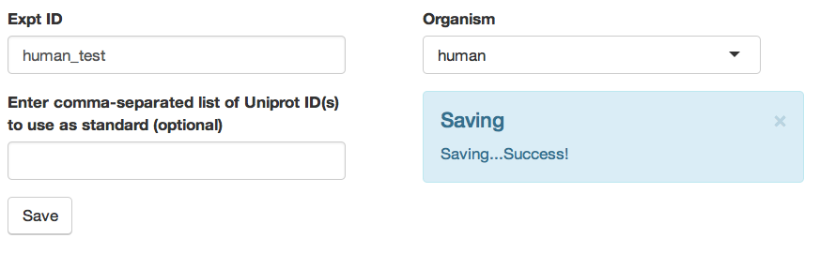
Data upload
Notes:
ss_dataUpload.png
ss_dataUpload02.png

Slide 5
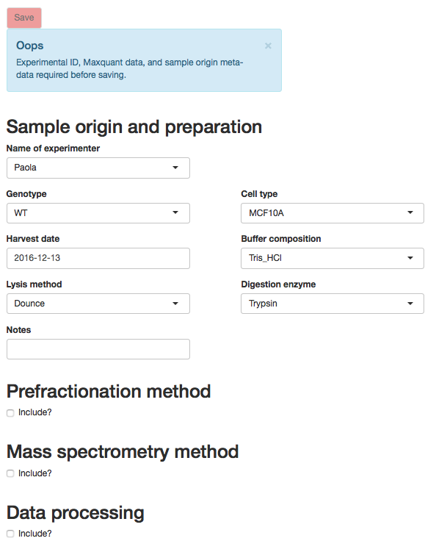
mandatory metadata
additional,
non-mandatory metadata

Slide 6

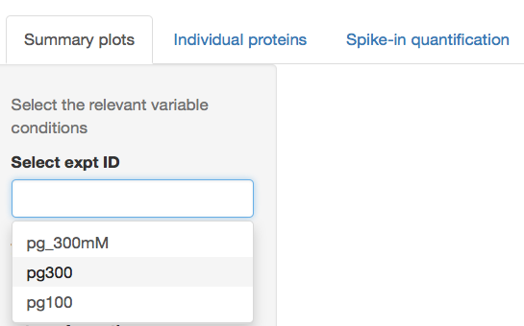
Select the type of plot
Select the experiment
Notes:
ss_appOverview02.png
ss_plotsOverview.png

Slide 7
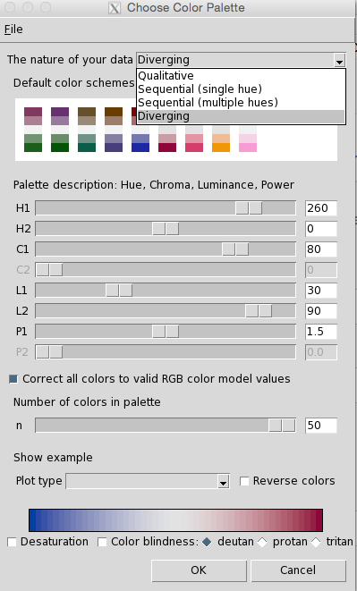
Notes:
ss_colorscheme.png

Slide 8
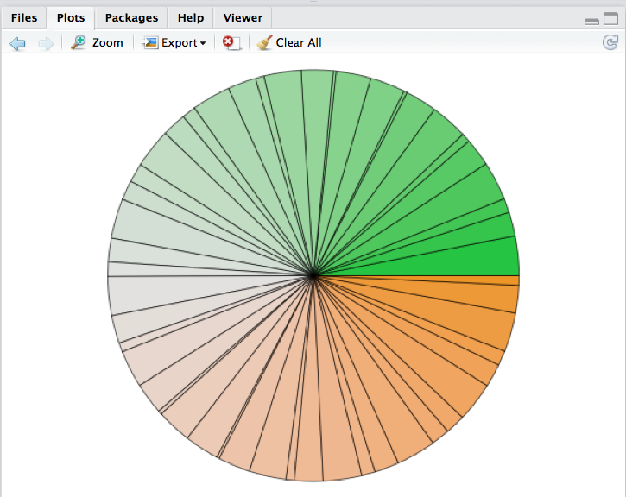
Notes:
ss_colorscheme_example.png

Slide 9
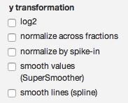
Notes:
ss_ytrafo.png

Slide 10
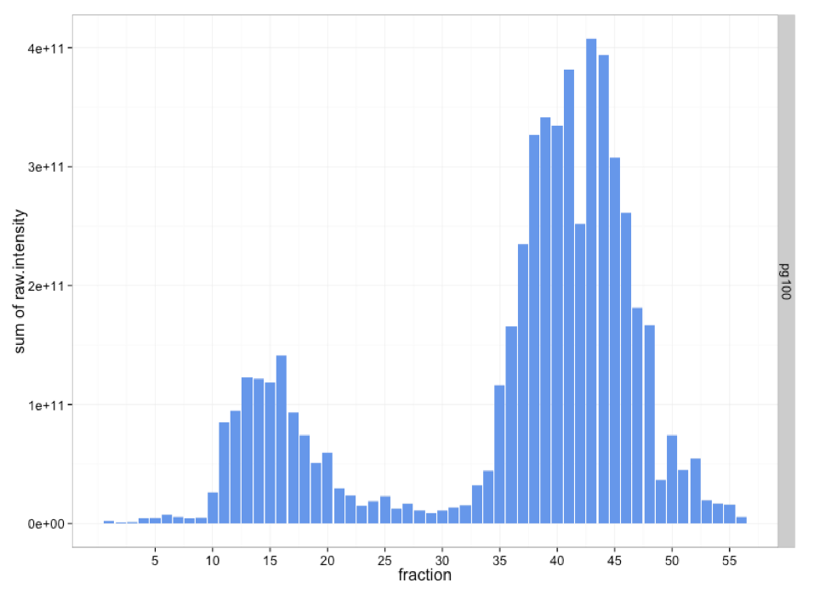
Notes:
ss_sumPlot_example.png

Slide 11
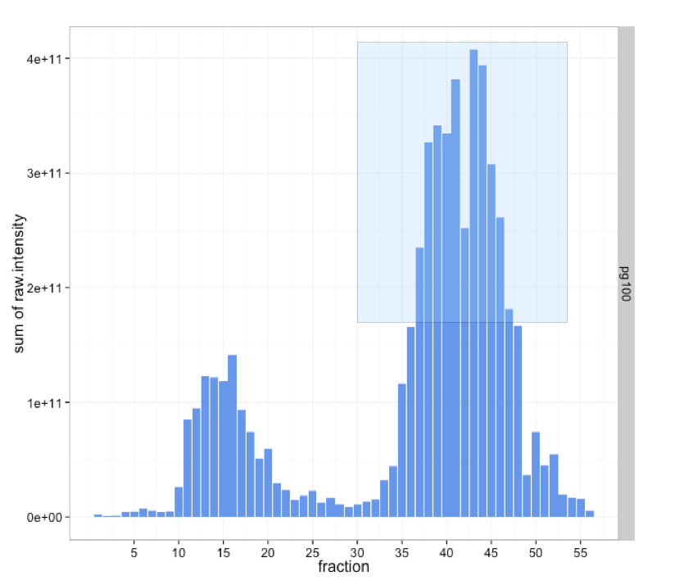
Notes:
ss_plotCustomizing01.png

Slide 12
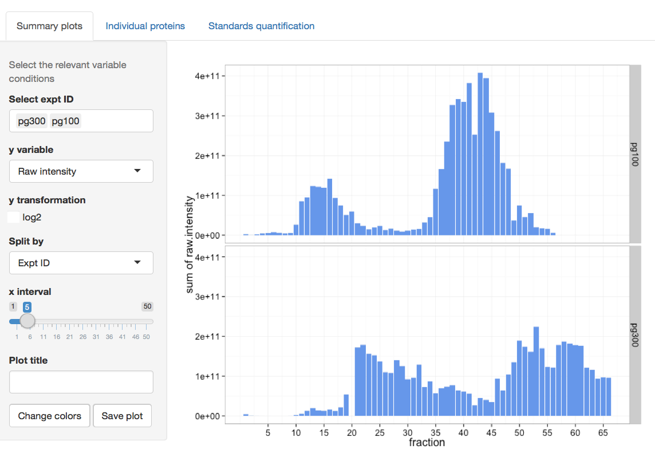
Notes:
ss_plotsOverview02.png

Slide 13
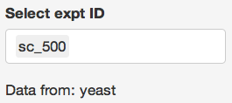

General usage
Notes:
ss_indProt_start.png
ss_uniprot_entry.png

Slide 14
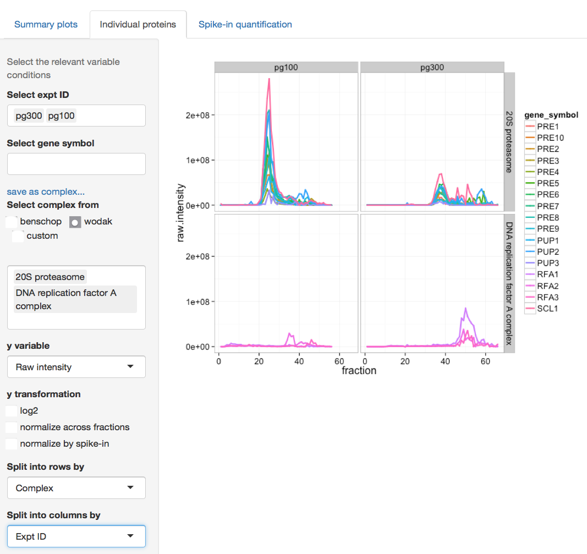
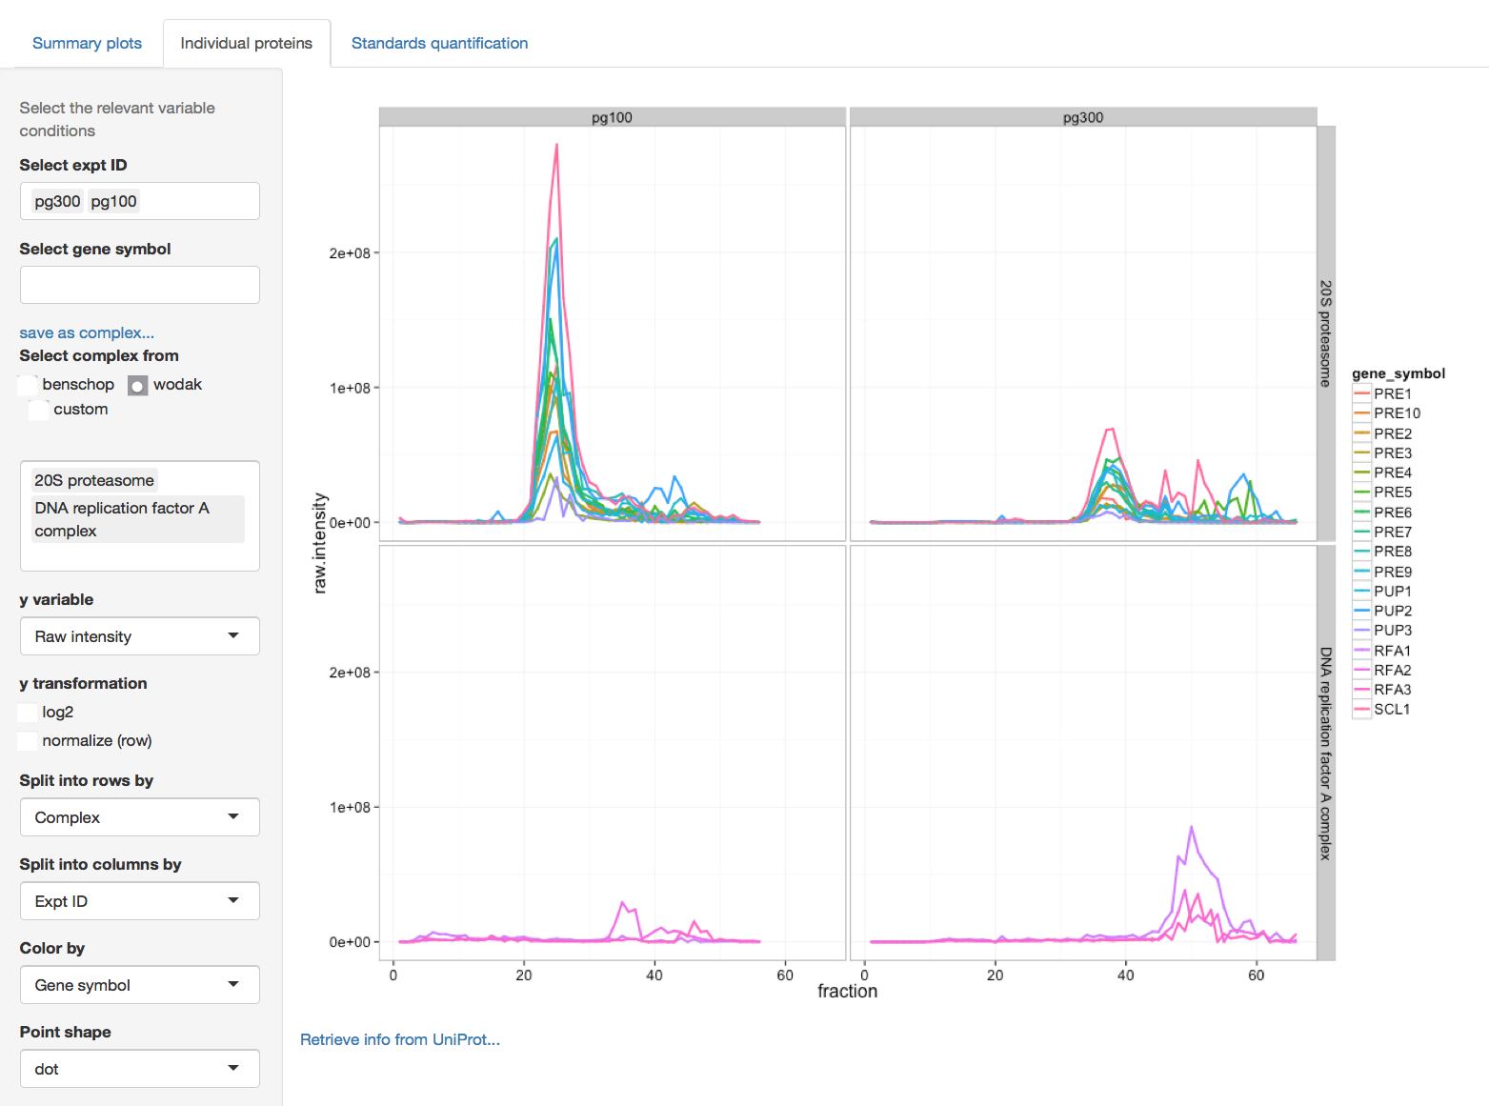

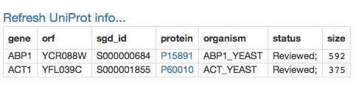
General usage
link to UniProt entry
Notes:
ss_indProt_example.png
ss_uniProtInfo01.png

Slide 15
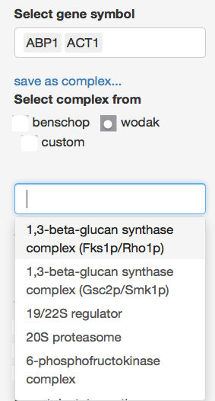
Defining complexes
define your own complexes based on the current selection of individual proteins
list of complexes for the selected set
Notes:
ss_complexes01.png

Slide 16
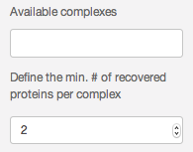
Selecting complexes
the number of recovered proteins will limit the number of complexes that can be selected
list of complexes within the selected list
Notes:
ss_complexes01.png

Slide 17
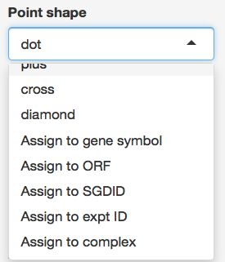
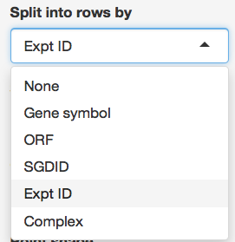
Customize plot
Notes:
ss_plotOptions.png

Slide 18
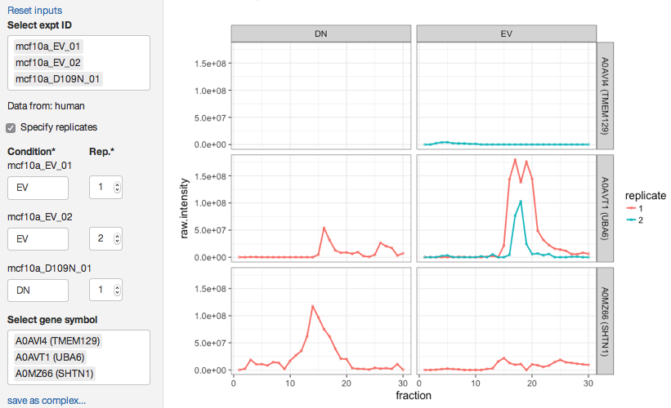
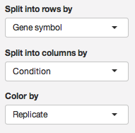
Customize plots

Slide 19
Customize plots
define names for the conditions and choose integers to distinguish different replicates

Slide 20
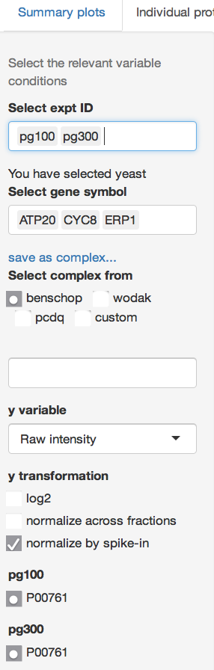
Normalize by spike-in
once you select “spike-in” normalization, the corresponding available proteins are indicated
experiment IDs
Notes:
ss_indProt_normSpikeIn.png

Slide 21
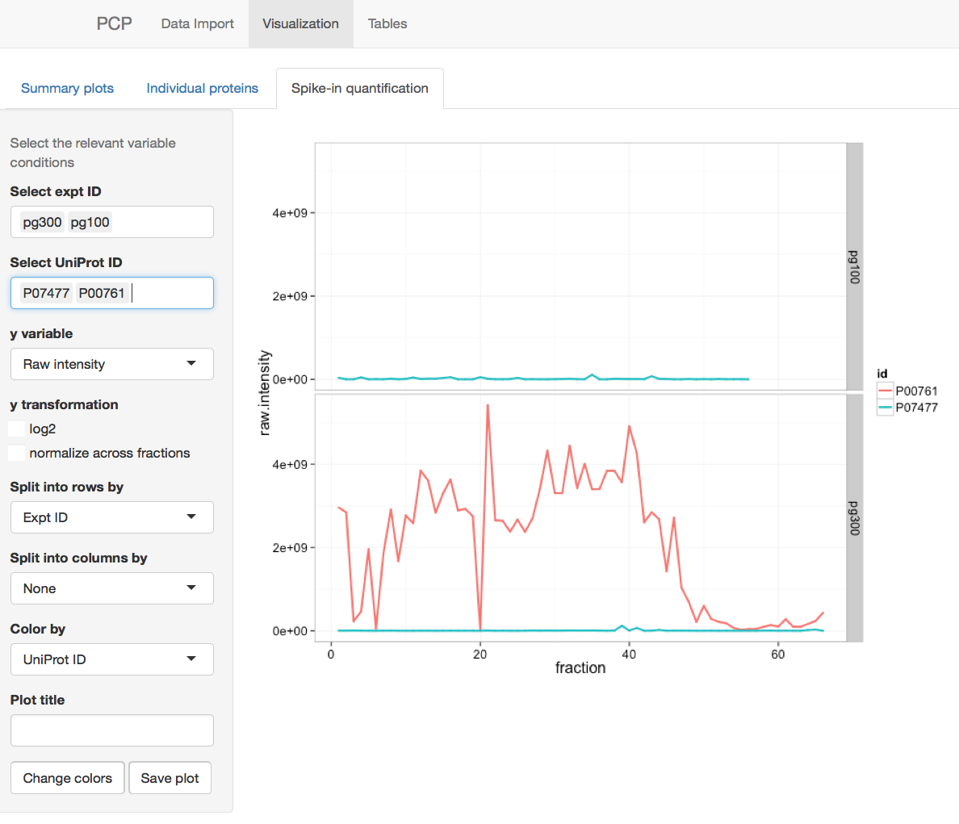
filled in automatically
Notes:
ss_spikeIn01.png

Slide 22

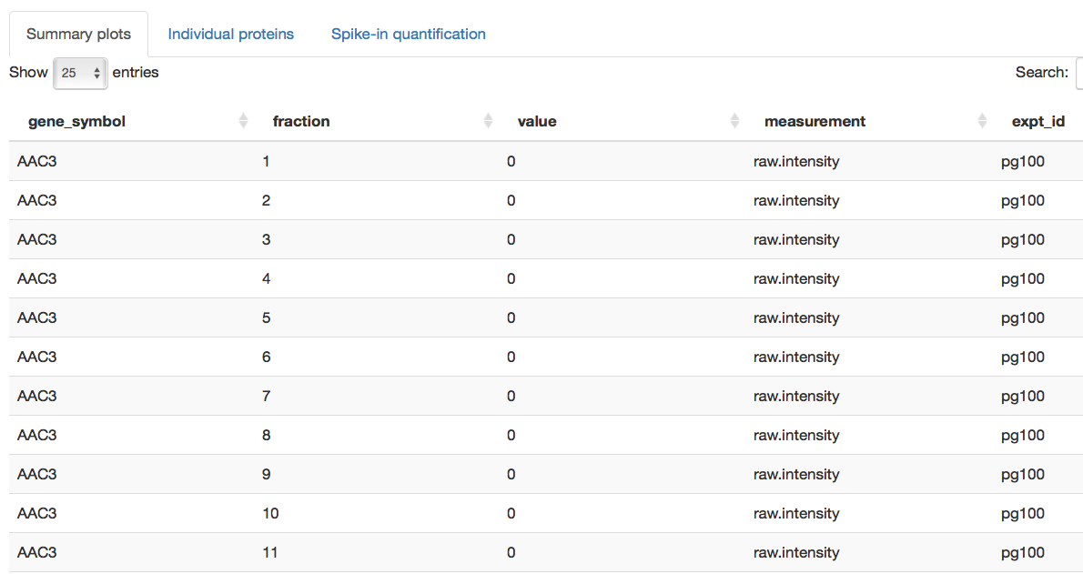
Notes:
ss_appOverview03.png
ss_table01.png

Slide 23
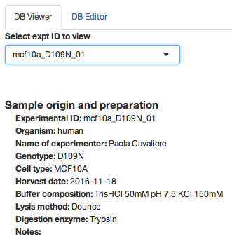

Slide 24
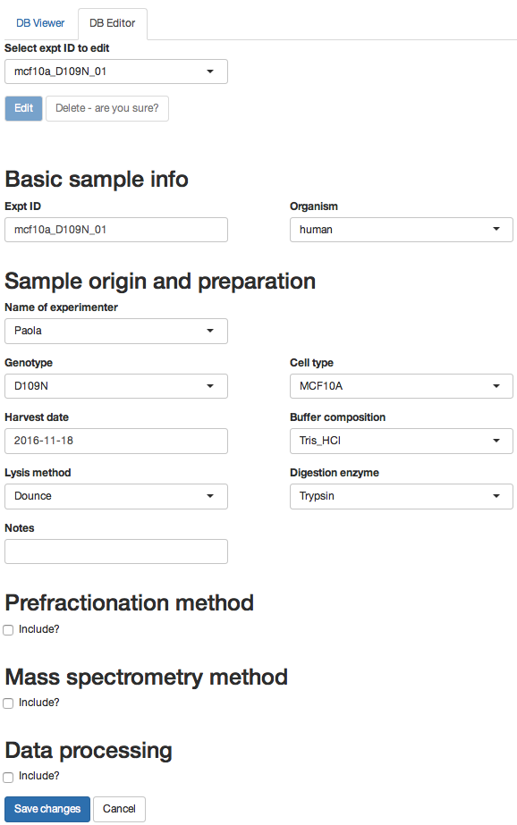

Slide 25
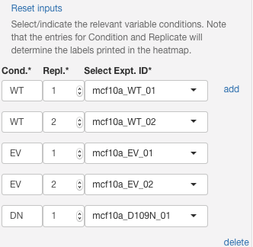
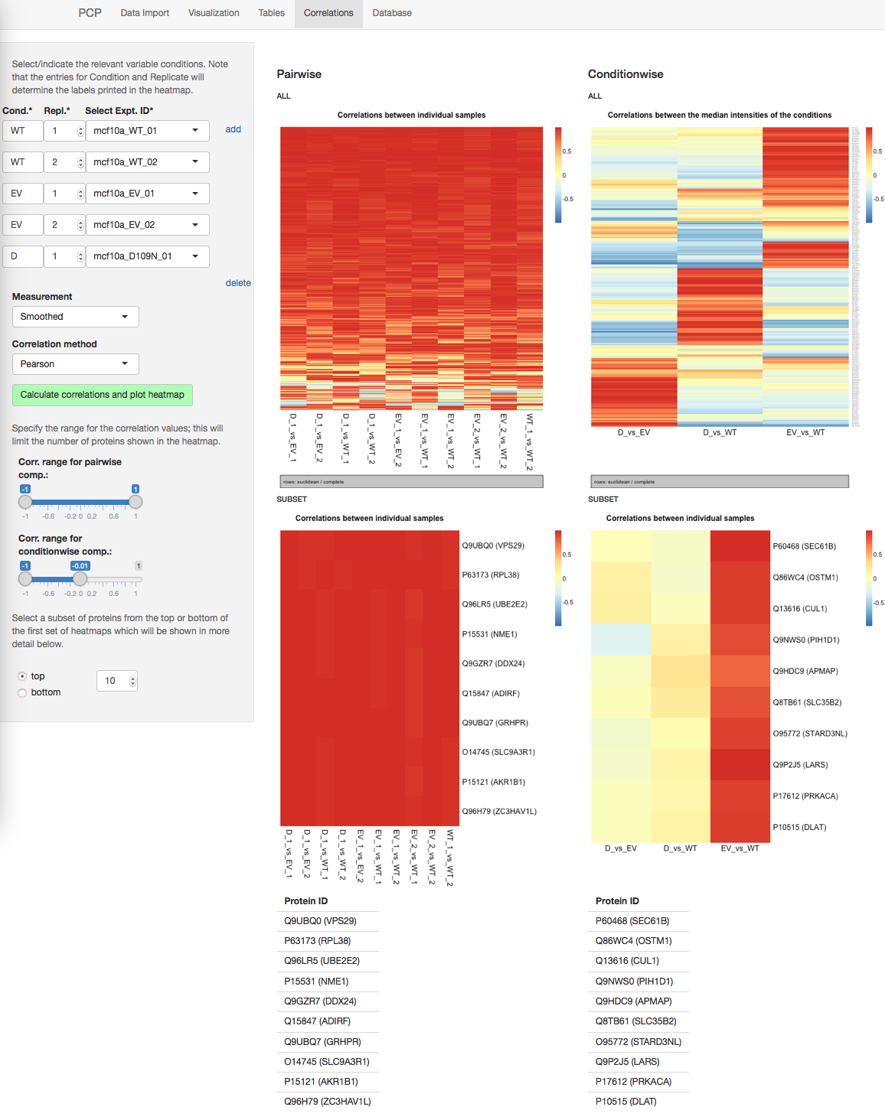

Slide 26
all proteins
within the specified correlation range
pairwise correlations between median values for each condition
pairwise correlations between every sample
subset of proteins
from the top or bottom of the heatmap above

