Slide 1
IMS Starter-Project
Jesse Morgan

Slide 2
Introduction
Who am I?
How did I approach the Specs?

Slide 3
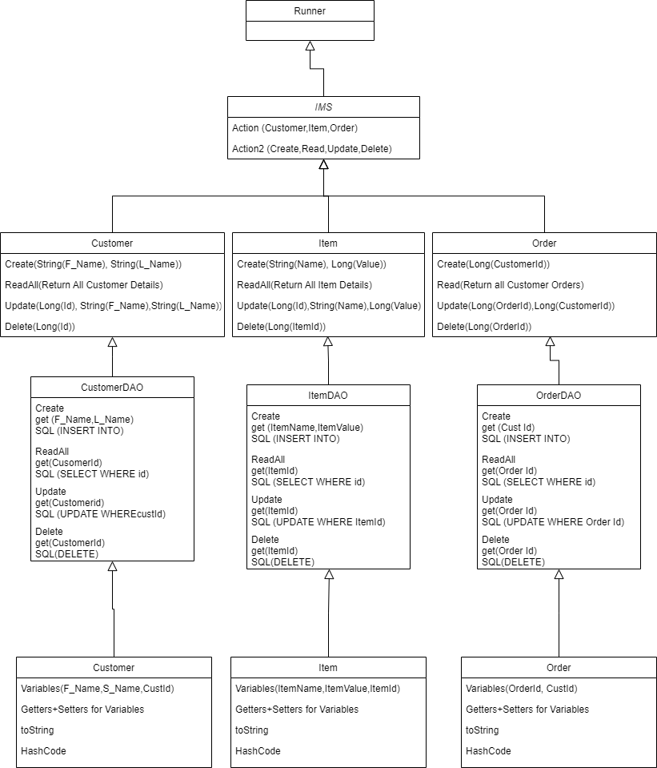
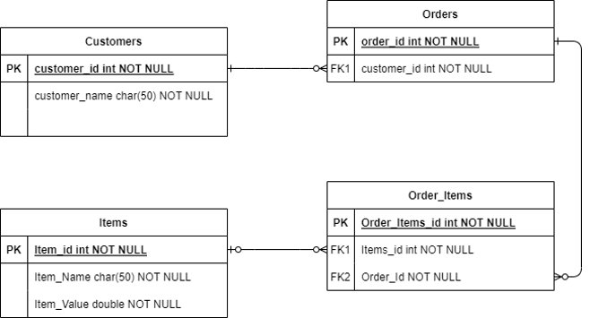

Slide 4
Consultant Journey
What prepared me for this project?

Slide 5
Java
Maven
Jira
Git
Sql

Slide 6
CI
Version Control

Slide 7
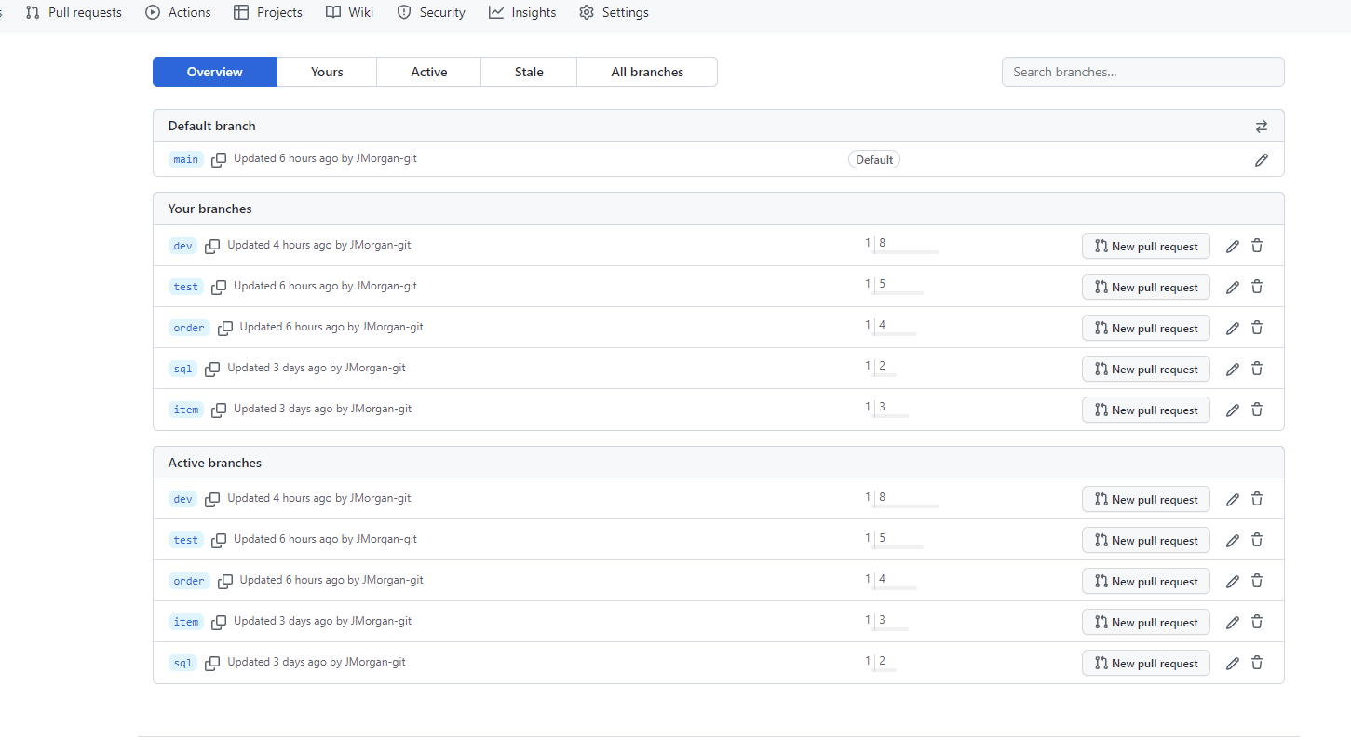

Slide 8
Testing

Slide 9
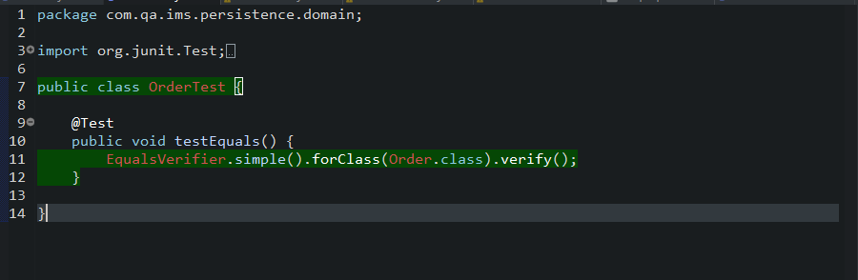
Domain Classes; Order, Item, Customer

Slide 10
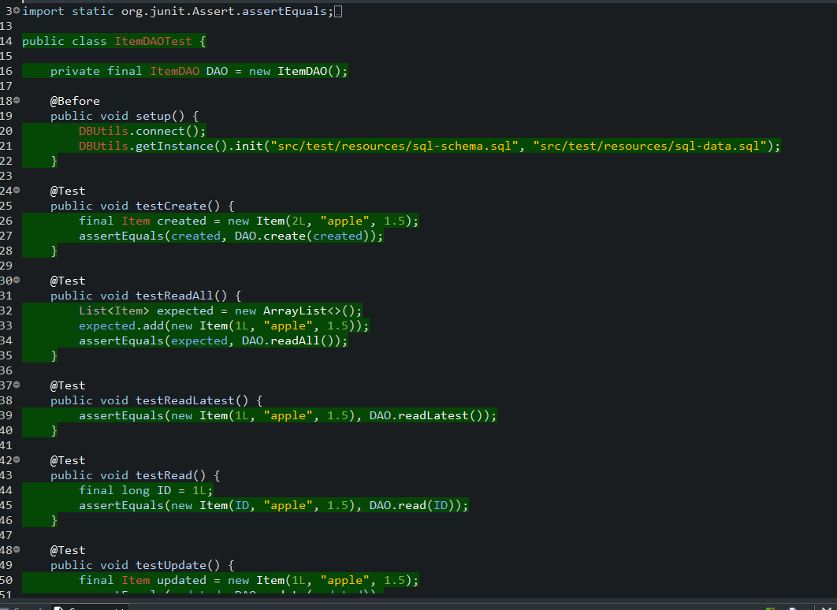
DAO Classes

Slide 11
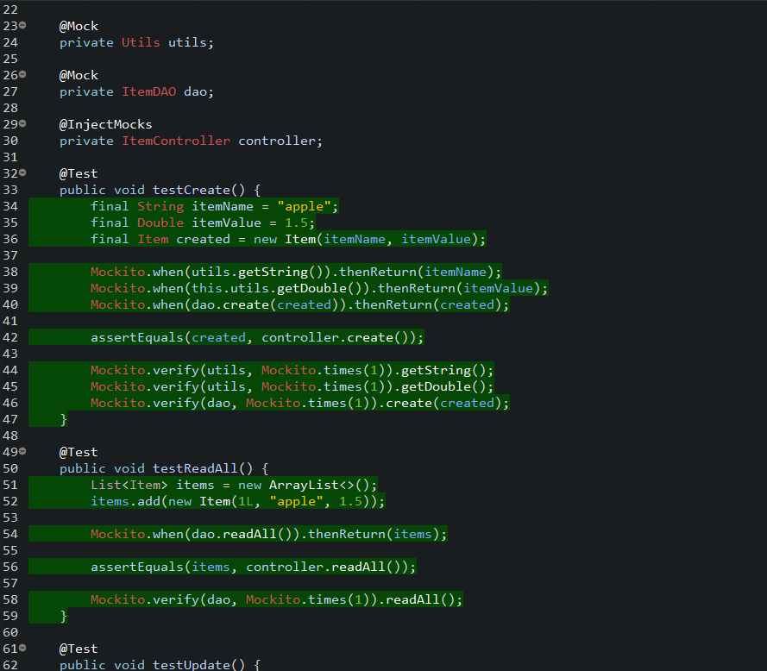
Controller Classes

Slide 12
Demonstration

Slide 13
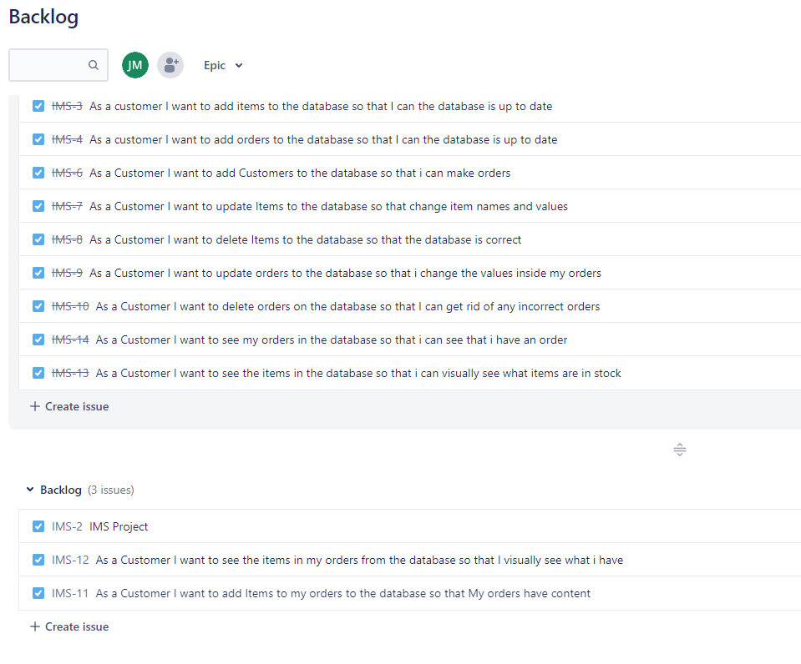
Sprint Review

Slide 14
Sprint Retrospective
What went well?
Improvements?

Slide 15
Conclusion

Slide 16
Questions

