Slide 1

What makes a good incident report classifier?
Justin Burack
+1(781) 290-3286 | jnburack@hotmail.com

Slide 2
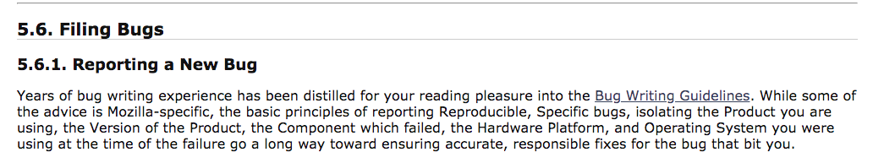
A Real Business Problem
Source: bugzilla.org

Slide 3


Slide 4
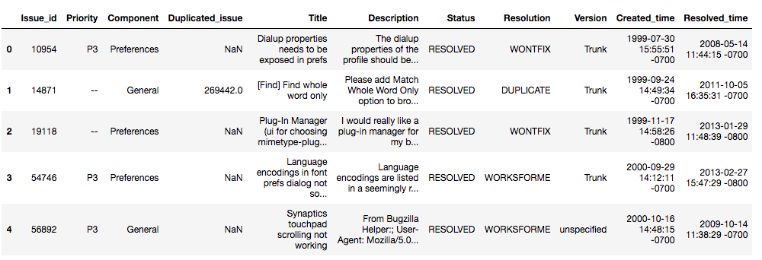
Bug report classifier
Automate labelling
Speed up business processes and digital transformation
Enable ease of digital transformation

Slide 5
Data Cleaning
Merge title and text together
Remove punctuation
Remove stopwords
Remove unnecessary fields

Slide 6
Feature Engineering
All lowercase, lemmatize
Assign Shannon Entropy
Assign TF-IDF
Remove words below a specific TF-IDF score

Slide 7
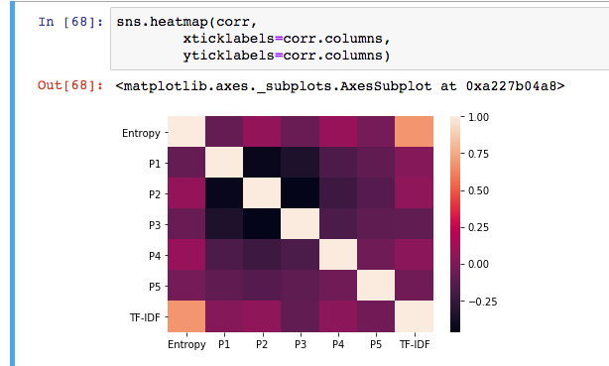

Slide 8
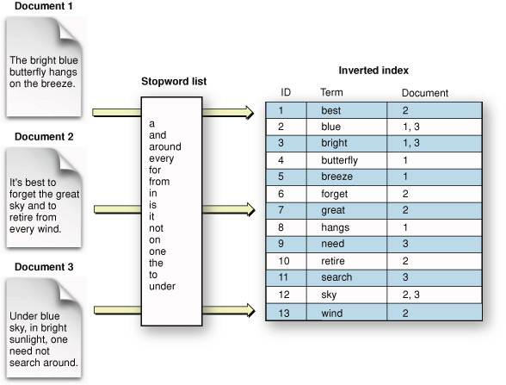
Starting with a baseline model
Source: CSE494, Arizona State University

Slide 9
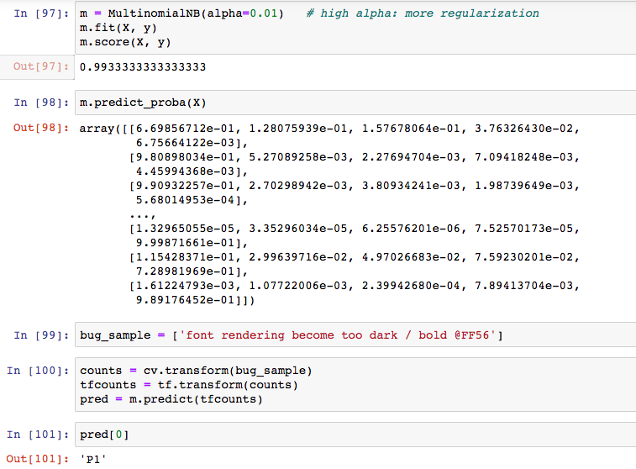

Slide 10
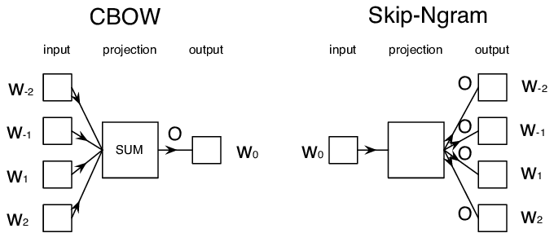
Scaling up...
Source: Ling, Wang & Dyer, Chris & Black, Alan & Trancoso, Isabel. (2015). Two/Too Simple Adaptations of Word2Vec for Syntax Problems. 10.3115/v1/N15-1142.

Slide 11
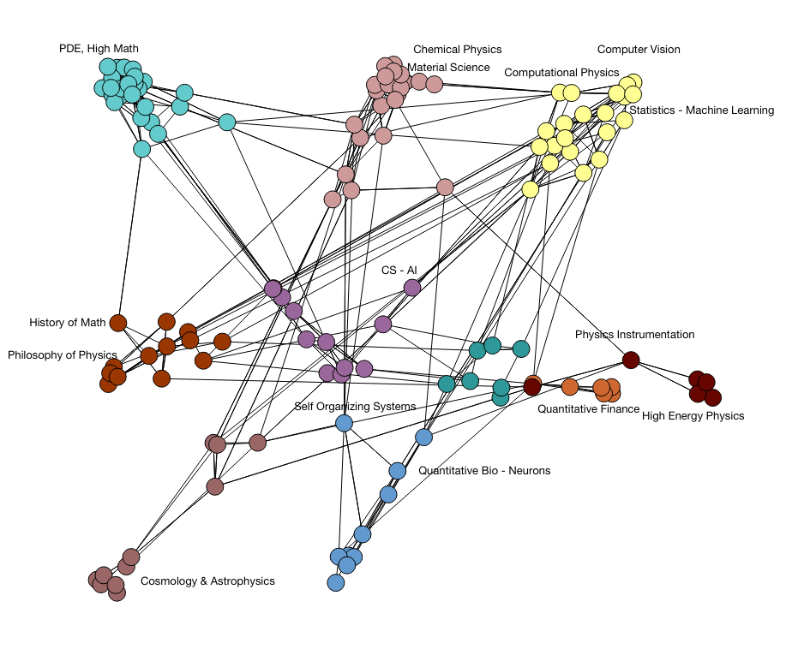
Doc2Vec
Source: sepehr125, SciExplorer, (2015), GitHub repository, https://github.com/sepehr125/arxiv-doc2vec-recommender

Slide 12
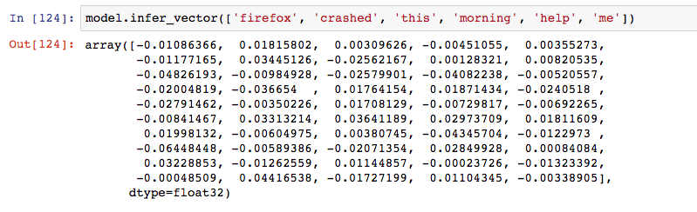

Slide 13
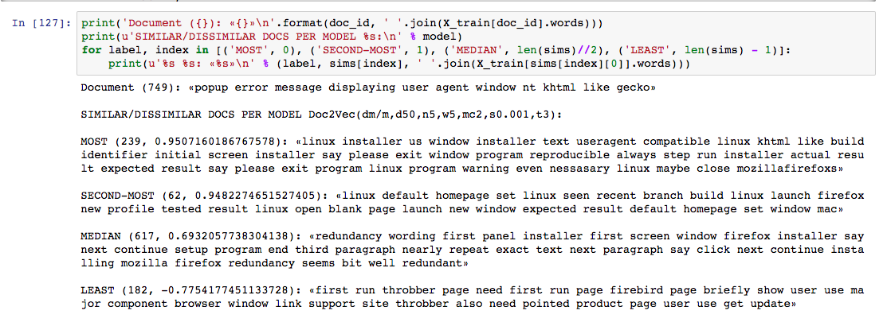

Slide 14
Doc2Vec + KNN
Soni, Devin. “Introduction to k-Nearest-Neighbors.” Medium, Towards Data Science, 16 July 2019, https://towardsdatascience.com/introduction-to-k-nearest-neighbors-3b534bb11d26.

Slide 15
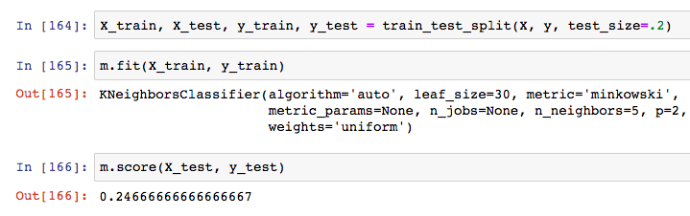

Slide 16


Slide 17
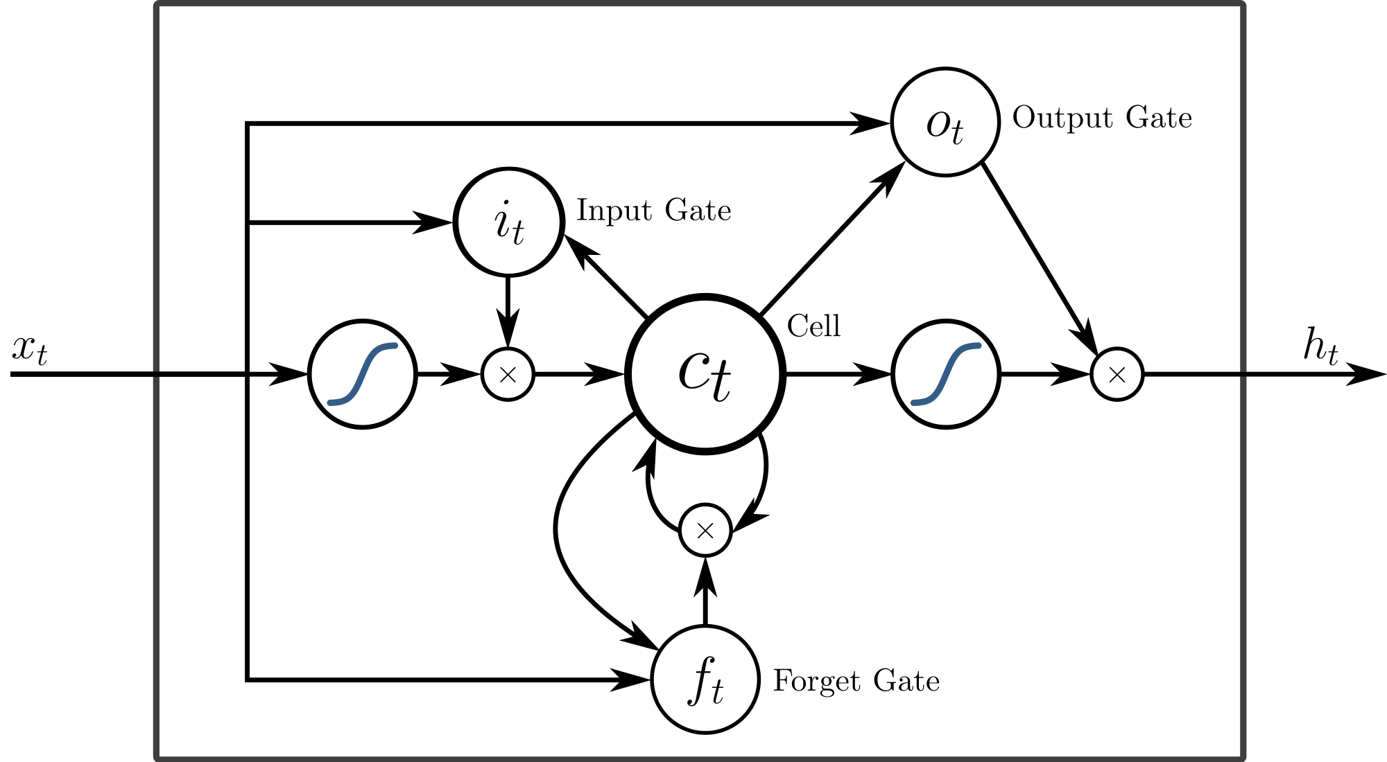
Tensorflow/Keras LSTM

Slide 18
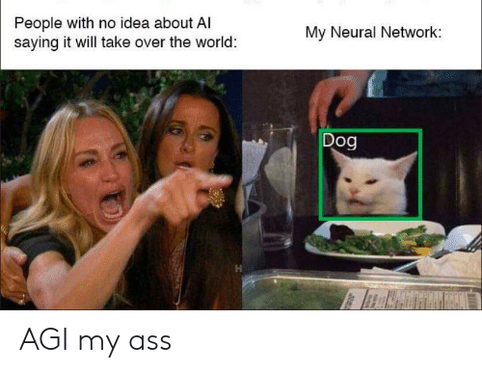

Slide 19
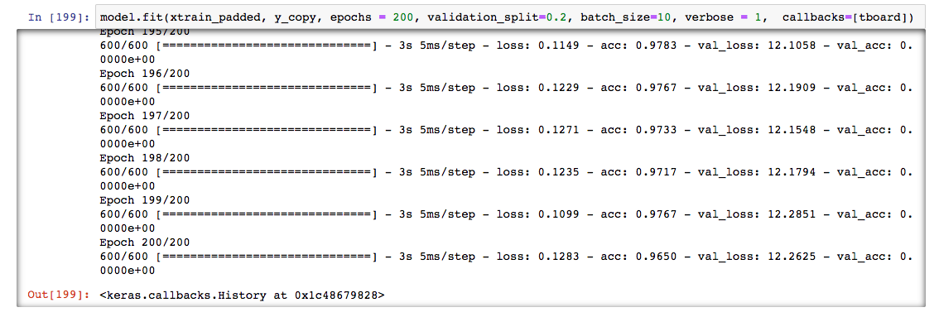

Slide 20
Why does it consistently overfit?
Lack of specialized terminology in Doc2Vec dataset
Grammatical errors and inconsistent wording
Use of punctuation in IT provides critical information
Priority categorization is often company/department specific
Every organization decides which issues get higher priority

Slide 21
Future Goals
Assign Priority measures to specific issue categories manually
Account for duplicate issues, time to resolution
Apply further regularization in my model
Test the neural network on manual inputs
Train an unsupervised model for Severity measures

Slide 22
Thank you...

