Slide 1
Genetic Algorithms for Activity Scheduling
Fernandez, Ryan Austin
Poblete, Clarisse Felicia M.

Slide 2
Outline
Introduction
Formal Definition of the Algorithm
Analysis of the Algorithm
Applications
Conclusion

Slide 3
Introduction
Activity Scheduling is a problem
Evident in professional organizations in universities
Complex problem

Slide 4
Review of Related Literature
Genetic Algorithms^{4,5}
Scheduling single set of exams for single set of students¹
Hashmap chromosome (timeslots to classes)³
Two ply chromosome²
1 Corne, D., Fang, H.L. & Mellish, C. (1993). Solving the Modular Exam Scheduling Problem with Genetic Algorithms. Technical Report 622, Department of Artificial Intelligence, University of Edinburgh.
2 Omara, F.A. & Arafa, M.M. (2010). Genetic algorithms for task scheduling problem, Journal of Parallel and Distributed Computing, 70(1), 13-22, ISSN 0743-7315.
3 Jankovic, M. (2008). Making a Class Schedule Using a Genetic Algorithm. Retrieved July 4, 2016, from Code Project: http://www.codeproject.com/Articles/23111/Making-a-Class- Schedule-Using-a-Genetic-Algorithm
4 Mitchell, T. (1997). Machine learning. McGraw-Hill.
5 Russell, S. & Norvig, P. (2010). Artificial Intelligence: A Modern Approach, 3rd Ed. New Jersey: Prentice-Hall.

Slide 5
Research Gap
None of the studies deal with a scheduling problem with tasks with target groups and venues with simple temporal constraints

Slide 6
Research Problem
Can a genetic algorithm effectively generate schedules with the previously mentioned constraints?

Slide 7
Formal Definition of the Algorithm
Genetic Algorithm
Uses the concept of evolutionary genetics
Answers come from sexual reproduction of previous candidates
Can search complex problem spaces
Can be programmed to run in parallel

Slide 8
Genetic Algorithm
Main components:
Fitness
Chromosomes
Crossover
Mutation

Slide 9
Fitness
How desirable a solution is
e.g. n-queens problem
Fitness is reciprocal of number of queens attacking each other.

Slide 10
Chromosome
Encoding of a solution
Must have clear distinct parts e.g. bits, hashmap
e.g. n-queens problem
a chromosome could look like the row of each queen on each column (1 4 3 2)

Slide 11
♛
 |  |  | ♛
 |  | ♛
 | ♛

Slide 12
Chromosome
Crossover: breeding of solutions
Crossover point
e.g. n-queens problem
breed n-queens solutions 4 1 3 2 and 2 4 3 1
result in 4 1 3 1 and 2 4 3 2

Slide 13
♛
 |  |  | ♛
 |  | ♛
 | ♛
♛ |  |  | ♛
 |  | ♛
 | ♛
 |  |  | ♛
♛
 |  | ♛
 | ♛
♛ |  |  | ♛
 |  | ♛
 | ♛

Slide 14
Chromosome
Mutation: introducing randomness to a solution
e.g. n-queens problem
mutate n-queens solution by randomly swapping two queens
4 1 3 2 can mutate to 4 2 3 1

Slide 15
 | ♛
 |  |  | ♛
 |  | ♛
♛
 |  |  | ♛
 | ♛
 |  | ♛
♛

Slide 16
The Algorithm
population = randomize population
while !termination condition
Create new empty population
Carry over elite clones from old population
Breed the remainder of the population
Mutate random members of the population
Get best chromosome

Slide 17
The Algorithm
Termination Conditions
Until a fitness threshold is reached
Until a fixed number of generations is reached
Until the best solution has remained unchanged for a fixed amount of generations

Slide 18
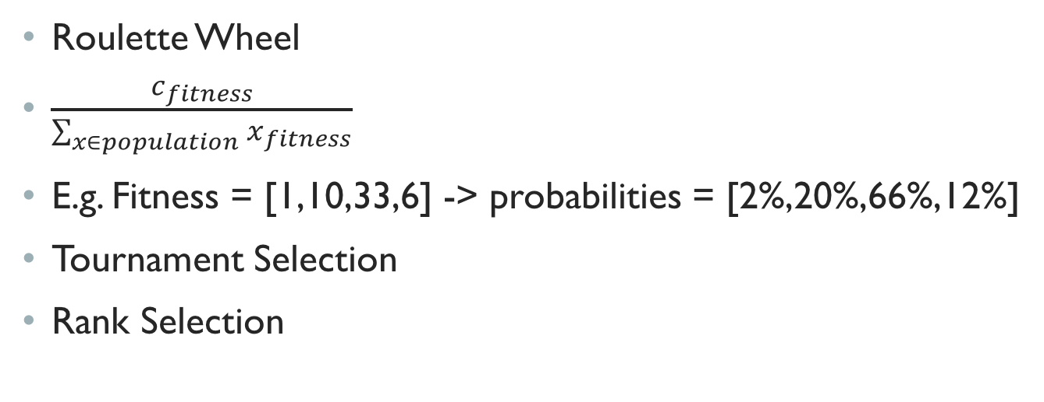
Chromosome Selection
Roulette Wheel
$\frac{c_{fitness}}{\sum_{x∈population}{x_{fitness}}}$
E.g. Fitness = [1,10,33,6] -> probabilities = [2%,20%,66%,12%]
Tournament Selection
Rank Selection

Slide 19
Analysis
Commonly used for optimization problems
Usually used for complex problems e.g. NP-class of problems
GA’s prefer certain schemata
E.g. n-queens solution that follow the 1 4 * * schemata are better than those with a 4 * 4 * schemata
Crowding

Slide 20
Vs. Neural Networks
Neural Networks move from one hypothesis to another slowly
GA may move quickly from one hypothesis to another

Slide 21
Application (Activity Scheduling)
Fitness = 1 / (punishment + 1)
Punishment = sum of all conflicts
For each date and time conflict regardless of target group, add 2 punishment points.
For each date and time conflict with intersecting target groups, add 7 punishment points.
For each date and time conflict with same venue, add 10 punishment points.
For each pair of activities where one activity takes place after the other on the same day, add 3 punishment points.
Punishment stacks up

Slide 22
Chromosome Design
 | Chromosome 1 | Chromosome 2
Act 1 | 08/12/16 14:00:00 | 08/19/16 13:00:00
Act 2 | 09/01/16 12:30:00 | 09/08/16 12:45:00
Act 3 | 08/15/16 08:00:00 | 09/01/16 10:45:00
Act 4 | 09/03/16 11:30:00 | 09/05/16 12:00:00
Units – assigned times

Slide 23
Chromosome Design
 | Chromosome 1 | Chromosome 2
Act 1 | 08/12/16 14:00:00 | 08/19/16 13:00:00
Act 2 | 09/01/16 12:30:00 | 09/08/16 12:45:00
Act 3 | 08/15/16 08:00:00 | 09/01/16 10:45:00
Act 4 | 09/03/16 11:30:00 | 09/05/16 12:00:00
Units – assigned times

Slide 24
Chromosome Design
 | Chromosome 1 | Chromosome 2
Act 1 | 08/12/16 14:00:00 | 08/19/16 13:00:00
Act 2 | 09/01/16 12:30:00 | 09/08/16 12:45:00
Act 3 | 09/01/16 10:45:00 | 08/15/16 08:00:00
Act 4 | 09/05/16 12:00:00 | 09/03/16 11:30:00
Units – assigned times

Slide 25
Chromosome Design
Mutation
For each activity, with probability 0.7, randomize the schedule of that activity
Choose a random date
Choose a random timeslot

Slide 26
Chromosome Design
Algorithm Parameters
Population Size: 50
Fitness Threshold: 0.14
Elitism Rate: 0.2
Mutation Rate: 0.4
Roulette Wheel Selection
1000 iterations

Slide 27
Results and Analysis
Satisfactory
Threshold allowed few acceptable
GOSM for LSCS as test script
Performed well with 22 activities

Slide 28
Conclusion
Genetic Algorithm performs well in this context
Implementation of the data model, algorithm, and system were successful
It is recommended to add more capabilities and constraints to the data model to better represent real life situations in scheduling

Slide 29
References
Corne, D., Fang, H.L. & Mellish, C. (1993). Solving the Modular Exam Scheduling Problem with Genetic Algorithms. Technical Report 622, Department of Artificial Intelligence, University of Edinburgh.
Czarn, A, et al. (2004). Statistical Exploratory Analysis of Genetic Algorithms. IEEE Transactions on Evolutionary Computation, 8(4). 405-421.
Omara, F.A. & Arafa, M.M. (2010). Genetic algorithms for task scheduling problem, Journal of Parallel and Distributed Computing, 70(1), 13-22, ISSN 0743-7315.
Jankovic, M. (2008). Making a Class Schedule Using a Genetic Algorithm. Retrieved July 4, 2016, from Code Project: http://www.codeproject.com/Articles/23111/Making
-a-Class- Schedule-Using-a-Genetic-Algorithm
Mitchell, T. (1997). Machine learning. McGraw-Hill.
Russell, S. & Norvig, P. (2010). Artificial Intelligence: A Modern Approach, 3rd Ed. New Jersey: Prentice-Hall.
Sadegheih, A. (2006). Scheduling problem using genetic algorithm, simulated annealing and the effects of parameter values on GA performance, Applied Mathematical Modelling, 30(2), 147-154, ISSN 0307-904X.
Wall, M.B. (1996). A Genetic Algorithm for Resource-Constrained Scheduling. Massachusetts Institute of Technology.

Slide 30
Thank you!

