Slide 1
Uncharted 2: Among Thieves
PROPONENTS: FERNANDEZ, RYAN AUSTIN
POBLETE, CLARISSE FELICIA M.
SAN PEDRO, MARC DOMINIC
TAN, JOHANSSON E.
ADVISER: CHARIBETH K. CHENG

Slide 2
Outline of the Presentation
Overview of Current State of Technology
Research Objectives and Scope and Limitations
System Design

Slide 3
Overview of Current State of Technology
Social Network
noun
a dedicated website or other application that enables users to communicate with each other by posting information, comments, messages, images, etc.

Slide 4
Community Detection
Detecting networks of users with similarity to each other
Multiple algorithms
Greedy Modularity Optimization¹
Clique Percolation Method²
Vertex Similarity²
1 Clauset, A., Newman, M. E. J., & Moore, C. (2004, Dec). Finding community structure in very large networks. Phys. Rev. E, 70 , 066111. doi: 10.1103/PhysRevE.70.066111
2 Tang, L., & Liu, H. (2010). Community detection and mining in social media. Morgan & Claypool. doi: 10.2200/S00298ED1V01Y201009DMK003

Slide 5
Community Detection
Multiple algorithms (cont.)
Hierarchical Clustering¹
Interest-based community detection²
k-means clustering³
1 Tang, L., & Liu, H. (2010). Community detection and mining in social media. Morgan & Claypool. doi: 10.2200/S00298ED1V01Y201009DMK003
2 Lim, K., & Datta, A. (2012). Following the follower: Detecting communities with common interests on twitter. In Proceedings of the 23rd ACM conference on hypertext and social media (ht12) (Vol. 1, pp. 317{318). Association for
Computing Machinery. doi: 10.1145/2309996.2310052
3 Zhang, Y., Wu, Y., & Yang, Q. (2012). Community discovery in twitter based on user interests. Journal of Computational Information Systems, 8 (3), 991-1000.

Slide 6
Similarity Parameters (Sentiment Analysis)
Formula for text similarity based on topics in the text¹
Similar word usage in communities vie Euclidean Distance²
Naive Bayes Subjective/Objective Positive/Negative Classifier³
Cosine similarity⁴
1 Zhang, Y., Wu, Y., & Yang, Q. (2012). Community discovery in twitter based on user interests. Journal of Computational Information Systems, 8 (3), 991-1000.
2 Bryden, J., Funk, S., & Jansen, V. A. (2013). Word usage mirrors community structure in the online social network twitter. EPJ Data Science, 2 (1), 1{9. doi: 10.1140/epjds15
3 Deitrick, W., & Hu, W. (2013). Mutually enhancing community detection and sentiment analysis on twitter networks.
4 Bakillah, M., Li, R.-Y., & Liang, S. H. L. (2015, February). Geo-located community detection in twitter with enhanced fast-greedy optimization of modularity: The case study of typhoon haiyan. Int. J. Geogr. Inf. Sci., 29 (2), 258{279. doi: 10.1080/13658816.2014.964247

Slide 7
Similarity Parameters (Other Parameters)
A majority of the studies dealt with Twitter
URL Similarity^{1,2}
Hashtag Similarity^{1,2}
Following Similarity^{1,2,3}
Retweeting Similarity^{1,2,3}
Mentions^{1,2}
1 Zhang, Y., Wu, Y., & Yang, Q. (2012). Community discovery in twitter based on user interests. Journal of Computational Information Systems, 8 (3), 991-1000.
2 Bakillah, M., Li, R.-Y., & Liang, S. H. L. (2015, February). Geo-located community detection in twitter with enhanced fast-greedy optimization of modularity: The case study of typhoon haiyan. Int. J. Geogr. Inf. Sci., 29 (2), 258{279. doi: 10.1080/13658816.2014.964247
3 Darmon, D., Omodei, E., & Garland, J. (2015, 08). Followers are not enough: A multifaceted approach to community detection in online social networks. PLoS ONE, 10 (8), 1-20. doi: 10.1371/journal.pone.0134860

Slide 8
Evaluation Metrics
Average number of mutual following links per user per community(FPUPC) to evaluate their communities.¹
1 Zhang, Y., Wu, Y., & Yang, Q. (2012). Community discovery in twitter based on user interests. Journal of Computational Information Systems, 8 (3), 991-1000.

Slide 9
Research Problem
Determine which algorithms and features provide more accurate communities considering both Facebook and Twitter

Slide 10
Significance of the Study Community Detection
Determining which combination of algorithm and parameter could contribute to future research in the domain

Slide 11
Target Users and Domain
This research can also be a very useful tool in the domains of
viral marketing
political endorsement.

Slide 12
Target Users and Domain
Interested companies may use the result of this research to improve their sales and marketing.
The government may use this to gauge
public opinion on certain issues
which geographical areas have a particular opinion.

Slide 13
Research Objectives, Scope, and Limitations General Objective
To generate social network communities using community detection algorithms and similarity parameters.

Slide 14
Specific Objective #1
Specific Objective
Scope and Limitations
To build a corpus of social media data
Tweepy
Anonymization

Slide 15
Specific Objective #2
Specific Objective
Scope and Limitations
To determine the various techniques and algorithms in detecting communities
K-means clustering
Divisive Hierarchical Clustering
Agglomerative Hierarchical Clustering
Fast Greedy Modularity Optimization

Slide 16
Specific Objective #3
Specific Objective
Scope and Limitations
To determine the parameters to use in detecting the communities
Word Frequency
Positive/Negative Posts
Subjective/Objective Posts
Follow Networks
Mentions
Hashtags

Slide 17
Specific Objective #4
Specific Objective
Scope and Limitations
To determine how to evaluate the detected communities
Average mutual followers per user per community (FPUPC)
Modularity

Slide 18
System Description

Slide 19
System Flow
Collect live data from Twitter.
Clean data from Twitter.
User selects algorithm.
User selects compatible parameter.
User generates communities.
System outputs evaluation of communities.

Slide 20
System Objectives
The system must be able to generate communities using a specific algorithm and similarity parameter.

Slide 21
Specific Objective #1
Specific Objective
Scope and Limitations
To collect data from Twitter
Public tweets
Posts, follow network, hashtag usage, mentions
Tweepy

Slide 22
Specific Objective #2
Specific Objective
Scope and Limitations
To clean the collected Twitter data
Anonymization

Slide 23
Specific Objective #3
Specific Objective
Scope and Limitations
To detect communities using the supported algorithms and parameters
K-Means Clustering
Divisive Hierarchical Clustering
Agglomerative Hierarchical Clustering
Fast Greedy Optimization of Modularity

Slide 24
Specific Objective #4
Specific Objective
Scope and Limitations
To display a visualization of the communities
HTML5

Slide 25
Specific Objective #5
Specific Objective
Scope and Limitations
To evaluate metrics for the communities
Modularity
FPUPC

Slide 26
System Architecture

Slide 27
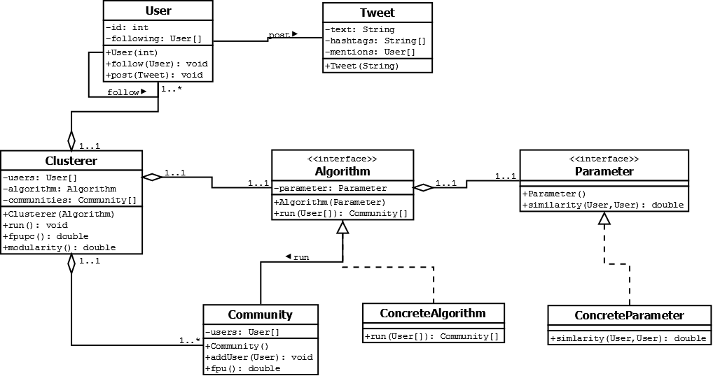
System Architecture

Slide 28
Thank You!

