Slide 1
The Multimedia Terminal Find Your Next Obsession Here
Austin Fernandez
Jonah Syfu
Stanley Yu Galan

Slide 2
Problem:
Finding similar content to media you like is difficult, especially cross-medium, for those who want to delve into video games, anime, etc.

Slide 3
Solution:
Create a site for people to collaborate in supplying data to aid consumers in finding inter-medium or cross-medium works that might interest them.

Slide 4
Functionalities:
Users:
User Registration User Login Search Media View Media Page Rate Media
Add Keyword Add Review Add Recommendation View Recommendations Propose New Media

Slide 5
Functionalities:
Admin:
View Proposals Verify Proposal View Keyword Proposals Verify Keyword Proposals All User Privileges previously stated

Slide 6
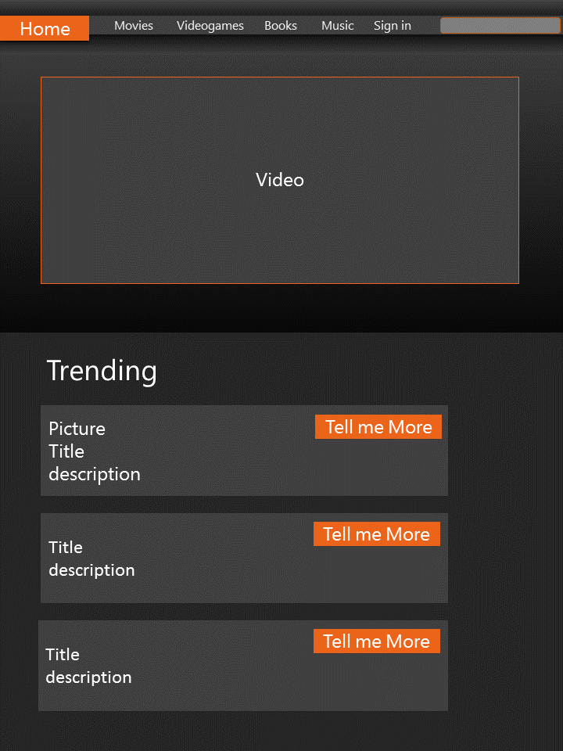
Design Mockup

