Slide 1
Efficient categorization of white blood cells by utilizing ResNet50V2 in the 4B-AdditionNet-based CNN network and ant colony optimization workflow
Made by: Bustya Balázs, Csizmadia Árpád, Nagy Norbert Botond, Novák-Schwartz József
Budapest 2022.11.08

Slide 2
WBC identification
Based on different attributes of the blood’s cellular components, like colour, size, texture, composition and shape, they are separated into three cell types: erythrocytes also known as Red Blood Cells (RBC), leukocytes (White Blood Cells or WBC short) and thrombocytes.

Slide 3
WBC analyzis purpose
WBC early diagnosis of severe diseases, like leukemia and others, can be established
manual blood sample analysis is very time consuming and costly

Slide 4
WBC analyzis steps
Preprocessing
CLAHE
Feature extraction
ResNet50V2
EfficientNetB0
4B- AdditionNet
Feature selection
ACO
Classification
LSVM, CSVM, QSVM, LDA, FKNN, CKNN

Slide 5
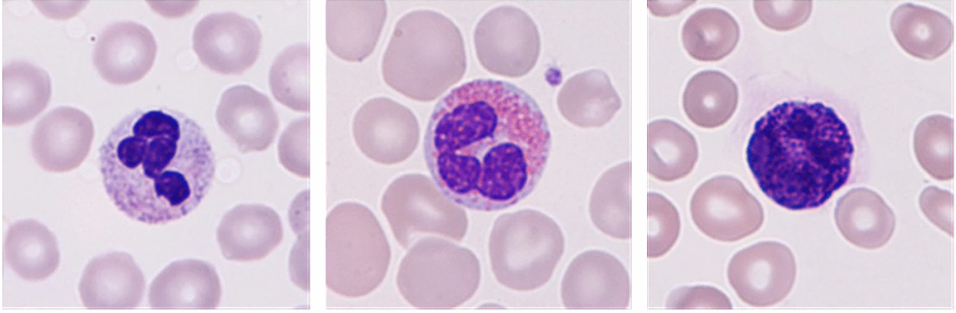
Dataset
Blood Cell Images dataset. This dataset is the augmented version of the BCCD dataset.
Public, free to use
Contains 12,500 augmented image (320 x 240 pixels, the bit depth is 24)
Labels: RBC, Platele, WBCs (Neutrophil , Eosinophil, Lymphocyte and Monocyte)

Slide 6
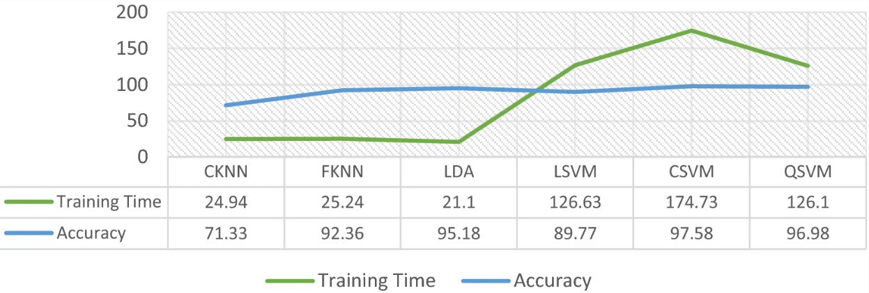
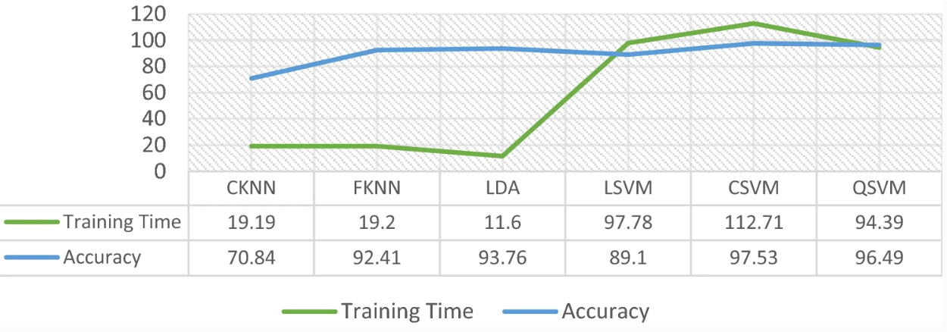
Results
Accuracy is the same
10 fold decrease in runtime
Cheaper, faster to train
Negative results on feature reduction

Slide 7

Thank you for your attention!
Any questions?

