Slide 1
Airflow Introduction
James Ng
2023-06-27

Slide 2
01 | What is Airflow?
02 | Python scripts
03 | Resources

Slide 3
What is Airflow?
01

Slide 4
What is Airflow?
Apache Airflow
orchestrate/automate workflows
schedule workflows
execute workflows, including (Extract, Transform, Load) ETL pipelines
History
October 2014: developed by Airbnb
January 2019: open-sourced under the Apache Software Foundation https://github.com/apache/airflow
Airflow allows you to define, schedule, and monitor complex workflows as Directed Acyclic Graphs (DAGs).
Airflow workflows are created via Python scripts, made easy by importing libraries and classes.
More info: Wikipedia

Slide 5
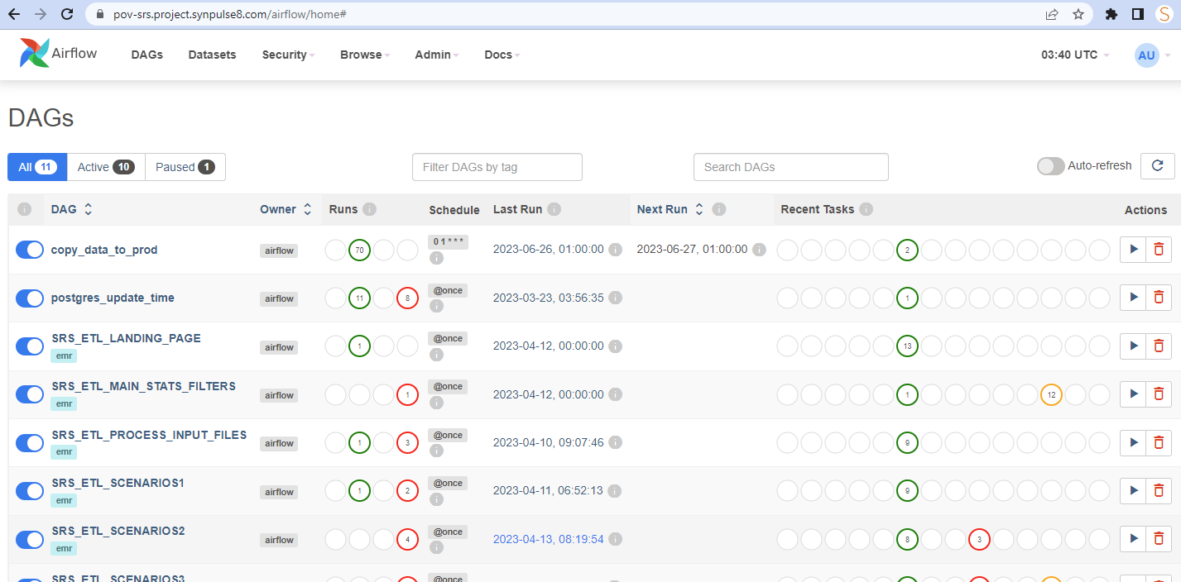

Slide 6
Key components
Scheduler To manage the execution of tasks based on their dependencies (workflow) and the defined schedule. It determines which tasks are ready to run and triggers their execution.
Web Server To provide a web-based user interface (UI) for interacting with Airflow. It allows users to monitor workflows, view logs, and manage DAGs, tasks, and connections.
Metadata Database To store the state of workflows, task instances, and other operational metadata. This database keeps track of the execution history, task status, and other relevant information.

Slide 7
Python scripts
02

Slide 8
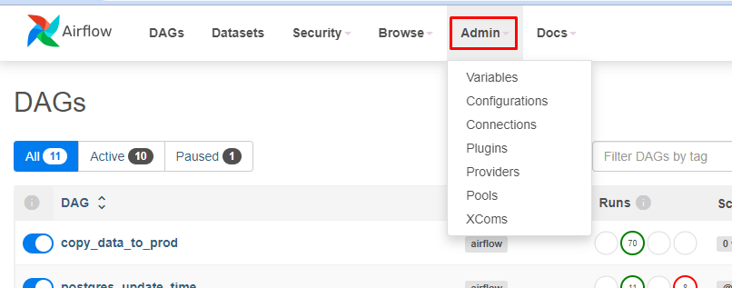
Configuration
Airflow → Admin → Configurations (view only) Airflow's configuration is managed through a configuration file: airflow.cfg which is usually located in the AIRFLOW_HOME directory (default is ~/airflow)
Airflow → Admin → Variables To store common variables used by any DAG
Airflow → Admin → Connections To securely store username and password

Slide 9
Python code
3 main script sections
import libraries (Airflow operators, sensors, etc)
set DAG variables
define DAG functions
DAG comprises 1 or more task(s)
Each task in the DAG is implemented as an operator, which defines what the task does
instantiate DAG objects
set task dependencies (workflow)

Slide 10
Resources
03

Slide 11
Installing Airflow (Windows, with WSL2)
Step-by-step instructions:
https://www.freecodecamp.org/news/install-apache-airflow-on-windows-without-docker/
Requirements:
to enable WSL2 (Windows Subsystem for Linux 2)
to install WSL2
Command Prompt → Run as administrator
> wsl --update
> wsl --install -d ubuntu

Slide 12

DataCamp: Introduction to Airflow
Course content:
https://github.com/JNYH/DataCamp_Introduction_to_Airflow/blob/master/Course_notes_solutions_answers_Introduction_to_Airflow.pdf

Slide 13
James Ng
Assistant Vice President
+65 97677746
james.ng@synpulse.com
https://www.linkedin.com/in/jnyh/

