Slide 1
datacamp
Data Management

Slide 2
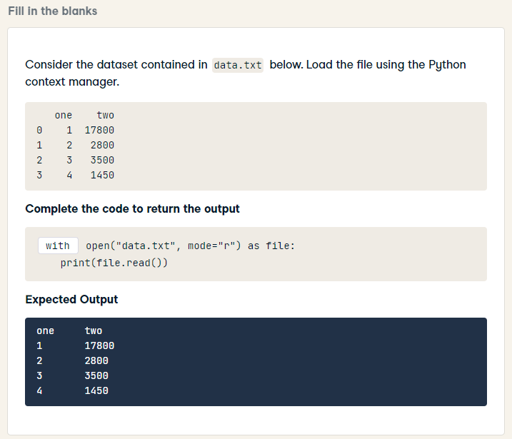
with open("data.txt", mode="r") as file:
print(file.read())

Slide 3
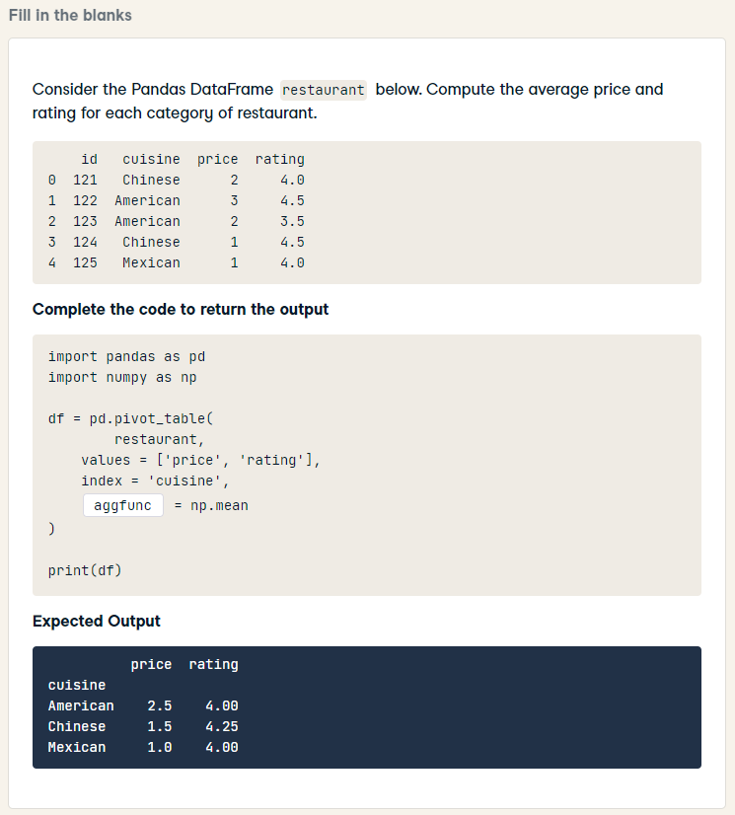
import pandas as pd
import numpy as np
df = pd.pivot_table(
restaurant,
values = ['price', 'rating'],
index = 'cuisine',
aggfunc = np.mean
)
print(df)

Slide 4
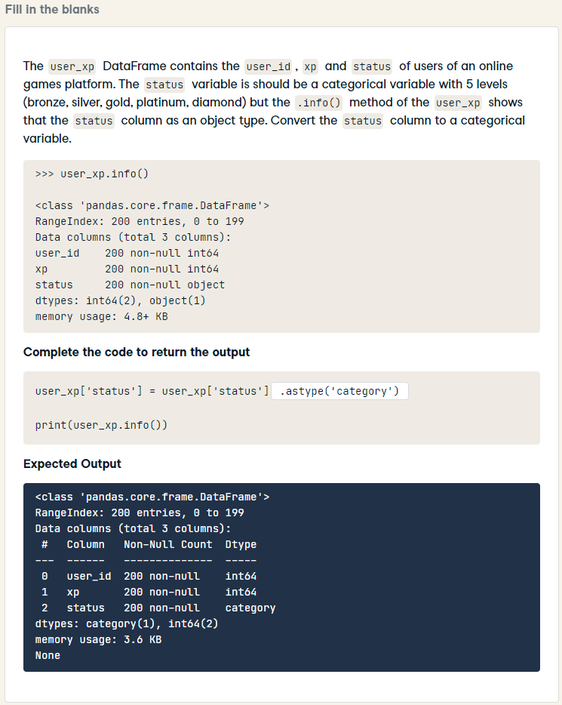
user_xp['status'] = user_xp['status'].astype('category')
print(user_xp.info())

Slide 5
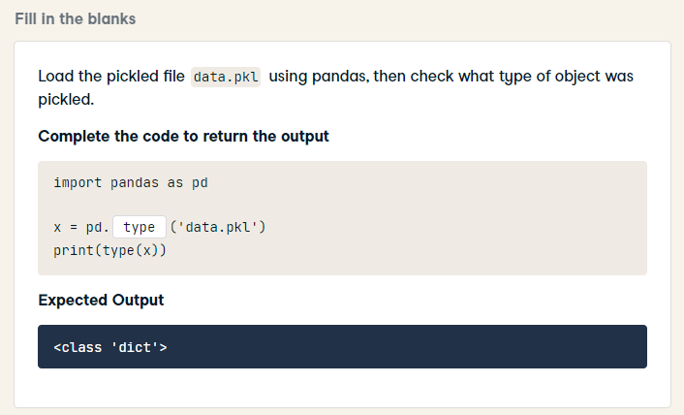
import pandas as pd
x = pd.read_pickle('data.pkl')
print(type(x))

Slide 6
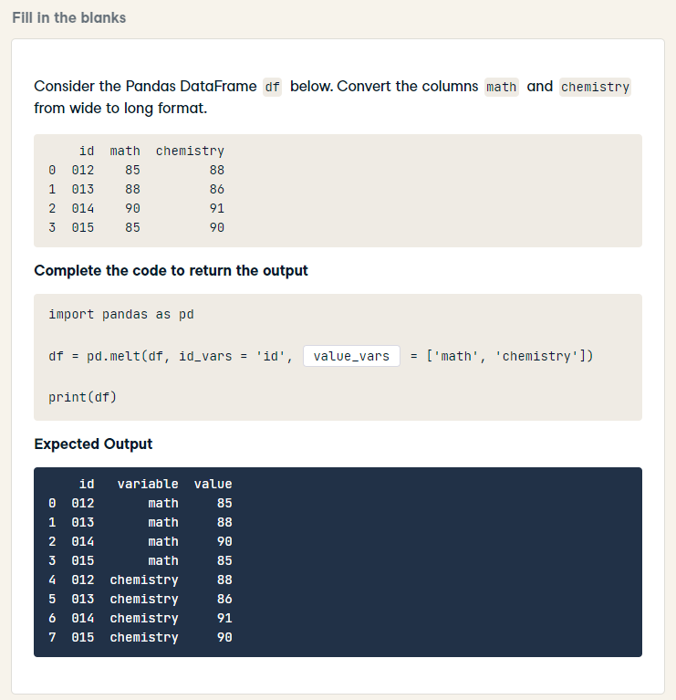
import pandas as pd
df = pd.melt(df, id_vars = 'id', value_vars = ['math', 'chemistry'])
print(df)

Slide 7
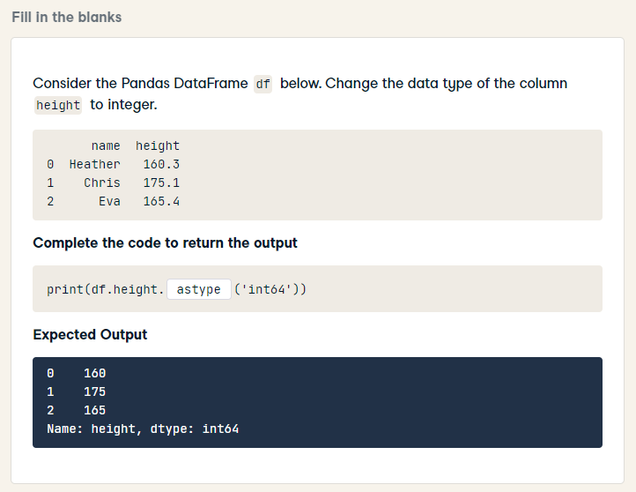
print(df.height.astype('int64'))

Slide 8
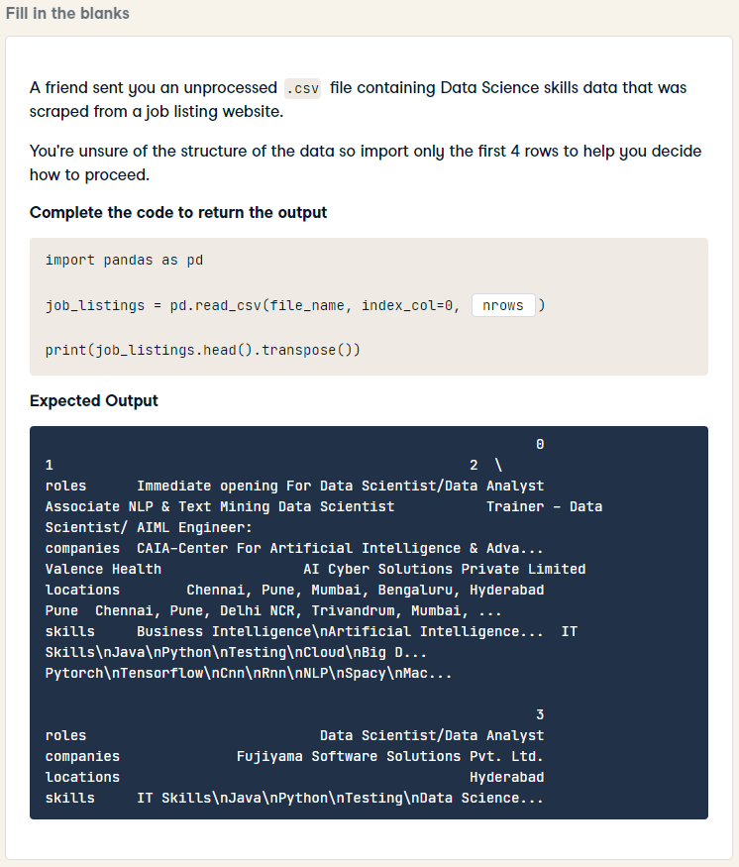
import pandas as pd
job_listings = pd.read_csv(file_name, index_col=0, nrows=4)
print(job_listings.head().transpose())

Slide 9
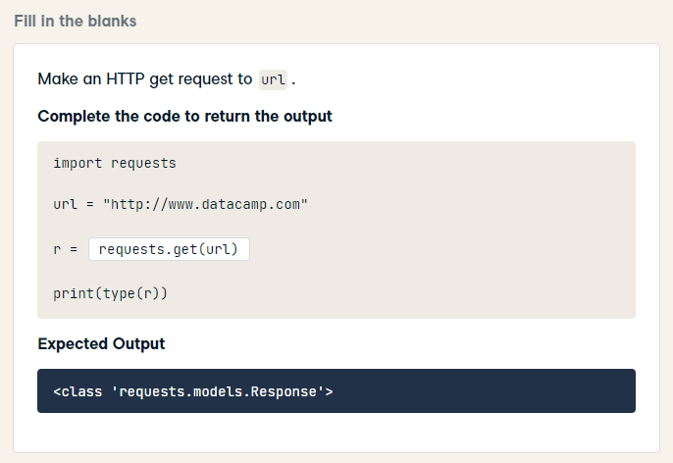
import requests
url = "http://www.datacamp.com"
r = requests.get(url)
print(type(r))

Slide 10
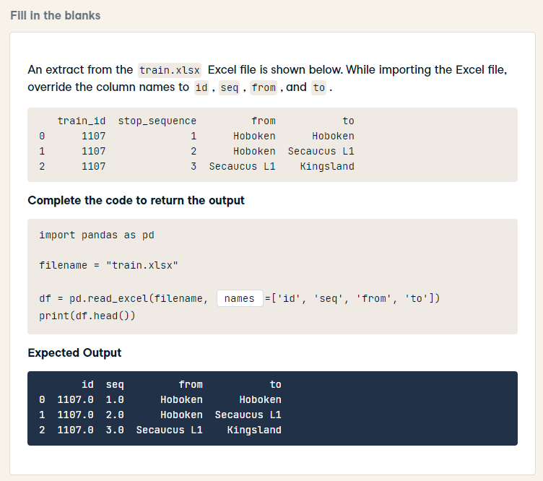
import pandas as pd
filename = "train.xlsx"
df = pd.read_excel(filename, names=['id', 'seq', 'from', 'to'])
print(df.head())

Slide 11
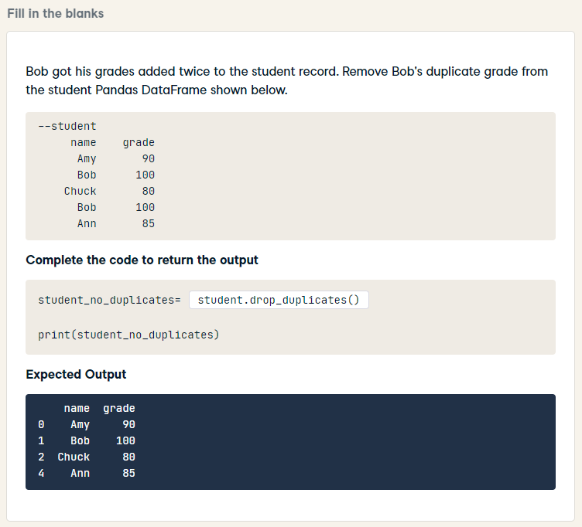
student_no_duplicates= student.drop_duplicates()
print(student_no_duplicates)

Slide 12
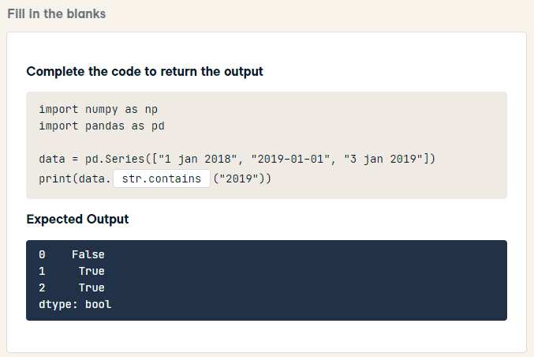
HARD
import numpy as np
import pandas as pd
data = pd.Series(["1 jan 2018", "2019-01-01", "3 jan 2019"])
print(data.str.contains("2019"))

Slide 13
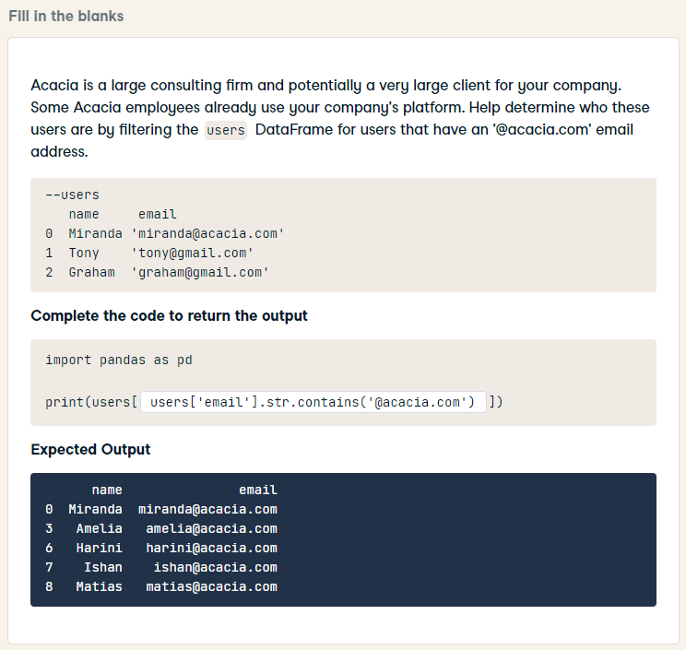
HARD
import pandas as pd
print(users[users['email'].str.contains('@acacia.com')])

Slide 14
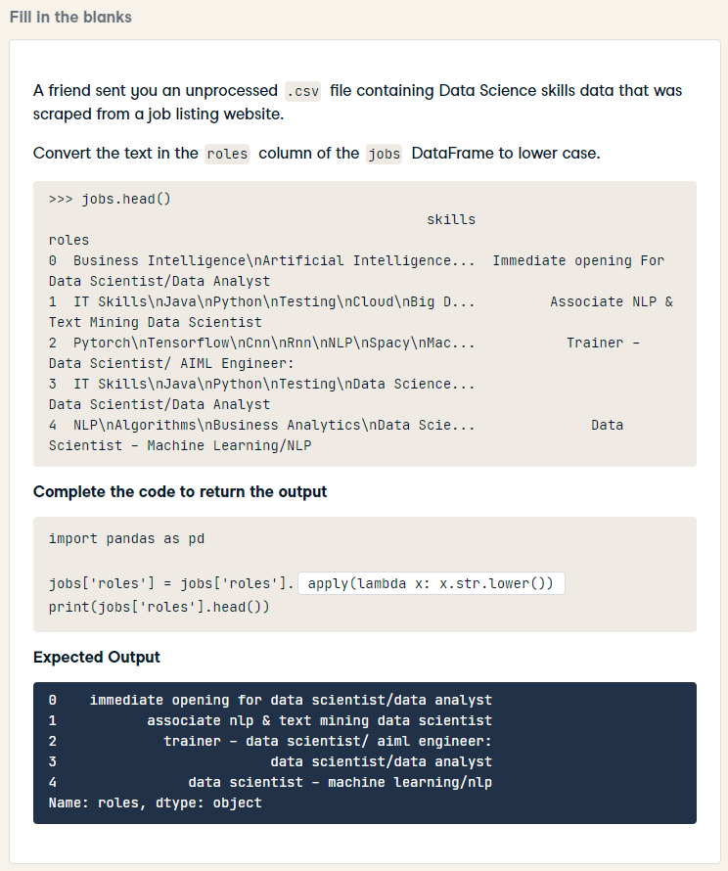
import pandas as pd
jobs['roles'] = jobs['roles'].str.lower()
print(jobs['roles'].head())

Slide 15
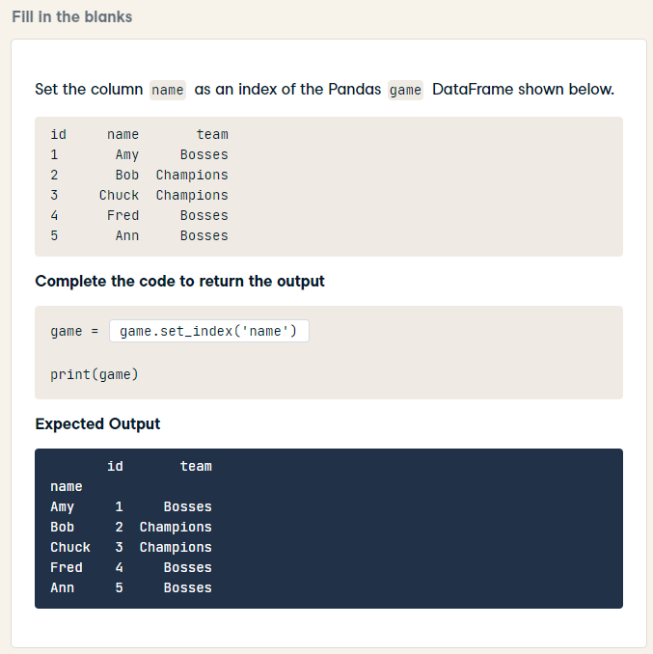
game = game.set_index('name')
print(game)

Slide 16
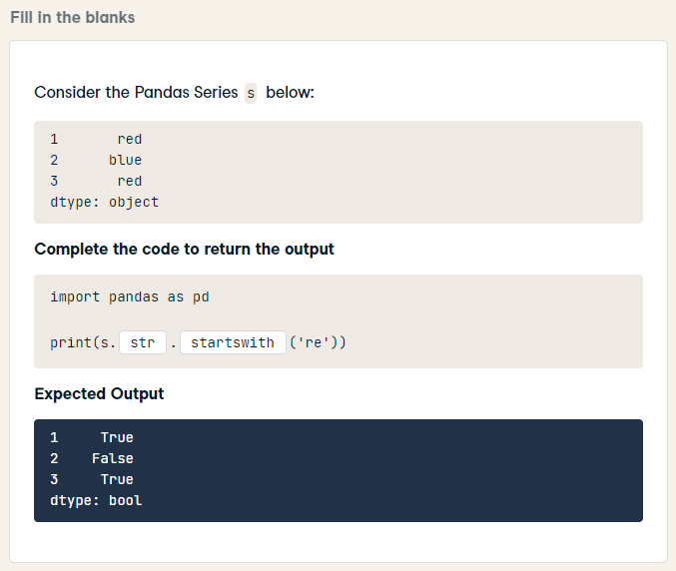
import pandas as pd
print(s.str.startswith('re'))

Slide 17
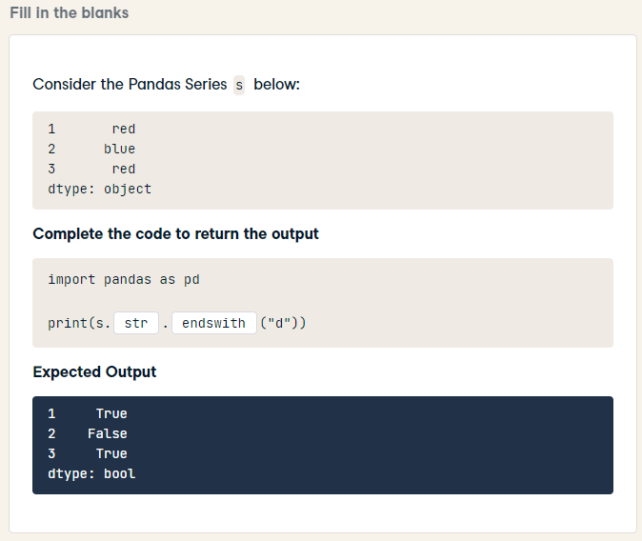
HARD
import pandas as pd
print(s.str.endswith("d"))

Slide 18
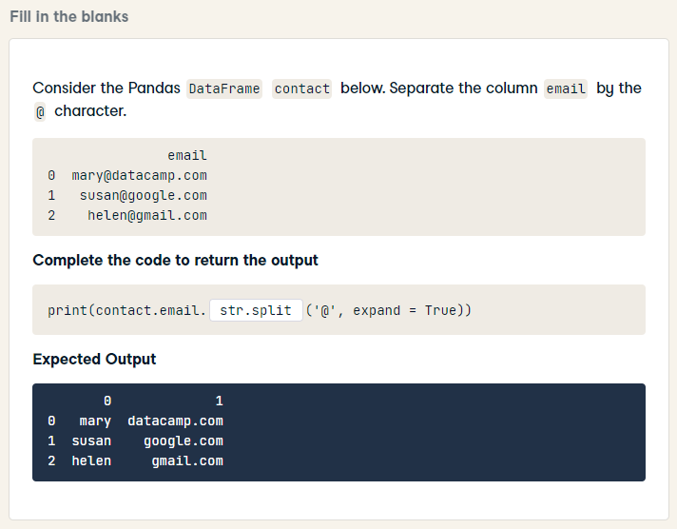
print(contact.email.str.split('@', expand = True))

Slide 19
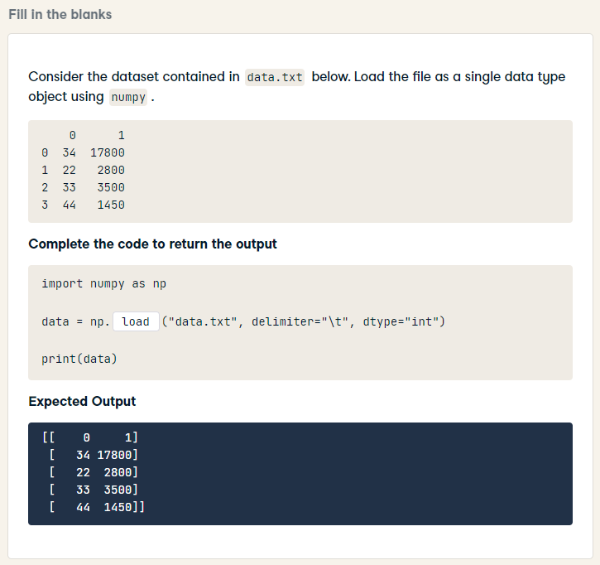
import numpy as np
data = np.loadtxt("data.txt", delimiter="\t", dtype="int")
print(data)

Slide 20
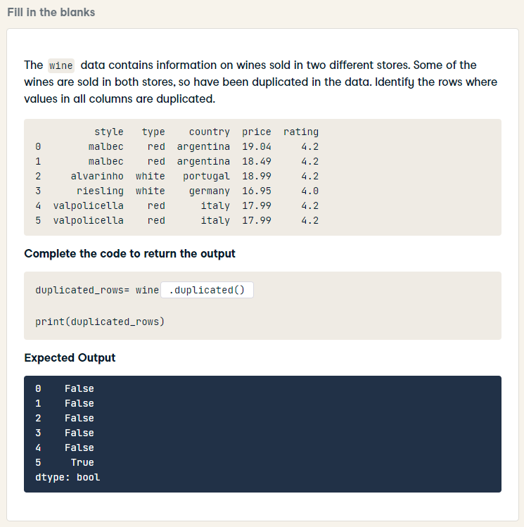
duplicated_rows= wine.duplicated()
print(duplicated_rows)

Slide 21
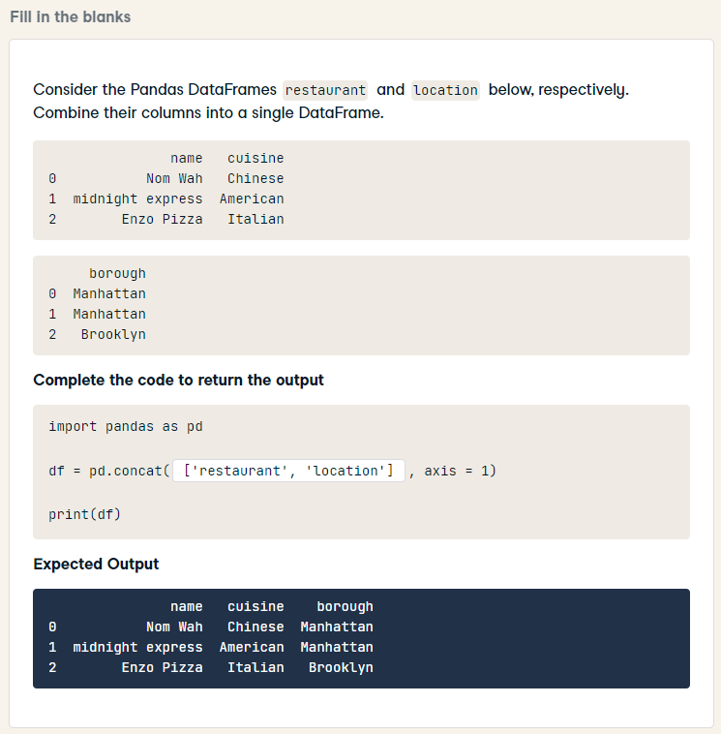
import pandas as pd
df = pd.concat([restaurant, location], axis = 1)
print(df)

Slide 22
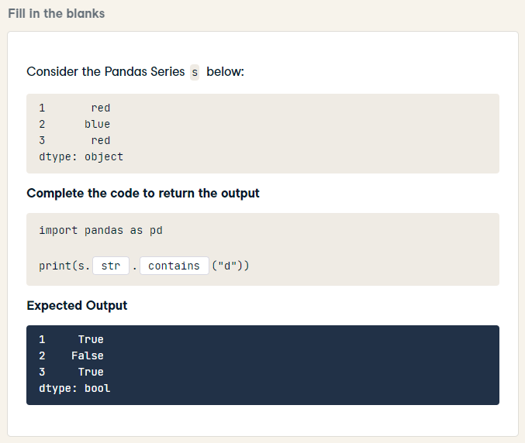
import pandas as pd
print(s.str.contains("d"))

Slide 23
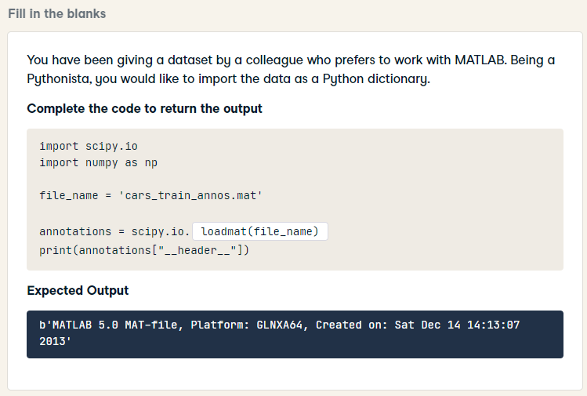
import scipy.io
import numpy as np
file_name = 'cars_train_annos.mat'
annotations = scipy.io.loadmat(file_name)
print(annotations["__header__"])

Slide 24
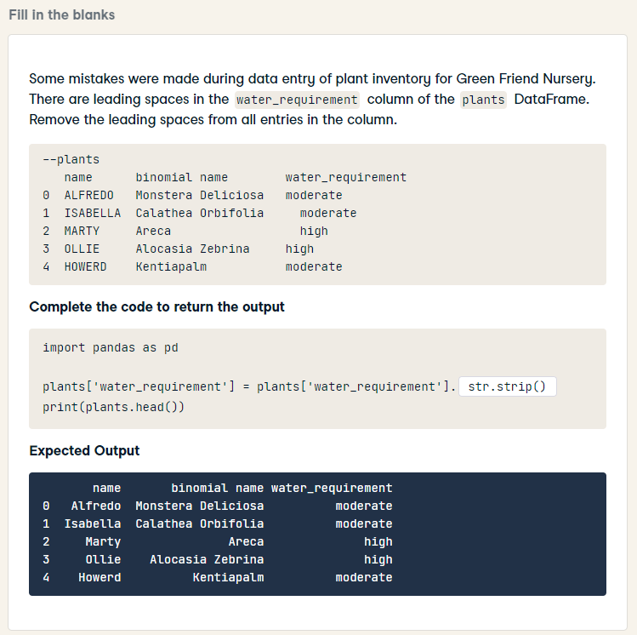
import pandas as pd
plants['water_requirement'] = plants['water_requirement'].str.strip()
print(plants.head())

Slide 25
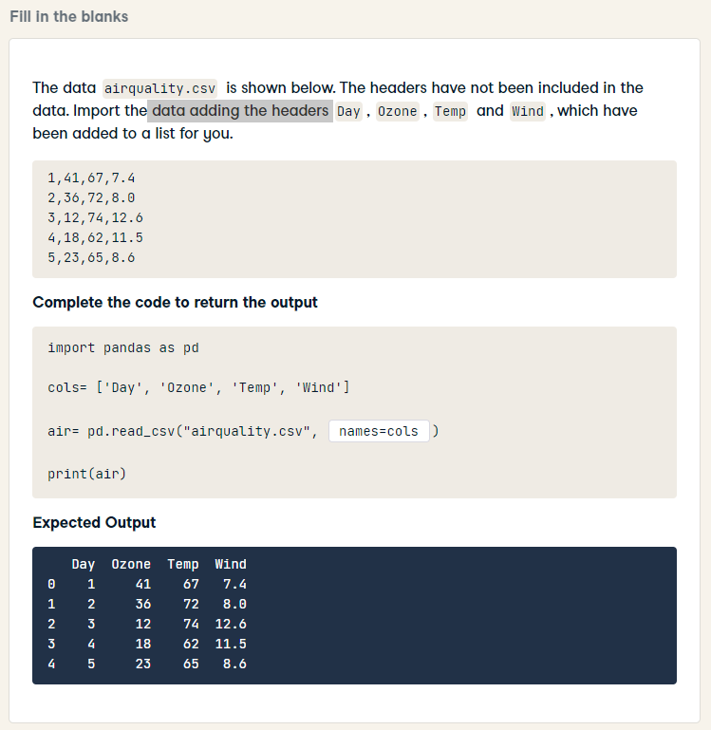
import pandas as pd
cols= ['Day', 'Ozone', 'Temp', 'Wind']
air= pd.read_csv("airquality.csv", names=cols)
print(air)

Slide 26
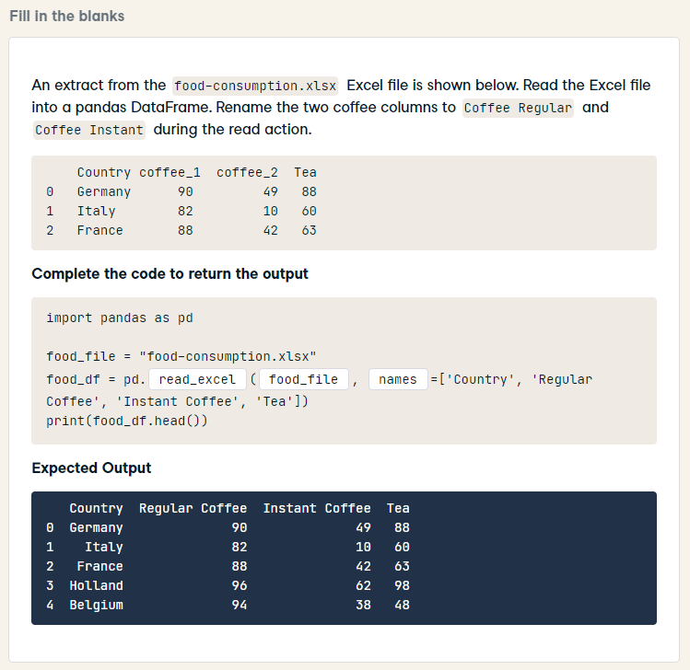
import pandas as pd
food_file = "food-consumption.xlsx"
food_df = pd.read_excel(food_file, names=['Country', 'Regular Coffee', 'Instant Coffee', 'Tea'])
print(food_df.head())

Slide 27
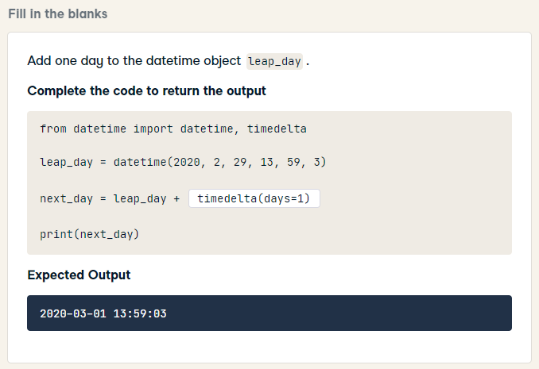
from datetime import datetime, timedelta
leap_day = datetime(2020, 2, 29, 13, 59, 3)
next_day = leap_day + timedelta(days=1)
print(next_day)

Slide 28
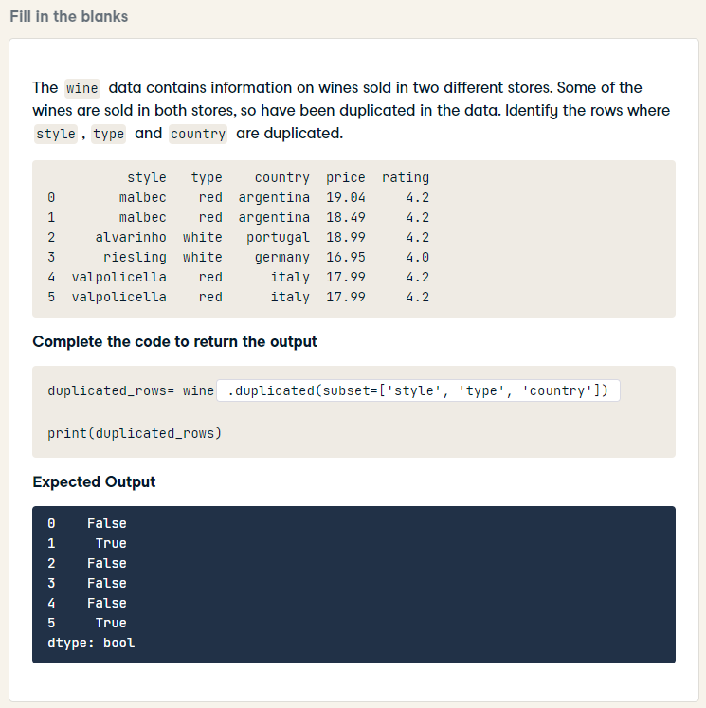
HARD
duplicated_rows= wine.duplicated(subset=['style', 'type', 'country'])
print(duplicated_rows)

Slide 29
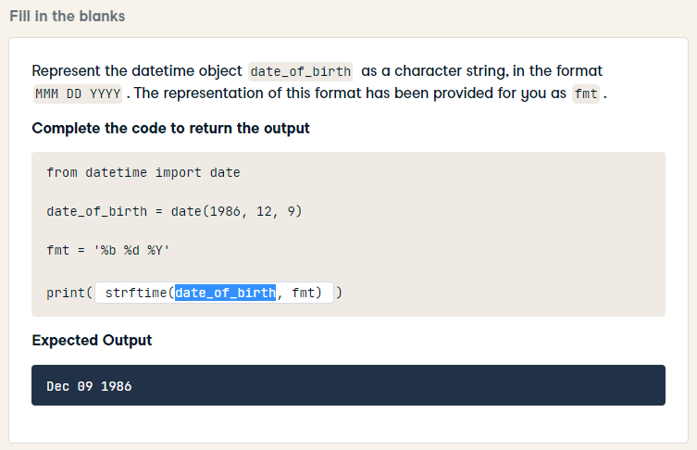
HARD
from datetime import date
date_of_birth = date(1986, 12, 9)
fmt = '%b %d %Y'
print(date_of_birth.strftime(fmt))

Slide 30
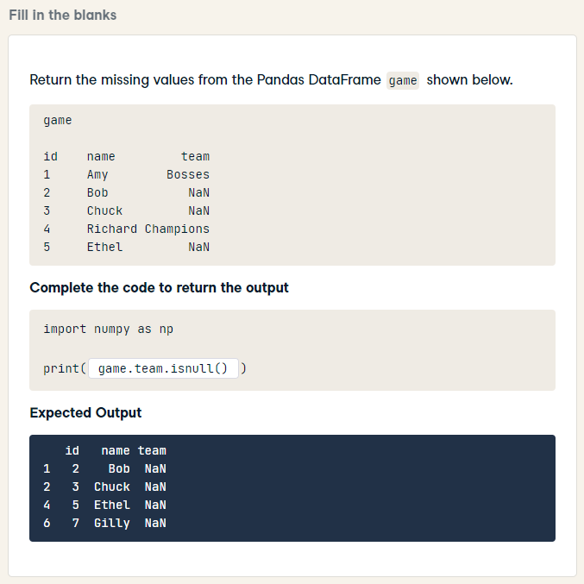
HARD
import numpy as np
print(game[game.isna().any(axis=1)])

Slide 31
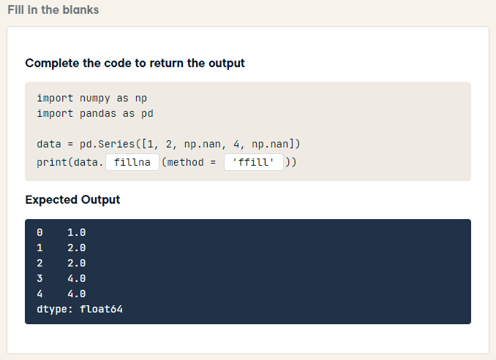
HARD
import numpy as np
import pandas as pd
data = pd.Series([1, 2, np.nan, 4, np.nan])
print(data.fillna(method = 'ffill'))

Slide 32
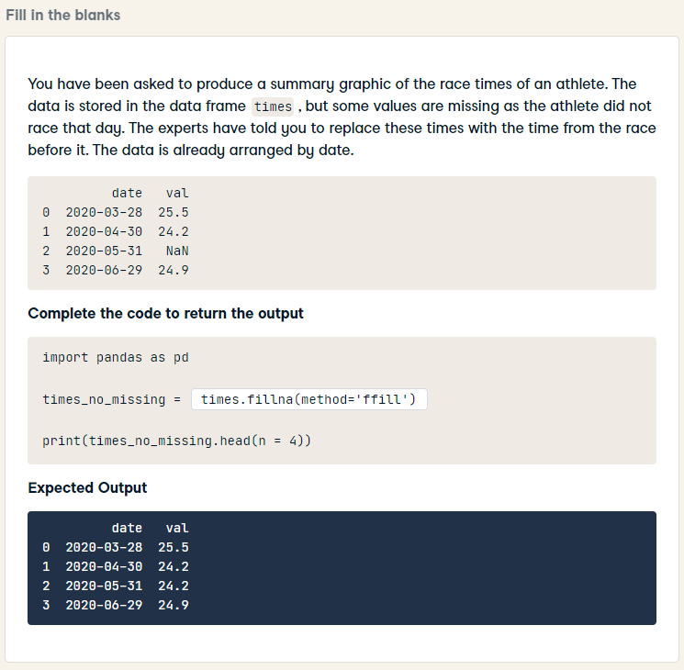
HARD
import pandas as pd
times_no_missing = times.fillna(method='ffill')
print(times_no_missing.head(n = 4))

Slide 33
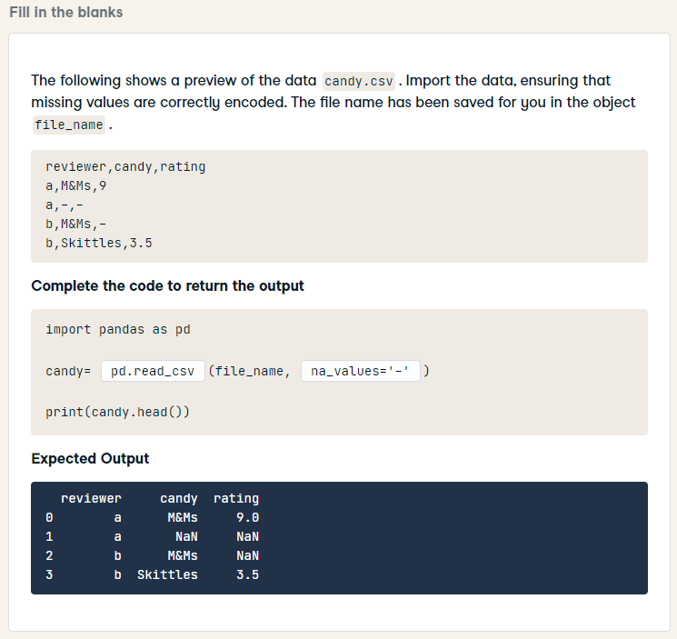
HARD
import pandas as pd
candy= pd.read_csv(file_name, na_values='-')
print(candy.head())

Slide 34
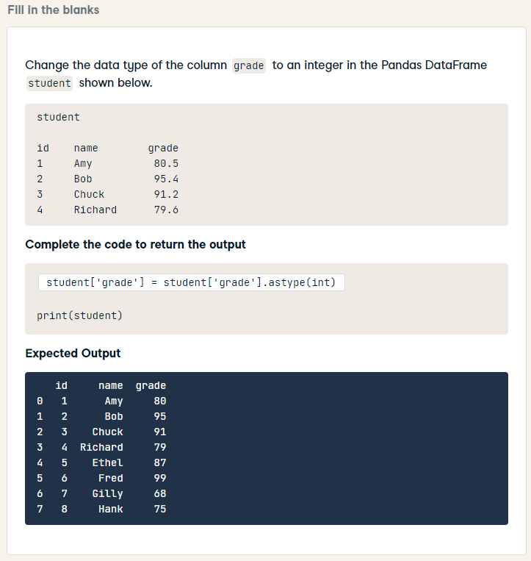
HARD
student['grade'] = student['grade'].astype(int)
print(student)

Slide 35
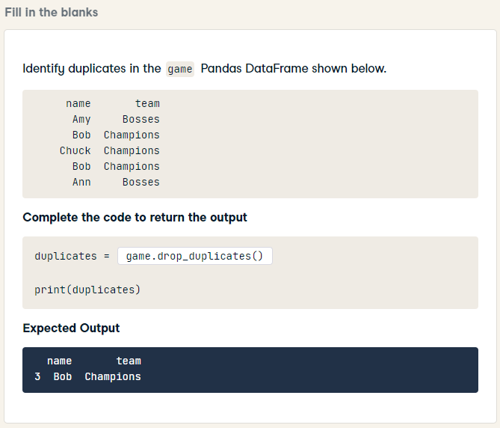
HARD
duplicates = game[game.duplicated()]
print(duplicates)

Slide 36
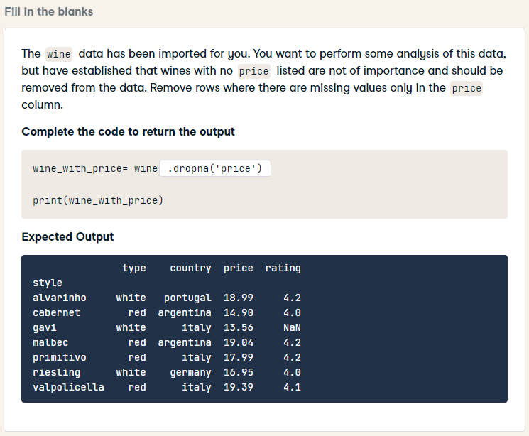
HARD
wine_with_price= wine.dropna(subset=['price'])
print(wine_with_price)

