Slide 1
datacamp
Model Development
Machine Learning Fundamentals in Python

Slide 2
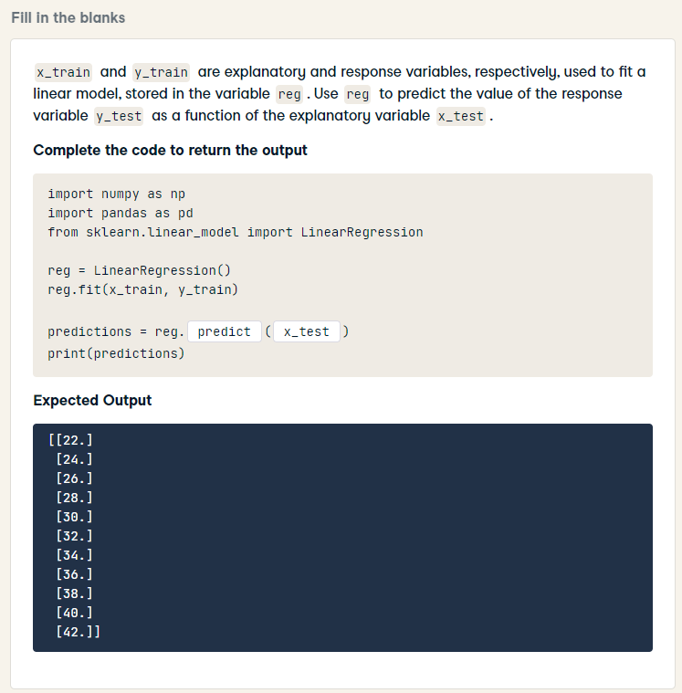
import numpy as np
import pandas as pd
from sklearn.linear_model import LinearRegression
reg = LinearRegression()
reg.fit(x_train, y_train)
predictions = reg.predict(x_test)
print(predictions)

Slide 3
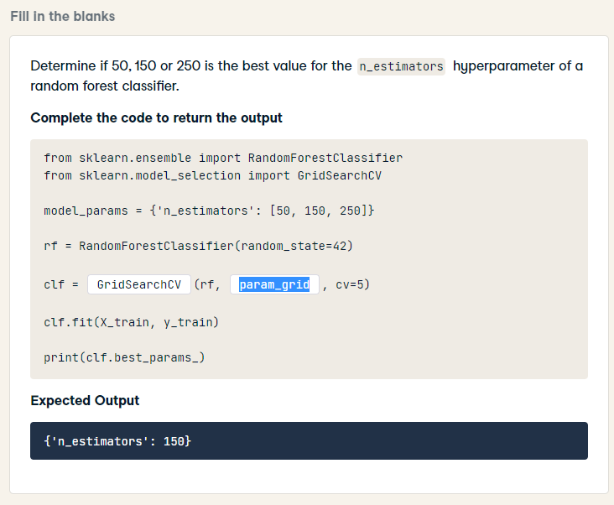
from sklearn.ensemble import RandomForestClassifier
from sklearn.model_selection import GridSearchCV
model_params = {'n_estimators': [50, 150, 250]}
rf = RandomForestClassifier(random_state=42)
clf = GridSearchCV(rf, model_params, cv=5)
clf.fit(X_train, y_train)
print(clf.best_params_)

Slide 4
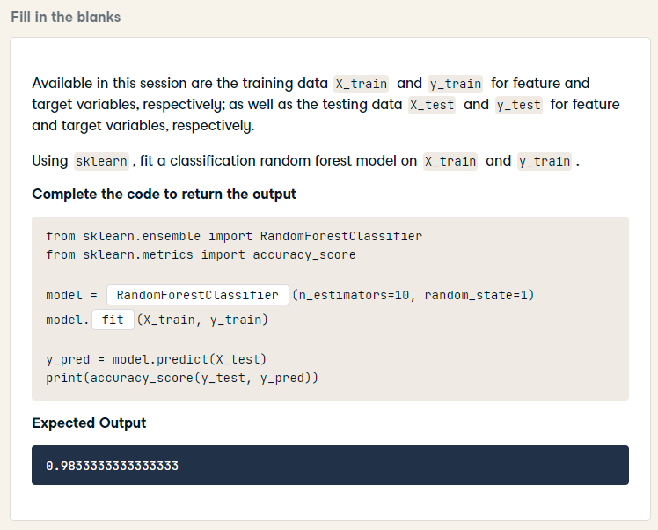
from sklearn.ensemble import RandomForestClassifier
from sklearn.metrics import accuracy_score
model = RandomForestClassifier(n_estimators=10, random_state=1)
model.fit(X_train, y_train)
y_pred = model.predict(X_test)
print(accuracy_score(y_test, y_pred))

Slide 5
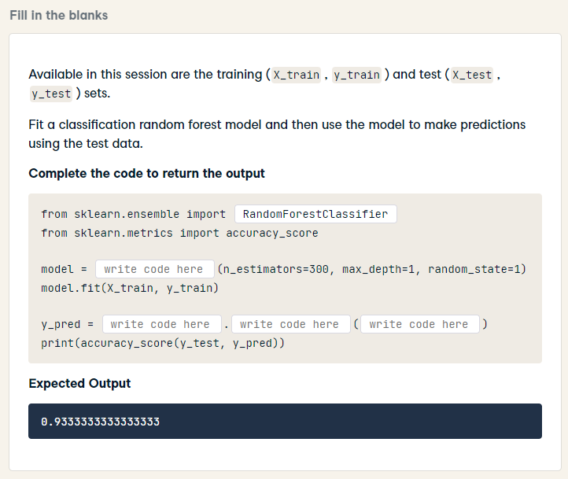
from sklearn.ensemble import RandomForestClassifier
from sklearn.metrics import accuracy_score
model = RandomForestClassifier(n_estimators=300, max_depth=1, random_state=1)
model.fit(X_train, y_train)
y_pred = model.predict(X_test)
print(accuracy_score(y_test, y_pred))

Slide 6
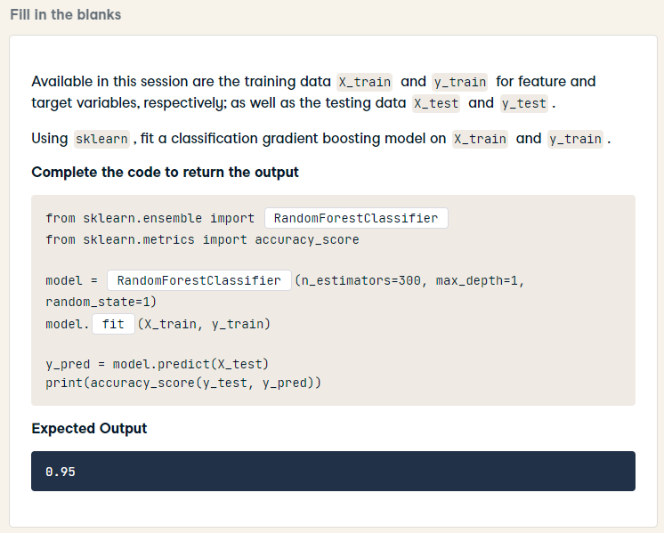
HARD
from sklearn.ensemble import GradientBoostingClassifier
from sklearn.metrics import accuracy_score
model = GradientBoostingClassifier(n_estimators=300, max_depth=1, random_state=1)
model.fit(X_train, y_train)
y_pred = model.predict(X_test)
print(accuracy_score(y_test, y_pred))

Slide 7
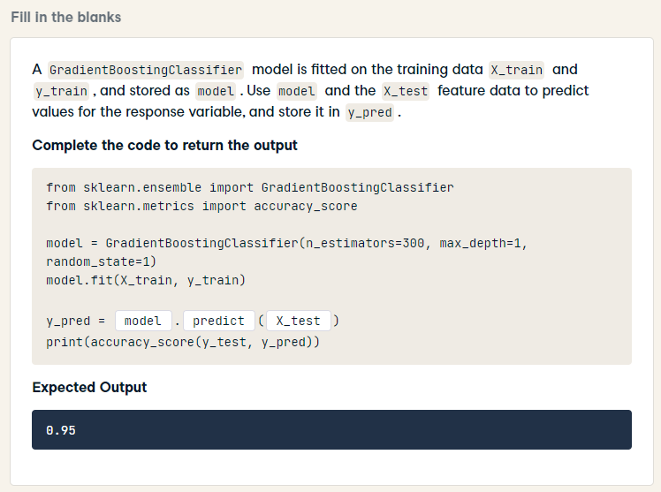
from sklearn.ensemble import GradientBoostingClassifier
from sklearn.metrics import accuracy_score
model = GradientBoostingClassifier(n_estimators=300, max_depth=1, random_state=1)
model.fit(X_train, y_train)
y_pred = model.predict(X_test)
print(accuracy_score(y_test, y_pred))

Slide 8
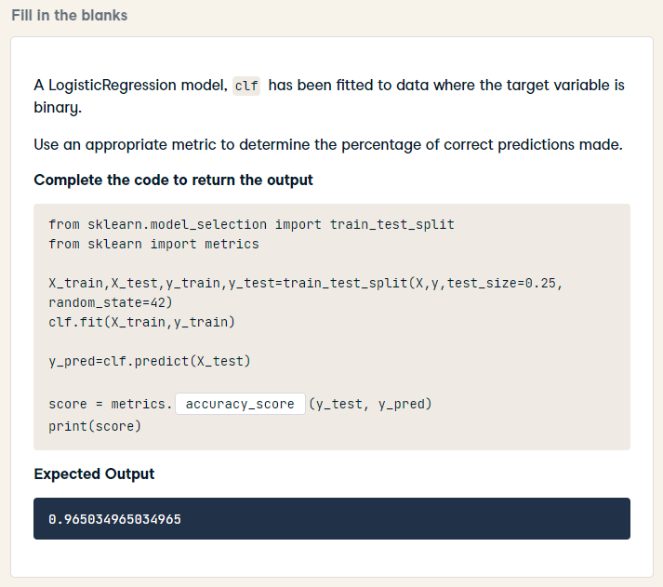
from sklearn.model_selection import train_test_split
from sklearn import metrics
X_train,X_test,y_train,y_test=train_test_split(X,y,test_size=0.25, random_state=42)
clf.fit(X_train,y_train)
y_pred=clf.predict(X_test)
score = metrics.accuracy_score(y_test, y_pred)
print(score)

Slide 9
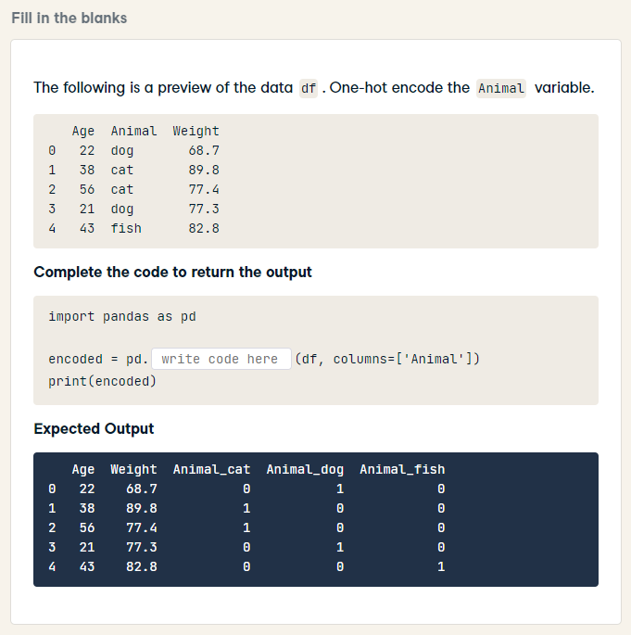
import pandas as pd
encoded = pd.get_dummies(df, columns=['Animal'])
print(encoded)

Slide 10
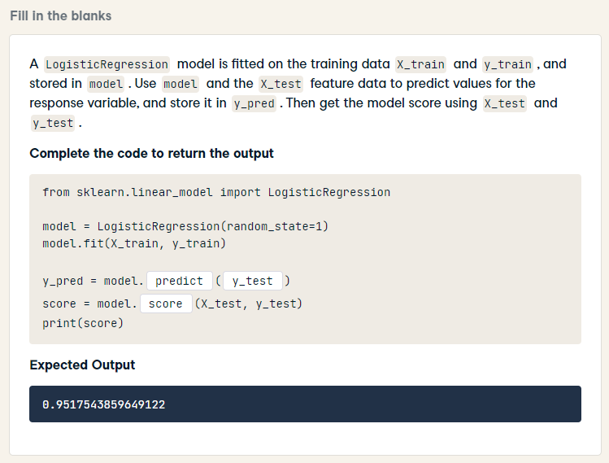
from sklearn.linear_model import LogisticRegression
model = LogisticRegression(random_state=1)
model.fit(X_train, y_train)
y_pred = model.predict(X_test)
score = model.score(X_test, y_test)
print(score)

Slide 11
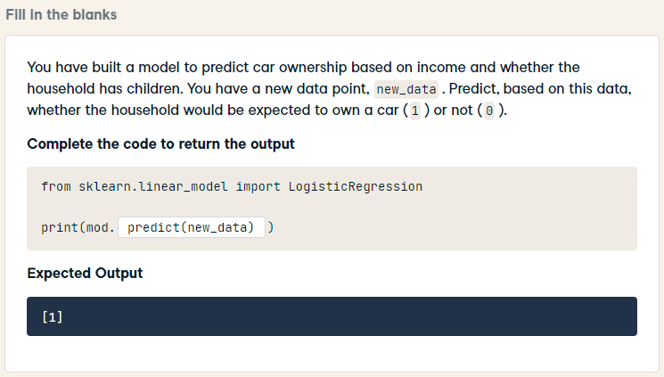
from sklearn.linear_model import LogisticRegression
print(mod.predict(new_data))

Slide 12
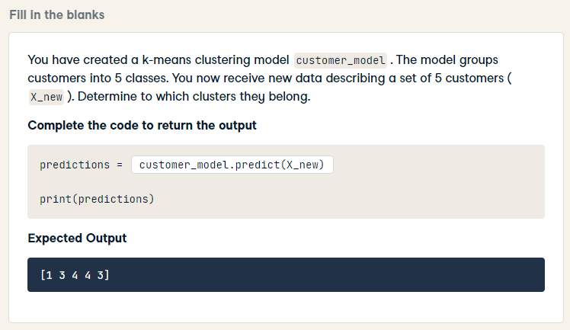
predictions = customer_model.predict(X_new)
print(predictions)

Slide 13
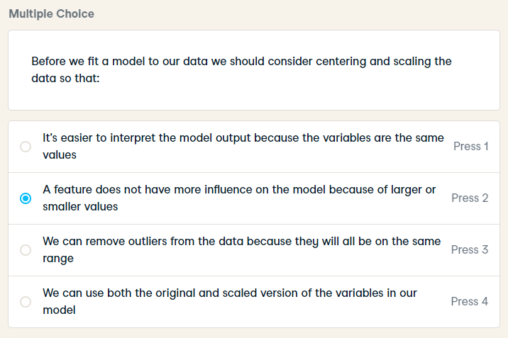
Before we fit a model to our data we should consider centering and scaling the data so that:

Slide 14
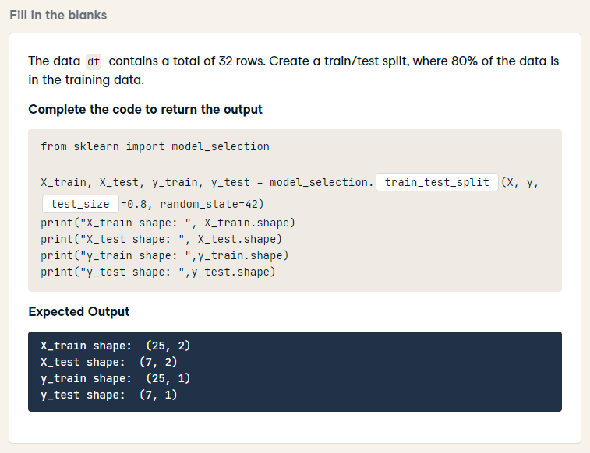
from sklearn import model_selection
X_train, X_test, y_train, y_test = model_selection.train_test_split(X, y, train_size=0.8, random_state=42)
print("X_train shape: ", X_train.shape)
print("X_test shape: ", X_test.shape)
print("y_train shape: ",y_train.shape)
print("y_test shape: ",y_test.shape)

Slide 15
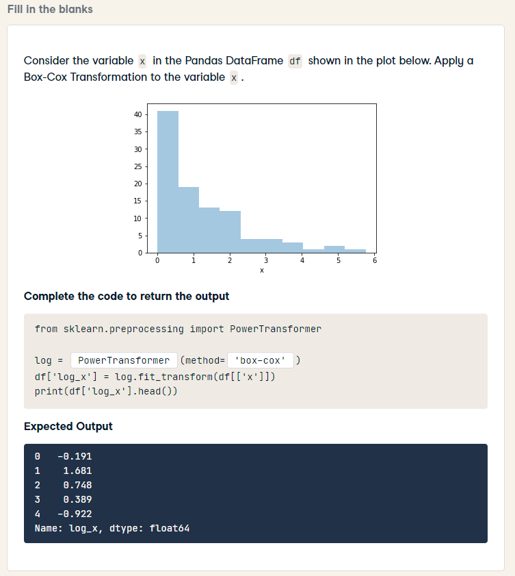
from sklearn.preprocessing import PowerTransformer
log = PowerTransformer(method='box-cox')
df['log_x'] = log.fit_transform(df[['x']])
print(df['log_x'].head())

Slide 16
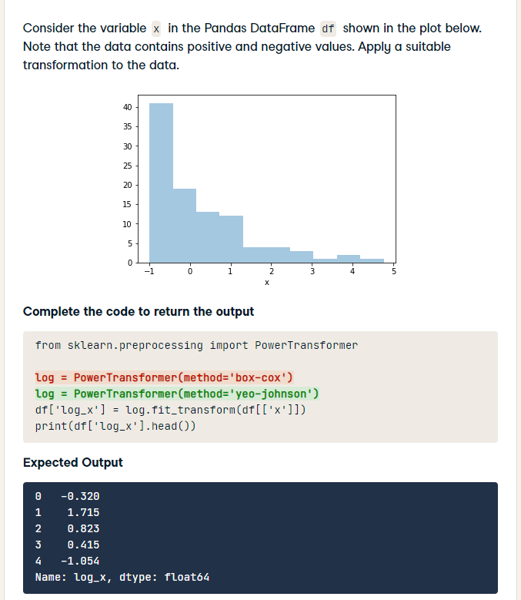
HARD
from sklearn.preprocessing import PowerTransformer
log = PowerTransformer(method='yeo-johnson')
df['log_x'] = log.fit_transform(df[['x']])
print(df['log_x'].head())

Slide 17
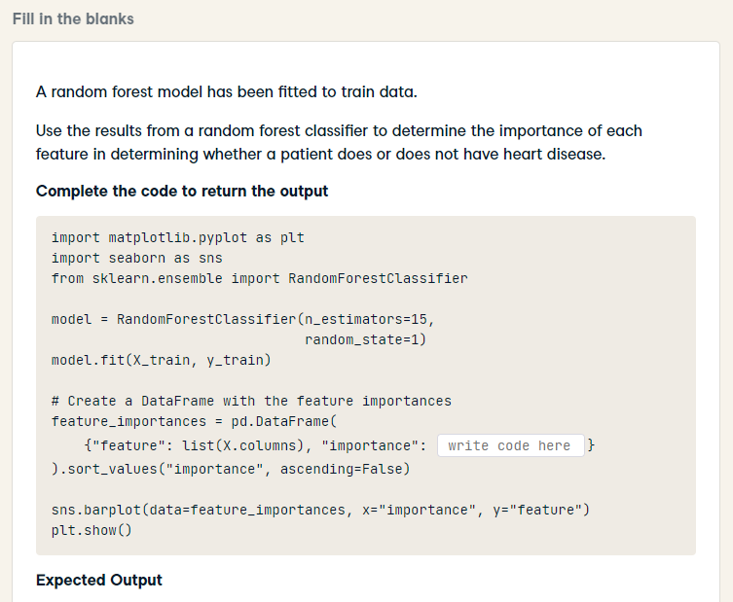
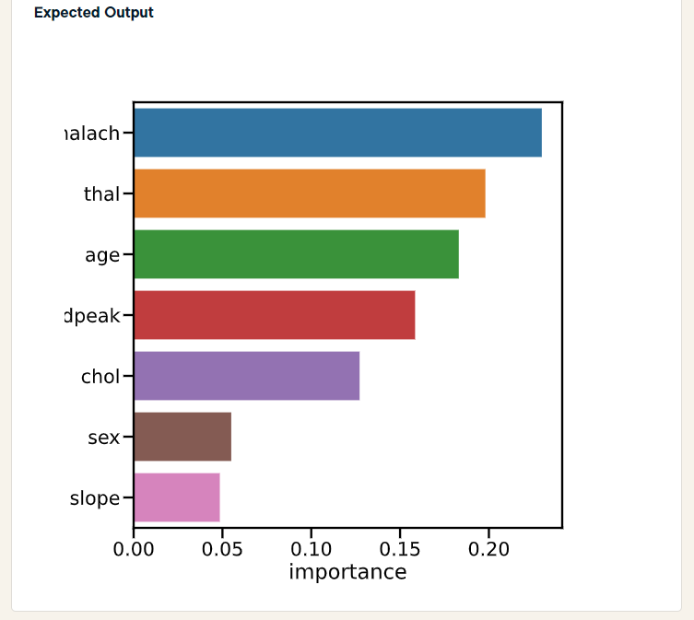
HARD
import matplotlib.pyplot as plt
import seaborn as sns
from sklearn.ensemble import RandomForestClassifier
model = RandomForestClassifier(n_estimators=15,
random_state=1)
model.fit(X_train, y_train)
# Create a DataFrame with the feature importances
feature_importances = pd.DataFrame(
{"feature": list(X.columns), "importance": model.feature_importances_}
).sort_values("importance", ascending=False)
sns.barplot(data=feature_importances, x="importance", y="feature")
plt.show()

Slide 18
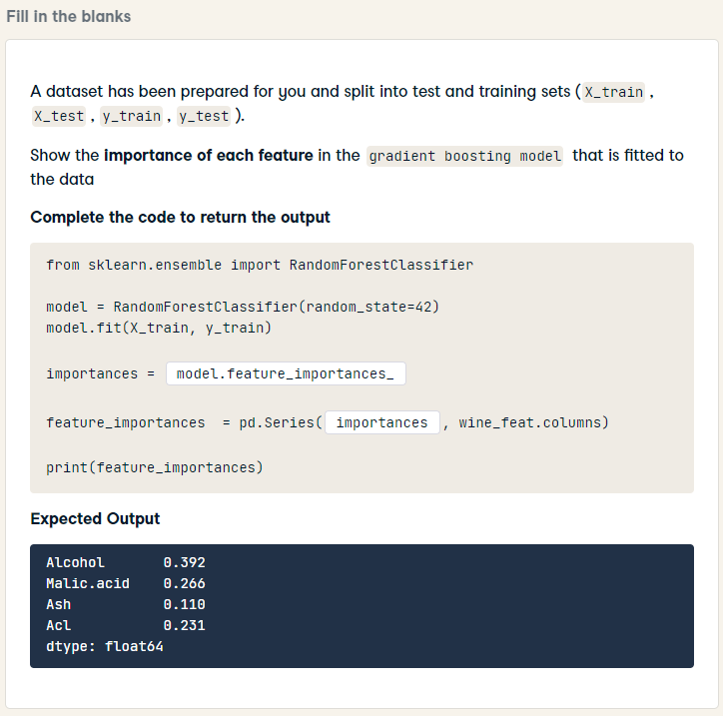
HARD
from sklearn.ensemble import RandomForestClassifier
model = RandomForestClassifier(random_state=42)
model.fit(X_train, y_train)
importances = model.feature_importances_
feature_importances = pd.Series(importances, wine_feat.columns)
print(feature_importances)

Slide 19
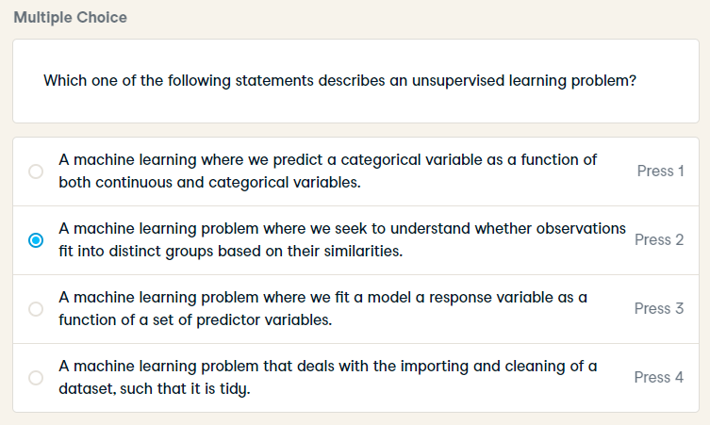
Which one of the following statements describes an unsupervised learning problem?

Slide 20
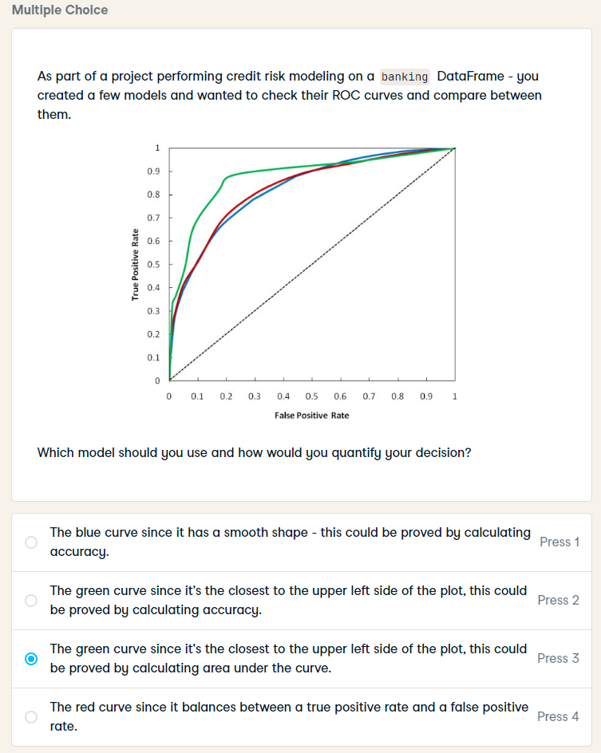
As part of a project performing credit risk modeling on a banking DataFrame - you created a few models and wanted to check their ROC curves and compare between them.
Which model should you use and how would you quantify your decision?

Slide 21
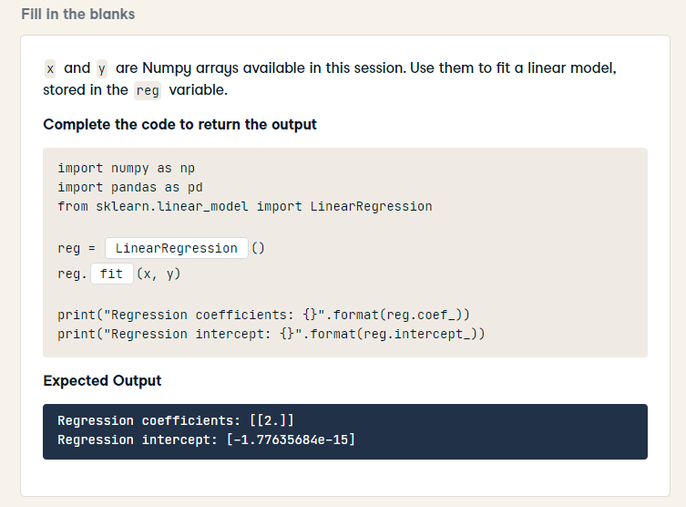
import numpy as np
import pandas as pd
from sklearn.linear_model import LinearRegression
reg = LinearRegression()
reg.fit(x, y)
print("Regression coefficients: {}".format(reg.coef_))
print("Regression intercept: {}".format(reg.intercept_))

Slide 22
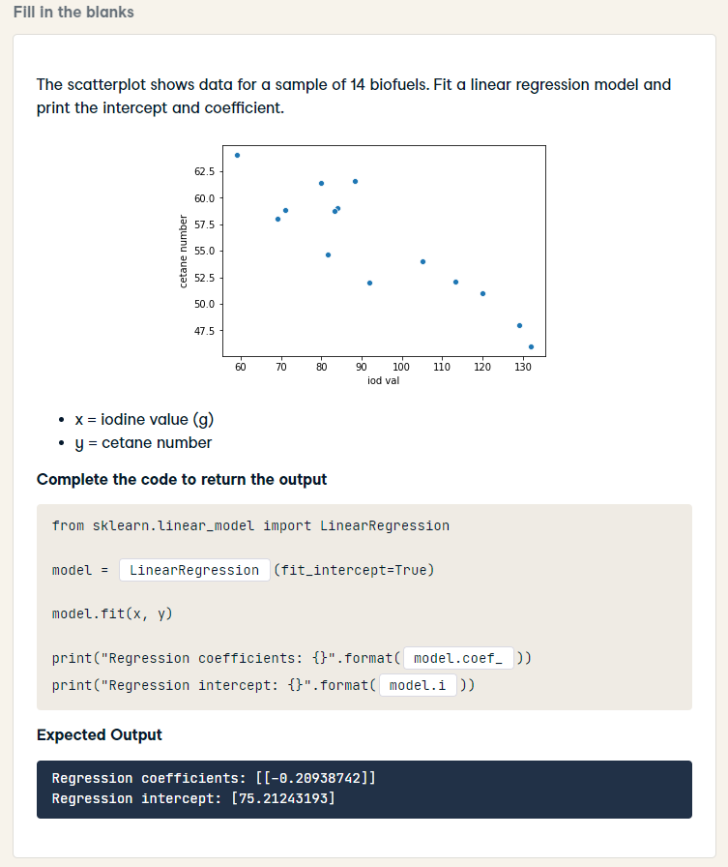
from sklearn.linear_model import LinearRegression
model = LinearRegression(fit_intercept=True)
model.fit(x, y)
print("Regression coefficients: {}".format(model.coef_))
print("Regression intercept: {}".format(model.intercept_))

Slide 23
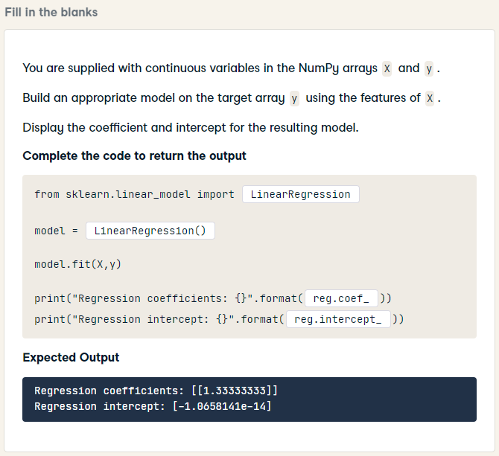
HARD
from sklearn.linear_model import LinearRegression
model = LinearRegression()
model.fit(X,y)
print("Regression coefficients: {}".format(model.coef_))
print("Regression intercept: {}".format(model.intercept_))

Slide 24
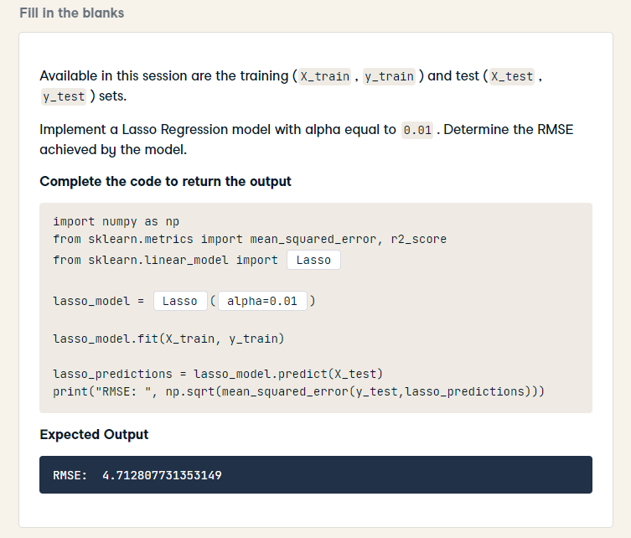
import numpy as np
from sklearn.metrics import mean_squared_error, r2_score
from sklearn.linear_model import Lasso
lasso_model = Lasso(alpha=0.01)
lasso_model.fit(X_train, y_train)
lasso_predictions = lasso_model.predict(X_test)
print("RMSE: ", np.sqrt(mean_squared_error(y_test,lasso_predictions)))

Slide 25
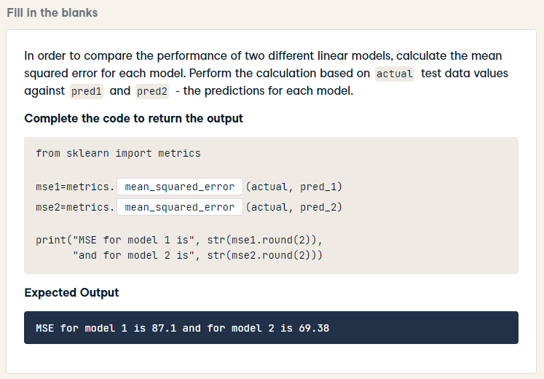
from sklearn import metrics
mse1=metrics.mean_squared_error(actual, pred_1)
mse2=metrics.mean_squared_error(actual, pred_2)
print("MSE for model 1 is", str(mse1.round(2)),
"and for model 2 is", str(mse2.round(2)))

Slide 26
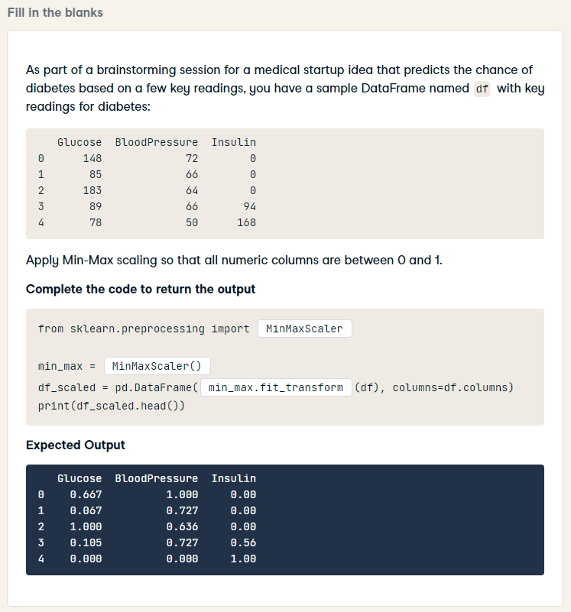
HARD
from sklearn.preprocessing import MinMaxScaler
min_max = MinMaxScaler()
df_scaled = pd.DataFrame(min_max.fit_transform(df), columns=df.columns)
print(df_scaled.head())

Slide 27
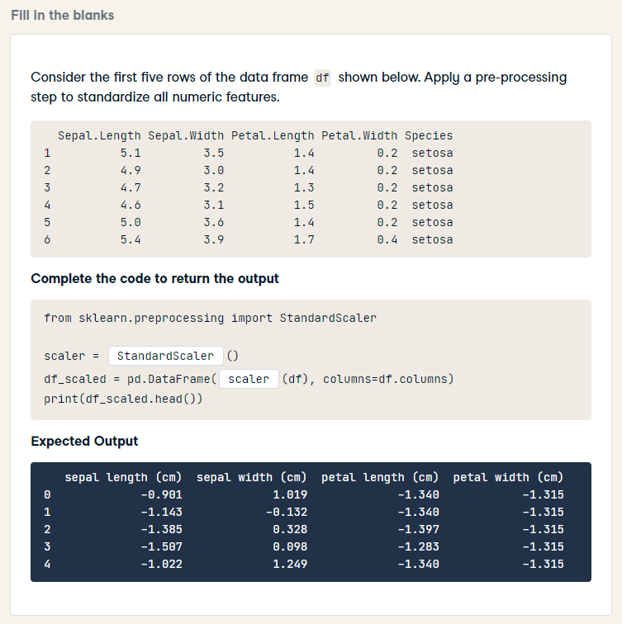
HARD
from sklearn.preprocessing import StandardScaler
scaler = StandardScaler()
df_scaled = pd.DataFrame(scaler.fit_transform(df), columns=df.columns)
print(df_scaled.head())

Slide 28
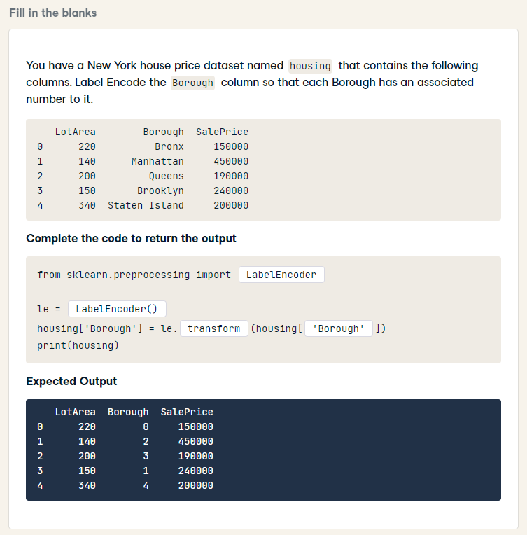
HARD
from sklearn.preprocessing import LabelEncoder
le = LabelEncoder()
housing['Borough'] = le.fit_transform(housing['Borough'])
print(housing)

Slide 29
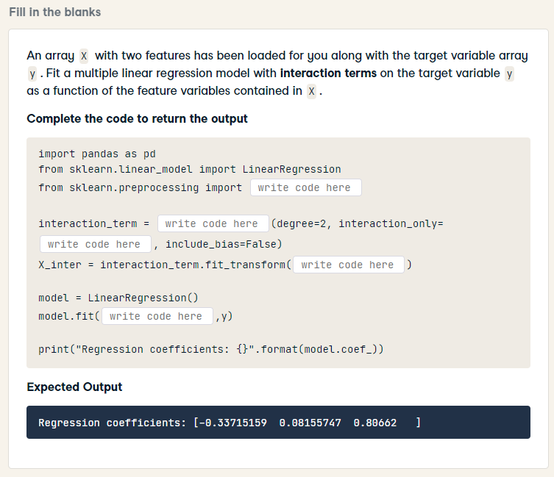
HARD
import pandas as pd
from sklearn.linear_model import LinearRegression
from sklearn.preprocessing import PolynomialFeatures
interaction_term = PolynomialFeatures(degree=2, interaction_only=True, include_bias=False)
X_inter = interaction_term.fit_transform(X)
model = LinearRegression()
model.fit(X_inter, y)
print("Regression coefficients: {}".format(model.coef_))

Slide 30
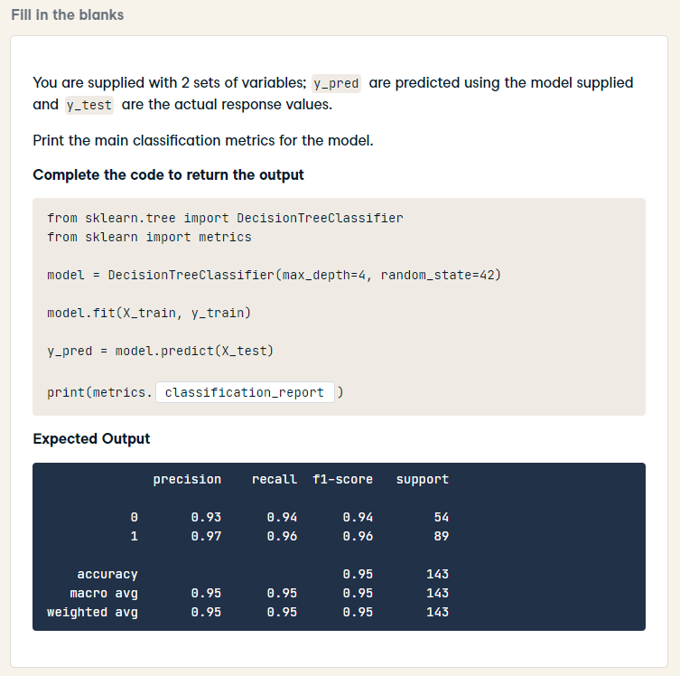
HARD
from sklearn.tree import DecisionTreeClassifier
from sklearn import metrics
model = DecisionTreeClassifier(max_depth=4, random_state=42)
model.fit(X_train, y_train)
y_pred = model.predict(X_test)
print(metrics.classification_report(y_test, y_pred))

Slide 31
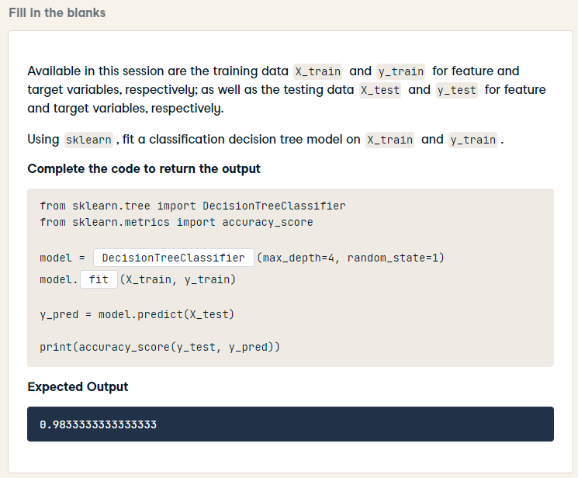
from sklearn.tree import DecisionTreeClassifier
from sklearn.metrics import accuracy_score
model = DecisionTreeClassifier(max_depth=4, random_state=1)
model.fit(X_train, y_train)
y_pred = model.predict(X_test)
print(accuracy_score(y_test, y_pred))

Slide 32
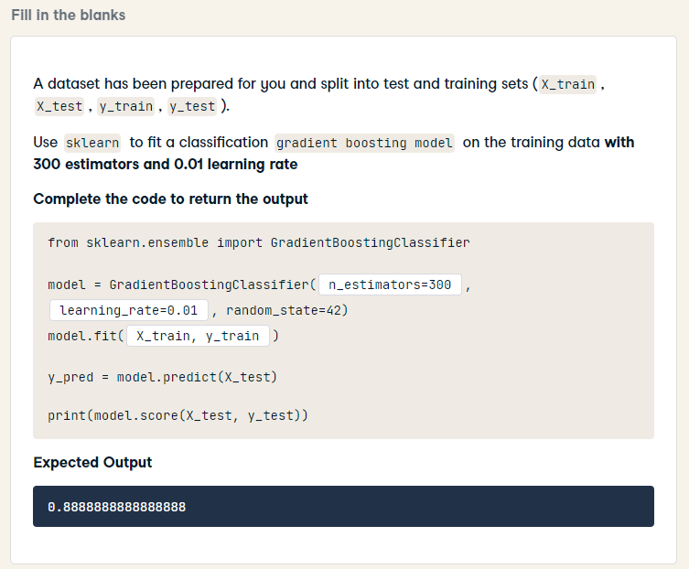
from sklearn.ensemble import GradientBoostingClassifier
model = GradientBoostingClassifier(n_estimators=300, learning_rate=0.01, random_state=42)
model.fit(X_train, y_train)
y_pred = model.predict(X_test)
print(model.score(X_test, y_test))

Slide 33
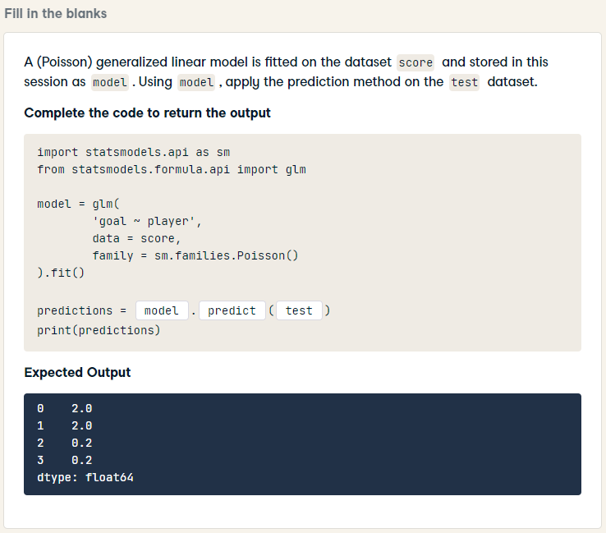
import statsmodels.api as sm
from statsmodels.formula.api import glm
model = glm(
'goal ~ player',
data = score,
family = sm.families.Poisson()
).fit()
predictions = model.predict(test)
print(predictions)

Slide 34
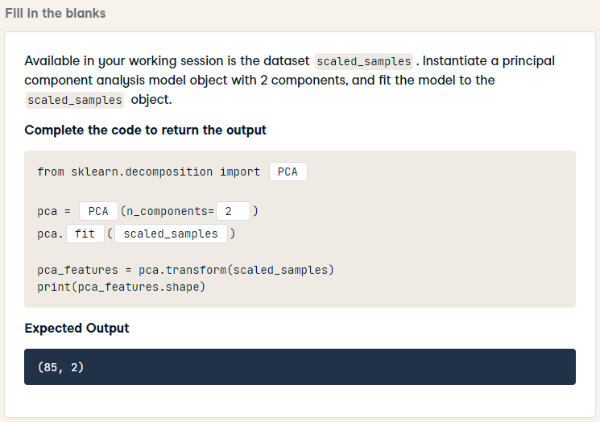
from sklearn.decomposition import PCA
pca = PCA(n_components= 2)
pca.fit(scaled_samples)
pca_features = pca.transform(scaled_samples)
print(pca_features.shape)

Slide 35
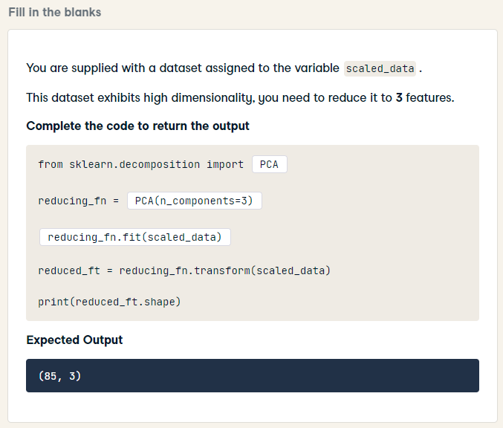
HARD
from sklearn.decomposition import PCA
reducing_fn = PCA(n_components=3)
reducing_fn.fit(scaled_data)
reduced_ft = reducing_fn.transform(scaled_data)
print(reduced_ft.shape)

Slide 36
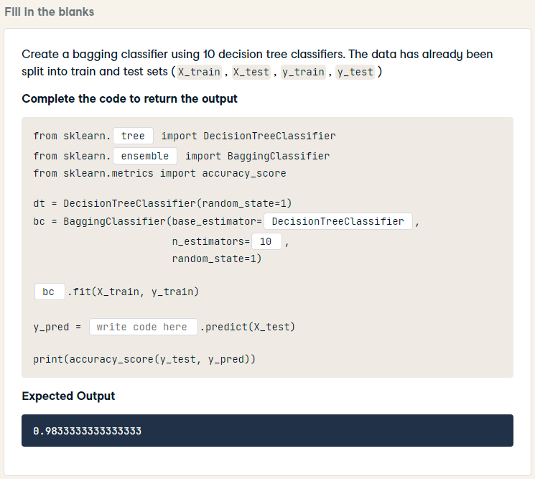
from sklearn.tree import DecisionTreeClassifier
from sklearn.ensemble import BaggingClassifier
from sklearn.metrics import accuracy_score
dt = DecisionTreeClassifier(random_state=1)
bc = BaggingClassifier(base_estimator=dt,
n_estimators=10,
random_state=1)
bc.fit(X_train, y_train)
y_pred = bc.predict(X_test)
print(accuracy_score(y_test, y_pred))

Slide 37
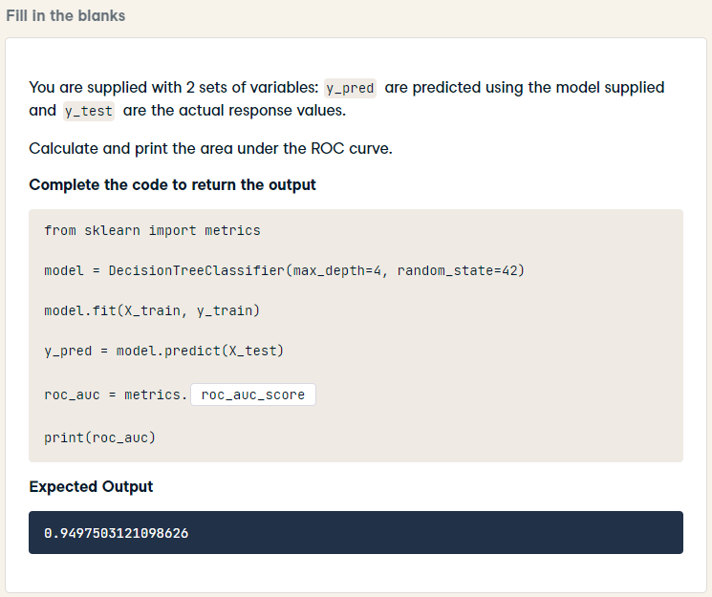
HARD
from sklearn import metrics
model = DecisionTreeClassifier(max_depth=4, random_state=42)
model.fit(X_train, y_train)
y_pred = model.predict(X_test)
roc_auc = metrics.roc_auc_score(y_test, y_pred)
print(roc_auc)

Slide 38
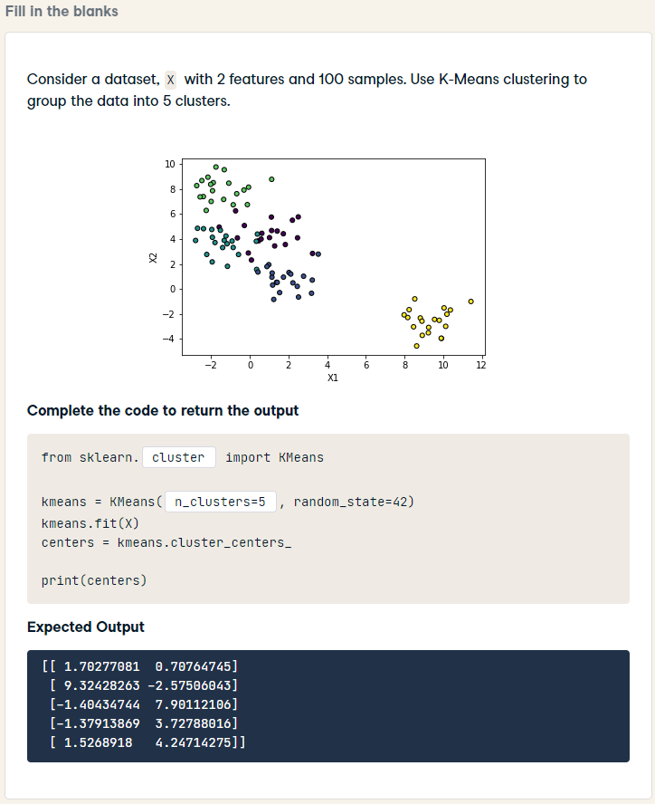
from sklearn.cluster import KMeans
kmeans = KMeans(n_clusters=5, random_state=42)
kmeans.fit(X)
centers = kmeans.cluster_centers_
print(centers)

Slide 39
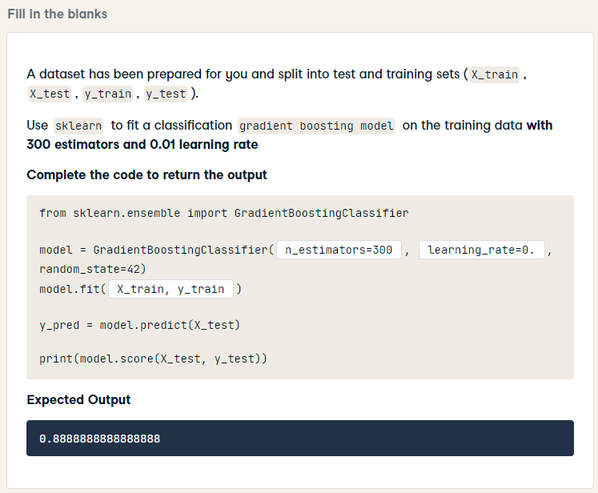
from sklearn.ensemble import GradientBoostingClassifier
model = GradientBoostingClassifier(n_estimators=300, learning_rate=0.01, random_state=42)
model.fit(X_train, y_train)
y_pred = model.predict(X_test)
print(model.score(X_test, y_test))

Slide 40
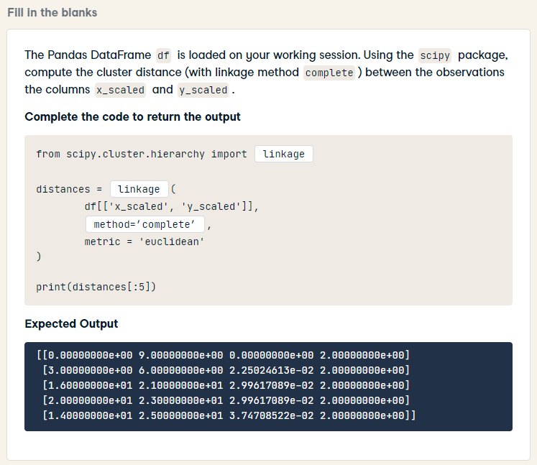
HARD
from scipy.cluster.hierarchy import linkage
distances = linkage(
df[['x_scaled', 'y_scaled']],
method = 'complete',
metric = 'euclidean'
)
print(distances[:5])

Slide 41
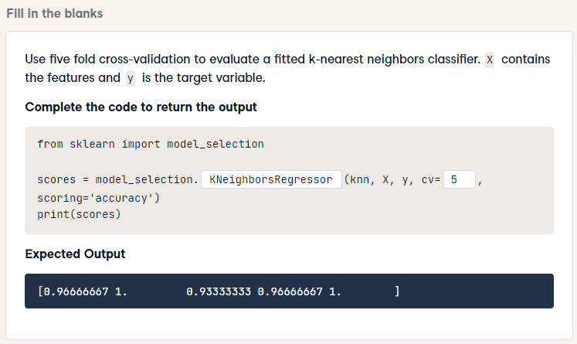
from sklearn import model_selection
scores = model_selection.cross_val_score(knn, X, y, cv=5, scoring='accuracy')
print(scores)

Slide 42
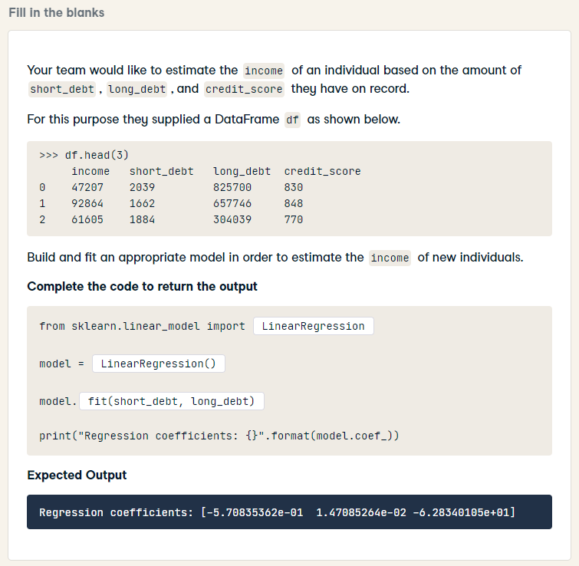
HARD
from sklearn.linear_model import LinearRegression
model = LinearRegression()
model.fit(short_debt, long_debt)
model.fit(df[['short_debt', 'long_debt', 'credit_score']], df['income'])
print("Regression coefficients: {}".format(model.coef_))

