Slide 1
datacamp
Model Development
Machine Learning Fundamentals in Python

Slide 2
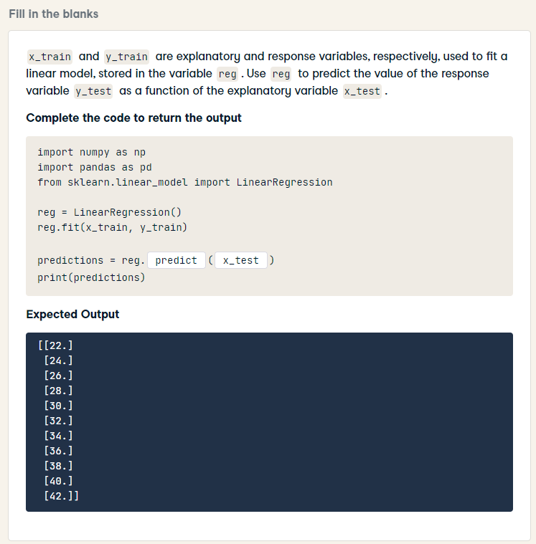
import numpy as np
import pandas as pd
from sklearn.linear_model import LinearRegression
reg = LinearRegression()
reg.fit(x_train, y_train)
predictions = reg.predict(x_test)
print(predictions)

Slide 3
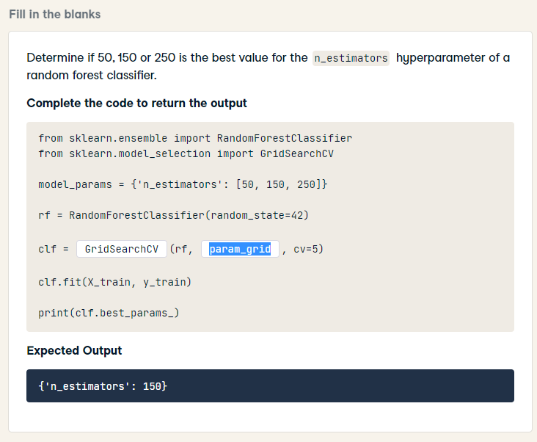
from sklearn.ensemble import RandomForestClassifier
from sklearn.model_selection import GridSearchCV
model_params = {'n_estimators': [50, 150, 250]}
rf = RandomForestClassifier(random_state=42)
clf = GridSearchCV(rf, model_params, cv=5)
clf.fit(X_train, y_train)
print(clf.best_params_)

Slide 4
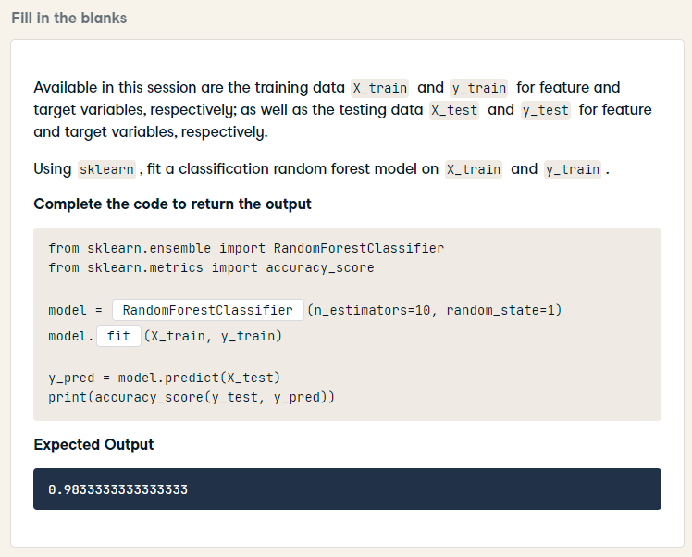
from sklearn.ensemble import RandomForestClassifier
from sklearn.metrics import accuracy_score
model = RandomForestClassifier(n_estimators=10, random_state=1)
model.fit(X_train, y_train)
y_pred = model.predict(X_test)
print(accuracy_score(y_test, y_pred))

Slide 5
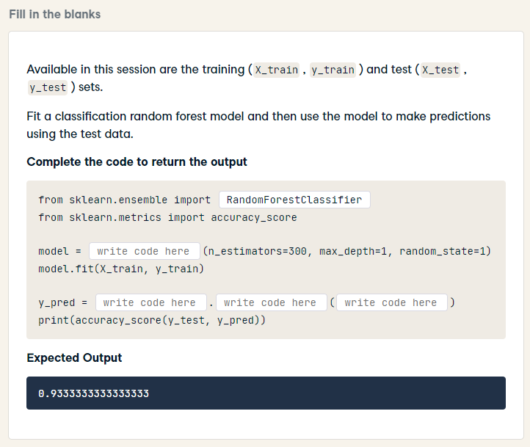
from sklearn.ensemble import RandomForestClassifier
from sklearn.metrics import accuracy_score
model = RandomForestClassifier(n_estimators=300, max_depth=1, random_state=1)
model.fit(X_train, y_train)
y_pred = model.predict(X_test)
print(accuracy_score(y_test, y_pred))

Slide 6
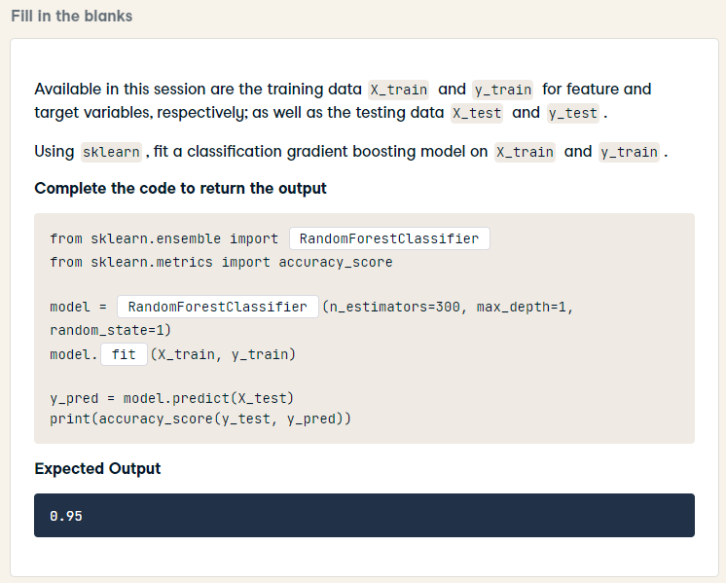
HARD
from sklearn.ensemble import GradientBoostingClassifier
from sklearn.metrics import accuracy_score
model = GradientBoostingClassifier(n_estimators=300, max_depth=1, random_state=1)
model.fit(X_train, y_train)
y_pred = model.predict(X_test)
print(accuracy_score(y_test, y_pred))

Slide 7
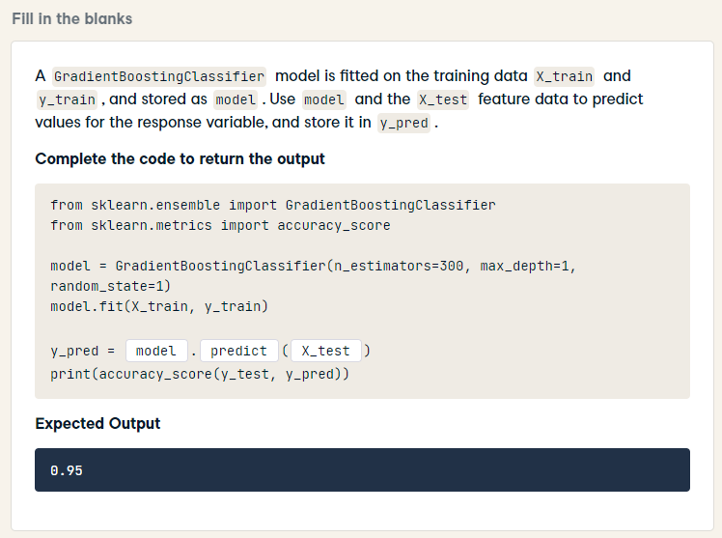
from sklearn.ensemble import GradientBoostingClassifier
from sklearn.metrics import accuracy_score
model = GradientBoostingClassifier(n_estimators=300, max_depth=1, random_state=1)
model.fit(X_train, y_train)
y_pred = model.predict(X_test)
print(accuracy_score(y_test, y_pred))

Slide 8
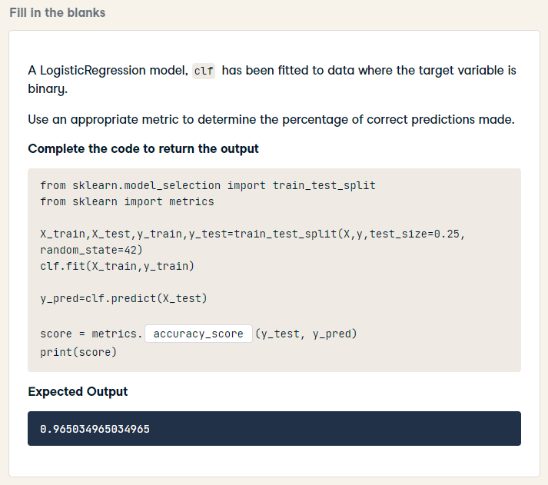
from sklearn.model_selection import train_test_split
from sklearn import metrics
X_train,X_test,y_train,y_test=train_test_split(X,y,test_size=0.25, random_state=42)
clf.fit(X_train,y_train)
y_pred=clf.predict(X_test)
score = metrics.accuracy_score(y_test, y_pred)
print(score)

Slide 9
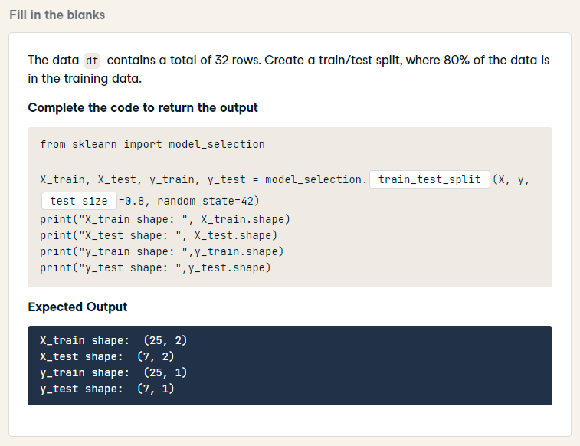
from sklearn import model_selection
X_train, X_test, y_train, y_test = model_selection.train_test_split(X, y, train_size=0.8, random_state=42)
print("X_train shape: ", X_train.shape)
print("X_test shape: ", X_test.shape)
print("y_train shape: ",y_train.shape)
print("y_test shape: ",y_test.shape)

Slide 10
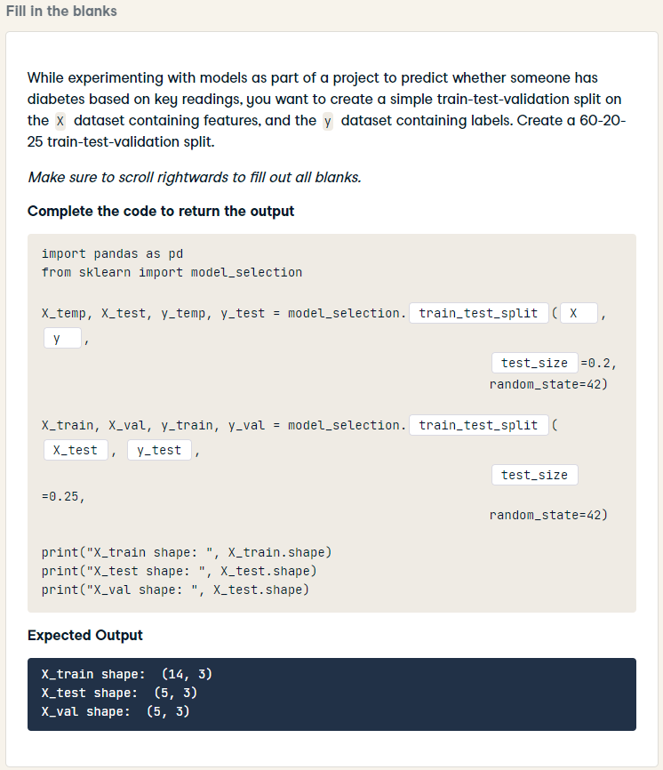
HARD
import pandas as pd
from sklearn import model_selection
X_temp, X_test, y_temp, y_test = model_selection.train_test_split(X, y,
test_size=0.2,
random_state=42)
X_train, X_val, y_train, y_val = model_selection.train_test_split(X_temp, y_temp,
test_size=0.25,
random_state=42)
print("X_train shape: ", X_train.shape)
print("X_test shape: ", X_test.shape)
print("X_val shape: ", X_test.shape)

Slide 11
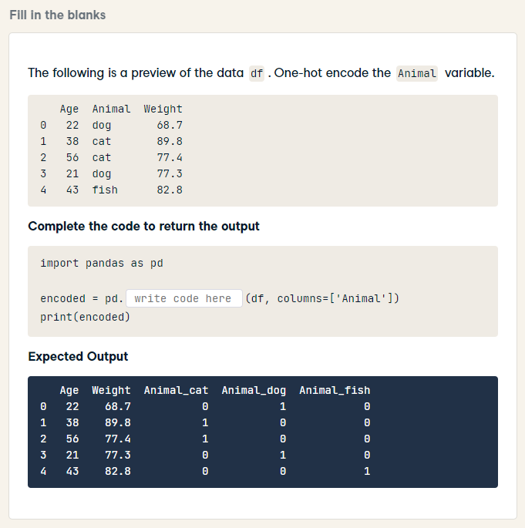
import pandas as pd
encoded = pd.get_dummies(df, columns=['Animal'])
print(encoded)

Slide 12
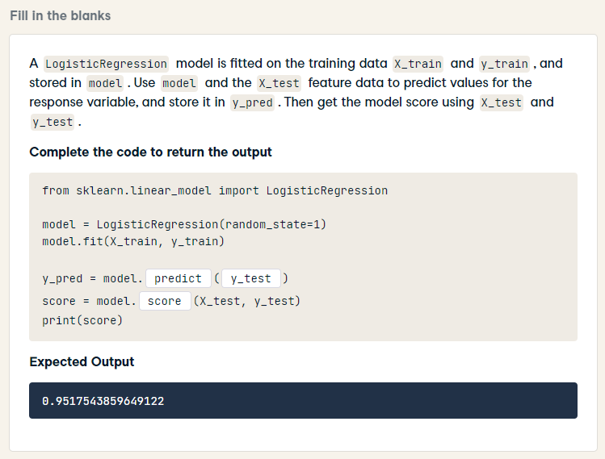
from sklearn.linear_model import LogisticRegression
model = LogisticRegression(random_state=1)
model.fit(X_train, y_train)
y_pred = model.predict(X_test)
score = model.score(X_test, y_test)
print(score)

Slide 13
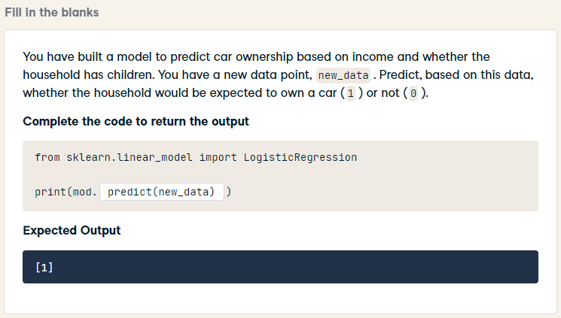
from sklearn.linear_model import LogisticRegression
print(mod.predict(new_data))

Slide 14
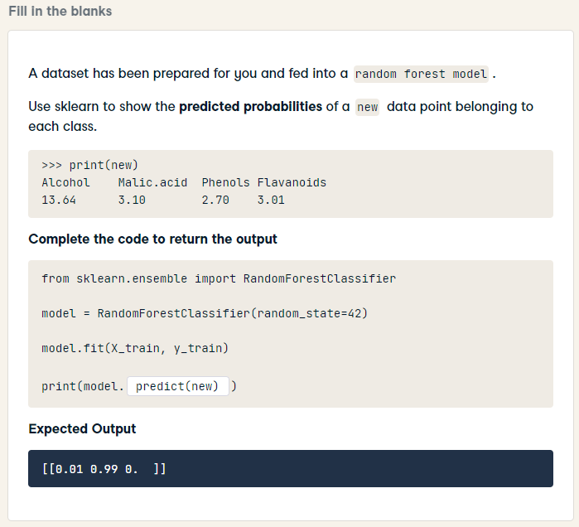
HARD
from sklearn.ensemble import RandomForestClassifier
model = RandomForestClassifier(random_state=42)
model.fit(X_train, y_train)
print(model.predict_proba(new))

Slide 15
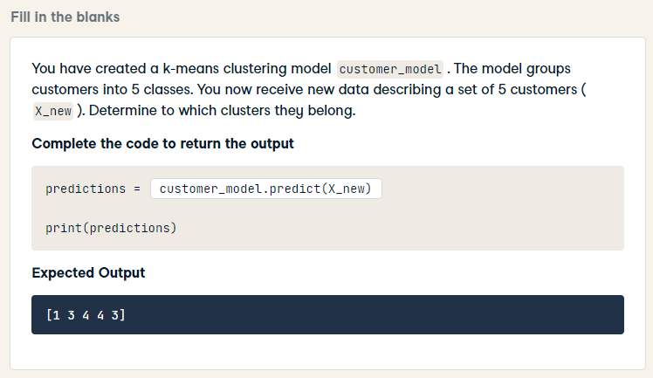
predictions = customer_model.predict(X_new)
print(predictions)

Slide 16
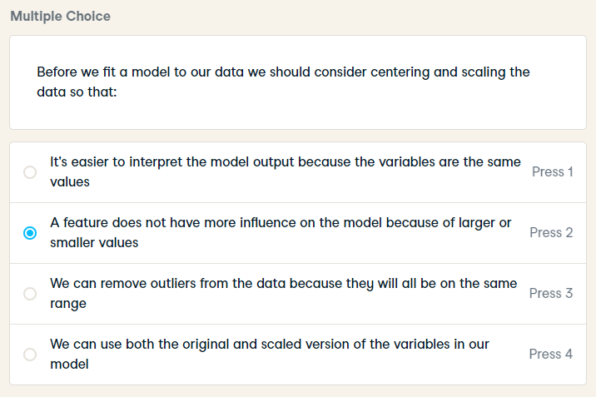
Before we fit a model to our data we should consider centering and scaling the data so that:

Slide 17
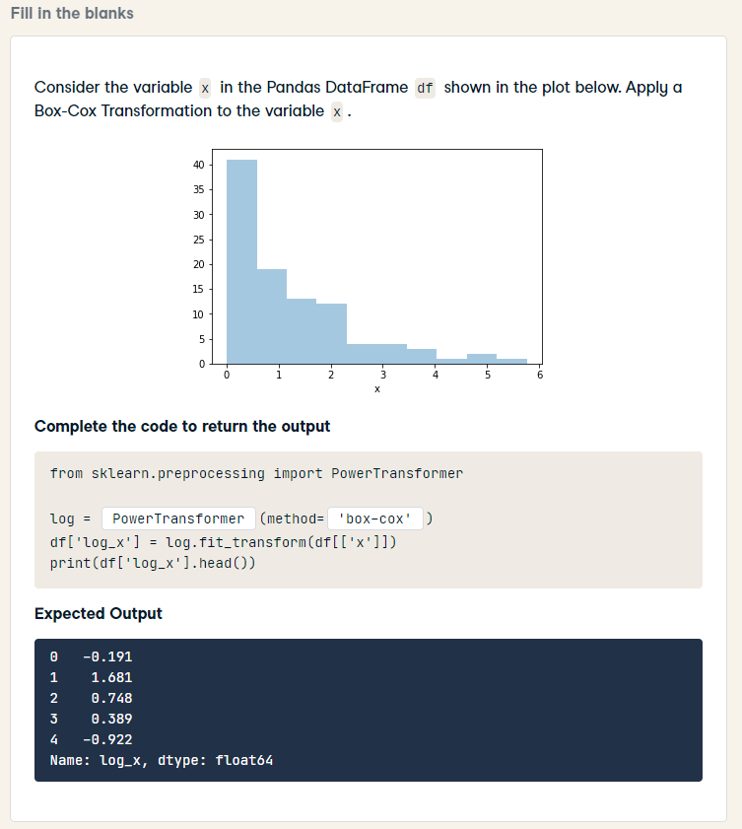
Box-Cox Transformation
similar question
next slide
from sklearn.preprocessing import PowerTransformer
log = PowerTransformer(method='box-cox')
df['log_x'] = log.fit_transform(df[['x']])
print(df['log_x'].head())

Slide 18
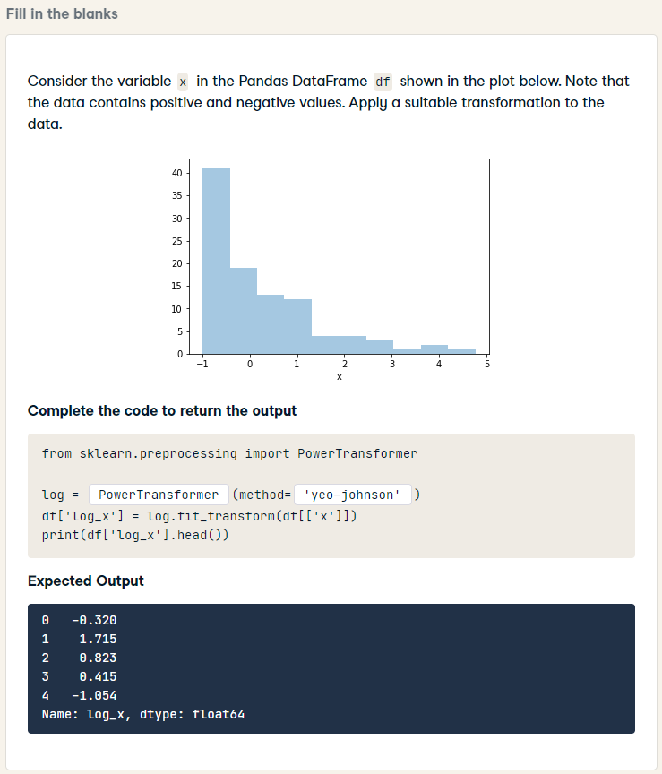
HARD
suitable transformation
similar question
previous slide
from sklearn.preprocessing import PowerTransformer
log = PowerTransformer(method='yeo-johnson')
df['log_x'] = log.fit_transform(df[['x']])
print(df['log_x'].head())

Slide 19
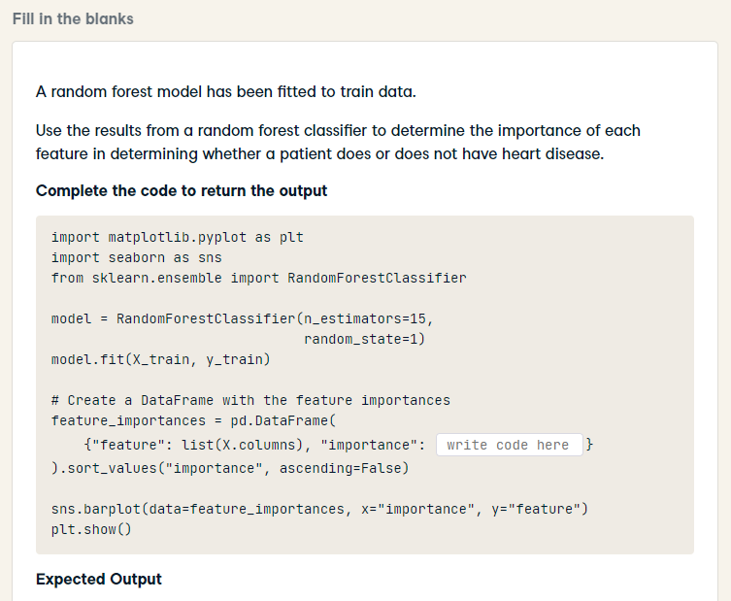
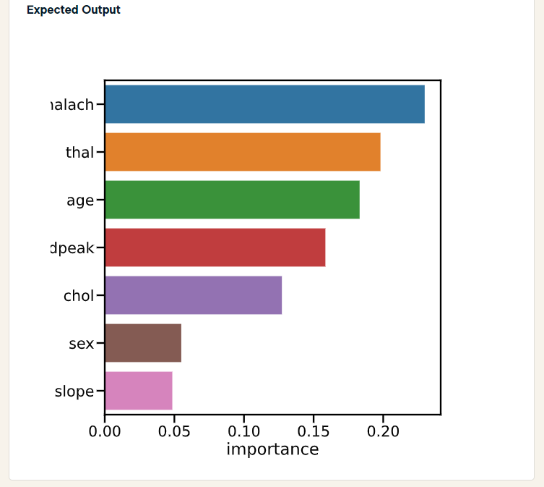
HARD
import matplotlib.pyplot as plt
import seaborn as sns
from sklearn.ensemble import RandomForestClassifier
model = RandomForestClassifier(n_estimators=15,
random_state=1)
model.fit(X_train, y_train)
# Create a DataFrame with the feature importances
feature_importances = pd.DataFrame(
{"feature": list(X.columns), "importance": model.feature_importances_}
).sort_values("importance", ascending=False)
sns.barplot(data=feature_importances, x="importance", y="feature")
plt.show()

Slide 20
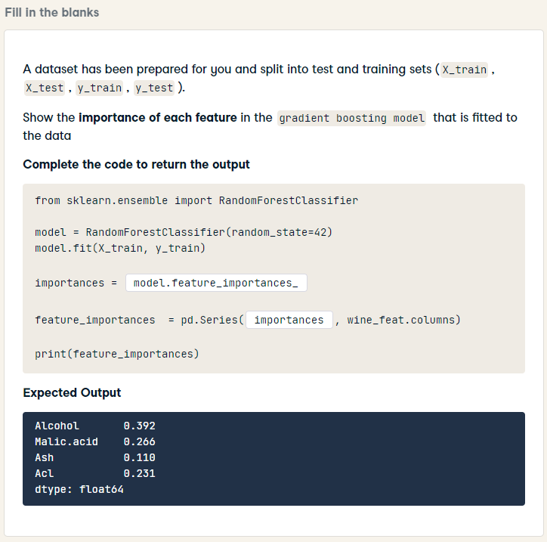
HARD
from sklearn.ensemble import RandomForestClassifier
model = RandomForestClassifier(random_state=42)
model.fit(X_train, y_train)
importances = model.feature_importances_
feature_importances = pd.Series(importances, wine_feat.columns)
print(feature_importances)

Slide 21
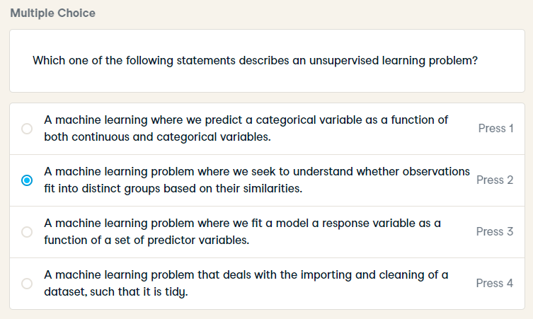
Which one of the following statements describes an unsupervised learning problem?

Slide 22
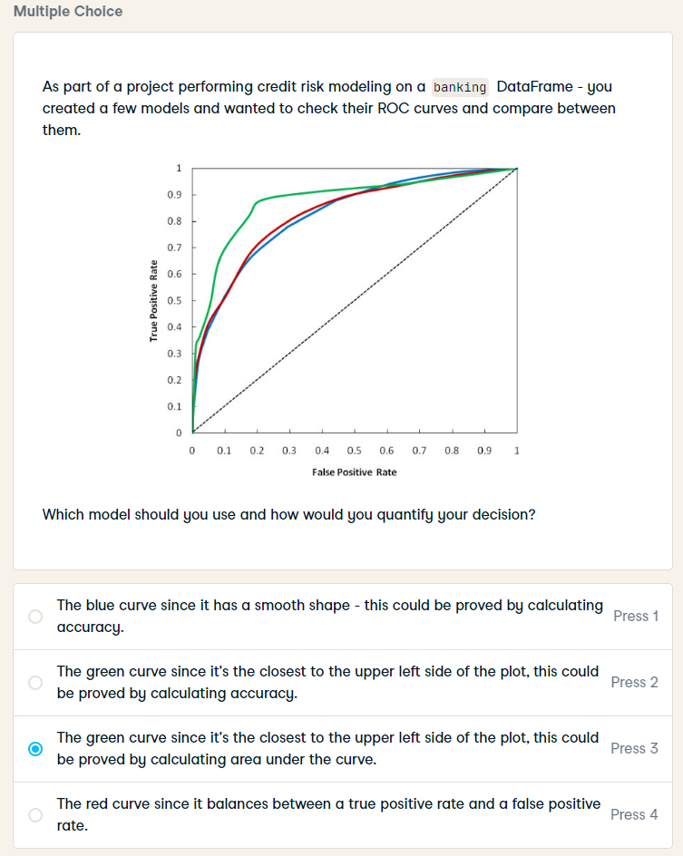
As part of a project performing credit risk modeling on a banking DataFrame - you created a few models and wanted to check their ROC curves and compare between them.
Which model should you use and how would you quantify your decision?

Slide 23
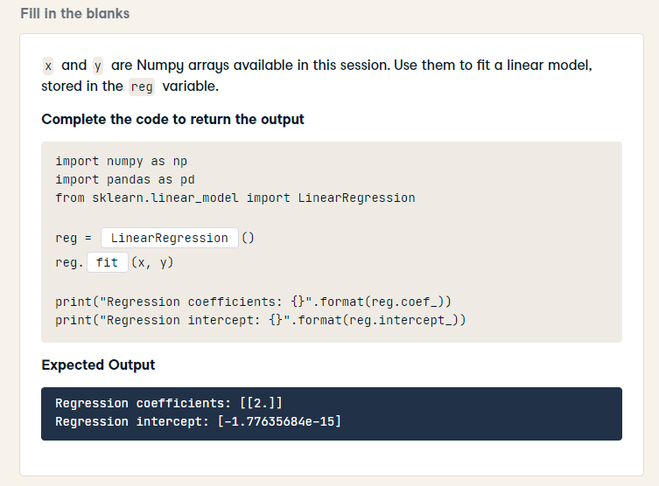
import numpy as np
import pandas as pd
from sklearn.linear_model import LinearRegression
reg = LinearRegression()
reg.fit(x, y)
print("Regression coefficients: {}".format(reg.coef_))
print("Regression intercept: {}".format(reg.intercept_))

Slide 24
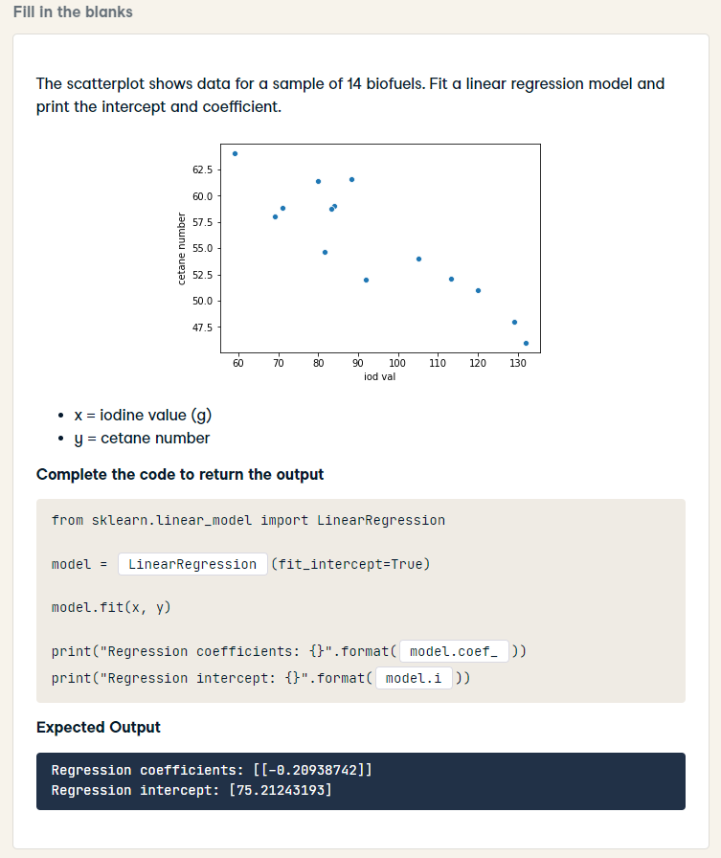
from sklearn.linear_model import LinearRegression
model = LinearRegression(fit_intercept=True)
model.fit(x, y)
print("Regression coefficients: {}".format(model.coef_))
print("Regression intercept: {}".format(model.intercept_))

Slide 25
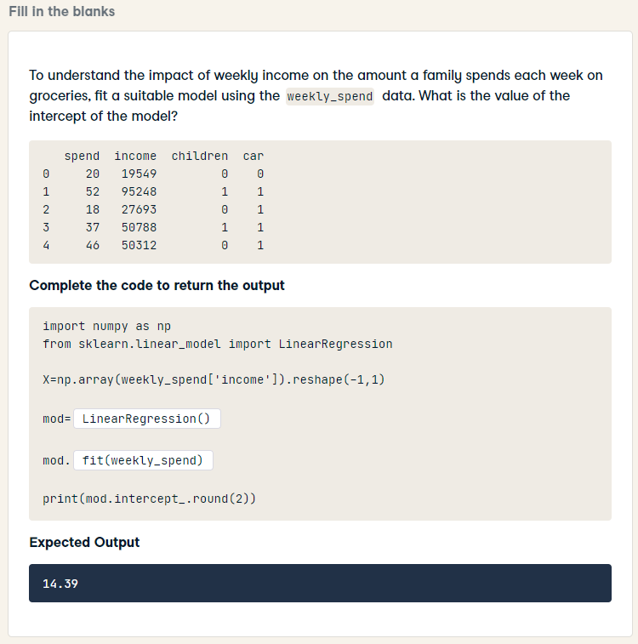
HARD
import numpy as np
from sklearn.linear_model import LinearRegression
X=np.array(weekly_spend['income']).reshape(-1,1)
mod= LinearRegression(fit_intercept=True)
mod.fit(X, weekly_spend["spend"])
print(mod.intercept_.round(2))

Slide 26
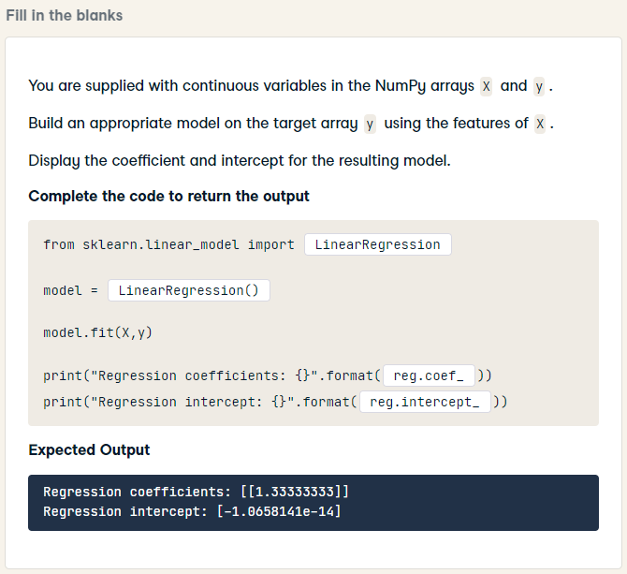
HARD
from sklearn.linear_model import LinearRegression
model = LinearRegression()
model.fit(X,y)
print("Regression coefficients: {}".format(model.coef_))
print("Regression intercept: {}".format(model.intercept_))

Slide 27
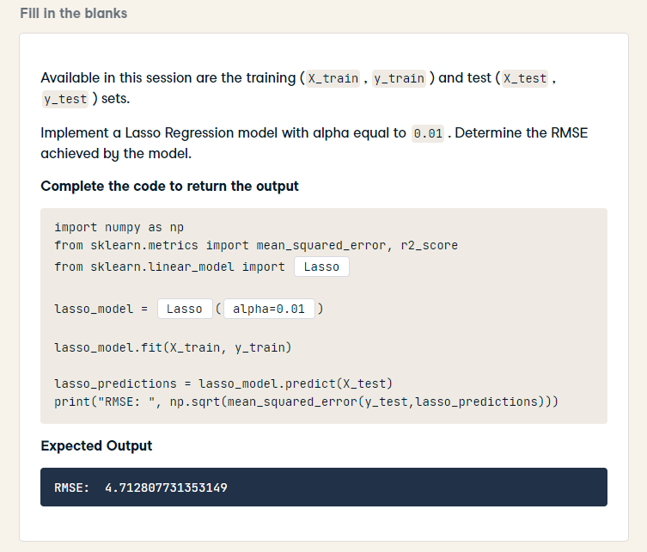
import numpy as np
from sklearn.metrics import mean_squared_error, r2_score
from sklearn.linear_model import Lasso
lasso_model = Lasso(alpha=0.01)
lasso_model.fit(X_train, y_train)
lasso_predictions = lasso_model.predict(X_test)
print("RMSE: ", np.sqrt(mean_squared_error(y_test,lasso_predictions)))

Slide 28
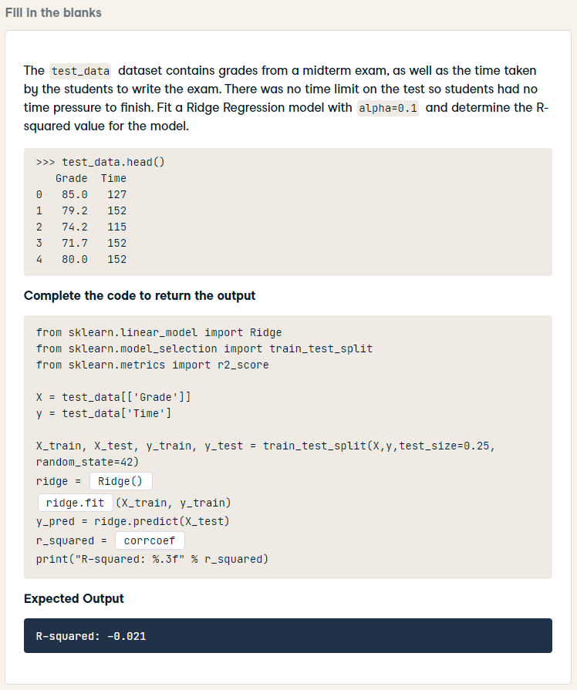
HARD
from sklearn.linear_model import Ridge
from sklearn.model_selection import train_test_split
from sklearn.metrics import r2_score
X = test_data[['Grade']]
y = test_data['Time']
X_train, X_test, y_train, y_test = train_test_split(X,y,test_size=0.25, random_state=42)
ridge = Ridge(alpha=0.1)
ridge.fit(X_train, y_train)
y_pred = ridge.predict(X_test)
r_squared = ridge.score(X_test, y_test)
print("R-squared: %.3f" % r_squared)

Slide 29
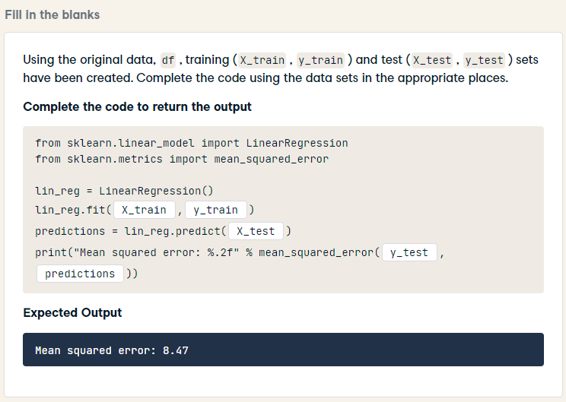
from sklearn.linear_model import LinearRegression
from sklearn.metrics import mean_squared_error
lin_reg = LinearRegression()
lin_reg.fit(X_train, y_train)
predictions = lin_reg.predict(X_test)
print(“Mean squared error: %.2f" % mean_squared_error(y_test, predictions))

Slide 30
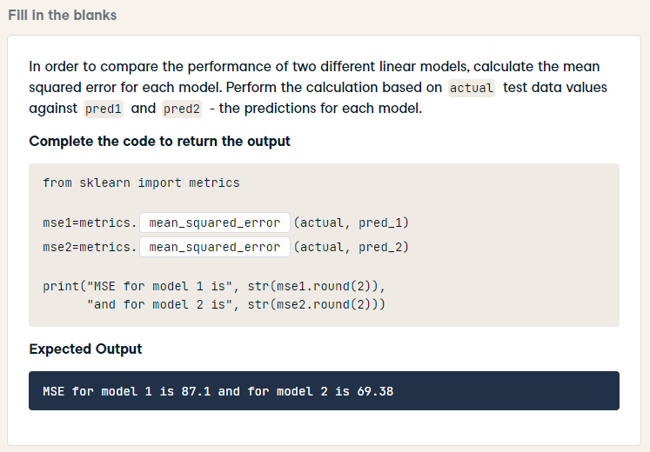
from sklearn import metrics
mse1=metrics.mean_squared_error(actual, pred_1)
mse2=metrics.mean_squared_error(actual, pred_2)
print("MSE for model 1 is", str(mse1.round(2)),
"and for model 2 is", str(mse2.round(2)))

Slide 31
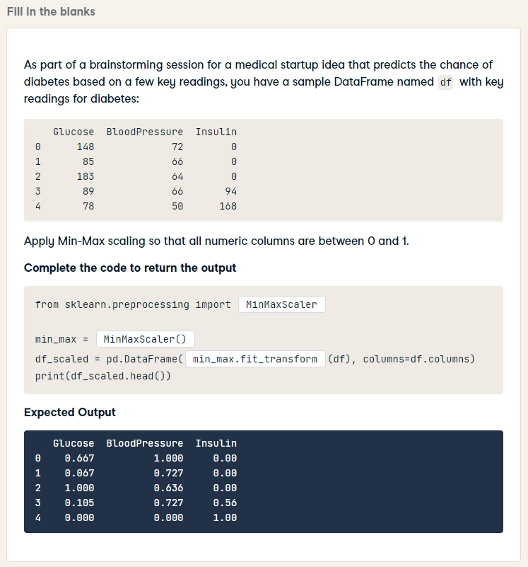
HARD
from sklearn.preprocessing import MinMaxScaler
min_max = MinMaxScaler()
df_scaled = pd.DataFrame(min_max.fit_transform(df), columns=df.columns)
print(df_scaled.head())

Slide 32
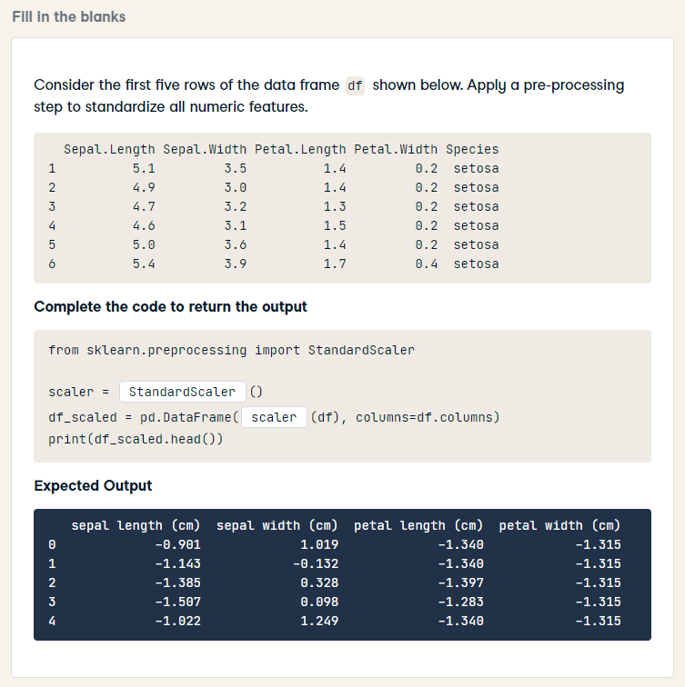
HARD
from sklearn.preprocessing import StandardScaler
scaler = StandardScaler()
df_scaled = pd.DataFrame(scaler.fit_transform(df), columns=df.columns)
print(df_scaled.head())

Slide 33
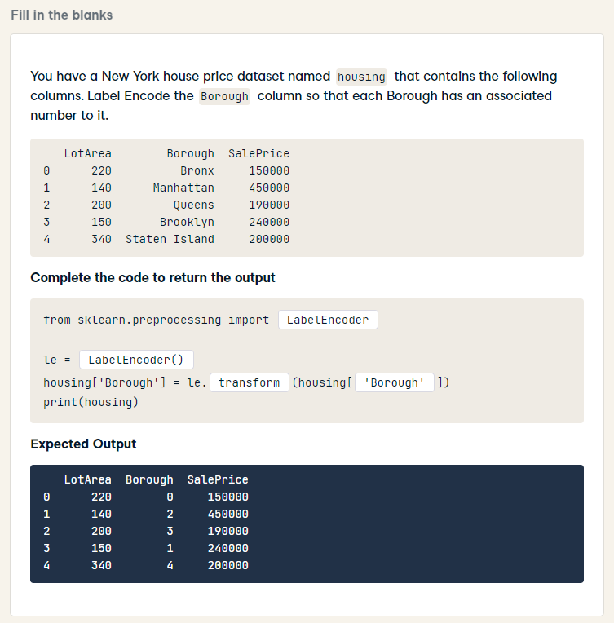
HARD
from sklearn.preprocessing import LabelEncoder
le = LabelEncoder()
housing['Borough'] = le.fit_transform(housing['Borough'])
print(housing)

Slide 34
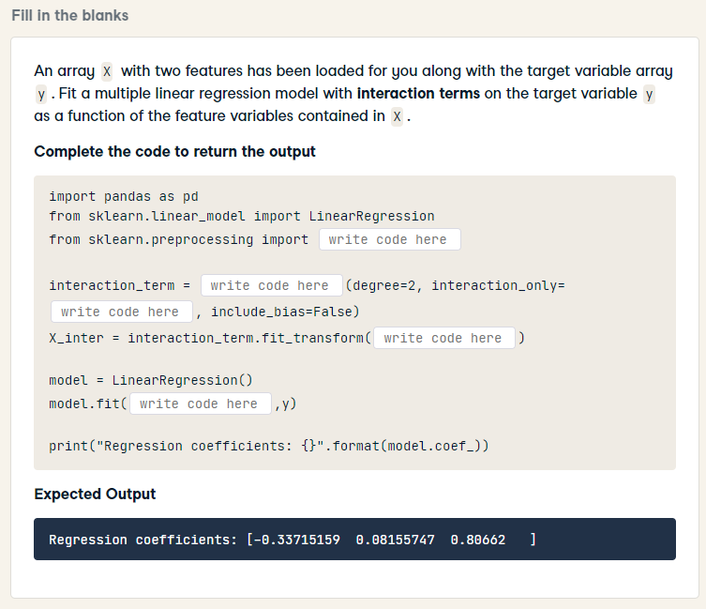
HARD
import pandas as pd
from sklearn.linear_model import LinearRegression
from sklearn.preprocessing import PolynomialFeatures
interaction_term = PolynomialFeatures(degree=2, interaction_only=True, include_bias=False)
X_inter = interaction_term.fit_transform(X)
model = LinearRegression()
model.fit(X_inter, y)
print("Regression coefficients: {}".format(model.coef_))

Slide 35
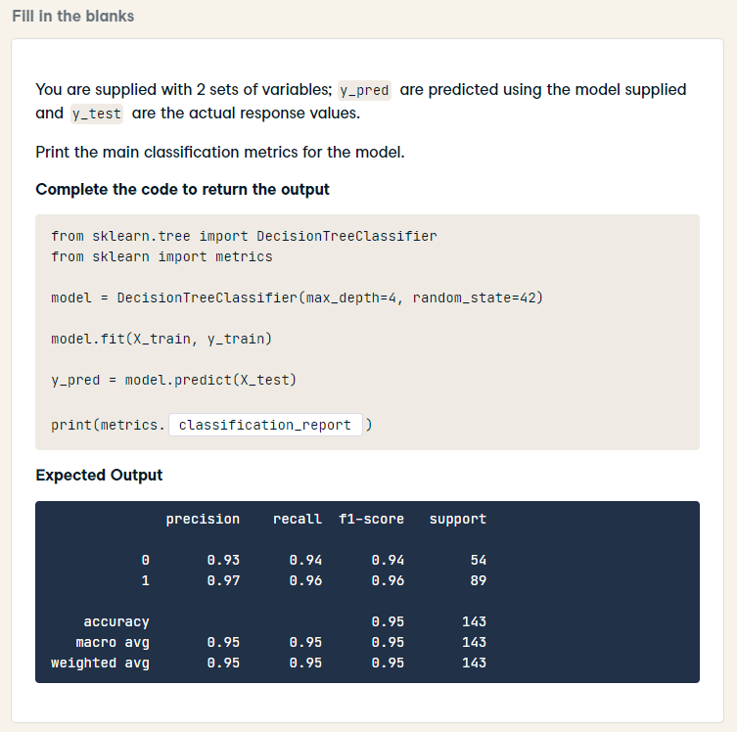
HARD
from sklearn.tree import DecisionTreeClassifier
from sklearn import metrics
model = DecisionTreeClassifier(max_depth=4, random_state=42)
model.fit(X_train, y_train)
y_pred = model.predict(X_test)
print(metrics.classification_report(y_test, y_pred))

Slide 36
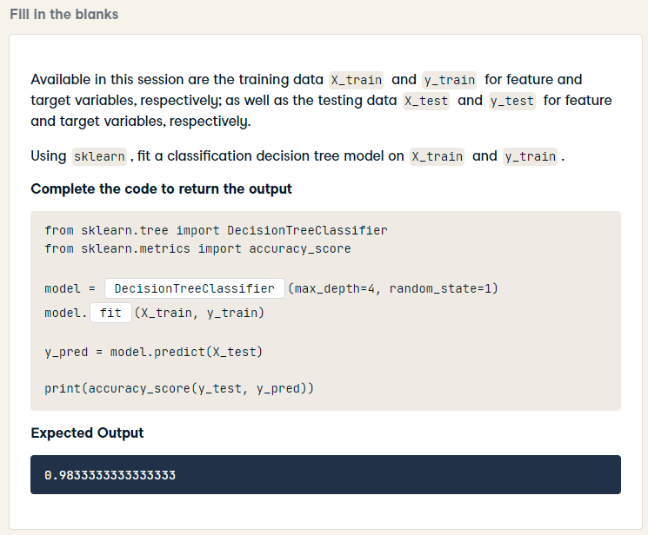
from sklearn.tree import DecisionTreeClassifier
from sklearn.metrics import accuracy_score
model = DecisionTreeClassifier(max_depth=4, random_state=1)
model.fit(X_train, y_train)
y_pred = model.predict(X_test)
print(accuracy_score(y_test, y_pred))

Slide 37
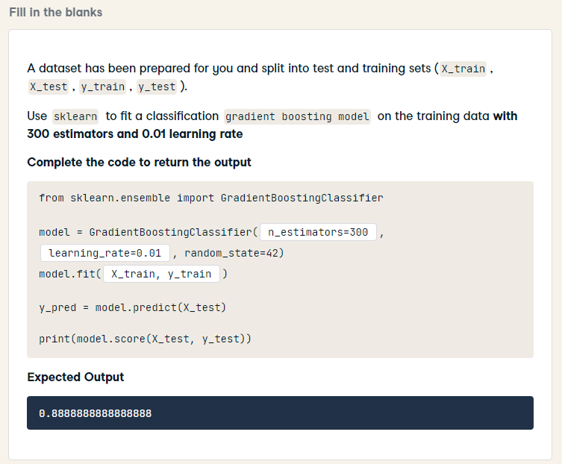
from sklearn.ensemble import GradientBoostingClassifier
model = GradientBoostingClassifier(n_estimators=300, learning_rate=0.01, random_state=42)
model.fit(X_train, y_train)
y_pred = model.predict(X_test)
print(model.score(X_test, y_test))

Slide 38
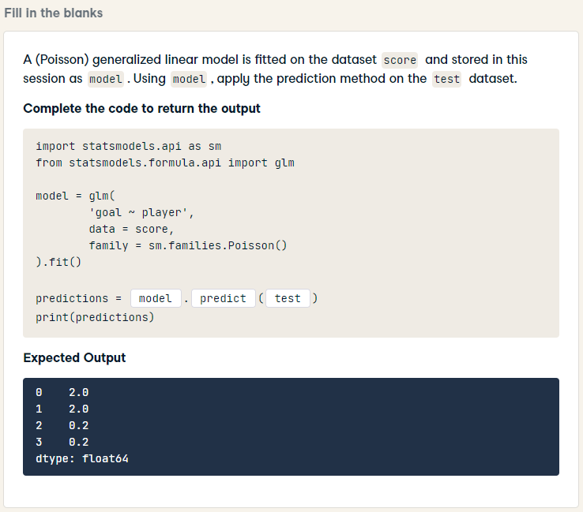
import statsmodels.api as sm
from statsmodels.formula.api import glm
model = glm(
'goal ~ player',
data = score,
family = sm.families.Poisson()
).fit()
predictions = model.predict(test)
print(predictions)

Slide 39
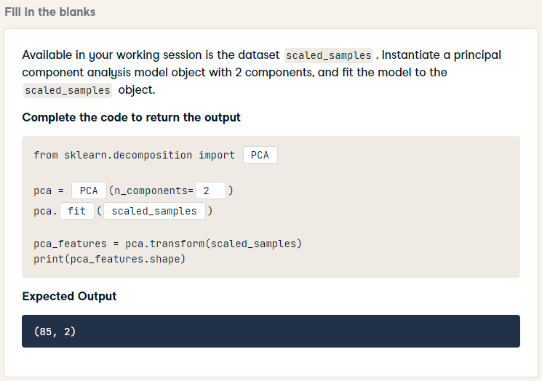
from sklearn.decomposition import PCA
pca = PCA(n_components= 2)
pca.fit(scaled_samples)
pca_features = pca.transform(scaled_samples)
print(pca_features.shape)

Slide 40
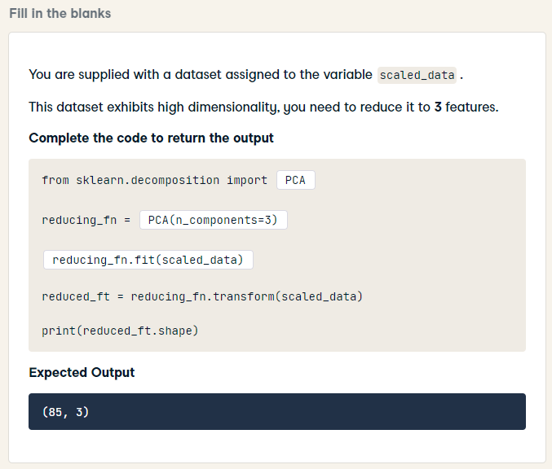
HARD
from sklearn.decomposition import PCA
reducing_fn = PCA(n_components=3)
reducing_fn.fit(scaled_data)
reduced_ft = reducing_fn.transform(scaled_data)
print(reduced_ft.shape)

Slide 41
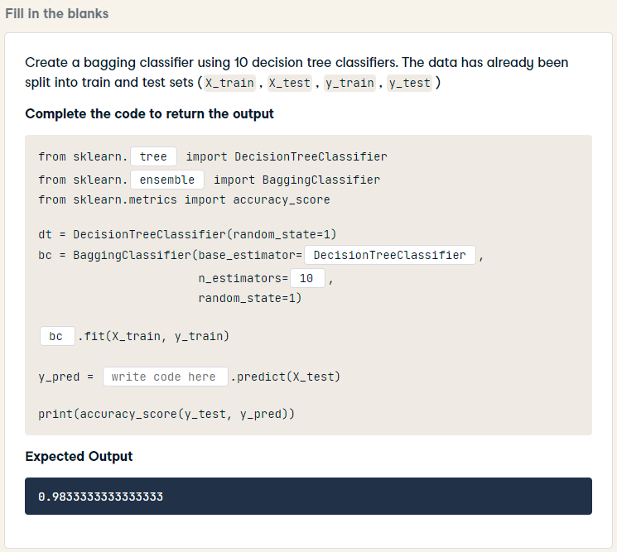
from sklearn.tree import DecisionTreeClassifier
from sklearn.ensemble import BaggingClassifier
from sklearn.metrics import accuracy_score
dt = DecisionTreeClassifier(random_state=1)
bc = BaggingClassifier(base_estimator= dt,
n_estimators= 10,
random_state=1)
bc.fit(X_train, y_train)
y_pred = bc.predict(X_test)
print(accuracy_score(y_test, y_pred))

Slide 42
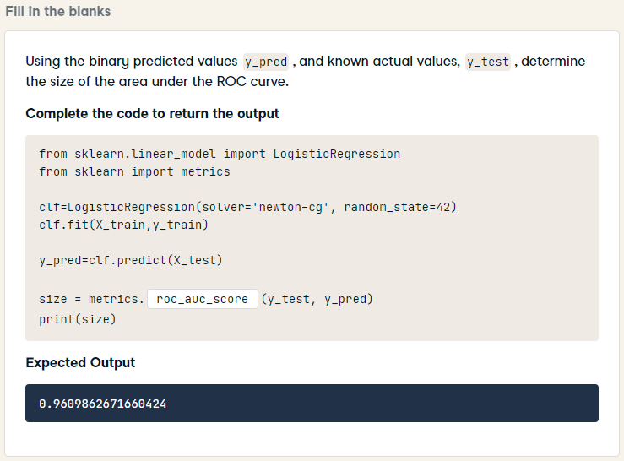
from sklearn.linear_model import LogisticRegression
from sklearn import metrics
clf=LogisticRegression(solver='newton-cg', random_state=42)
clf.fit(X_train,y_train)
y_pred=clf.predict(X_test)
size = metrics.roc_auc_score(y_test, y_pred)
print(size)

Slide 43
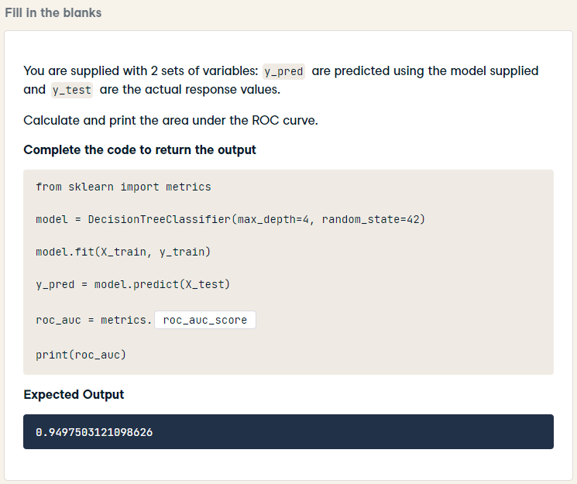
HARD
from sklearn import metrics
model = DecisionTreeClassifier(max_depth=4, random_state=42)
model.fit(X_train, y_train)
y_pred = model.predict(X_test)
roc_auc = metrics.roc_auc_score(y_test, y_pred)
print(roc_auc)

Slide 44
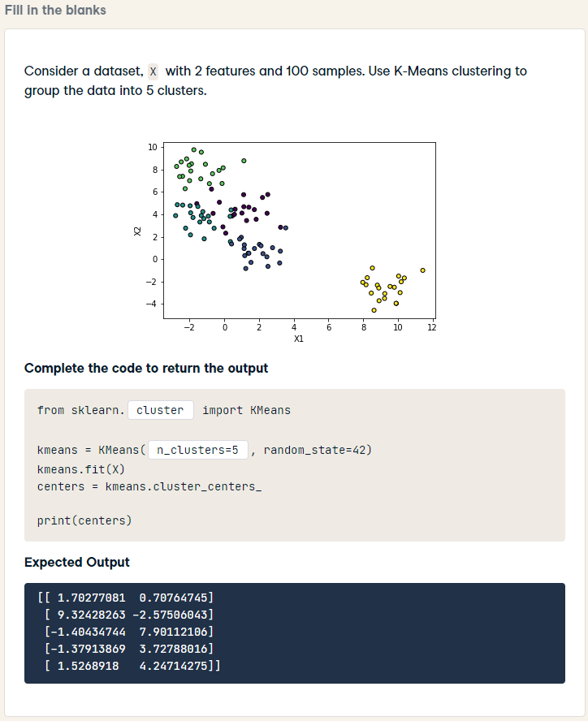
from sklearn.cluster import KMeans
kmeans = KMeans(n_clusters=5, random_state=42)
kmeans.fit(X)
centers = kmeans.cluster_centers_
print(centers)

Slide 45
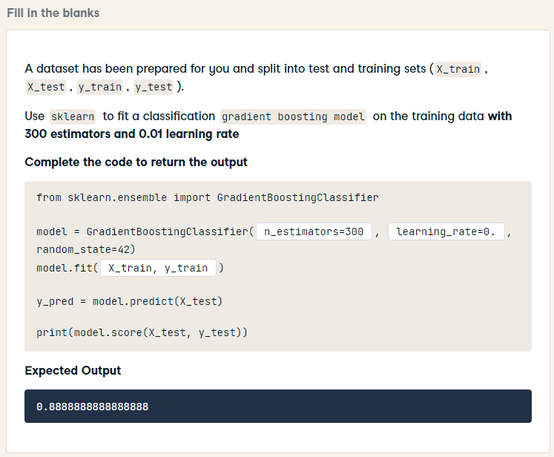
from sklearn.ensemble import GradientBoostingClassifier
model = GradientBoostingClassifier(n_estimators=300, learning_rate=0.01, random_state=42)
model.fit(X_train, y_train)
y_pred = model.predict(X_test)
print(model.score(X_test, y_test))

Slide 46
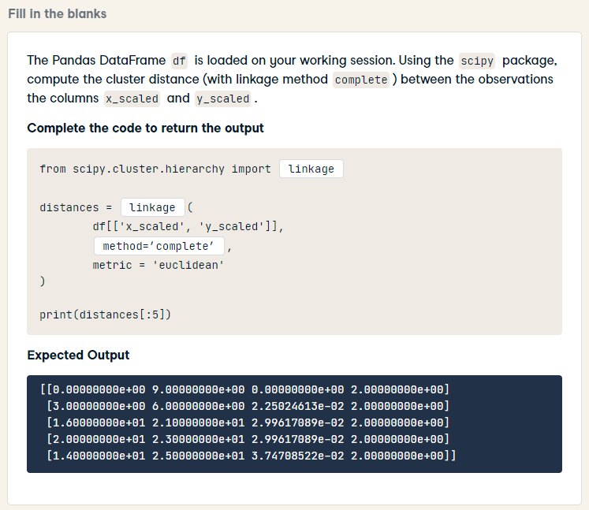
HARD
from scipy.cluster.hierarchy import linkage
distances = linkage(
df[['x_scaled', 'y_scaled']],
method = 'complete',
metric = 'euclidean'
)
print(distances[:5])

Slide 47
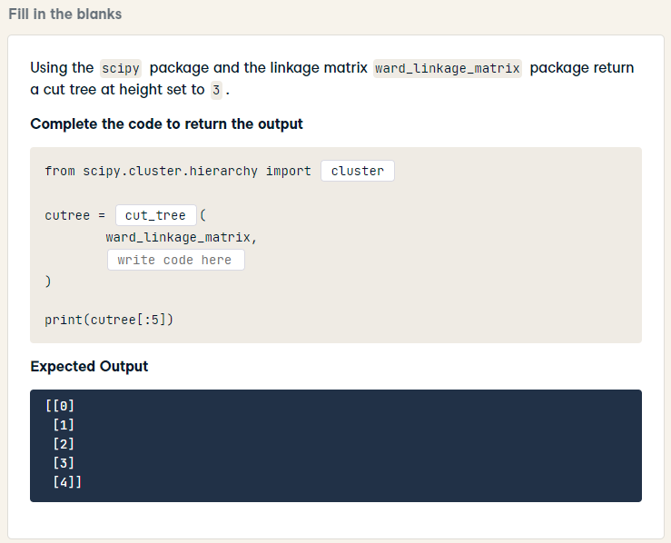
HARD
from scipy.cluster.hierarchy import cut_tree
cutree = cut_tree(
ward_linkage_matrix,
height = 3
)
print(cutree[:5])

Slide 48
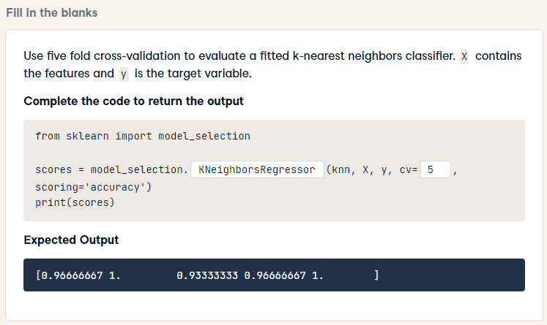
from sklearn import model_selection
scores = model_selection.cross_val_score(knn, X, y, cv=5, scoring='accuracy')
print(scores)

Slide 49
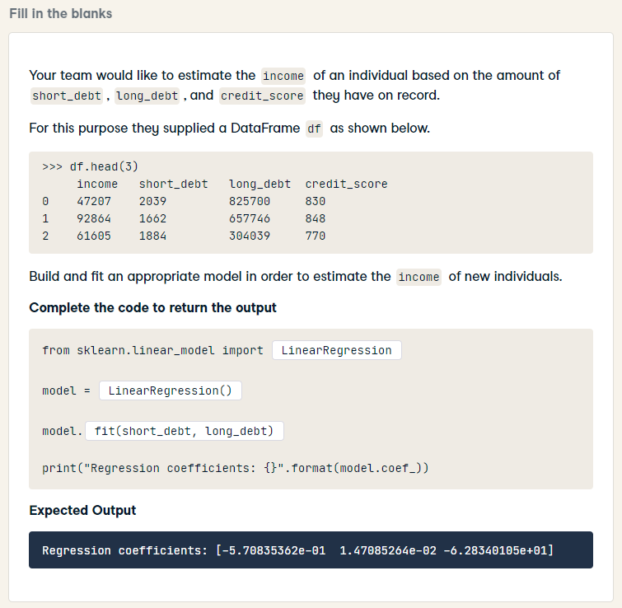
HARD
from sklearn.linear_model import LinearRegression
model = LinearRegression()
model.fit(df[['short_debt', 'long_debt', 'credit_score']], df['income'])
print("Regression coefficients: {}".format(model.coef_))

Slide 50
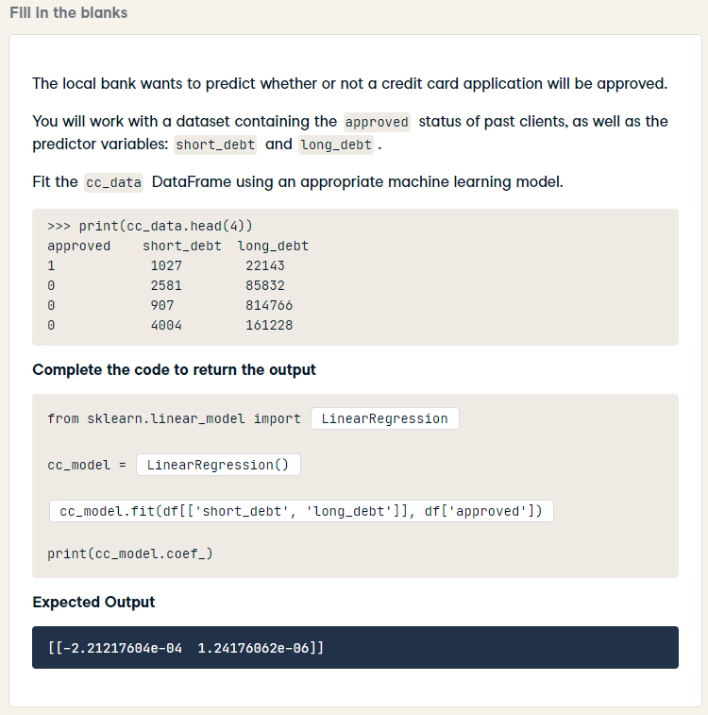
HARD
from sklearn.linear_model import LogisticRegression
cc_model = LogisticRegression()
cc_model.fit(cc_data[["short_debt", "long_debt"]], cc_data["approved"])
print(cc_model.coef_)

Slide 51

HARD
from sklearn.linear_model import LinearRegression
mod= LinearRegression()
mod.fit(weekly_spend[['income', 'children']], weekly_spend['spend'])
print(mod.coef_[1].round(2))

