Slide 1
datacamp
Statistical Experimentation
Statistics Fundamentals with Python
https://app.datacamp.com/learn/assessments?technologies=Python

Slide 2
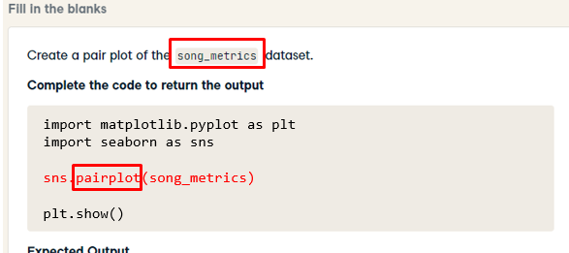
Hint: search key variable in code

Slide 3
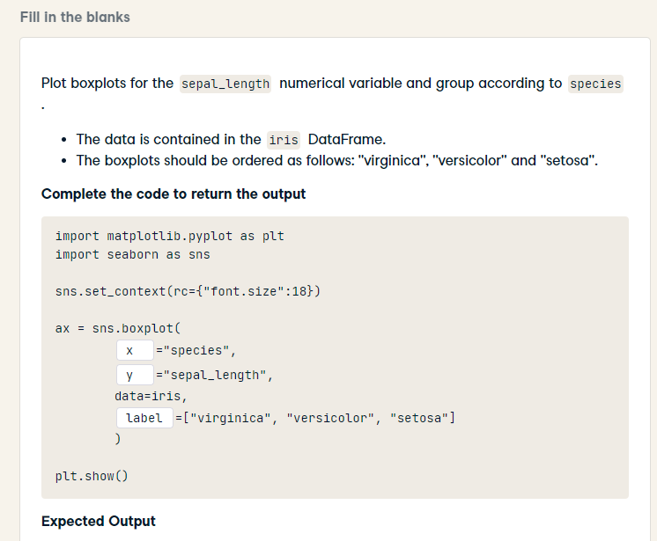
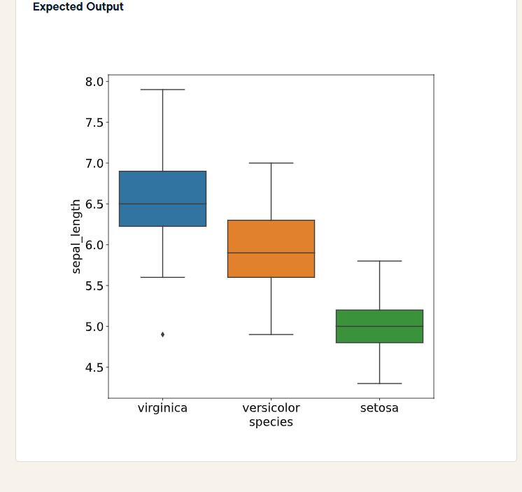
import matplotlib.pyplot as plt
import seaborn as sns
sns.set_context(rc={"font.size":18})
ax = sns.boxplot(
x = "species",
y = "sepal_length",
data=iris,
order = ["virginica", "versicolor", "setosa"]
)
plt.show()

Slide 4
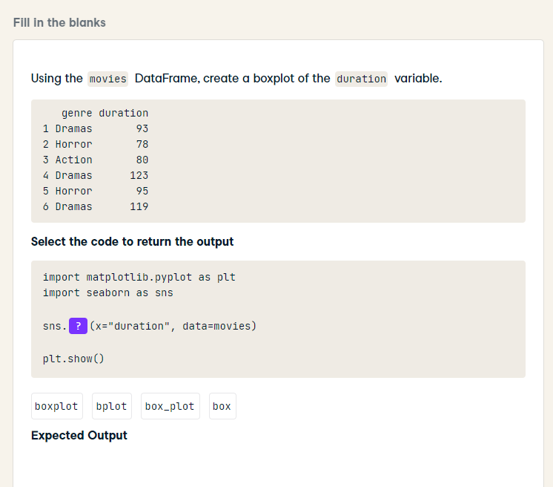
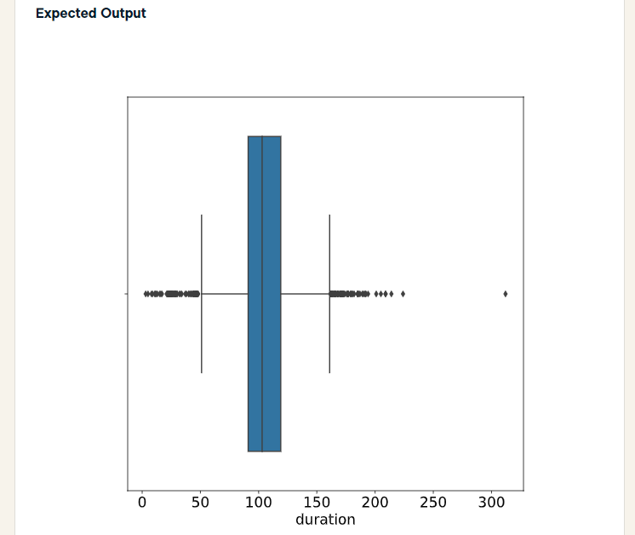
import matplotlib.pyplot as plt
import seaborn as sns
sns.boxplot(x="duration", data=movies)
plt.show()

Slide 5
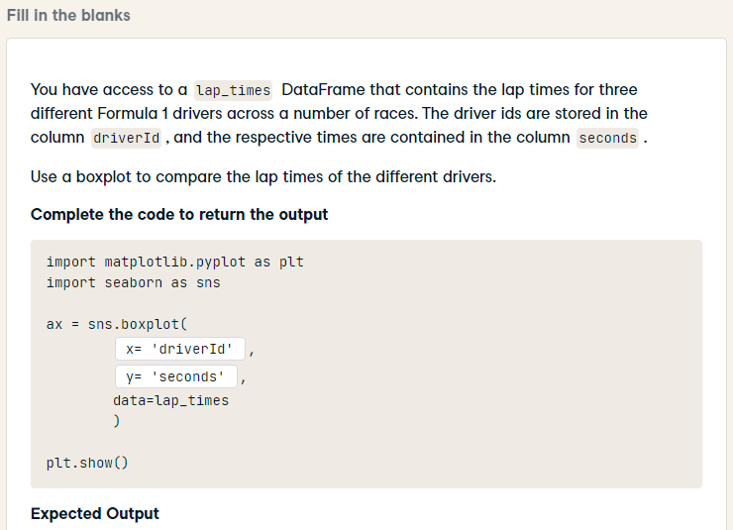
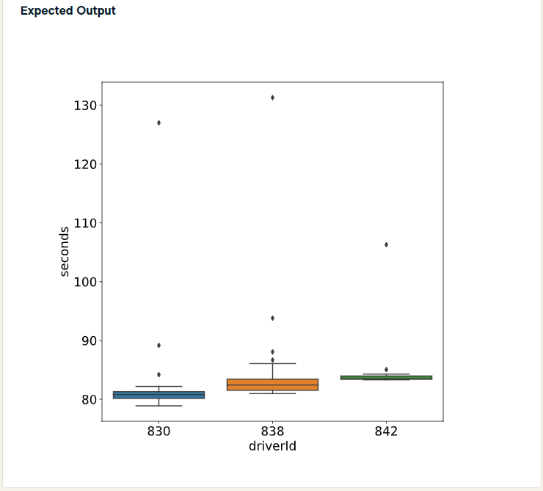
import matplotlib.pyplot as plt
import seaborn as sns
ax = sns.boxplot(
x='driverId',
y='seconds',
data=lap_times
)
plt.show()

Slide 6
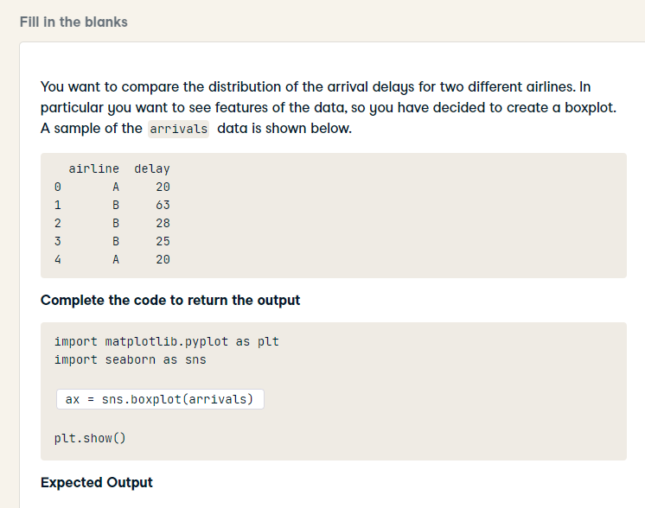
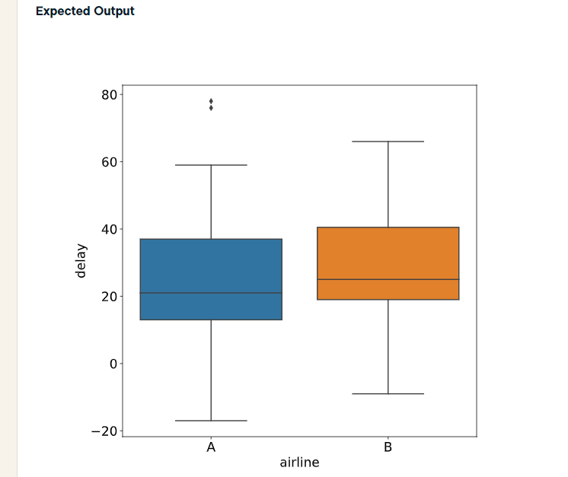
import matplotlib.pyplot as plt
import seaborn as sns
sns.boxplot(x='airline', y='delay', data=arrivals)
plt.show()

Slide 7
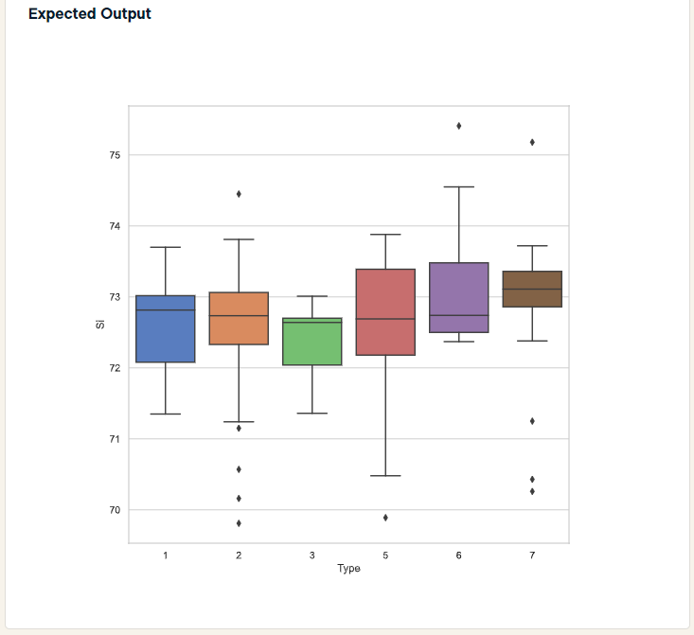
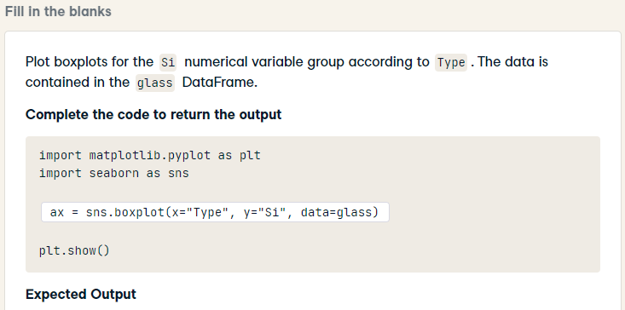
import matplotlib.pyplot as plt
import seaborn as sns
ax = sns.boxplot(x="Type", y="Si", data=glass)
plt.show()

Slide 8
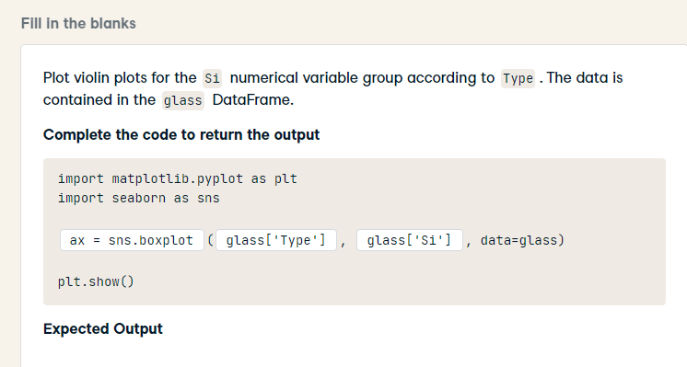
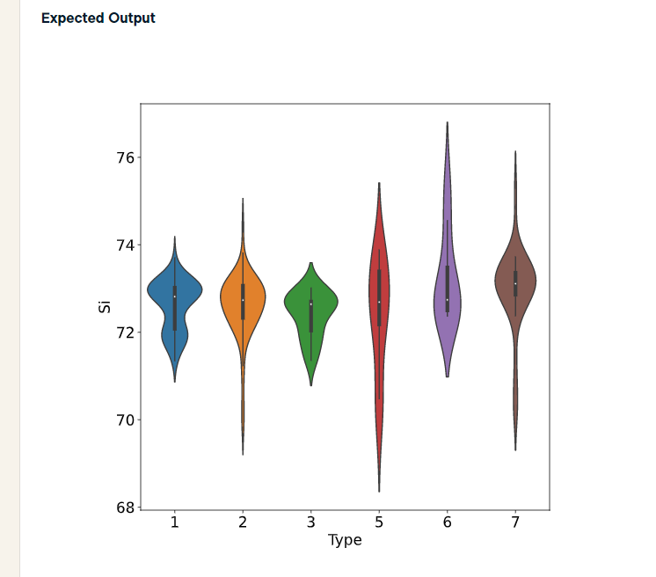
import matplotlib.pyplot as plt
import seaborn as sns
ax = sns.violinplot(x="Type", y="Si", data=glass)
plt.show()

Slide 9
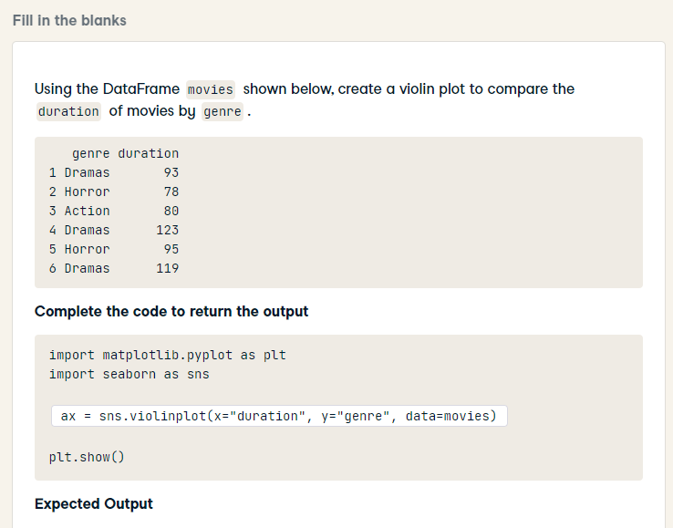
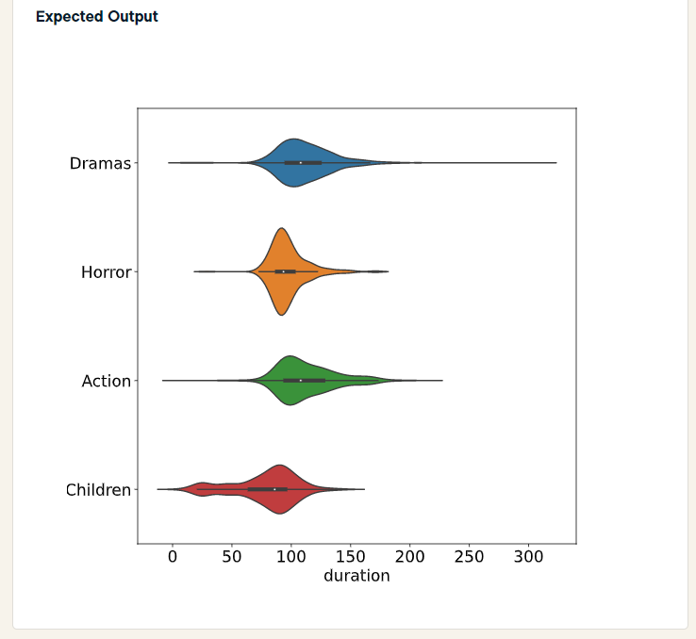
HARD
import matplotlib.pyplot as plt
import seaborn as sns
ax = sns.violinplot(x="duration", y="genre", data=movies)
plt.show()

Slide 10
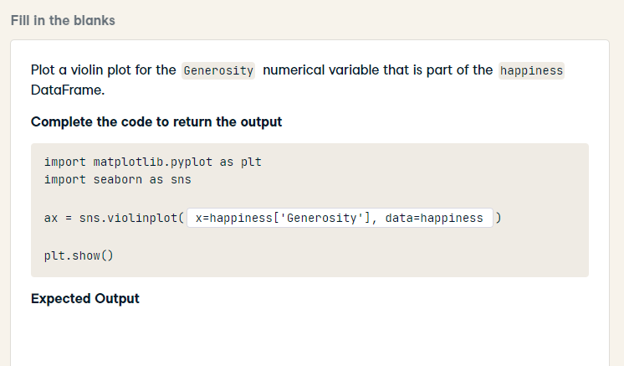
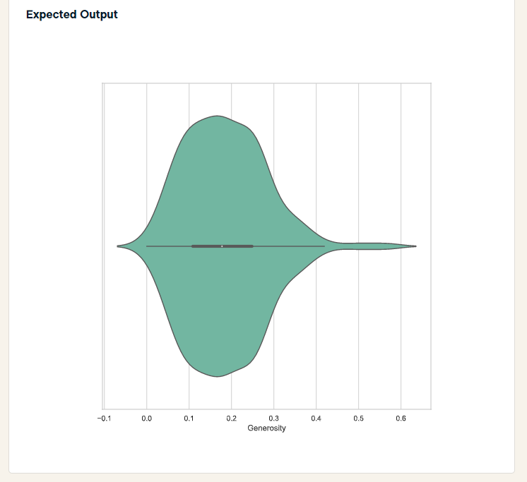
import matplotlib.pyplot as plt
import seaborn as sns
ax = sns.violinplot(x='Generosity', data=happiness)
plt.show()

Slide 11
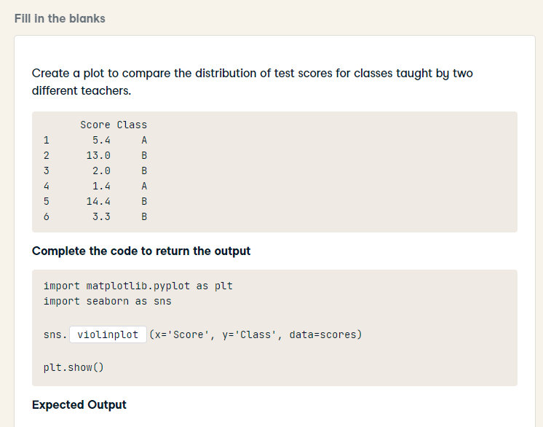
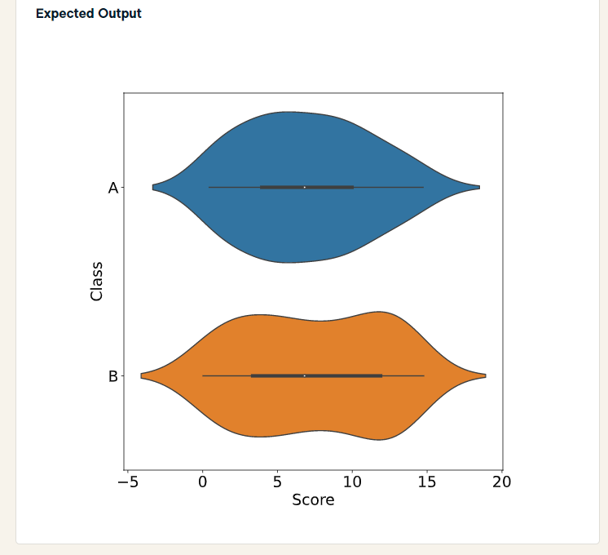
import matplotlib.pyplot as plt
import seaborn as sns
sns.violinplot(x='Score', y='Class', data=scores)
plt.show()

Slide 12
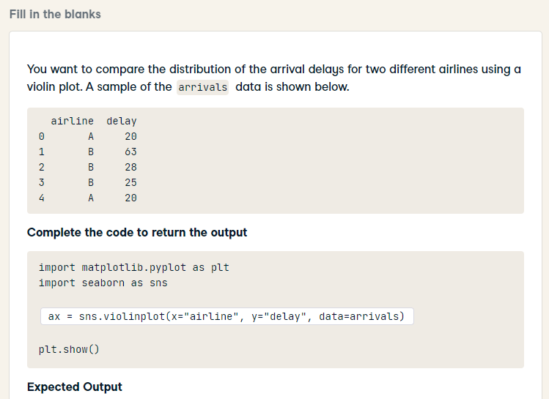
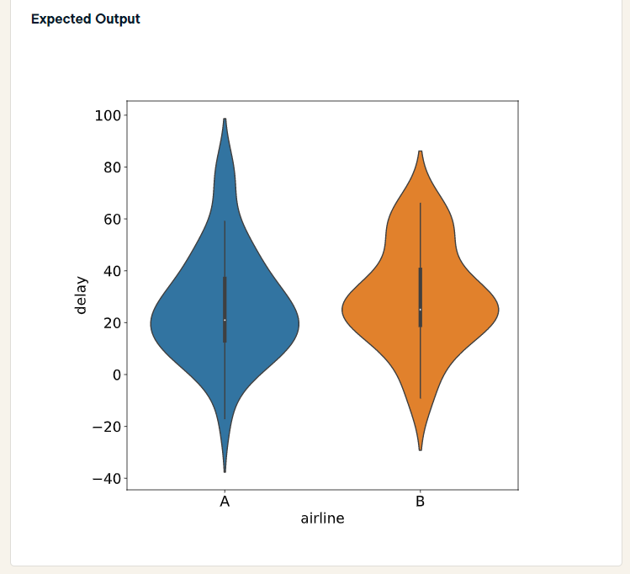
HARD
import matplotlib.pyplot as plt
import seaborn as sns
ax = sns.violinplot(x='airline', y='delay', data=arrivals)
plt.show()

Slide 13
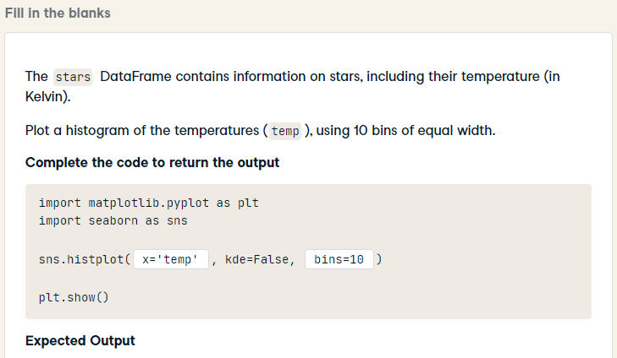
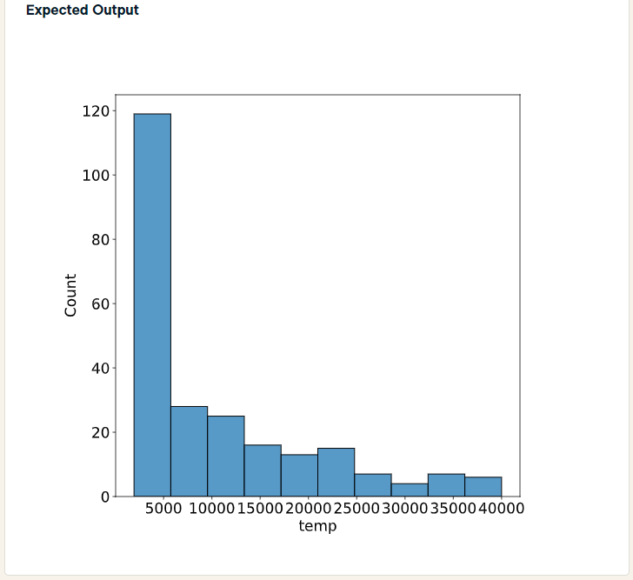
HARD
import matplotlib.pyplot as plt
import seaborn as sns
sns.histplot(stars['temp'], kde=False, bins=10)
plt.show()

Slide 14
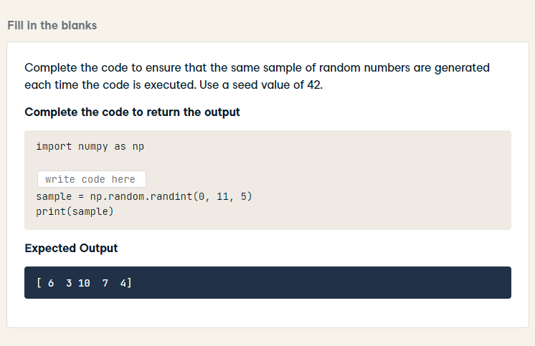
import numpy as np
np.random.seed(42)
sample = np.random.randint(0, 11, 5)
print(sample)

Slide 15
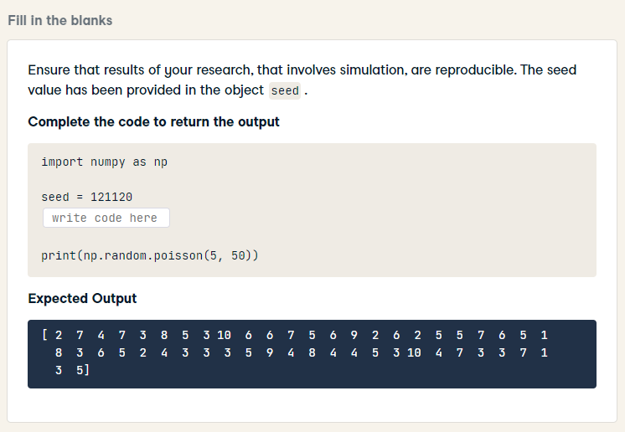
import numpy as np
seed = 121120
np.random.seed(seed)
print(np.random.poisson(5, 50))
print(sample)
print(samples)

Slide 16
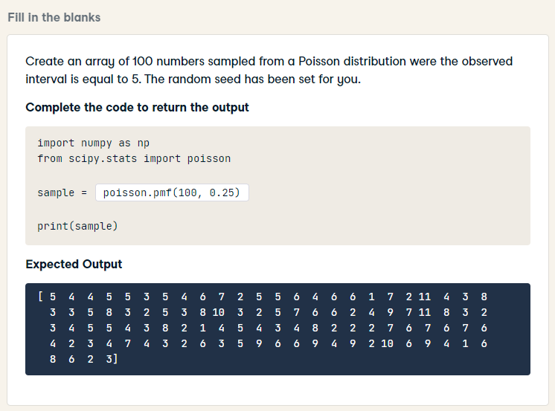
HARD
import numpy as np
from scipy.stats import poisson
sample = np.random.poisson(5, 100)
print(sample)

Slide 17
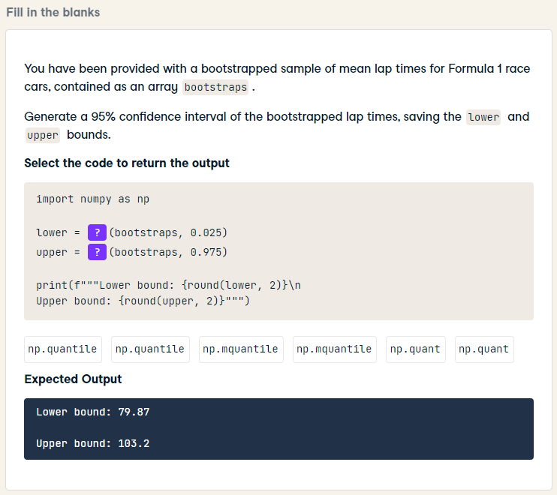
import numpy as np
lower = np.quantile(bootstraps, 0.025)
upper = np.quantile(bootstraps, 0.975)
print(f"""Lower bound: {round(lower, 2)}\n
Upper bound: {round(upper, 2)}""")

Slide 18
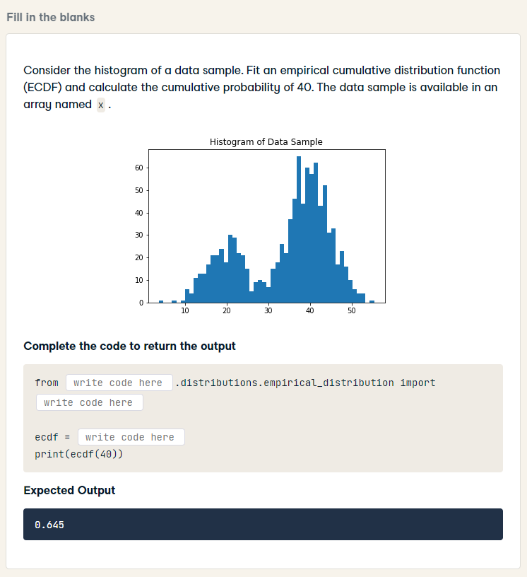
HARD
from statsmodels.distributions.empirical_distribution import ECDF
ecdf = ECDF(x)
print(ecdf(40))

Slide 19
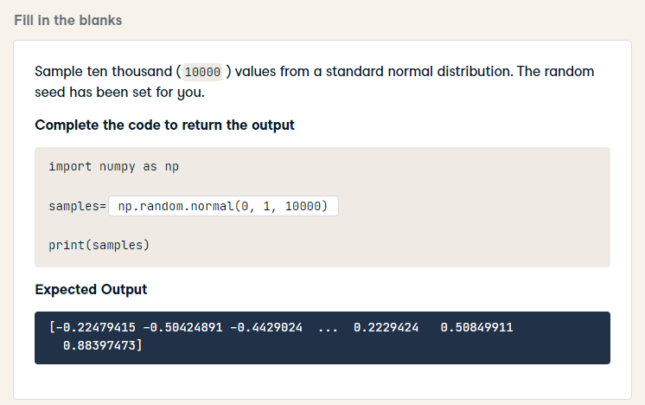
import numpy as np
samples= np.random.normal(0, 1, 10000)
print(samples)

Slide 20
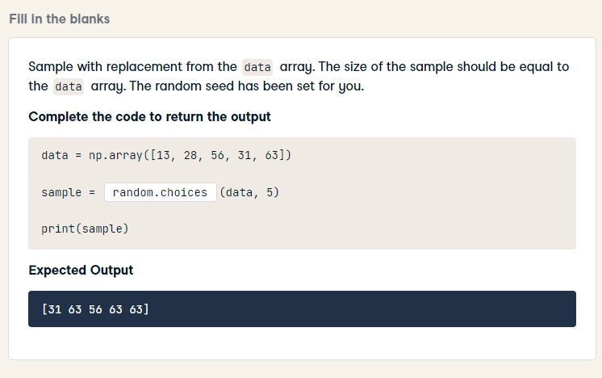
data = np.array([13, 28, 56, 31, 63])
sample = np.random.choice(data, 5)
print(sample)

Slide 21
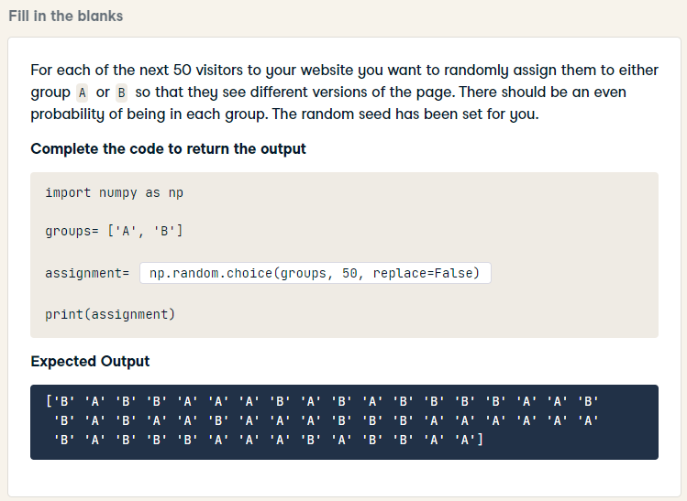
HARD
import numpy as np
groups= ['A', 'B']
assignment= np.random.choice(groups, 50)
print(assignment)

Slide 22
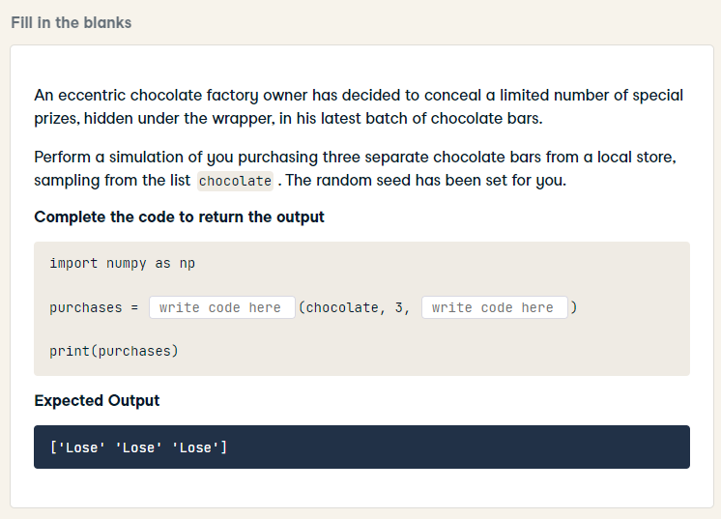
HARD
import numpy as np
purchases = np.random.choice(chocolate, 3, replace=False)
print(purchases)

Slide 23
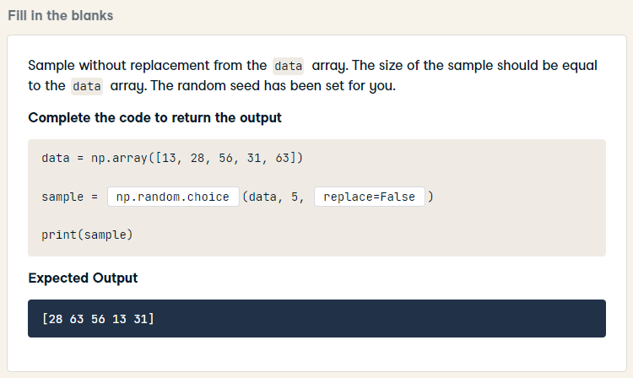
HARD
data = np.array([13, 28, 56, 31, 63])
sample = np.random.choice(data, 5, replace=False)
print(sample)

Slide 24
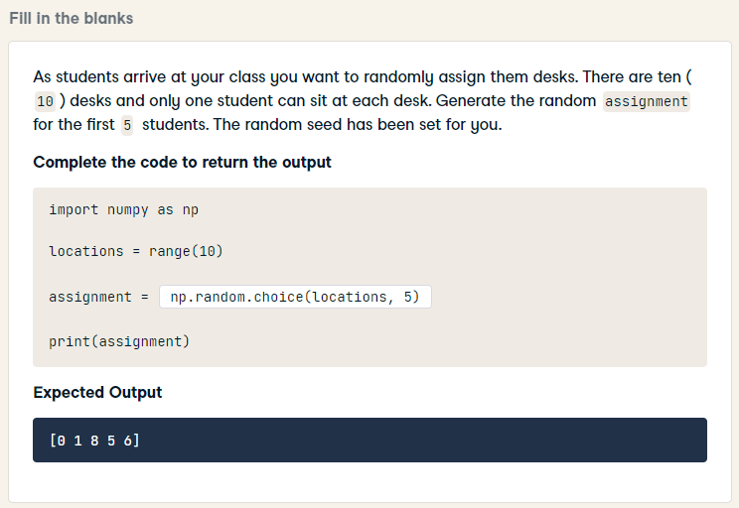
HARD
import numpy as np
locations = range(10)
assignment = np.random.choice(locations, 5, replace=False)
print(assignment)

Slide 25
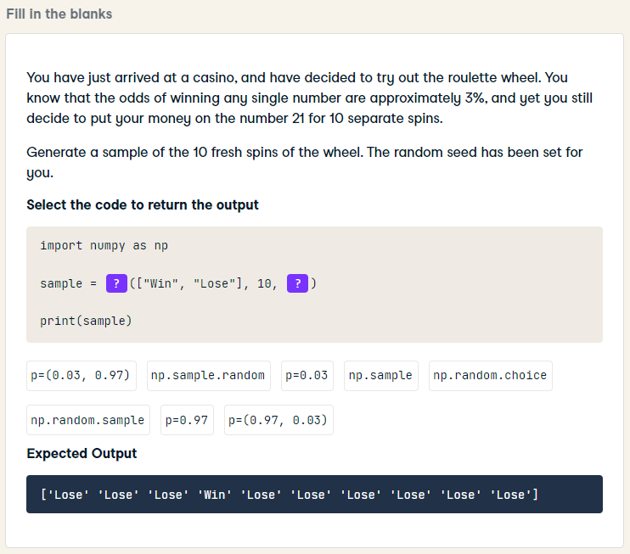
HARD
import numpy as np
sample = np.random.choice(["Win", "Lose"], 10, p=(0.03, 0.97))
print(sample)

Slide 26
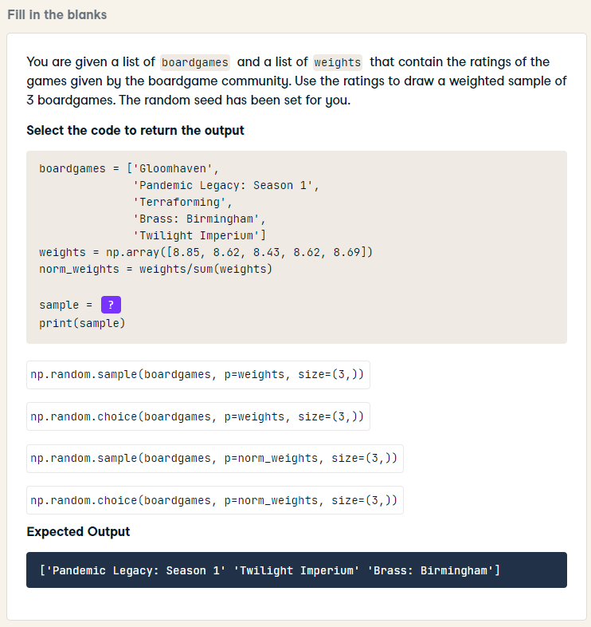
HARD
boardgames = ['Gloomhaven',
'Pandemic Legacy: Season 1',
'Terraforming',
'Brass: Birmingham',
'Twilight Imperium']
weights = np.array([8.85, 8.62, 8.43, 8.62, 8.69])
norm_weights = weights/sum(weights)
sample = np.random.choice(boardgames, p=norm_weights, size=(3,))
print(sample)

Slide 27
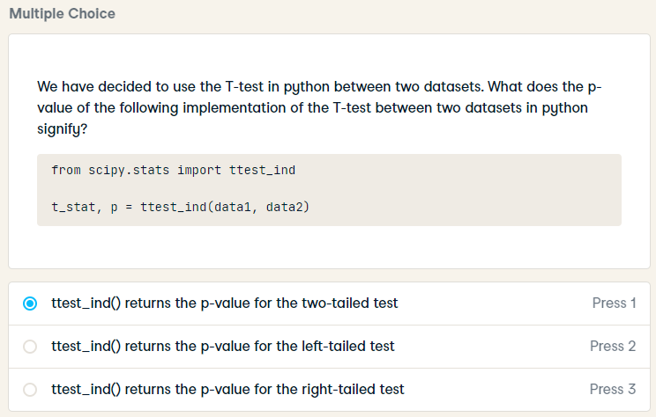
We have decided to use the T-test in python between two datasets. What does the p-value of the following implementation of the T-test between two datasets in python signify?
from scipy.stats import ttest_ind
t_stat, p = ttest_ind(data1, data2)
ttest_ind calculates the T-test for the means of TWO INDEPENDENT samples of scores. This is a two-sided test for the null hypothesis that 2 independent samples have identical average (expected) values

Slide 28
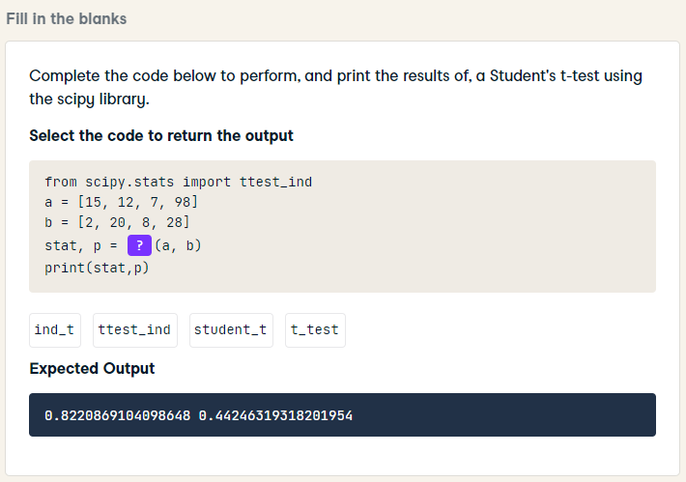
from scipy.stats import ttest_ind
a = [15, 12, 7, 98]
b = [2, 20, 8, 28]
stat, p = ttest_ind(a, b)
print(stat,p)

Slide 29
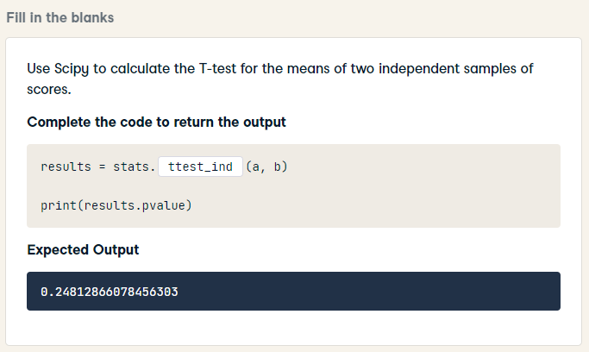
results = stats.ttest_ind(a, b)
print(results.pvalue)

Slide 30
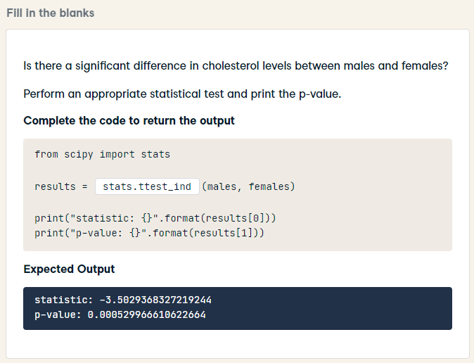
HARD
from scipy import stats
results = stats.ttest_ind(males, females)
print("statistic: {}".format(results[0]))
print("p-value: {}".format(results[1]))

Slide 31
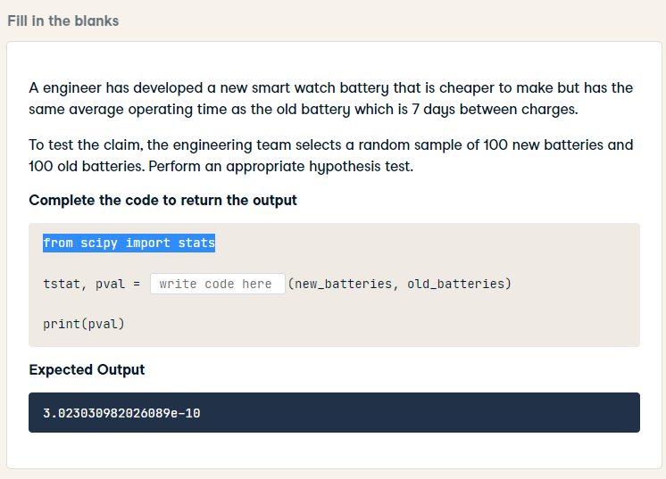
HARD
from scipy import stats
tstat, pval = stats.ttest_ind(new_batteries, old_batteries)
print(pval)

Slide 32
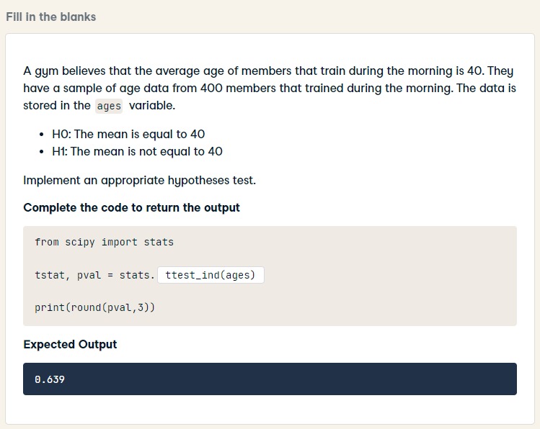
HARD
from scipy import stats
tstat, pval = stats.ttest_1samp(ages, 40)
print(round(pval,3))

Slide 33
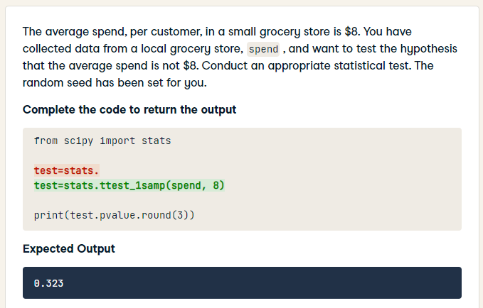
HARD
from scipy import stats
test= stats.ttest_1samp(spend, 8)
print(test.pvalue.round(3))

Slide 34
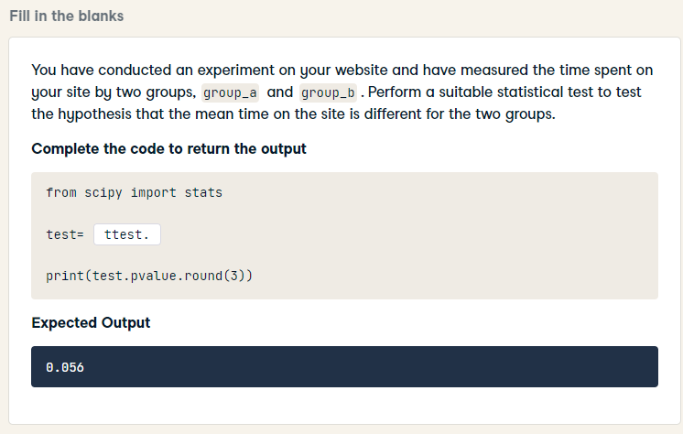
HARD
from scipy import stats
test= stats.ttest_ind(group_a, group_b)
print(test.pvalue.round(3))

Slide 35
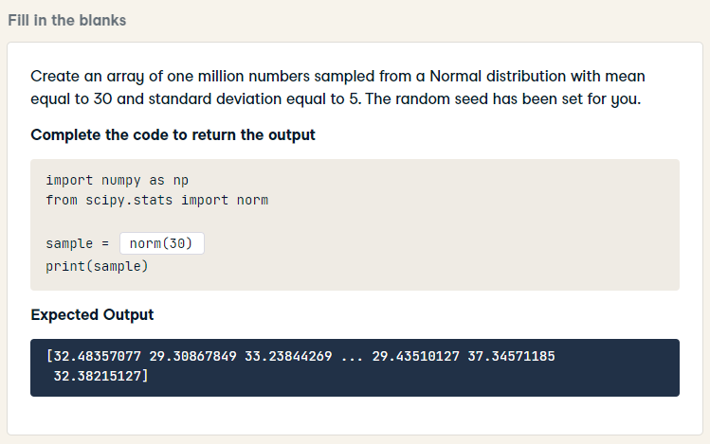
HARD
import numpy as np
from scipy.stats import norm
sample = np.random.normal(30, 5, 1000000)
print(sample)

Slide 36
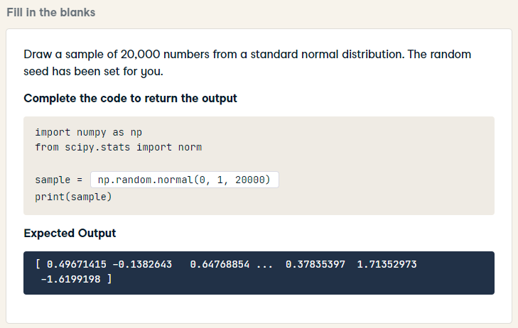
HARD
import numpy as np
from scipy.stats import norm
sample = np.random.normal(0, 1, 20000)
print(sample)

Slide 37
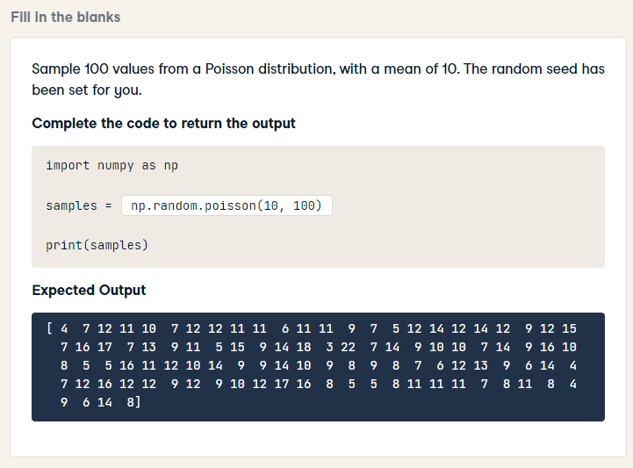
import numpy as np
samples = np.random.poisson(10, 100)
print(samples)

Slide 38
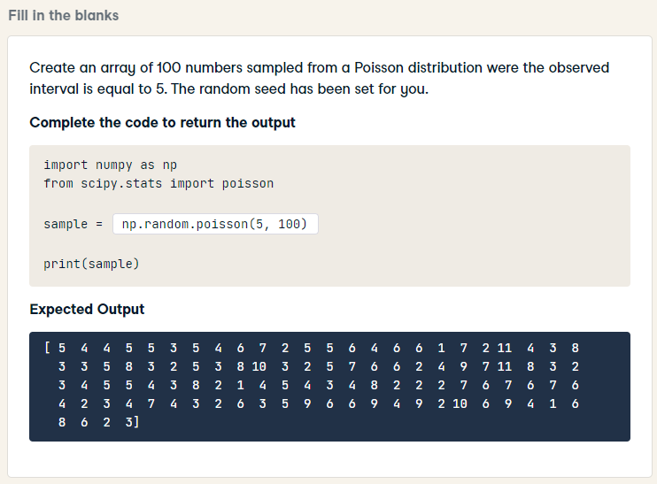
HARD
import numpy as np
from scipy.stats import poisson
sample = np.random.poisson(5, 100)
print(sample)

Slide 39
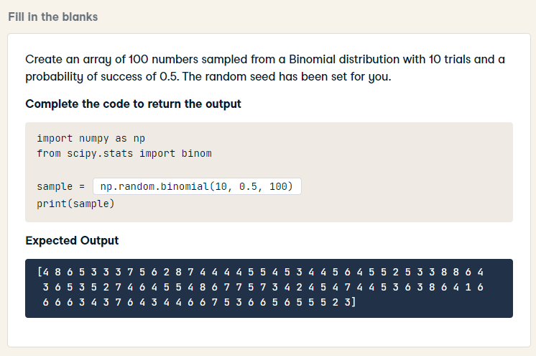
import numpy as np
from scipy.stats import binom
sample = np.random.binomial(10, 0.5, 100)
print(sample)

Slide 40
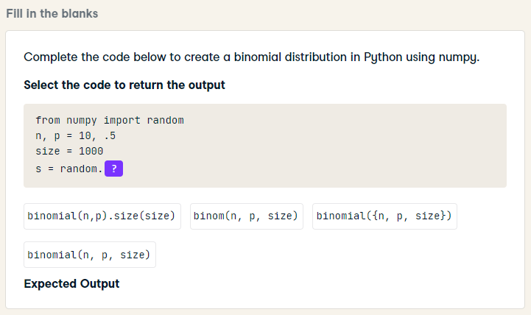
from numpy import random
n, p = 10, .5
size = 1000
s = random.binomial(n, p, size)

Slide 41

HARD
import numpy as np
sample = np.random.exponential(1/56,100000)
print(sample)

Slide 42

from scipy.stats import poisson, norm, beta, binom
prob = binom.pmf(2, 10, 0.25)
print(prob)

Slide 43

related t-test
import pandas as pd
from scipy import stats
statistic,pvalue = stats.ttest_rel(df['City_A'], df['City_B'])
print(statistic,pvalue)

Slide 44

from scipy.stats import ttest_rel
a = [15, 12, 7, 98]
b = [2, 20, 8, 28]
stat, p = ttest_rel(a, b)
print(stat,p)

Slide 45

According to the following Shapiro-Wilk test results:
ShapiroResult(statistic=0.9844282269477844, pvalue=0.024980217218399048)

Slide 46

A class has 20 students, 18 male and 2 female. We take a random sample of 10 students where each student is equally likely to be selected. What method of sampling is this?

Slide 47

A class has 20 students, 18 male and 2 female. We take a random sample of 10 students by selecting 9 random male and 1 random female. What method of sampling is this?

Slide 48

HARD
What could we conclude from the following results from a Pearson's correlation:
r = 0.78
p-value = 0.85

Slide 49

What could we conclude from the following results from a Pearson's correlation:
r = 0.25
p-value = 0.01

Slide 50

To create a chi-squared distribution in Python using numpy, we can use the following code:
from numpy import random
chisquare(df=2, size=4)
What does the df stand for in the chisquare function?

Slide 51

from scipy import stats
obs =[10,10,10,20,50,10,15]
exp = [5,15,10,15,15,10,55]
result = stats.chisquare(obs,exp)
print(result)

Slide 52

HARD
from scipy import stats
results = stats.chisquare(os_purchases, axis=None)
print(results)

Slide 53

import numpy as np
df = 2 # number of degrees of freedom
chisq_data = np.random.chisquare(df, 100)
print(chisq_data)

Slide 54

import scipy.stats as stats
results = stats.friedmanchisquare(a, b, c)
print(results.pvalue)

Slide 55

import scipy.stats as stats
results = stats.pearsonr(df['A'], df['B'])
print(results)

Slide 56

For feature selection in your Machine Learning model, you ran a Chi-square test to determine the relationship between the independent and the one dependent categorical feature. The results obtained are the following:
chi2 value: 134.54869375910293
p-value: 1.510066805092378e-136
According to these results, we can conclude that:

Slide 57

import numpy as np
normal_dist_data = np.random.normal(loc=1, scale=2, size=100)
print(normal_dist_data)

Slide 58


from numpy.random import default_rng
import seaborn as sns
import matplotlib.pyplot as plt
dist = rng.standard_normal(1000)
sns.displot(dist, color='lightblue')
plt.show()

Slide 59

import scipy.stats as stats
result = stats.binom.pmf(k=8, n=15, p=0.5)
print(result)

Slide 60

import scipy.stats as stats
prob = stats.binom.cdf(k=70, n=100, p=0.5)
print(prob)

Slide 61

import scipy.stats as stats
prob = stats.poisson.cdf(k=180, mu=145)
print(prob)

Slide 62

HARD
from scipy.stats import norm
probability_60 = norm(loc = 70 , scale = 10 ).cdf(60) * 100
print(f"Probability of the person being less than 60 kg is {probability_60}%")

Slide 63

HARD
from scipy.stats import norm
prob = 1 - norm.cdf(90, 71, 15)
print(prob)

Slide 64

HARD
from scipy.stats import norm
prob = norm.cdf(180, 170, 10) -\
norm.cdf(160, 170, 10)
print(prob)

Slide 65

import pandas as pd
df.sample(n=3,replace=True,random_state=1)

Slide 66

from scipy.stats import norm
import numpy as np
values = np.linspace(1, 100, 30)
probability_pdf = norm.pdf(3, loc=np.mean(values), scale=np.std(values))
print(probability_pdf)

Slide 67

import scipy.stats as stats
results = stats.shapiro(dt_total_score)
print(results.pvalue)

Slide 68

import scipy.stats as stats
results = stats.f_oneway(treatment_1, treatment_2)
print(results.statistic)

Slide 69

If the output of the following code block is: (4.36, 0.04), what can you infer about the variables a and b?
from scipy.stats import f_oneway
data1 = [15, 20, 12, 30]
data2 = [20, 30, 19, 40]
data3 = [9, 11, 12, 15]
stat, p = f_oneway(data1, data2, data3)
print(stat, p)

Slide 70

import scipy.stats as stats
results = stats.f_oneway(c, a)
print(results.statistic)

Slide 71


import matplotlib.pyplot as plt
import seaborn as sns
sns.pairplot(valuation[['age', 'mpg', 'value']], diag_kind = 'kde')
plt.show()

Slide 72


HARD
import matplotlib.pyplot as plt
import seaborn as sns
sns.pairplot(heart, diag_kind = 'kde')
plt.show()

Slide 73

import matplotlib.pyplot as plt
import seaborn as sns
sns.pairplot(song_metrics)
plt.show()

Slide 74


import matplotlib.pyplot as plt
import seaborn as sns
sns.kdeplot(airline_a, shade = True, label = "A")
sns.kdeplot(airline_b, shade = True, label = "B")
plt.legend()
plt.show()

