Slide 1
datacamp
Analytic Fundamental

Slide 2
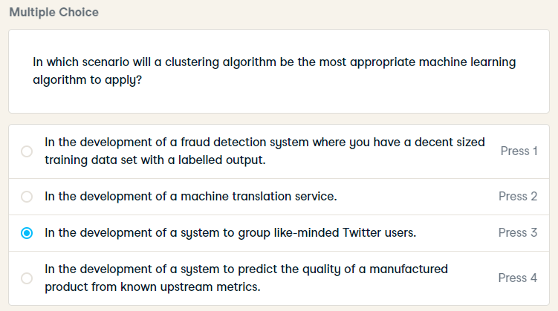
In which scenario will a clustering algorithm be the most appropriate machine learning algorithm to apply?

Slide 3
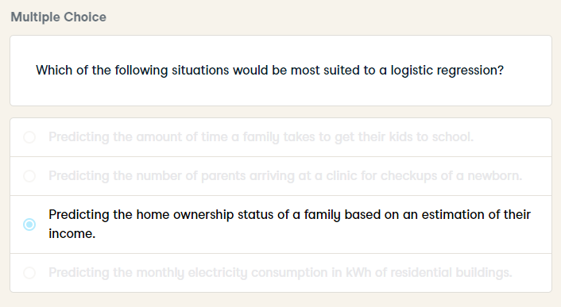
Which of the following situations would be most suited to a logistic regression?

Slide 4
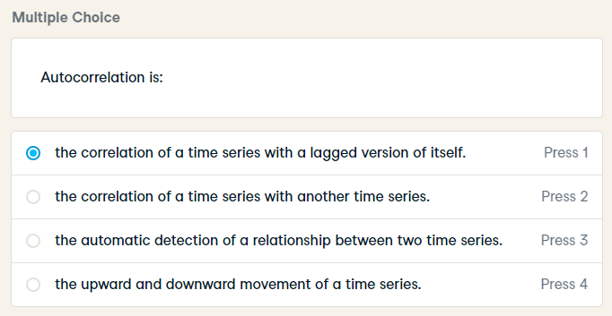
Autocorrelation is:

Slide 5
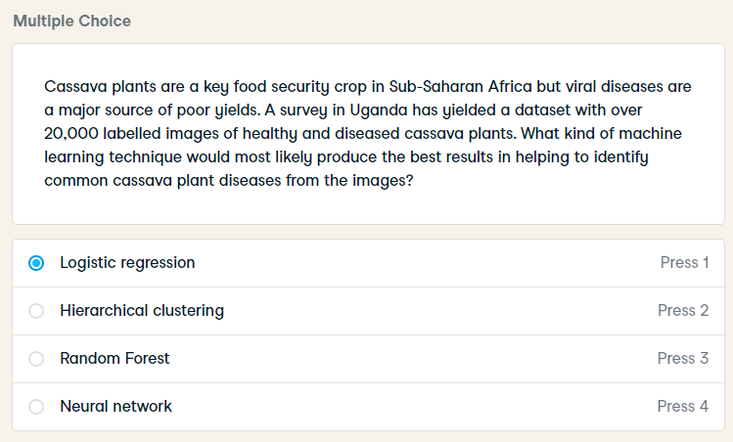
Cassava plants are a key food security crop in Sub-Saharan Africa but viral diseases are a major source of poor yields. A survey in Uganda has yielded a dataset with over 20,000 labelled images of healthy and diseased cassava plants. What kind of machine learning technique would most likely produce the best results in helping to identify common cassava plant diseases from the images?

Slide 6
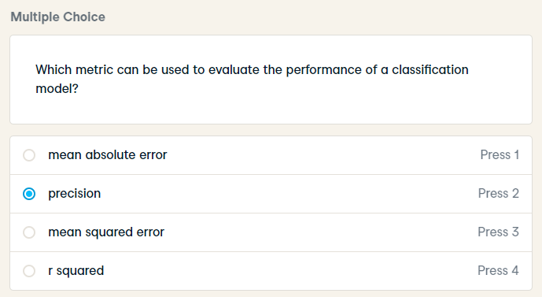
Which metric can be used to evaluate the performance of a classification model?

Slide 7
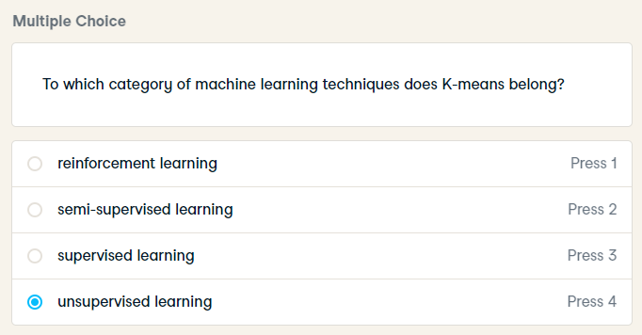
To which category of machine learning techniques does K-means belong?

Slide 8
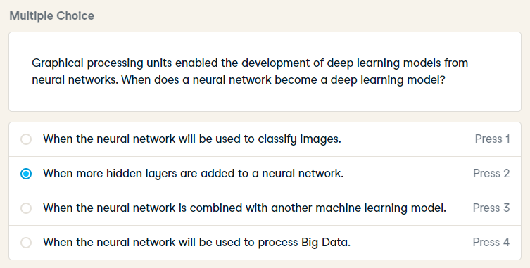
Graphical processing units enabled the development of deep learning models from neural networks. When does a neural network become a deep learning model?

Slide 9
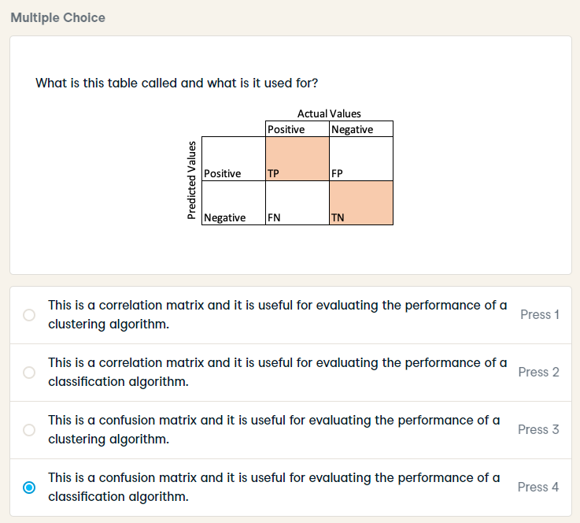
What is this table called and what is it used for?

Slide 10
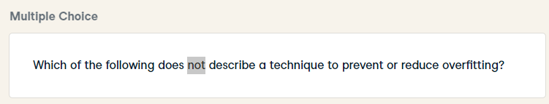
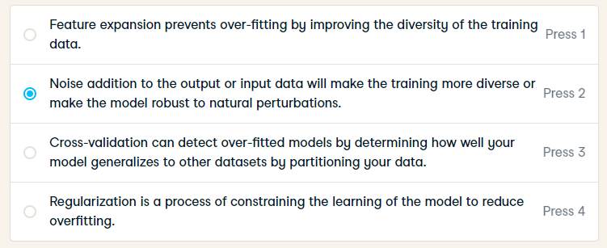
HARD
Which of the following does not describe a technique to prevent or reduce overfitting?

Slide 11
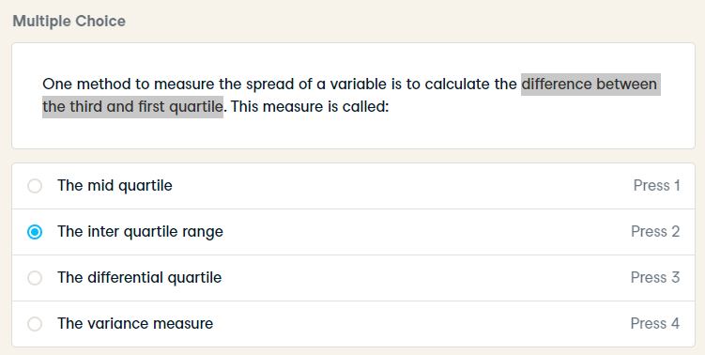
One method to measure the spread of a variable is to calculate the difference between the third and first quartile. This measure is called:

Slide 12
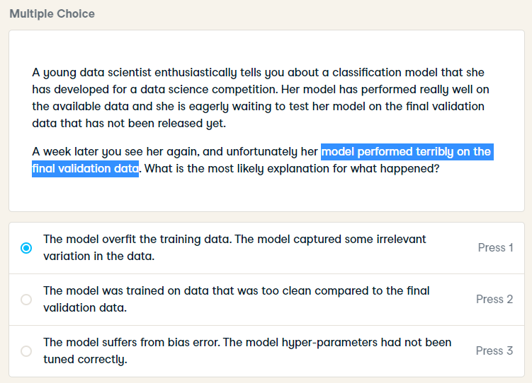
A young data scientist enthusiastically tells you about a classification model that she has developed for a data science competition. Her model has performed really well on the available data and she is eagerly waiting to test her model on the final validation data that has not been released yet.
A week later you see her again, and unfortunately her model performed terribly on the final validation data. What is the most likely explanation for what happened?

Slide 13
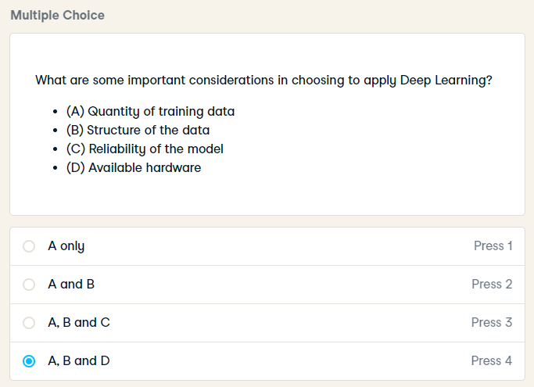
What are some important considerations in choosing to apply Deep Learning?
(A) Quantity of training data
(B) Structure of the data
(C) Reliability of the model
(D) Available hardware

Slide 14
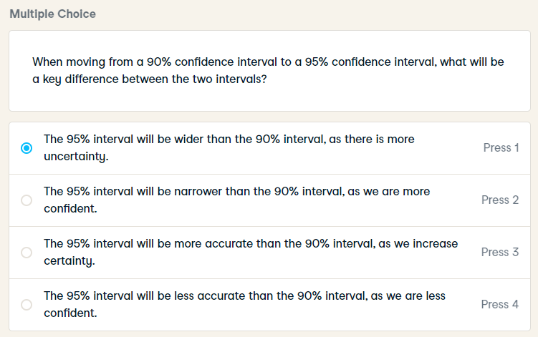
HARD
When moving from a 90% confidence interval to a 95% confidence interval, what will be a key difference between the two intervals?

Slide 15
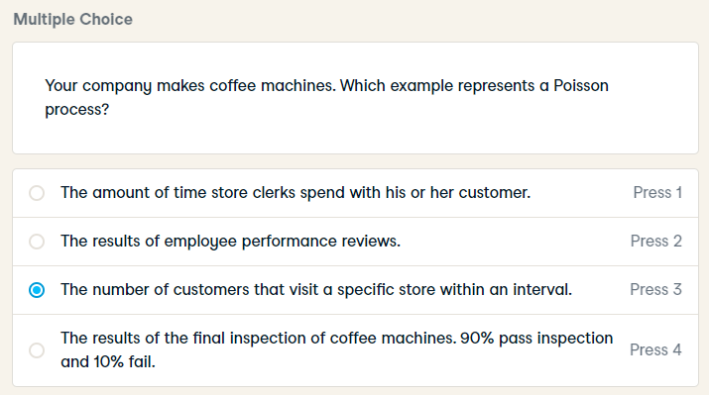
Your company makes coffee machines. Which example represents a Poisson process?

Slide 16
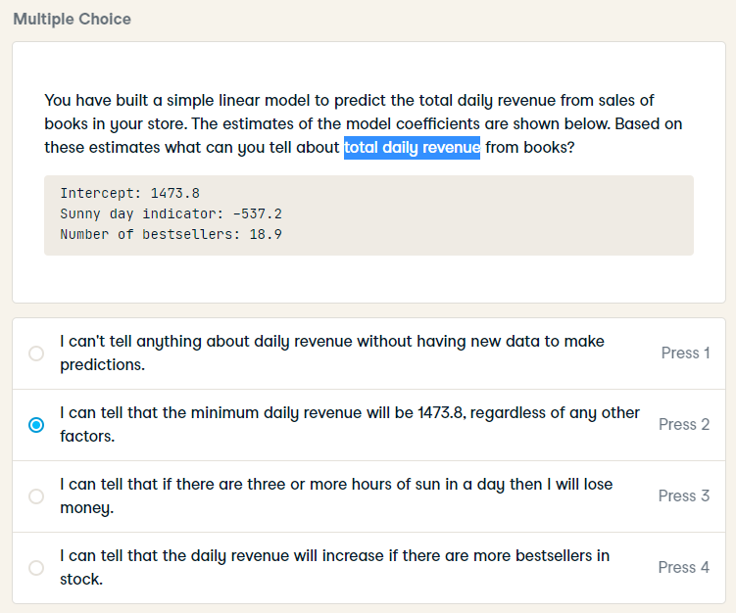
HARD
You have built a simple linear model to predict the total daily revenue from sales of books in your store. The estimates of the model coefficients are shown below. Based on these estimates what can you tell about total daily revenue from books?

Slide 17
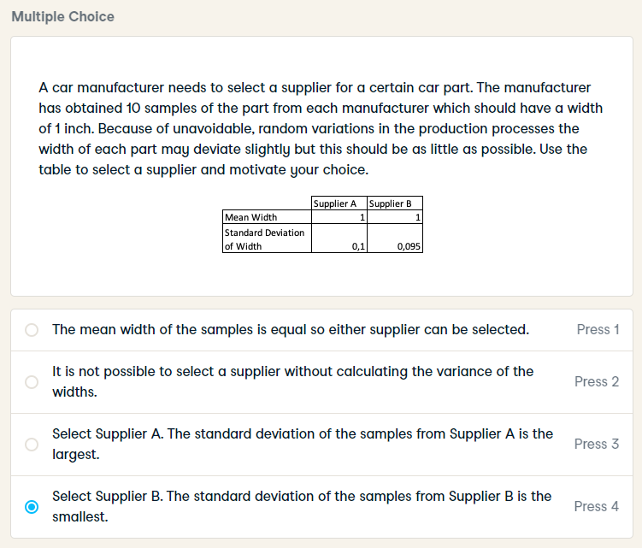
A car manufacturer needs to select a supplier for a certain car part. The manufacturer has obtained 10 samples of the part from each manufacturer which should have a width of 1 inch. Because of unavoidable, random variations in the production processes the width of each part may deviate slightly but this should be as little as possible. Use the table to select a supplier and motivate your choice.

Slide 18
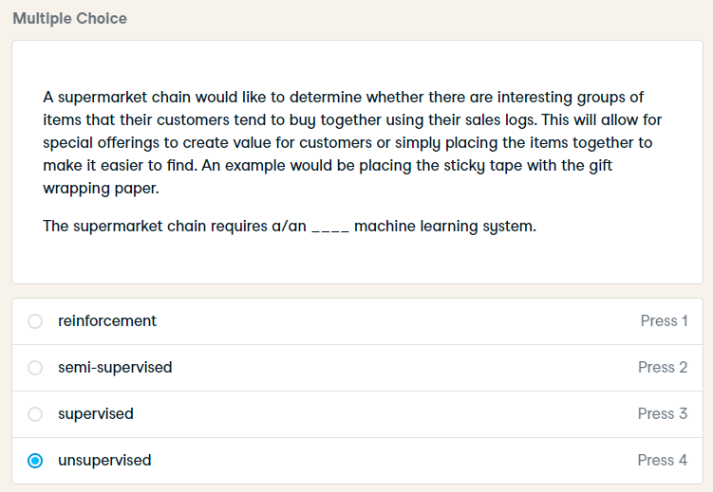
HARD
A supermarket chain would like to determine whether there are interesting groups of items that their customers tend to buy together using their sales logs. This will allow for special offerings to create value for customers or simply placing the items together to make it easier to find. An example would be placing the sticky tape with the gift wrapping paper.

Slide 19
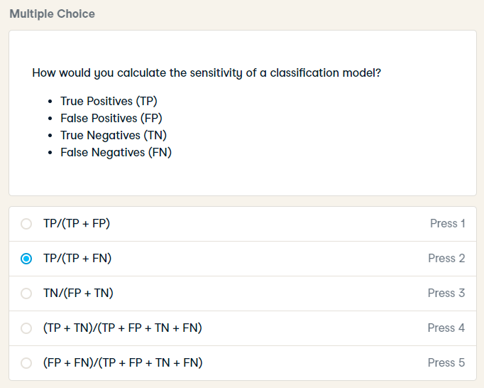
HARD
How would you calculate the sensitivity of a classification model?

Slide 20
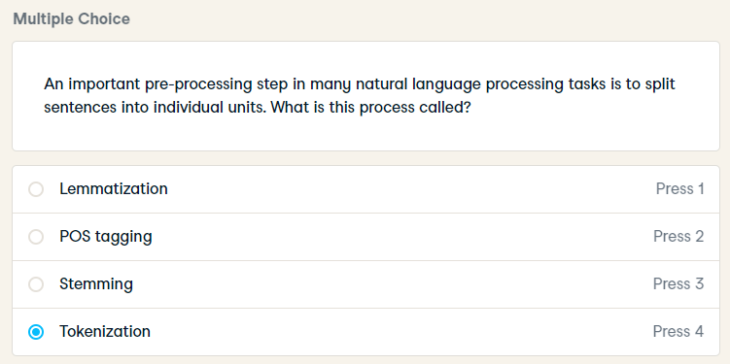
An important pre-processing step in many natural language processing tasks is to split sentences into individual units. What is this process called?

Slide 21
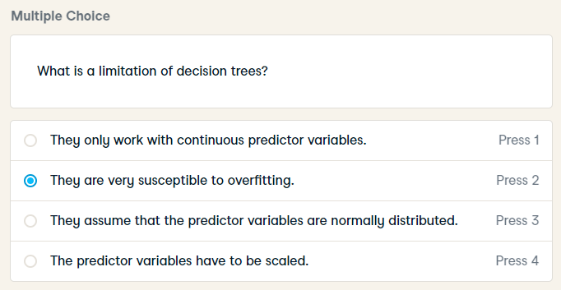
What is a limitation of decision trees?

Slide 22
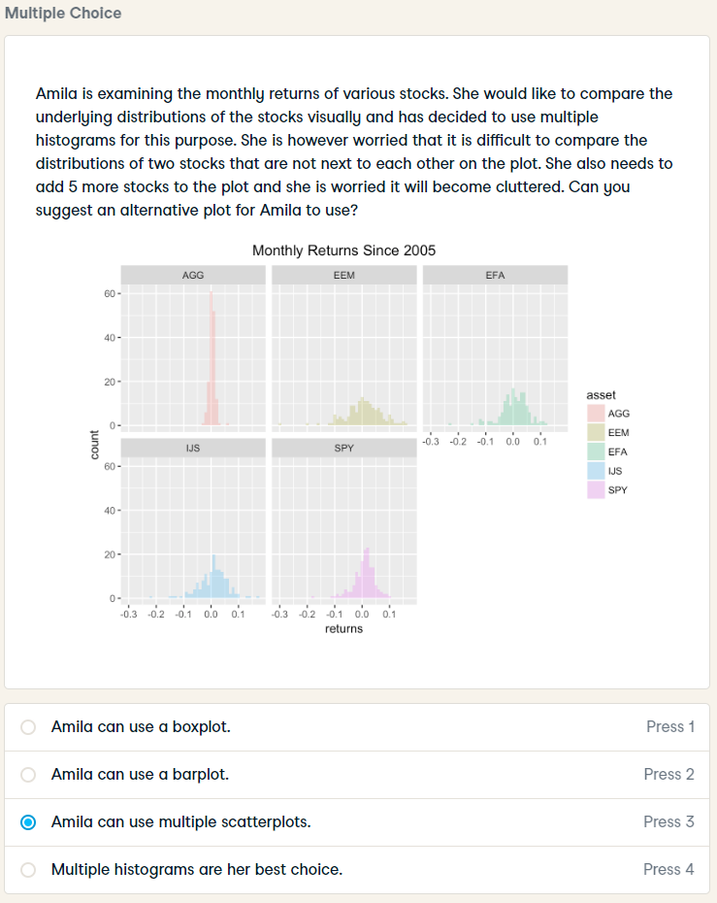
Amila is examining the monthly returns of various stocks. She would like to compare the underlying distributions of the stocks visually and has decided to use multiple histograms for this purpose. She is however worried that it is difficult to compare the distributions of two stocks that are not next to each other on the plot. She also needs to add 5 more stocks to the plot and she is worried it will become cluttered. Can you suggest an alternative plot for Amila to use?

Slide 23
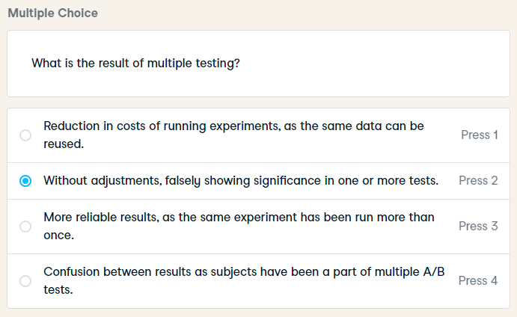
HARD
What is the result of multiple testing?

Slide 24
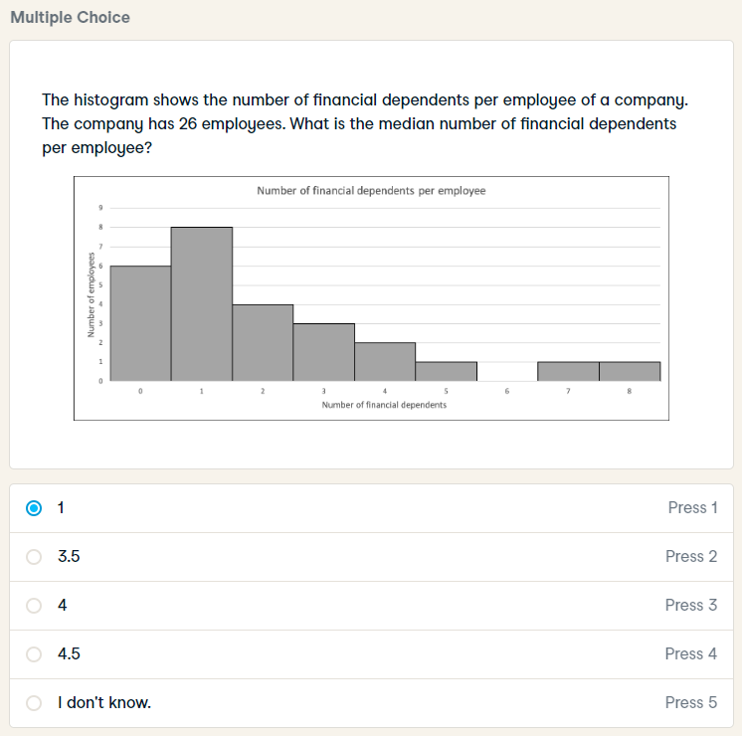
The histogram shows the number of financial dependents per employee of a company. The company has 26 employees. What is the median number of financial dependents per employee?

