Slide 1
datacamp
Model Development

Slide 2
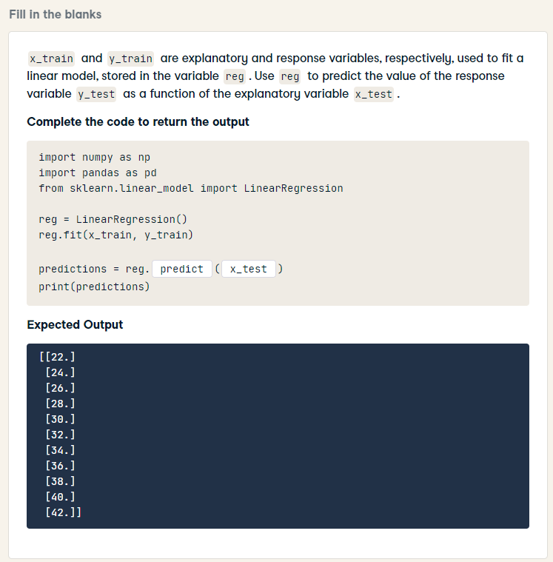
import numpy as np
import pandas as pd
from sklearn.linear_model import LinearRegression
reg = LinearRegression()
reg.fit(x_train, y_train)
predictions = reg.predict(x_test)
print(predictions)

Slide 3
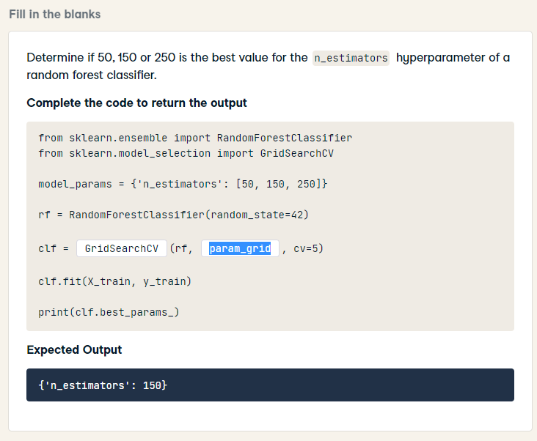
from sklearn.ensemble import RandomForestClassifier
from sklearn.model_selection import GridSearchCV
model_params = {'n_estimators': [50, 150, 250]}
rf = RandomForestClassifier(random_state=42)
clf = GridSearchCV(rf, model_params, cv=5)
clf.fit(X_train, y_train)
print(clf.best_params_)

Slide 4
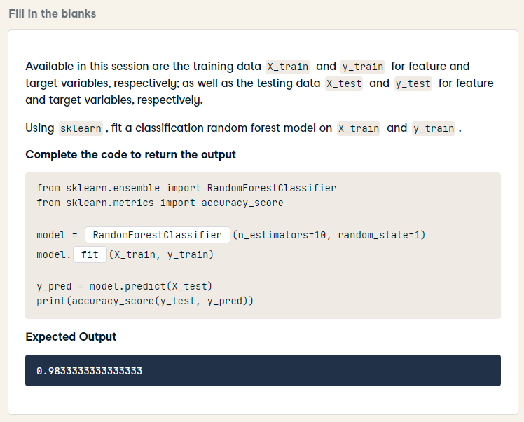
from sklearn.ensemble import RandomForestClassifier
from sklearn.metrics import accuracy_score
model = RandomForestClassifier(n_estimators=10, random_state=1)
model.fit(X_train, y_train)
y_pred = model.predict(X_test)
print(accuracy_score(y_test, y_pred))

Slide 5
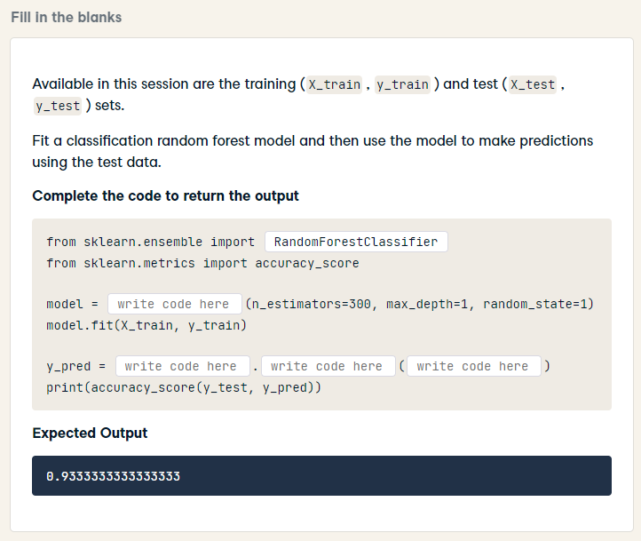
from sklearn.ensemble import RandomForestClassifier
from sklearn.metrics import accuracy_score
model = RandomForestClassifier(n_estimators=300, max_depth=1, random_state=1)
model.fit(X_train, y_train)
y_pred = model.predict(X_test)
print(accuracy_score(y_test, y_pred))

Slide 6
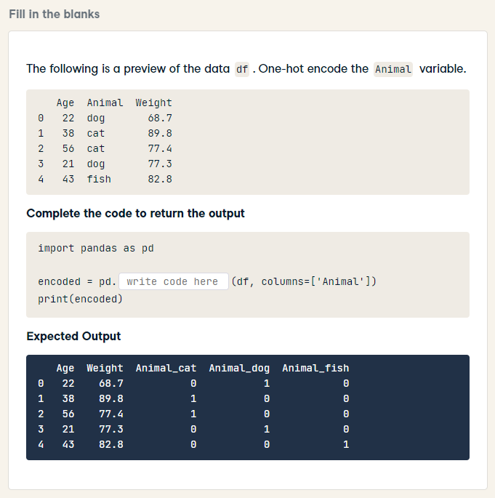
import pandas as pd
encoded = pd.get_dummies(df, columns=['Animal'])
print(encoded)

Slide 7
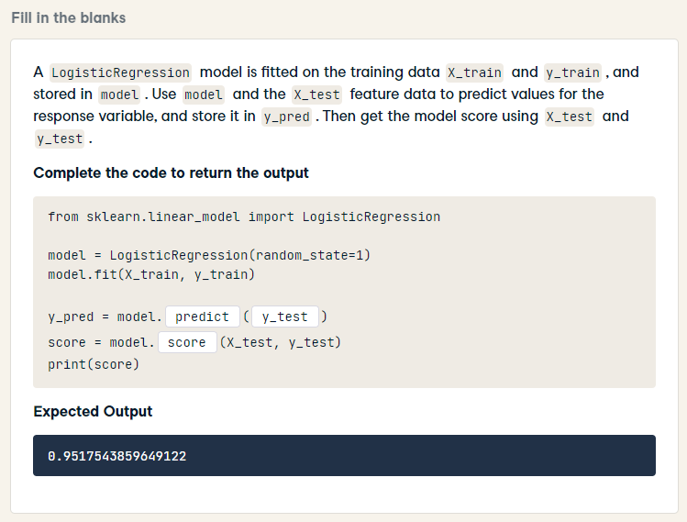
from sklearn.linear_model import LogisticRegression
model = LogisticRegression(random_state=1)
model.fit(X_train, y_train)
y_pred = model.predict(X_test)
score = model.score(X_test, y_test)
print(score)

Slide 8
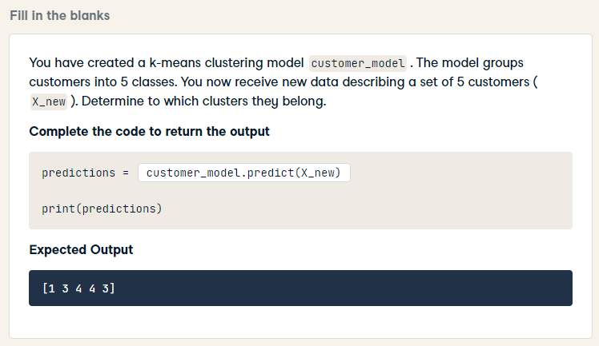
predictions = customer_model.predict(X_new)
print(predictions)

Slide 9
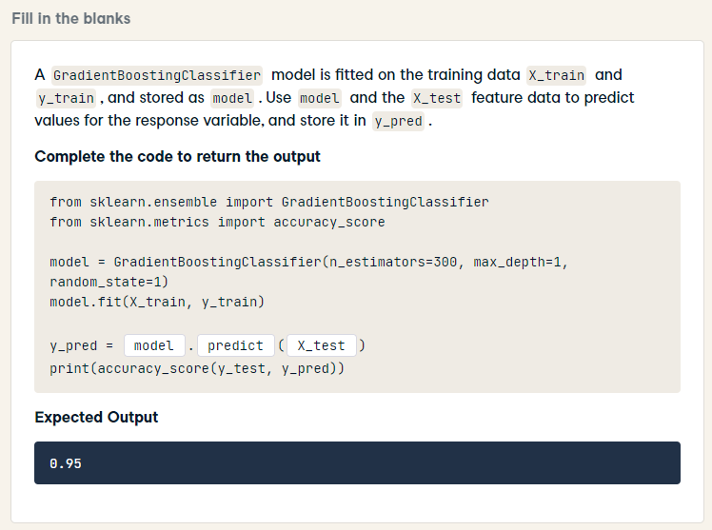
from sklearn.ensemble import GradientBoostingClassifier
from sklearn.metrics import accuracy_score
model = GradientBoostingClassifier(n_estimators=300, max_depth=1, random_state=1)
model.fit(X_train, y_train)
y_pred = model.predict(X_test)
print(accuracy_score(y_test, y_pred))

Slide 10
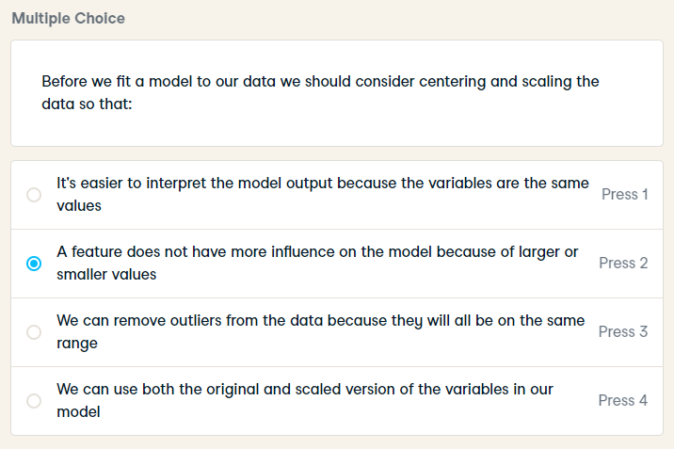
Before we fit a model to our data we should consider centering and scaling the data so that:

Slide 11
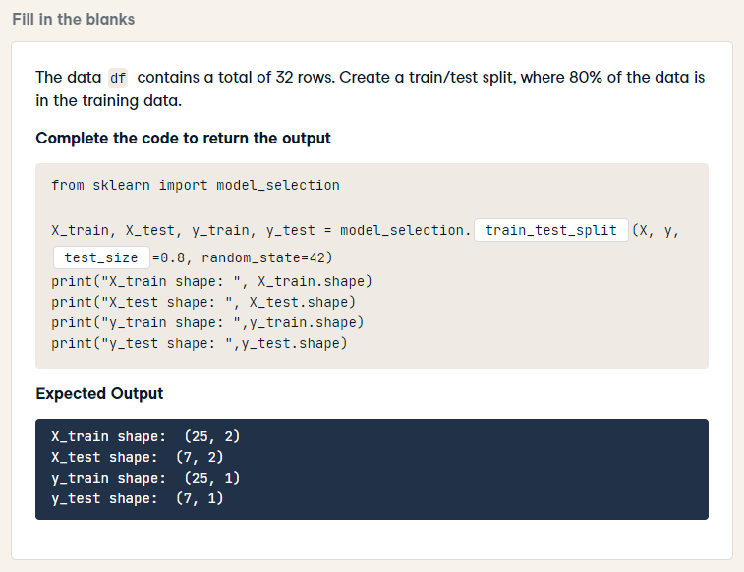
from sklearn import model_selection
X_train, X_test, y_train, y_test = model_selection.train_test_split(X, y, train_size=0.8, random_state=42)
print("X_train shape: ", X_train.shape)
print("X_test shape: ", X_test.shape)
print("y_train shape: ",y_train.shape)
print("y_test shape: ",y_test.shape)

Slide 12
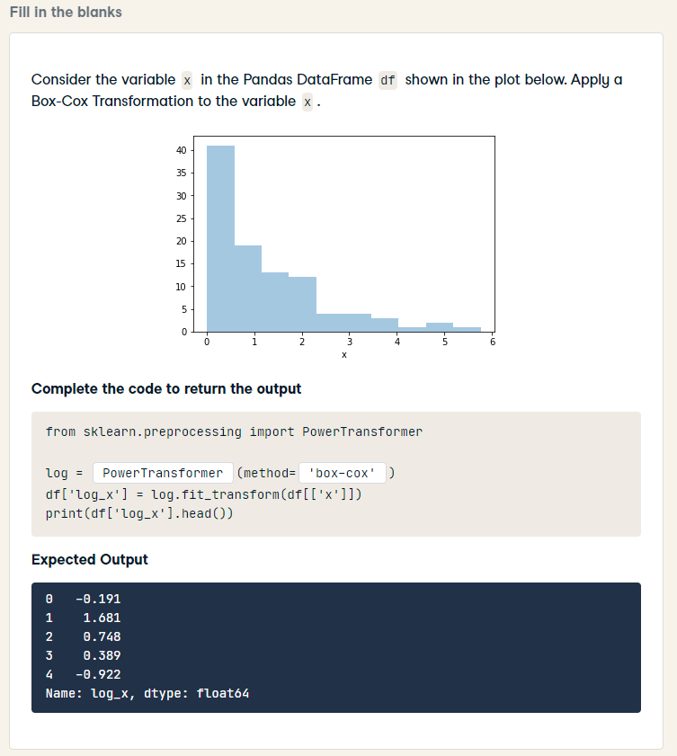
from sklearn.preprocessing import PowerTransformer
log = PowerTransformer(method='box-cox')
df['log_x'] = log.fit_transform(df[['x']])
print(df['log_x'].head())

Slide 13
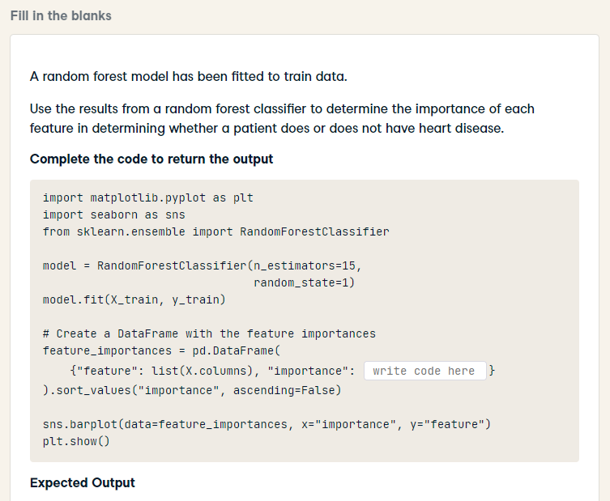
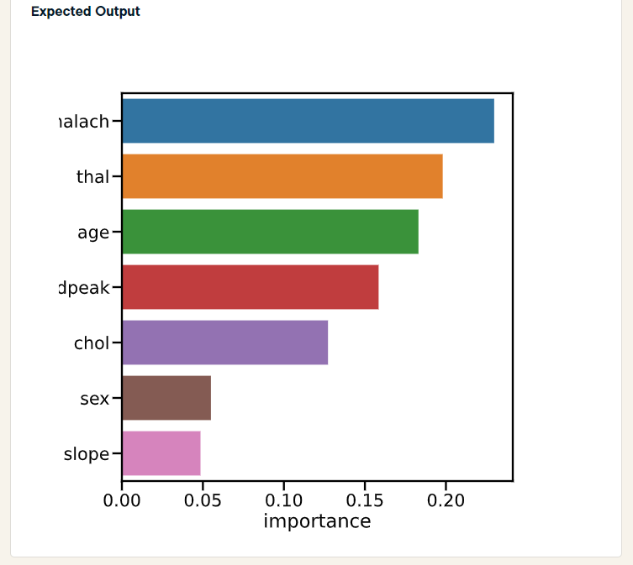
HARD
import matplotlib.pyplot as plt
import seaborn as sns
from sklearn.ensemble import RandomForestClassifier
model = RandomForestClassifier(n_estimators=15,
random_state=1)
model.fit(X_train, y_train)
# Create a DataFrame with the feature importances
feature_importances = pd.DataFrame(
{"feature": list(X.columns), "importance": model.feature_importances_}
).sort_values("importance", ascending=False)
sns.barplot(data=feature_importances, x="importance", y="feature")
plt.show()

Slide 14
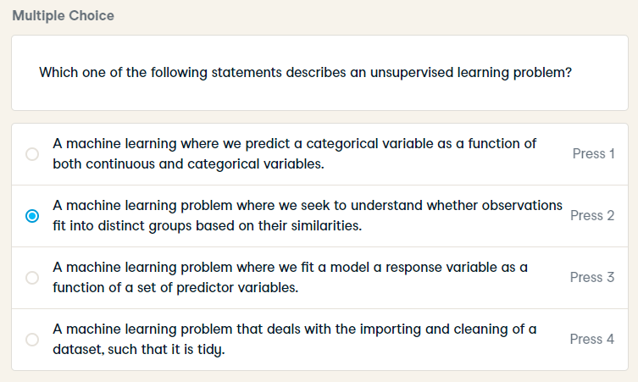
Which one of the following statements describes an unsupervised learning problem?

Slide 15
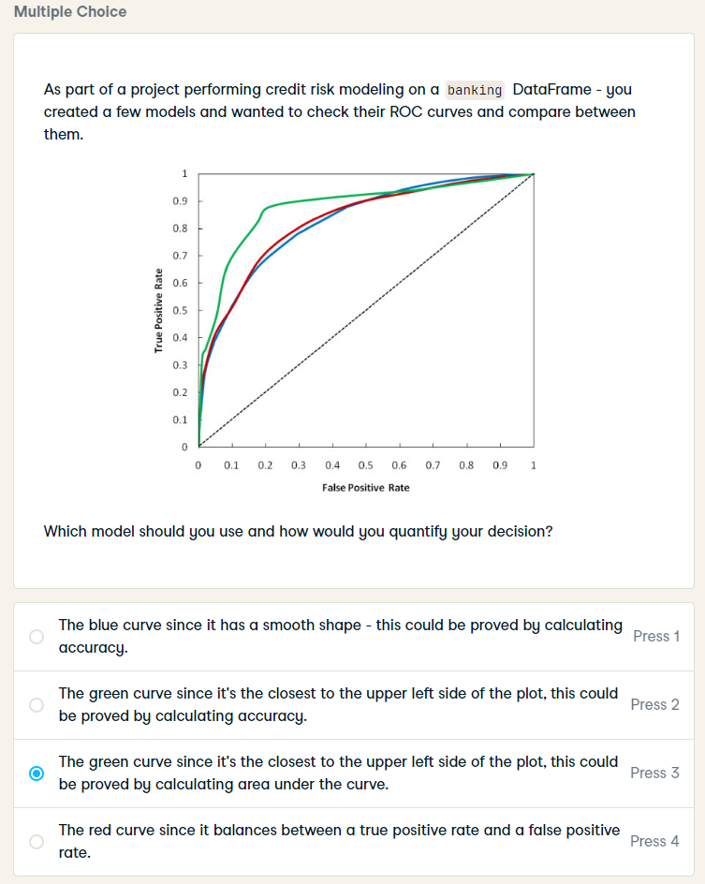
As part of a project performing credit risk modeling on a banking DataFrame - you created a few models and wanted to check their ROC curves and compare between them.
Which model should you use and how would you quantify your decision?

Slide 16
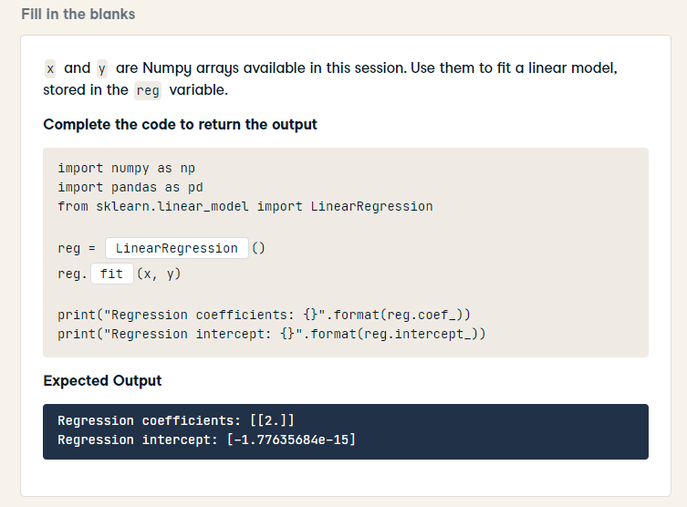
import numpy as np
import pandas as pd
from sklearn.linear_model import LinearRegression
reg = LinearRegression()
reg.fit(x, y)
print("Regression coefficients: {}".format(reg.coef_))
print("Regression intercept: {}".format(reg.intercept_))

Slide 17
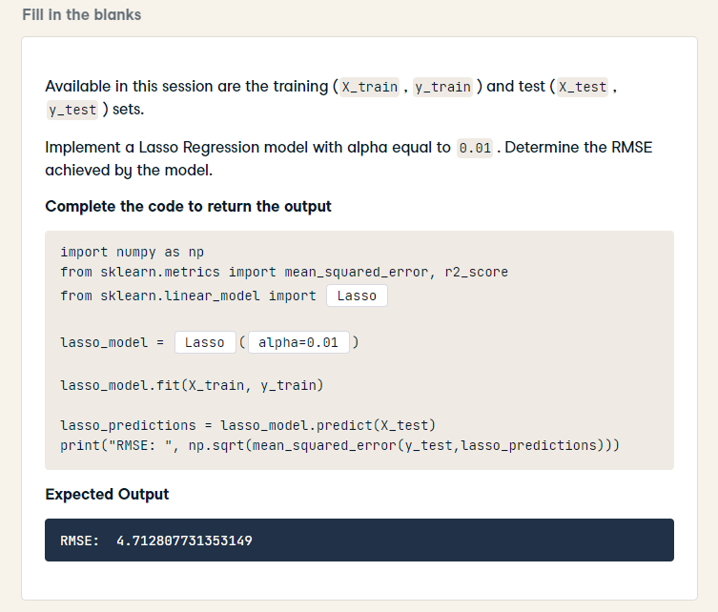
import numpy as np
from sklearn.metrics import mean_squared_error, r2_score
from sklearn.linear_model import Lasso
lasso_model = Lasso(alpha=0.01)
lasso_model.fit(X_train, y_train)
lasso_predictions = lasso_model.predict(X_test)
print("RMSE: ", np.sqrt(mean_squared_error(y_test,lasso_predictions)))

Slide 18
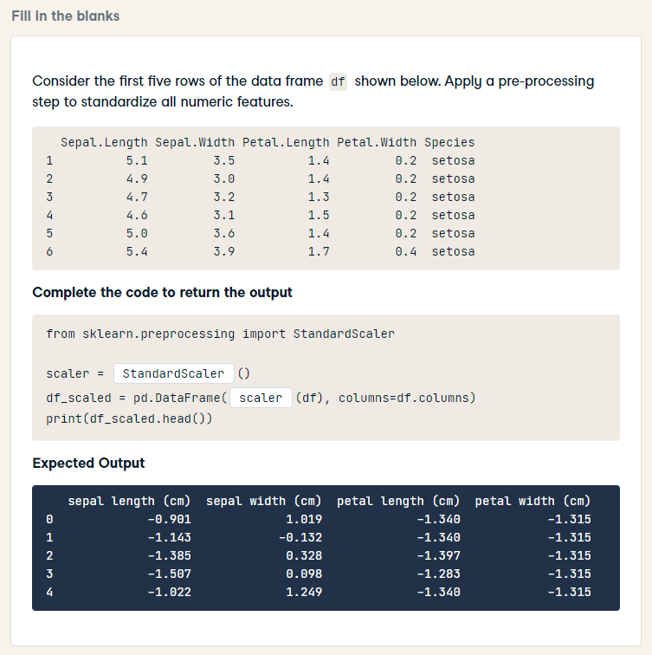
HARD
from sklearn.preprocessing import StandardScaler
scaler = StandardScaler()
df_scaled = pd.DataFrame(scaler.fit_transform(df), columns=df.columns)
print(df_scaled.head())

Slide 19
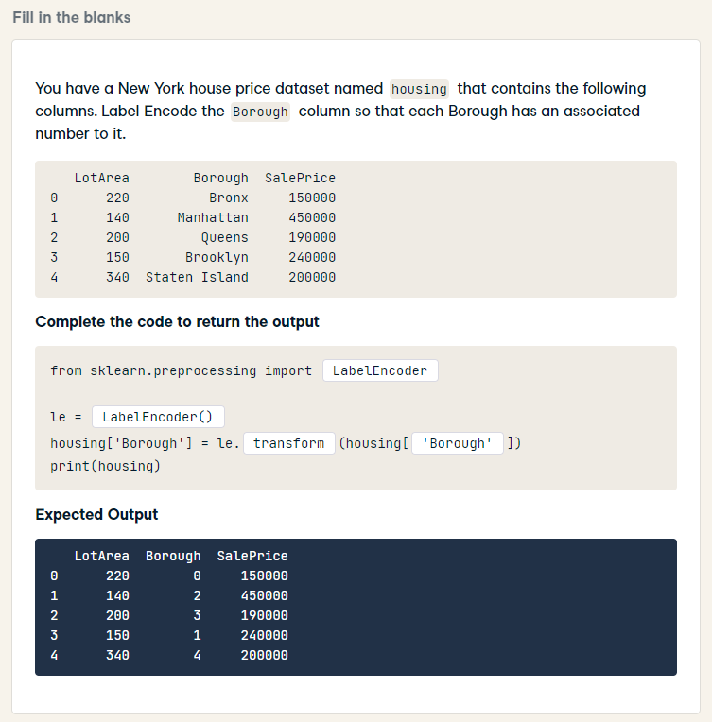
HARD
from sklearn.preprocessing import LabelEncoder
le = LabelEncoder()
housing['Borough'] = le.fit_transform(housing['Borough'])
print(housing)

Slide 20
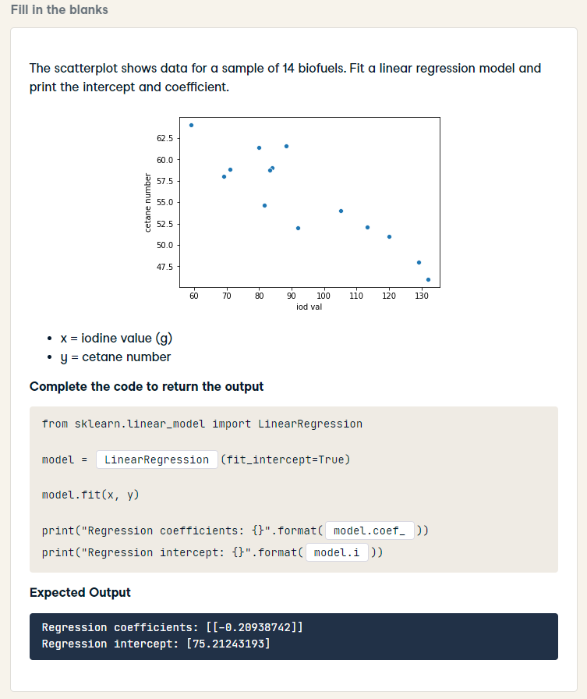
from sklearn.linear_model import LinearRegression
model = LinearRegression(fit_intercept=True)
model.fit(x, y)
print("Regression coefficients: {}".format(model.coef_))
print("Regression intercept: {}".format(model.intercept_))

Slide 21
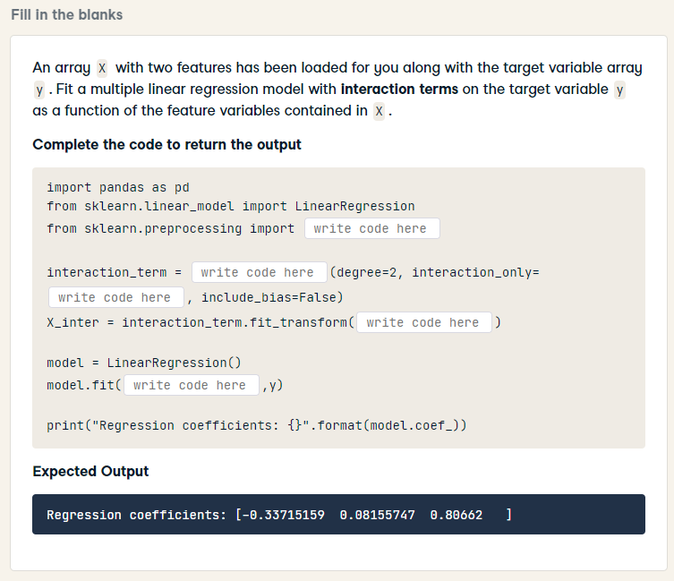
HARD
import pandas as pd
from sklearn.linear_model import LinearRegression
from sklearn.preprocessing import PolynomialFeatures
interaction_term = PolynomialFeatures(degree=2, interaction_only=True, include_bias=False)
X_inter = interaction_term.fit_transform(X)
model = LinearRegression()
model.fit(X_inter, y)
print("Regression coefficients: {}".format(model.coef_))

Slide 22
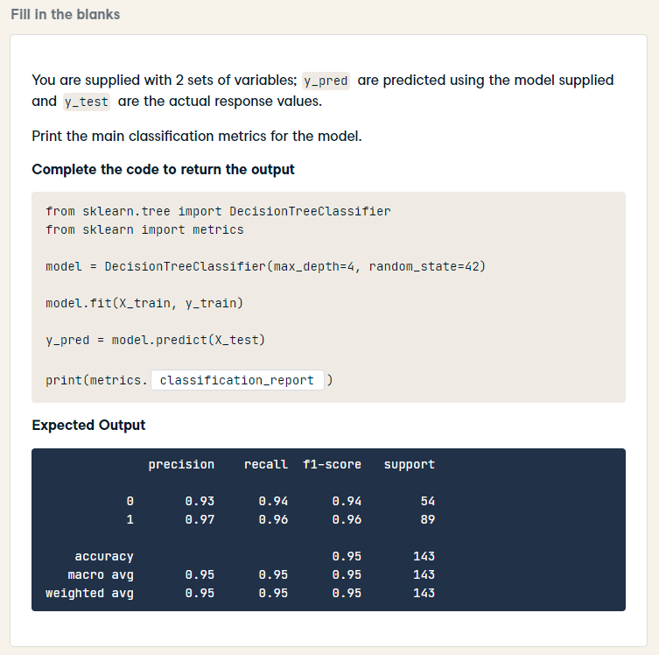
HARD
from sklearn.tree import DecisionTreeClassifier
from sklearn import metrics
model = DecisionTreeClassifier(max_depth=4, random_state=42)
model.fit(X_train, y_train)
y_pred = model.predict(X_test)
print(metrics.classification_report(y_test, y_pred))

Slide 23
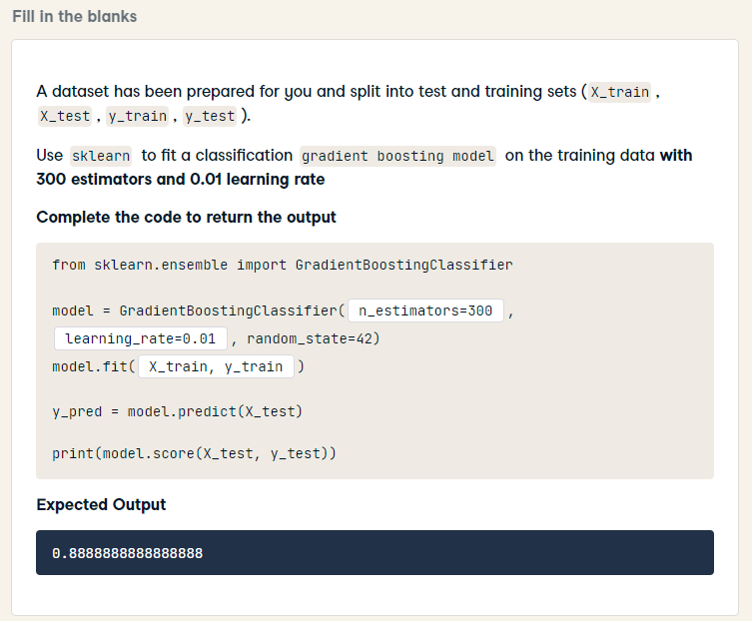
from sklearn.ensemble import GradientBoostingClassifier
model = GradientBoostingClassifier(n_estimators=300, learning_rate=0.01, random_state=42)
model.fit(X_train, y_train)
y_pred = model.predict(X_test)
print(model.score(X_test, y_test))

Slide 24
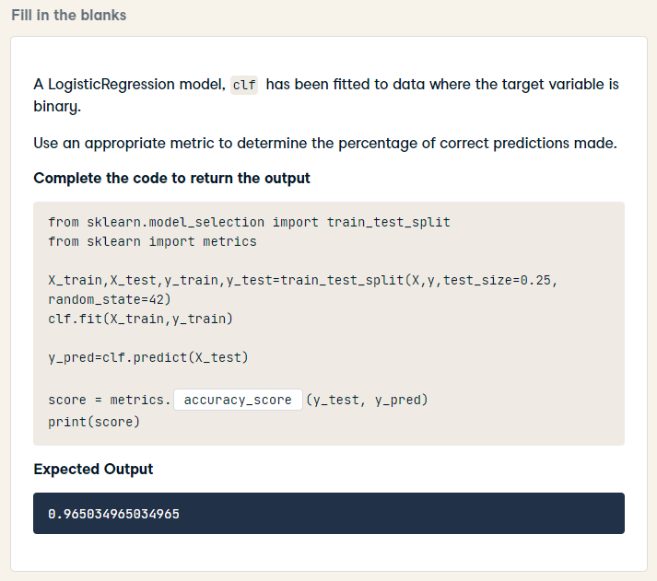
from sklearn.model_selection import train_test_split
from sklearn import metrics
X_train,X_test,y_train,y_test=train_test_split(X,y,test_size=0.25, random_state=42)
clf.fit(X_train,y_train)
y_pred=clf.predict(X_test)
score = metrics.accuracy_score(y_test, y_pred)
print(score)

