Slide 1
datacamp
Statistical Experimentation

Slide 2
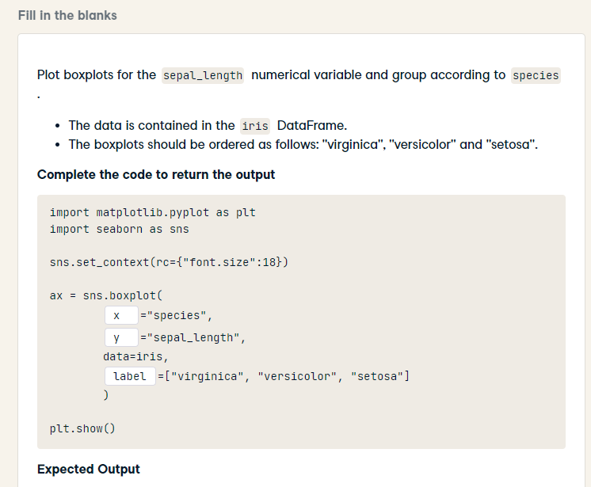
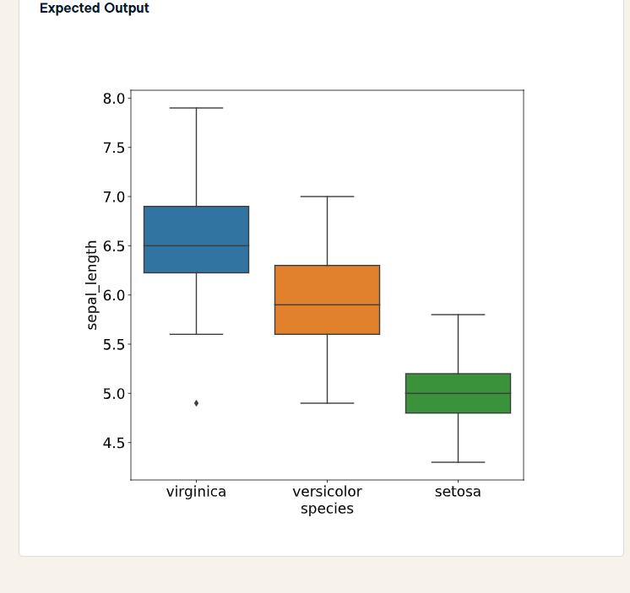
import matplotlib.pyplot as plt
import seaborn as sns
sns.set_context(rc={"font.size":18})
ax = sns.boxplot(
x = "species",
y = "sepal_length",
data=iris,
order = ["virginica", "versicolor", "setosa"]
)
plt.show()

Slide 3
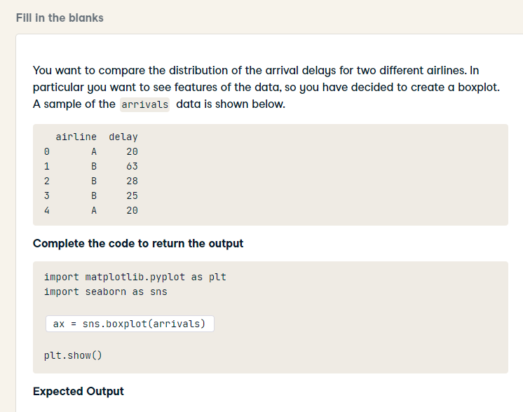
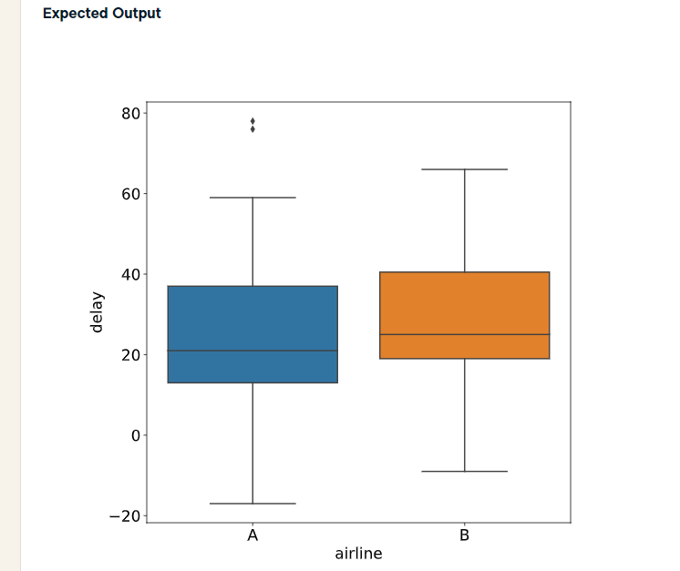
import matplotlib.pyplot as plt
import seaborn as sns
sns.boxplot(x = 'airline', y = 'delay', data = arrivals)
plt.show()

Slide 4
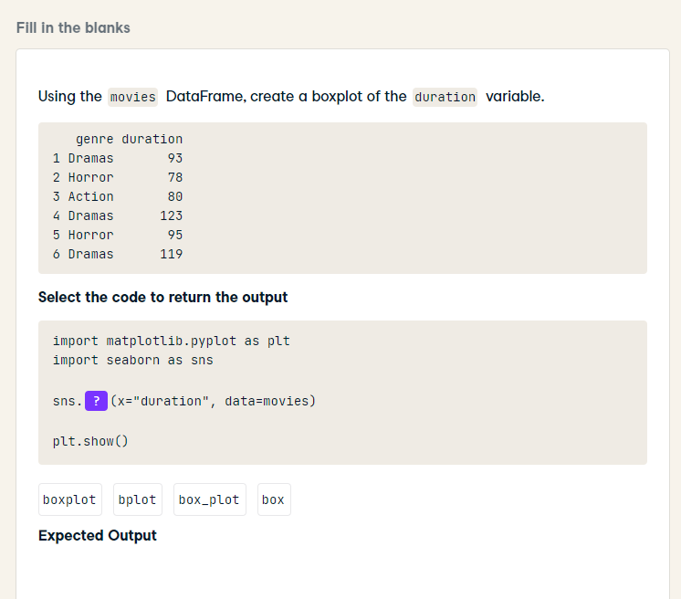
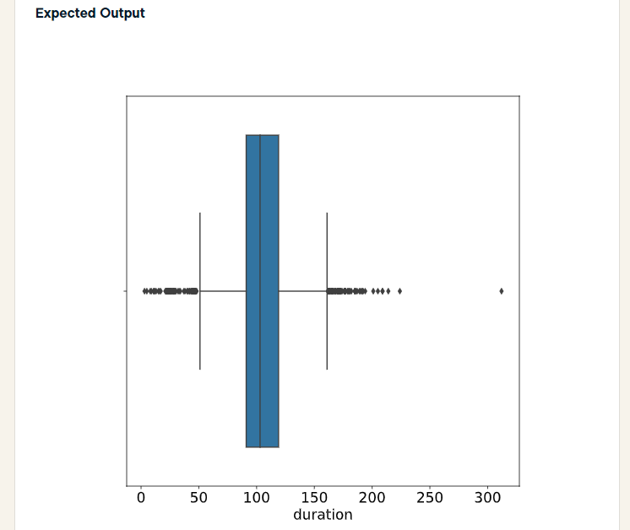
import matplotlib.pyplot as plt
import seaborn as sns
sns.boxplot(x="duration", data=movies)
plt.show()

Slide 5
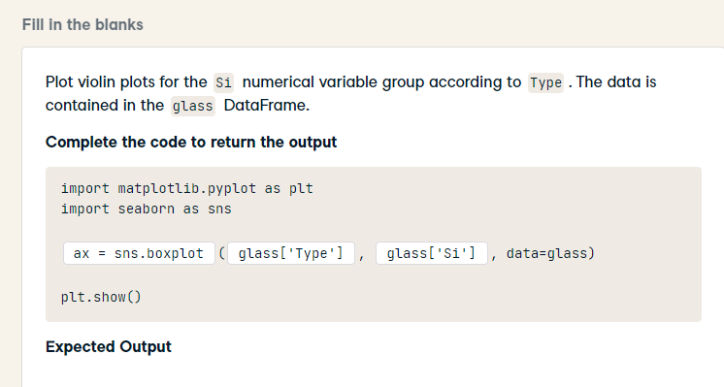
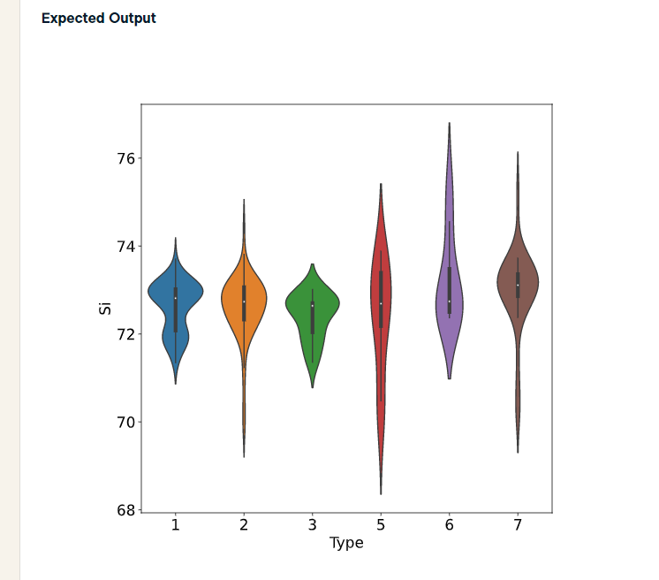
import matplotlib.pyplot as plt
import seaborn as sns
ax = sns.violinplot(x="Type", y="Si", data=glass)
plt.show()

Slide 6
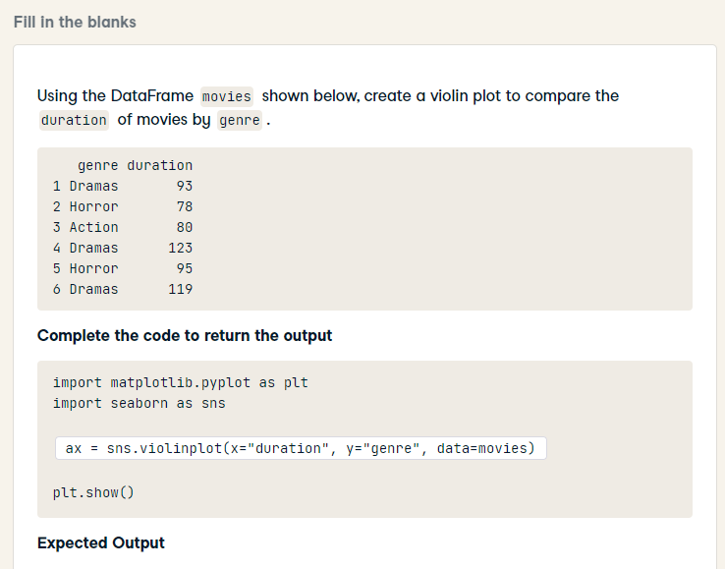
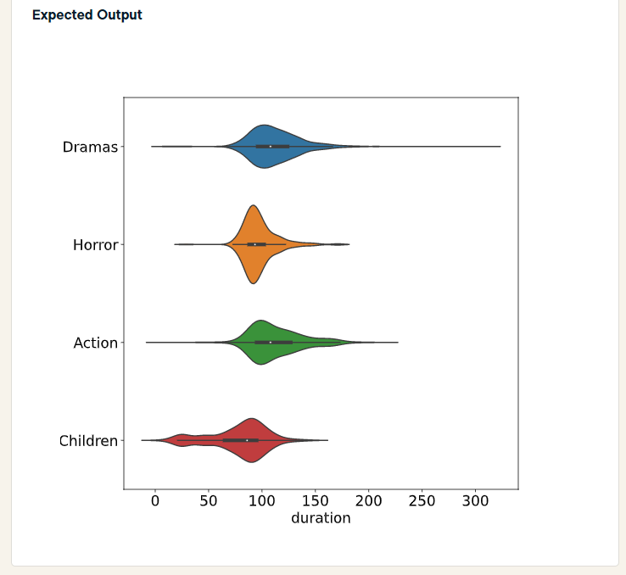
import matplotlib.pyplot as plt
import seaborn as sns
ax = sns.violinplot(x="duration", y="genre", data=movies)
plt.show()

Slide 7
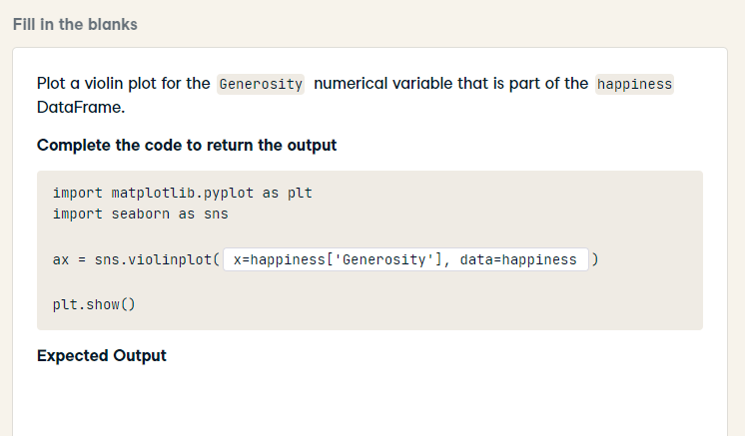
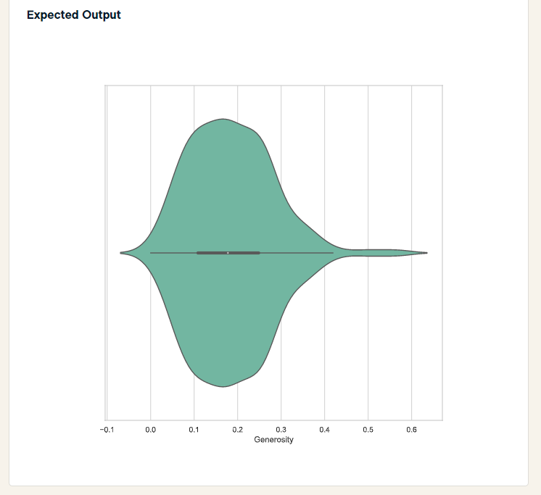
import matplotlib.pyplot as plt
import seaborn as sns
ax = sns.violinplot(x='Generosity', data=happiness)
plt.show()

Slide 8
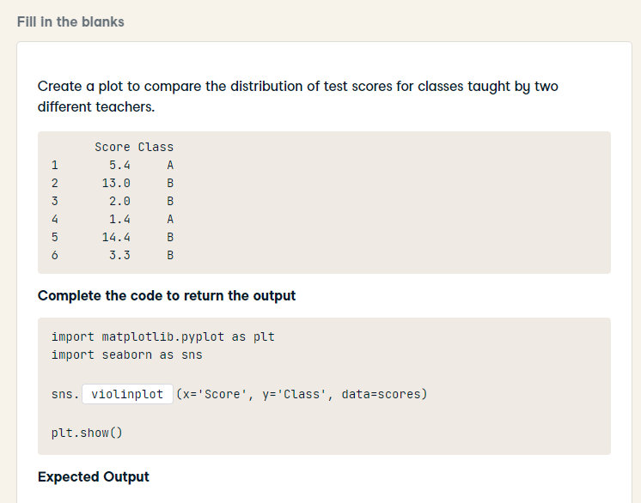
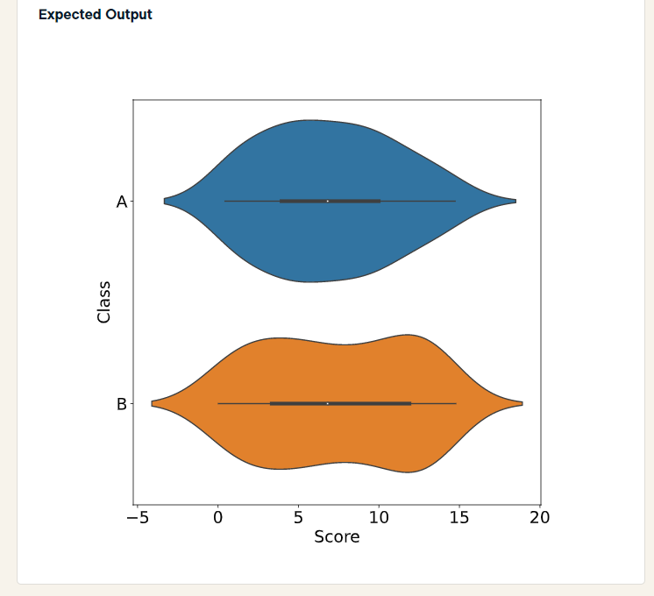
import matplotlib.pyplot as plt
import seaborn as sns
sns.violinplot(x='Score', y='Class', data=scores)
plt.show()

Slide 9
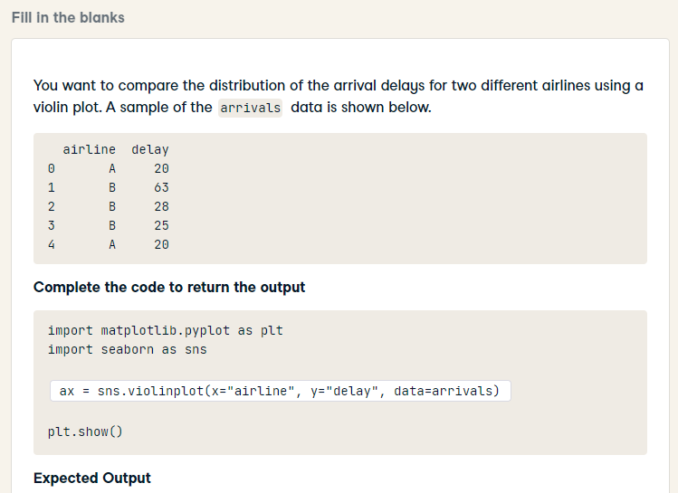
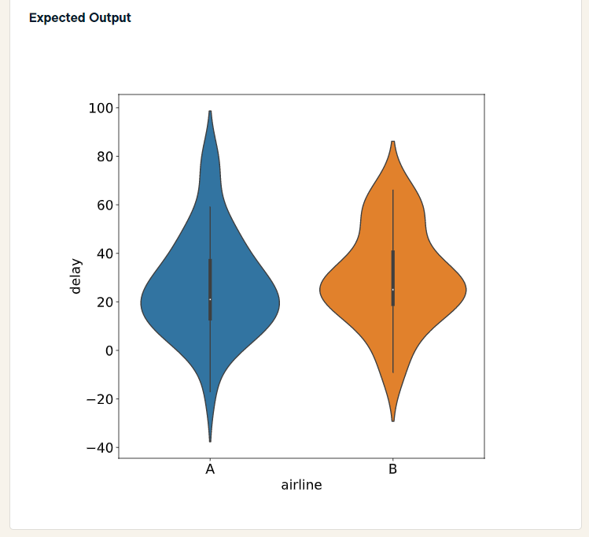
import matplotlib.pyplot as plt
import seaborn as sns
ax = sns.violinplot(x="airline", y="delay", data=arrivals)
plt.show()

Slide 10
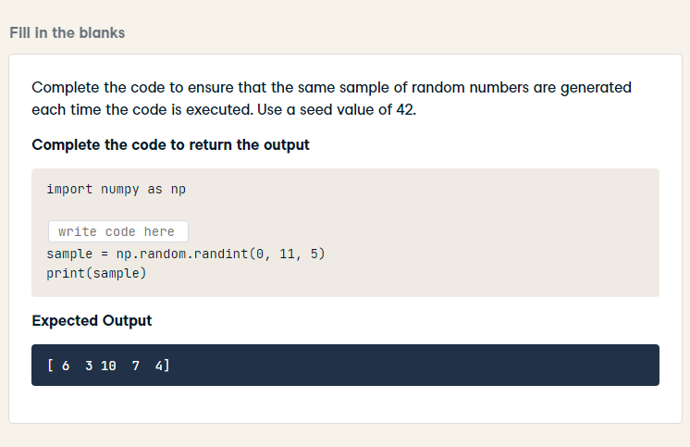
import numpy as np
np.random.seed(42)
sample = np.random.randint(0, 11, 5)
print(sample)

Slide 11
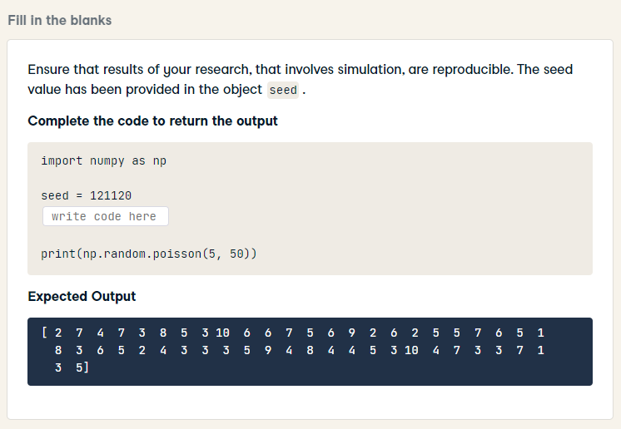
import numpy as np
seed = 121120
np.random.seed(seed)
print(np.random.poisson(5, 50))

Slide 12
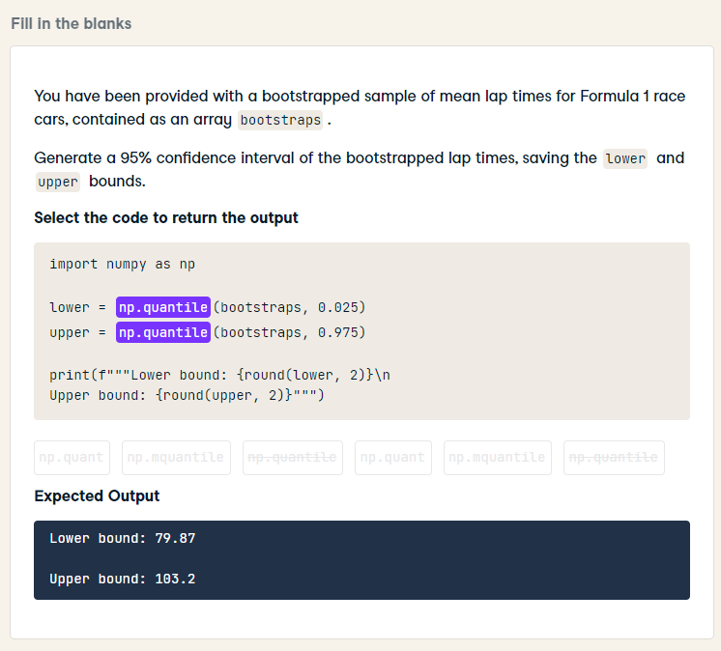
import numpy as np
lower = np.quantile(bootstraps, 0.025)
upper = np.quantile(bootstraps, 0.975)
print(f"""Lower bound: {round(lower, 2)}\n
Upper bound: {round(upper, 2)}""")

Slide 13
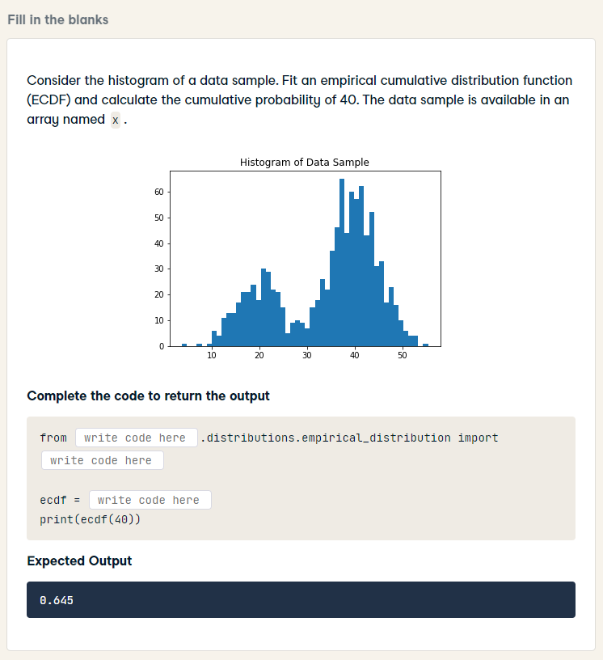
from statsmodels.distributions.empirical_distribution import ECDF
ecdf = ECDF(x)
print(ecdf(40))

Slide 14
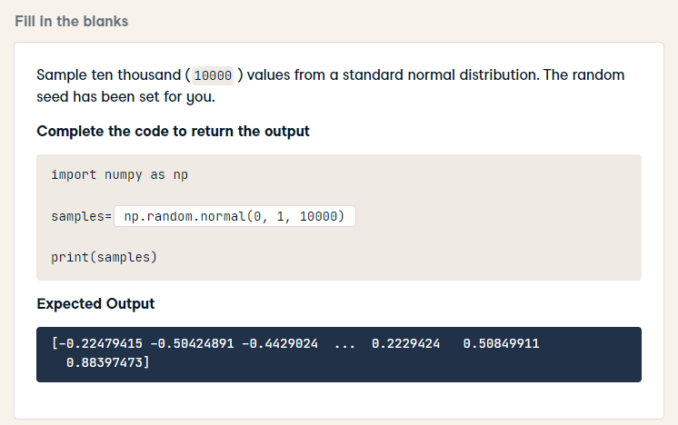
import numpy as np
sample = np.random.normal(0, 1, 10000)
print(samples)

Slide 15
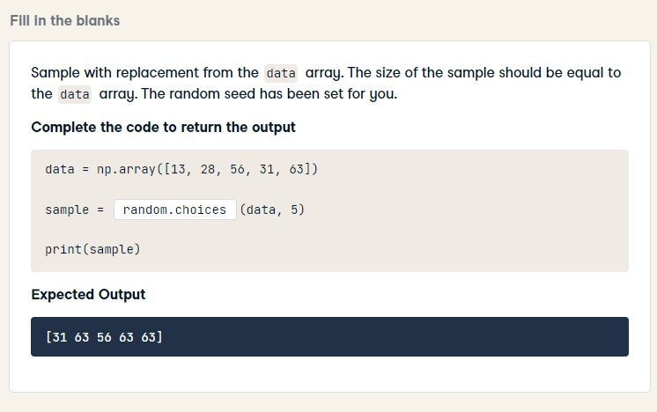
data = np.array([13, 28, 56, 31, 63])
sample = np.random.choice(data, 5)
print(sample)

Slide 16
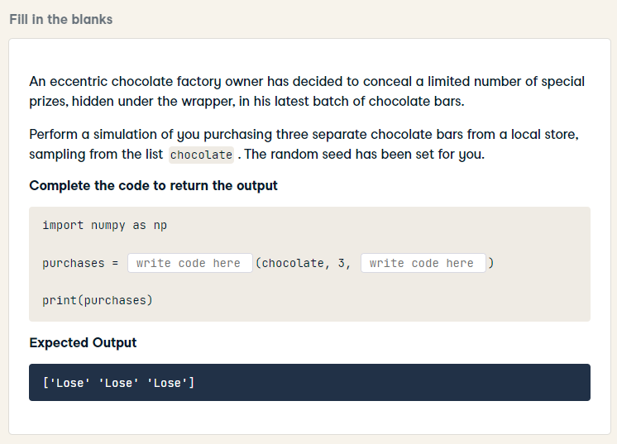
import numpy as np
purchases = np.random.choice(chocolate, 3, replace=False)
print(purchases)

Slide 17
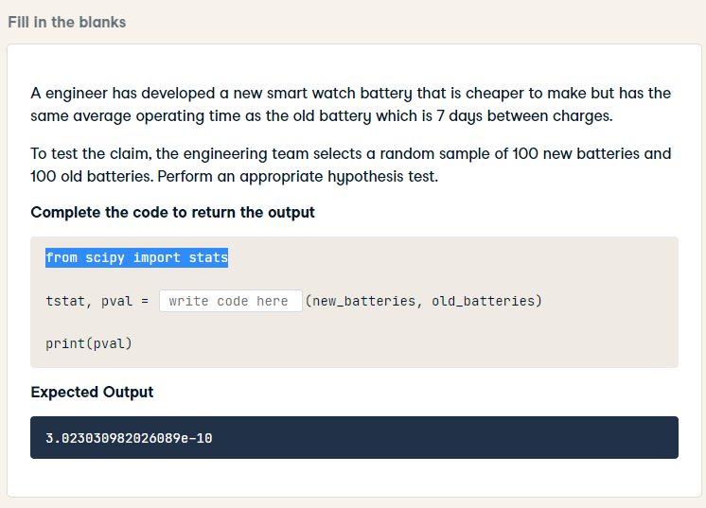
from scipy import stats
tstat, pval = stats.ttest_ind(new_batteries, old_batteries)
print(pval)

Slide 18
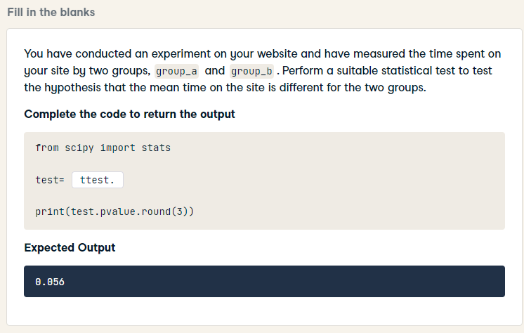
from scipy import stats
test= stats.ttest_ind(group_a, group_b)
print(test.pvalue.round(3))

Slide 19
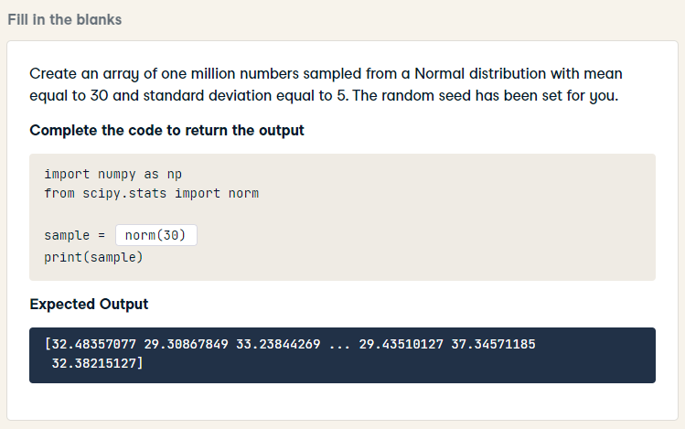
import numpy as np
from scipy.stats import norm
sample = np.random.normal(30, 5, 1000000)
print(sample)

Slide 20
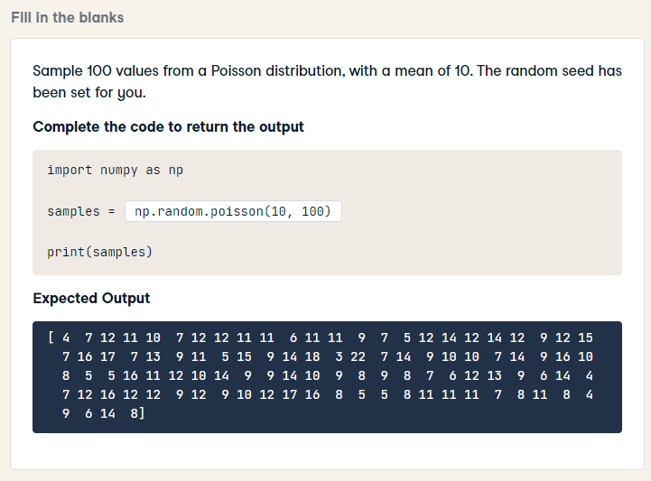
import numpy as np
samples = np.random.poisson(10, 100)
print(samples)

Slide 21
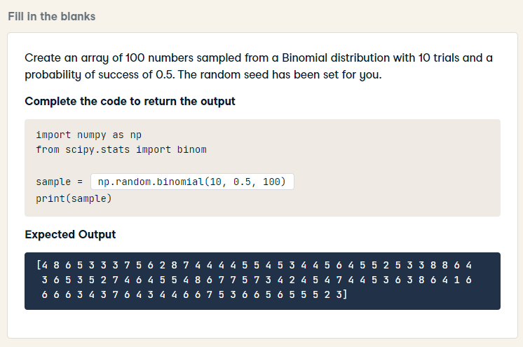
import numpy as np
from scipy.stats import binom
sample = np.random.binomial(10, 0.5, 100)
print(sample)

Slide 22
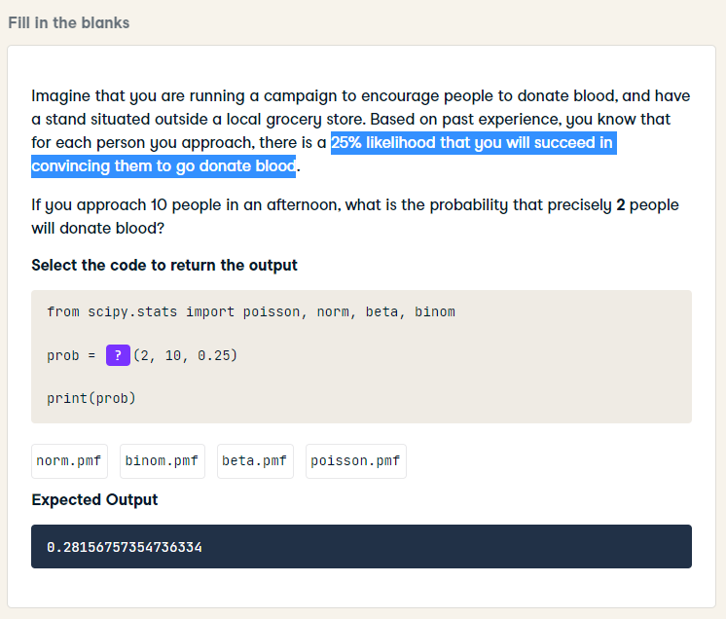
from scipy.stats import poisson, norm, beta, binom
prob = binom.pmf(2, 10, 0.25)
print(prob)

