Slide 1
datacamp
Model Development
Machine Learning Fundamentals in Python

Slide 2
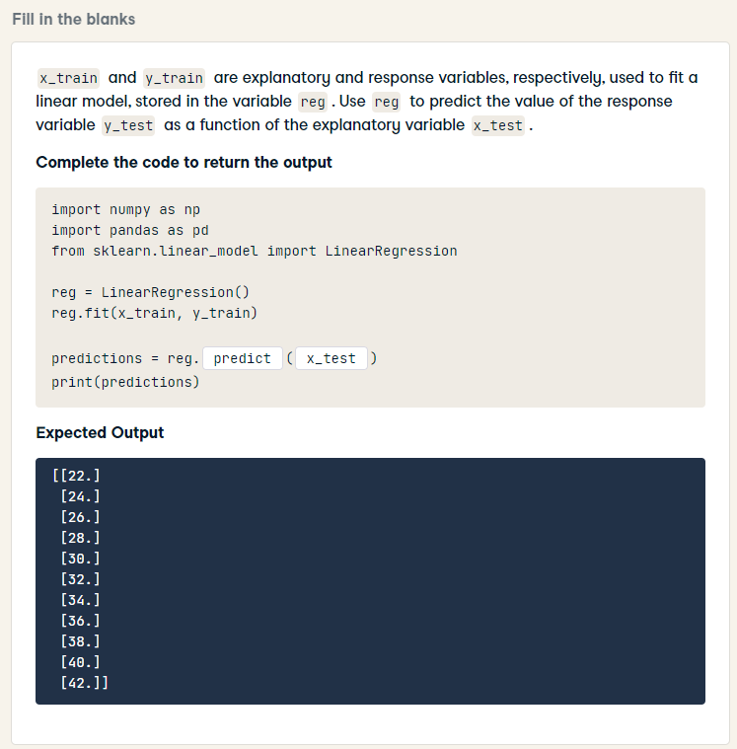
import numpy as np
import pandas as pd
from sklearn.linear_model import LinearRegression
reg = LinearRegression()
reg.fit(x_train, y_train)
predictions = reg.predict(x_test)
print(predictions)

Slide 3
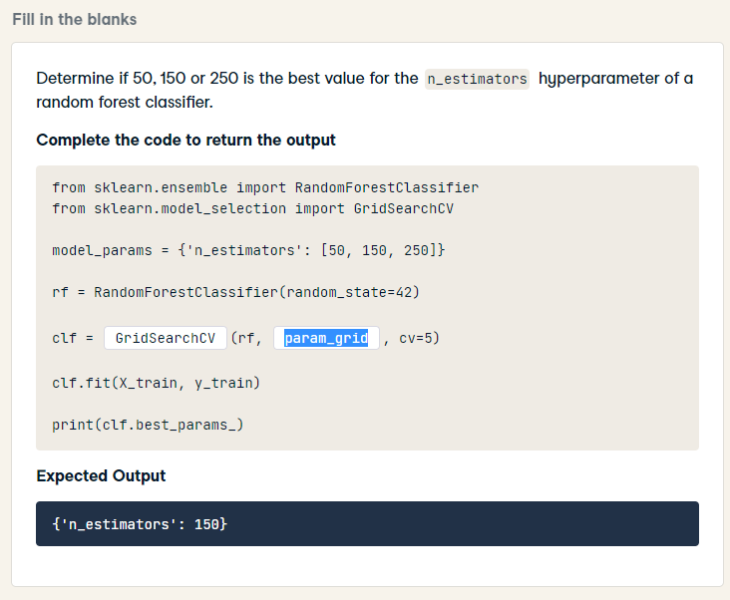
from sklearn.ensemble import RandomForestClassifier
from sklearn.model_selection import GridSearchCV
model_params = {'n_estimators': [50, 150, 250]}
rf = RandomForestClassifier(random_state=42)
clf = GridSearchCV(rf, model_params, cv=5)
clf.fit(X_train, y_train)
print(clf.best_params_)

Slide 4
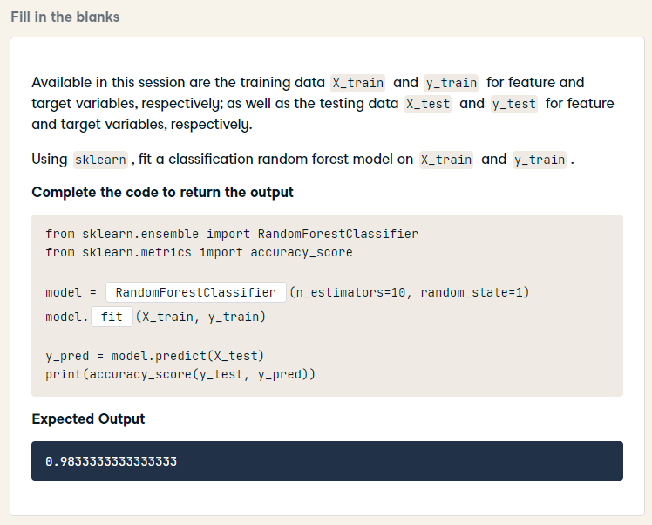
from sklearn.ensemble import RandomForestClassifier
from sklearn.metrics import accuracy_score
model = RandomForestClassifier(n_estimators=10, random_state=1)
model.fit(X_train, y_train)
y_pred = model.predict(X_test)
print(accuracy_score(y_test, y_pred))

Slide 5
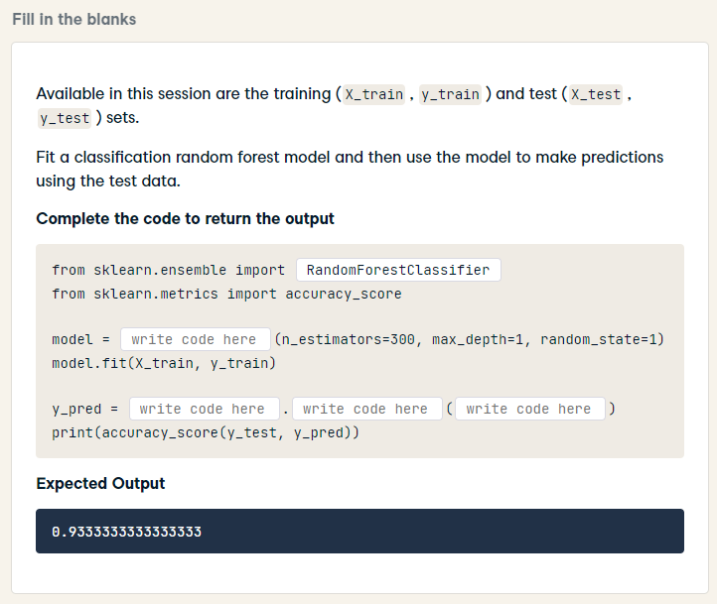
from sklearn.ensemble import RandomForestClassifier
from sklearn.metrics import accuracy_score
model = RandomForestClassifier(n_estimators=300, max_depth=1, random_state=1)
model.fit(X_train, y_train)
y_pred = model.predict(X_test)
print(accuracy_score(y_test, y_pred))

Slide 6
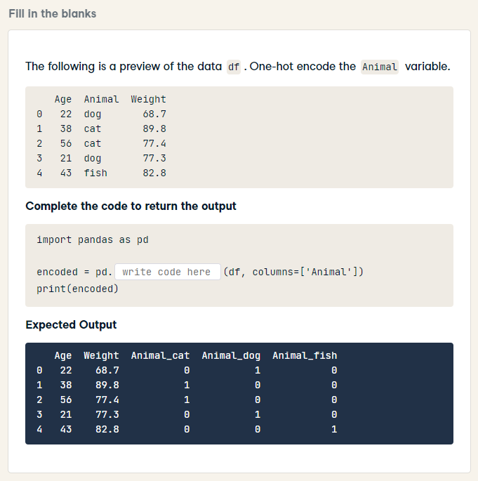
import pandas as pd
encoded = pd.get_dummies(df, columns=['Animal'])
print(encoded)

Slide 7
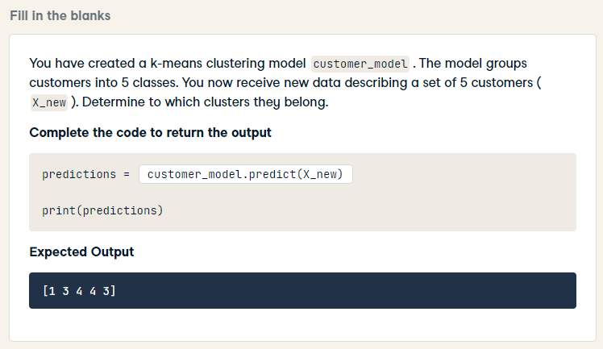
predictions = customer_model.predict(X_new)
print(predictions)

Slide 8
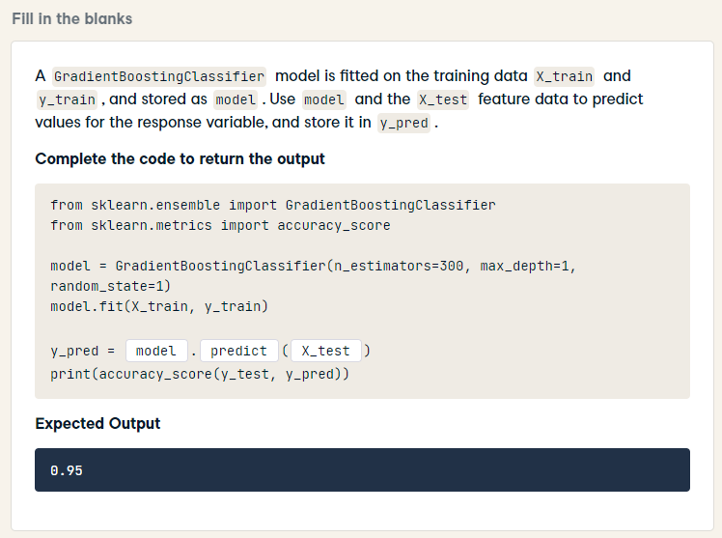
from sklearn.ensemble import GradientBoostingClassifier
from sklearn.metrics import accuracy_score
model = GradientBoostingClassifier(n_estimators=300, max_depth=1, random_state=1)
model.fit(X_train, y_train)
y_pred = model.predict(X_test)
print(accuracy_score(y_test, y_pred))

Slide 9
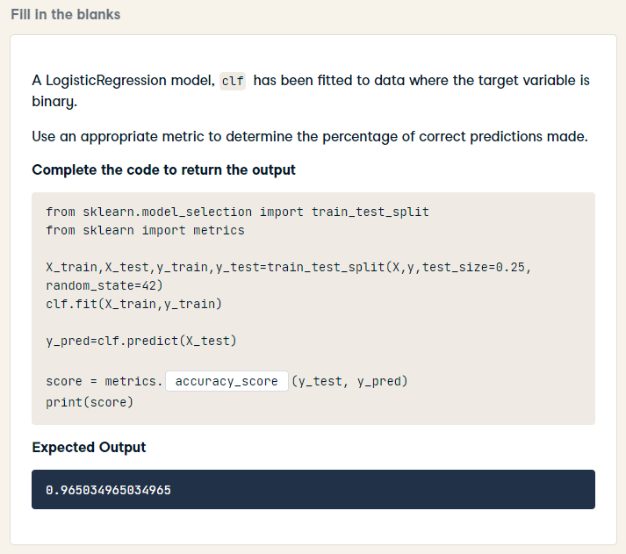
from sklearn.model_selection import train_test_split
from sklearn import metrics
X_train,X_test,y_train,y_test=train_test_split(X,y,test_size=0.25, random_state=42)
clf.fit(X_train,y_train)
y_pred=clf.predict(X_test)
score = metrics.accuracy_score(y_test, y_pred)
print(score)

Slide 10
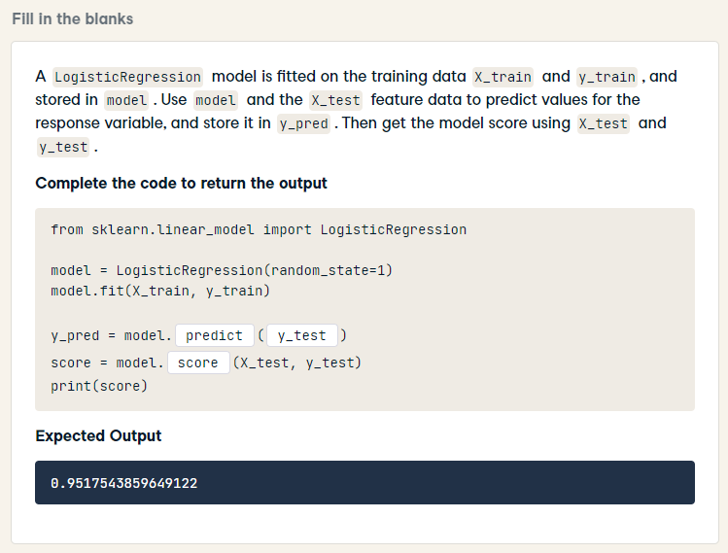
from sklearn.linear_model import LogisticRegression
model = LogisticRegression(random_state=1)
model.fit(X_train, y_train)
y_pred = model.predict(X_test)
score = model.score(X_test, y_test)
print(score)

Slide 11
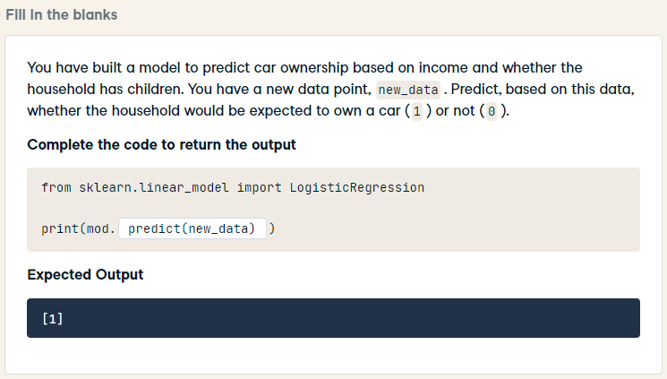
from sklearn.linear_model import LogisticRegression
print(mod.predict(new_data))

Slide 12
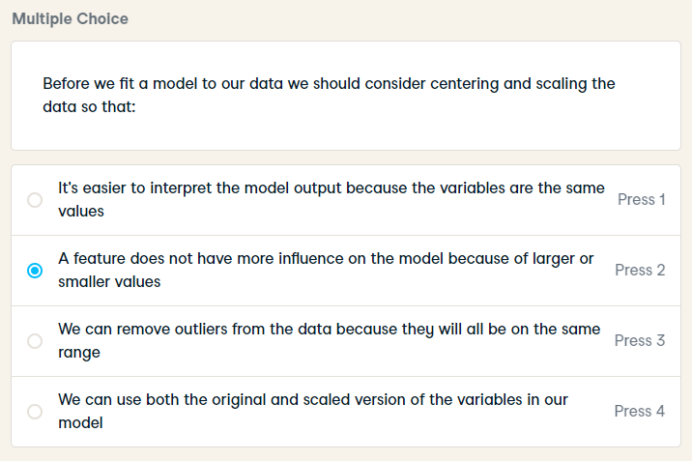
Before we fit a model to our data we should consider centering and scaling the data so that:

Slide 13
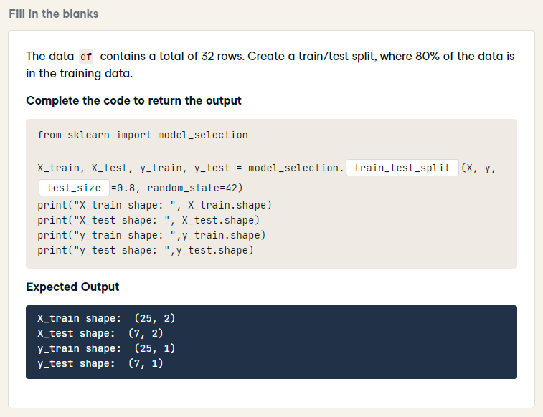
from sklearn import model_selection
X_train, X_test, y_train, y_test = model_selection.train_test_split(X, y, train_size=0.8, random_state=42)
print("X_train shape: ", X_train.shape)
print("X_test shape: ", X_test.shape)
print("y_train shape: ",y_train.shape)
print("y_test shape: ",y_test.shape)

Slide 14
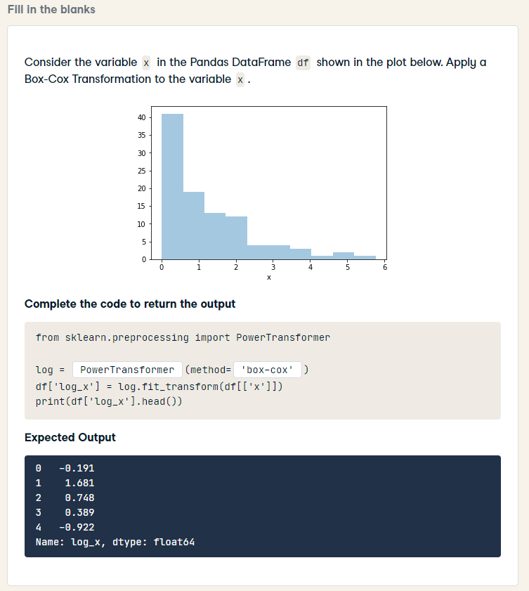
from sklearn.preprocessing import PowerTransformer
log = PowerTransformer(method='box-cox')
df['log_x'] = log.fit_transform(df[['x']])
print(df['log_x'].head())

Slide 15
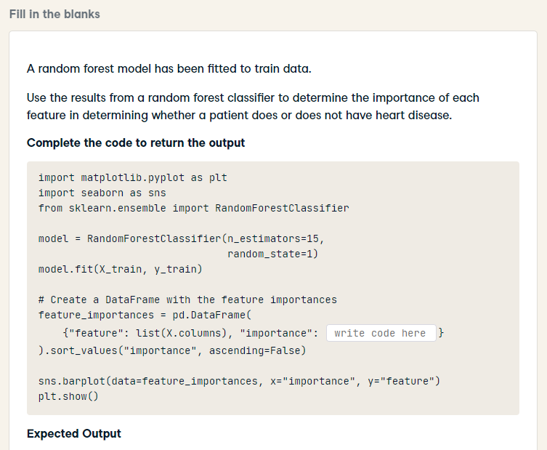
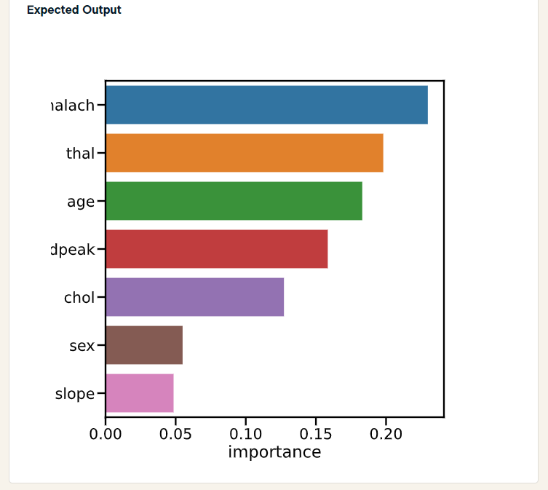
HARD
import matplotlib.pyplot as plt
import seaborn as sns
from sklearn.ensemble import RandomForestClassifier
model = RandomForestClassifier(n_estimators=15,
random_state=1)
model.fit(X_train, y_train)
# Create a DataFrame with the feature importances
feature_importances = pd.DataFrame(
{"feature": list(X.columns), "importance": model.feature_importances_}
).sort_values("importance", ascending=False)
sns.barplot(data=feature_importances, x="importance", y="feature")
plt.show()

Slide 16
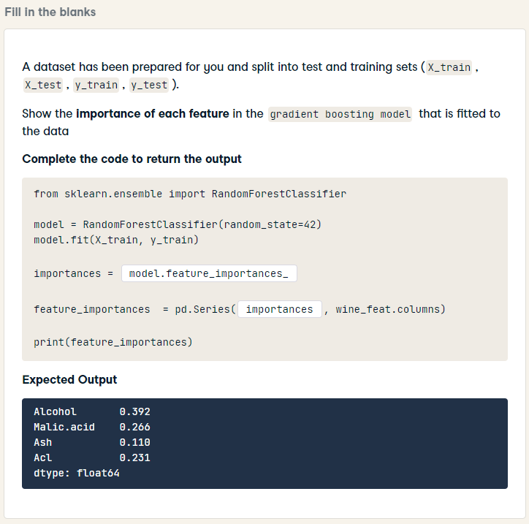
HARD
from sklearn.ensemble import RandomForestClassifier
model = RandomForestClassifier(random_state=42)
model.fit(X_train, y_train)
importances = model.feature_importances_
feature_importances = pd.Series(importances, wine_feat.columns)
print(feature_importances)

Slide 17
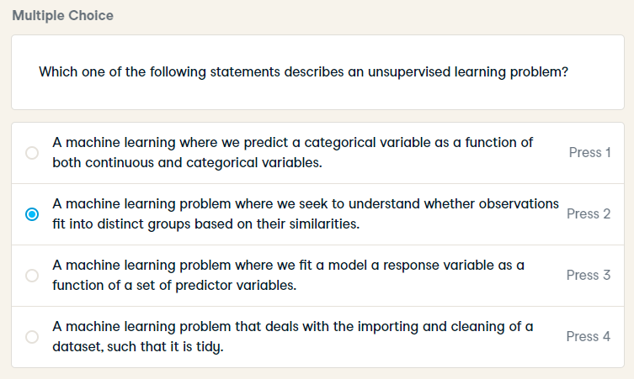
Which one of the following statements describes an unsupervised learning problem?

Slide 18
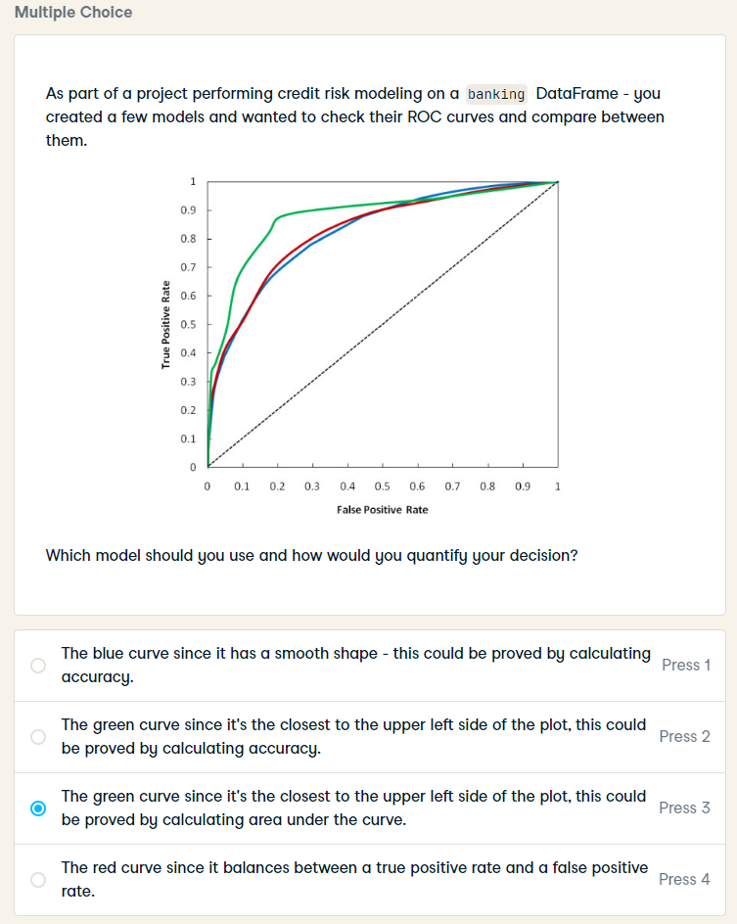
As part of a project performing credit risk modeling on a banking DataFrame - you created a few models and wanted to check their ROC curves and compare between them.
Which model should you use and how would you quantify your decision?

Slide 19
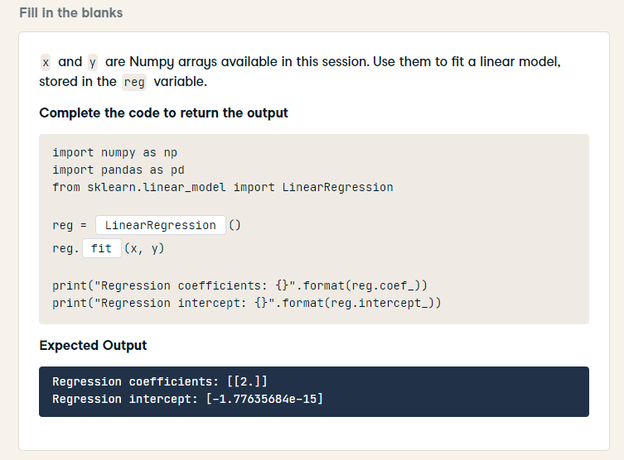
import numpy as np
import pandas as pd
from sklearn.linear_model import LinearRegression
reg = LinearRegression()
reg.fit(x, y)
print("Regression coefficients: {}".format(reg.coef_))
print("Regression intercept: {}".format(reg.intercept_))

Slide 20
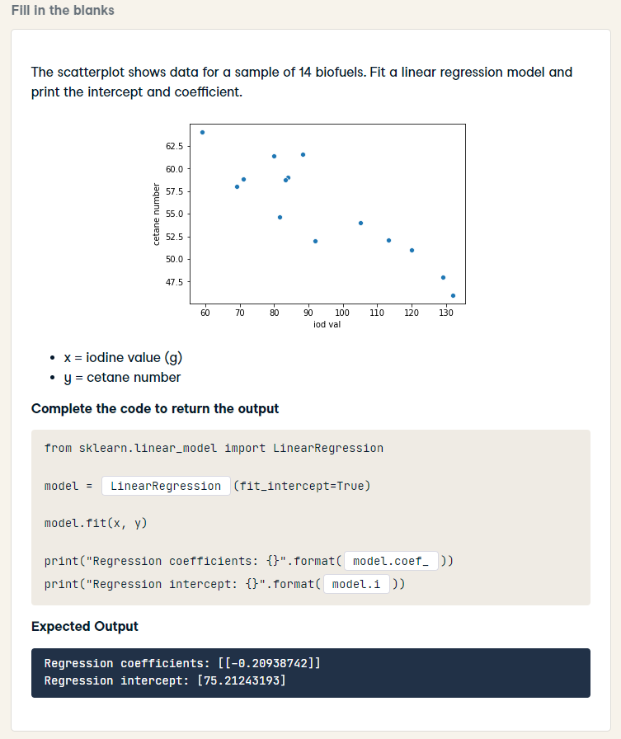
from sklearn.linear_model import LinearRegression
model = LinearRegression(fit_intercept=True)
model.fit(x, y)
print("Regression coefficients: {}".format(model.coef_))
print("Regression intercept: {}".format(model.intercept_))

Slide 21
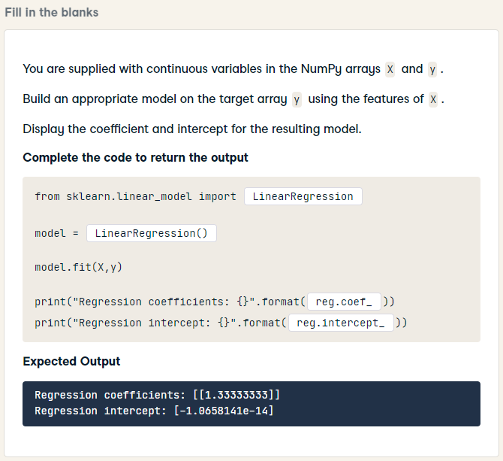
HARD
from sklearn.linear_model import LinearRegression
model = LinearRegression()
model.fit(X,y)
print("Regression coefficients: {}".format(model.coef_))
print("Regression intercept: {}".format(model.intercept_))

Slide 22
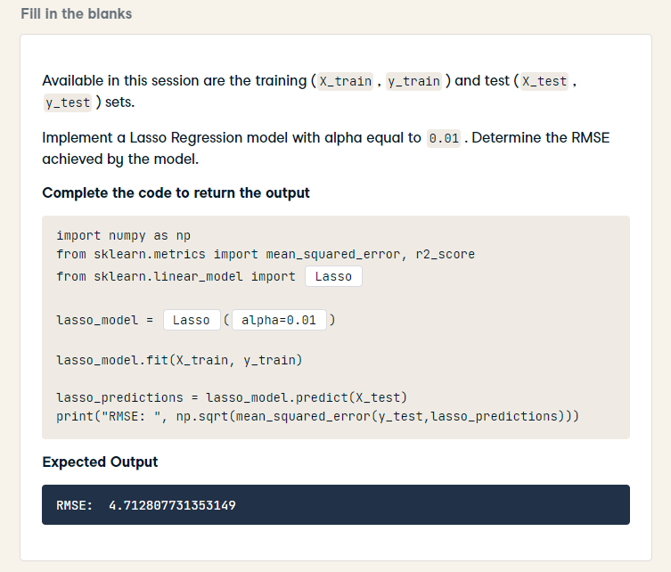
import numpy as np
from sklearn.metrics import mean_squared_error, r2_score
from sklearn.linear_model import Lasso
lasso_model = Lasso(alpha=0.01)
lasso_model.fit(X_train, y_train)
lasso_predictions = lasso_model.predict(X_test)
print("RMSE: ", np.sqrt(mean_squared_error(y_test,lasso_predictions)))

Slide 23
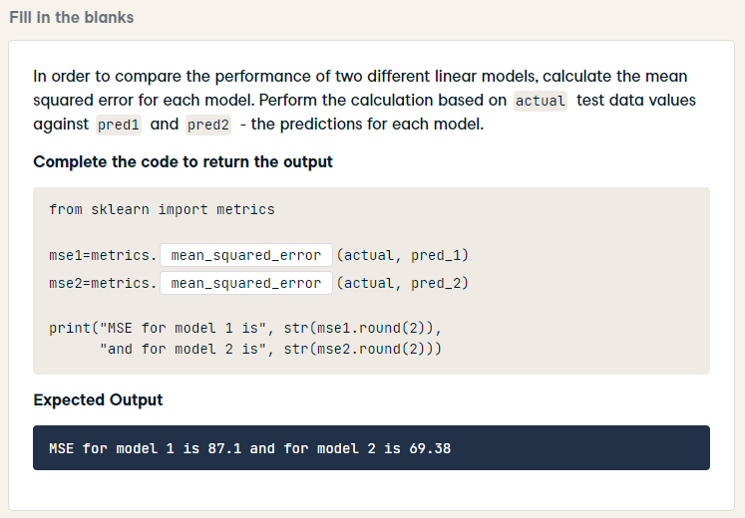
from sklearn import metrics
mse1=metrics.mean_squared_error(actual, pred_1)
mse2=metrics.mean_squared_error(actual, pred_2)
print("MSE for model 1 is", str(mse1.round(2)),
"and for model 2 is", str(mse2.round(2)))

Slide 24
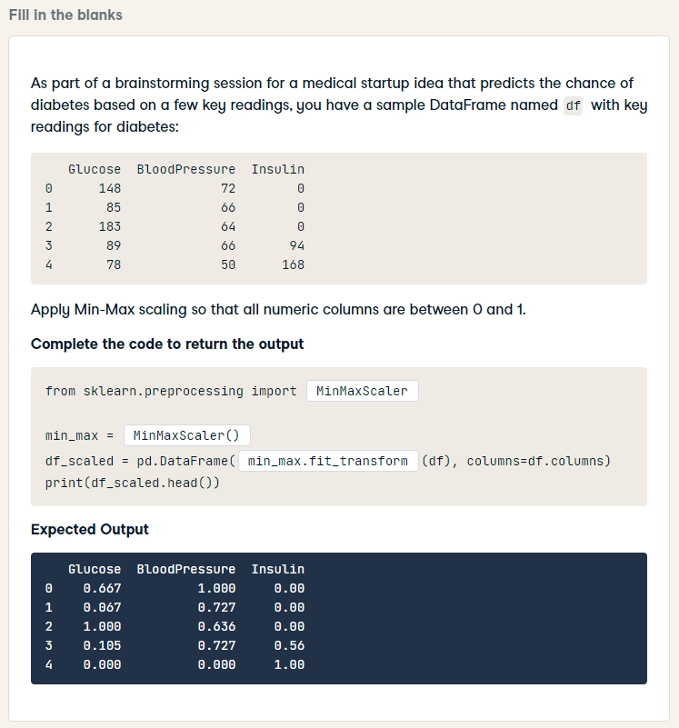
HARD
from sklearn.preprocessing import MinMaxScaler
min_max = MinMaxScaler()
df_scaled = pd.DataFrame(min_max.fit_transform(df), columns=df.columns)
print(df_scaled.head())

Slide 25
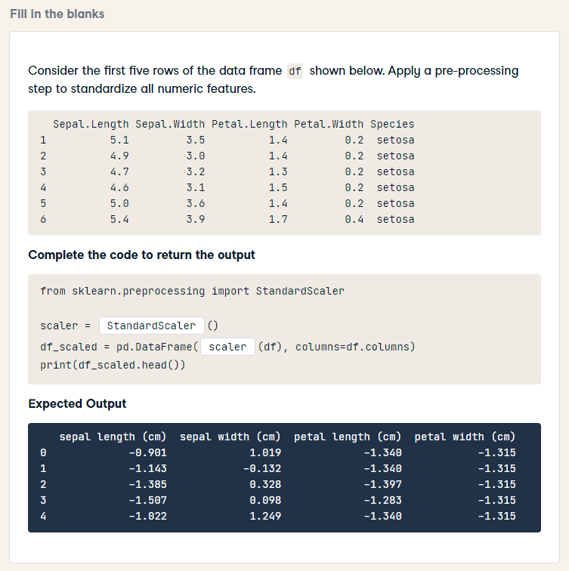
HARD
from sklearn.preprocessing import StandardScaler
scaler = StandardScaler()
df_scaled = pd.DataFrame(scaler.fit_transform(df), columns=df.columns)
print(df_scaled.head())

Slide 26
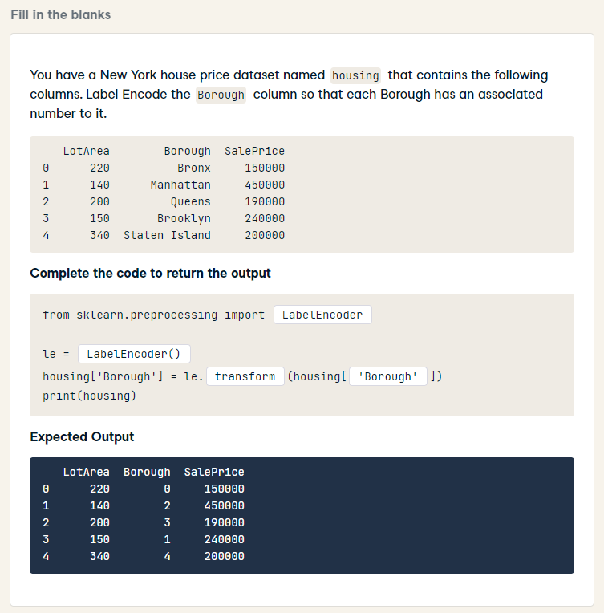
HARD
from sklearn.preprocessing import LabelEncoder
le = LabelEncoder()
housing['Borough'] = le.fit_transform(housing['Borough'])
print(housing)

Slide 27
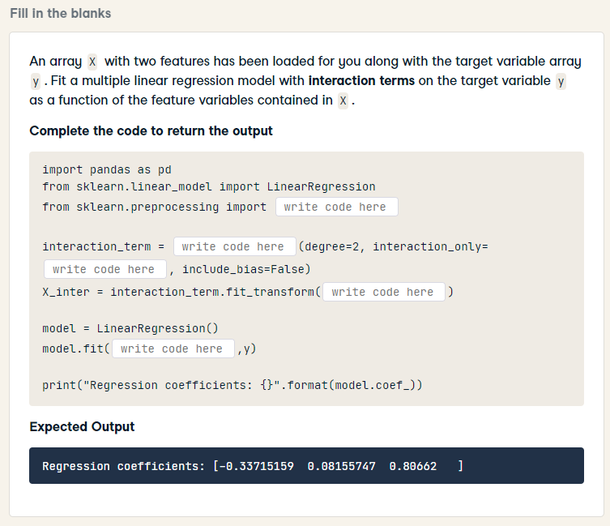
HARD
import pandas as pd
from sklearn.linear_model import LinearRegression
from sklearn.preprocessing import PolynomialFeatures
interaction_term = PolynomialFeatures(degree=2, interaction_only=True, include_bias=False)
X_inter = interaction_term.fit_transform(X)
model = LinearRegression()
model.fit(X_inter, y)
print("Regression coefficients: {}".format(model.coef_))

Slide 28
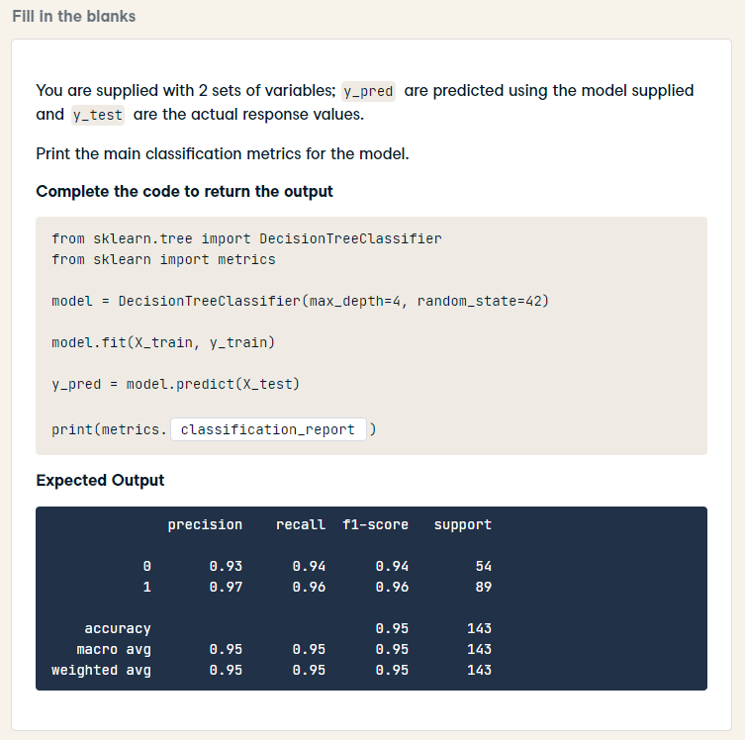
HARD
from sklearn.tree import DecisionTreeClassifier
from sklearn import metrics
model = DecisionTreeClassifier(max_depth=4, random_state=42)
model.fit(X_train, y_train)
y_pred = model.predict(X_test)
print(metrics.classification_report(y_test, y_pred))

Slide 29
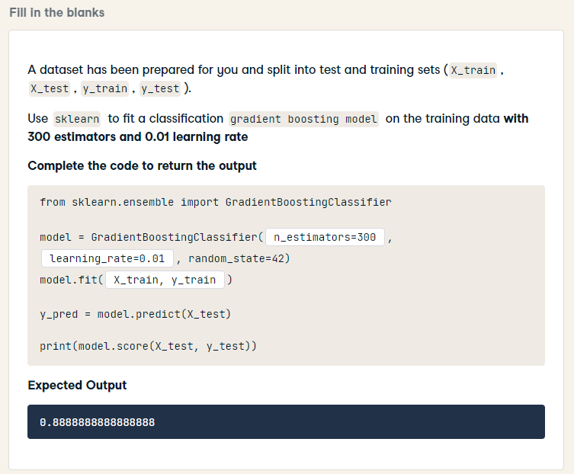
from sklearn.ensemble import GradientBoostingClassifier
model = GradientBoostingClassifier(n_estimators=300, learning_rate=0.01, random_state=42)
model.fit(X_train, y_train)
y_pred = model.predict(X_test)
print(model.score(X_test, y_test))

Slide 30
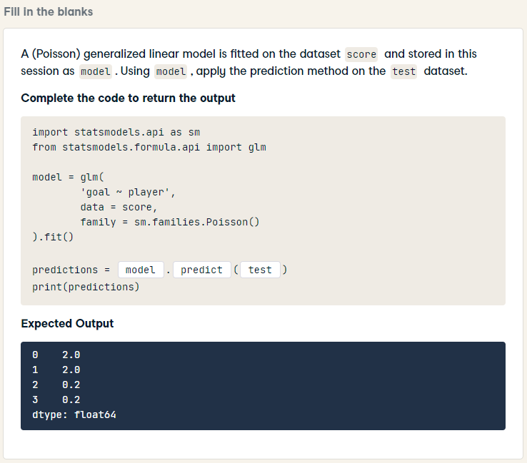
import statsmodels.api as sm
from statsmodels.formula.api import glm
model = glm(
'goal ~ player',
data = score,
family = sm.families.Poisson()
).fit()
predictions = model.predict(test)
print(predictions)

Slide 31
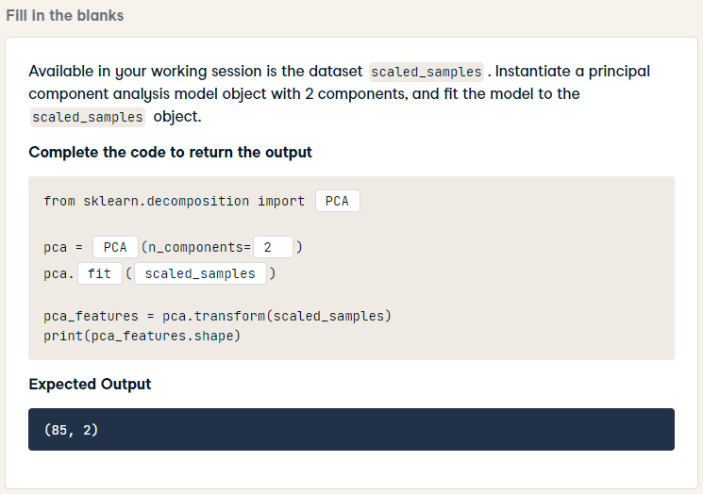
from sklearn.decomposition import PCA
pca = PCA(n_components= 2)
pca.fit(scaled_samples)
pca_features = pca.transform(scaled_samples)
print(pca_features.shape)

Slide 32
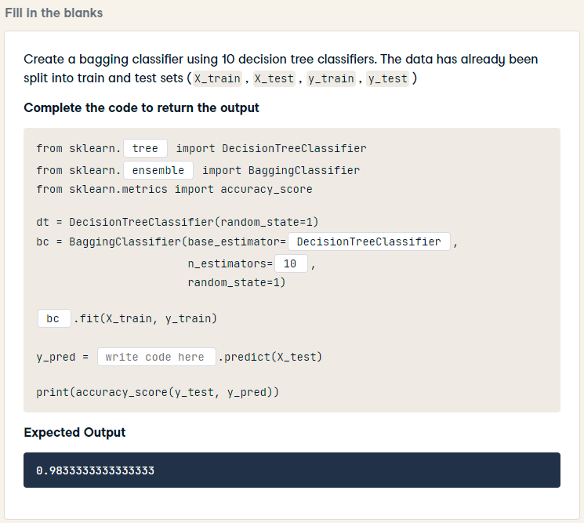
from sklearn.tree import DecisionTreeClassifier
from sklearn.ensemble import BaggingClassifier
from sklearn.metrics import accuracy_score
dt = DecisionTreeClassifier(random_state=1)
bc = BaggingClassifier(base_estimator=dt,
n_estimators=10,
random_state=1)
bc.fit(X_train, y_train)
y_pred = bc.predict(X_test)
print(accuracy_score(y_test, y_pred))

Slide 33
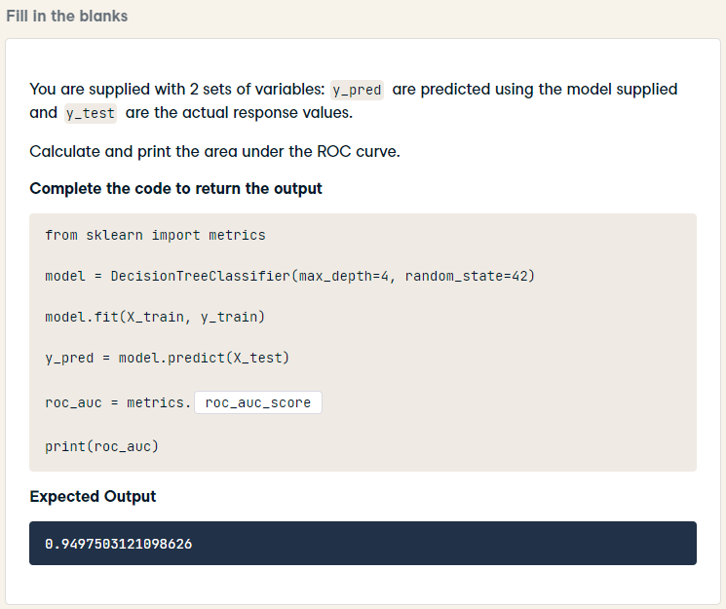
HARD
from sklearn import metrics
model = DecisionTreeClassifier(max_depth=4, random_state=42)
model.fit(X_train, y_train)
y_pred = model.predict(X_test)
roc_auc = metrics.roc_auc_score(y_test, y_pred)
print(roc_auc)

Slide 34
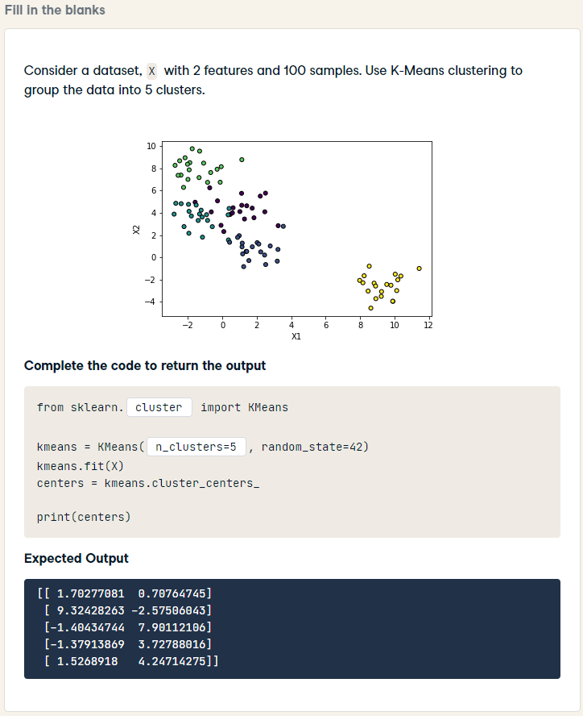
from sklearn.cluster import KMeans
kmeans = KMeans(n_clusters=5, random_state=42)
kmeans.fit(X)
centers = kmeans.cluster_centers_
print(centers)

Slide 35
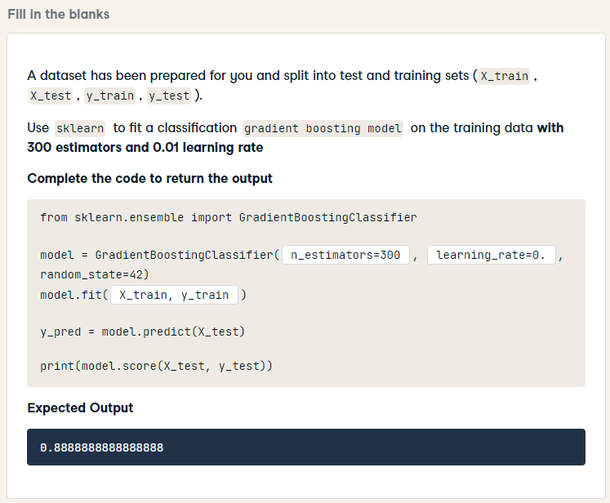
from sklearn.ensemble import GradientBoostingClassifier
model = GradientBoostingClassifier(n_estimators=300, learning_rate=0.01, random_state=42)
model.fit(X_train, y_train)
y_pred = model.predict(X_test)
print(model.score(X_test, y_test))

Slide 36
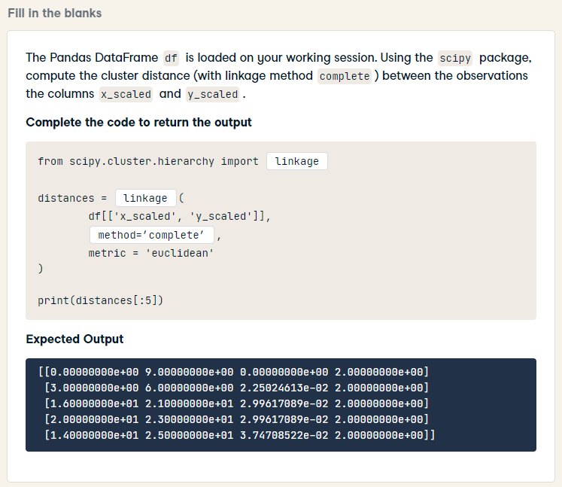
HARD
from scipy.cluster.hierarchy import linkage
distances = linkage(
df[['x_scaled', 'y_scaled']],
method = 'complete',
metric = 'euclidean'
)
print(distances[:5])

Slide 37
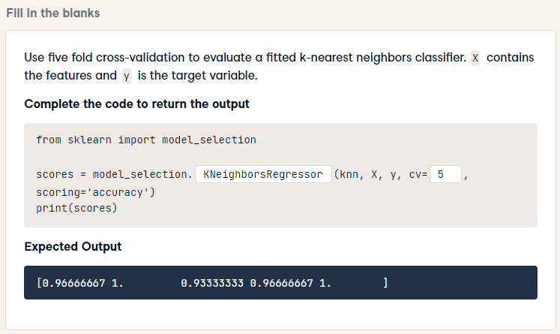
from sklearn import model_selection
scores = model_selection.cross_val_score(knn, X, y, cv=5, scoring='accuracy')
print(scores)

