Slide 1
Classification Analysis Telco Customer Churn
James
19 Aug 2019

Slide 2
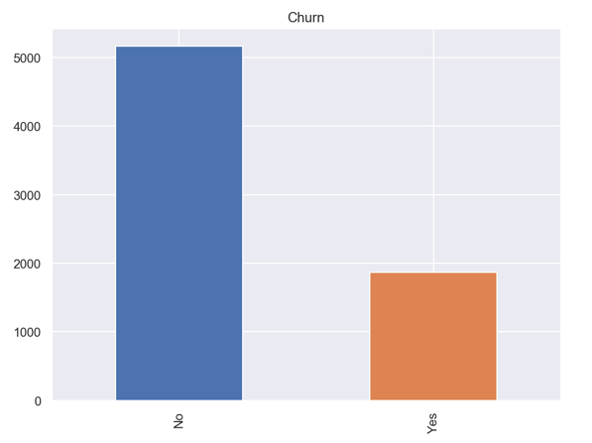

Project goals
To predict if a Telco customer will churn
Data set:
IBM Sample Data Sets
26%

Slide 3
Features
Demographic info:
Gender, SeniorCitizen, Partner, Dependents
Services subscribed:
PhoneService, MultipleLine, InternetService, OnlineSecurity, OnlineBackup, DeviceProtection, TechSupport, StreamingTV, StreamingMovies
Customer account info:
CustomerID, Contract, PaperlessBilling, PaymentMethod, MonthlyCharges, TotalCharges, Tenure
Target
Churn

Slide 4
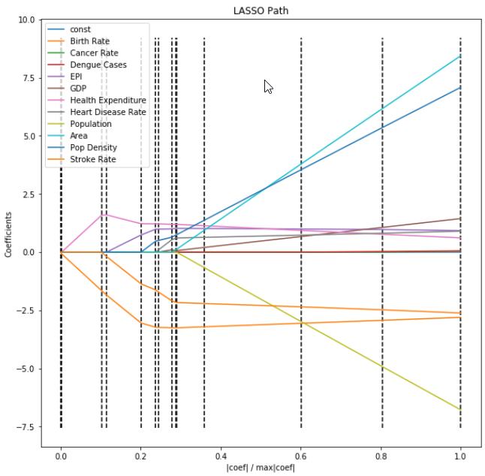
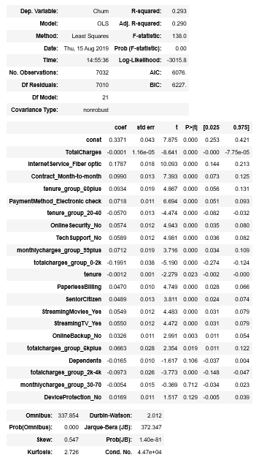
Feature selection
Selection criteria
Coefficient from LassoCV
p-value and coefficient from Statsmodels
Drop feature and check F1-Score

Slide 5
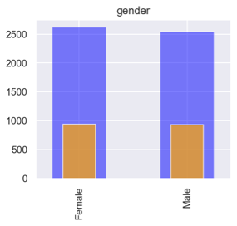
Feature selection
Example of useless feature to drop

Slide 6
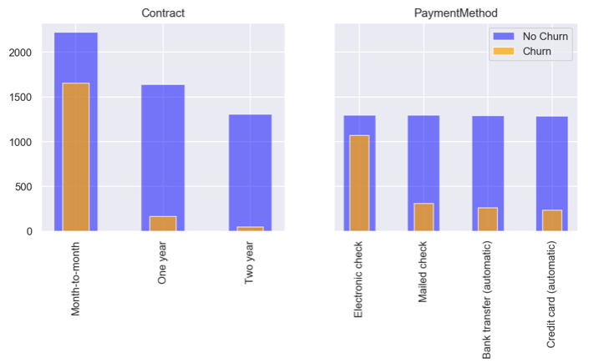
Feature selection
Example of useful feature

Slide 7
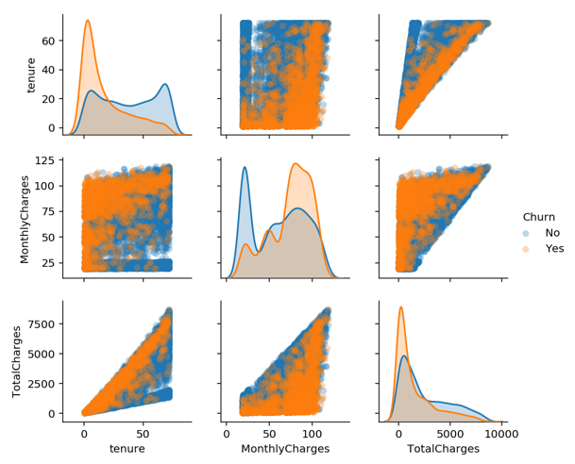
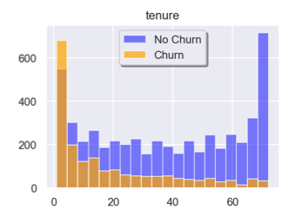
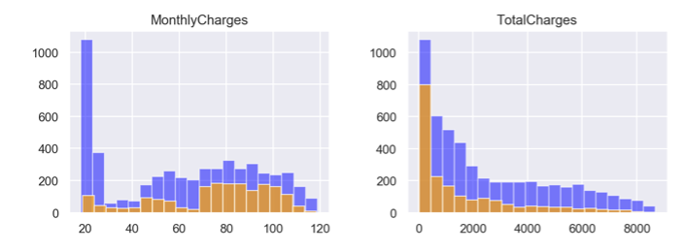
Feature engineering
Split feature into classes

Slide 8
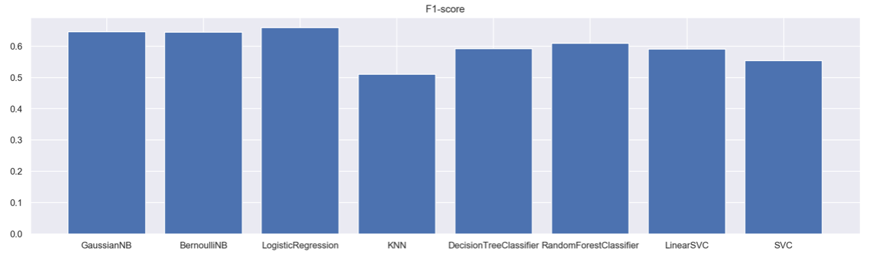
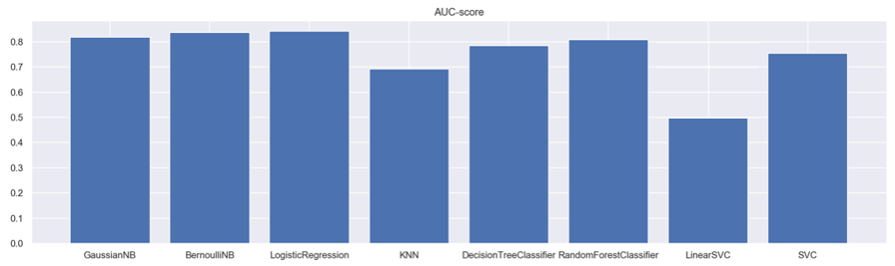
Model selection

Slide 9
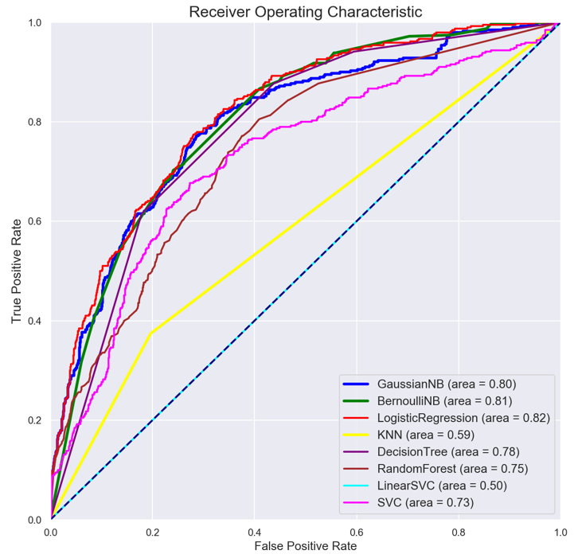
Model selection

Slide 10
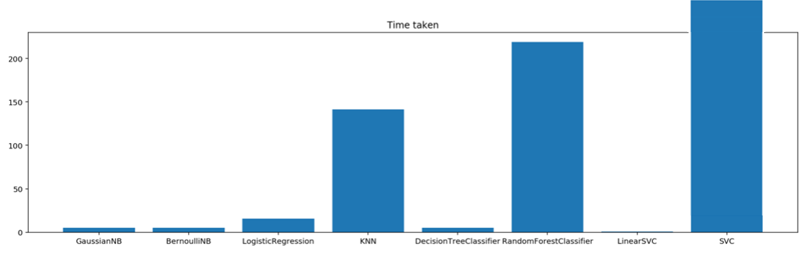
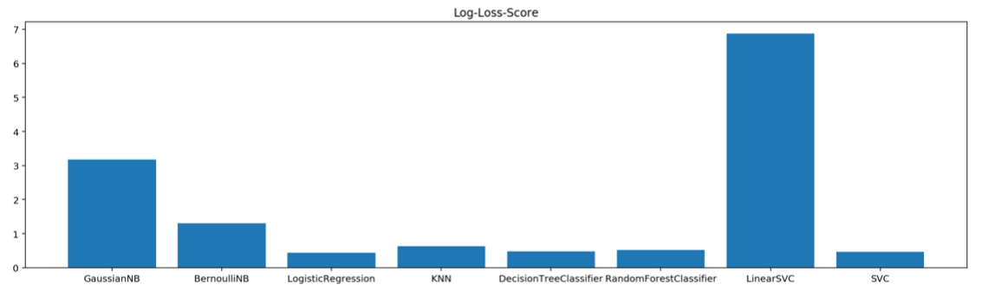
Model selection
Model selected:
Logistic Regression

Slide 11
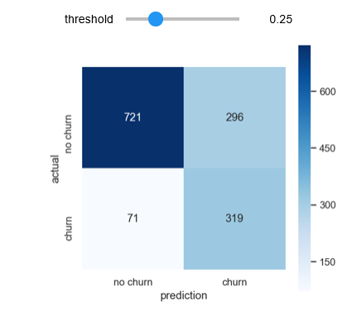
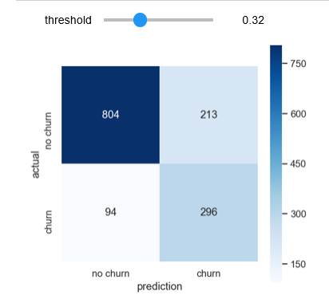
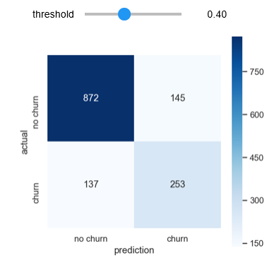
Hyperparameter tuning
Logistic Regression
Precision: 58% (58% churn predictions are correct)
Recall: 76% (76% churn customers classified correctly)

Slide 12
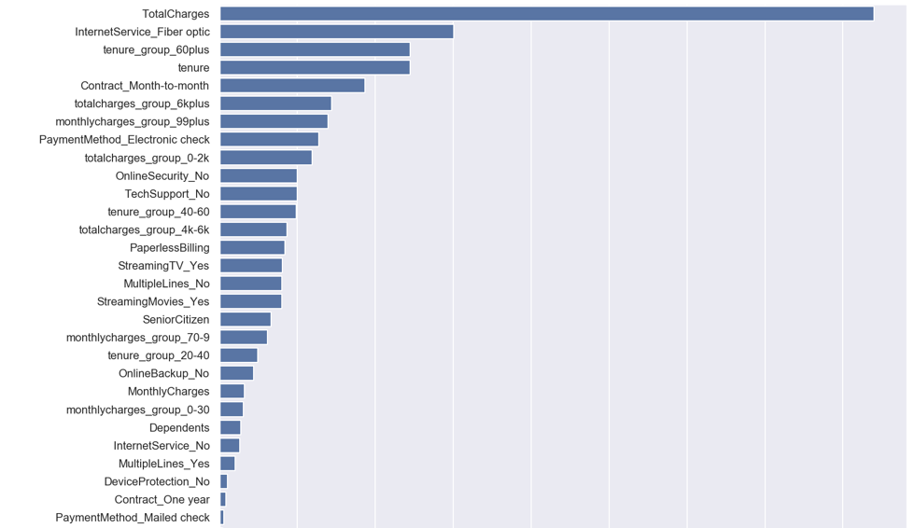
Evaluate model on test data
F1-Score: 0.643
Logistic Regression
F1-Score: 0.655
F1-Score: 0.659

Slide 13
Proposed implementation
Logistic Regression
18 features
Focus for further analysis

Slide 14

Thank you
https://www.linkedin.com/in/jnyh/
James Ng
19 Aug 2019

Slide 15
Approach
Obtain (data acquisition)
Download data from SQL to Pandas
Scrub (data cleaning)
remove extra spaces, empty rows/columns, outliers, remove null fields
Explore (data exploration)
correlation, feature engineering /selection
Model
regression analysis, cross validation, regularization, results comparison
Interpret and Communicate
optimised statistical results, data visualization

Slide 16
Hyperparameter tuning
Logistic Regression
58% churn predictions are correct
76% churn customers classified correctly
Precision: 52%
Recall: 82%
Precision: 58%
Recall: 76%
Precision: 64%
Recall: 65%

Slide 17
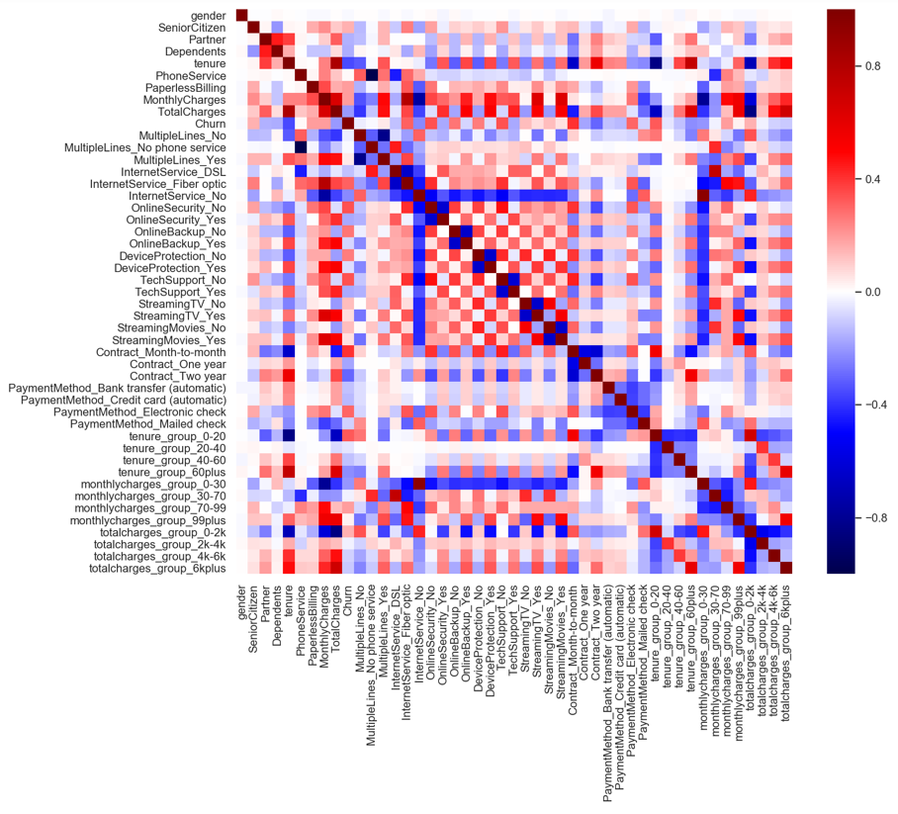
Feature correlation

