Slide 1

Diabetes Classifier
Building a machine learning classifier model for diabetes
Diabetes
Based on medical diagnostic measurements

Slide 2
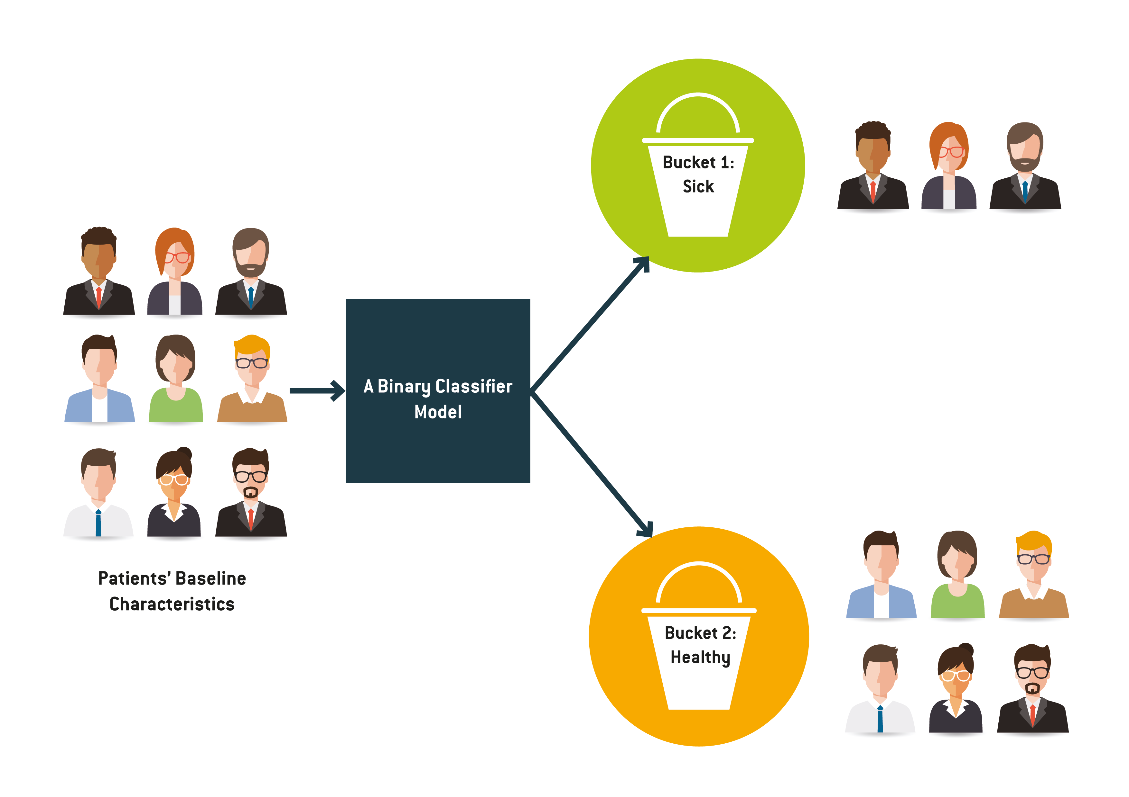



Objective
To build a predictive machine learning model to predict based on diagnostic measurements whether a patient has diabetes
No Diabetes
Classifier
Model
Patients’ medical
predictor variables
Diabetes
Python codes are available: https://github.com/JNYH/diabetes_classifier

Slide 3
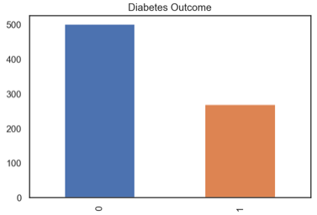
Dataset
downloaded from Kaggle
There are 768 observations with 8 medical predictor features (input) and 1 target variable (output 0 for ”no” or 1 for ”yes”)
65%
35%
The 8 medical predictor features are: · Pregnancies: Number of times pregnant · Glucose: Plasma glucose concentration a 2 hours in an oral glucose tolerance test · BloodPressure: Diastolic blood pressure (mm Hg) · SkinThickness: Triceps skin fold thickness (mm) · Insulin: 2-Hour serum insulin (mu U/ml) · BMI: Body mass index (weight in kg/(height in m)²) · DiabetesPedigreeFunction: Diabetes pedigree function · Age: Age (years)

Slide 4
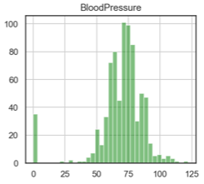
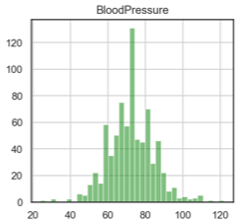
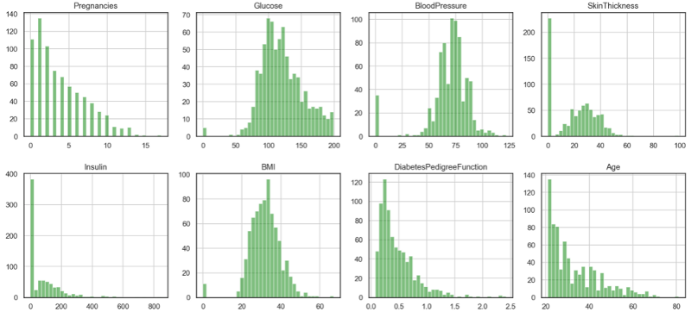
Exploratory Data Analysis (EDA)
To remove zero values

Slide 5
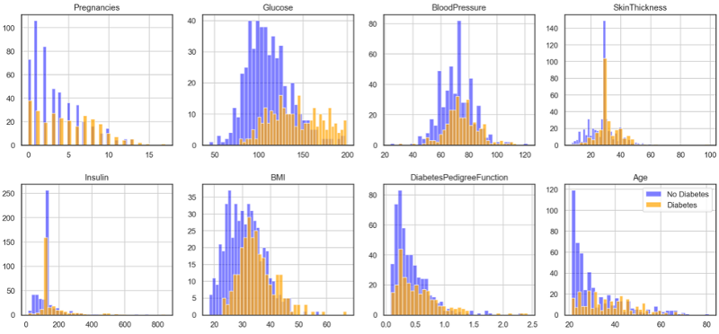
Exploratory Data Analysis (EDA)
To analyse feature-outcome distribution in visualisation

Slide 6
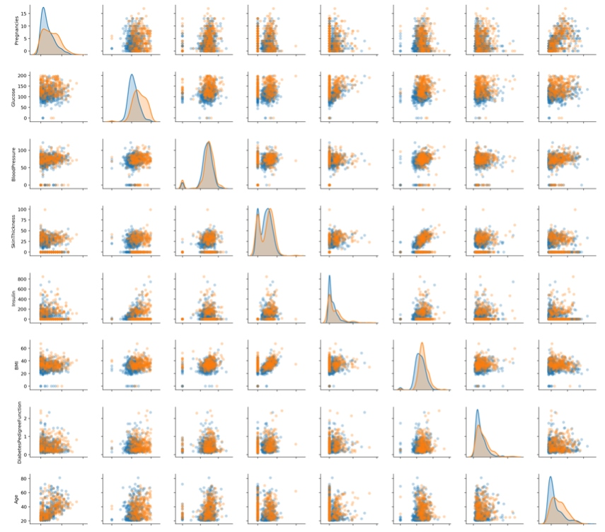
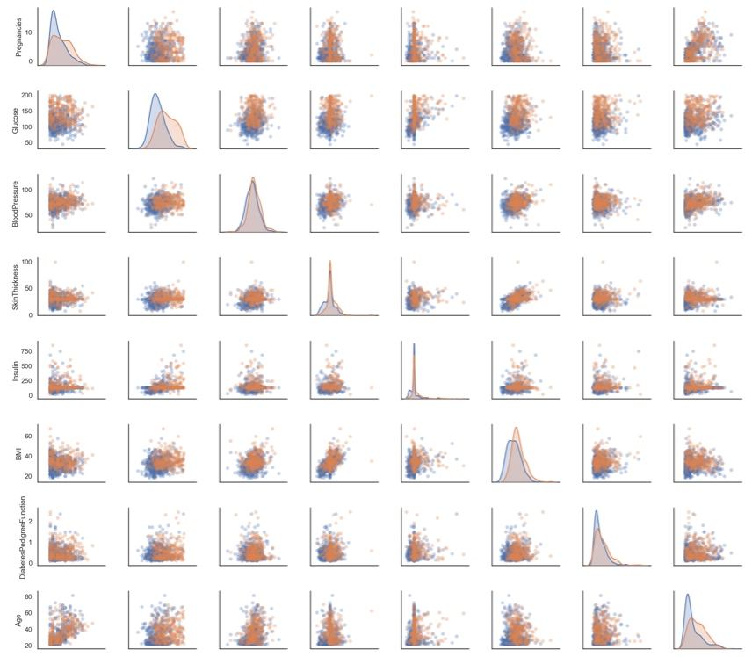
Pair Plots
Before removing zero values
After removing zero values

Slide 7
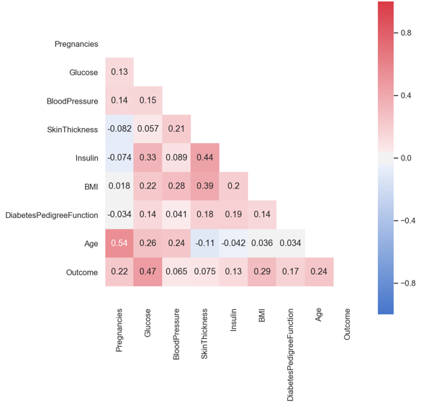
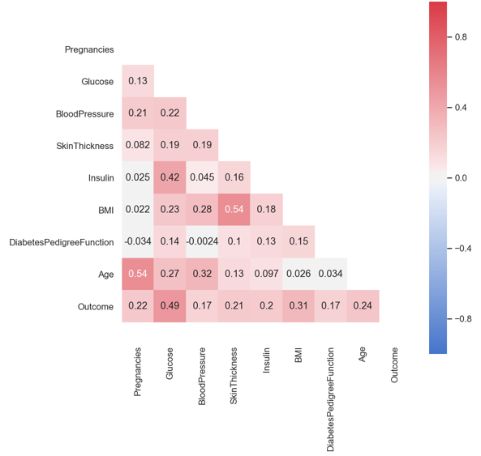
Features Correlation
Before removing zero values
After removing zero values

Slide 8
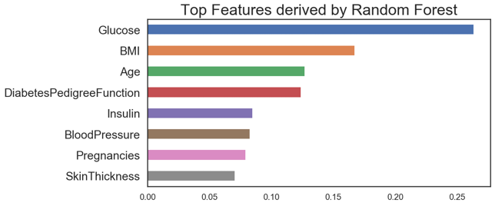
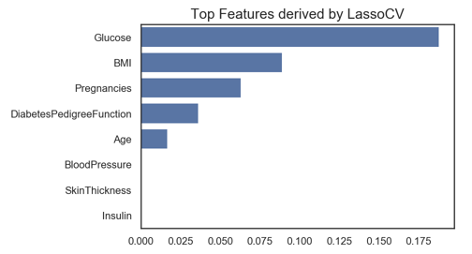
Feature Importance
‘Glucose’ and ‘BMI’ are the most important medical predictor features.

Slide 9
Model Evaluation
The performance metrics used in the evaluation are: · Accuracy Score: proportion of correct predictions out of the whole dataset. Be careful when the target class is imbalance, for example, if a model predicts nobody to have Glucose-6-Phosphate Dehydrogenase (G6PD) Deficiency, then such useless model would be 95% accurate. · Precision Score: proportion of correct predictions out of all predicted diabetic cases. · Recall Score: proportion of correct predictions out of all actual diabetic cases. · F1 Score: optimised balance between Precision and Recall for binary targets. · Area Under ROC Curve: prediction scores from area under Receiver Operating Characteristic (ROC) curve, which is a relationship between True Positive Rate and False Positive Rate. · Log Loss: aka logistic loss or cross-entropy loss, defined as the negative log-likelihood of the true labels given a probabilistic classifier’s predictions, and has to be as low as possible.
Below 9 models have been evaluated: · Gaussian Naive Bayes · Bernoulli Naive Bayes · Multinomial Naive Bayes · Logistic Regression · K Nearest Neighbour · Decision Tree Classifier · Random Forest Classifier · Support Vector Classification (SVC) · Linear SVC

Slide 10
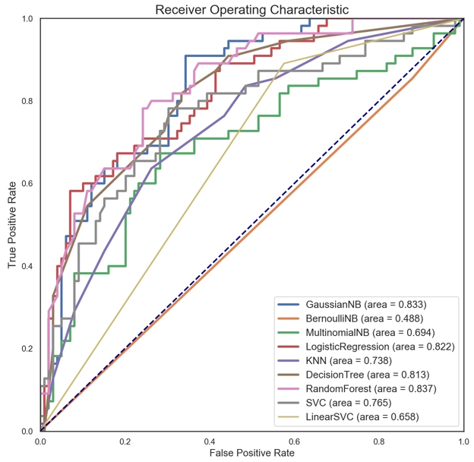
Model Performance

Slide 11
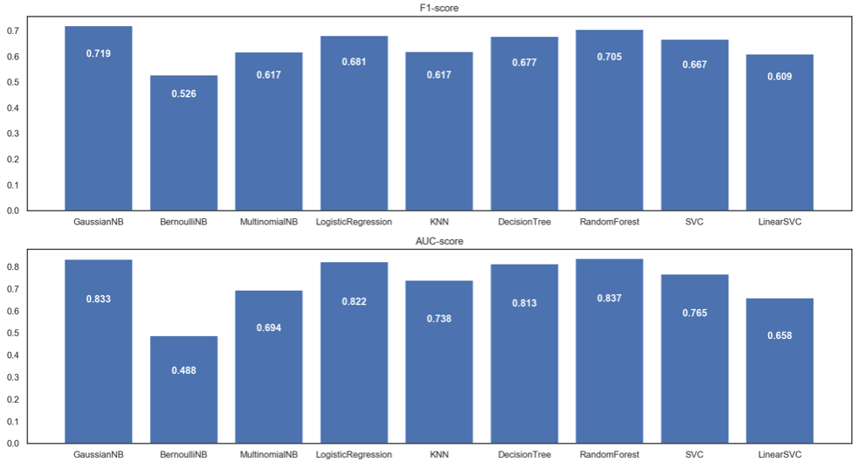
Model Performance

Slide 12
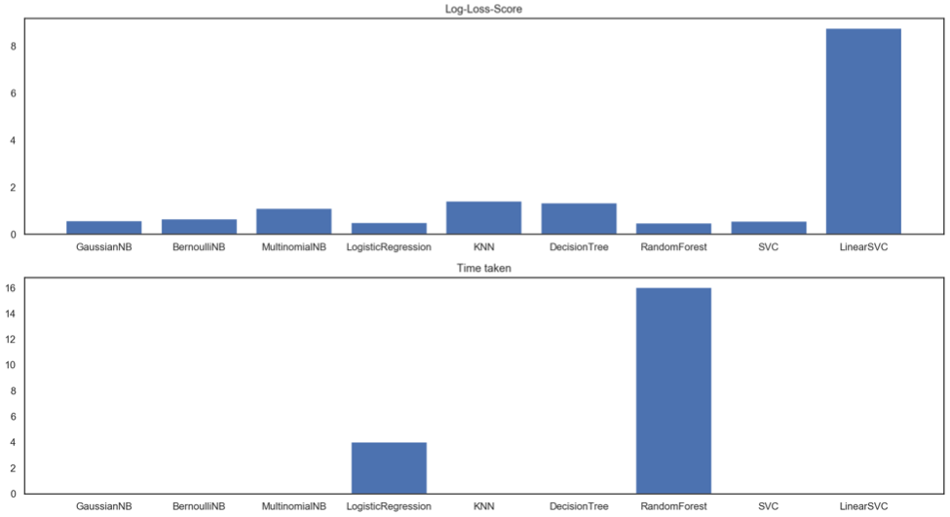
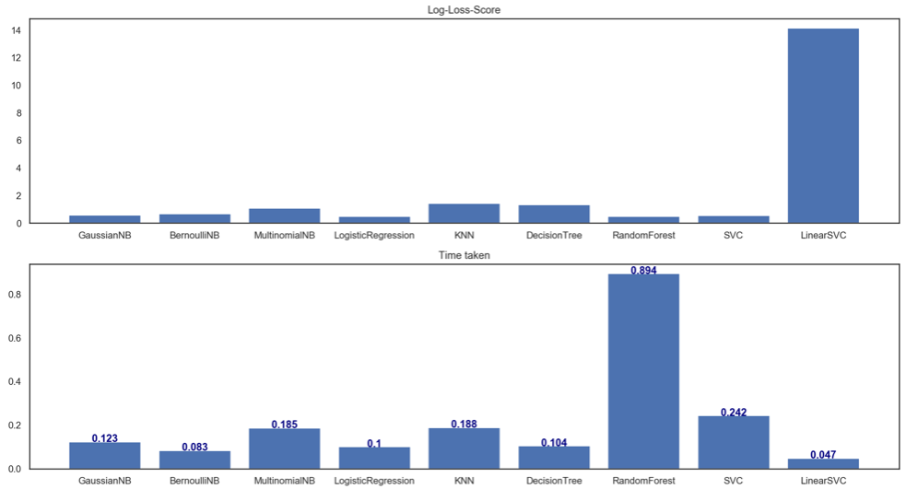
Model Performance

Slide 13
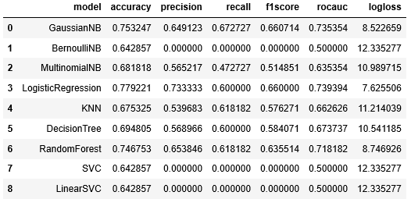
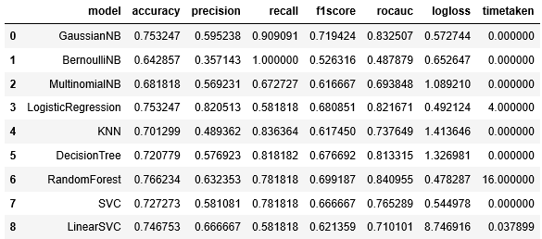
Model Comparison
Baseline
(using default parameters)
After tuning hyperparameters
F1-Score has improved for all models after tuning the threshold and other hyperparameters.
= improvement

Slide 14
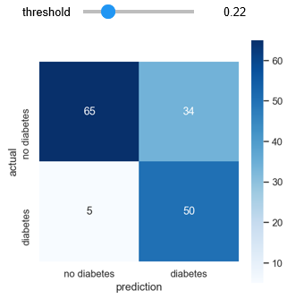
Conclusion
Optimal threshold 0.207
F1 Score = 0.719
proportion of correct predictions out of all predicted diabetic cases
In this project, the Gaussian Naive Bayes model has achieved prediction (Recall) score of 90.9%
Out of all diabetic patients, 90.9% of them will be classified correctly using medical diagnostic measurements
Precision = 50/84
= 0.595
proportion of correct predictions out of all actual diabetic cases
Recall = 50/55
= 0.909
Python codes are available: https://github.com/JNYH/diabetes_classifier

