Slide 1
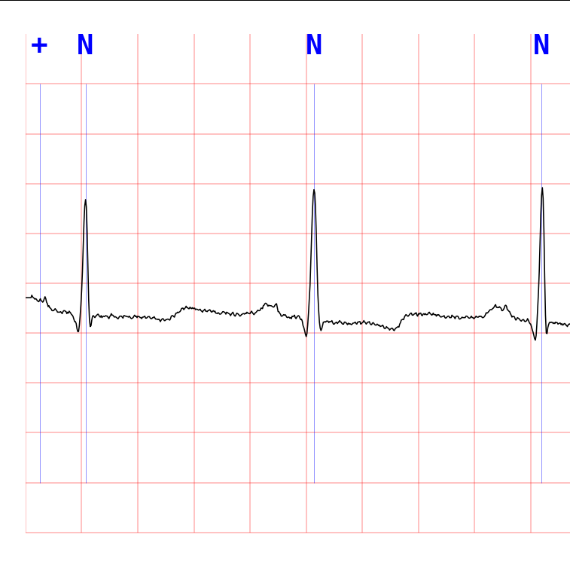
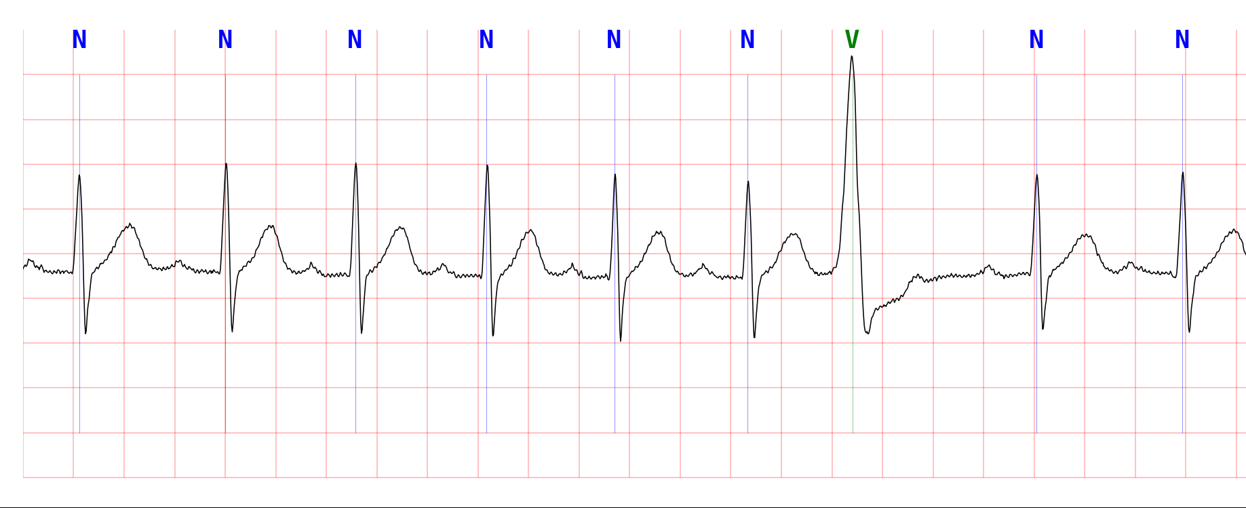
Image dimension
(0,0) origin
x
45
750
36
74.5
36
66.2
46
7522

Slide 2
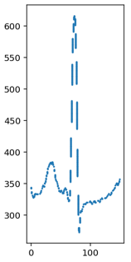
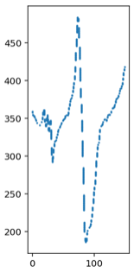
Image pre-processing, locate plot

Slide 3
Extract plots into vector representation
750
[N]
Normal beat
n=930
150
Total train data
n=2043
750
[V]
V-beat
n=1113
150

Slide 4
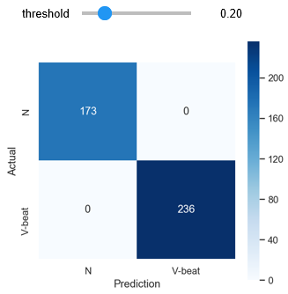
Model selection, Train/Fit model
Model:
LogisticRegression
(C=0.001, optimal threshold = 0.198)
Accuracy score is
Training: 99.9%
Validation: 99.7%

Slide 5
Test model
Model prediction of test data (180 images) in csv ﬁle:
The ﬁrst column is the ﬁlename
The second column is location of 'V' beat in second
See test_results.csv

Slide 6
Next steps, to improve the model
Additional 12 features
Split into 4 quadrants
Find min, max, mean for each quadrant
Additional 3 features
Split into 4 quadrants
Find moving average of 2 consecutive quadrants
0
36
37
74
75
112
113
149

