Slide 1
Objective
Use machine learning and image processing to detect the location of V-beat in Electrocardiogram (ECG), given a collection of ECG strip images
Train images n=540
Test images n=180

Slide 2
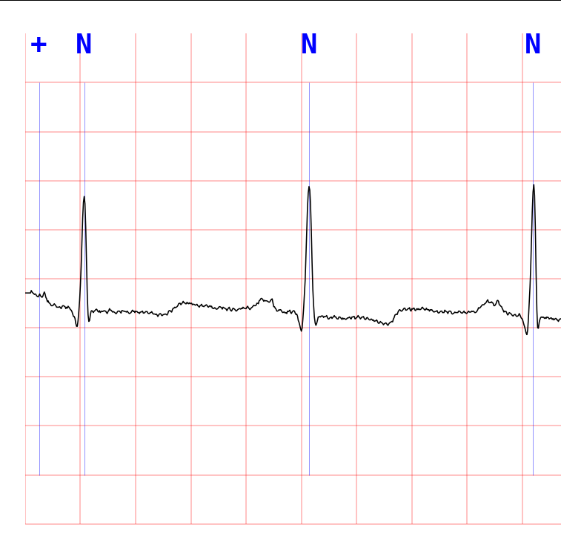
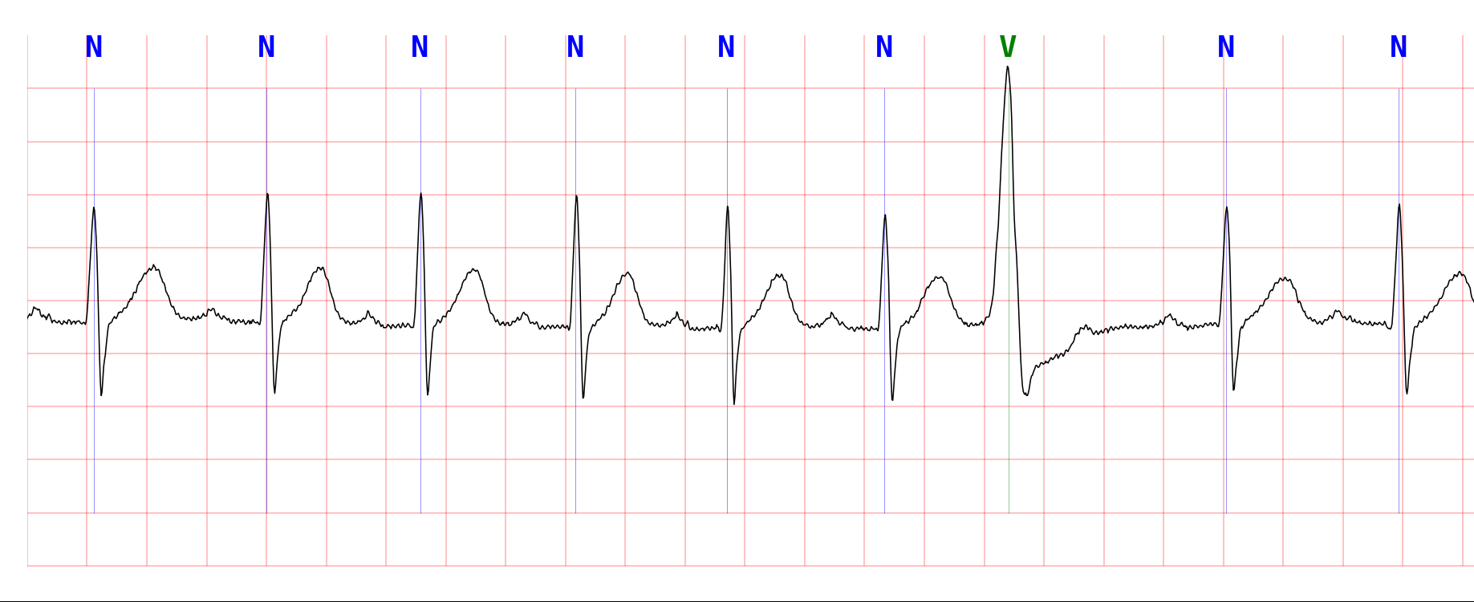
Image dimension (in pixel)
(0,0) origin
x
45
750
(0.2 sec)
36
74.5
(20 sec)
66.2
36
7450
46
7522

Slide 3
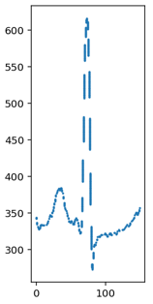
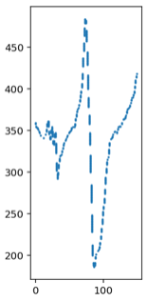
Image pre-processing, locate plot

Slide 4
Extract plots into vector representation
750
[N]
Other beat
n=930
150
Total train data
n=2043
750
[V]
V-beat
n=1113
150

Slide 5
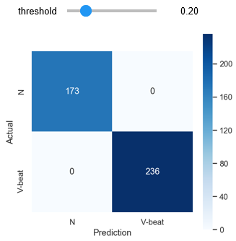
Model selection, Train/Fit the model
Model for binary classification:
Logistic Regression
(C=0.001, optimal threshold = 0.198)
Split 80/20 for train/validate
Accuracy score achieved:
Training: 99.9%
Validation: 99.7%
Confusion matrix for validation data
(n=409)

Slide 6

Test the model
Model prediction of test data in csv ﬁle (180 rows):
The ﬁrst column is the ﬁlename
The second column is location of 'V' beat in second
test_results.csv
Notebook and more details:
https://github.com/JNYH/ecg_vbeat

Slide 7
Next steps, to improve the model
Additional 12 features
Split into 4 quadrants
Find min, max, mean for each quadrant
Additional 3 features
Split into 4 quadrants
Find moving average of 2 consecutive quadrants
q1
0
36
q2
37
74
q3
75
112
q4
113
149

