Slide 1
Objective
Use machine learning and image processing to detect the location of V-beat in Electrocardiogram (ECG), given a collection of ECG strip images
Train images n=540
Test images n=180

Slide 2
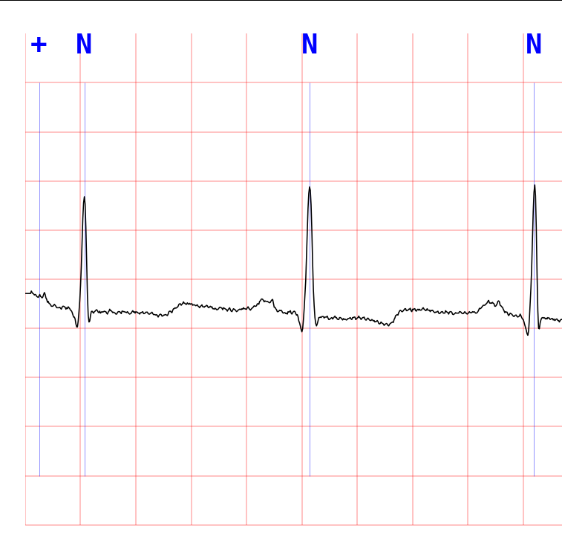
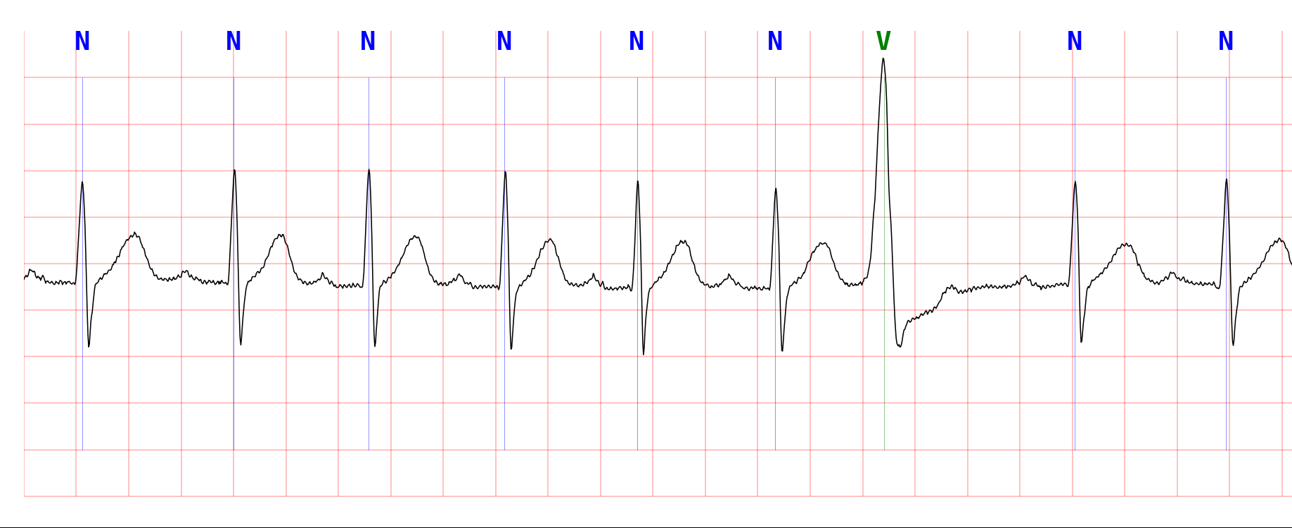
Image dimension (in pixel)
(0,0) origin
x
45
750
(0.2 sec)
36
74.5
(20 sec)
66.2
36
7450
46
7522

Slide 3
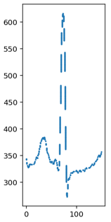
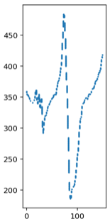
Image pre-processing, locate plot

Slide 4
Extract plots into vector representation
750
[N]
Other beat
n = 2,098
160
Total train data
n = 3,211
750
[V]
V-beat
n = 1,113
160

Slide 5
Feature Engineering
To improve the model with summary statistics
Additional 16 features:
Split into 4 quadrants
Find min, max, mean, median for each quadrant
Additional 12 features:
Split into 4 quadrants
Combine 2 consecutive quadrants (ie, 3 segments)
Find min, max, mean, median for each segment
q1
0
39
q2
40
79
q3
80
119
q4
120
159
s1
s2
s3

Slide 6
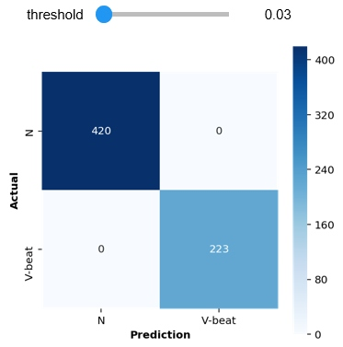
Model selection, Train/Fit the model
Model for binary classification:
Logistic Regression
(C=0.001, optimal threshold = 0.026)
Split 80/20 to train/validate
Accuracy score achieved:
Training: 100%
Validation: 100%
Confusion matrix for validation data
(n = 643)

Slide 7

Test the model, test results
Model prediction of test data in csv ﬁle (180 rows):
First column is the ﬁlename
Second column is location of 'V' beat (in seconds)
test_results.csv
Notebook and more details:
https://github.com/JNYH/ecg_vbeat

