Slide 1
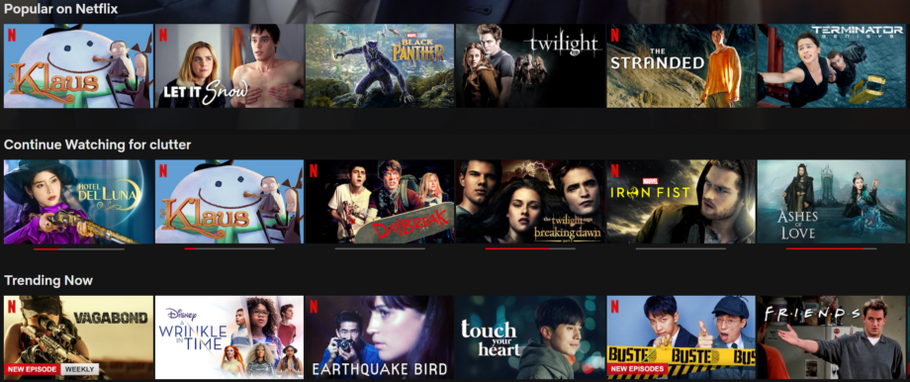
Content-based recommender using Natural Language Processing (NLP)
A guide to build a content-based movie recommender model based on NLP

Slide 2
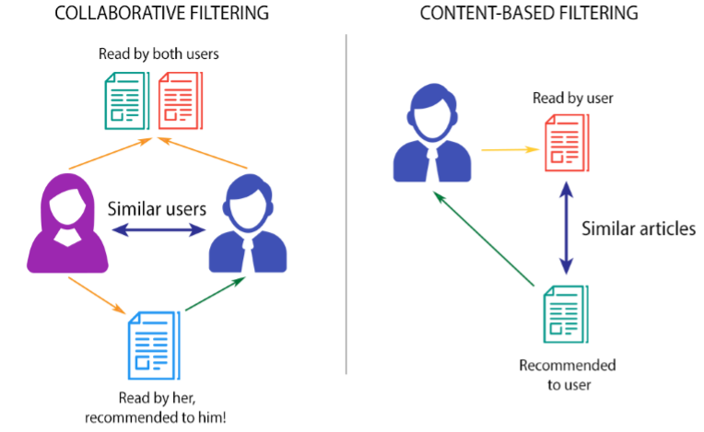

2 types of recommender systems
Collaborative Filtering
Content-Based Filtering
Watched by both users
Watched by user
Similar users
Similar movies
Recommended to user
Watched by her,
Recommended to him

Slide 3
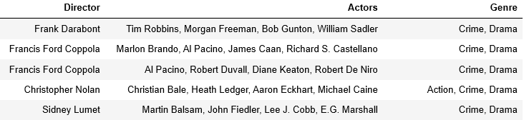
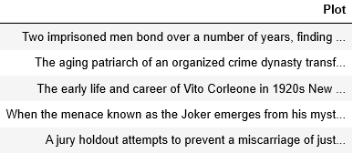
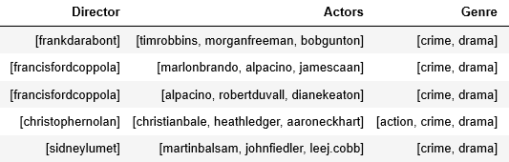
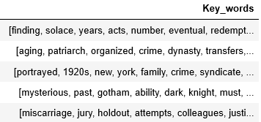
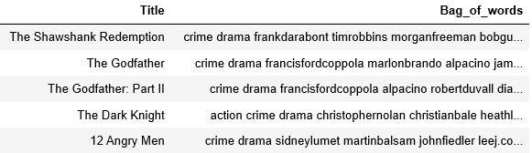
Data pre-processing

Slide 4
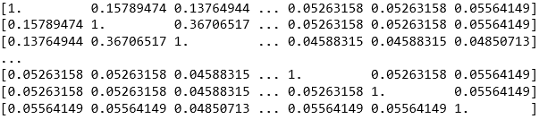

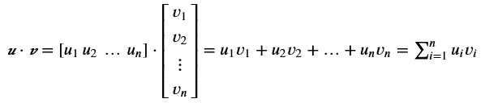
Similarity Matrix
Movie0 Movie1 Movie2 … Movie247 Movie248 Movie249
Movie0
Movie1
Movie2
…
Movie247
Movie248
Movie249

