Slide 1
Optimize Street Team Deployment in NYC Subway
KELSEY, Ken, James

Slide 2
Project goals
To identifying stations with high traffic and favorable demographics
Assumptions:
Turnstile activities = traffic volume
The busiest stations = more reach

Slide 3
Data processed
MTA subway data from data.ny.gov
Demographic data from U.S. Census Bureau
Mapping New York City Census Data on Kaggle.com

Slide 4
Areas explored
Traffic volume by station

Slide 5
Areas explored
weekly patterns of ridership (weekday/weekend) - weekly dip on the weekends

Slide 6
Areas explored
Traffic volume by time (morning/lunch/afternoon/evening)

Slide 7

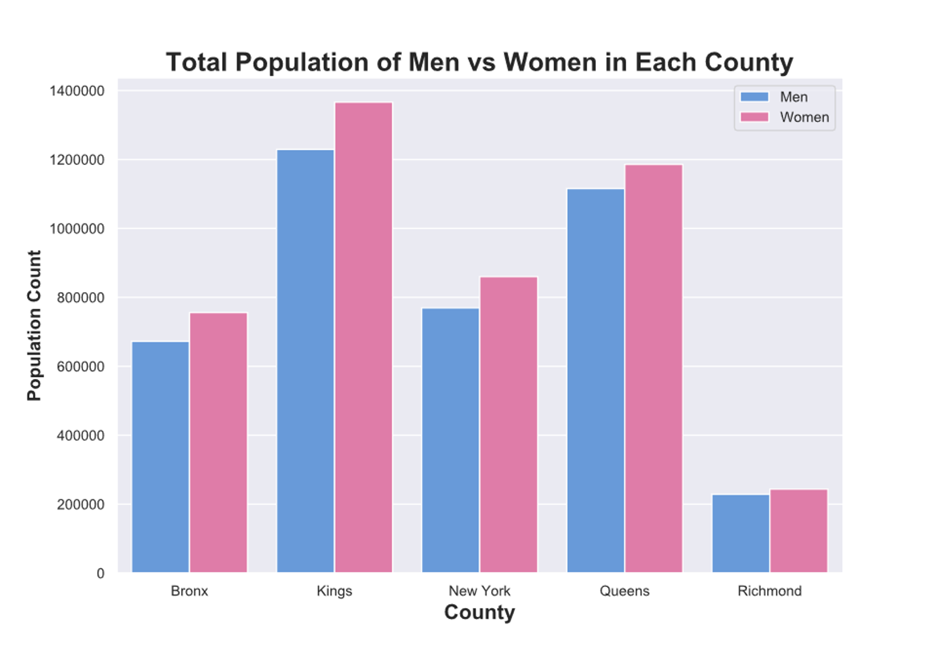
Areas explored
Geographic & demographic information about areas around stations to gather profiles of those most likely to contribute

Slide 8
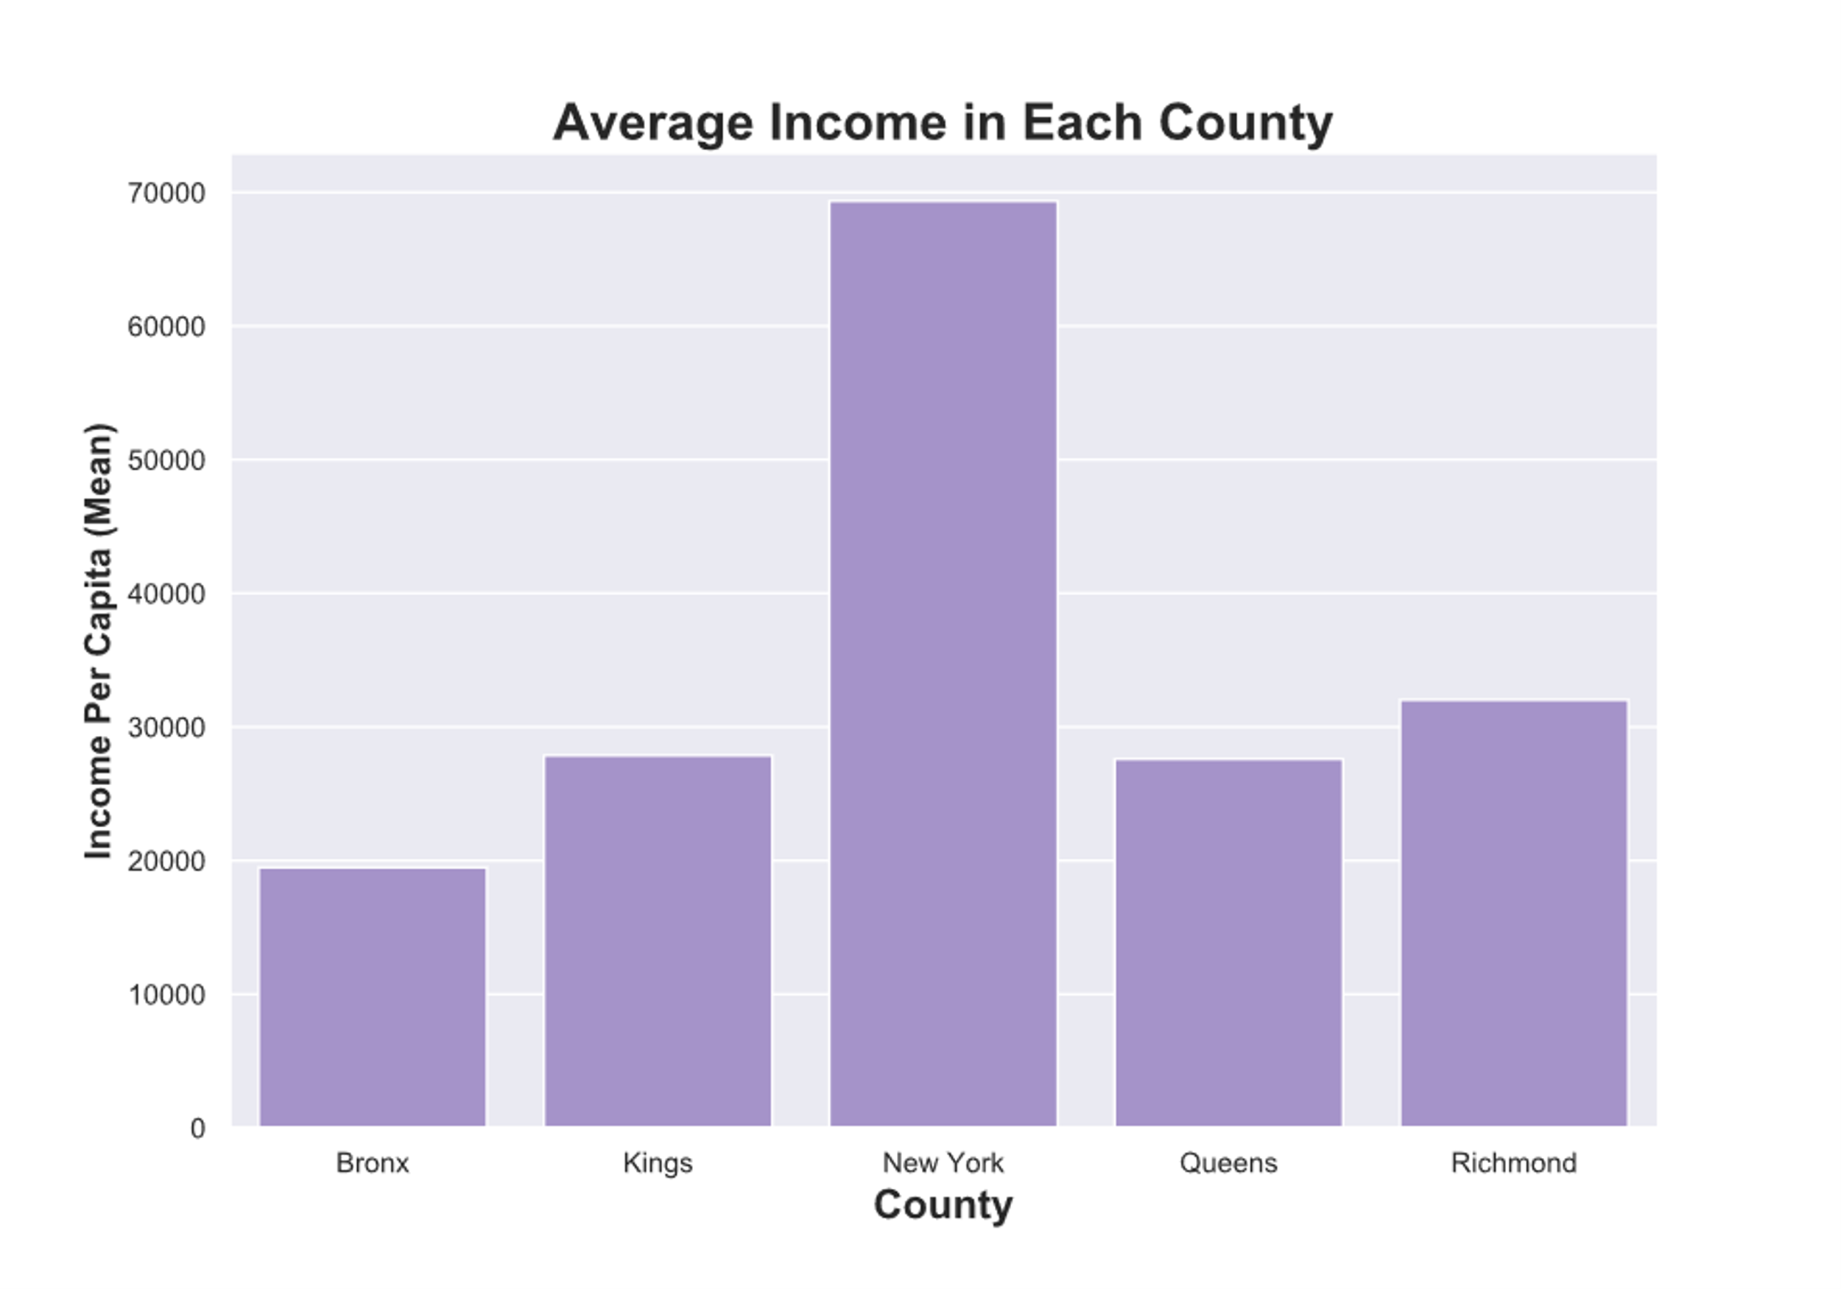
Areas explored
Geographic & demographic information about areas around stations to gather profiles of those most likely to contribute

Slide 9
Results
Top 5 busiest station
1. Penn Station 2. 23rd Street 3. Herald Square 4. Times Square 5. Grand Central
Peak traffic day (Wednesday)
Peak traffic time (rush hours, lunch, evening)
Demographics by gender
Demographics by income (confirm that demographics were favorable for each station)

Slide 10
Recommendation
Time
evening hours preferred
people rush to work in the morning
Place
Top 5 stations identified
high female population: majority (>50%) female population
high income residenial area
high traffic flow in & out of station

Slide 11
Next Steps
Tourist data?
More yearly data needed to recommend monthly seasonality
An efficient process that deploys teams and collects signature results in real time
Top 5 stations differ from MTA published results

Slide 12
Thank you

