Slide 1
Optimize Street Team Deployment in NYC Subway
KELSEY, Ken, James
12 Jul 2019

Slide 2
WTWY Project goals
To identifying stations with high traffic and favorable demographics
Assumptions:
Turnstile activities = traffic volume
The busiest stations = more reach

Slide 3
Data processed
MTA Turnstile Data from data.ny.gov
MTA Geographical Data from data.ny.gov
Demographic Data from U.S. Census Bureau
Mapping New York City Census Data on Kaggle.com

Slide 4

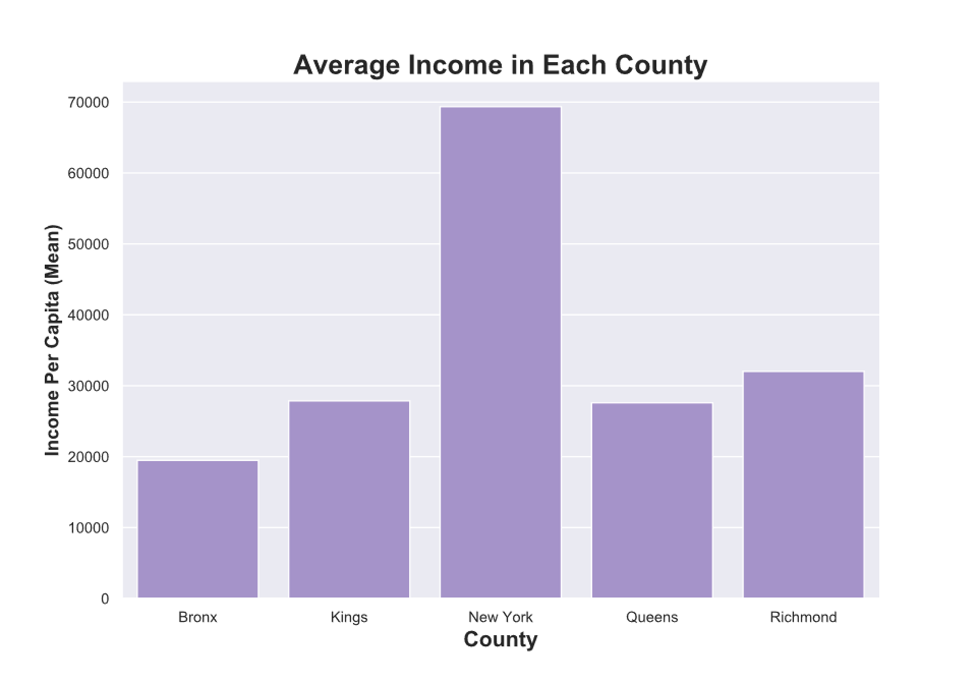
Areas explored
Geographic & demographic information
- Income

Slide 5
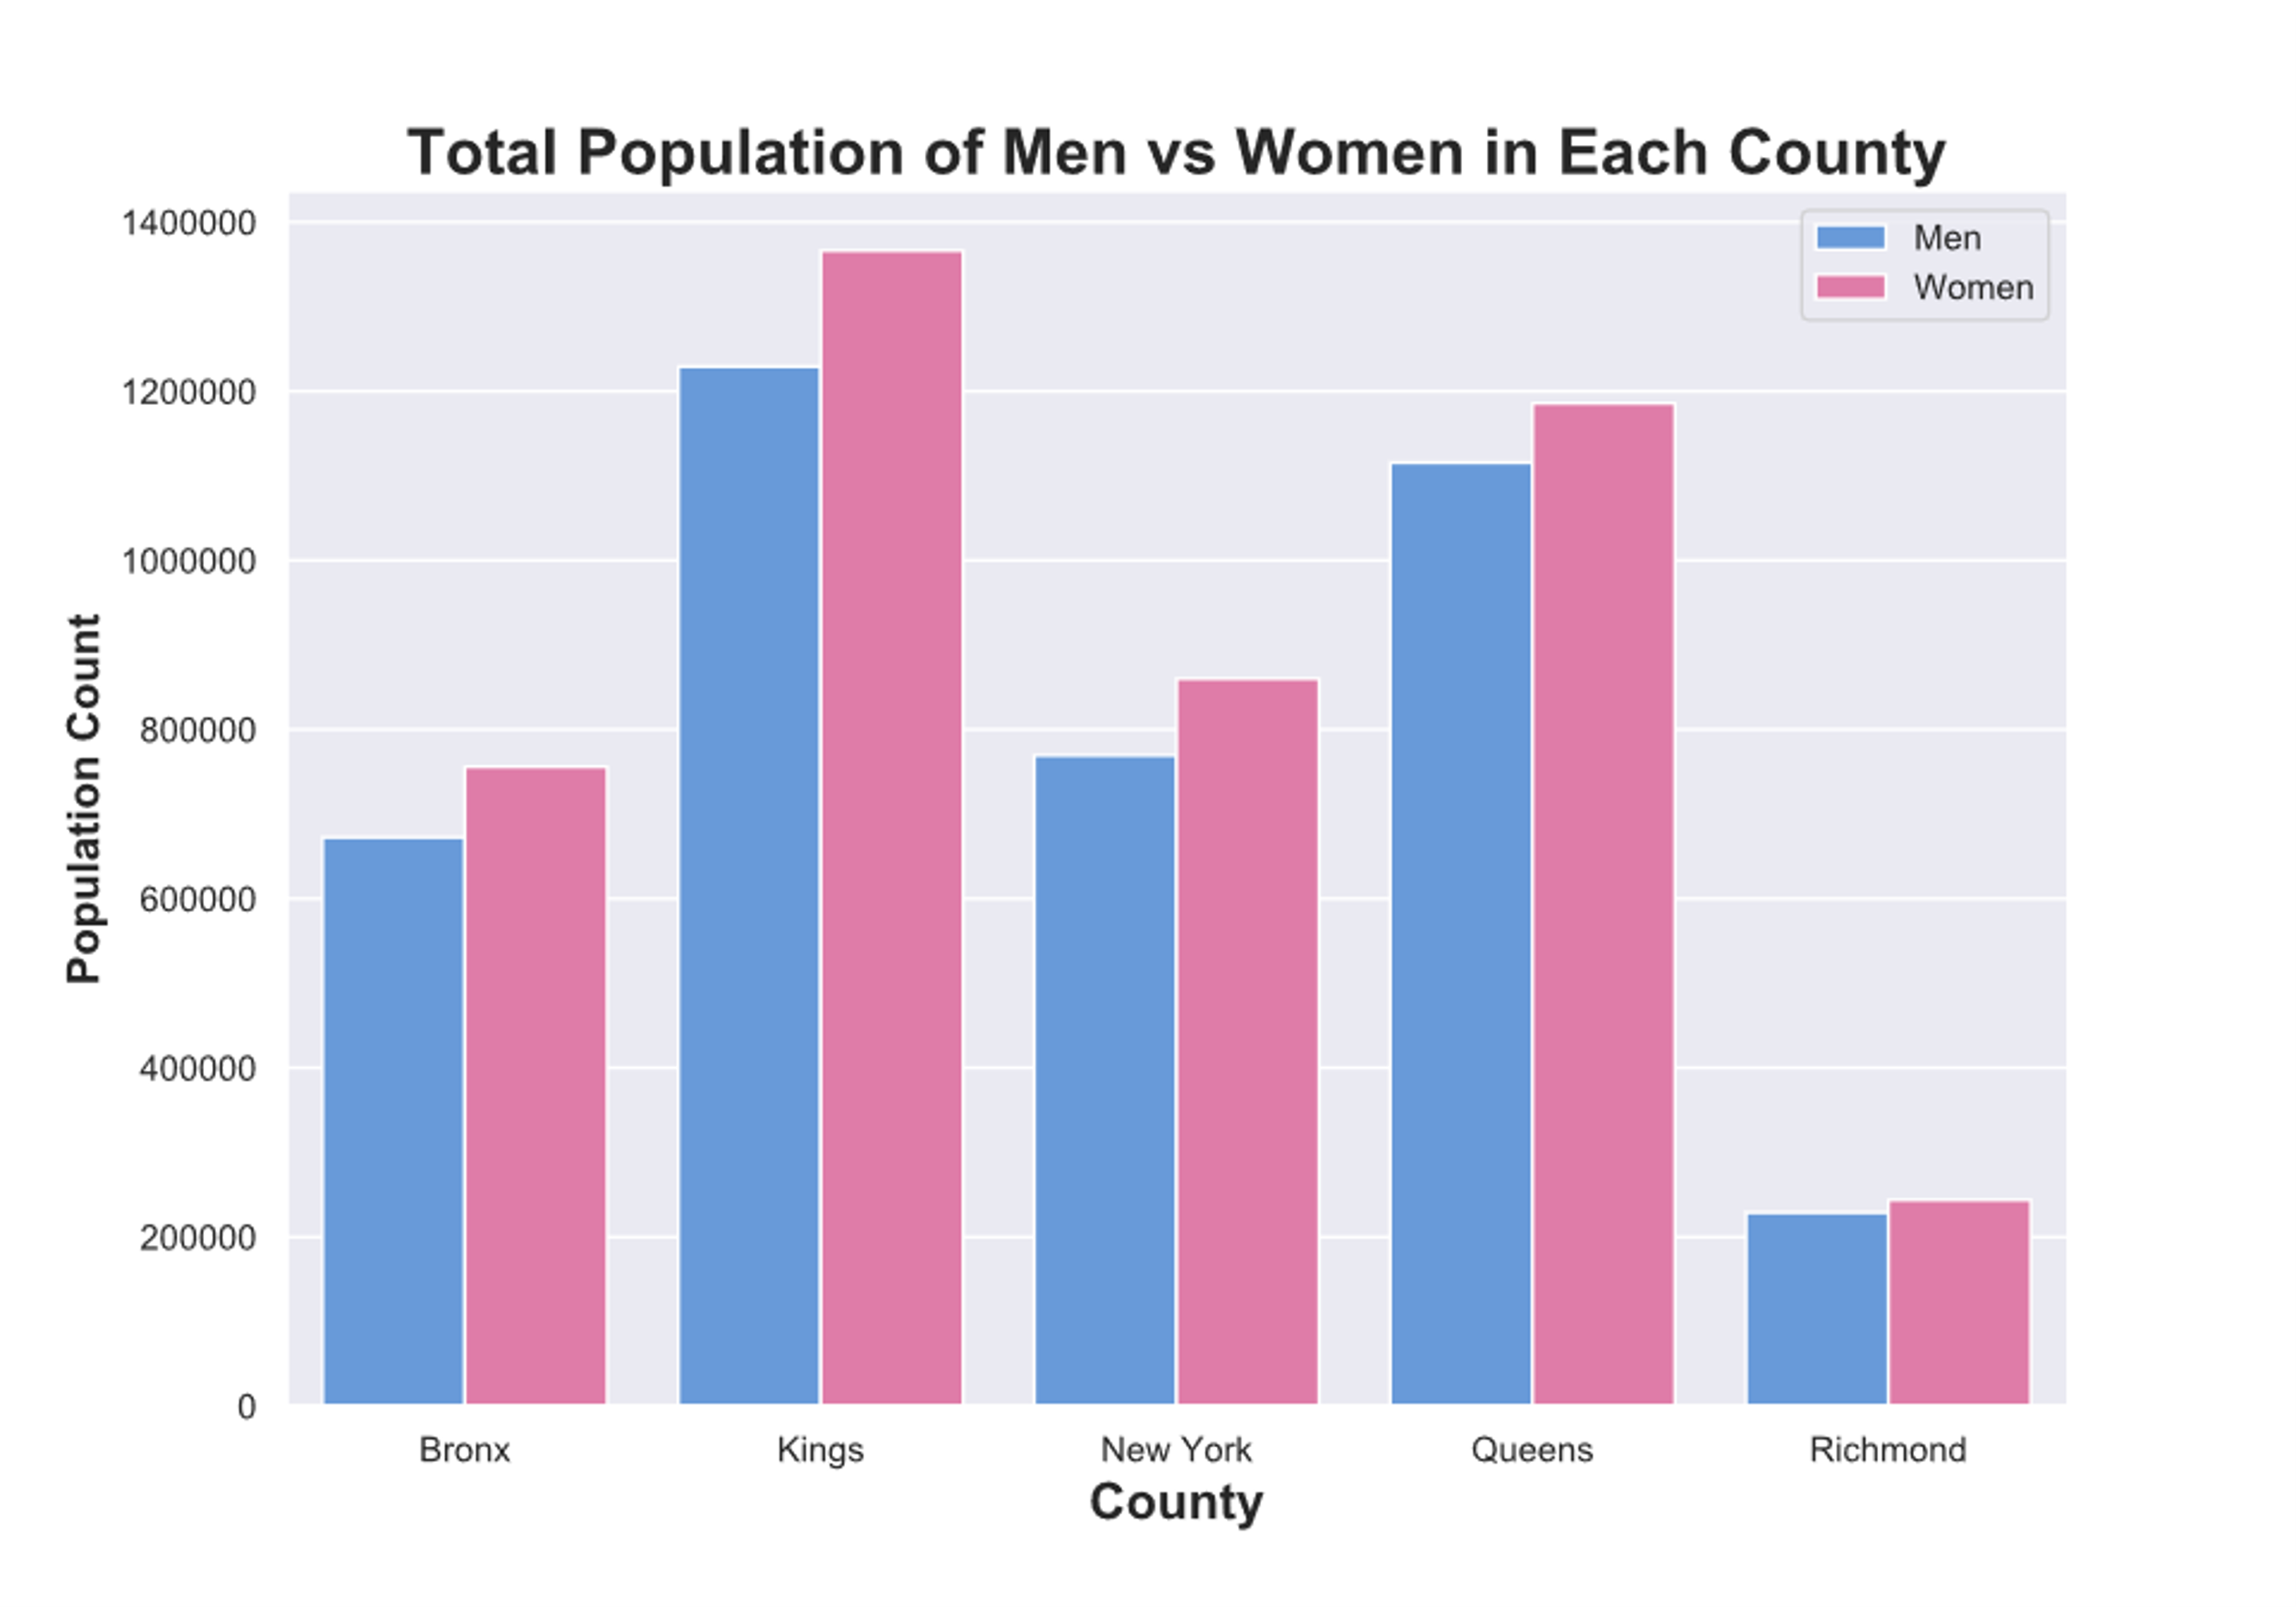
Areas explored
Geographic & demographic information
- Gender proportion

Slide 6
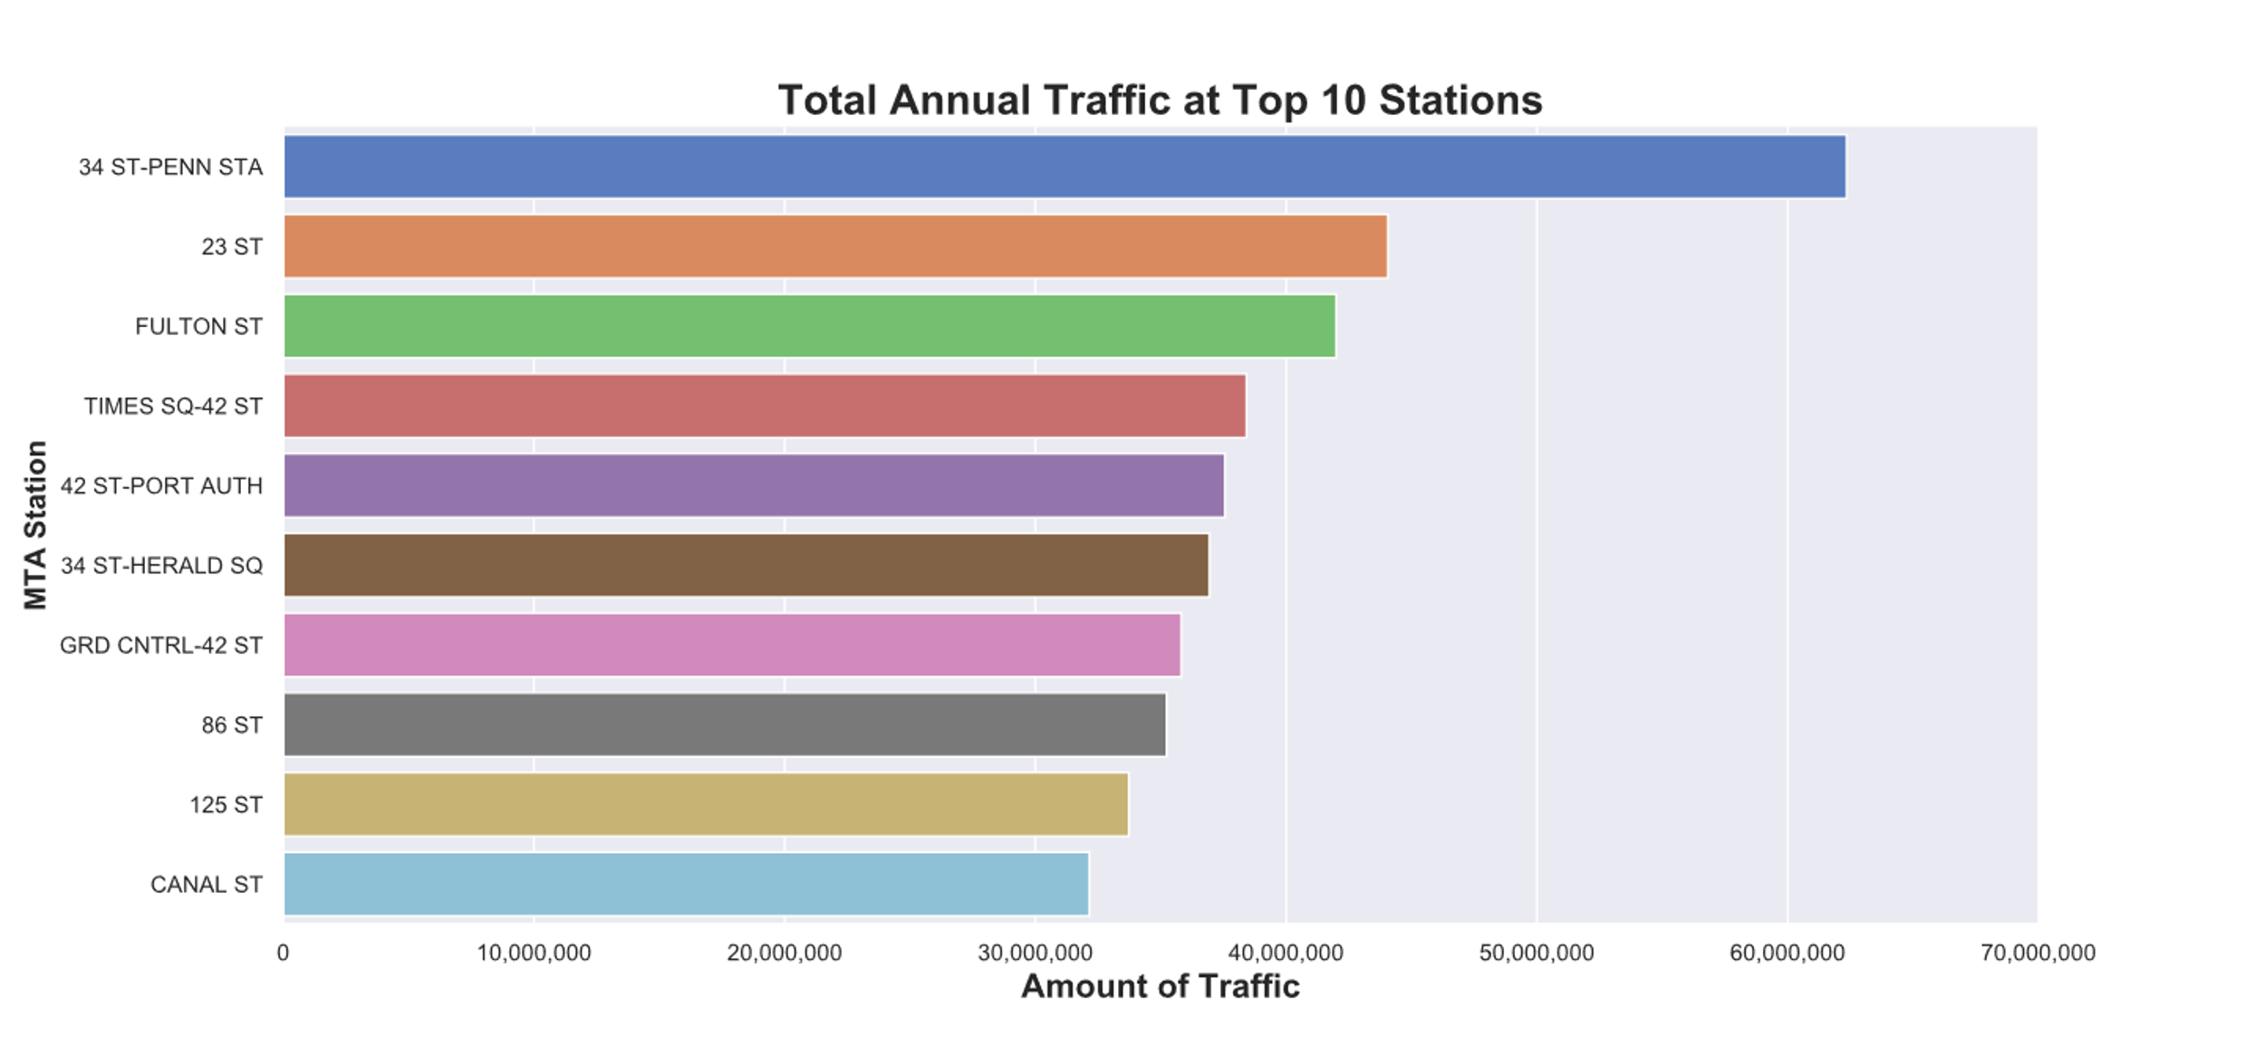
Areas explored
62.3 Mil
44.1 Mil
Traffic volume by station (Year 2017)
42.0 Mil
38.4 Mil
37.6 Mil

Slide 7
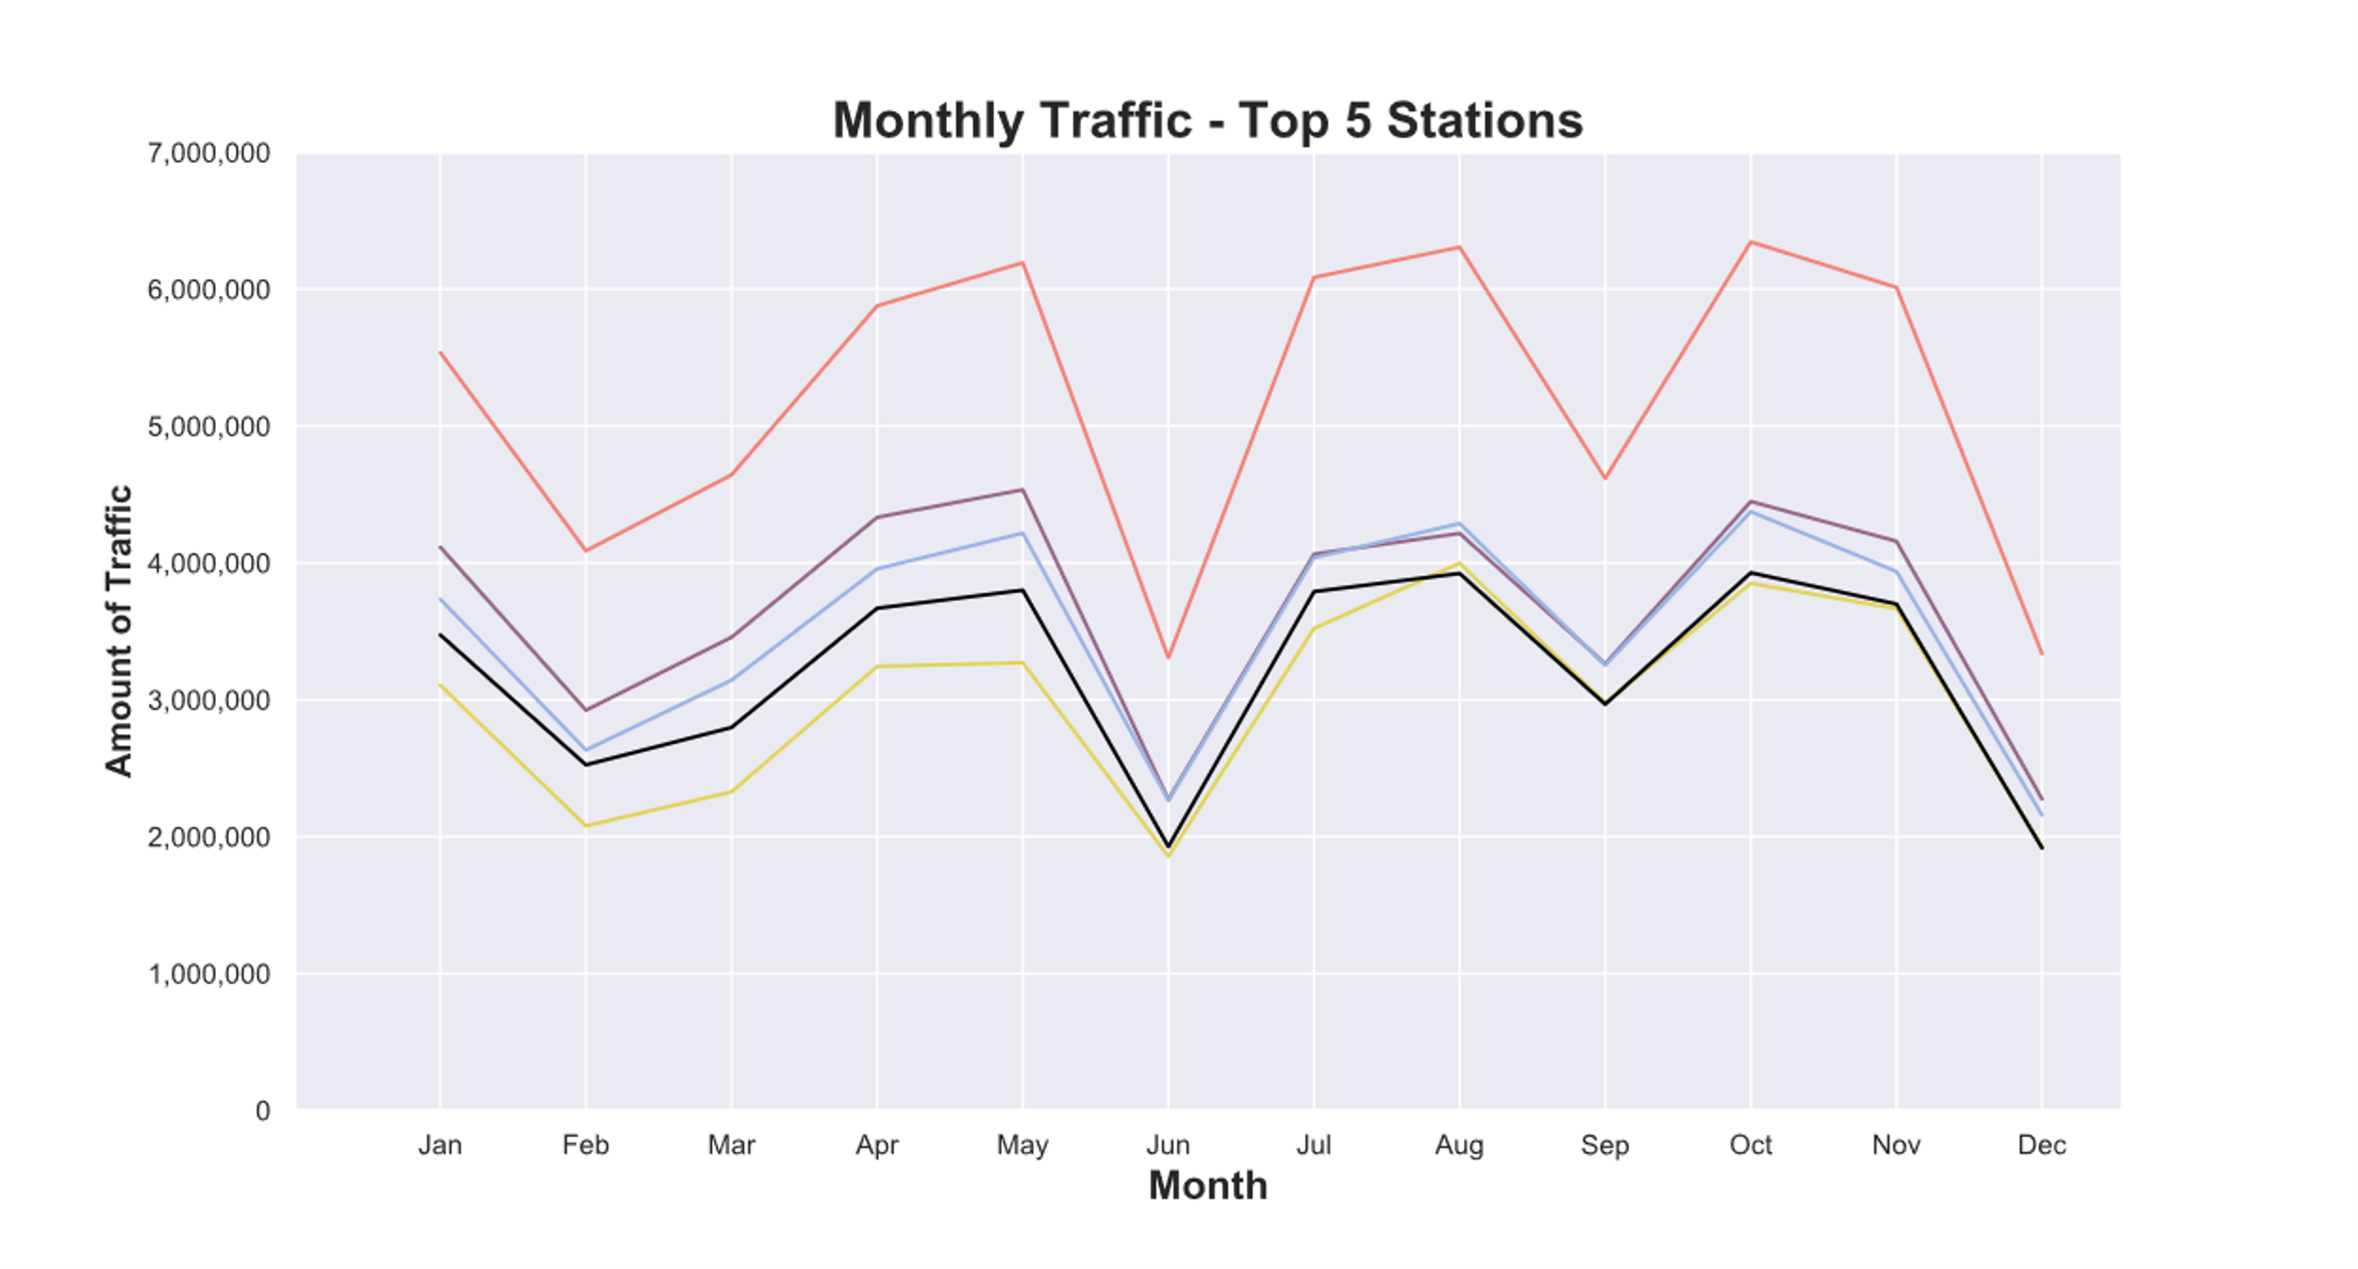

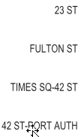
Areas explored
Traffic volume by month

Slide 8
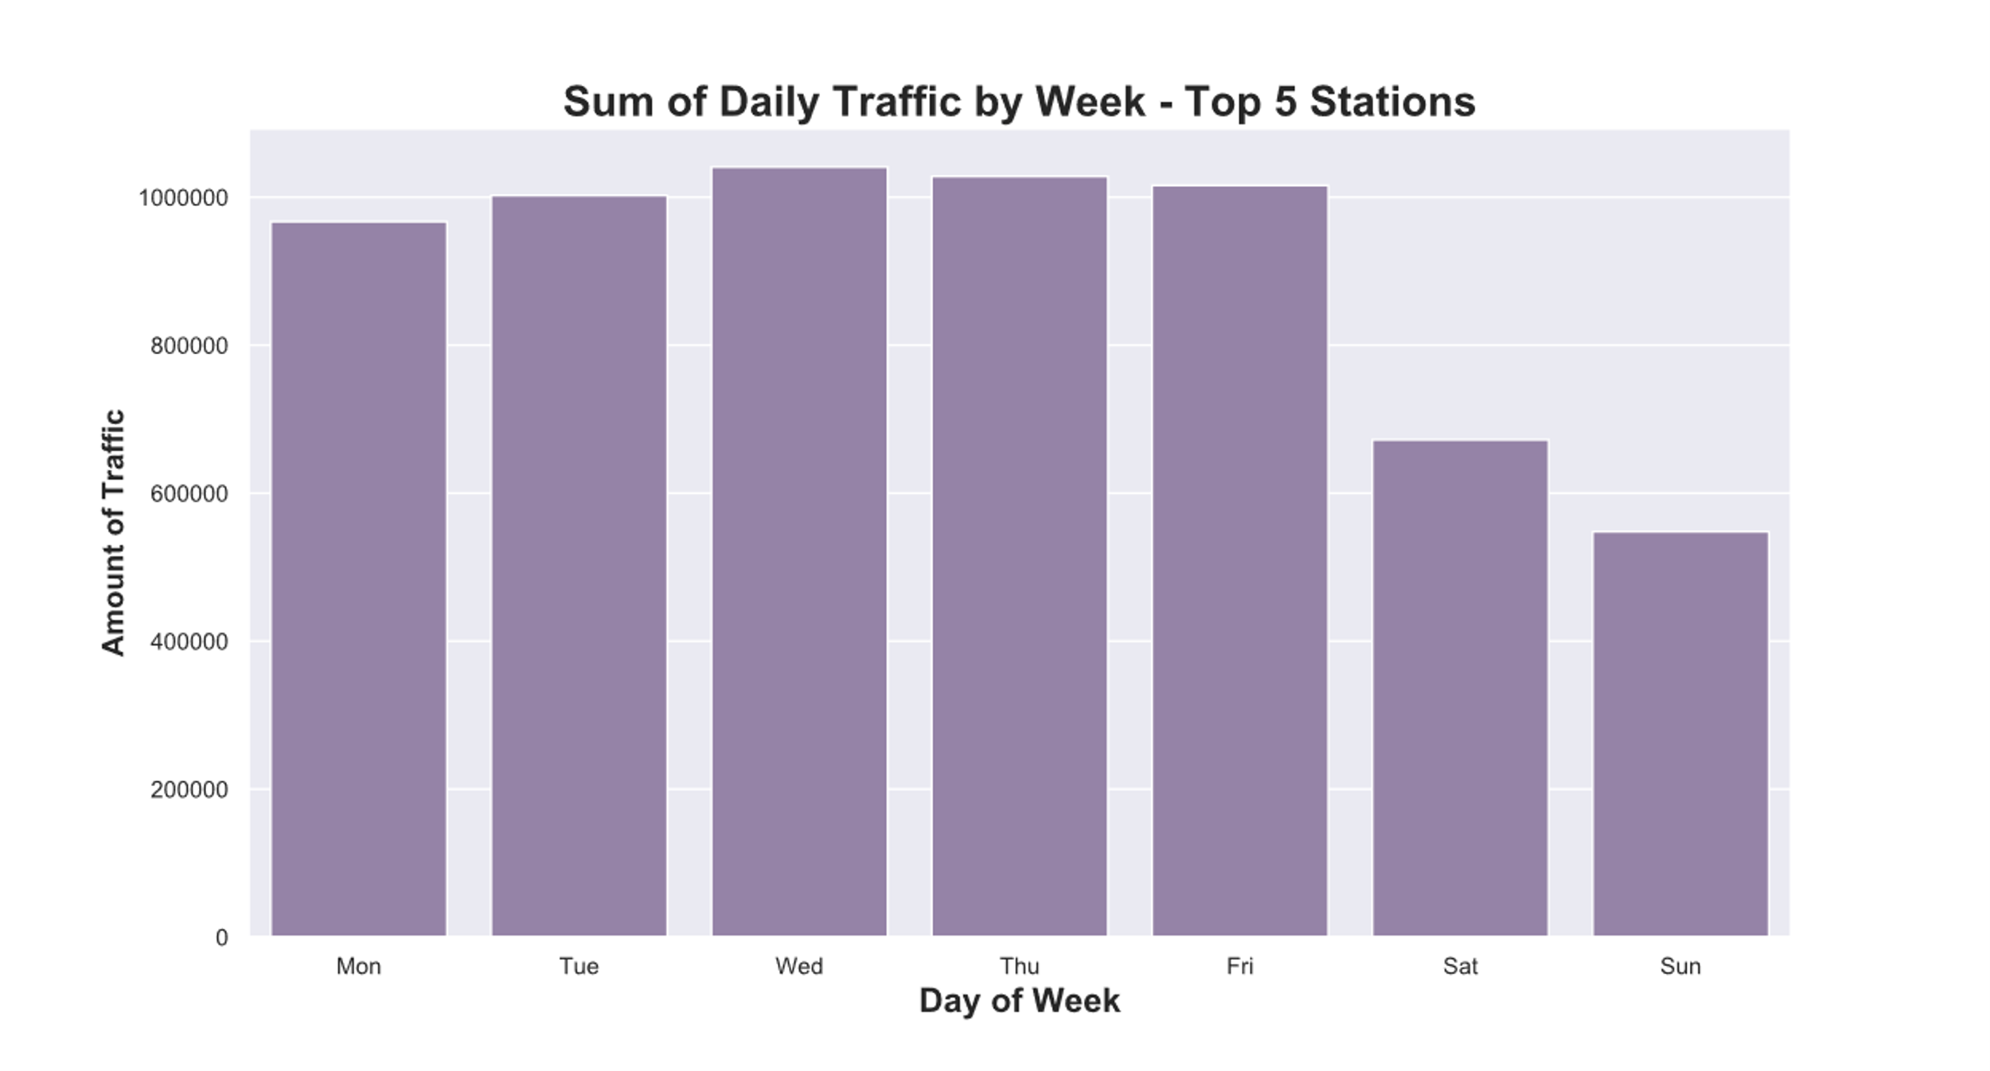
Areas explored
Weekly traffic patterns

Slide 9
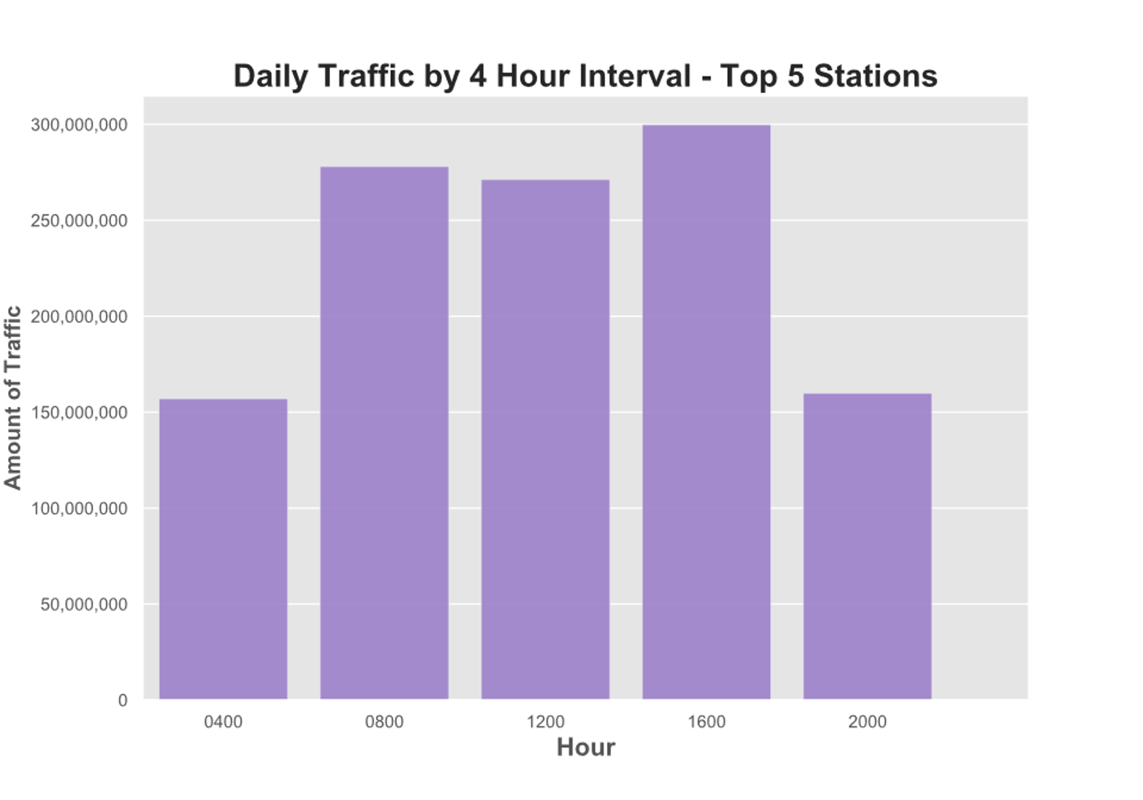
Areas explored
Traffic volume by time
16:00-20:00
08:00-12:00
12:00-16:00

Slide 10
Summary results
Top 5 busiest stations (entire year 2017)
1. 34 Street-Penn Station 2. 23rd Street 3. Fulton Street 4. Times Square 5. 42 Street-Port Auth
Peak traffic month: October, August, May
Peak traffic day: Wednesday, Thursday, Friday
Peak traffic time: 16:00-20:00, 08:00-12:00, 12:00-16:00
High income residential area with majority (>50%) female population: New York County

Slide 11
Recommendation
Month: October
Day: Wednesday
Time: 16:00-20:00
Evening hours preferred (people rush to work in the morning)
Place:
1. 34 Street-Penn Station 2. 23rd Street 3. Fulton Street 4. Times Square 5. 42 Street-Port Auth
Deploy teams according to geographical cluster
Refer to Heat Map

Slide 12
Next Steps
Additional yearly data needed to conclude monthly seasonality
To incorporate more demographic data (such as education and industry data)

Slide 13
Thank you
KELSEY, Ken, James
12 Jul 2019

Slide 14
Interesting insights
Top 5 stations differ from MTA published results
(probably due to different data sets)

Slide 15
Approach
Import data
Clean data (remove extra spaces, empty rows/columns, outliers)
Group data
Sort data to finalise summary statistics
Plot final statistical results

