Slide 1
Deep Learning for HIV-1 Subtype Classification
A BiLSTM and Focal Loss Approach on unaligned pol Gene Sequences
MSB7216: Deep Learning for Health Data

Slide 2
Abstract & Overview
Background: HIV-1 subtyping is essential for guiding antiretroviral therapy and tracking epidemiological spread.
Previous Work: Existing tools heavily rely on computationally expensive Multiple Sequence Alignment (MSA) or k-mer counting.
Problem Statement: MSA struggles with hypermutations, and genomic databases suffer from severe geographical class imbalance.
Objective: To develop an automated, alignment-free Deep Learning classifier to categorize raw nucleotide sequences into Subtypes A, B, C, and D.
Significance: Eliminating the MSA bottleneck enables faster, more scalable, and highly accurate subtyping for clinical deployment.

Slide 3
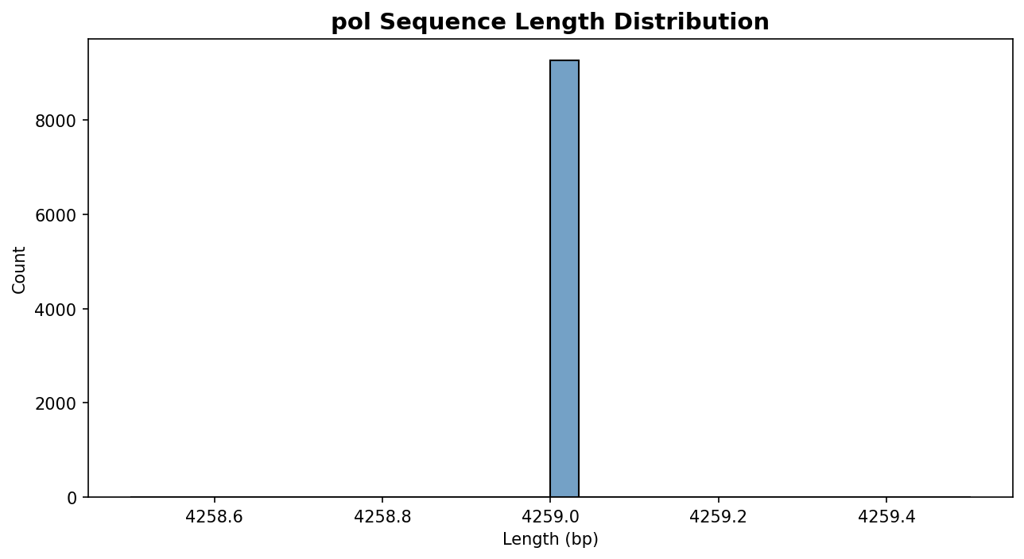
The Dataset & Geographical Bias
Data sourced from Los Alamos National Laboratory (LANL).
Severe Bias: Subtype B dominates North America & Europe (52.2% of data).
Sequence Length Variability: Shown in the plot, padded to 3000bp.

Slide 4
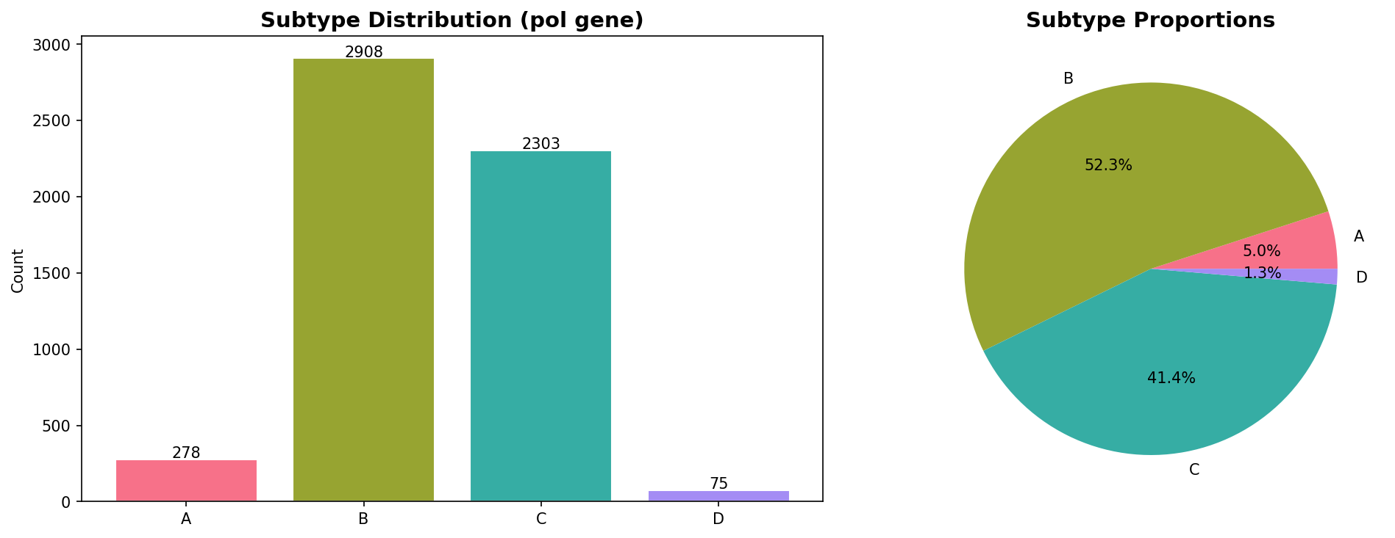
Methodology: Processing & Encoding
Alignment gaps ('-') completely stripped.
1. One-Hot Encoding: Used for MLP and 1D-CNN.
2. Label Embedding: Integers used for BiLSTM inputs.

Slide 5
Methodology: Class Balancing
Standard categorical cross-entropy caused precision degradation.
Implemented pure Focal Loss (Gamma=2.0).
Forces the gradient to focus heavily on hard-to-predict minority strains (A, C, D).

Slide 6
Methodology: Architectures
1. Baseline MLP (73.8k Params): GlobalAvgPool -> Dense(16) -> Classifier.
2. 1D-CNN (200k Params): 4 Conv1D layers (filters: 32 to 128) alternating with MaxPool & Dropout (0.5).
3. BiLSTM (2.1M Params): 128-dim Embedding -> 2-layer Bidirectional LSTM (256 hidden) -> Dense(128).

Slide 7
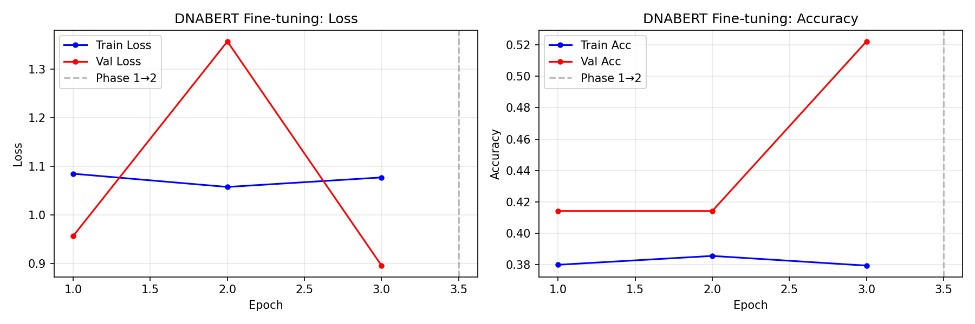
Methodology: Transfer Learning
Exploratory phase utilizing DNABERT.
Pre-trained on the human genome via Masked Language Modeling.
Classification head fine-tuned to test cross-domain transfer learning to viral genomes.

Slide 8
Methodology: Explainability
Universal Saliency Map using Input-Gradient Attention.
Highlights the exact nucleotide regions driving the BiLSTM's classifications.

Slide 9
Results: Model Comparison
Model | Test Accuracy | Macro Precision | Macro Recall | Macro F1
Baseline MLP | 0.6527 | 0.5082 | 0.7472 | 0.5114
1D-CNN | 0.5222 | 0.1305 | 0.2500 | 0.1715
BiLSTM | 0.9473 | 0.6274 | 0.6982 | 0.6541
DNABERT | 0.5222 | 0.1305 | 0.2500 | 0.1715

Slide 10
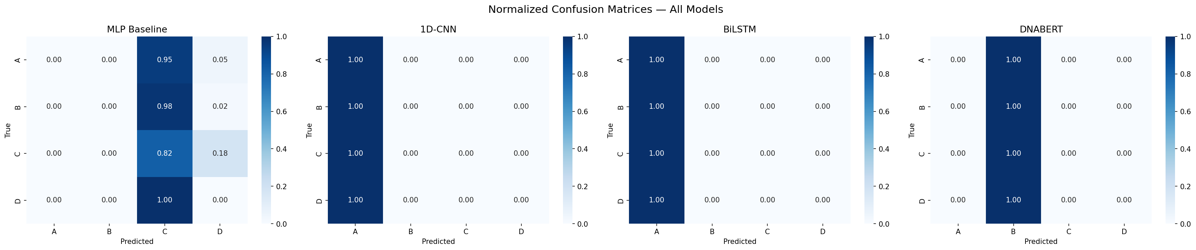
Results: Confusion Matrices
BiLSTM accurately maps minority classes.
CNN and DNABERT collapsed entirely (52.22% Subtype B baseline).

Slide 11
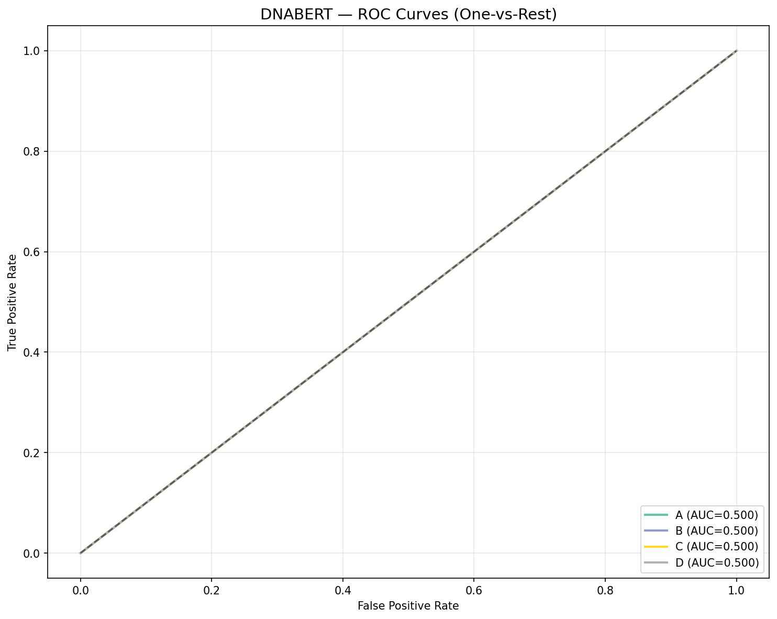
Results: ROC Curves
The Receiver Operating Characteristic confirms the BiLSTM's high true positive rate across all four classes.

Slide 12
Error Analysis
Causes: CNNs and DNABERT collapsed due to geographic imbalance.
Implications: Saliency Maps show BiLSTMs rely on conserved regions. When 'viral drift' mutates these domains, confidence drops.

Slide 13
Limitations & Challenges
1. Extreme Geographical Imbalance: Hard for spatial models (CNN) to overcome.
2. Computational Limits: VRAM restricted DNABERT's ability to learn 3000bp sequences.
3. Domain Gap: Human genome pre-training doesn't translate perfectly to viruses.

Slide 14
Deployment Strategy
Decoupled production deployment module.
Automatically loads the highest-performing architecture (BiLSTM).
Ready for real-time FASTA inference.

Slide 15
Conclusion & Future Work
Conclusion: Alignment-free Deep Learning (BiLSTM) handles viral genomic imbalances far better than CNNs, achieving 94.73% accuracy.
Future Work: Expand to Circulating Recombinant Forms (CRFs) and launch via FastAPI.

