Slide 1
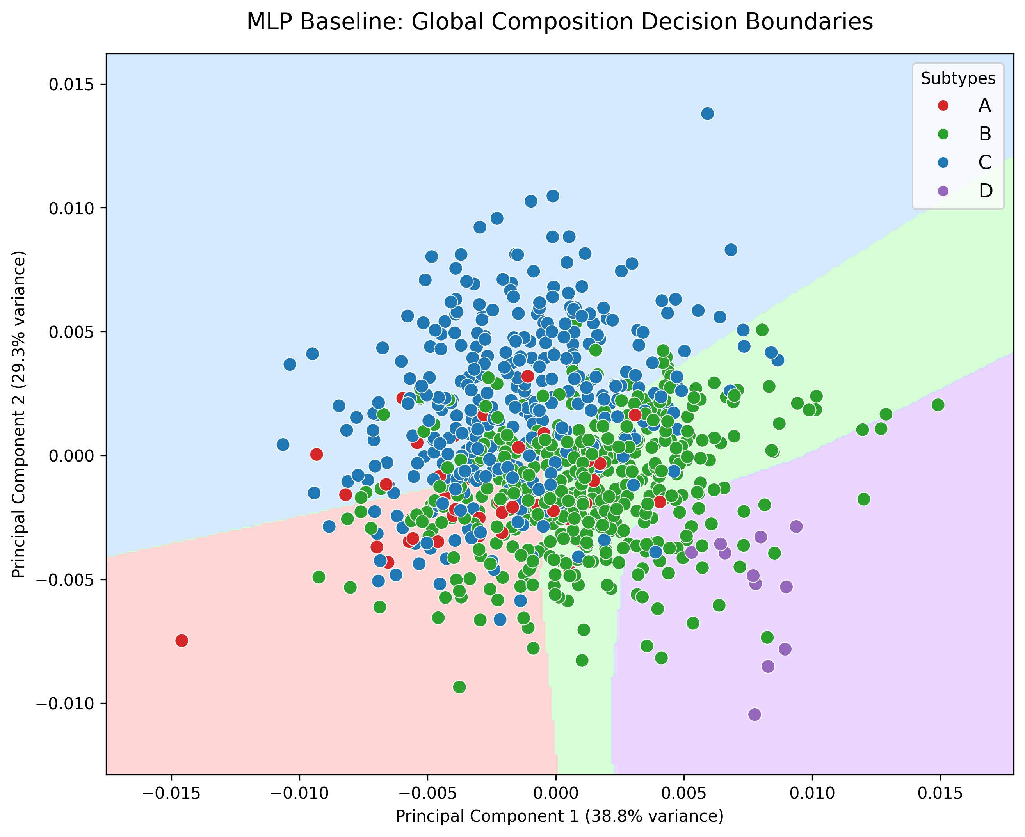
Deep Learning for HIV-1 Subtype Classification
A BiLSTM and Focal Loss Approach on unaligned pol Gene Sequences
MSB7216: Deep Learning for Health Data

Slide 2
Abstract & Overview
• Background: HIV-1 subtyping is essential for guiding antiretroviral therapy and tracking epidemiological spread.
• Previous Work: Existing tools heavily rely on computationally expensive Multiple Sequence Alignment (MSA) or k-mer counting.
• Problem Statement: MSA struggles with hypermutations, and genomic databases suffer from severe geographical class imbalance.
• Objective: To develop an automated, alignment-free Deep Learning classifier to categorize raw nucleotide sequences into Subtypes A, B, C, and D.
• Significance: Eliminating the MSA bottleneck enables faster, more scalable, and highly accurate subtyping for clinical deployment.

Slide 3
Data Acquisition (Kameris Experiment)
• Data was acquired by parsing 9,270 HIV-1 pol gene accessions utilized in the Kameris et al. experiment.
• A JSON file was pulled from the Kameris GitHub repository to extract specific LANL sequence IDs.
• These IDs were fed into the LANL HIV Sequence Database to batch download the raw FASTA sequences.
• Sequences were then strictly filtered to our 4 target classes: Subtypes A, B, C, and D.
• Severe Bias: Subtype B heavily dominates the final dataset (52.2%).

Slide 4
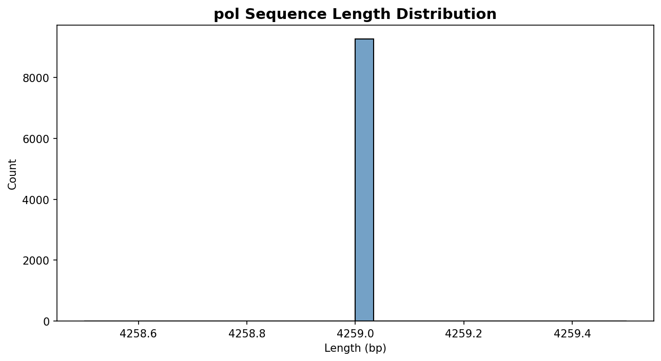
Methodology: Processing & Encoding
• Gap Stripping: Alignment gaps ('-') completely removed.
• Padding: Unaligned sequences padded/truncated to uniform 3000bp.
• One-Hot Encoding: Matrix [L x 4] for spatial models (CNN, MLP).
• Label Embedding: Integer mapping for sequential models (BiLSTM).
Raw Sequence | Cleaned Sequence | Integer Encoding
A-T-C--G | ATCG | [1, 4, 2, 3]
T--C-A-N | TCAN | [4, 2, 1, 0]

Slide 5
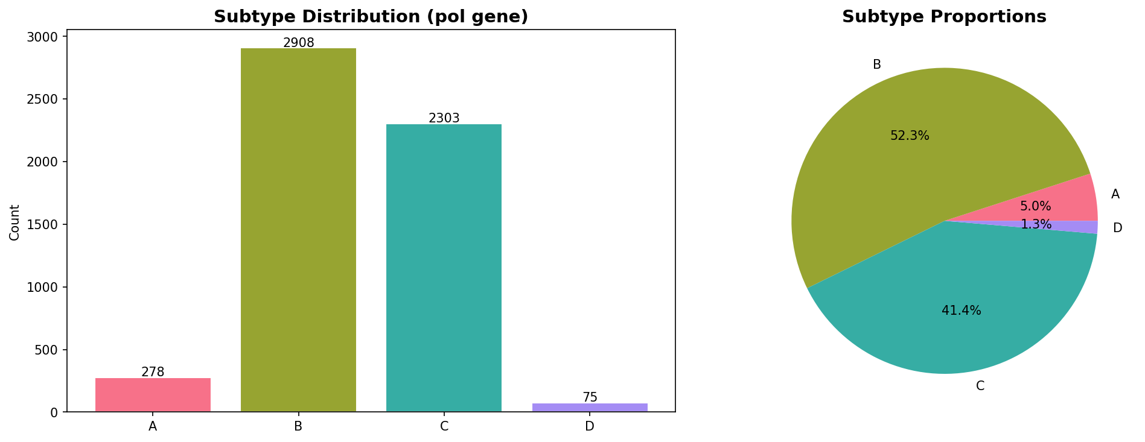
Methodology: Data Splitting & Class Balancing
• Stratified Split: Data divided into 70% Train, 15% Val, and 15% Test.
• Class Imbalance: Subtype B severely dominates the data (>52%).
• Standard cross-entropy caused precision collapse in minority classes.
• Solution: Pure Focal Loss (Gamma=2.0) applied natively in PyTorch.
• Forces gradient to focus on hard-to-predict minority strains (A, C, D).

Slide 6
Methodology: Architectures
• 1. Baseline MLP (73.8k Params): GlobalAvgPool -> Dense(16) -> Classifier.
• 2. 1D-CNN (200k Params): 4 Conv1D layers (filters: 32 to 128) alternating with MaxPool & Dropout (0.5).
• 3. BiLSTM (2.1M Params): 128-dim Embedding -> 2-layer Bidirectional LSTM (256 hidden) -> Dense(128).

Slide 7
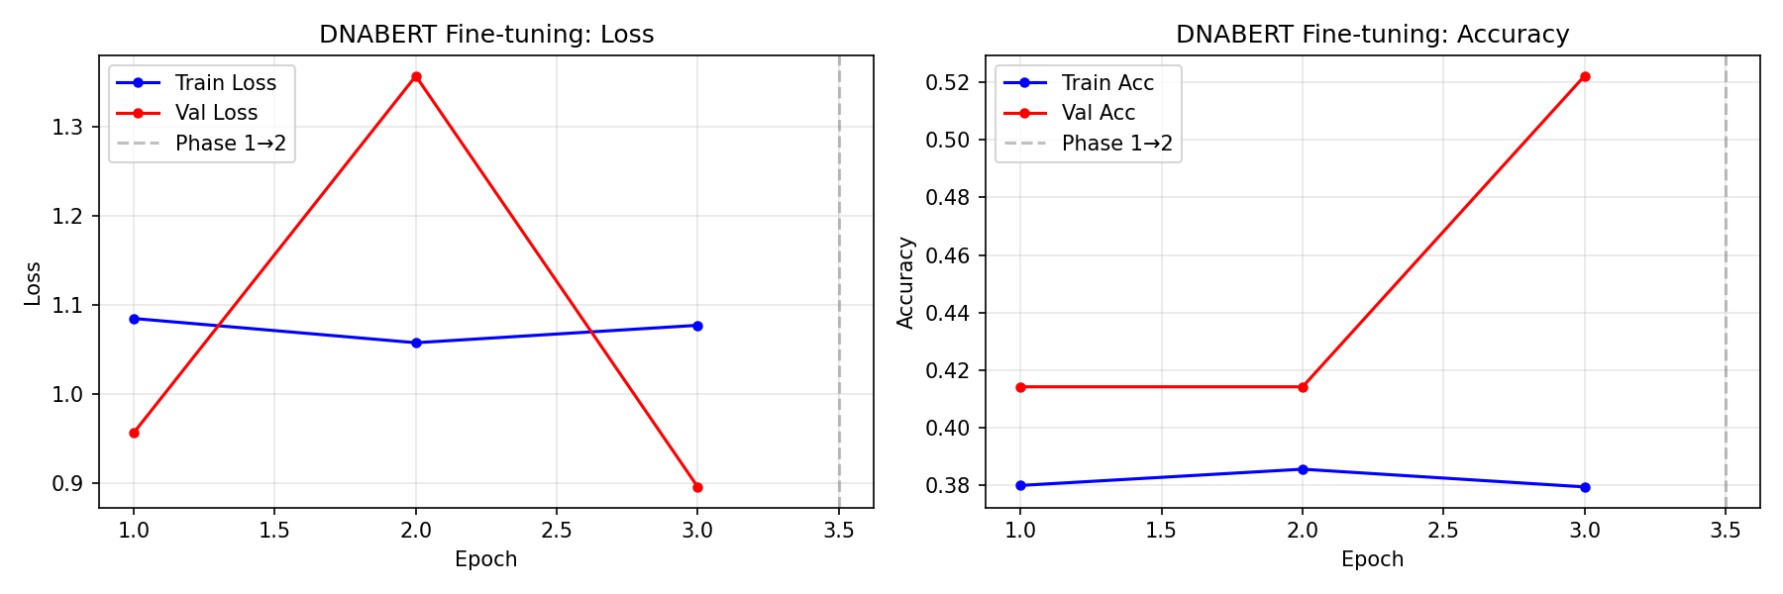
Methodology: Transfer Learning
• Exploratory phase utilizing DNABERT.
• Pre-trained on the human genome via Masked Language Modeling.
• Classification head fine-tuned to test cross-domain transfer learning to viral genomes.

Slide 8
Methodology: Explainability
• Universal Saliency Map using Input-Gradient Attention.
• Highlights the exact nucleotide regions driving the BiLSTM's classifications.

Slide 9
Results: Model Comparison
Model | Test Accuracy | Macro Precision | Macro Recall | Macro F1
Baseline MLP | 0.6527 | 0.5082 | 0.7472 | 0.5114
1D-CNN | 0.5222 | 0.1305 | 0.2500 | 0.1715
BiLSTM | 0.9473 | 0.6274 | 0.6982 | 0.6541
DNABERT | 0.5222 | 0.1305 | 0.2500 | 0.1715

Slide 10
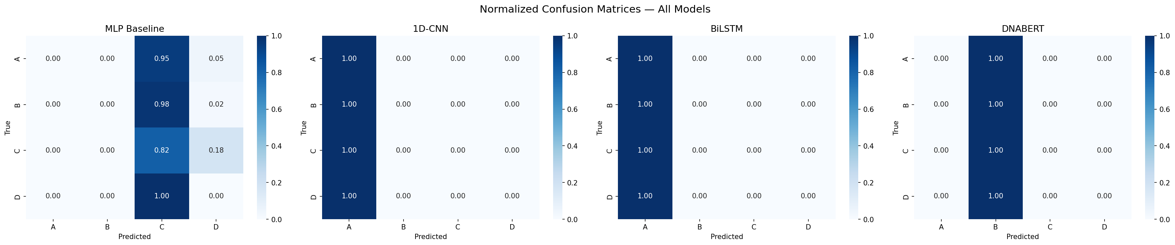
Results: Confusion Matrices
• BiLSTM accurately maps minority classes.
• CNN and DNABERT collapsed entirely (52.22% Subtype B baseline).

Slide 11
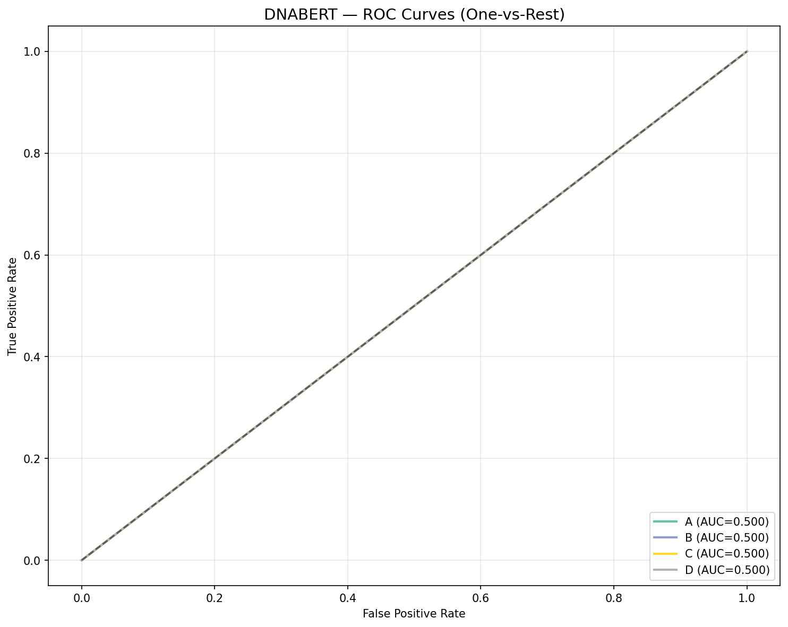
Results: ROC Curves
• The Receiver Operating Characteristic confirms the BiLSTM's high true positive rate across all four classes.

Slide 12
Error Analysis
• Causes: CNNs and DNABERT collapsed due to geographic imbalance.
• Implications: Saliency Maps show BiLSTMs rely on conserved regions. When 'viral drift' mutates these domains, confidence drops.

Slide 13
Limitations & Challenges
• 1. Extreme Geographical Imbalance: Hard for spatial models (CNN) to overcome.
• 2. Computational Limits: VRAM restricted DNABERT's ability to learn 3000bp sequences.
• 3. Domain Gap: Human genome pre-training doesn't translate perfectly to viruses.

Slide 14
Deployment Strategy
• Decoupled production deployment module.
• Automatically loads the highest-performing architecture (BiLSTM).
• Ready for real-time FASTA inference.

Slide 15
Conclusion & Future Work
• Conclusion: Alignment-free Deep Learning (BiLSTM) handles viral genomic imbalances far better than CNNs, achieving 94.73% accuracy.
• Future Work: Expand to Circulating Recombinant Forms (CRFs) and launch via FastAPI.

