Slide 1
Deep Learning for HIV-1 Subtype Classification using Pol gene
MSB7216: Deep Learning for Health Data
Jovita Nagawa
2025/HD07/26007

Slide 2
Background
HIV-1 subtyping is essential for guiding antiretroviral therapy and tracking epidemiological spread.
Existing tools heavily rely on computationally expensive Multiple Sequence Alignment (MSA) or k-mer counting.
MSA struggles with hypermutations, and genomic databases and is computationally expensive
Objective: To develop an automated, alignment-free Deep Learning classifier to categorize raw nucleotide sequences into Subtypes A, B, C, and D.
Eliminating the MSA bottleneck enables faster, more scalable, and highly accurate subtyping for clinical deployment.

Slide 3
Dataset
Data was acquired by parsing 9,270 HIV-1 pol gene accessions utilized in the Kameris et al. experiment.
A JSON file was pulled from the Kameris GitHub repository to extract specific LANL sequence IDs.
These IDs were fed into the LANL HIV Sequence Database to batch download the raw FASTA sequences.
Sequences were then strictly filtered to our 4 target classes: Subtypes A, B, C, and D.
Severe Bias: Subtype B heavily dominates the final dataset (52.2%).

Slide 4
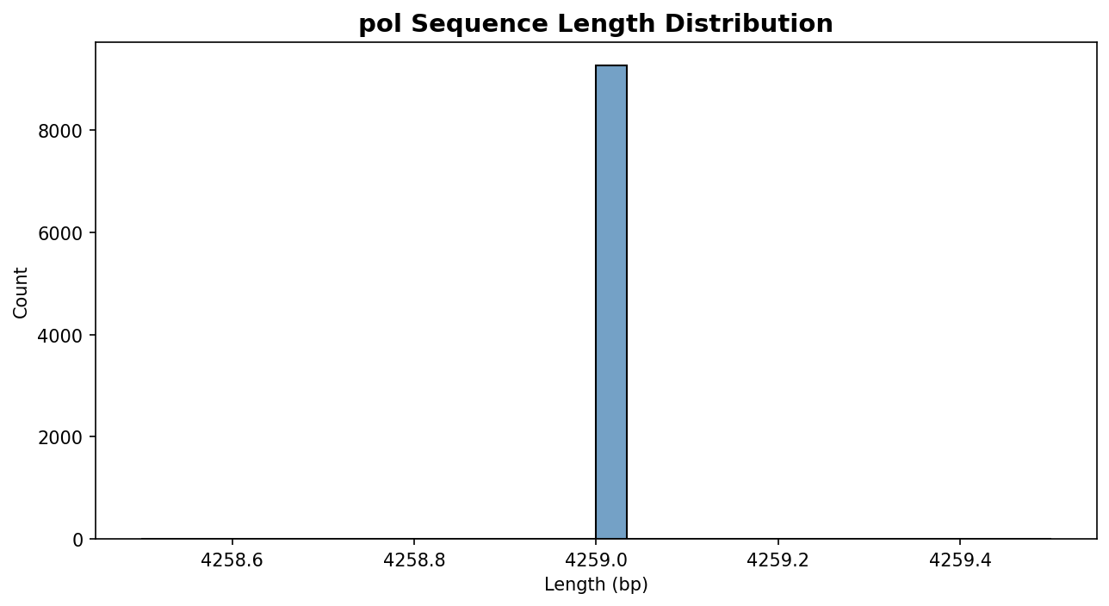
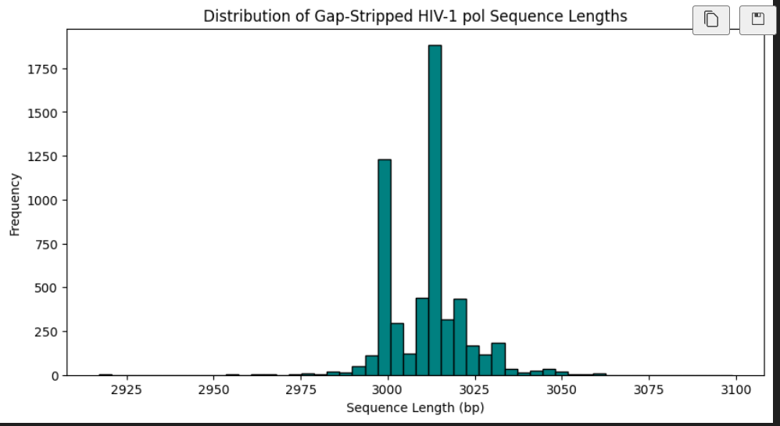
Methodology: Processing & Encoding
Gap Stripping: Alignment gaps ('-') completely removed.
Padding: Unaligned sequences padded/truncated to uniform 3000bp.
One-Hot Encoding: Matrix [L x 4] for spatial models (CNN, MLP).
Label Embedding: Integer mapping for sequential models (BiLSTM).

Slide 5
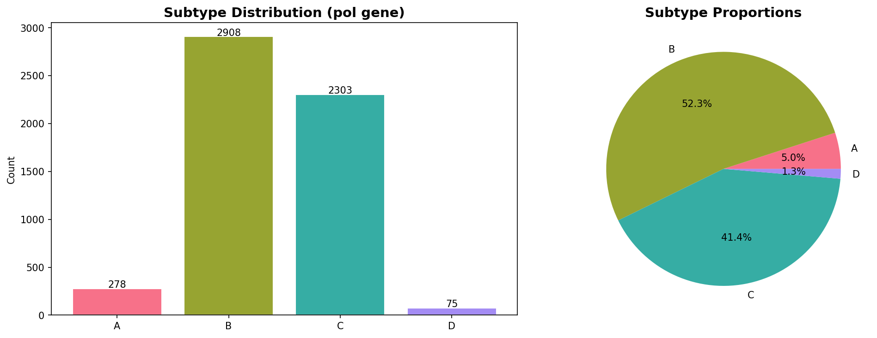
Data Splitting & Class Balancing
Stratified Split: Data divided into 70% Train, 15% Val, and 15% Test.
Class Imbalance: Subtype B severely dominates the data (>52%).
Standard cross-entropy caused precision collapse in minority classes
Solution: Pure Focal Loss (Gamma=2.0) applied natively in PyTorch.
Forces gradient to focus on hard-to-predict minority strains (A, C, D).

Slide 6
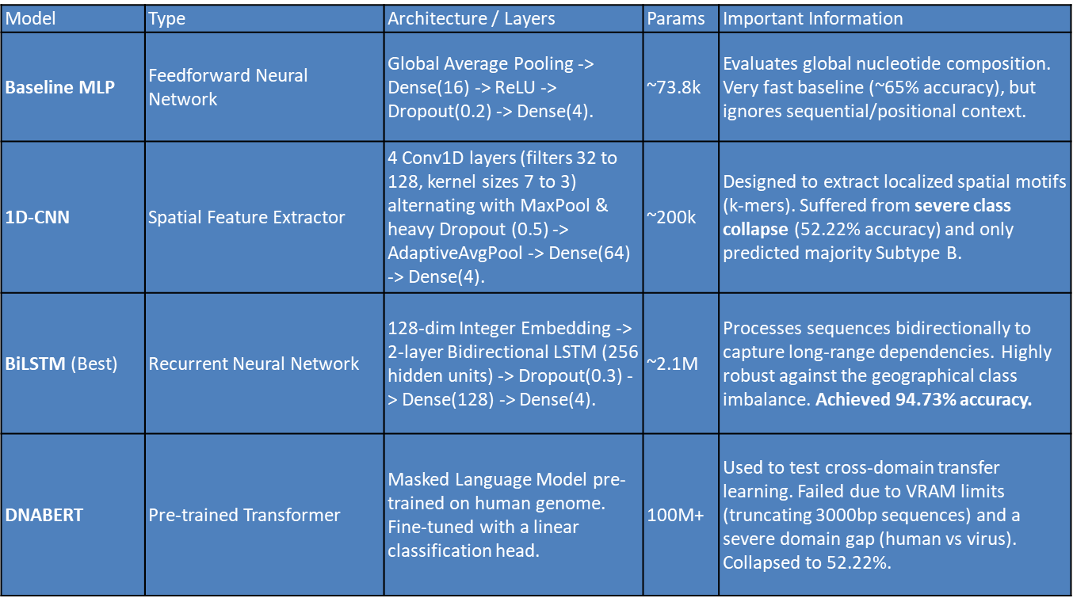
Experiments: Models

Slide 7
Methodology
Transfer Learning
DNABERT, pre-trained on the human genome via Masked Language Modeling.
• Classification head fine-tuned to test cross-domain transfer learning to viral genomes.
Explainability
• Universal Saliency Map using Input-Gradient Attention.
• Highlights the exact nucleotide regions driving the BiLSTM's classifications

Slide 8
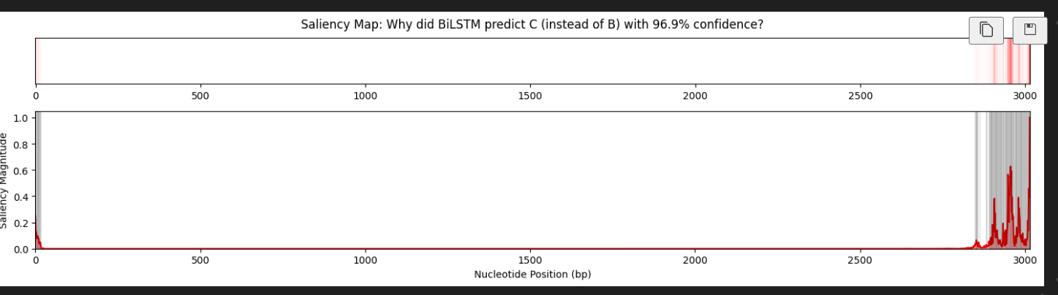
Methodology
Saliency Maps show BiLSTMs rely on conserved regions. When 'viral drift' mutates these domains, confidence drops.

Slide 9
Results: Model Comparison
Model | Test Accuracy | Macro Precision | Macro Recall | Macro F1
Baseline MLP | 0.6527 | 0.5082 | 0.7472 | 0.5114
1D-CNN | 0.5222 | 0.1305 | 0.2500 | 0.1715
BiLSTM | 0.9473 | 0.6274 | 0.6982 | 0.6541
DNABERT | 0.5222 | 0.1305 | 0.2500 | 0.1715

Slide 10
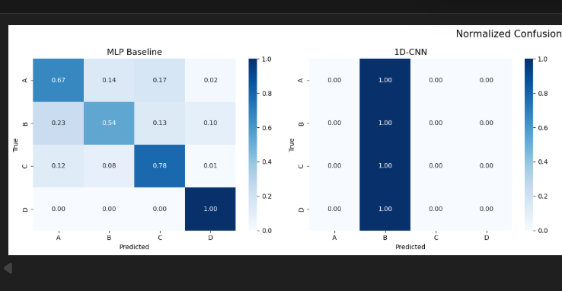
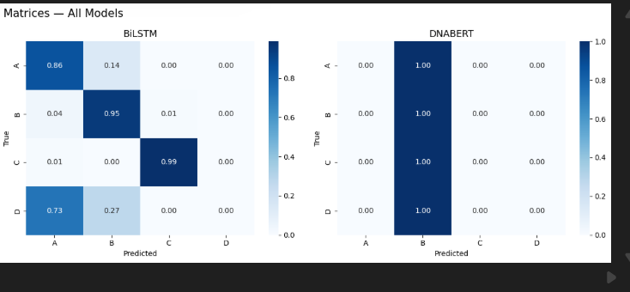
Results: Confusion Matrices

Slide 11
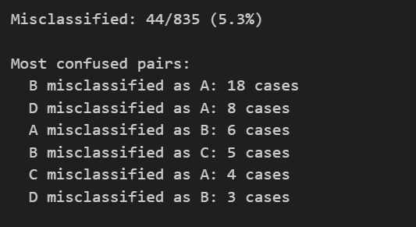
Error Analysis
Even the best model did not classify a single class with 100% accuracy.
Thus need to fine tune it and check whether retraining it on balanced dataset would be better.

Slide 12
Limitations & Challenges
1. Extreme Geographical Imbalance: Hard for spatial models (CNN) to overcome.
2. Computational Limits: VRAM restricted DNABERT's ability to learn 3000bp sequences.
3. Domain Gap with transfer learning: Human genome pre-training doesn't translate perfectly to viruses.
4. Compute constraints

Slide 13
Conclusion & Future Work
Alignment-free Deep Learning (BiLSTM) handles viral genomic imbalances far better than CNNs, achieving 94.73% accuracy.
Future Work
Resample data to balance classes and retrain model
Finetune CNN to check for any possible better performance
Expand to Circulating Recombinant Forms (CRFs) and other subtypes

