Slide 1
Employee salary prediction using Gradient Boosting Classifier
CAPSTONE PROJECT
Presented By:
Student Name: J Nandini
College Name: Madanapalle Institute of Technology and Science(MITS)
Department: Computer Science and Engineering(Data Science)
AICTE ID: STU67677bd9c8b3d1734835161

Slide 2
OUTLINE
Problem Statement (Should not include solution)
System Development Approach (Technology Used)
Algorithm & Deployment (Step by Step Procedure)
Result
Conclusion
Future Scope(Optional)
References

Slide 3
Problem Statement: Organizations often face challenges in identifying which employees are likely to earn higher salaries based on various personal and professional attributes. Accurately predicting whether an employee earns above or below a certain salary threshold can help in decision-making related to hiring, promotions, and workforce planning. Manual evaluation is time-consuming and prone to bias, hence there is a need for a data-driven approach.
Mention what your project is all about min 5 line:
This project aims to build a machine learning model that predicts whether an employee earns more
than $50K annually based on demographic and work-related features. The model is trained using the
Adult Income dataset from the UCI repository. Features like age, education, occupation,
hours-per-week, and others are used to make the prediction. The trained model is integrated into a
user-friendly web application using streamlit, allowing real-time salary classification. This solution
can be valuable for HR analytics and organizational workforce insights.

Slide 4
1. System Requirements
Hardware Requirements:
Processor: Intel i5
RAM: Minimum 4 GB (8 GB recommended)
Storage: At least 1 GB of free disk space
Camera (optional for UI enhancements or login)
Software Requirements:
Operating System: Windows 11
Python 3.12.7
Jupyter Notebook (Anaconda )
Streamlit (for web-based deployment)

Slide 5
🔧 2.Libraries Used in the Project
Pandas: To read and clean the employee dataset(.csc file).
Numpy: For numerical operations on the dataset.
Matplotlib.pyplot: To create boxplots and detect outliers in features like age and hours-per-week.
Seaborn: To visualize data distributions (e.g.,countplots, histograms).
sklearn.model_selection → train_test_split: To split the dataset into training and testing parts.
sklearn.preprocessing → LabelEncoder: To convert text columns (e.g., education, occupation) into numbers.
sklearn.preprocessing → StandardScaler: To scale numeric data so that all features are on the same scale.
sklearn.ensemble → RandomForestClassifier: To train a machine learning model that predicts if salary >50K or ≤50K.
Sklearn.metrics(accuracy_scor,confusion_matrix, classification_report): To evaluate how well the model performs
Joblib: To save the trained model as best_model.pkl. So it can be used later in the Streamlit app.
Streamlit: To build a web app where users can input employee details and see the prediction result instantly

Slide 6
Algorithm & Deployment
.
Loaded dataset using pandas and explored initial structure.
Handled missing values and encoded categorical columns.
Performed EDA using seaborn, matplotlib.
Scaled features and split data into training/testing sets.
Trained models: Logistic Regression, Random Forest, KNN, SVM, GradientBoosting.
Evaluated models using accuracy, precision, recall, F1-score.
Selected the best-performing model and saved using joblib.
Created a streamlit app to accept user inputs via sidebar.
Loaded saved model and predicted salay class (>50k/<=50k).
Displayed results and messages dynamically in the UI.
Run the app locally using streamlit run app.py .
Deploy the app using platforms like Github pages.

Slide 7
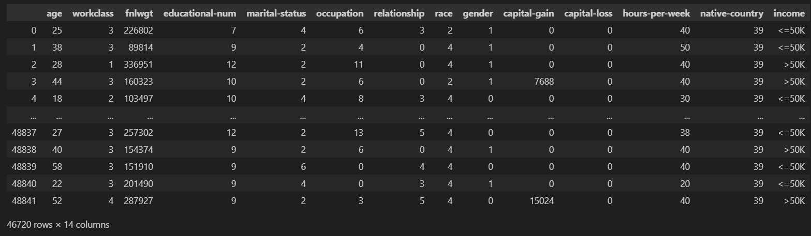
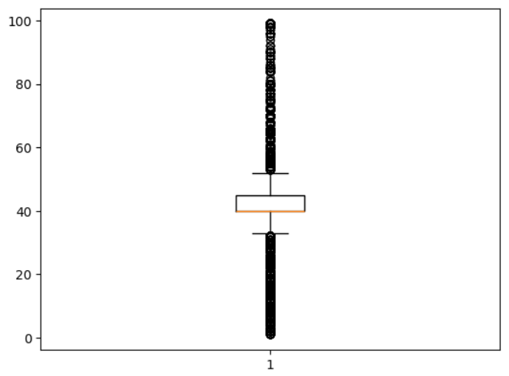
Result Github Link: https://github.com/JNandini18/Employee_Salary_Prediction.git

Slide 8
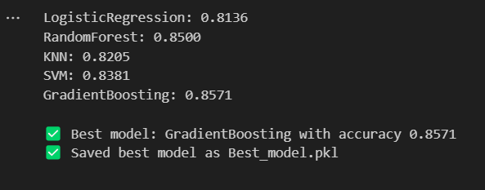
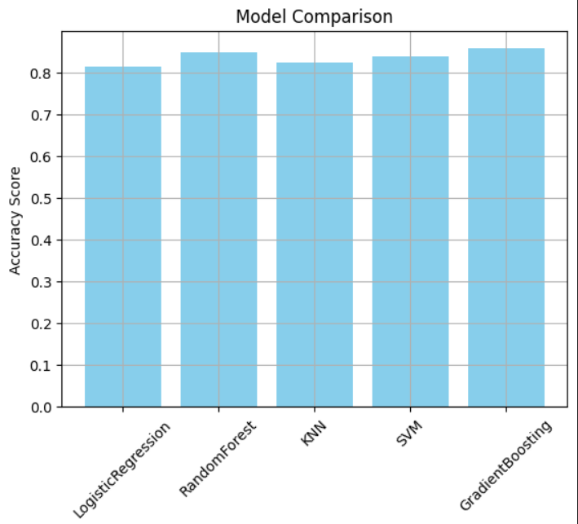
Result
Github link:
https://github.com/JNandini18/Employee_Salary_Prediction.git

Slide 9
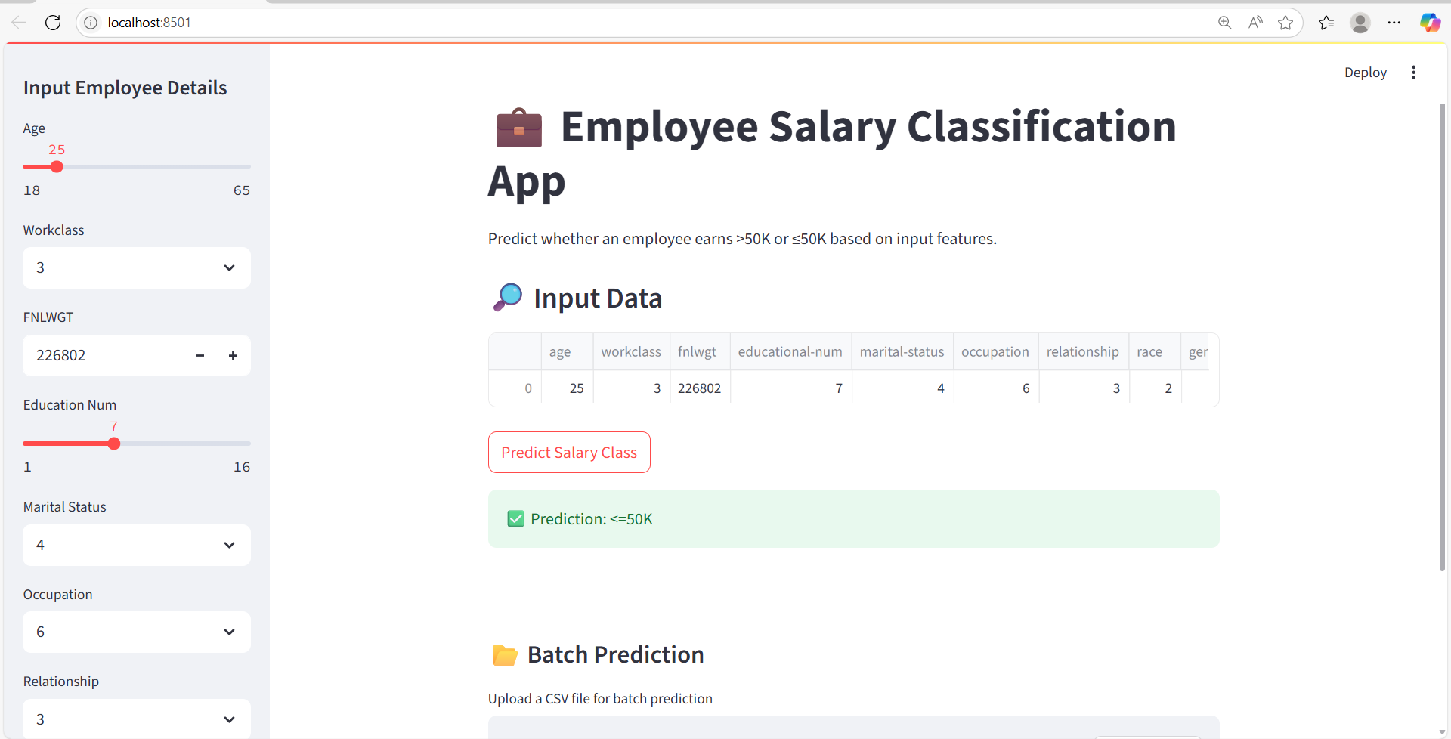
Conclusion
🔍 Key Findings:
Multiple machine learning algorithms were tested: Logistic Regression, Random Forest, KNN, SVM, and Gradient Boosting.
The models were evaluated using accuracy and classification metrics (precision, recall, F1-score, Support).
The best-performing model was automatically selected based on highest accuracy and saved using joblib.
The selected model was successfully deployed using Streamlit to create an interactive web application.

Slide 10
Future scope(Optional)
UI/UX Improvements
🎨 Enhanced Interface: Improve the UI with better layout, icons, and field validations.
📱 Responsive Design: Make the app mobile-friendly for HR professionals on-the-go.

Slide 11
References
Scikit-learn: Machine Learning in Python
Streamlit : The fastest way to build and share data apps
Employee Salary Classification
Pandas: Python Data Analysis Library
Matplotlib and Seaborn for Data Visualization
Joblib: Efficient Serialization for Python

Slide 12
THANK YOU

