Slide 1
طراحی کنترلر جرثقیل‌های سقفی با قید محدودیت دامنه نوسان رد طول مسیر و حذف نوسانات پسماند از طریق کنترل طول کابل

Slide 2
پروژه تخصصی کارشناسی
رشته مهندسی مکانیک
محمد جواد محمدی
استاد راهنما: دکتر محمد جعفر صدیق دامغانی

Slide 3

مقدمه و کلیات تحقیق

Slide 4
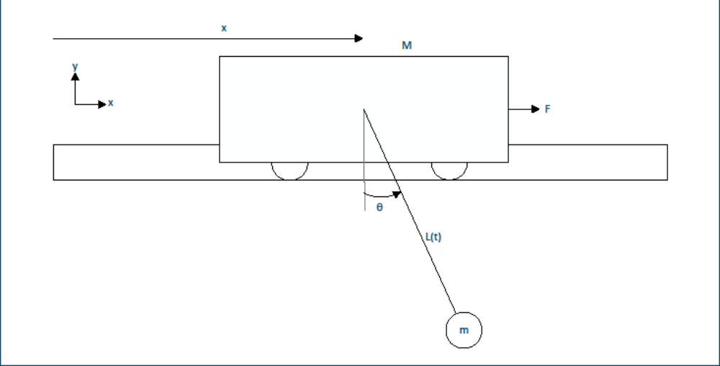
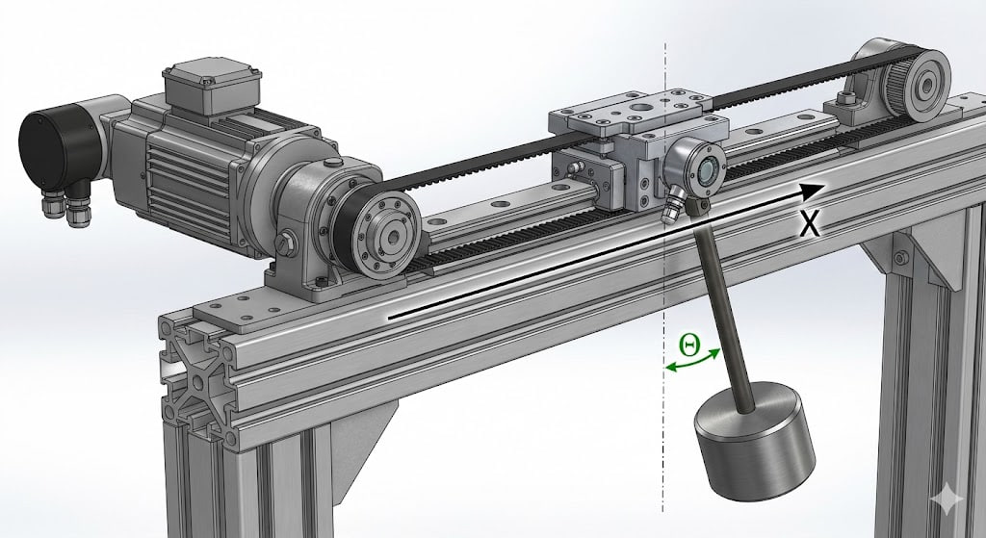

معرفی سیستم

Slide 5
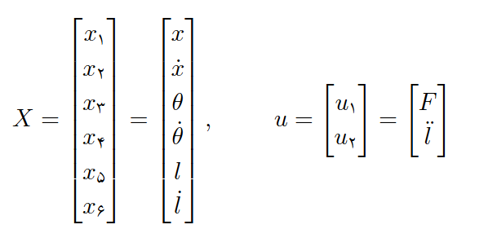
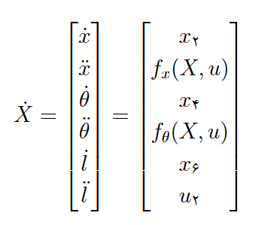

فضای حالت

Slide 6
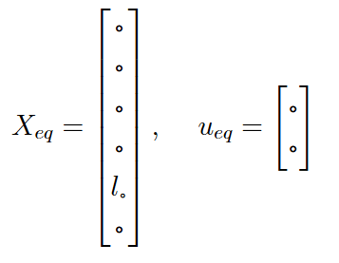

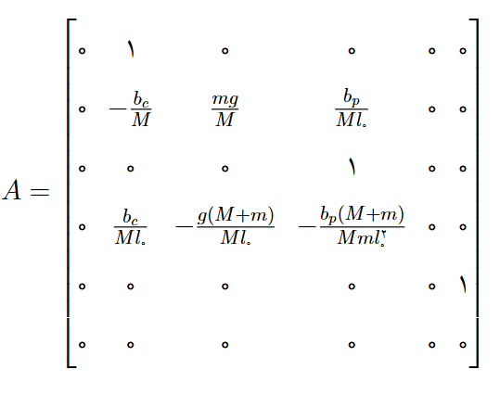
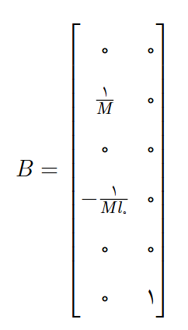
خطی سازی

Slide 7
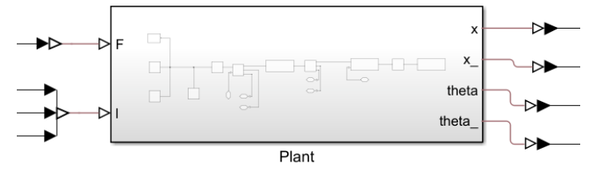
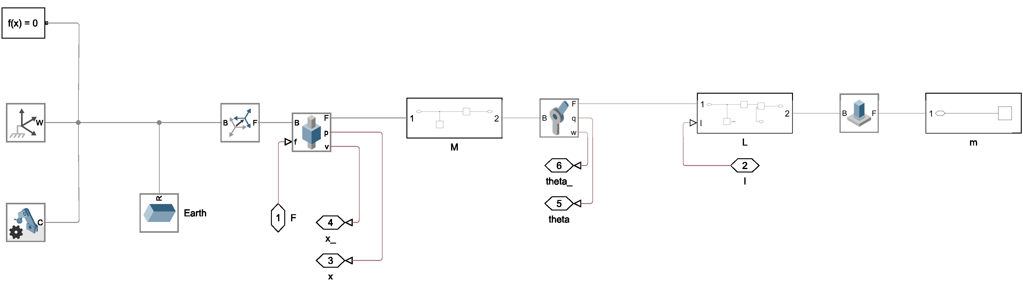
مدل فیزیکی در محیط SIMSCAPE

Slide 8
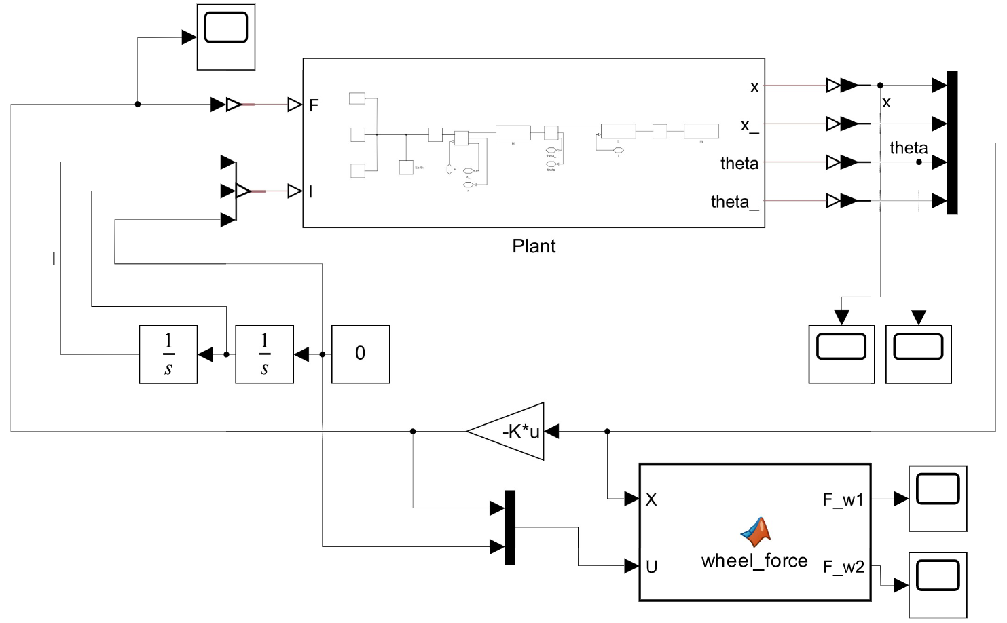
Lqr design
m = 0.2;
M = 1;
g = 9.81;
bc = 0.1;
bp = 0.05;
l0 = 0.5;
x0 = -0.5; % or -5
Q = diag([1000, 10, 500, 10]);
K = [31.6228 14.0488 -17.7264 0.3611]

Slide 9
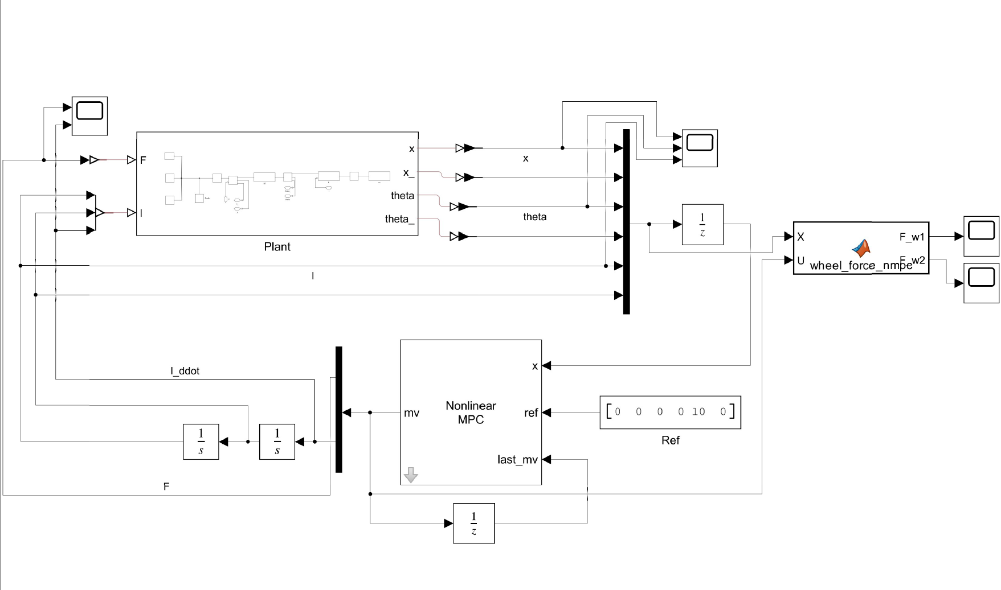
NMPC Design
Ts = 0.05;
prediction_horizon = 25;
control_horizon = 5;
theta_max = deg2rad(15);
l_max = 1.5;
l_min = 0.1;
f_max = 50;
l_ddot_max = 5;
Q = [150, 20, 300, 20, 50, 10];
R = [1, 1];
R_delta = [150, 150];

Slide 10
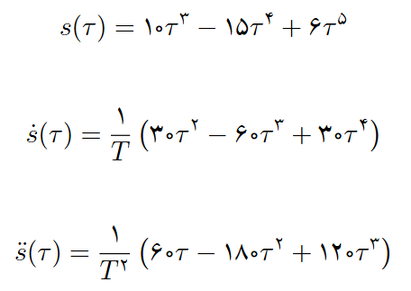
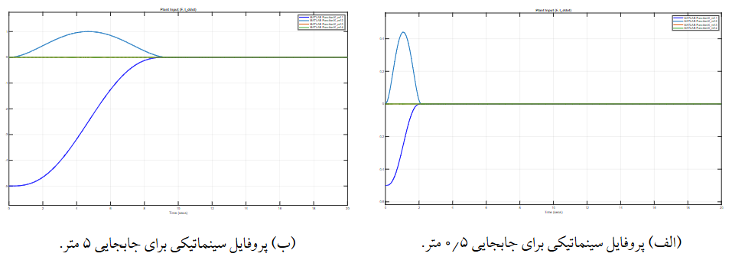
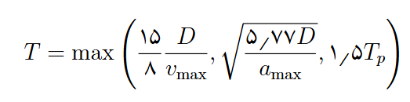

Trajectory

Slide 11
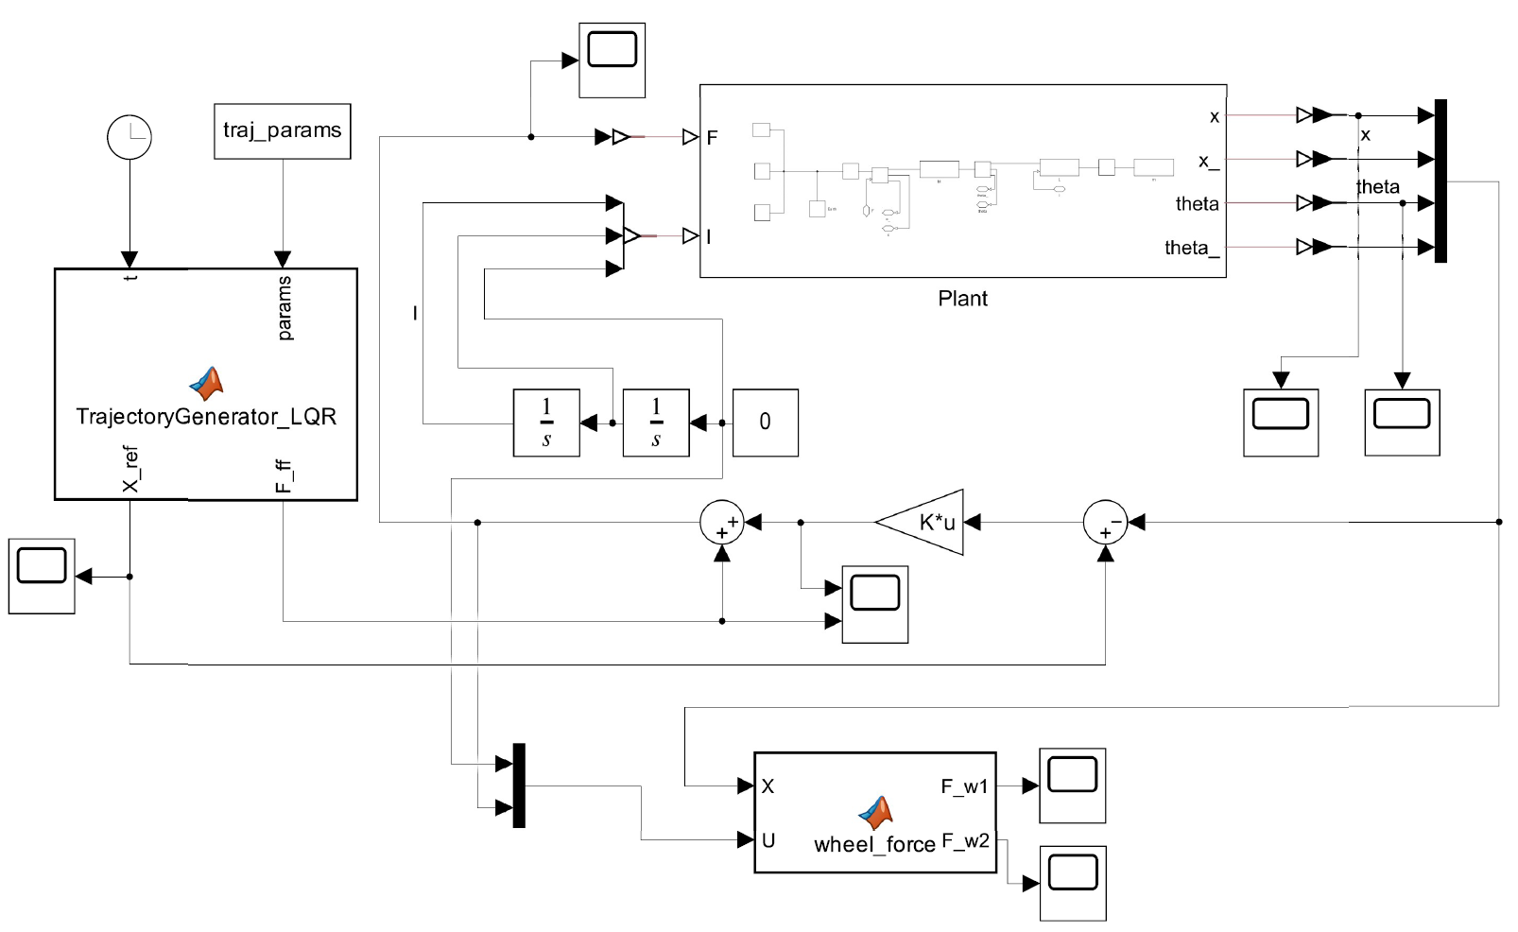
Simscape impelementation

Slide 12
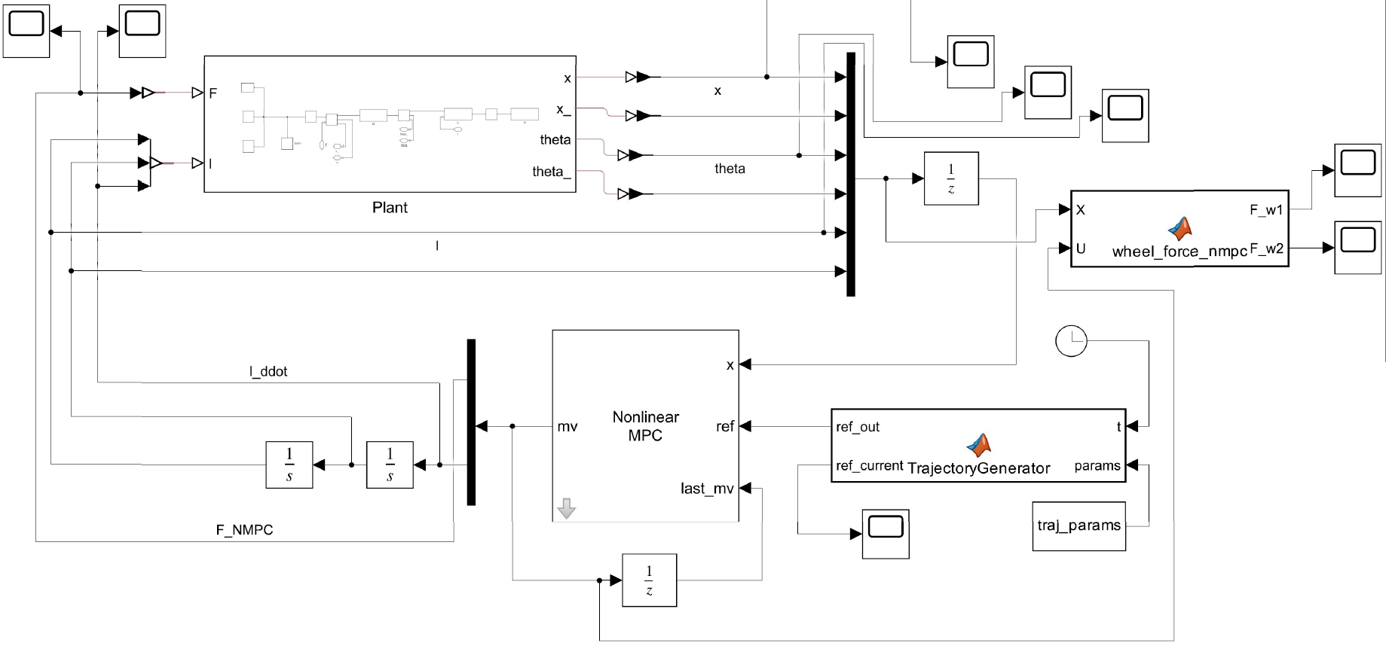

Slide 13
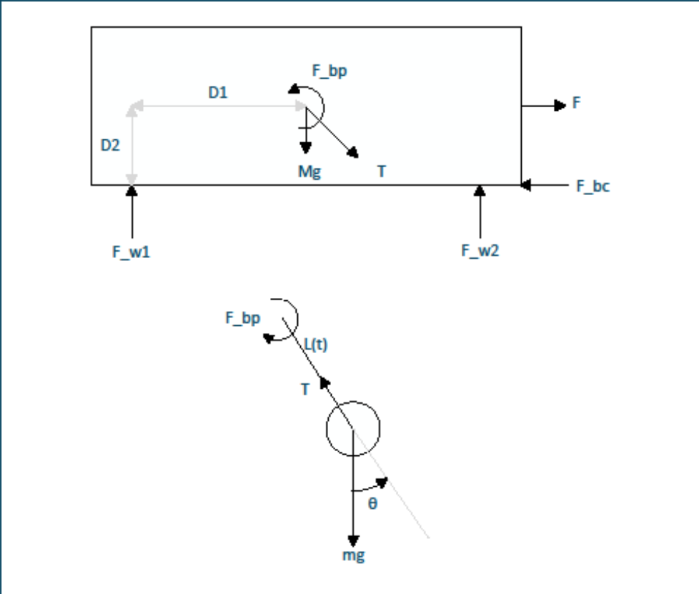
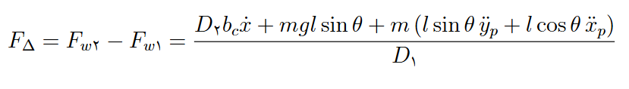



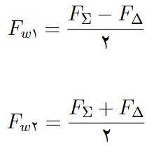

Forces on wheels

Slide 14
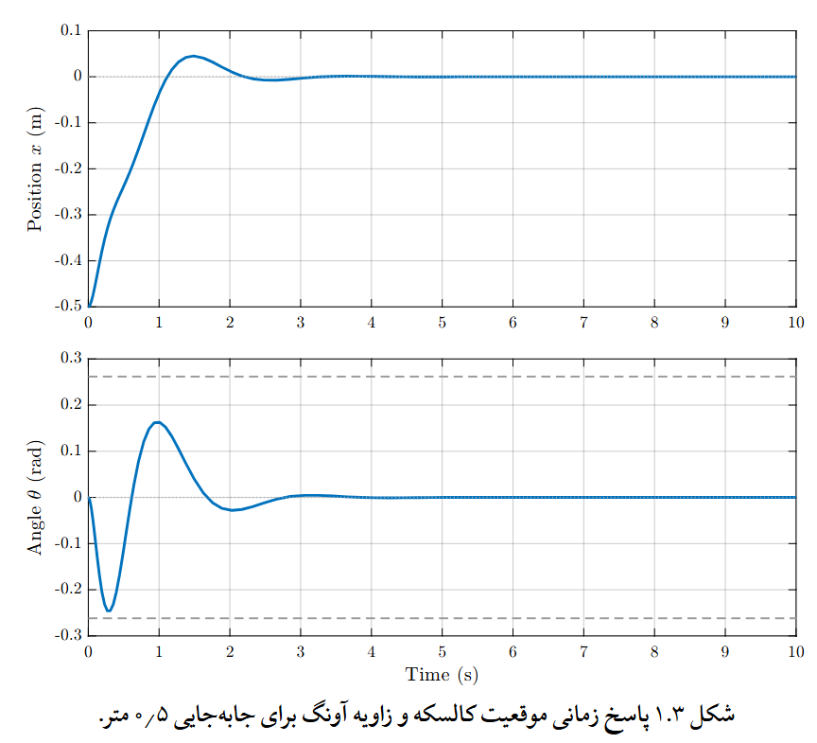
Results LQR setpoint

Slide 15
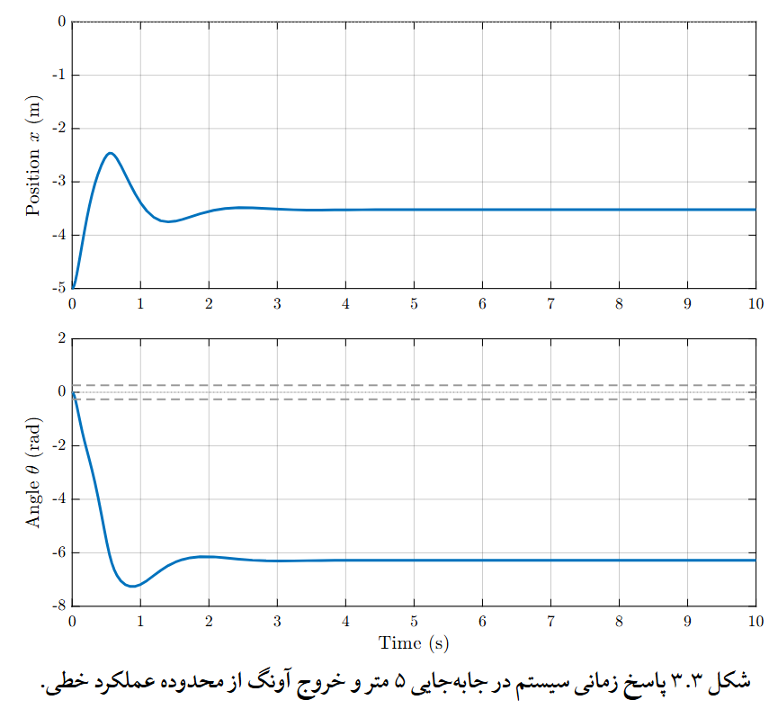

Slide 16
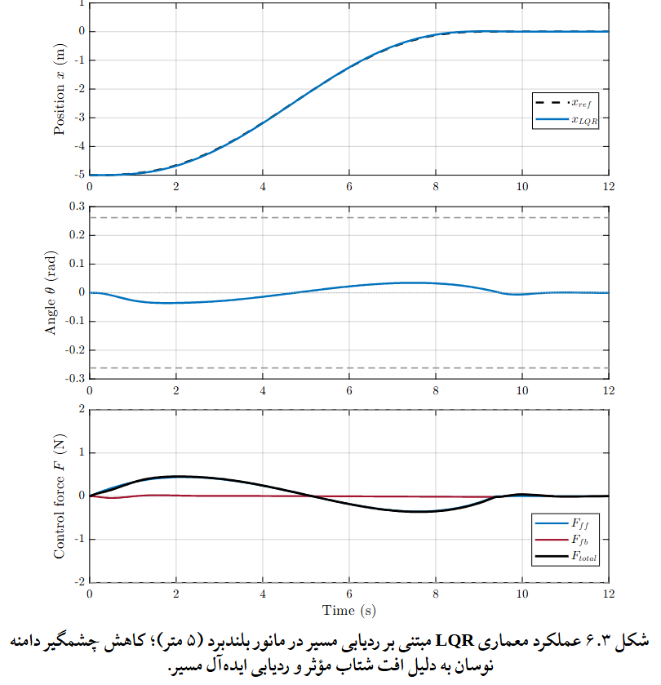
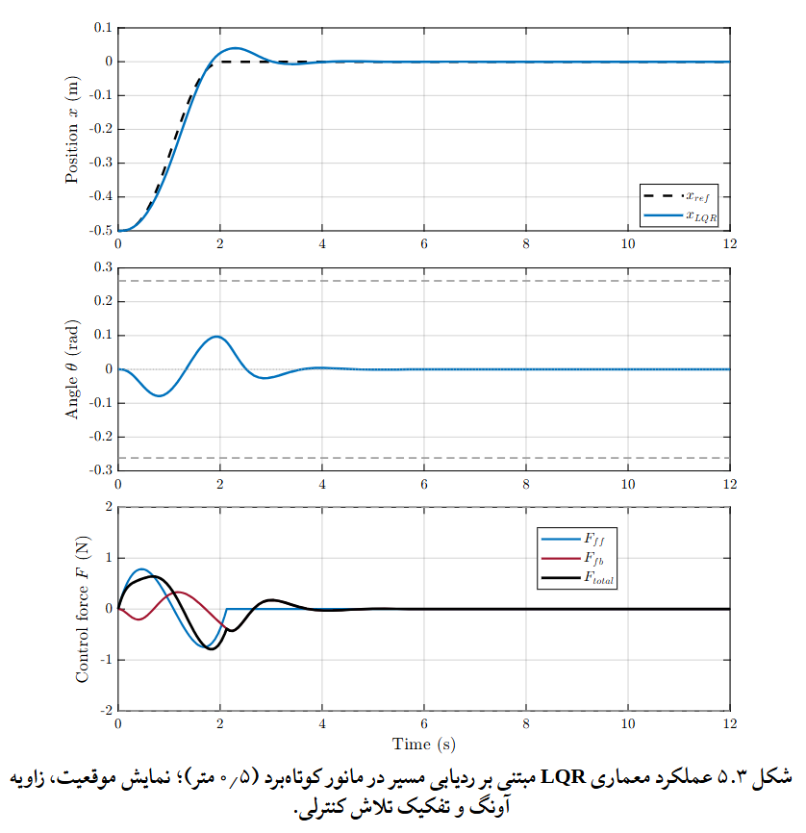
LQr Trajectory

Slide 17
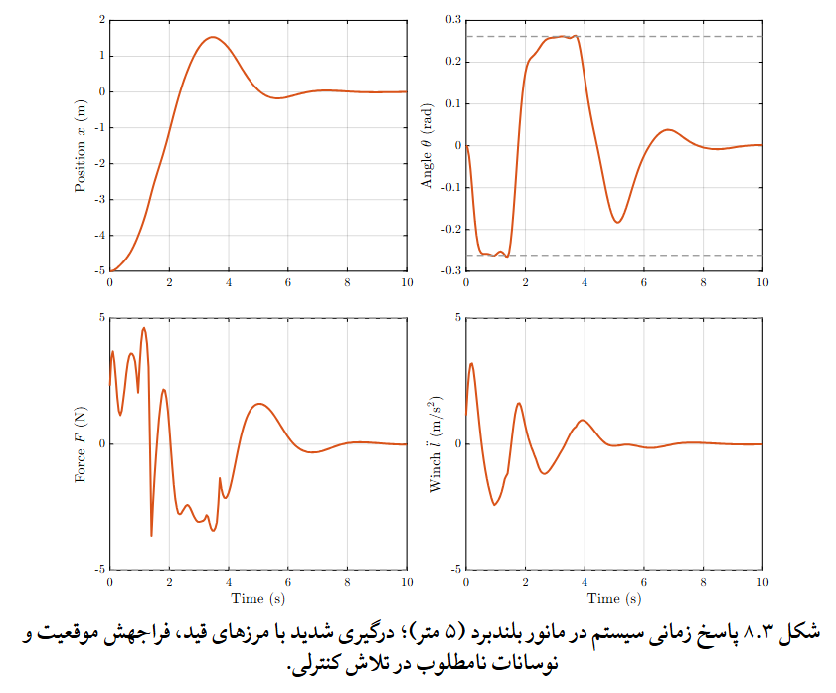
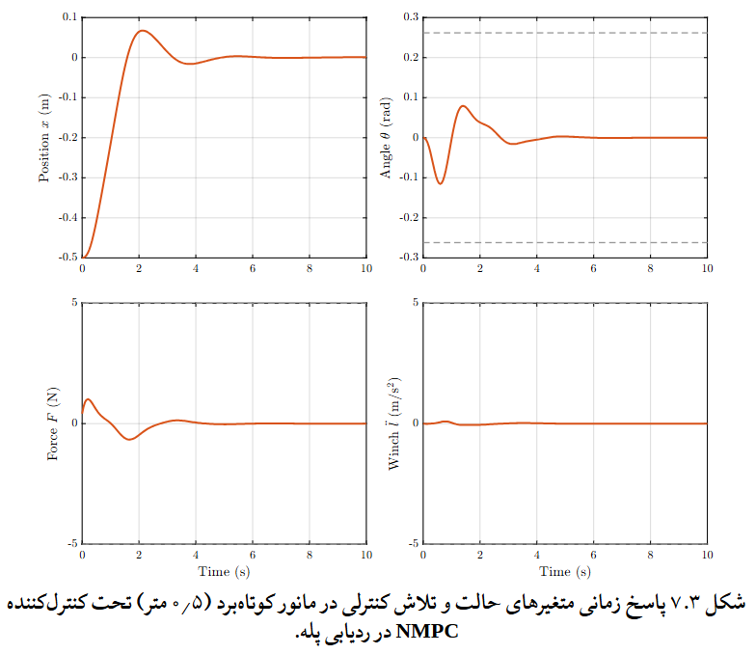
Nmpc setpoint

Slide 18
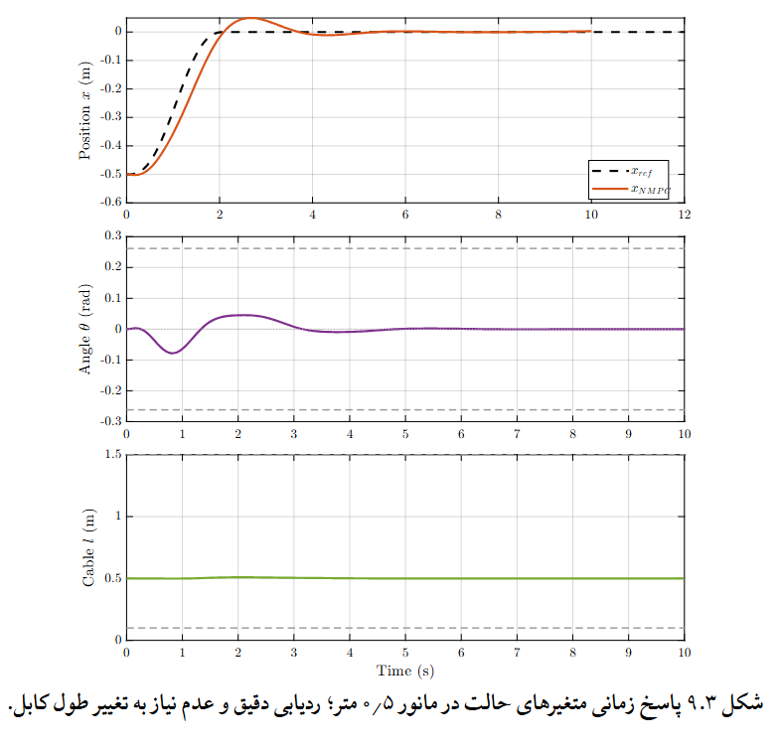
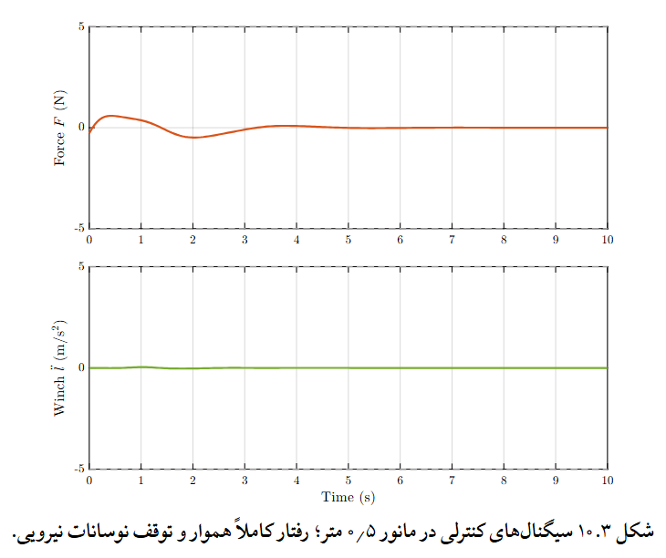
Nmpc trajectory

Slide 19
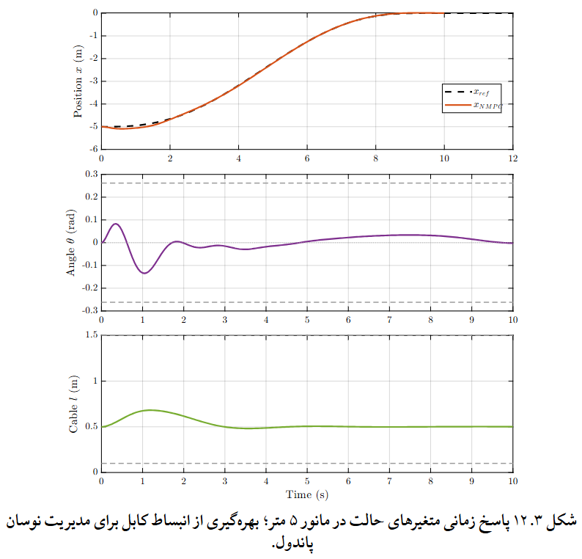
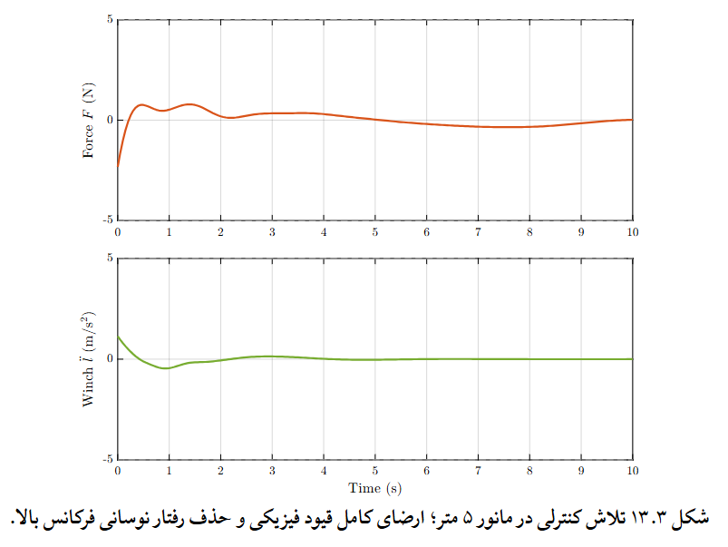
Nmpc Trajectory

Slide 20
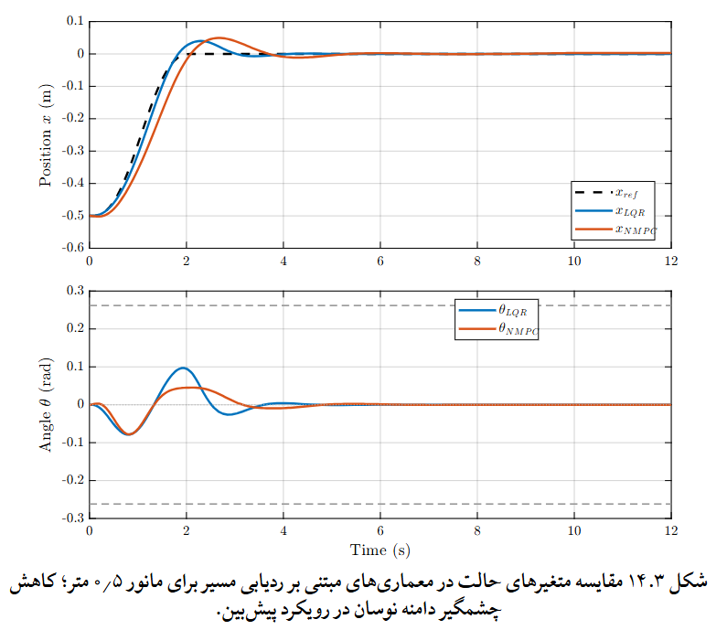
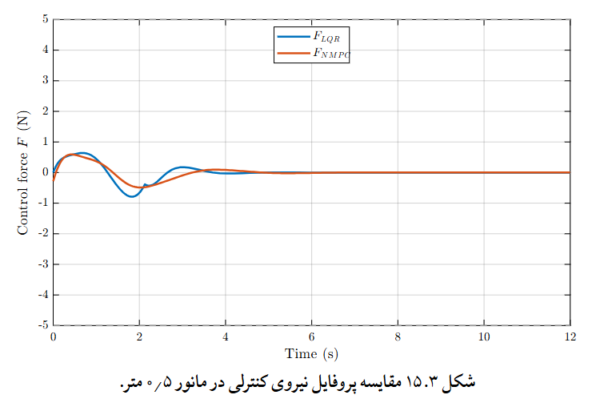
compare

Slide 21
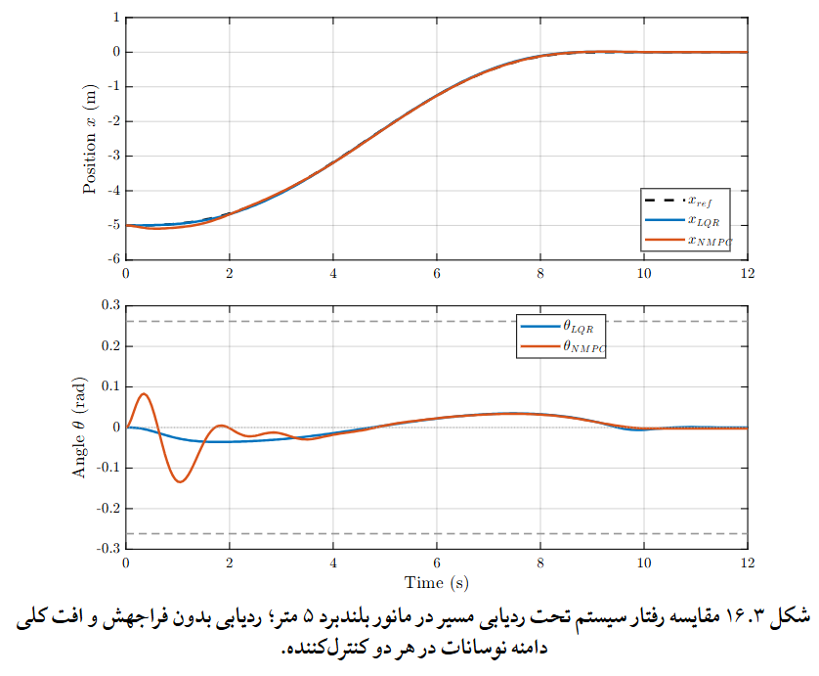
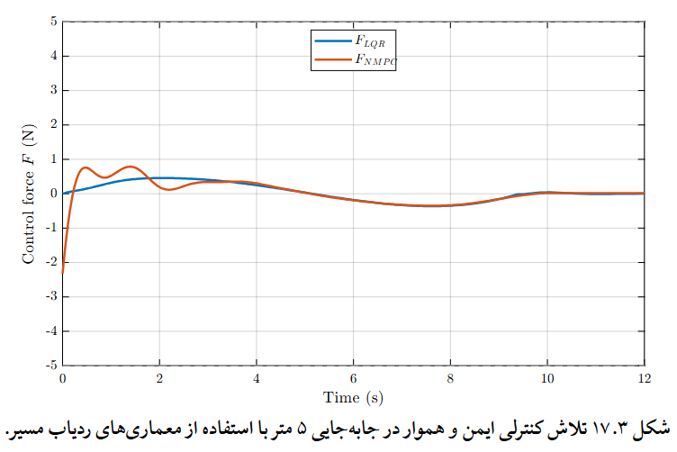
compare

Slide 22
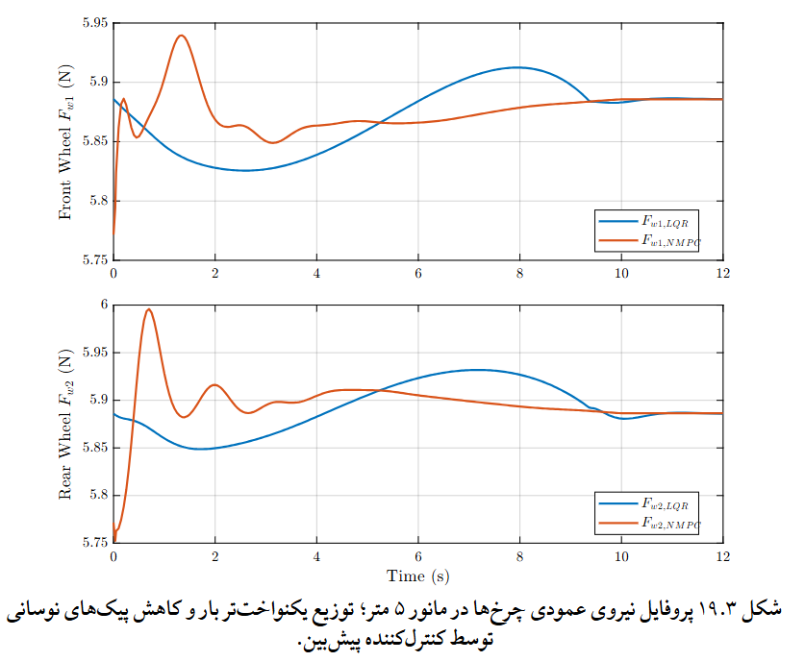
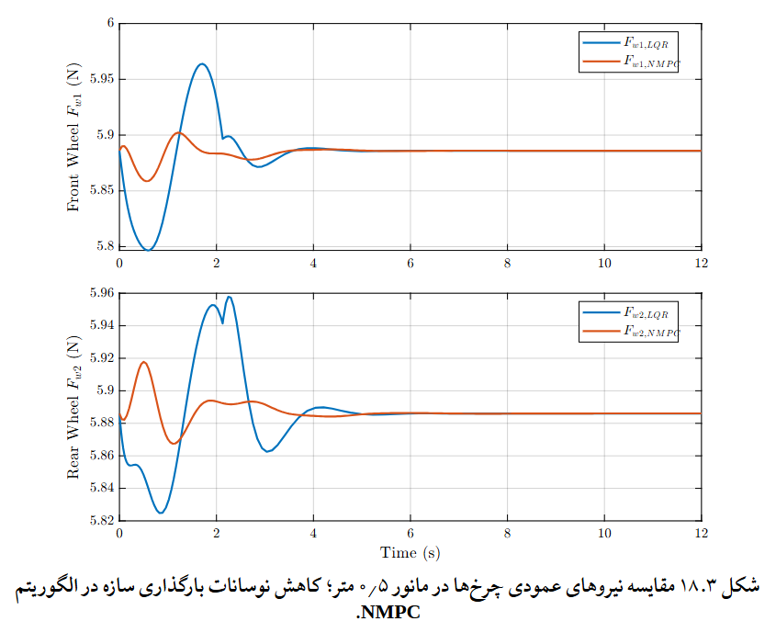
compare

Slide 23
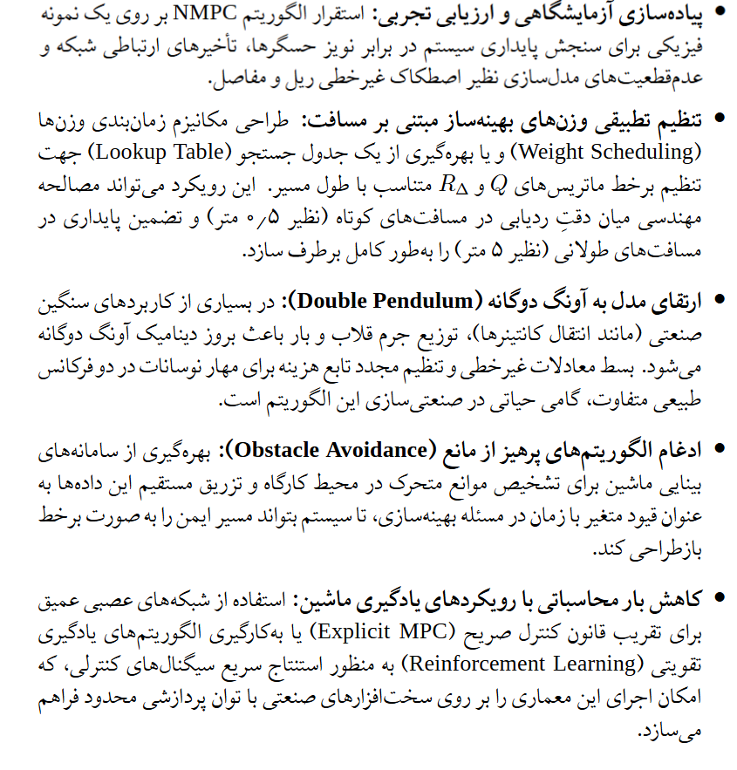
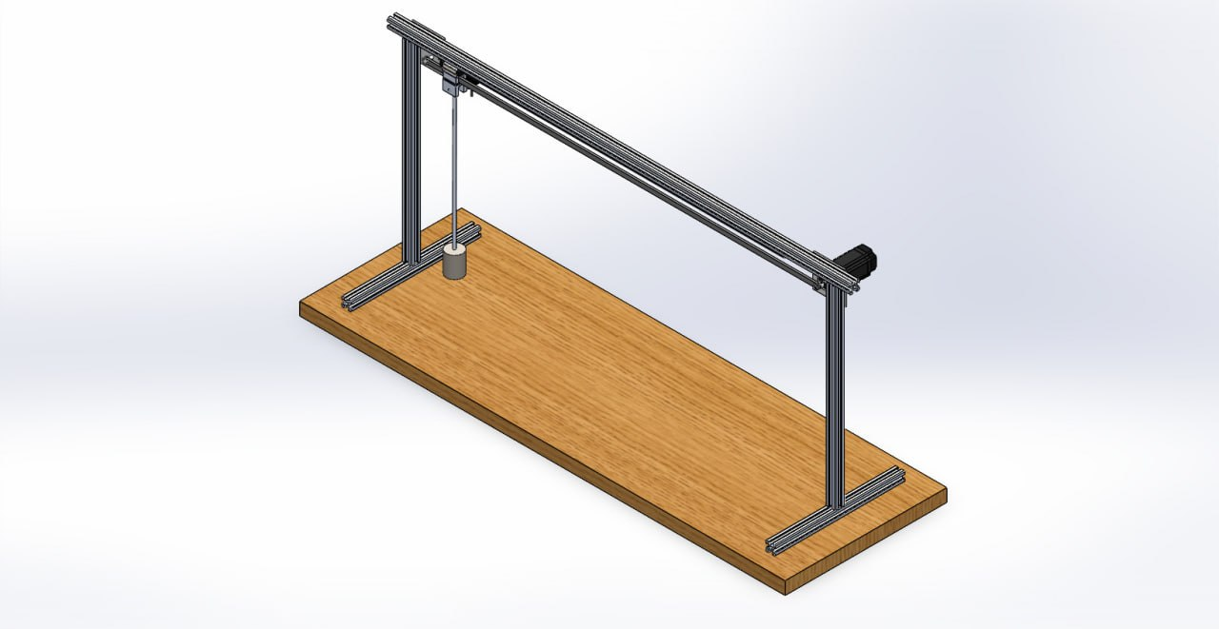
Future works

Slide 24
refrences
Ramli, L., Mohamed, Z., Abdullahi, A. M., et al. (2017). Control strategies for crane systems: A comprehensive review. Mechanical Systems and Signal Processing, 95, 1–23.
Ramli, L., Mohamed, Z., & Jaafar, H. I. (2018). A neural network-based input shaping for swing suppression of an overhead crane. Mechanical Systems and Signal Processing.
Sun, N., Wu, Y., Chen, H., & Fang, Y. (2018). An energy-optimal solution for transportation control of cranes with double pendulum dynamics. Mechanical Systems and Signal Processing, 102, 87–101.
Golovin, I., & Palis, S. (2017). Design of parallel feed-forward compensator and its application to electromechanical system with friction load. IFAC-PapersOnLine, 50(1), 15524–15529.
Homaeinezhad, M. R., Mousavi Alvar, M. M., Soordi, A., et al. (2026). Solution to asymptotic stability in tracking control of nonlinear systems with control input differentiation, actuator dynamics, and saturation constraints. IET Control Theory & Applications.
Allgöwer, F., Findeisen, R., & Nagy, Z. K. (2004). Nonlinear Model Predictive Control: From Theory to Application. Journal of the Chinese Institute of Chemical Engineers, 35(3), 299–316.
Zak, S. H. (2017). An Introduction to Model-Based Predictive Control (MPC). Purdue University, ECE680 Lecture Notes.
Anderson, B. D. O., & Moore, J. B. (1990). Optimal Control: Linear Quadratic Methods. Prentice Hall.
Kettler, M., Zauchner, P., & Unterweger, H. (2020). Determination of wheel loads from runway cranes based on rail strain measurement. Engineering Structures, 213, 110546.

Slide 25
از توجه شما متشکرم
محمدجواد محمدی m.javad.mohammadi@ut.ac.ir

