Slide 1
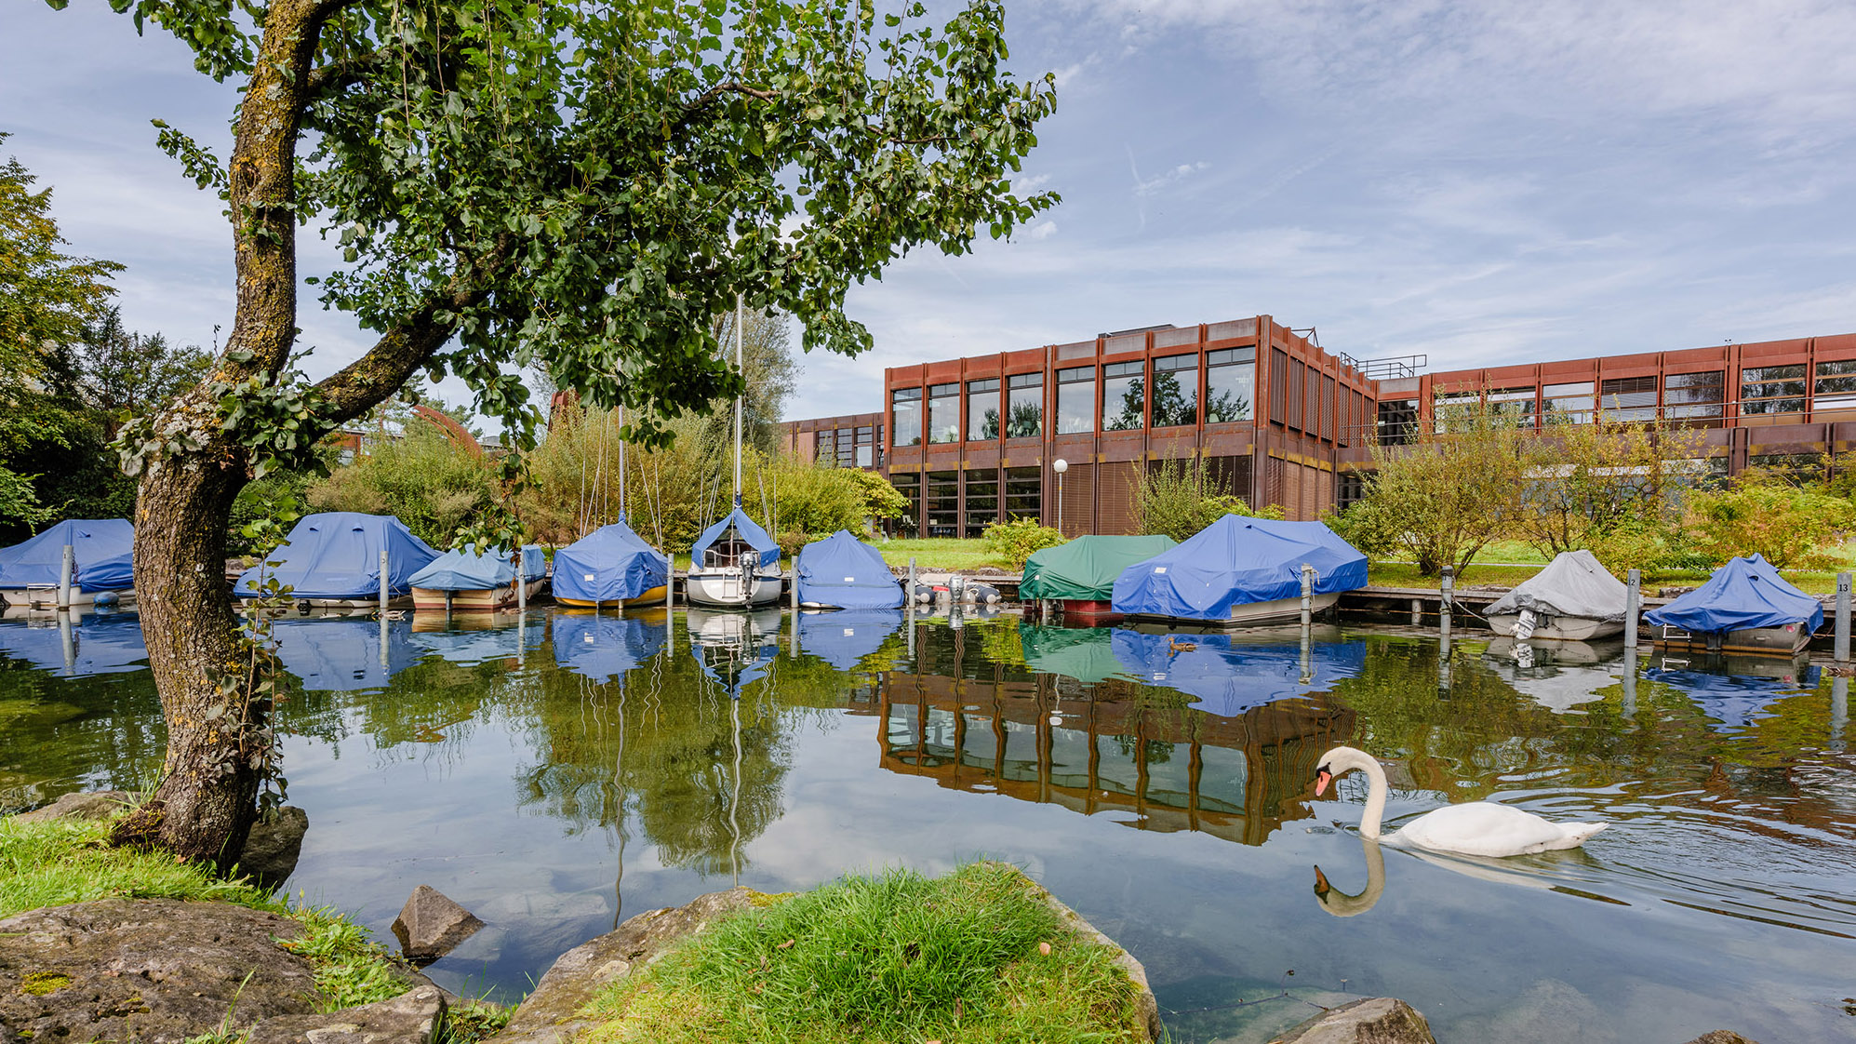
Preprocessing & Visualization (2) Exercises
Exercises in Data Science
Prof Dr. Daniel P. Politze
Studiengang Wirtschaftsingenieurwesen

Slide 2
Binning
Given Dataset: 13,20,22,36,45,54,61,64,70 (n = 9)
Smoothing by bin means (bin depth of 3): 1. Sort dataset 2. Divide data into groups (of the size of the bin depth). 3. Calculate the average of the groups.
Solution dataset (rounded): 18, 18, 18, 45, 45, 45, 65, 65, 65
What is the purpose of smoothing?
The goal is to reduce the impact of outliers and "smooth" the data.
Fluctuations are reduced, and trends become more visible

Slide 3

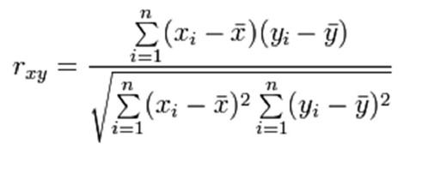


Correlation
Calculate the correlation coefficient: Calculate the mean of the X values Calculate the mean of the Y values
Calculation of differences:

Slide 4
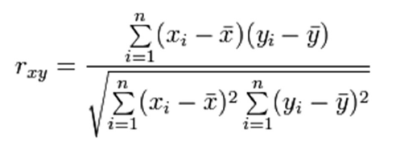



Correlation
Product of Differences:
Squares of Differences
Substituting into the formula:

Slide 5
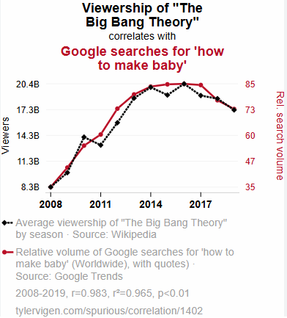
What can be said about this graph?
Positive Correlation
The two numbers do show a correlation, but one does not explain the other
Correlation ≠ Causality
What would a negative correlation look like?

Slide 6
Chi Square
OST wants to determine whether there is a relationship between the field of study and the preferred mode of commuting to OST. For this purpose, 200 students were surveyed.
 | Computer Science Students observed (expected) | WING Students observed (expected)
Public Transport | 60 | 40
Car | 30 | 50
Bicycle | 20 | 20

Slide 7
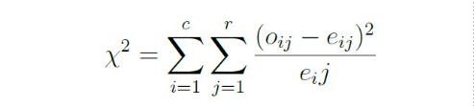



Chi Square
 | Computer Science Students observed (expected) | WING Students observed (expected) | Summe
Public Transport | 60 | 40 | 100
Car | 30 | 50 | 80
Bicycle | 20 | 20 | 40
Summe | 110 | 110 | 220
= The observed value in the cell
= The expected value in the cell
= Number of columns in the table
= Number of rows in the table

Slide 8
Chi Square
 | Computer Science Students observed (expected) | WING Students observed (expected) | Sum
Public Transport | 60 | 40 | 100
Car | 30 | 50 | 80
Bicycle | 20 | 20 | 40
Sum | 110 | 110 | 220
Calculate the sums of rows and columns

Slide 9

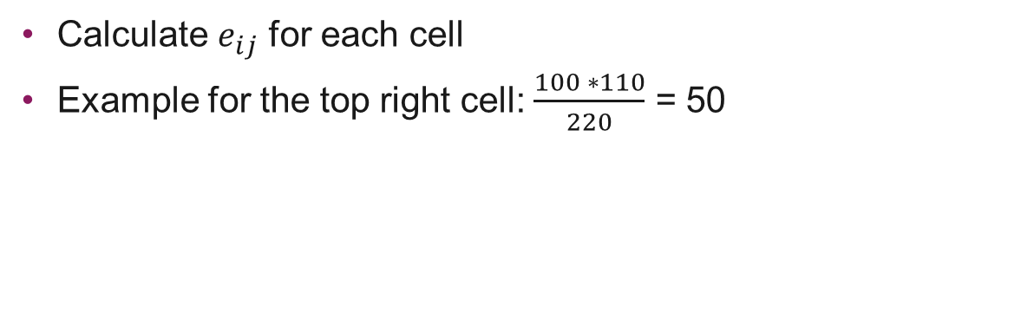
Chi Square
 | Computer Science Students observed (expected) | WING Students observed (expected) | Summe
ÖV | 60 | 40 | 100
Auto | 30 | 50 | 80
Fahrrad | 20 | 20 | 40
Summe | 110 | 110 | 220
Calculate $e_{ij}$ for each cell
Example for the top right cell: $\frac{100 ∗110}{220}$ = 50

Slide 10
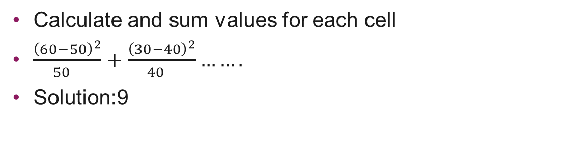
Chi Square
 | Computer Science Students observed (expected) | WING Students observed (expected) | Sum
Public Transport | 60 (50) | 40 (50) | 100
Car | 30 (40) | 50 (40) | 80
Bicycle | 20 (20) | 20 (20) | 40
Sum | 110 | 110 | 220
Calculate and sum values for each cell
$\frac{{\left(60−50\right)}^{2}}{{50}^{}}+$ $\frac{{\left(30−40\right)}^{2}}{{40}^{}}…….$
Solution:9

Slide 11

Chi Square
 | Computer Science Students observed (expected) | WING Students observed (expected) | Sum
Public Transport | 60 (50) | 40 (50) | 100
Car | 30 (40) | 50 (40) | 80
Bycicle | 20 (20) | 20 (20) | 40
Sum | 110 | 110 | 220
Degrees of freedom = → r = rows, c = columns
(3-1) * (2-1) = 2
Compare value for alpha = 0.05 → 9 > 5.991
Null hypothesis is rejected → There is a relationship between the field of study and the mode of transportation

Slide 12


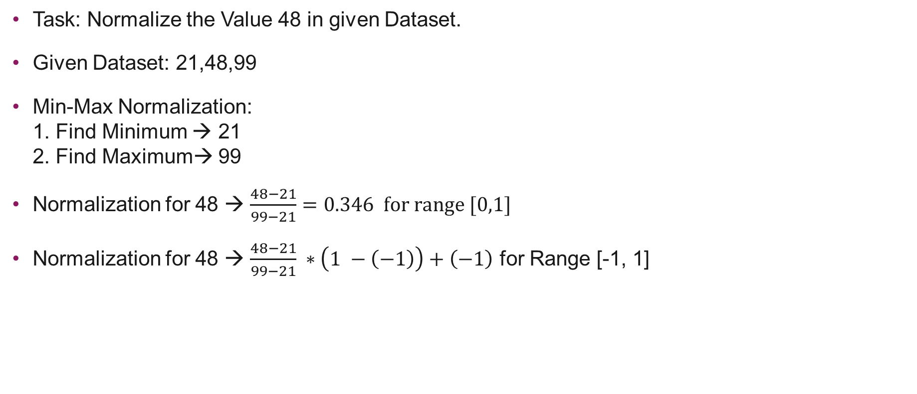
Min-Max Normalization
Normalization
Task: Normalize the Value 48 in given Dataset.
Given Dataset: 21,48,99
Min-Max Normalization: 1. Find Minimum → 21 2. Find Maximum→ 99
Normalization for 48 → $\frac{48−21}{99−21}=0.346 for range [0,1]$
Normalization for 48 → $\frac{48−21}{99−21} ∗\left(1 −\left(−1\right)\right)+\left(−1\right)$ for Range [-1, 1]

Slide 13


Normalization by Decimal Scaling
Task: Normalize the value 48 in given dataset.
Given dataset: 21,48,99
Max = 99 → j = 2
Formula for Normalization by Decimal Scaling →
Normalization for 48 → $\frac{48}{{10}^{2}}=0.48$

Slide 14

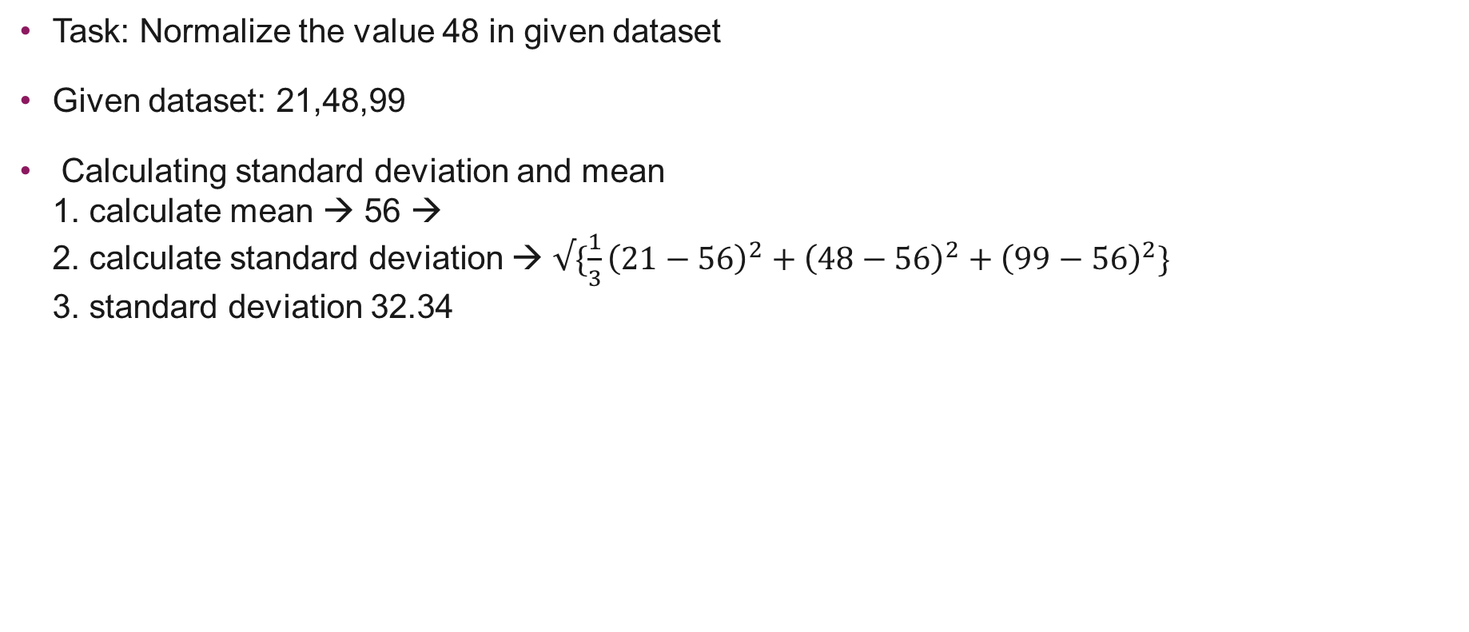
Z-Score Normalization
Task: Normalize the value 48 in given dataset
Given dataset: 21,48,99
Calculating standard deviation and mean 1. calculate mean → 56 → 2. calculate standard deviation → $√\{\frac{1}{3}{\left(21−56\right)}^{2}+{\left(48−56\right)}^{2}+{\left(99−56\right)}^{2}\}$ 3. standard deviation 32.34

Slide 15

Z-Score Normalisierung
Add values into formula → ${v´}_{i}=\frac{v_{i}−μ}{σ}$
${v´}_{i}=\frac{48−56}{32.34}=−0.247$

Slide 16
Discretization
Do an equidepth binning on the attribute Age. When done the attribute should hold just 3 distinct values. Decide on meaningful labels for the created bins. Always specify the bins' lower and upper boundaries.
How should we start?

Slide 17
Discretization
Making 3 Bins with same depth → {7,7,8,9},{11,12,13,22}{22,36,38,64}
Proposing Label for each bin → Children, Youths, Adults
What do we do if new data comes in? Example Age 10 or 22 ?

Slide 18
Discretization
Make sure that there are no gaps between the bins
Make sure that there are no overlaps between the bins.
Children
Youths
Adults
0-10
11-21
>21

Slide 19
Discretization
How do an equiwidth binning on the attribute Age – again with 3 bins. What would be meaningful labels for the bins this time? Again specify the bins' lower and upper boundaries.
How do we start?

Slide 20

Discretization
Calculate the difference between the min value and max value → 64 – 7 = 57
Every bin has an age range of $\frac{57}{3}=19$
Calculate the new bins → 7 + 19 = 26 → Range of [7,26)
Solution: [7,26),[26,45),[45,64)
Are we done?

Slide 21
Discretization
Make sure that there are no gaps between the bins
Make sure that there are no overlaps between the bins.
Children
Youths
Adults
0-25
26-45
>45

Slide 22
Stratified Sampling
Data Reduction
Use a sample size of 5 and the strata “youth”, “middle-aged” and “senior”. Assume that everyone belongs to the category youth who’s in the range of 0-19, for the group middle aged everyone in the range of 20-51 and everyone above 51 is categorized as senior.
Given Dataset: 13, 15, 16, 16, 19, 20, 20, 21, 22, 22, 25, 25, 25, 25, 30, 33, 33, 35, 35, 35, 35, 36, 40, 45, 46, 52, 70
How do we start?
Notes:
Discussion: Whats a goos size s for a sample?
For a given function and a specified degree of error it is possible to determine a sufficient sample size (using the central limit theorem)

Slide 23
Stratified Sampling
Categorize the data:
Youth → (13,15,16,16,19) 5 values Middle-Aged → (20,20,21,22,22,25,25,25,25,30,33,33,35,35,35,35,36,40,45,46) 20 Values Senior → (52,70) 2 Values
How do we know much samples we have to take from each category?

Slide 24
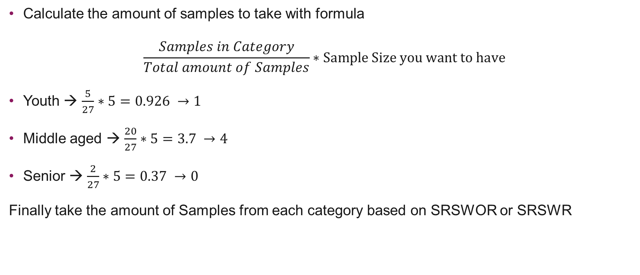
Stratified Sampling
Calculate the amount of samples to take with formula
$$\frac{Samples in Category}{Total amount of Samples}∗Sample Size you want to have$$
Youth → $\frac{5}{27}∗5=0.926 →1$
Middle aged → $\frac{20}{27}∗5=3.7 →4$
Senior → $\frac{2}{27}∗5=0.37 →0$
Finally take the amount of Samples from each category based on SRSWOR or SRSWR

