Slide 1


Merging Similar Control-Flow Regions in LLVM for Performance and Code Size Benefits
Charitha Saumya (Presenter), Kirshanthan Sundararajah, Milind Kulkarni
LLVM Developers’ Meeting 2022
November 7th – 10th 2022

Slide 2
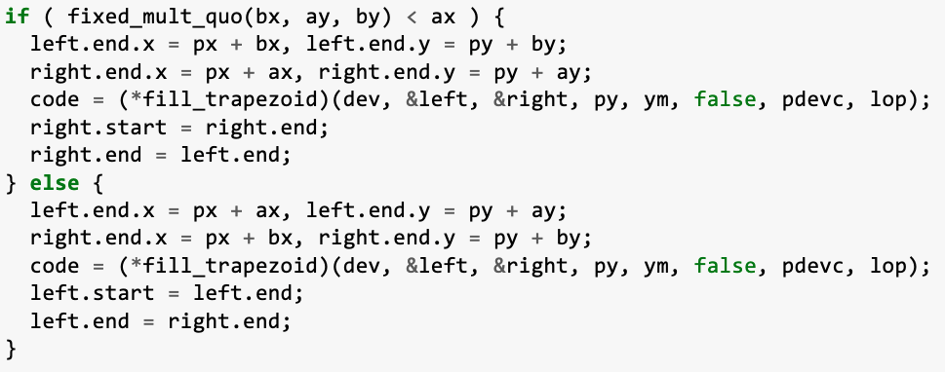
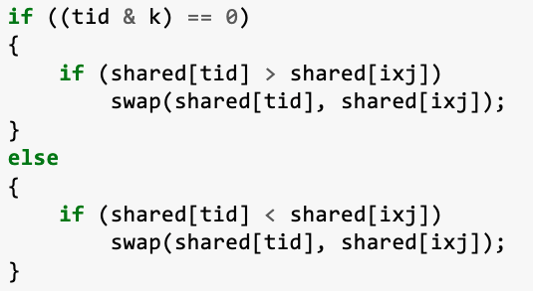
Similar Code inside Conditional Branches is Plentiful
Source : CUDA implementation of bitonic sort
Source : mibench/ghostscript benchmark
Identical/similar operation sequences inside if and then sections
Similar control–flow regions inside if and else sections
2

Slide 3
Code Size Reduction
br %cmp , %A, %B
%A.B :
%sel.1 = select %cmp, %b, %q
%a.p = add %sel.1, 10
%c.r = mul %a.p, 20
br %cmp , .....
%A :
%a = add %b, 10
%c = mul %a, 20
.....
%B :
%p = add %q, 10
%r = mul %p, 20
.....
Size reduction = cost(add) + cost(mul) - cost(select)
3

Slide 4

Reducing Control-flow Divergence
Contains a
Divergent Branch
A
A
B
B
C
C
time
D
D
- Thread group (warp/wavefront)
4

Slide 5
Reducing Control-flow Divergence
%B:
...
%a = load ..
%a = mul ….
%b = div ….
….
A
A
B
B
C
C
time
%C:
...
%p = load ..
%q = mul ….
%r = div ….
….
D
D
5

Slide 6
Reducing Control-flow Divergence
%B:
...
%a = load ..
%a = mul ….
%b = div ….
….
Convergent execution of common instructions
A
A
A
B’
B
C’
B
C
BC
C
time
B’’
%C:
...
%p = load ..
%q = mul ….
%r = div ….
….
C’’
D
D
D
6

Slide 7
Code Sinking and Code Hoisting
……….
……….
……….
add ..
store …
br
…….
add ..
store …
br
Code Sinking
Identical instruction sequences are moved to common successor
select ..
select ..
add ..
select ..
select ..
store ..
…...
…….
7

Slide 8
Code Sinking and Code Hoisting
….
br %c, label %A, label %B
select ..
select ..
add ..
select ..
select ..
store ..
br %c, label %A, label %B
%A :
add ....
store …
....
%B :
add ....
store ….
....
Code Hoisting
Identical instruction sequences are moved to common predecessor
%A:
....
%B:
.....
8

Slide 9
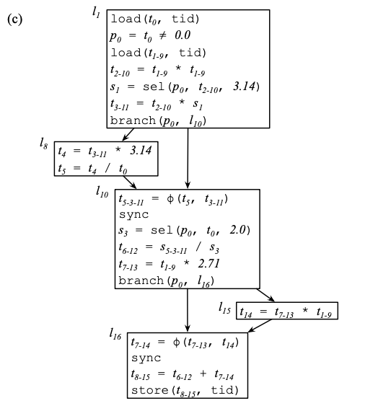
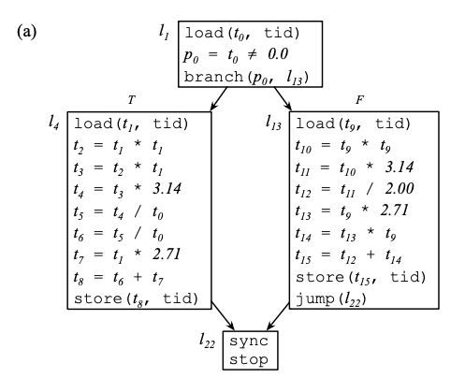
Branch Fusion
Convergent execution of common instructions
Branch Fusion
using
Instruction alignment
These techniques are limited to exploiting similarity at basic block level (e.g., diamond shaped control-flow)
Image Source : B. Coutinho, D. Sampaio, F. M. Q. Pereira and W. Meira Jr., "Divergence Analysis and Optimizations,” , PACT’11
9

Slide 10
Control-Flow Melding (CFM)
%A
T
F
%A
T
F
%B
T
F
Control–Flow
Melding
%M.1
T
F
%C
%D
T
F
T
F
%M.2
%E
%F
%M.3
T
F
%G
T
F
Control-flow Regions with Similar computations
Melded control-flow
10

Slide 11
Program Structure Tree
Represents all Single-Entry Single-Exit (SESE) regions in a CFG
Can be obtained using the RegionInfo interface in LLVM
%A
T
F
Region
%A-%G
%B
T
F
Region
%B-%G
%C
%D
T
F
T
F
%E
%F
Region
%C-%G
Region
%D-%G
%G
T
F
11

Slide 12
Meldable Regions
Two SESE regions can be melded if,
Dominated by a conditional branch
No path exists that goes through both the SESE regions
Entry blocks of the regions must post-dominate either the left or right successor of the conditional branch
They are isomorphic (have same control-flow signature)
%E
%L
%M
%A
%P
T
F
T
F
%B
%Q
%C
%R
Region %A-%C
Region %P-%R
12

Slide 13
Region Alignment
E
E
T
F
Multiple isomorphic regions in if and else paths?
Regions are aligned based on Melding Profitability
Melding Profitability : metric that measures the similarity of two regions base on instruction frequencies
A
D
D
E
A
E
B
B
F
C
F
C
G
G
X
X
Left regions : A-B, B-C
Right Regions : D-E, E-F, F-G
Region Alignment :
A-B with E-F
B-C with F-G
13

Slide 14
Instruction Alignment
P
Q
P
Q
A
B
R
S
A
B
Aligned region pair
R
S
Instruction alignment for A and B computed using instruction compatibility and cost
Aligned
Unaligned
14

Slide 15
Code Generation
Generated melded control-flow
Generated melded instructions
P
Q
A
B
R
S
Aligned instruction pair
P_Q
%add = add nsw i32 %0, %1
%add1 = add nsw i32 %4, %5
P
Q
A_B
Generated code
R_S
%sel1 = select i1 %cmp, i32 %0, i32 %4
%sel2 = select i1 %cmp, i32 %1, i32 %5
%6 = add nsw i32 %sel1, %sel2
A
B
aligned
Unaligned instructions are executed conditionally
R
S
Unaligned
aligned
15

Slide 16

Ensuring Correctness
Melding can break the def-use chains outside the melded regions
%B:
...
%x = ….
...
%B:
...
%x = ….
...
%A:
%A:
R_{T}
R_{F}
R_{T_F}
%x no longer dominates %y !!
%D:
...
%y = mul %x ...
...
%D:
...
%y = mul %x ...
...
%C:
%C:
16

Slide 17
Ensuring Correctness
Melding can break the def-use chains outside the melded regions
%B:
...
%x = ….
...
%B:
...
%x = ….
...
%A:
%A:
%P:
%m = phi [undef, %A], [%x, %B]
....
R_{T}
R_{F}
PHI node added to preserve the dominance relation
R_{F}
R_{T}
%D:
...
%y = mul %x ...
...
%C:
%D:
...
%y = mul %m ...
%C:
17

Slide 18
Ensuring Correctness
Handling PHI instructions
%A_P:
...
%x_l = ….
...
%A:
...
%x = ….
...
%P:
...
%l = ….
...
%B_Q:
…
%y = …
%m = ….
...
%B:
...
%y = ….
...
%Q:
...
%m = ….
...
%C_R:
%p1 = phi [%x_l, %A_P], [%y, %B_Q]
%p2 = phi [%x_l, %A_P], [%m, %B_Q]
....
%C:
%p1 = phi [%x, %A], [%y, %B]
....
%R:
%p2 = phi [%l, %P], [%m, %Q]
....
18

Slide 19
Implementation (CPU Code Size)
LLVM-IR transformation pass
Process all if-then-else branches
Uses TargetTransformInfo interface
For instruction alignment
For evaluating the code size before and after
Collect conditional branches
Branches left to process?
No
Finish
Yes
apply the transformation
Code size reduced?
Yes
No
Discard the changes
19

Slide 20
Implementation (GPU Divergence Reduction)
Process only divergent if-the-else branches
Uses LLVM DivergenceAnalysis
Uses a custom instruction latency cost model to evaluate the profitability
20

Slide 21
Evaluation (GPU Divergence Reduction)
Speedups on AMD Radeon Pro Vega 20 GPU + AMD Ryzen CPU
Comparison against both -O3 (full opts) and Branch Fusion with full opts
Benchmarks
Bitonic Sort (BIT)
Parallel and Concurrent Merge (PCM)
Mergesort (MS)
LU-decomposition (LUD)
N-Queens (NQU)
Speckle Reducing Anisotropic Diffusion (SRAD)
DCT Quantization (DCT)
21

Slide 22
Performance
Control-flow Melding (CFM)
Branch Fusion
+ - Best block size
BIT, PCM, NQU : Performance improvement over branch fusion comes from CFM’s ability to meld at region level
22
Notes:
This plot shows the speedups that we got for ...
CFM works better than BF in some cases because ...

Slide 23
Evaluation (Code Size Reduction)
Reduction in the text section of the final binary in x86
Comparison against –Oz
Benchmarks Suites
MiBench
SPEC 2006
SPEC 2017
23

Slide 24
Code Size Reductions – MiBench
24

Slide 25
Code Size Reductions – SPEC
SPEC06
SPEC17
25

Slide 26
Summary
Code :
https://github.com/charitha22/llvm-project-codesize/tree/cfm-dev
Contact Us :
Charitha Saumya (cgusthin@purdue.edu)
https://charitha22.github.io/
Similar code inside conditional branches is quite common
Traditional techniques like code hoisting/sinking are not sufficient to fully exploit the code similarity
We propose Control-Flow Melding (CFM) that merge similar code at region level
Our LLVM implementation of CFM shows its utility as a general compiler transformation
26

Slide 27
Merging Similar Control-Flow Regions in LLVM for Performance and Code Size Benefits
Charitha Saumya (Presenter), Kirshanthan Sundararajah, Milind Kulkarni
LLVM Developers’ Meeting 2022
November 7th – 10th 2022

