Slide 1


YARPGen: A Compiler Fuzzer for Loop Optimizations and Data-Parallel Languages
Vsevolod Livinskii, University of Utah
Dmitry Babokin, Intel Corporation
John Regehr, University of Utah
November 9th, 2022

Slide 2
Summary of Found Bugs
120 completely new errors in total
40% are wrong code bugs
27 bugs in LLVM
61 bugs in GCC
12 bugs in ISPC
16 bugs in the DPC++
2 bugs in SDE
2 bugs in Alive2

Slide 3
YARPGen Features
Detect wrong code bugs
Avoid Undefined Behavior statically
Target optimizations explicitly
Easily extensible for C-family languages
Including compilers for emerging languages
Easy to use

Slide 4
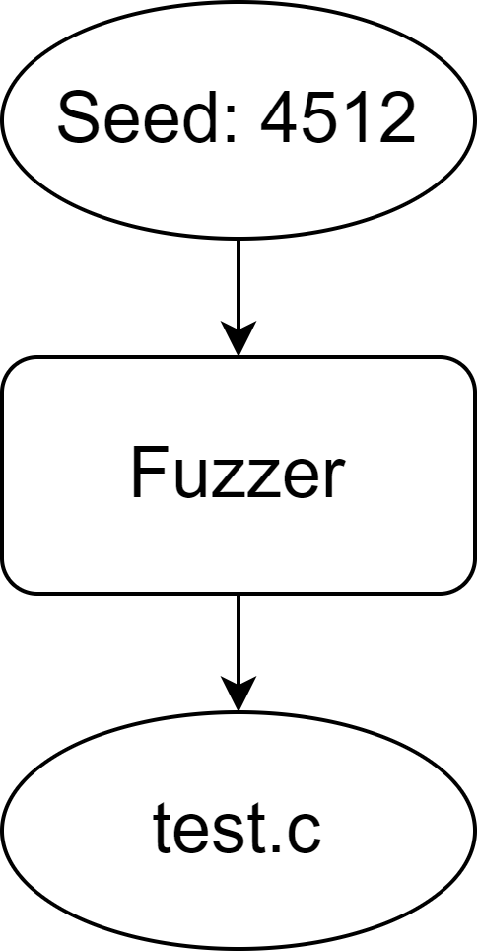
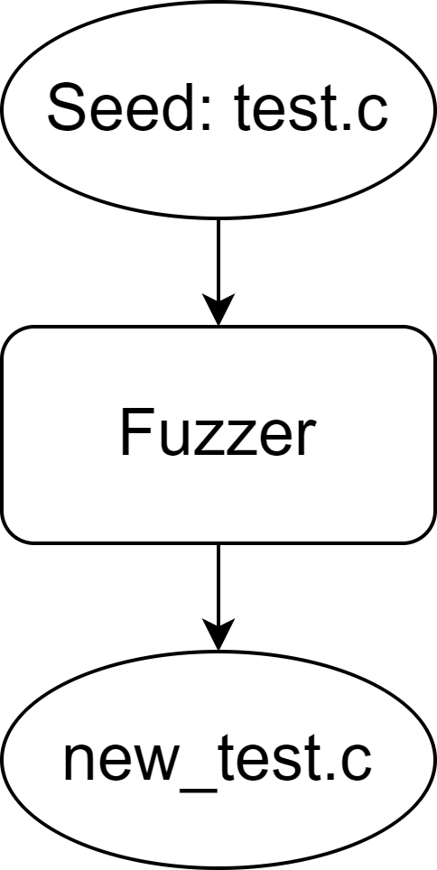
Fuzzing Approaches
Generative
Mutation-based

Slide 5
YARPGen Features
Detect wrong code bugs
Avoid Undefined Behavior statically
Target optimizations explicitly
Easily extensible for C-family languages
Including compilers for emerging languages
Easy to use

Slide 6
Undefined Behavior (UB)
# include <stdio.h>
int main () {
int x = 1;
x = x++ + ++x;
printf ("%d\n", x);
return 0;
}
Who is wrong?
>$ icc test.cpp && ./a.out
5
>$ clang++ test.cpp && ./a.out
4
No one!
Program contains UB
https://godbolt.org/z/dfETYae9T

Slide 7
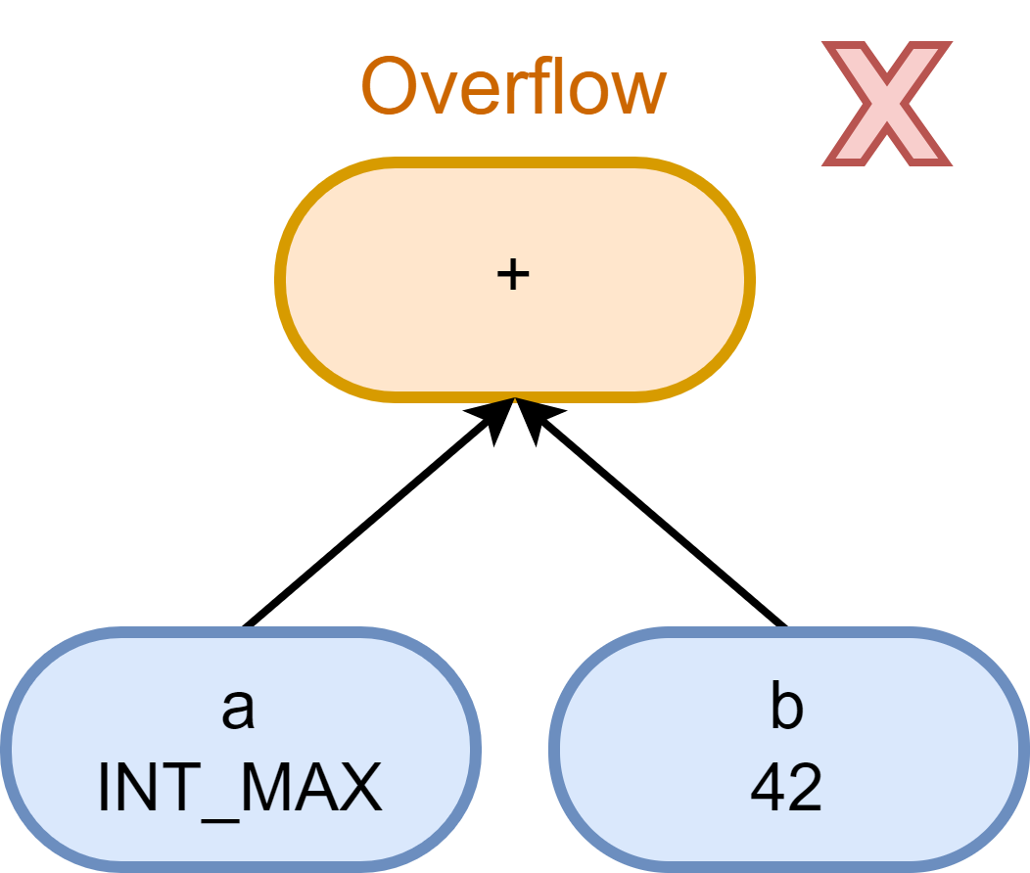
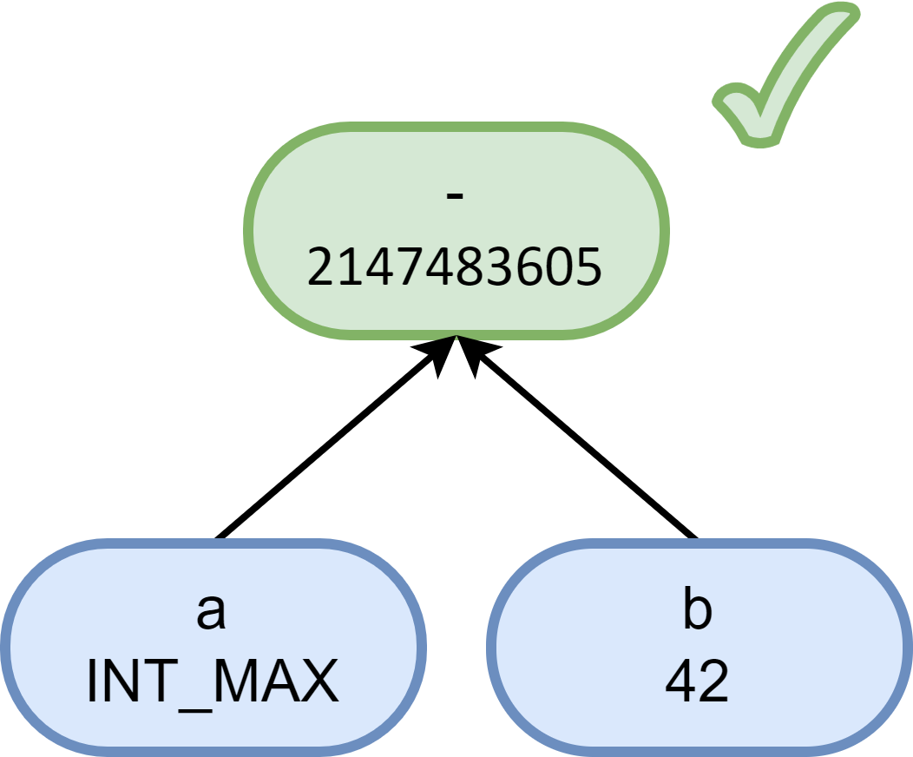
Static Undefined Behavior Avoidance
Based on concrete value tracking and rewrite rules
Rewrite
"Random testing for C and C++ compilers with YARPGen.“ contains more details

Slide 8
UB Avoidance for Loops
var_37 = 20;
var_43 = 99;
…
var_10 = (var_37 / 15) - var_43;
driver.cpp
arr_37[20] = {20, 20, 20, ...};
var_43 = 99;
…
for (int i = 0; i < 19; ++i) {
arr_10[i] = (arr_37[i] / 15) - var_43;
}
test.cpp
arr_37[20] = {20, 20, 20, ...};
var_43 = 99;
…
arr_10[0] = (arr_37[0] / 15) - var_43;

Slide 9
YARPGen Features
Detect wrong code bugs
Avoid Undefined Behavior statically
Target optimizations explicitly
Easily extensible for C-family languages
Including compilers for emerging languages
Easy to use

Slide 10
Generation Policies
IR elements
Loop Nest, Loop Sequence, Stencil, Reduction
Explicit mechanisms
Common Subexpression Buffer, Used Constant Buffer
Skewed Probability
Vectorizable Loops, INT_MAX / INT_MIN
The goal is to generate code that is likely to trigger optimization

Slide 11
Loop Fusion and Loop Sequence
for (i=0; i < (d ? e : 10); i++)
a[i] = c[i] + b[i];
for (j=0; j < (d ? e : 10); j++)
b[j] = b[j] * c[j];
for (i=0; i < (d ? e : 10); i++){
a[i] = c[i] + b[i];
b[i] = b[i] * c[i];
}
Hard to generate purely at random
Loop Sequence as first-class IR element for synchronized decisions

Slide 12
Loop Patterns: Stencil
for (int i = 1; i < n - 1; ++i)
out[i] = (in[i - 1] +
in[i] +
in[i + 1]) / 3;
.LBB0_2:
fadd d1, d0, d1
fmov d2, d0
ldr d0, [x9], #8
fmov d3, x10
subs x8, x8, #1
fadd d1, d1, d0
fmul d3, d1, d3
fmov d1, d2
str d3, [x1], #8
b.ne .LBB0_2
GVN propagates value to
next loop iteration
Stencil as a pattern
arrays
dimensions
stride

Slide 13
YARPGen Features
Detect wrong code bugs
Avoid Undefined Behavior statically
Target optimizations explicitly
Easily extensible for C-family languages
Including compilers for emerging languages
Easy to use

Slide 14

Multi-language Support and IR Lowering
Matrix multiplication
$$c_{ij}=\sum_{k=1}^{K}{a_{ik}b_{kj}};i=1,…, M ;j=1, …,N$$

Slide 15
Multi-language Support and IR Lowering
C++
ISPC
for (int i = 0; i < M; i++)
for (int j = 0; j < K; j++)
for (int k = 0; k < N; k++)
c[i][j] += a[i][k] * b[k][j];
foreach (m = 0 ... M) {
for (k = 0; k < K; k++) {
sum = 0.0f;
for (n = 0; n < N; n++) {
aValue = a[m*N + n];
bValue = b[n*K + k];
sum += aValue * bValue;
}
c[m*K + k] = sum;
}
}

Slide 16
Multi-language Support and IR Lowering
Loop #1: i in [0, 10), step 2
If-then (d):
a[i] = b[i] ^ d
Else:
a[i] = b[i] & d
Loop #2: j in [0, 10), step 2
c[i] = b[j] + 134
for (int i = 0; i < 10; i += 2){
if (d)
a[i] = b[i] ^ d;
else
a[i] = b[i] & d;
}
for (int j = 0; j < 10; j += 2)
c[i] = b[j] + 134;
Lowering
C-family languages has similar UB rules
High-level IR is (mostly) independent from target languages
contains common information

Slide 17
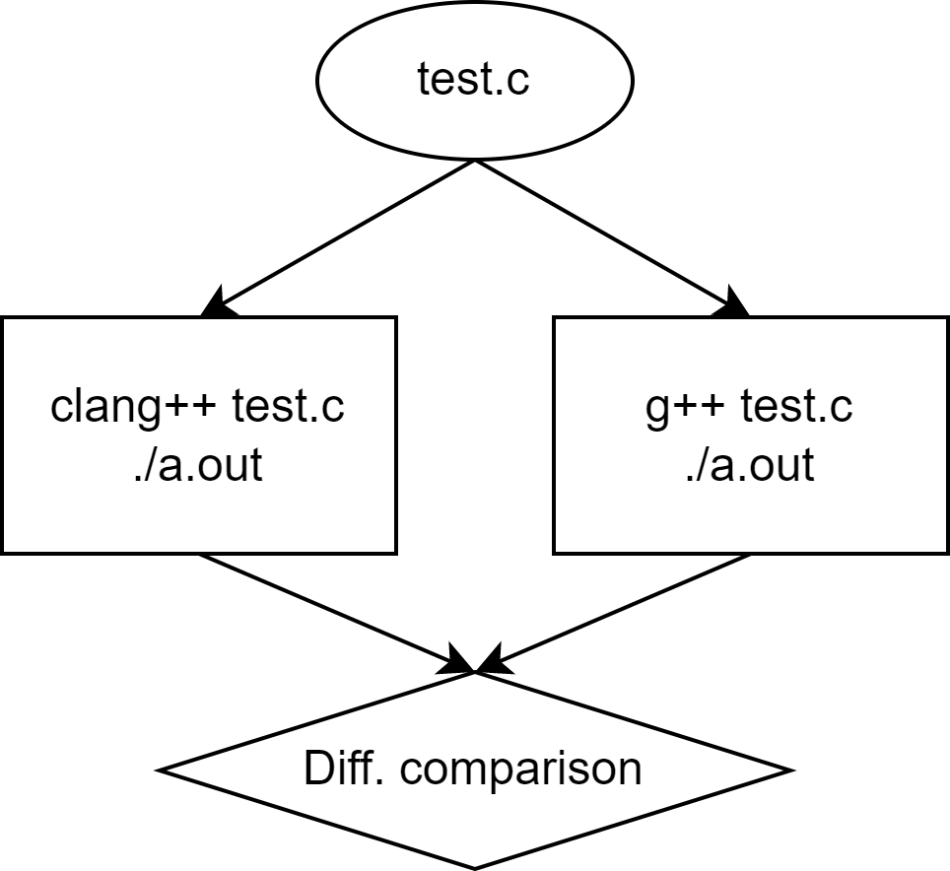
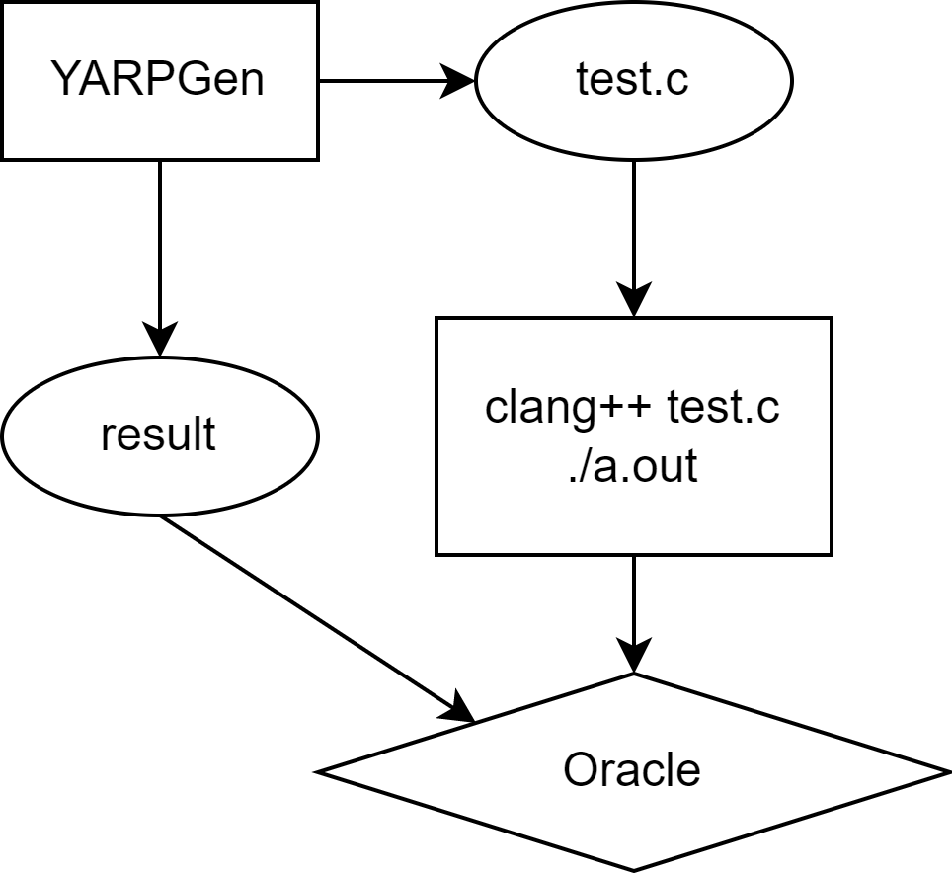
Test Oracles
Differential testing
Ground truth

Slide 18
YARPGen Features
Detect wrong code bugs
Avoid Undefined Behavior statically
Target optimizations explicitly
Easily extensible for C-family languages
Including compilers for emerging languages
Easy to use

Slide 19
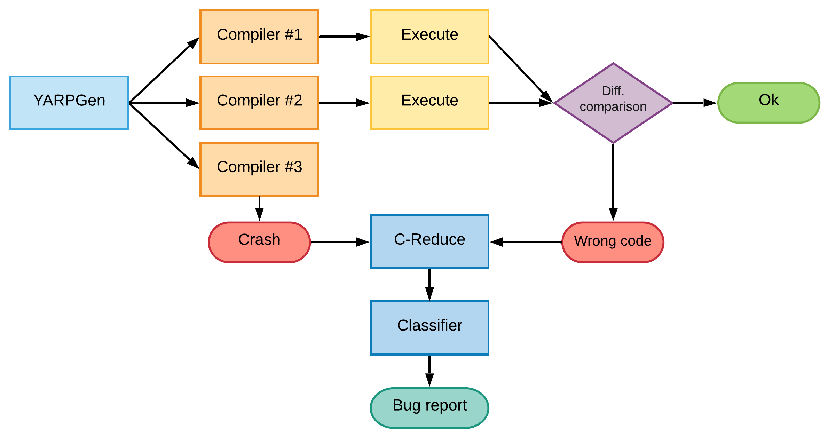
Automated Testing System

Slide 20
Limitations
No floating-point support
Only stdlib function calls
Lack of dynamic memory allocation
…
Some are research question; others require more engineering resources

Slide 21
Bugs Distribution by Kind

Slide 22
Bugs Distribution by Components
LLVM (27 bugs)
GCC (61 bugs)

Slide 23
Fixed Bugs
LLVM
70% fixed
18 fixed, 7 new, 1 resolved, 1 confirmed
GCC
95% fixed
58 fixed, 3 assigned

Slide 24
Test Example
/* LoopNest 2 */
for (short i_2 = ((((int) ((short) var_6))) - (181))/*0*/; i_2 < ((((int) ((short) ((((bool) (signed char)4)) && (((bool) ((((((bool) var_2)) || (((bool) 3431126726U)))) ? (((unsigned int) ((int) std::max((((unsigned short) (signed char)-39)), ((unsigned short)63238))))) : (((((bool) arr_2 [i_0] [i_0])) ? (((unsigned int) ((int) (unsigned short)2297))) : (var_1)))))))))) + (13))/*14*/; i_2 += ((((int) ((short) var_9))) + (20186))/*3*/) {
#pragma clang loop vectorize(enable)
for (long long int i_3 = 0LL/*0*/; i_3 < ((((long long int) var_7)) - (3048972888LL))/*18*/; i_3 += 2LL/*2*/) {
arr_15[i_3] = ((int) ((((((unsigned long long int) ((3243476438U) << (((int) arr_5 [i_0 / 5]))))) & (((((bool) var_2)) ? (var_8) : (((unsigned long long int) ((int) arr_12 [i_0] [i_1] [i_2] [i_1] [i_1] [i_1]))))))) << (((((int) arr_10 [i_0] [i_1 + 1] [i_2])) << (((int) arr_5 [i_2 / 14]))))));
arr_16[i_2][i_1] = ((unsigned short) ((unsigned char) ((((int) arr_10 [i_3] [i_1] [i_2])) & (((int) arr_12 [i_2] [i_1] [i_1 - 3] [i_2] [i_2] [i_3])))));

Slide 25
LLVM Bug #51677
void test() {
#pragma clang loop vectorize_predicate(enable)
for (char a = 4; a < var_3; a++) {
arr_13[a] = arr_12[a - 3];
var_23 = arr_12[a - 1];
}
}
>$ clang++ -O0 -march=skx func.cpp driver.cpp && sde -skx -- ./a.out
1
>$ clang++ -O1 -march=skx func.cpp driver.cpp && sde -skx -- ./a.out
0

Slide 26

https://github.com/intel/yarpgen
Paper in submission, available upon request

Slide 27

Special thanks to Intel and LLVM developers, who fix reported bugs!

Slide 28
Looking for Job
Expected graduation: end of Spring 2023
CV: livinskii.com/#cv
Email: Vsevolod.Livinskii@gmail.com

Slide 29
https://github.com/intel/yarpgen
Paper in submission, available upon request

