Slide 1
MC/DC: Enabling easy-to-use safety-critical code coverage analysis with LLVM
Alan Phipps, Texas Instruments
2022 LLVM Developers’ Meeting

Slide 2
What is Source-based Code Coverage?
A measurement for how thoroughly code has been executed during testing
Ideally all sections of code have an associated test
Un-executed code may be at higher risk of having lurking bugs
Presently Supported Coverage criteria (in increasing level of granularity)
Function
Percentage of code functions executed at least once
Line
Percentage of code lines executed at least once
Region
Percentage of code statements executed at least once
Branch (Recently added)
Percentage of condition branches taken at least once
Notes:
LLVM is “Source-based”, meaning it is tied directly to the source code through Abstract Syntax Trees.
A customer could easily run into a defect in code that isn’t tested. It’s has happened that functions could be left out of test coverage only to manifest in user code.

Slide 3
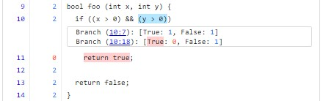
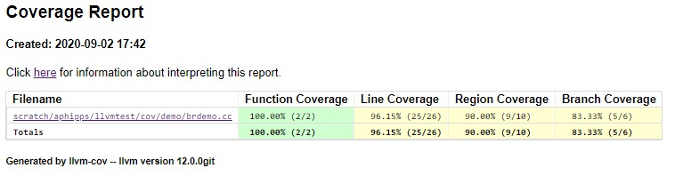
LLVM Coverage Visualization
LLVM Coverage Utility (llvm-cov)

Slide 4
What is Branch Coverage?
Condition
A leaf-level boolean expression (cannot be broken down into simpler boolean exprs)
if (x == 2) …
A condition yields a Branch that evaluates to either true or false
Decision
A boolean expression composed of conditions and zero or more logical operators
if ((x == 2) && (y == 4)) …
A decision without a logical operator is a condition
LLVM Branch Coverage provides a measurement of Condition outcomes. i.e. whether conditions evaluate to both true and false
9| 2|bool foo (int x, int y) {
10| 2| if ((x > 0) && (y > 0))
------------------
| Branch (10:7): [True: 1, False: 1]
| Branch (10:18): [True: 0, False: 1]
------------------
11| 0| return true;
12| 2|
13| 2| return false;
14| 2|}
Notes:
LLVM Branch Coverage is very similar to GCOV – i.e. it’s condition-based, rather than decision-based. Thus, it is very useful and straightforward to measure.

Slide 5
The Limits of Branch Coverage
bool test(bool A, bool B, bool C, bool D) {
return (A && B) || C;
}
When testing, how can we know that we’ve covered all critical paths?
‘A’ | ‘B’ | ‘C’ | Result
F | - | F | F
F | - | T | T
T | T | - | T
T | F | T | T
T | F | F | F
A
True:2
False:1
B
False:1
True:1
C
True:1
False:1
100% Branch Coverage leaves out critical paths

Slide 6
What is MC/DC?
“Modified Condition/Decision Coverage”
A metric pertaining to conditions in a Boolean expression decision in which:
Each condition has been shown to affect that decision outcome independently
“Modified” refers to changing the test input to yield a different test path
Given n conditions, there are 2^{n} total possible test paths (exponential)
Only n+1 test paths required to show MC/DC (linear)
Notes:
Testing every test vector permutation scales exponentially (2^{n})
MC/DC answers the question, “What is a critical path?”
MC/DC gives us a linear alternative to testing all paths by testing paths that independently affect the overall result

Slide 7
Example
return ((A && B) || C);
Test Vector | ‘A’ | ‘B’ | ‘C’ | Result
1 | F | - | F | F
2 | F | - | T | T
3 | T | T | - | T
4 | T | F | T | T
5 | T | F | F | F
MC/DC is achieved if an “Independence Pair” can be found for each condition
As the condition outcome is varied between True/False, the Result also varies True/False
All other condition outcomes are held fixed or don’t-care (unevaluatable/masked out)
Notes:
Given the condition we looked at, there are 5 possible test vectors (given that C/C++ has short-circuit semantics on logical operators).
When Condition A is False, ‘B’ is skipped and considered unevaluatable. It is ‘masked’ as a don’t-care value.

Slide 8
Example
return ((A && B) || C);
Test Vector | ‘A’ | ‘B’ | ‘C’ | Result | ‘A’ Pair
1 | F | - | F | F | *
2 | F | - | T | T
3 | T | T | - | T | *
4 | T | F | T | T
5 | T | F | F | F
MC/DC is achieved if an “Independence Pair” can be found for each condition
As the condition outcome is varied between True/False, the Result also varies True/False
All other condition outcomes are held fixed or don’t-care (unevaluatable/masked out)

Slide 9
Example
return ((A && B) || C);
Test Vector | ‘A’ | ‘B’ | ‘C’ | Result | ‘A’ Pair | ‘B’ Pair
1 | F | - | F | F | *
2 | F | - | T | T
3 | T | T | - | T | * | *
4 | T | F | T | T
5 | T | F | F | F |  | *
MC/DC is achieved if an “Independence Pair” can be found for each condition
As the condition outcome is varied between True/False, the Result also varies True/False
All other condition outcomes are held fixed or don’t-care (unevaluatable/masked out)

Slide 10
Example
return ((A && B) || C);
Test Vector | ‘A’ | ‘B’ | ‘C’ | Result | ‘A’ Pair | ‘B’ Pair | ‘C’ Pair
1 | F | - | F | F | * |  | *
2 | F | - | T | T |  |  | *
3 | T | T | - | T | * | *
4 | T | F | T | T
5 | T | F | F | F |  | *
MC/DC is achieved if an “Independence Pair” can be found for each condition
As the condition outcome is varied between True/False, the Result also varies True/False
All other condition outcomes are held fixed or don’t-care (unevaluatable/masked out)
Notes:
MC/DC is therefore achieved if test vectors 1, 2, 3, and 5 are executed.

Slide 11
Example
return ((A && B) || C);
Test Vector | ‘A’ | ‘B’ | ‘C’ | Result | ‘A’ Pair | ‘B’ Pair | ‘C’ Pair
1 | F | - | F | F | * |  | *
2 | F | - | T | T |  |  | *
3 | T | T | - | T | * | *
4 | T | F | T | T |  |  | (*)
5 | T | F | F | F |  | * | (*)
MC/DC is achieved if an “Independence Pair” can be found for each condition
As the condition outcome is varied between True/False, the Result also varies True/False
All other condition outcomes are held fixed or don’t-care (unevaluatable/masked out)

Slide 12
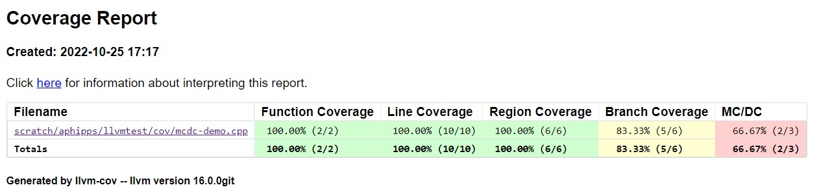
LLVM Coverage Report Visualization + MC/DC

Slide 13
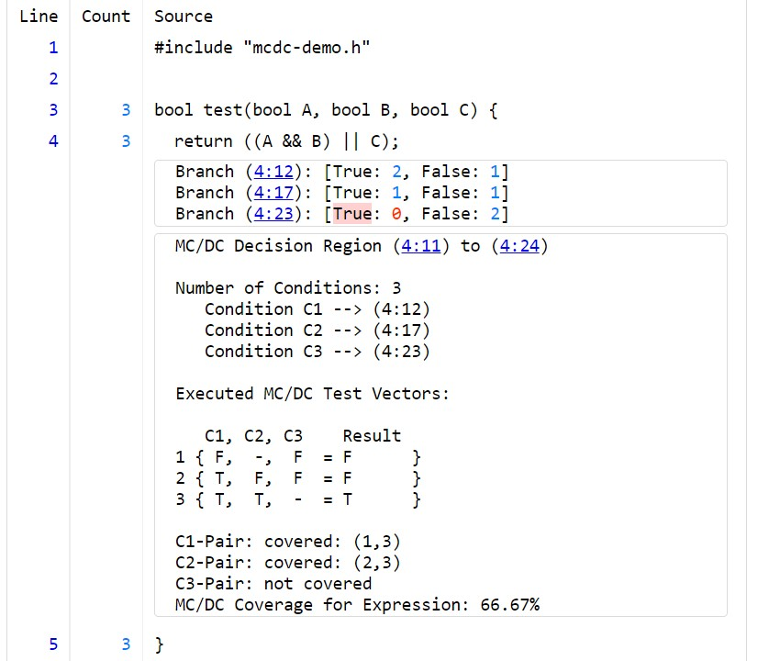
LLVM Coverage Visualization + MC/DC
Branch Coverage View
Condition Aliases C{1, 2, 3, …} and
Source Location Mapping
Actual Executed Test Vectors
Calculated Metrics for Expression

Slide 14
When is MC/DC really important?
Required for safety-critical embedded application development
Automotive (ISO 26262 “Road vehicles – Functional Safety” standard)
Aviation (DO-178 Aviation standard)
Applicable also to Railway, Industrial, Medical, and Space
LLVM is being used increasingly in the embedded space
Supporting MC/DC in LLVM makes sense to facilitate embedded development
Notes:
MC/DC is a higher level of granular coverage, improving code robustness
In general, it’s a good practice, even if it may not always be necessary

Slide 15
How is MC/DC implemented in LLVM?

Slide 16
What has been done? What can LLVM do?
LOG-based MC/DC (most common and very robust)
Code is instrumented to track condition outcomes of a test vector
Data is output to a file (or stdout) during execution and used as input to a tool
Today, LLVM really only has raw profile counter data in memory
Counters really aren’t suitable to tracking test vector execution, and they don’t scale well
Goal: Support LOG-based MC/DC without outputting data to a file
Leverage clang-based instrumentation to track condition outcomes
Efficiently store the data to memory where it can be extracted by coverage tools
Notes:
Decided on LOG-based approach where the execution of each test vector is tracked in memory; this makes it very easy to use as there are no output/input files to deal with.
I chose not to extend the existing Counter infrastructure to track test vectors because they didn’t scale well, and when tracking test vectors, we only ever really care about whether a test vector was executed, not how many ties it was executed. So all we really need is to track Boolean values, which we can do with bitmaps. This keeps the memory requirements very low, which is important in embedded applications.

Slide 17
Design Concept: Bitmap Coverage Objects
Track a global bitmap in memory in which each bit represents an executed test vector
Instrumented per Boolean expression with two or more conditions
Treated like profile counters but handled differently and kept in a separate section in memory
Variable-length, depending on number of possible test vectors (between 8 bits and 2^{n} bits)
2-3 conditions:
(A && B) || C → 8-bits
4 conditions:
(A && B) || (C && D) → 16-bits
5 conditions:
(A && B) || (C && D) || E → 32-bits
0 | 0 | 1 | 0 | 0 | 1 | 1 | 0
0 | 0 | 1 | 0 | 0 | 1 | 1 | 0
0 | 0 | 1 | 0 | 0 | 1 | 1 | 0
0 | 0 | 1 | 0 | 0 | 1 | 1 | 0
We’ll limit the number of conditions measured to six to keep everything small
Notes:
Minimal size is 8-bits – the size scales exponentially by bits rather than by Counters
We’ll limit the number of conditions measured to six to keep things simple
Other vendors do this too, but this could be expandable (given a compiler option)
Most functional safety code pertinent to MC/DC has no more than 2-3 conditions at a time
Short-circuiting means we’ll never actually have 2^{n} test vectors
But this object is extensible to ‘unique-cause’ languages too, where applicable

Slide 18
How do Bitmap bits map to test vectors?
if ( (A && B) || (C && D) ) …
Test Vector | ‘A’ | ‘B’ | ‘C’ | ‘D’
1 | T | T | - | -
2 | T | F | T | T
3 | T | F | T | F
4 | T | F | F | -
5 | F | - | T | T
6 | F | - | T | F
7 | F | - | F | -
Test Vector | ‘A’ | ‘B’ | ‘C’ | ‘D’ | Value
1 | 1 | 1 | 0 | 0 | 12
2 | 1 | 0 | 1 | 1 | 11
3 | 1 | 0 | 1 | 0 | 10
4 | 1 | 0 | 0 | 0 | 8
5 | 0 | 0 | 1 | 1 | 3
6 | 0 | 0 | 1 | 0 | 2
7 | 0 | 0 | 0 | 0 | 0
Goal: instrument the evaluation of each condition in a Boolean expression
The resulting value gives us an index into a global, Decision-level Bitmap
Notes:
Each True/False test path is also known as a “Test Vector”

Slide 19
How do Bitmap bits map to test vectors?
The value of each test vector execution yields an index into a Global bitmap
i.e. Each bit in the global mask represents a test vector
if ( (A && B) || (C && D) ) …
Test Vector | ‘A’ | ‘B’ | ‘C’ | ‘D’ | Value
1 | 1 | 1 | 0 | 0 | 12
2 | 1 | 0 | 1 | 1 | 11
3 | 1 | 0 | 1 | 0 | 10
4 | 1 | 0 | 0 | 0 | 8
5 | 0 | 0 | 1 | 1 | 3
6 | 0 | 0 | 1 | 0 | 2
7 | 0 | 0 | 0 | 0 | 0
Global Bitmap
0 | 0 | 0 | 0 | 1 | 0 | 0 | 0 | 0 | 0 | 0 | 0 | 0 | 0 | 0 | 0

Slide 20
How do Bitmap bits map to test vectors?
The value of each test vector execution yields an index into a Global Bitmap
i.e. Each bit in the global mask represents a test vector
if ( (A && B) || (C && D) ) …
Test Vector | ‘A’ | ‘B’ | ‘C’ | ‘D’ | Value
1 | 1 | 1 | 0 | 0 | 12
2 | 1 | 0 | 1 | 1 | 11
3 | 1 | 0 | 1 | 0 | 10
4 | 1 | 0 | 0 | 0 | 8
5 | 0 | 0 | 1 | 1 | 3
6 | 0 | 0 | 1 | 0 | 2
7 | 0 | 0 | 0 | 0 | 0
Global Bitmap
0 | 0 | 0 | 0 | 1 | 1 | 0 | 0 | 0 | 0 | 0 | 0 | 0 | 0 | 0 | 0
Notes:
During execution, counters and bitmaps are merged together by the profile runtime (or offline by llvm-profdata)
Bitmaps only require a bitwise OR operation to merge them, so there is no possibility of overflow

Slide 21
Source Region Mapping
Introduce a new Decision mapping region type
Ties a Boolean expression to source code
Contains index of a Decision-level Bitmap
Contains number of conditions
Extend existing Branch Regions to include IDs
Represents Control Flow through conditions
Keep language-specific information away from llvm-cov!
Only give it what it needs to do the MC/DC analysis
IDs allow llvm-cov to construct list of possible test vectors
(A && B) || (C && D)
A
ID:1
T:2,F:3
T
F
ID:2
T:-,F:3
B
T
F
C
ID:3
T:4,F:-
T
F
ID:4
T:-,F:-
D
T
F
Notes:
We also have to be able to map these bitmaps to the source code. LLVM/clang does this through Counter Mapping Regions

Slide 22
Visualization (llvm-cov)
Extract the Branch Region IDs and build the list of possible test vectors
Function (foo)
CodeRegion1 (9:24-10:23)
CodeRegion2 (11:0-11:12)
CodeRegion3 (12:0-14:0)
MCDCDecisionRegion:
MCDCDecisionRegion (10:4-10:23)
MCDCBranchRegions:
MCDCBranchRegion1 (10:5-10:11)
MCDCBranchRegion2 (10:16-10:22)
MCDCBranchRegion3 (10:27-10:33)
MCDCBranchRegion4 (10:38-10:44)
Test Vector | ‘A’ | ‘B’ | ‘C’ | ‘D’ | Value
1 | 1 | 1 | 0 | 0 | 12
2 | 1 | 0 | 1 | 1 | 11
3 | 1 | 0 | 1 | 0 | 10
4 | 1 | 0 | 0 | 0 | 8
5 | 0 | 0 | 1 | 1 | 3
6 | 0 | 0 | 1 | 0 | 2
7 | 0 | 0 | 0 | 0 | 0
Notes:
This allows llvm-cov to map the index value in a bitmap coverage object to an actual test vector

Slide 23
Visualization (llvm-cov)
Construct the list of executed test vectors
Function (foo)
CodeRegion1 (9:24-10:23)
CodeRegion2 (11:0-11:12)
CodeRegion3 (12:0-14:0)
MCDCDecisionRegion:
MCDCDecisionRegion (10:4-10:23)
MCDCBranchRegions:
MCDCBranchRegion1 (10:5-10:11)
MCDCBranchRegion2 (10:16-10:22)
MCDCBranchRegion3 (10:27-10:33)
MCDCBranchRegion4 (10:38-10:44)
Test Vector | ‘A’ | ‘B’ | ‘C’ | ‘D’ | Value
1 | 1 | 1 | 0 | 0 | 12
2 | 1 | 0 | 1 | 1 | 11
3 | 1 | 0 | 1 | 0 | 10
4 | 1 | 0 | 0 | 0 | 8
5 | 0 | 0 | 1 | 1 | 3
6 | 0 | 0 | 1 | 0 | 2
7 | 0 | 0 | 0 | 0 | 0
Global Bitmap
0 | 0 | 0 | 0 | 1 | 1 | 0 | 0 | 0 | 0 | 0 | 0 | 1 | 0 | 0 | 0
Notes:
The associated Decision’s bitmap is extracted
Each true index value represents an executed test vector

Slide 24
Visualization (llvm-cov)
Look for an Independence Pair for each Condition
Test Vector | ‘A’ | ‘B’ | ‘C’ | ‘D’ | Result
2 | T | F | T | T | T
3 | T | F | T | F | F
5 | F | - | T | T | T
Notes:
Each executed test vector is compared against the other test vectors to find Independence Pairs
This is notably brute-force and computationally expensive, but in practice isn’t bad for 2-3 conditions
Show the Independence Pair found for each Condition (if available)
If Pairs are found for all Conditions, MC/DC is 100% satisfied for the Decision

Slide 25
Visualization (llvm-cov)
Look for an Independence Pair for each Condition
Test Vector | ‘A’ | ‘B’ | ‘C’ | ‘D’ | Result | A-Pair
2 | T | F | T | T | T | -
3 | T | F | T | F | F | -
5 | F | - | T | T | T | -
Condition A: No Independence Pair Found
Notes:
Each executed test vector is compared against the other test vectors to find Independence Pairs
This is notably brute-force and computationally expensive, but in practice isn’t bad for 2-3 conditions
Show the Independence Pair found for each Condition (if available)
If Pairs are found for all Conditions, MC/DC is 100% satisfied for the Decision

Slide 26
Visualization (llvm-cov)
Look for an Independence Pair for each Condition
Test Vector | ‘A’ | ‘B’ | ‘C’ | ‘D’ | Result | A-Pair | B-Pair
2 | T | F | T | T | T | - | -
3 | T | F | T | F | F | - | -
5 | F | - | T | T | T | - | -
Condition B: No Independence Pair Found
Notes:
Each executed test vector is compared against the other test vectors to find Independence Pairs
This is notably brute-force and computationally expensive, but in practice isn’t bad for 2-3 conditions
Show the Independence Pair found for each Condition (if available)
If Pairs are found for all Conditions, MC/DC is 100% satisfied for the Decision

Slide 27
Visualization (llvm-cov)
Look for an Independence Pair for each Condition
Test Vector | ‘A’ | ‘B’ | ‘C’ | ‘D’ | Result | A-Pair | B-Pair | C-Pair
2 | T | F | T | T | T | - | - | -
3 | T | F | T | F | F | - | - | -
5 | F | - | T | T | T | - | - | -
Condition C: No Independence Pair Found
Notes:
Each executed test vector is compared against the other test vectors to find Independence Pairs
This is notably brute-force and computationally expensive, but in practice isn’t bad for 2-3 conditions
Show the Independence Pair found for each Condition (if available)
If Pairs are found for all Conditions, MC/DC is 100% satisfied for the Decision

Slide 28
Visualization (llvm-cov)
Look for an Independence Pair for each Condition
Test Vector | ‘A’ | ‘B’ | ‘C’ | ‘D’ | Result | A-Pair | B-Pair | C-Pair | D-Pair
2 | T | F | T | T | T | - | - | - | *
3 | T | F | T | F | F | - | - | - | *
5 | F | - | T | T | T | - | - | -
Condition D: Independence Pair Found!
A-Pair: not covered
B-Pair: not covered
C-Pair: not covered
D-Pair: covered
MC/DC Coverage for Expression: 25%
Notes:
Each executed test vector is compared against the other test vectors to find Independence Pairs
This is notably brute-force and computationally expensive, but in practice isn’t bad for 2-3 conditions
Show the Independence Pair found for each Condition (if available)
If Pairs are found for all Conditions, MC/DC is 100% satisfied for the Decision

Slide 29
Current State of LLVM MC/DC
Implementation is complete -- in the process of upstreaming the work!
Phabricator Review https://reviews.llvm.org/D136385
Will be included with stock LLVM Source-based Code Coverage
But enabled in clang via command-line option
clang –fprofile-instr-generate –fcoverage-mapping –fmcdc foo.cc –o foo
A lot of ways to improve MC/DC and Branch Coverage! Want to be involved?
Contact me! a-phipps@ti.com
2020 Branch Coverage Presentation
https://www.youtube.com/watch?v=H1hvtJPGWNQ
Notes:
Code size impact / RAM impact
CMSIS MatrixFunctions 0.18% / 0.05%
CMSIS MatrixFunctions (w/ Matrix Checking) 1.39% / 0.80%
CMSIS FilteringFunctions 0.03% / 0.02%

Slide 30
Thank you!
Acknowledgements
Vedant Kumar, Apple

