Slide 1
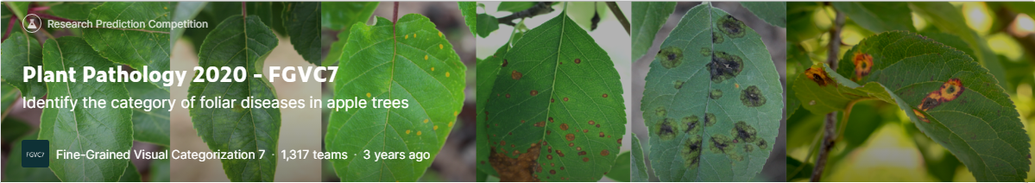
廖昱凱

Slide 2
Goal of the competition
This competition will distinguish between leaves which are healthy, those which are infected with apple rust, those that have apple scab, and those with more than one disease.
The score is the average of the individual AUCs of each predicted column.

Slide 3
Dataset Description
Train.csv(1821*5)
image_id: the foreign key
Combinations: whether infected with two or more diseases(0 or 1)
Healthy: whether healthy(0 or 1)
Rust: whether infected with apple rust(0 or 1)
Scab: whether infected with apple scab(0 or 1)
Images: a folder containing the train and test images, in jpg format(train:1821, test:1821).

Slide 4
Images Data Augmentation
tf.keras.preprocessing.image.ImageDataGenerator(
rotation_range = 0.35,
zoom_range = 0.2,
horizontal_flip = True,
vertical_flip = True,
shear_range = 0.2,
width_shift_range = 0.15,
height_shift_range = 0.15,)

Slide 5
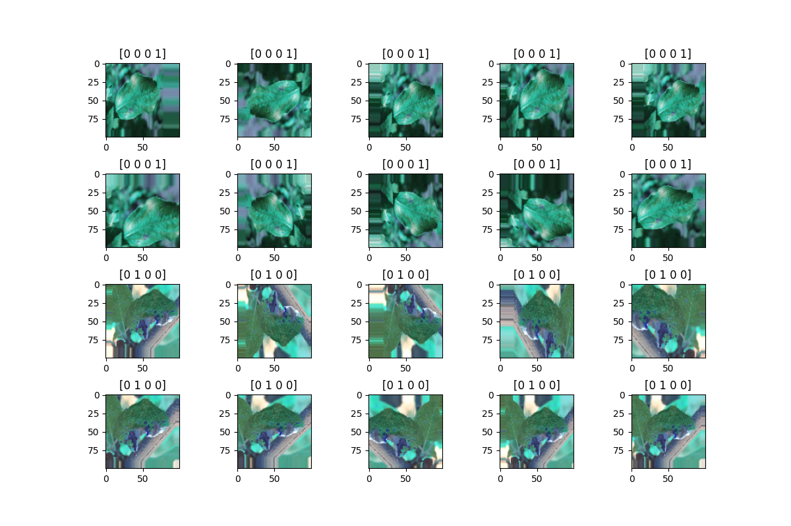
Images Data Augmentation
Train.shape = (18210, 100, 100, 3)

Slide 6
Preprocessing Dataset Images
Split data (test size = 0.15):
x_train.shape = (15478, 100, 100, 3)
x_test.shape = (2732, 100, 100, 3)
y_train.shape = (15478, 4)
y_test.shape = (2732, 4)

Slide 7
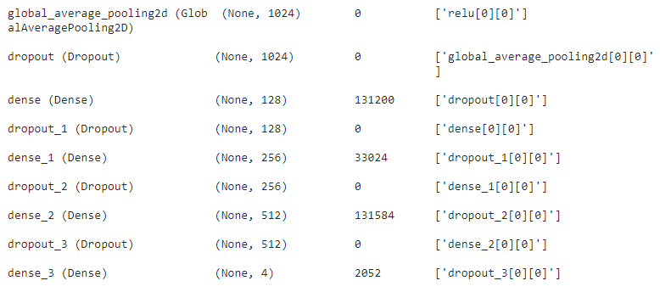
Build Model
Transformer learning: DenseNet121
Rate = 0.5
sigmoid
Rate = 0.3
relu
Rate = 0.3
relu
Rate = 0.3
softmax
Optimizer:Adam, loss: categorical crossentropy

Slide 8
Train Model
Model.fit(epochs = 30,
batch_size = 32,
ReduceLROnPlateau(monitor = loss, factor = 0.1),
EarlyStopping(monitor = loss, patience = 3))

Slide 9
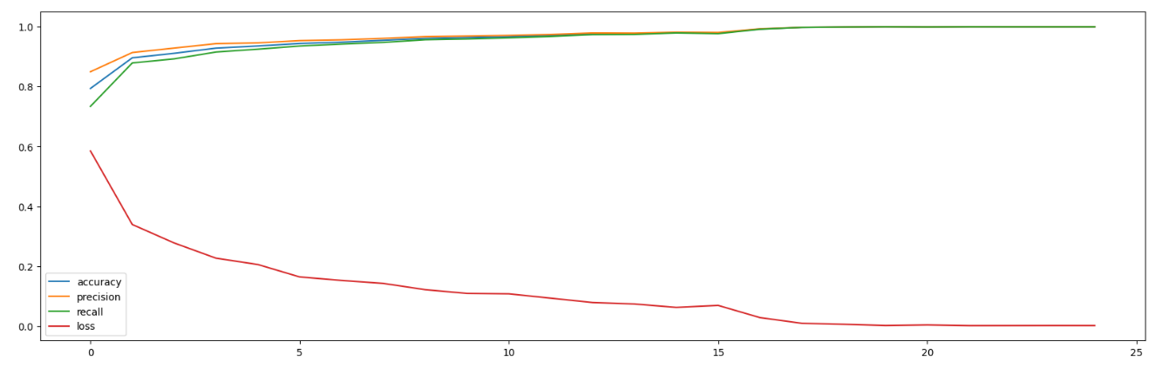
Final Results
Loss | Accuracy | Precision | recall | F1-score
0.0669 | 0.9876 | 0.9876 | 0.9876 | 0.9876

Slide 10
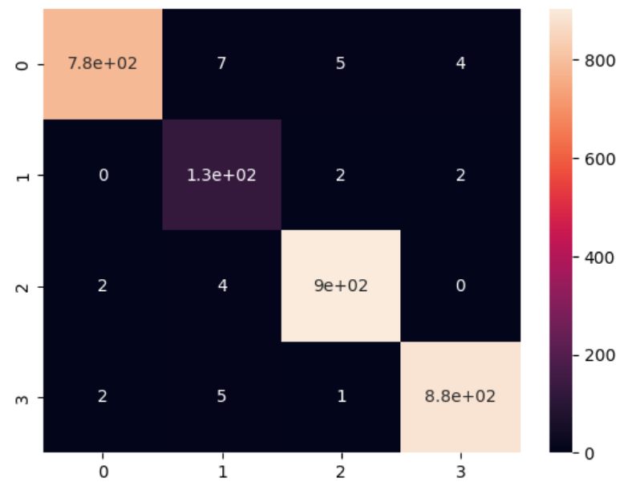
Final Results
True label
Predicted label

Slide 11
CNN Features + XGBOOST
Use DenseNet121 Extract features(15478, 1024)
Use XGBClassifier(max_depth = 50, n_estimators = 500)
The accuracy of CNN Features + XGBOOST is: 0.98755

Slide 12
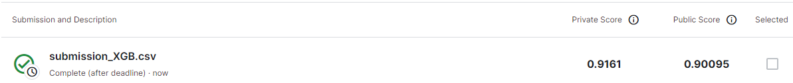
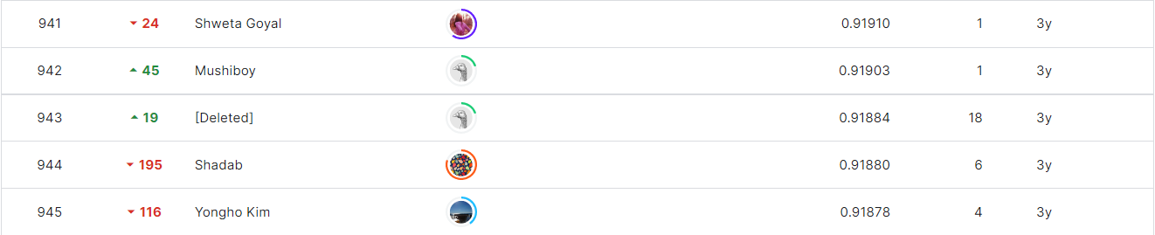
Final Results
DenseNet121 + XGBOOST
DenseNet121
The score is the average of the individual AUCs of each predicted column.

