Slide 1
⌂
DREAM HOME
Designing Dream Homes with Artificial Intelligence
An AI-assisted platform for personalized house design, layout planning, and visualization

Slide 2
THE CHALLENGE
Problem Statement
!
Designing a home traditionally requires architects, engineers, and specialized CAD software.
“How can homeowners without
technical skills design a house
that truly fits their life?”
!
Standard design tools demand technical expertise most homeowners simply don't have.
!
The process is slow, expensive, and offers little room for real-time personalization.
Users struggle to visualize how their preferences (style, layout, budget) translate into an actual design.
Core question driving this project
!
2

Slide 3
WHAT WE AIM TO ACHIEVE
Objectives
🎯
Simplify Design
🤖
AI-Driven Assistance
🎨
Personalization
Make house design accessible to users with no architectural background.
Use AI to interpret preferences and generate layout suggestions automatically.
Let users customize style, layout, and budget to fit their real needs.
👁
Visualization
⏱
Save Time & Cost
📈
Scalability
Provide clear visual representations of generated house designs.
Cut down the time and expense of early-stage design iterations.
Build a system that adapts to a wide range of user needs and property types.
3

Slide 4
BOUNDARIES OF THE PROJECT
Scope
IN SCOPE
OUT OF SCOPE
✓ AI-assisted layout and style suggestions
✕ Structural / civil engineering calculations
✓ User input of preferences: budget, rooms, style
✕ Legal approvals and building-code compliance
✓ 2D/visual representation of generated designs
✕ Full 3D photorealistic rendering (future work)
✓ Web-based front-end for design interaction
✕ On-site construction management
✓ Basic customization and iteration workflow
✕ Interior furniture procurement
4

Slide 5
WHAT OTHERS HAVE DONE
Literature Review
Project Name | Author(s) | Year | Methodology | Advantages | Disadvantages
Graph2Plan | Ruizhen Hu et al. | 2020 | Graph2Plan using GNNs and CNNs to generate floor plans from layout graphs. | Realistic layouts; preserves room adjacency. | Needs graph input and large datasets.
HouseLLM | Ziyang Zong et al. | 2024 | HouseLLM combines LLMs with conditional diffusion for text-to-floor plan generation. | Natural language input; high-quality layouts. | Computationally expensive; refinement required.
HouseMind | Sizhong Qin et al. | 2026 | HouseMind uses multimodal LLMs with room-instance tokenization. | Generation, editing and understanding in one framework. | Requires large multimodal training.
House-GAN | Nauata et al. | 2020 | House-GAN uses Generative Adversarial Networks to synthesize floor plans from graph constraints. | Fast generation and realistic room layouts. | May generate invalid geometries; training instability.
FLNet | Li et al. | 2022 | FLNet applies graph-constrained deep learning for floor layout generation. | Good spatial consistency and user constraint handling. | Performance depends on training data quality.
DeepFloorplan | Hu et al. | 2021 | DeepFloorplan uses CNN-based image processing for floor plan segmentation and reconstruction. | Accurate wall and room detection from images. | Less effective on noisy or complex plans.
5

Slide 6
WHERE THINGS STAND TODAY
Existing System
Traditional design workflows and standard design software both fall short for the everyday homeowner.
Traditional Architectural Process
Standard CAD / Design Software
–
Requires hiring a professional architect
–
Powerful but built for trained professionals
–
Multiple manual revision cycles
–
No adaptive or intelligent suggestions
–
High cost and long turnaround time
–
Minimal personalization for non-experts
6

Slide 7
OUR SOLUTION
Proposed System
An AI-driven platform that guides users end-to-end — from preferences to a visualized design.
1
2
3
4
Capture Preferences
→
AI Analysis
→
Design Suggestions
→
Visualization
Layout, style, budget, and functional needs collected from the user.
AI models process inputs and identify suitable design patterns.
System recommends layouts and design elements matched to input.
User receives a clear visual representation of the proposed house.
Casa de Ensueño
7

Slide 8
IS IT ACHIEVABLE?
Feasibility Study
⚙
💰
📋
Technical Feasibility
Economic Feasibility
Operational Feasibility
Built on mature, well-supported web and AI frameworks; team has the required skill set to implement and integrate them.
Relies on open-source tools and cloud services, keeping development cost low relative to project scope.
Simple, guided user interface requires no training; fits naturally into how users already plan a home.
8

Slide 9
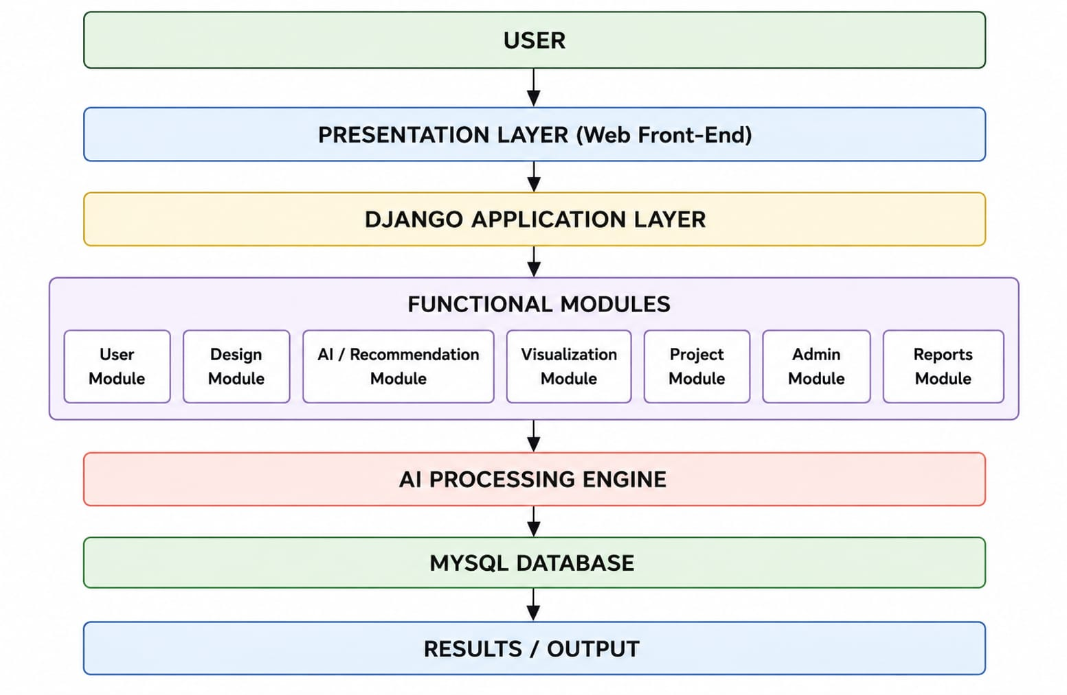
HOW IT'S BUILT
System Architecture
9

Slide 10
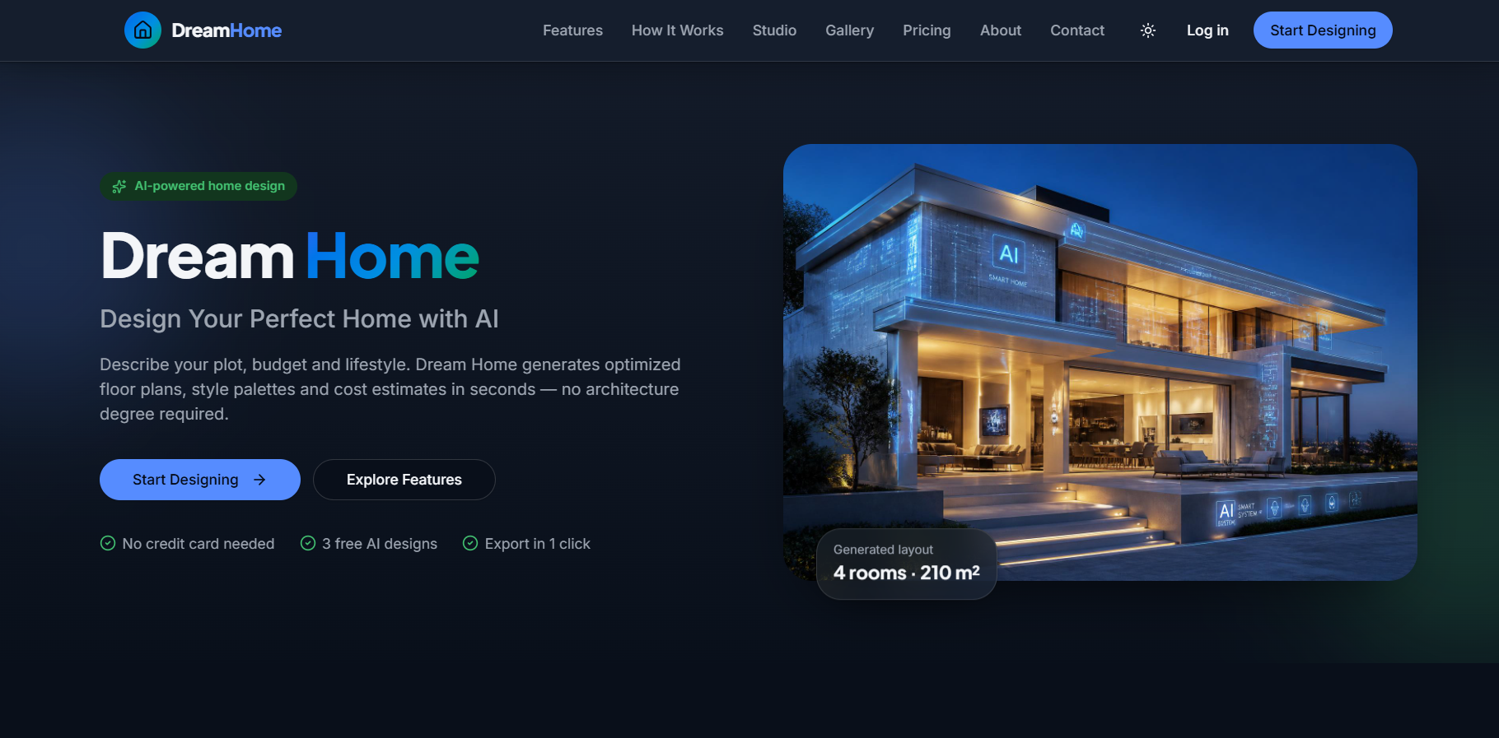
USER INTERFACE BLUEPRINT
Wireframe Design
10

Slide 11
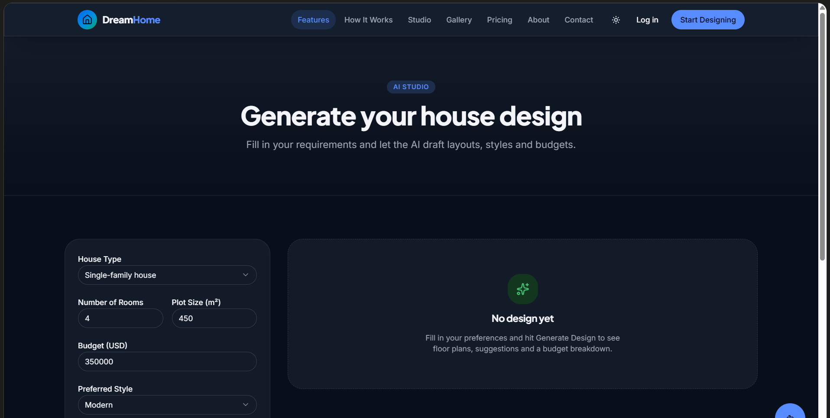
USER INTERFACE BLUEPRINT
Wireframe Design
10

Slide 12
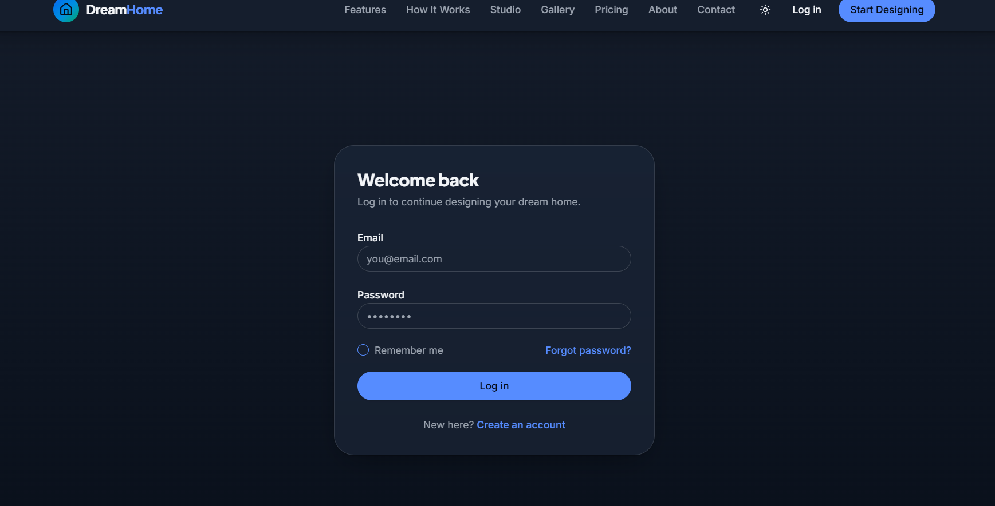
USER INTERFACE BLUEPRINT
Wireframe Design
10

Slide 13
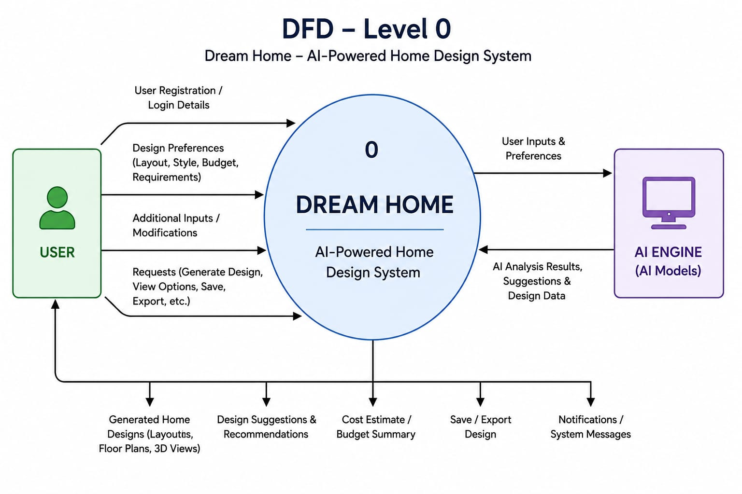
DFD – Level 0

Slide 14
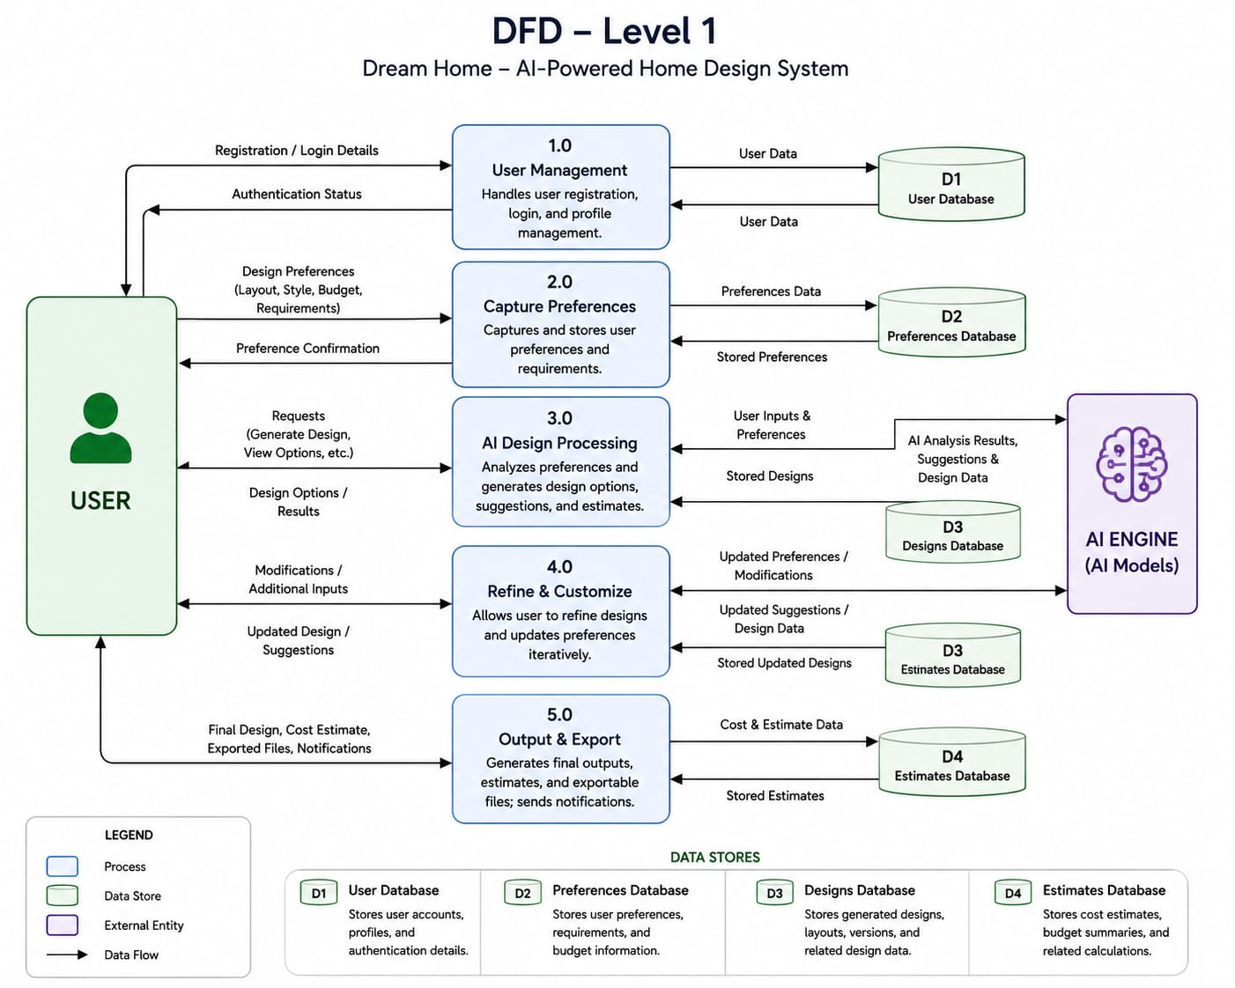
DFD – Level 1

Slide 15
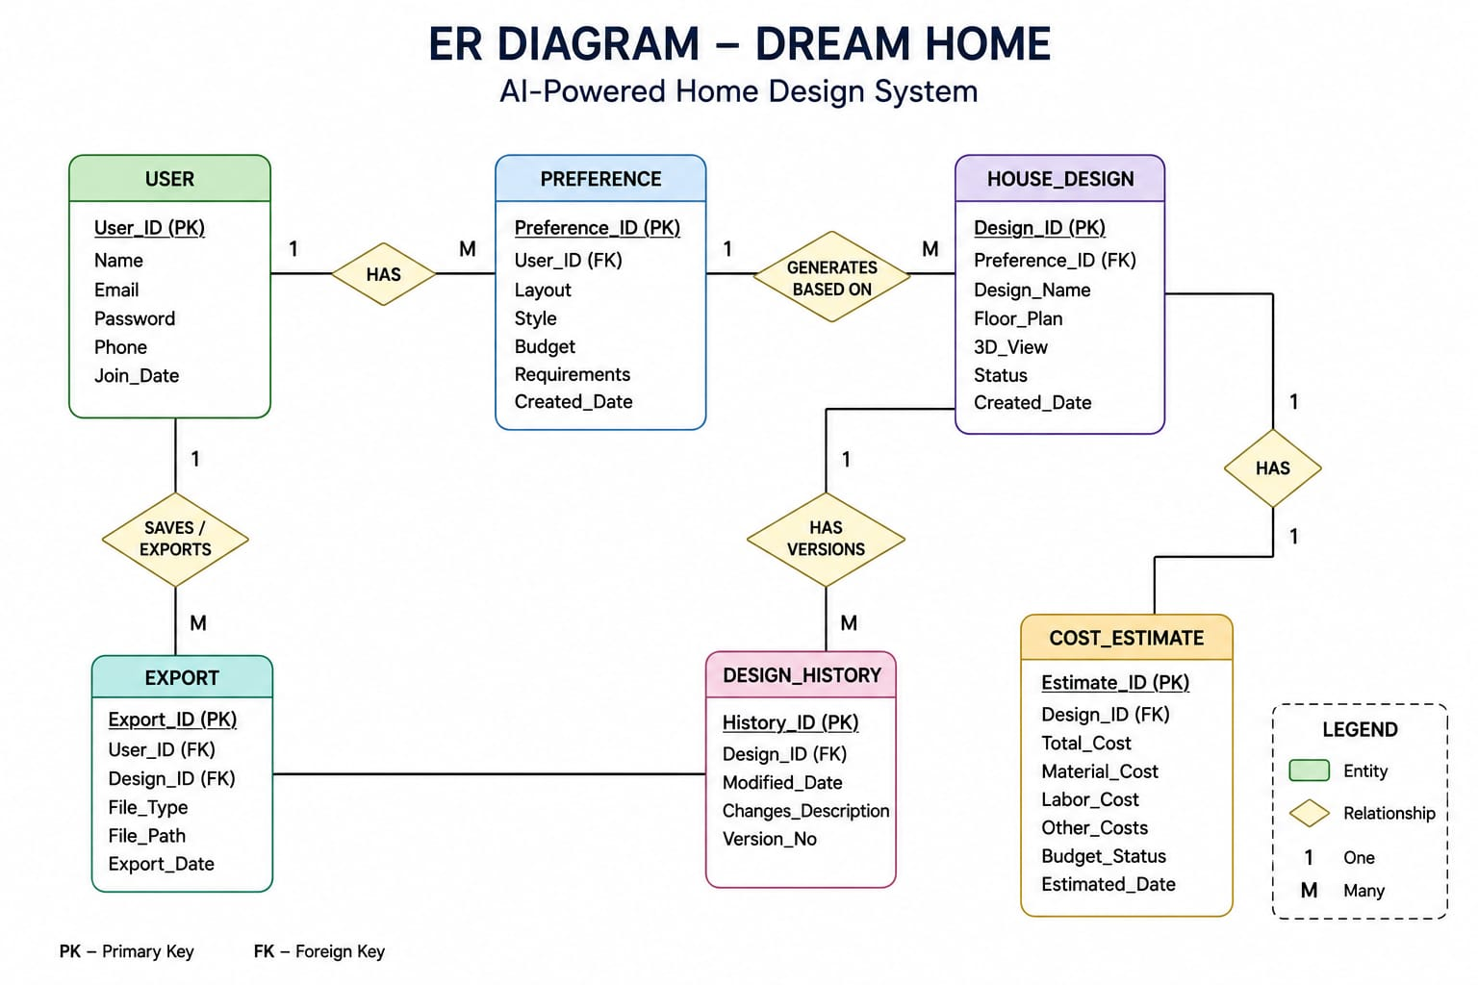
ER Diagram

Slide 16
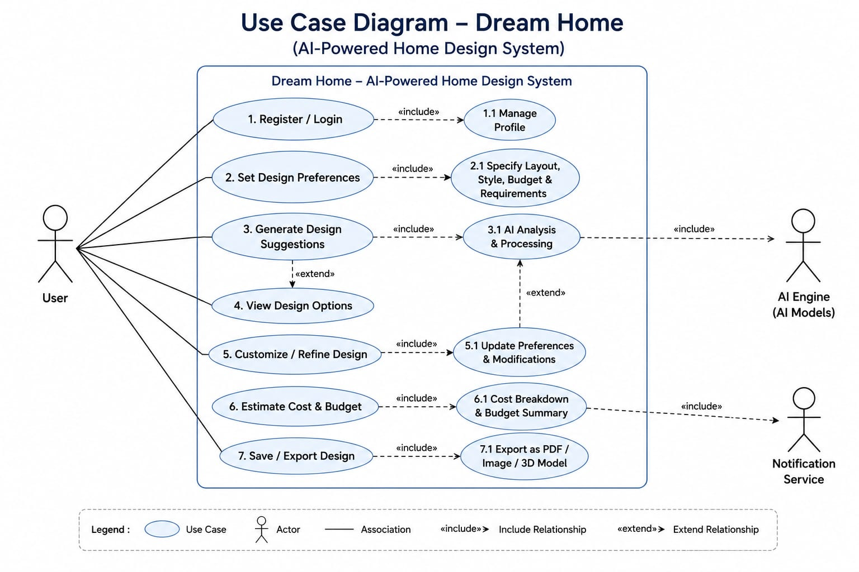
Use Case Diagram

Slide 17
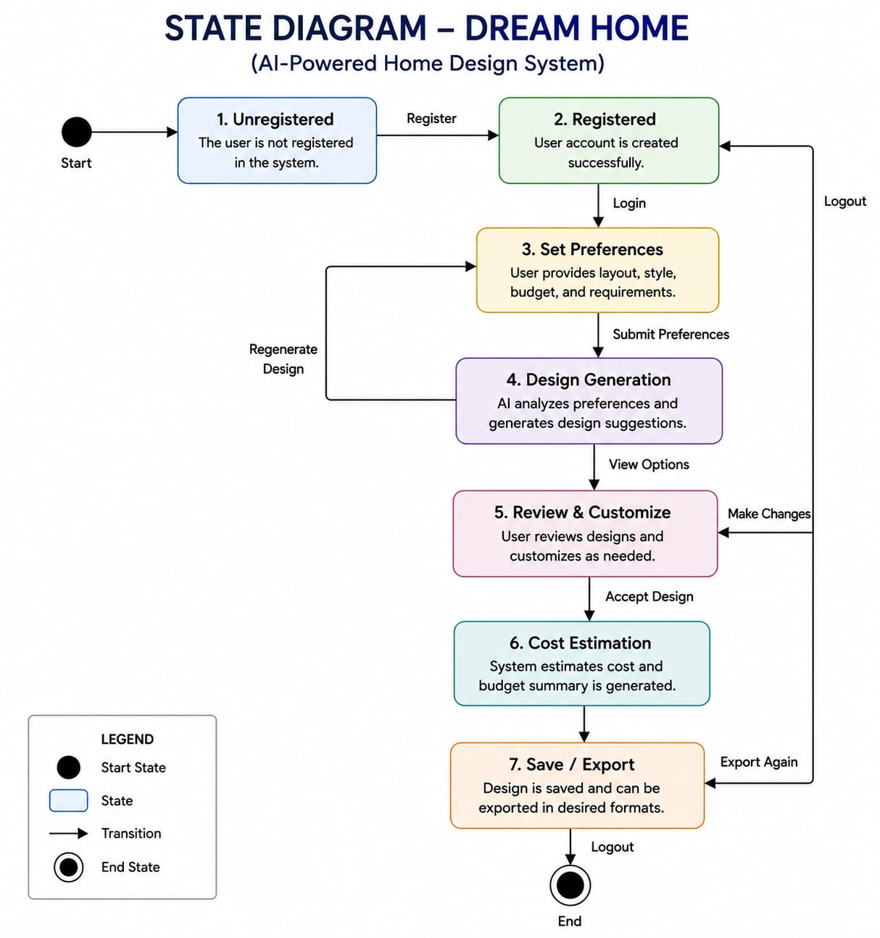
State Diagram

Slide 18
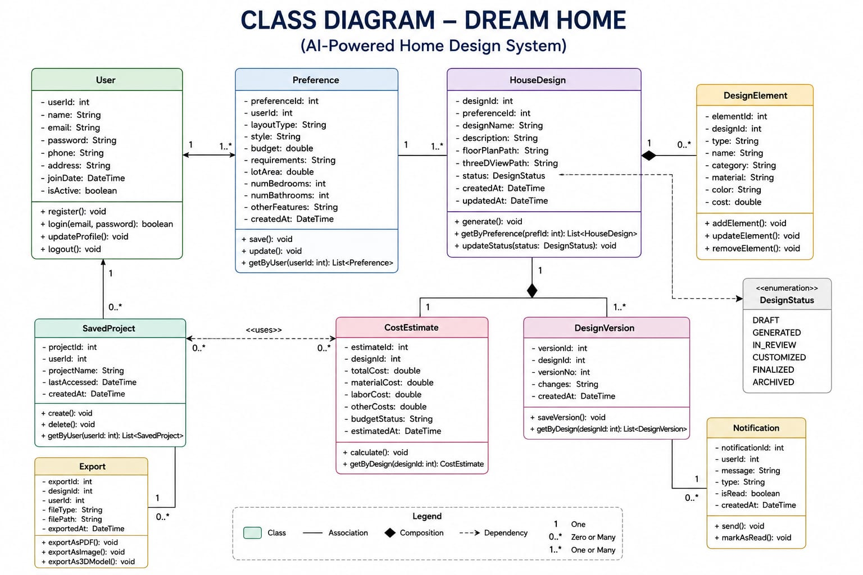
Class Diagram

Slide 19
HOW WE WORK
Methodology — Agile Approach
1
2
3
4
Sprint 1
Sprint 2
Sprint 3
Sprint 4
Requirement gathering & research
Design & architecture
Core development
Testing & refinement
Literature review, problem definition, objective setting
System architecture, wireframes, UML modeling
Front-end build-out, AI module integration
Feasibility validation, user feedback, iteration
12

Slide 20
BUILDING BLOCKS OF THE SYSTEM
Modules
👤
User Management
📝
Preference Input
🧠
AI Design Engine
Registration, login, and profile/preferences storage.
Captures layout, style, budget, and functional requirements.
Core AI logic that analyzes input and generates suggestions.
🏠
Layout Generator
🖼
Visualization
💾
Save & Export
Produces optimized house layouts based on AI recommendations.
Renders visual representations of the generated design.
Allows users to store, revisit, and export finished designs.
13

Slide 21
WHAT POWERS IT
Technology Stack
Front-end
Back-end
AI & ML
HTML/CSS/Bootstrap/JavaScript
Python / Django
Python, TensorFlow / scikit-learn
Database
Design Tools
Version Control
MongoDB
Figma (wireframes & UI mockups)
Git & GitHub
14

Slide 22
CURRENT STATUS
Front-end Progress
Landing & onboarding screens
100%
Preference input forms
90%
Navigation & dashboard shell
85%
Design canvas / preview UI
60%
AI suggestion integration (UI side)
35%
Next up: connect the AI suggestion engine end-to-end and add live layout previews to the design canvas.
15

Slide 23
REFERENCES
References
1.
Autodesk. (2024). AutoCAD Architecture — Product Documentation. Autodesk Inc.
2.
React. (2024). React — A JavaScript Library for Building User Interfaces. Meta Open Source.
3.
MongoDB Inc. (2024). MongoDB Manual. MongoDB Documentation.
4.
TensorFlow. (2024). TensorFlow Core Documentation. Google Brain Team.
5.
Nielsen, J. (2020). Usability Engineering Basics. Nielsen Norman Group.
6.
Various authors. (2022–2024). Generative design and AI in architecture — survey of recent literature.

Slide 24
Thank You

