Slide 1
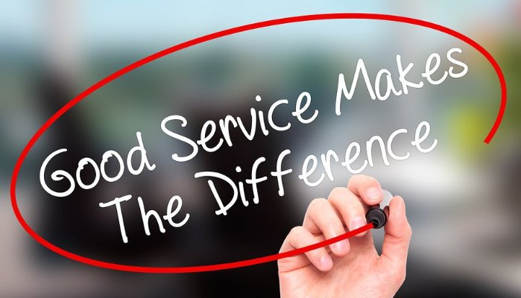
Three Customer Service Presentations
Fernando Sutanto 2101617225
Jeffry 2101634956
Raditya Trikurnia 2101630945
Steven Hendry 2101629092
William Andrew 2101627635

Slide 2

Characteristics of Good Customer Service
Promptness
Politeness
Professionalism
Personalization

Slide 3

Achieving Good Customer Service
Know Your Product Service
Be Friendly
Say Thank You
Train Your Staff
Show Respect
Listen
Be Responsive
Ask for Feedback
Use Feedback You Receive

Slide 4

Customer Service Tools
Online Communities
Discussions Forums
Social Media
Automatic Callback
Live Chat
SMS Text Support
Self-service Sites
Mobile Apps
Help Ticket System
Customer Satisfaction Surveys
Customer Portal
Connected Devices

Slide 5
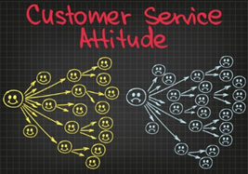
Maintaining Good Attitude
Cultivate Self-Awareness
Overcome Problems with Creativity
Say Cheese
Tame the Voice in Your Head
Surround Yourself with Positive Anchors

